Slide 1
The NAEP Mathematics Exam
The Nations Report Card

Slide 2
Problems with the NAEP
The NAEP is unfocused
There are far too many mathematical errors
The level of the exam is far below the levels in high achieving countries

Slide 3
Number of Grade 4 Learning Expectations per State by Content Strand
 | Number & Operation | Geometry | Measurement | Algebra | Data Analysis, Probability & Statistics | Total Number of Learning Expectations
California | 16 | 11 | 4 | 7 | 5 | 43
Texas | 15 | 7 | 3 | 4 | 3 | 32
New York | 27 | 8 | 10 | 5 | 6 | 56
Florida | 31 | 11 | 17 | 10 | 20 | 89
Ohio | 15 | 8 | 6 | 6 | 13 | 48
Michigan | 37 | 5 | 11 | 0 | 3 | 56
New Jersey | 21 | 10 | 8 | 6 | 11 | 56
North Carolina | 14 | 3 | 2 | 3 | 4 | 26
Georgia | 23 | 10 | 5 | 3 | 4 | 45
Virginia | 17 | 8 | 11 | 2 | 3 | 41
Reys, et al., 2006

Slide 4
And for NAEP
Grade | Num | Meas | Geom | Data | Alg | Total
4 | 26 | 10 | 15 | 9 | 10 | 70
8 | 34 | 20 | 21 | 22 | 18 | 115
12 | 27 | 14 | 20 | 26 | 23 | 110

Slide 5
The Quality of the NAEP Problems
Last year, The Brookings Institute asked me to review the algebra questions on the NAEP
Of the 41 eighth grade NAEP algebra problems provided, 8 were incorrect and one was meaningless
Moreover about 10 of the correct problems were just questions about vocabulary, not mathematics

Slide 6
Of the 22 grade 4 questions provided, four were incorrect, four others were essentially vocabulary, only one could be judged mildly challenging at fourth grade level

Slide 7
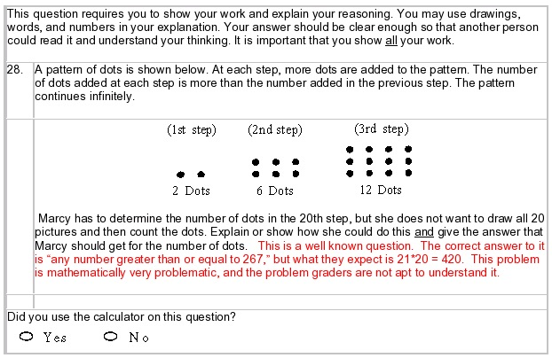
From the NAEP

Slide 8
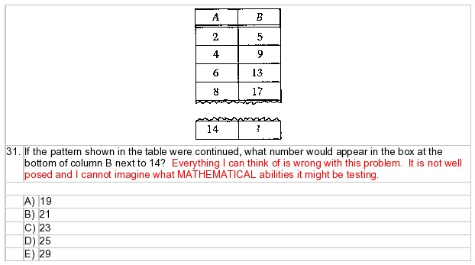
From NAEP

Slide 9
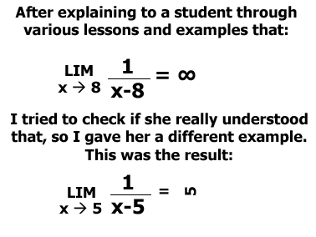
What’s wrong with patterns?

Slide 10
The Balance of Subjects is Way Off
Very little attention is paid to basic operations, and essentially none to skills with fractions.

Slide 11
The Balance of Subjects is Way Off
Two typical fraction standards in grade 8 (there are none in grade 4):
  Provide a mathematical argument to explain operations with two or more fractions,
  interpret rational number operations and the relationships between them
There is exactly one grade 8 standard that asks for operations with integers or fractions:
  Perform computations with rational numbers.

Slide 12
When the Report Card is Flawed What do the Grades Mean?

Slide 13
All this tracks back to a refusal to involve real math experts in test development
A few mathematicians including two members of this distinguished panel have been members of NAGB but were not even allowed access to the exams

Slide 14
High Achieving Countries Focus on Six Topics in The First Four or Five Grades
Place Value and Basic Number Skills
Fractions and Decimals
Ratios, Rates Percents, Proportions
Functions and Equations
Beginning Algebra
Measurement and Geometry

Slide 15
As do the NCTM Focus Topics

Slide 16
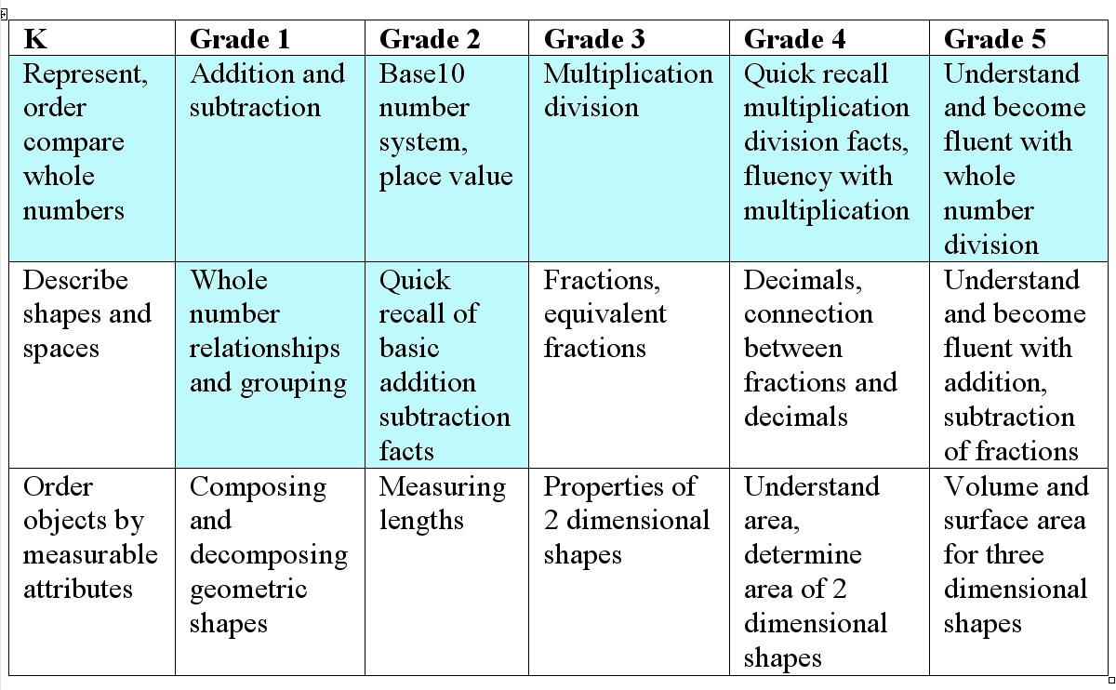
Focus Topics – Numbers

Slide 17
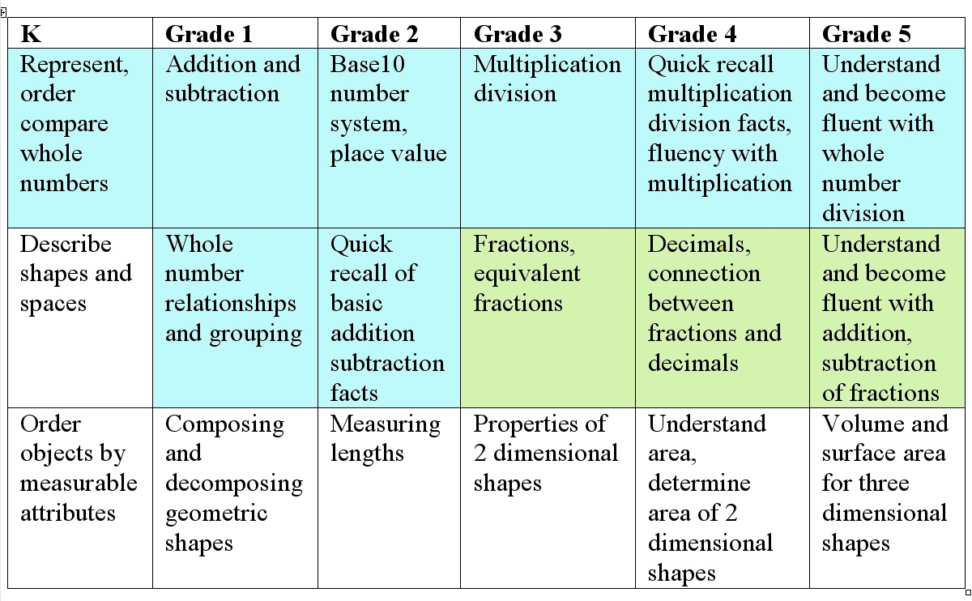
Focus Topics Fractions

Slide 18
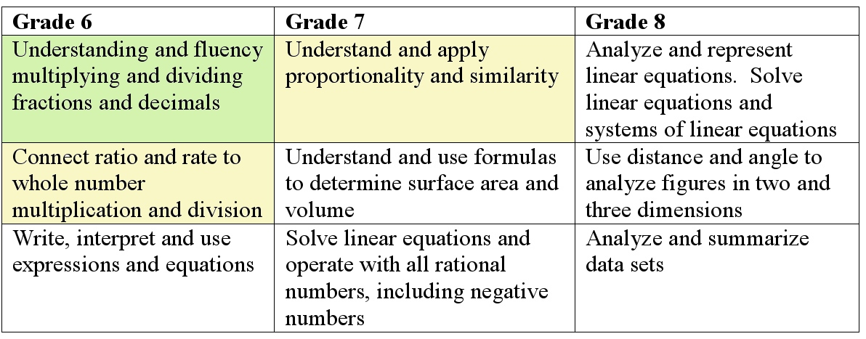
Focus Topics Fractions, Ratios

Slide 19
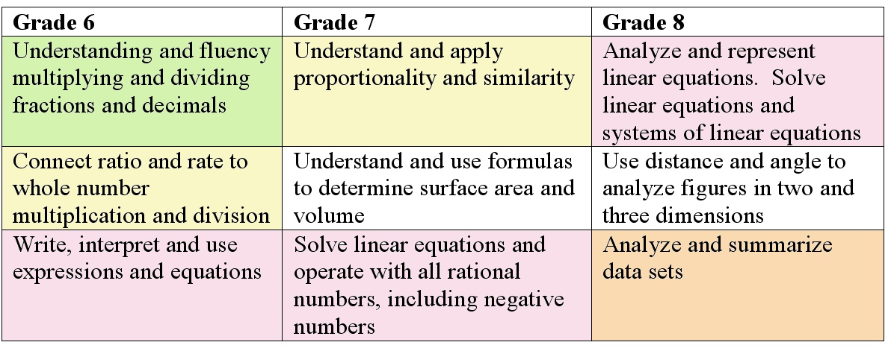
Focus Topics, Algebra, Data

Slide 20
The Process of Constructing the NAEP has to be Improved
At a minimum experts in both math and math education have to be involved in test construction and validation but even more is needed as we’ve indicated

Slide 21
And the Sooner there are new NAEP Standards the Better

