Slide 1
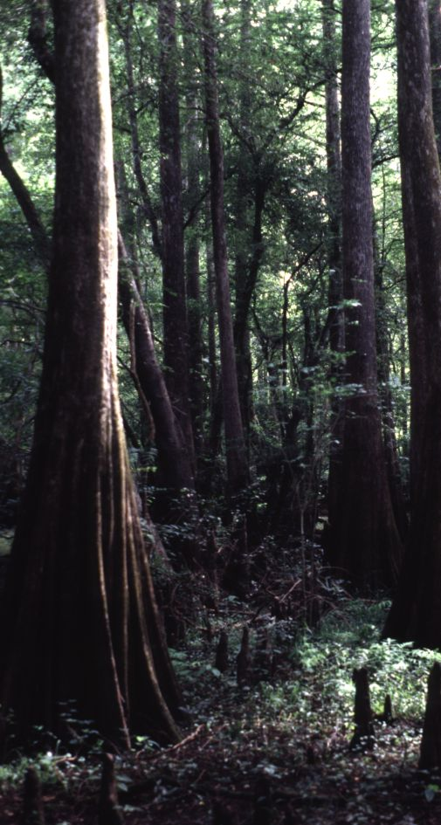

Hydrology,
Topography, and Soils of
Lower Suwannee River Floodplain Forests and
Ecological Consequences of Potential Flow Reductions
Helen Light
U.S. Geological Survey

Slide 2

Study Area
N
W
i
t
h
l
a
A
c
o
A
o
l
t
c
a
l
h
p
e
a
a
e
h
a
n
R
t
i
v
i
e
R
r
c
i
v
e
r
R
O
i
v
e
r
c
e
e
e
a
n
n
a
n
w
u
S
S
a
F
e
n
R
i
v
e
t
r
a
Gulf
of
Mexico

Slide 3
Study Area
N
N
Riverine
W
i
t
h
l
a
A
c
o
A
o
l
t
c
a
l
h
p
e
a
a
e
h
a
n
R
t
i
v
i
e
R
r
c
i
v
e
r
Upper
Tidal
O
R
i
v
e
r
c
e
e
e
a
n
n
a
n
w
u
S
S
a
F
e
n
R
i
v
e
t
r
a
Lower
Tidal
Gulf
of
Mexico

Slide 4

Goals
N
RIVER HYDROLOGY
TOPOGRAPHY
SOILS
Riverine
FLOODPLAIN HYDROLOGY
FOREST
FOREST
COMPOSITION
DISTRIBUTION
Upper
Tidal
FLOW-DEPENDENT
FACTORS
Lower
Tidal
IMPACTS OF FLOW
REDUCTIONS

Slide 5
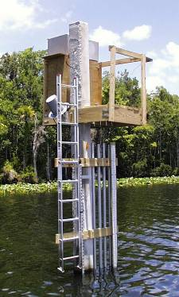
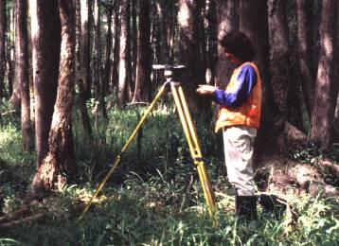
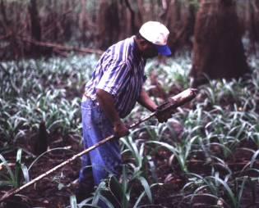
Hydrology
N
Topography
Riverine
Upper
Tidal
Soils
Lower
Tidal

Slide 6
Topography
N
Riverine
Range 11 feet
Levees & ridges prominent
Upper
Tidal
Range 3 feet
Levees minor or absent
Hummocks common
Tidal creeks common
Lower
Tidal

Slide 7
Soils
N
Riverine
Mineral soils
Upper
Tidal
Saturated muck
Saturated muck
Saline
Lower
Tidal

Slide 8
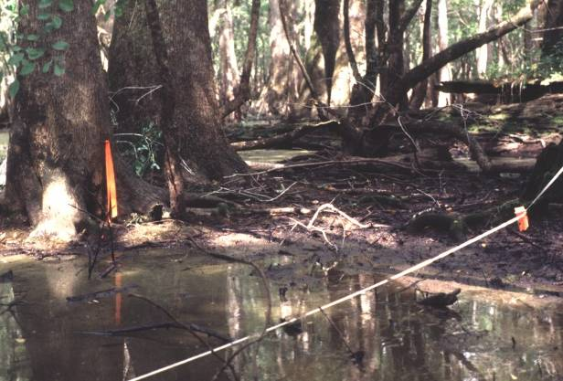
Floodplain Inundation
N
Riverine
Upper
Tidal
Lower
Tidal

Slide 9
Floodplain Inundation
N
Riverine
Flow dependent at all flows
Upper
Tidal
Flow dependent at high flows
Little or no relation to flow
Lower
Tidal

Slide 10
Goals
N
RIVER HYDROLOGY
TOPOGRAPHY
SOILS
Riverine
FLOODPLAIN HYDROLOGY
FOREST
FOREST
COMPOSITION
DISTRIBUTION
Upper
Tidal
FLOW-DEPENDENT
FACTORS
Lower
Tidal
IMPACTS OF FLOW
REDUCTIONS

Slide 11
Flow Dependent Factors
N
Riverine
Flood depths
Inundation
Saturation
Upper
Tidal
Flood depths
Inundation
Salinity
Lower
Tidal

Slide 12
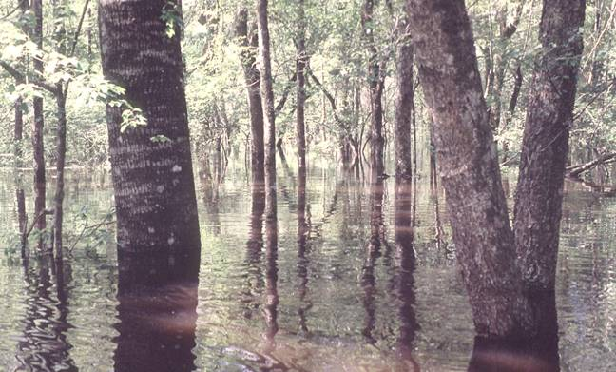
Flood depths affects composition by limiting seedling survival

Slide 13
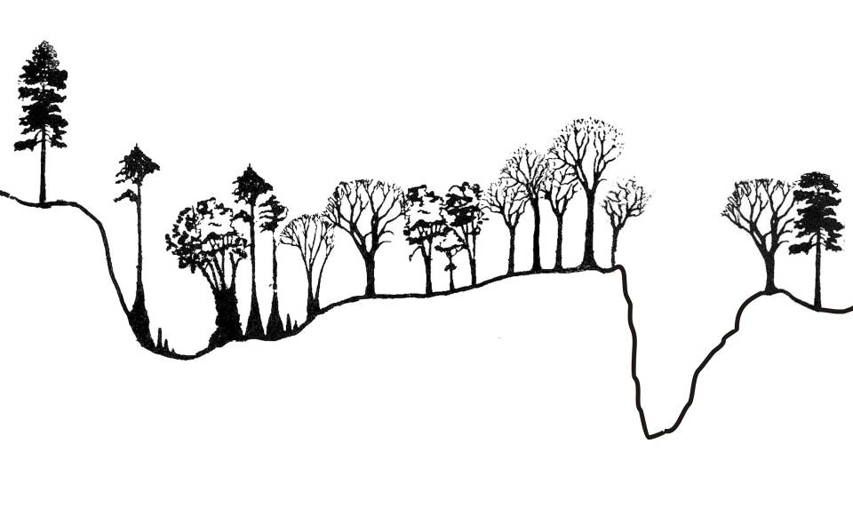
Floodplain Cross Section
High
water

Slide 14
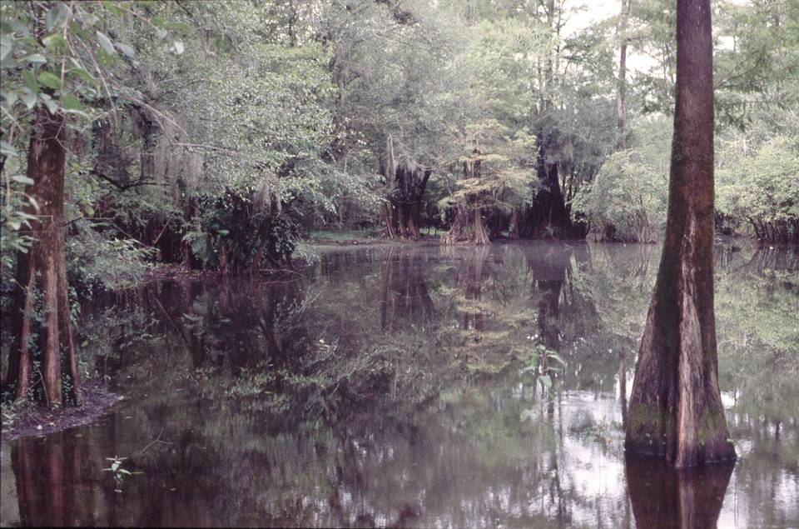
Aquatic habitat in floodplain is flow dependent

Slide 15
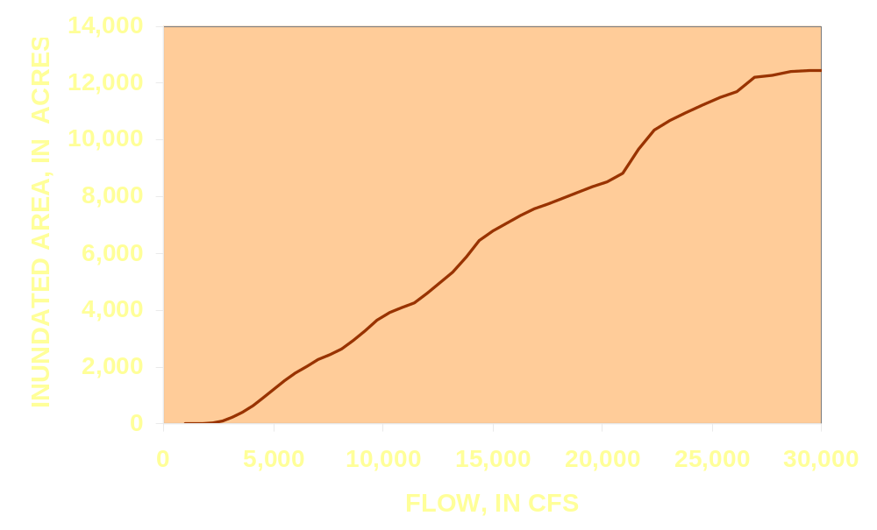
Inundated Area in Relation to Flow
(Riverine)
Notes:
Inundated area in relation to flow (riverine only)

Slide 16
Loss of Forests at Tree Line
OPEN WATER
HAMMOCK
MARSHES
AQUATIC BEDS
SWAMP
SWAMPS REPLACED BY MARSH

Slide 17
Ecological Consequences of Flow Reductions
Forest composition changes:
Exotic species
Opportunistic species
Human disturbance
Lower quality of BLH
Fewer wet swamps
Forest mortality at tree line

Slide 18
Ecological Consequences of Flow Reductions
Decreased inundation and saturation:
Aquatic habitat for fishes & invertebrates
Nutrient and detritus transport
Nitrate removal
Water retention during droughts
Vulnerability to fire

