Slide 1
THE CORNELL NET CARBOHYDRATE AND PROTEIN SYSTEM
Danny Fox, Tom Tylutki, and Luis Tedeschi Animal Science Department
Cornell University

Slide 2
DESCRIPTIVE INFORMATION
Name: Cornell Net Carbohydrate and Protein System
Description: A nutrition model designed to formulate farm specific feeding programs for all classes of beef, dual purpose and dairy cattle
Computer programs: stand alone in windows; written in visual basic

Slide 3
CNCPS MODEL DEVELOPERS:
A team of 12 scientists and 40 graduate students over past 25 yrs
Integrated model: Danny Fox, Luis Tedeschi, Tom Tylutki.
Cattle requirements: Danny Fox, Tom Tylutki, Luis Tedeschi, Michael Van Amburgh.
Rumen fermentation: James Russell, Ronald Pitt, Luis Tedeschi.
Feed composition: Charles Sniffen, Danny Fox, Peter Van Soest, Alice Pell, Larry Chase, Luis Tedeschi, Tom Tylutki.
Amino acid requirements: William Chalupa, Tom Overton.

Slide 4
Tool Purpose: The CNCPS addresses the NRCS 592 Feed Management Standard
Use Land Grant University recommendations to:
Meet animal requirements while reducing the N and P excreted in manure
Improve net farm income by feeding nutrients more efficiently
Optimize use of forages and concentrates grown on the farm to minimize nutrient imports

Slide 5
Area of concern: imported feed nutrients in NY¹
64-76% of imported N is retained on farm
62-80% of imported N is from feeds
68-81% of imported P is retained on farm
45-81% of imported P is from feeds
67-89% of imported K is retained on farm
16-62% of imported K is from feeds
¹Klausner et al., 1993

Slide 6
Imported feed nutrients: impact on mass nutrient balances on dairy farms in N Y¹
 | Nitrogen, Lb/acre retained | Phosphorus, lb/acre retained
Organic | 20 | 0
Large conventional | 170 | 32
Small conventional | 100 | 34
Grazing | 172 | 30
Amish | 82 | 30
¹Shana Bloomfield MPS thesis, Cornell University.

Slide 7
Focus and scale: reduce N and P mass balance through precision feeding of whole herd
    Compute farm specific nutrient requirements and feed utilization
    Compute whole herd feed budgets and nutrient excretion
    Improve utilization of home grown forages

Slide 8
The CNCPS has 3 Components:
1. The CNCPS computer model: computes nutrient requirements and supply.
2. Feed library: contains over 150 feeds with composition values needed to use the CNCPS.
3. Users guide: a tutorial with model equations and case studies.

Slide 9
Users of the CNCPS model: have training in ruminant nutrition
Feeding consultants use to evaluate and improve feeding programs and diagnose problems.
Educators use as a teaching tool for students and consultants.
Researchers use to set research priorities and to design and interpret experiments.
Researchers use to apply research results.

Slide 10
Documentation and user information
On our web site: www.cncps.cornell.edu
Over 50 journal articles (see web site).
Cornell Animal Science Bulletin 213.
CD containing CNCPS computer program, journal articles, and Bulletin 213
(Michelle Cole: mlc44@cornell.edu).

Slide 11
Computer programs available to apply the CNCPS model
CNCPS VERSION 5.0 (www.cncps.cornell.edu)
CPM DAIRY (Cornell Penn Miner)
(ejjancze@vet.upenn.edu)
Dalex computer systems for the feed industry
  (www.dalex.com)
  Estimated users: over 2000 worldwide (over 500 version 5 and CPM Dairy in NY)

Slide 12
Geographical use
Inputs and outputs in CNCPS version 5.034 are universal for all cattle types
  Have users in 42 countries; major regional variables that need to be determined are certain feed characteristics (i.e. digestion rates) . Typically develop regional feed libraries (i.e. UK, Brazil, Mexico, South Africa, Korea, Japan).
  All other variables are site specific

Slide 13
CNCPS inputs: factors used to compute farm specific maintenance requirements
Body weight
Physiological State
  Dry
  Lactating
  Compensating
Acclimatization
  Previous temperature
Heat or Cold stress
  External Insulation
    Coat Condition
    Wind speed
    Hide Thickness
  Internal Insulation
    Condition Score
    Age
Notes:
4

Slide 14
CNCPS inputs: factors used to compute farm specific growth requirements and body reserves
Average body weight of the group
Average mature size of the group
Target age at first calving
Body condition score

Slide 15
CNCPS inputs: factors used to compute farm specific pregnancy and lactation requirements
expected birth weight and days pregnant are used to predict pregnancy requirements
amount and composition of milk are used to compute lactation requirements

Slide 16
CNCPS inputs: feed amounts and analyses to determine energy and protein supplied to the animal
Dry matter
Ash
NDF
Ether extract
Lignin
Starch
Crude protein
Soluble crude protein
Non-protein nitrogen
NDF Protein
ADF Protein

Slide 17
CNCPS outputs: animal requirements
Predicts maintenance requirements for breed type and environmental conditions.
Computes growth requirements for any mature size.
Predicts requirements for days pregnant.
Predicts requirements for target milk amount.
Predicts energy reserves fluxes to account for positive or negative energy balance.
Notes:
2

Slide 18
CNCPS Model outputs: nutrients supplied by the diet to meet animal requirements
Computes carbohydrate and protein fractions available for rumen fermentation from each feed.
Uses a mechanistic rumen model to predict microbial growth and energy and protein absorbed from each feed.
Notes:
2

Slide 19
CNCPS model outputs: balances
Energy and protein allowable growth and milk production
Nitrogen balances
  Rumen ammonia (critical to maximize fiber digestion)
  Rumen peptides (maximize microbial protein produced from grains)
  Absorbed amino acids (meet animal tissue and milk requirements)
Mineral balances

Slide 20
CNCPS outputs: daily and annual nutrients in manure
N, P and K excreted for each group
N, P, and K excreted by whole herd
% of N, P, and K fed that is purchased
Total herd manure production

Slide 21
CNCPS outputs: herd feed requirements and cost
Annual requirement for each diet ingredient
  By group
  For total herd
Daily and annual feed cost and return over feed

Slide 22
Success of the CNCPS in addressing the NRCS 592 Feed Management Standard
Field evaluations
Results on case study Dairy farms in NY:
  Reduced N and P in manure about 1/3
  Reduced feed costs $50 to $130/cow/year
Feeding Consultants experiences with using the CNCPS:
  With accurate inputs, CNCPS can predict actual milk within 1 to 2 lb./day.
  typically report 2 to 4 kg more milk produced/day.
  identifies factor most limiting milk production.

Slide 23
Data sharing with other tools: the cuNMPS
CNCPS 5.0 designed to address NRCS 592 standards:
  minimize excess N and P on the farm by:
    Computing farm specific requirements and feed utilization
    Computing whole herd feed budgets and nutrient excretion
    Improving utilization of home grown forages
Cornell Cropware 2.0 designed to address 590 standards:
  manage manure to maximize recycling
  minimize potential leakage into surface and ground water

Slide 24
Integration and development of cuNMPS tools for precision feed management: work in progress.
Precision Feed Management
Precision Feeding
Comprehensive Forage Management

Slide 25
Potential for precision feed management by implementing the cuNMPS tools¹
 | Purchased feed, $/day | Milk, Lb./year | Nitrogen, lb/year | Phosphorus, lb/year
Before | 1813 | 27,622 | 309,043 | 43,435
After | 1375 | 40,167 | 256,349 | 31,192
% change | -34.2 | 45 | -17.1 | -28.2
¹Tylutk et al., 2002 Cornell Nutrition Conference. Results of a 5 year case study on a 600 cow dairy.

Slide 26
Use of CNCPS in addressing watershed TMDL restrictions:
Cannonsville Reservoir case study
Information from Precision Feeding project of Paul Cerosaletti, Dairy and Field Crops specialist, Delaware Co. Extension

Slide 27
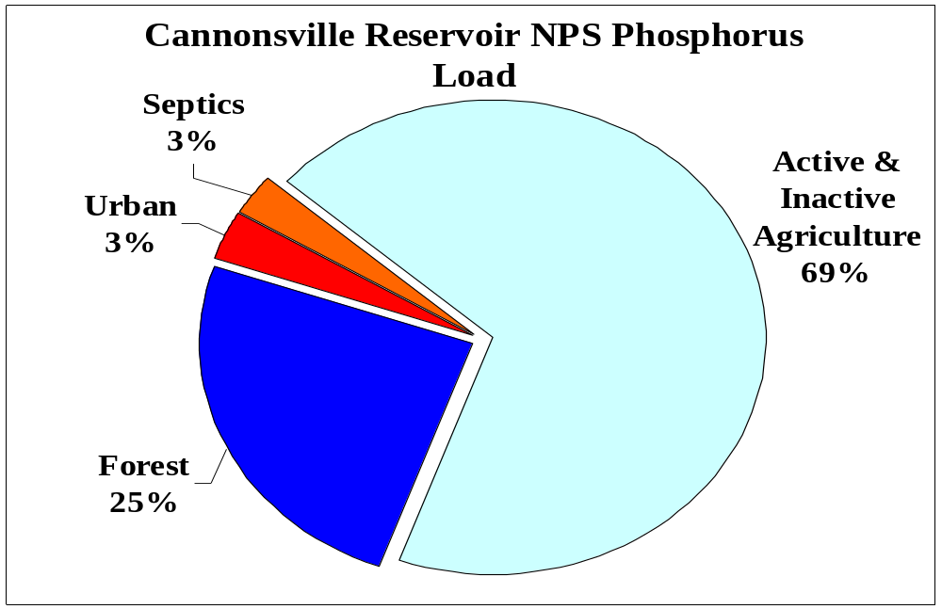
Bishop, 2001

Slide 28
Impact of Feed P imports
18 - 41 kg Feed P imported per cow/year
7000 – 8000 mature cows in Cannonsville Reservoir Basin
= 126,000 – 328,000 kg P imported into Basin per year as feed
50,000 kg avg. annual P loading to the Cannonsville Reservoir

Slide 29
Results – Dietary Intervention with the CNCPS¹
Reduced Manure P Content:
  Average for Herds A&B
  Before = 1.32 % of fecal DM
  After = .88 % of fecal DM
  33% reduction (agrees with CNCPS model)
¹Paul Cerosaletti Precision feeding study; Cannonsville Reservoir Basin

Slide 30
Dietary P Reductions
- Implications for Cannonsville
7000-8000 mature cows in Cannonsville basin
Assume 9 kg per cow/yr reduction across all mature cows is achieved

Slide 31
Dietary P Reductions
- Implications for Cannonsville
Results in:
64,000 – 73,000 kg
less P imported per year into the basin and excreted in dairy manure produced in basin
50,000 kg avg. annual P load into Cannonsville reservoir

Slide 32
Future plans for CNCPS
Keep refining the CNCPS to improve accuracy in predicting cattle requirements, feed biological values, and nutrient excretion
Improve user friendliness
Increase use by feed industry in NY
Integrate with other cuNMPS tools
  Cropware
  Whole farm forage management
Link with whole watershed management tools

