Slide 1

CARES Planning Initiatives
VISN 23
Summary

Slide 2
Presentation Outline
February 2003 Changes in Planning Initiatives
VISN Overview
VISN-Level Issues
  Special Disability Programs
  Effective Use of Resources
    Proximity
    Vacant Space
  VISN/PI Team Identified Issues
  Collaborative Opportunities
  Nursing Home Care
VISN Markets ( 5)
Market Planning Initiatives
  Access
  Inpatient
  Outpatient
  Small Facility Planning Initiative

Slide 3
Changes in CARES Projections
The Revised CARES Projections Incorporates the following:
  The Census 2000 into the Veteran Population projections and therefore, the Enrollment projections
  The new Enrollment Policy Decisions
    Eligibility for new enrollment; and
    Increased co-pays

Slide 4
February 2003 Changes in Planning Initiatives
Type of Planning Initiative | Iowa Market |  | Minnesota Market |  | Nebraska Market |  | North Dakota Market |  | South Dakota Market
 | PI in Nov 2002 | PI in Feb 2003 | PI in Nov 2002 | PI in Feb 2003 | PI in Nov 2002 | PI in Feb 2003 | PI in Nov 2002 | PI in Feb 2003 | PI in Nov 2002 | PI in Feb 2003
Small Facility PI: | Yes Des Moines Knoxville | Yes Knoxville Des Moines | Yes St. Cloud | Yes St. Cloud | No | No | No | No | Yes Sioux Falls Hot Springs | Yes Hot Springs
Capacity PI:
Inpt. Medicine | Yes | Yes | Yes | Yes | Yes | Yes |  |  | Yes | Yes
Inpt. Surgery |  |  | Yes | Yes
Inpt. Psychiatry | Yes | Yes | Yes | s | Yes |  |  |  |  | Ye
Outpt. Primary Care | Yes | Yes | Yes | Yes |  |  |  |  | Yes | Yes
Outpt. Specialty Care | Yes | Yes | Yes | Yes | Yes | Yes | Yes | Yes | Yes
Outpt. Mental Health | Yes
Indicates Planning Initiative.

Slide 5
VISN 23 Overview
Enrollees
  Projected to decline by 10% from FY 2001 level to FY 2022
Planning Initiatives (PIs)
  Access
    5 Markets have PIs related to access in Primary Care, 4 in Acute Hospital Care, and 1 in Tertiary Care
  Inpatient Demand
    4 Markets have PIs related to decreased demand in Medicine Care
    1 Market has a PI related to decreased demand in Surgical Care
  Outpatient Demand
    2 Markets have PIs related to increased demand in Primary Care
    1 Market has a PI related to decreased demand in Primary Care
    4 Markets have PIs related to increased demand in Specialty Care.
  Small Facility
    3 Markets have PIs related to facilities with projected acute care beds less than 40

Slide 6
VISN 23 Overview
Other VISN-Level Issues
  Special Disability Programs
  Proximity
    No Acute Care facilities are within the 60-mile Guideline
    No Tertiary Care facilities are within the 120-mile Guideline
  VISN/PI Team Identified Issues
    Need for SCI Center (none at present)
    Renovation of Grand Island, Nebraska NHCU
    Renovation of inpatient units at Iowa City and Fargo
    Lead paint issues in Child Care Centers or Quarters at Des Moines, Knoxville, Minneapolis, St. Cloud, Grand Island, Fargo, Fort Meade, and Hot Springs
    EU lease opportunities exist
  Collaborative Opportunities
    Minneapolis is one of the top 20 high potential EU opportunities
    VBA collaborative opportunities in Des Moines, Minneapolis, and Lincoln
    NCA collaborative opportunity in Knoxville
    Expansion of the Central Region Federal Healthcare Alliance (VA, DoD, and TriCare)
      Offutt AFB, Minot AFB, Grand Forks AFB, Ellsworth AFB

Slide 7
VISN Overview
Nursing Home Care:
  The need for NHCU care remains high over the planning period. However, the NHCU component of VA’s LTC Planning Model is in process of review to update the projections.
  Market Plans shall still consider any space and/or capital needs for NHCU care needs. (Realignment, renovations, conversion of space, etc.)

Slide 8
VISN Overview
NHCU
Nursing Home Care:
  The need for NHCU care remains high over the planning period. The NHCU component of VA’s LTC Planning Model is in process of review to update the projections and should be available March 1st.
  Market Plans shall still consider any space and/or capital needs for NHCU care needs. (Realignment, renovations, conversion of space, etc.)

Slide 9
Domiciliary Policy
Domiciliary projections will not be part of this CAREs cycle.
However, DOMs may and should be included in Market Plans to reuse vacant space or as a result of realignments (especially when homelessness or residential rehab is the focus of Dom bed use).

Slide 10
VISN 23 – Issues
Special Disability Programs
Blind Rehab: No Planning Initiative
SCI: While the data could be interpreted as supporting new SCIUs in each VISN without an SCIU, existing referral patterns and availability of beds in neighboring VISNs suggest the addition of four new SCIUs could be supported by the data (VISNs 2, 16, 19, and 23). Develop PI to address.
Mental Health (SCMI, PTSD, SA): Certain aspects of projections were flat lined. MH service developing alternative projection methodology.
Dom/Homelessness: Postponed until next year.
TBI: Postponed until next year.

Slide 11
VISN Level Issues
Effective Use of Resources – Proximity
Acute Care Hospitals with similar missions that are within 60 miles of each other:
  None
Tertiary Care Hospitals within 120 miles of each other:
  None

Slide 12

VISN Level Issues
Effective Use of Resources – Space
Current vacant space:
420,424 square feet
Once the future workload demand data is translated into future space needs, any excess space that is identified will be added to the Vacant Space pool.
The final Planning Initiative for all VISNs will be to reduce this total Vacant Space pool by at least 10% beginning in FY2004 and 30 % in FY2005.

Slide 13
VISN Level Issues
PI Team Identified Issues
Listed below are other issues that the VISN will consider when developing the Market Plans:
    Need for SCI Center (none at present)
    Renovation of Grand Island, Nebraska NHCU
    Renovation of inpatient units at Iowa City and Fargo
    Lead paint issues in Child Care Centers or Quarters at Des Moines, Knoxville, Minneapolis, St. Cloud, Grand Island, Fargo, Fort Meade, and Hot Springs
    EU lease opportunities exist

Slide 14
VISN Level Issues
Collaborative Opportunities
The following collaborative opportunities have been identified for VISN 23 to consider when completing Market Plans:
  VBA
    VBA collaborative opportunities in Des Moines, Minneapolis, and Lincoln
  NCA identification of areas they would like to expand:
    NCA collaborative opportunity in Knoxville
  Enhanced-Use possible opportunities for vacant space:
    Minneapolis is one of the top 20 high potential EU opportunities
  DoD
    Expansion of the Central Region Federal Healthcare Alliance (VA, DoD, and TriCare)
      Offutt AFB, Minot AFB, Grand Forks AFB, Ellsworth AFB

Slide 15
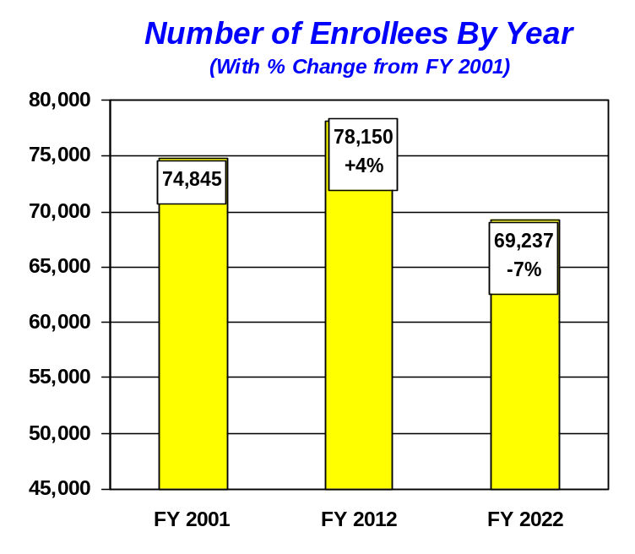
VISN 23 Iowa Market
Description of Market Area:
  Iowa and western Illinois are rural areas served by seven strategically-located CBOCs and three VA medical centers. Primary care, mental health, inpatient care, and long term care are available to veterans. The Iowa City VA Medical Center provides tertiary care services.
  Medical Centers:
    Knoxville
    Des Moines
    Iowa City

Slide 16
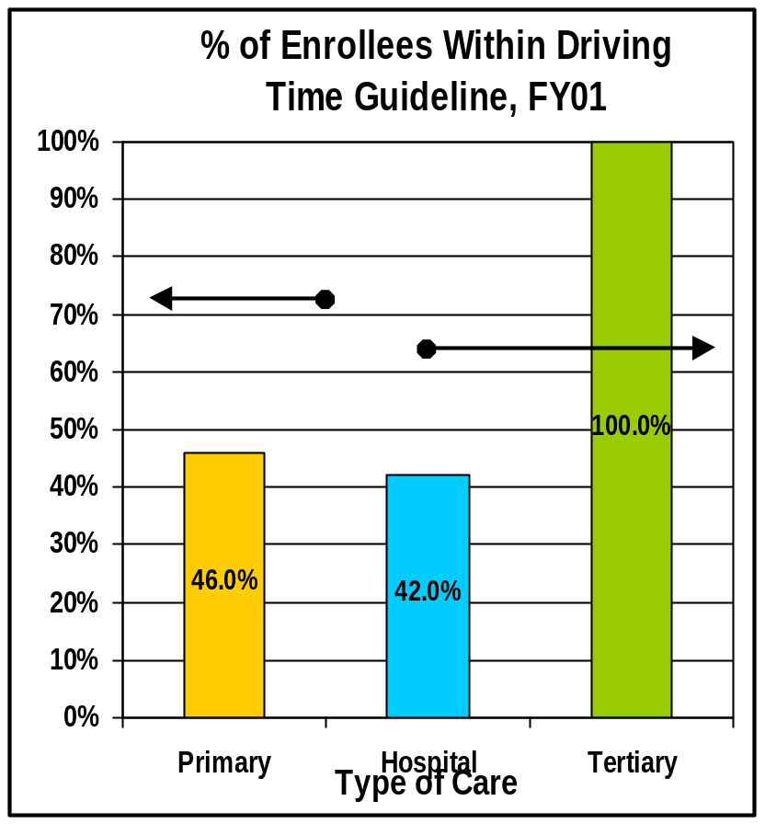
VISN 23 Iowa Market
CARES Planning Initiatives
Access
  Primary Care: 46% of the veterans residing within the Market are within the Access Guideline
  Hospital Care: 42% of the veterans residing within the Market are within the Access Guideline
  Tertiary Care: 100% of the veterans residing within the Market are within the Access Guideline
70%
65%
Access Data 12/31/02
This represents the Travel Time Guideline.

Slide 17
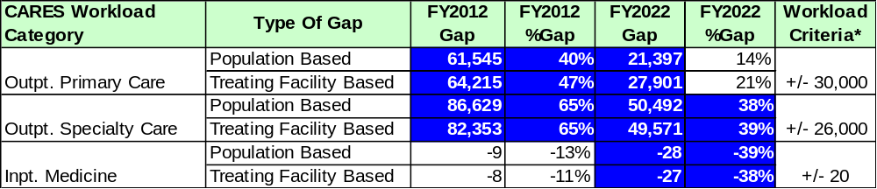
VISN 23 Iowa Market
CARES Planning Initiatives
*NOTES: Significant Gaps are determined by first applying a percentage change criteria (+/-25%) for each CARES Category. If the gap meets this threshold, then it must meet the workload threshold criteria (beds for inpatient categories and stops for outpatient categories).

Slide 18
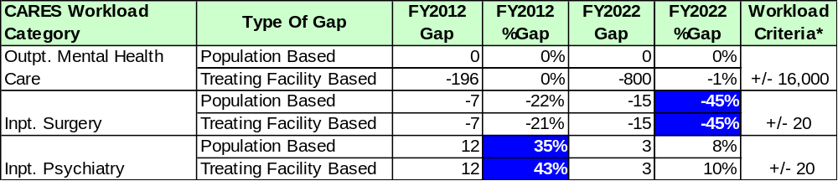
VISN 23 Iowa Market
CARES Non-PI Workload Gaps
*NOTES: A Significant Gap is determined by first applying a percentage change criteria (+/-25%) for each CARES Category. If the gap meets this threshold, then it must meet the workload threshold criteria (beds for inpatient categories and stops for outpatient categories).

Slide 19
VISN 23 Iowa Market
CARES Planning Initiatives
Small Facility Planning Initiative:
  The following facilities were projected to have less than 40 beds in FY 2012 and/or 2022.
PI? | Facility Name | FY2012 (Beds) | FY2022 (Beds) | Rationale
Y | Des Moines | 34 | 24 | Medical Center needs to evaluate bed levels for quality and efficiency
Y | Knoxville | 26 | 20 | Medical Center needs to evaluate bed levels for quality and efficiency

Slide 20
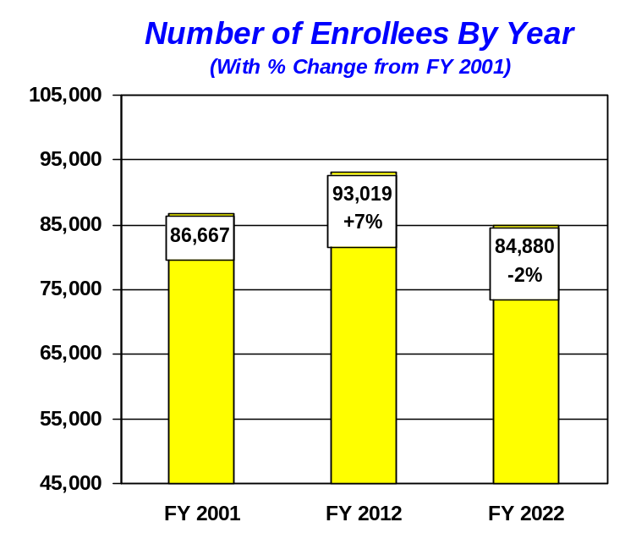
VISN 23 Minnesota Market
Description of Market Area:
  This market includes most of Minnesota and western Wisconsin. The major urban area is a seven-county metropolitan area. A large number of counties remain rural in northern and southern Minnesota. Health care services include primary care, mental health, inpatient care, tertiary care and long-term care. The major tertiary referral center is in Minneapolis. There are two medical centers and 8 CBOCs throughout the market.
  Medical Centers:
    Minneapolis
    St. Cloud

Slide 21
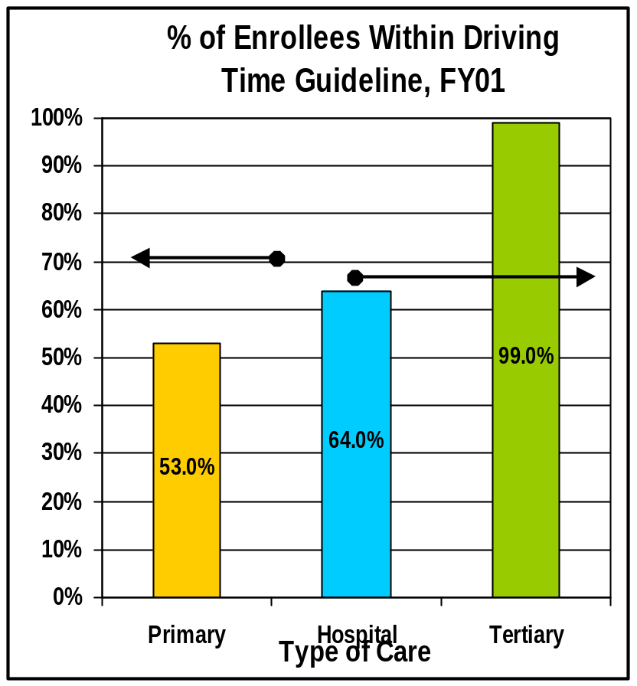
VISN 23 Minnesota Market
CARES Planning Initiatives
Access
  Primary Care: 53% of the veterans residing within the Market are within the Access Guideline
  Hospital Care: 64% of the veterans residing within the Market are within the Access Guideline
  Tertiary Care: 99% of the veterans residing within the Market are within the Access Guideline
70%
65%
Access Data 12/31/02
This represents the Travel Time Guideline.

Slide 22
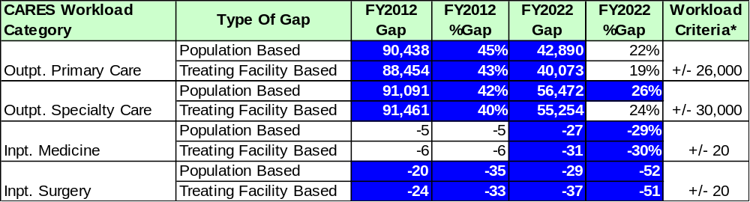
VISN 23 Minnesota Market
CARES Planning Initiatives
*NOTES: Significant Gaps are determined by first applying a percentage change criteria (+/-25%) for each CARES Category. If the gap meets this threshold, then it must meet the workload threshold criteria (beds for inpatient categories and stops for outpatient categories).

Slide 23
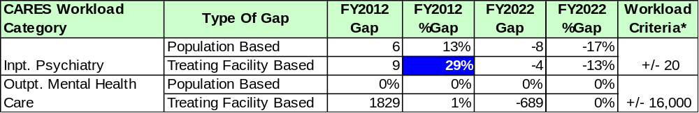
VISN 23 Minnesota Market
CARES Non-PI Workload Gaps
*NOTES: A Significant Gap is determined by first applying a percentage change criteria (+/-25%) for each CARES Category. If the gap meets this threshold, then it must meet the workload threshold criteria (beds for inpatient categories and stops for outpatient categories).

Slide 24
VISN 23 Minnesota Market
CARES Planning Initiatives
Small Facility Planning Initiative:
  The following facility was projected to have less than 40 beds in FY 2012 and/or 2022.
PI? | Facility Name | FY2012 (Beds) | FY2022 (Beds) | Rationale
Y | St. Cloud | 26 | 18 | The VISN needs to evaluate bed levels for quality and efficiency and determine if realignment is necessary

Slide 25
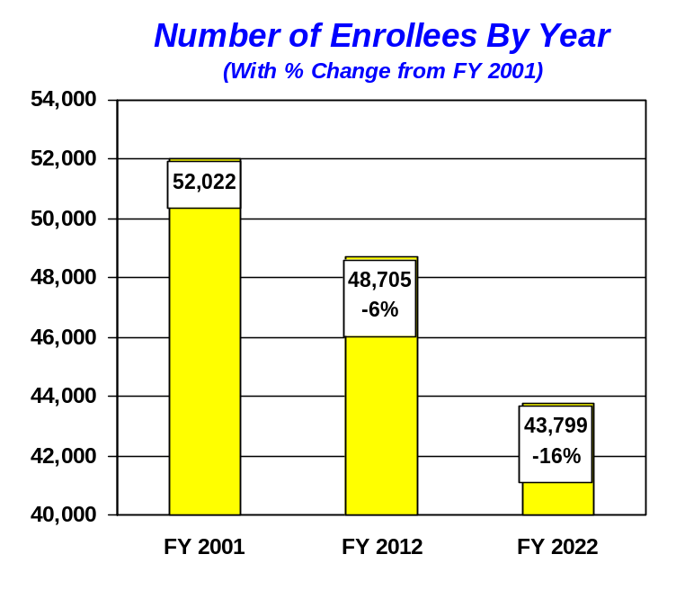
VISN 23 Nebraska Market
Description of Market Area:
  The Nebraska market has two urban areas in Omaha and Lincoln, surrounded by rural counties in Nebraska and Iowa. The major urban areas are located in the northeastern section of the market. The tertiary medical center is located at Omaha, VA nursing home care is available at Grand Island, and three CBOCs serve the market area.
  Medical Centers:
    Grand Island
    Lincoln (CBOC)
    Omaha

Slide 26
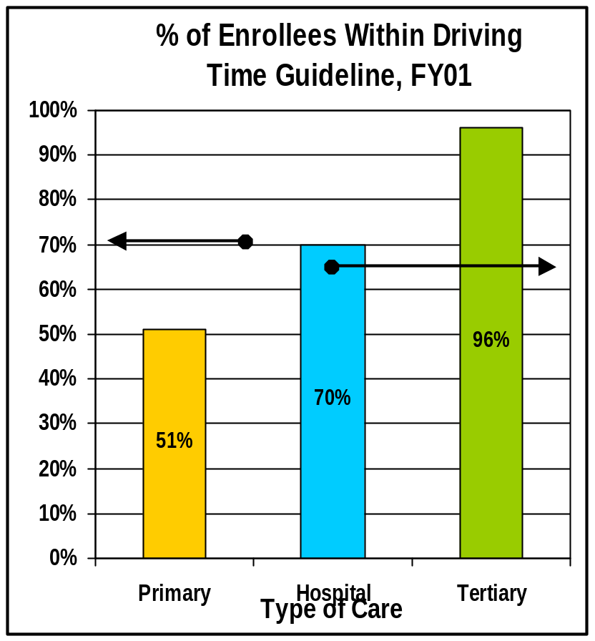
VISN 23 Nebraska Market
CARES Planning Initiatives
Access
  Primary Care: 51% of the veterans residing within the Market are within the Access Guideline
  Hospital Care: 70% of the veterans residing within the Market are within the Access Guideline
  Tertiary Care: 96% of the veterans residing within the Market are within the Access Guideline
70%
65%
Access Data 12/31/02
This represents the Travel Time Guideline.

Slide 27
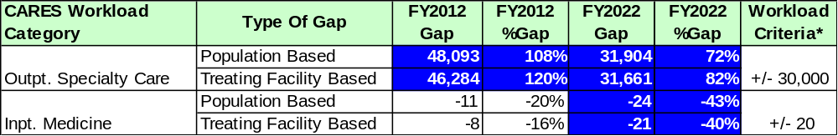
VISN 23 Nebraska Market
CARES Planning Initiatives
*NOTES: Significant Gaps are determined by first applying a percentage change criteria (+/-25%) for each CARES Category. If the gap meets this threshold, then it must meet the workload threshold criteria (beds for inpatient categories and stops for outpatient categories).

Slide 28
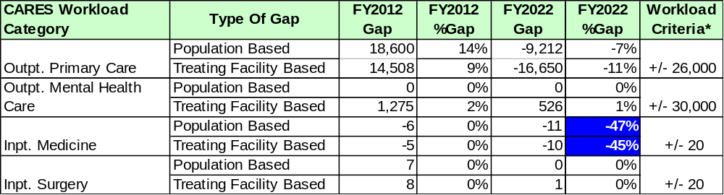
VISN 23 Nebraska Market
CARES Non-PI Workload Gaps
*NOTES: A Significant Gap is determined by first applying a percentage change criteria (+/-25%) for each CARES Category. If the gap meets this threshold, then it must meet the workload threshold criteria (beds for inpatient categories and stops for outpatient categories).

Slide 29
VISN 23 Nebraska Market
CARES Planning Initiatives
Small Facility Planning Initiative:
  No facilities were projected to have less than 40 beds in FY 2012 and/or 2022.
PI? | Facility Name | FY2012 (Beds) | FY2022 (Beds) | Rationale
 | None

Slide 30
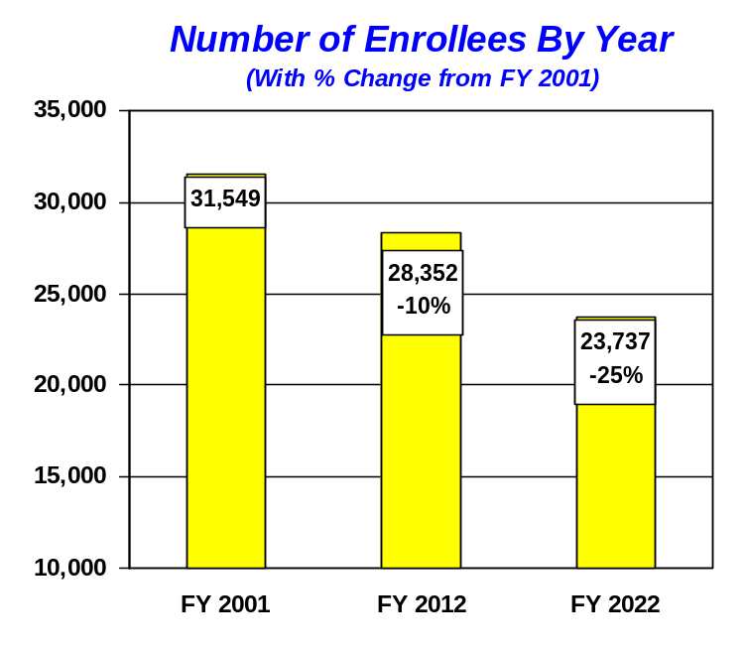
VISN 23 North Dakota Market
Description of Market Area:
  The market area, which is most of North Dakota and Northwest Minnesota, consists of one medical center and 4 CBOCs. Health care services include primary care, mental health, inpatient and long-term care. The CBOCs are dispersed throughout. North Dakota will continue to have a large number of rural and highly rural areas. Fargo is the largest urban population center.
  Medical Center:
    Fargo

Slide 31
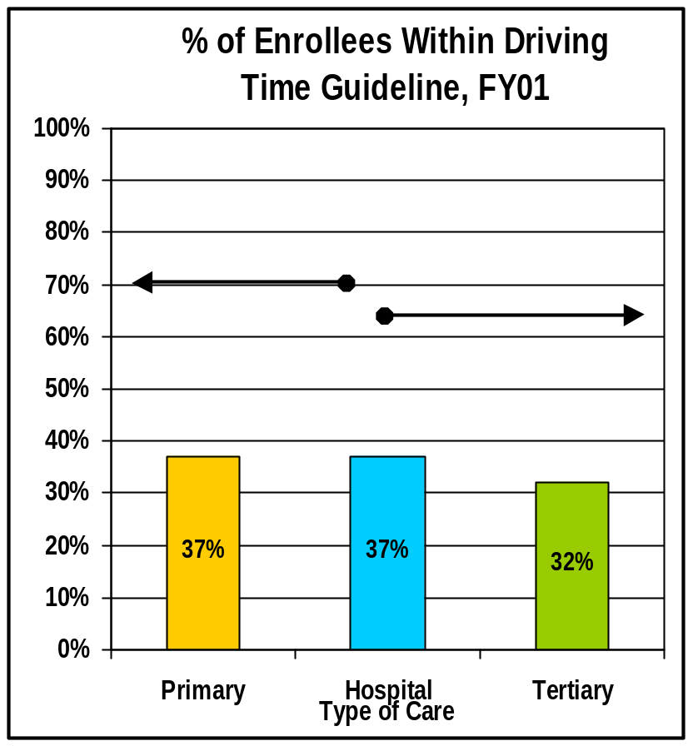
VISN 23 North Dakota Market
CARES Planning Initiatives
Access
  Primary Care: 37% of the veterans residing within the Market are within the Access Guideline
  Hospital Care: 37% of the veterans residing within the Market are within the Access Guideline
  Tertiary Care: 32% of the veterans residing within the Market are within the Access Guideline
70%
65%
Access Data 12/31/02
This represents the Travel Time Guideline.

Slide 32
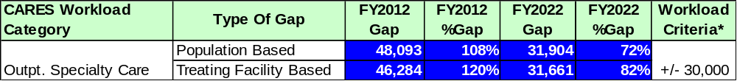
VISN 23 North Dakota Market
CARES Planning Initiatives
*NOTES: Significant Gaps are determined by first applying a percentage change criteria (+/-25%) for each CARES Category. If the gap meets this threshold, then it must meet the workload threshold criteria (beds for inpatient categories and stops for outpatient categories).

Slide 33
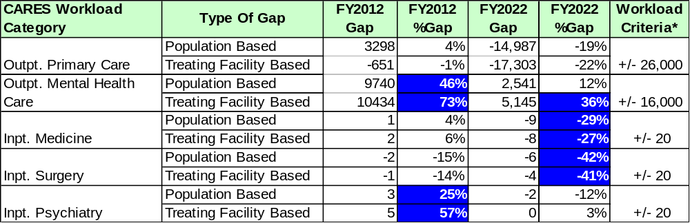
VISN 23 North Dakota Market
CARES Non-PI Workload Gaps

Slide 34
VISN 23 North Dakota Market
CARES Planning Initiatives
Small Facility Planning Initiative:
  The following facility was projected to have less than 40 beds in FY 2012 and/or 2022.
PI? | Facility Name | FY2012 (Beds) | FY2022 (Beds) | Rationale
 | None

Slide 35
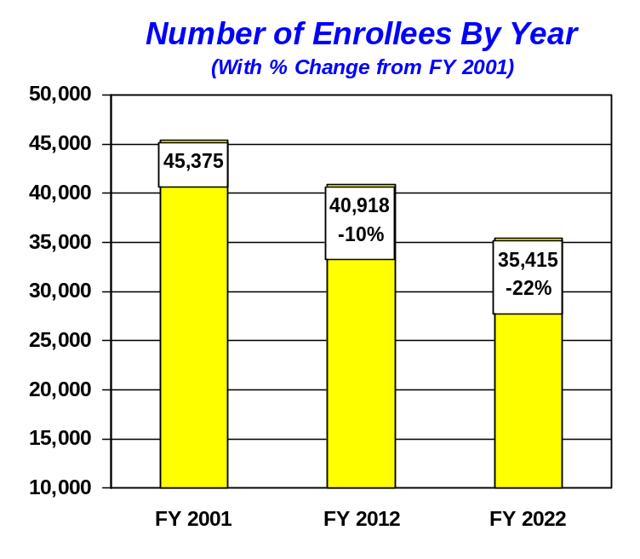
VISN 23 South Dakota Market
Description of Market Area:
  South Dakota, northwestern Nebraska, southeastern Minnesota and northwest Iowa comprise the South Dakota market. The three population bases are in Rapid City, Sioux Falls and Sioux City. There are many rural and highly rural counties. This market has three VA Medical Centers. A full range of services, excluding tertiary care, is available and 12 CBOCs are distributed across the market area. Services include primary care, mental health, inpatient care, long term care and domiciliary care. Tertiary care referrals are made to Minneapolis.
  Medical Centers:
    Fort Meade
    Hot Springs
    Sioux Falls

Slide 36
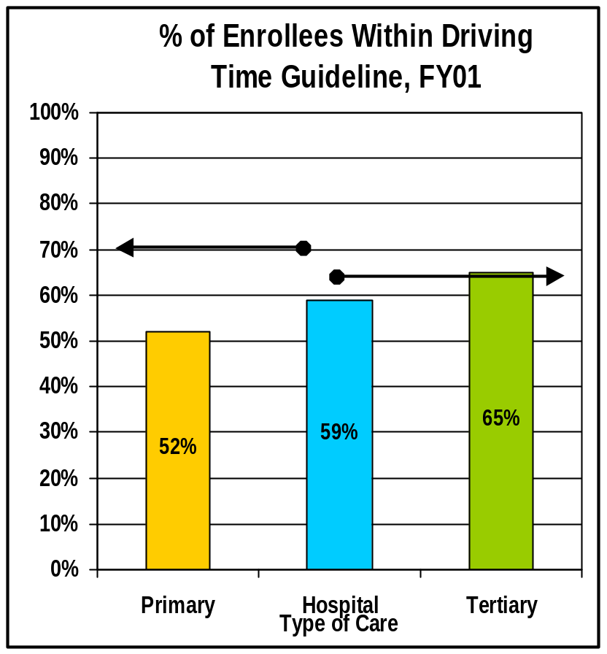
VISN 23 South Dakota Market
CARES Planning Initiatives
Access
  Primary Care: 52% of the veterans residing within the Market are within the Access Guideline
  Hospital Care: 59% of the veterans residing within the Market are within the Access Guideline
  Tertiary Care: 65% of the veterans residing within the Market are within the Access Guideline
70%
65%
Access Data 12/31/02
This represents the Travel Time Guideline.

Slide 37
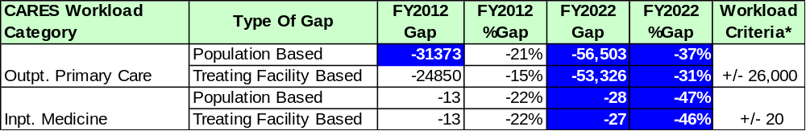
VISN 23 South Dakota Market
CARES Planning Initiatives
*NOTES: Significant Gaps are determined by first applying a percentage change criteria (+/-25%) for each CARES Category. If the gap meets this threshold, then it must meet the workload threshold criteria (beds for inpatient categories and stops for outpatient categories).

Slide 38
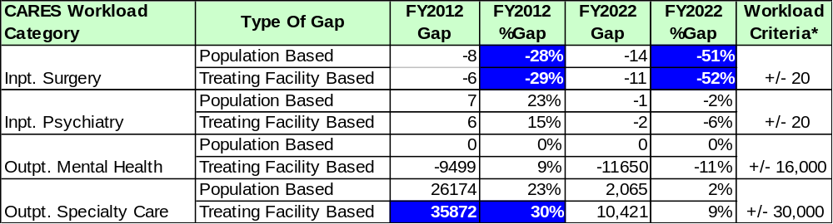
VISN 23 South Dakota Market
CARES Non-PI Workload Gaps
*NOTES: A Significant Gap is determined by first applying a percentage change criteria (+/-25%) for each CARES Category. If the gap meets this threshold, then it must meet the workload threshold criteria (beds for inpatient categories and stops for outpatient categories).

Slide 39
VISN 23 South Dakota Market
CARES Planning Initiatives
Small Facility Planning Initiative:
  The following facilities were projected to have less than 40 beds in FY 2012 and/or 2022.
PI? | Facility Name | FY2012 (Beds) | FY2022 (Beds) | Rationale
Y | Hot Springs | 23 | 20 | The VISN needs to evaluate bed levels for quality, efficiency, and realignment opportunities

