Slide 1
Drowning in Sour Oil
Adapting to a New Crude Quality Dynamic
2005 EIA Midterm Energy Outlook
April 12, 2005
Jay Saunders
Energy Analyst
Deutsche Bank
212 250 2998

Slide 2
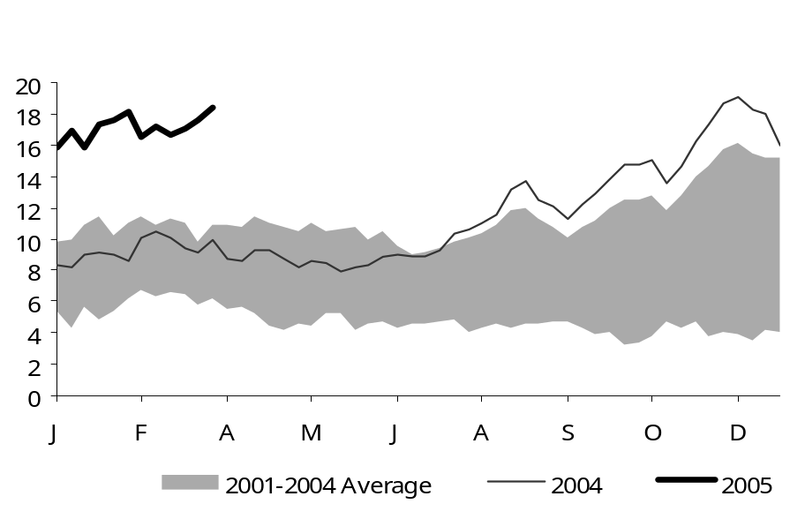
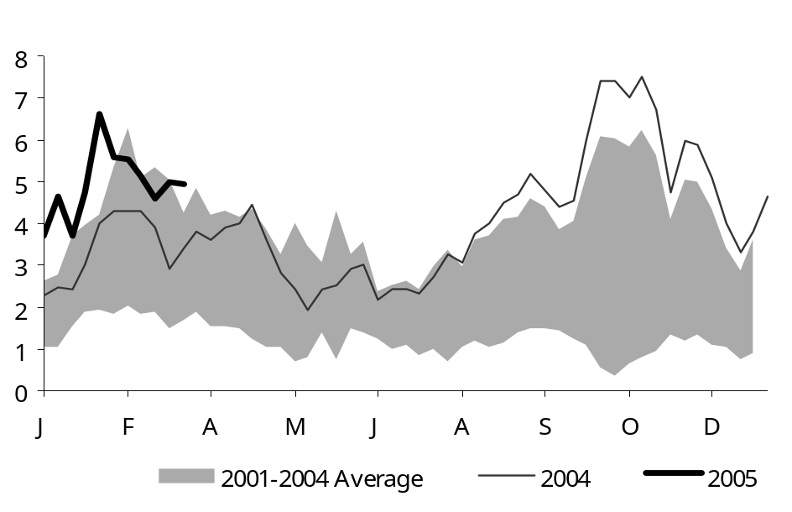
Issue at Hand: Crude Quality Spreads Going Nuts
WTI - Maya
WTI - WTS
Source: Bloomberg, Deutsche Bank

Slide 3
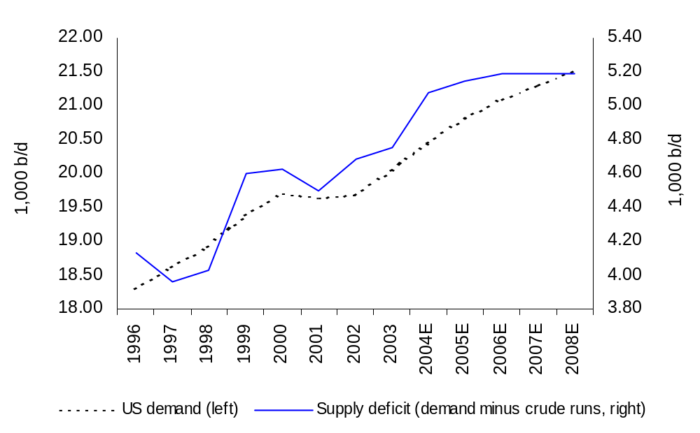
Deutsche Bank Securities Inc.
Refining capacity deficit continues to rise

Slide 4
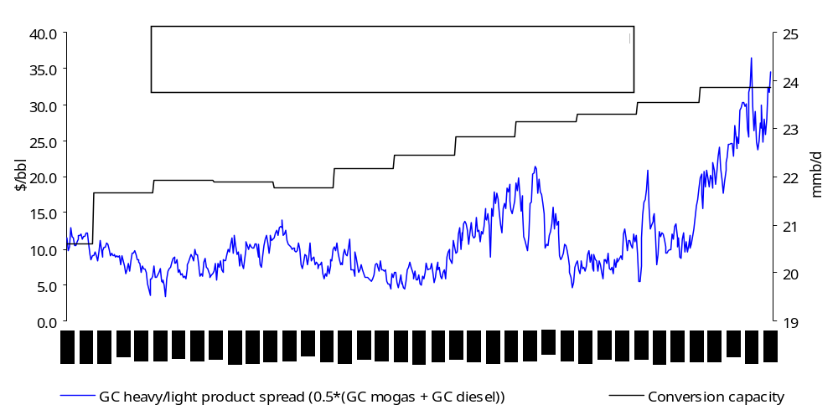
Heavy/light product spread vs conversion capacity
… Additions don’t pace demand
Source: DOE/EIA, Bloomberg, Deutsche Bank

Slide 5
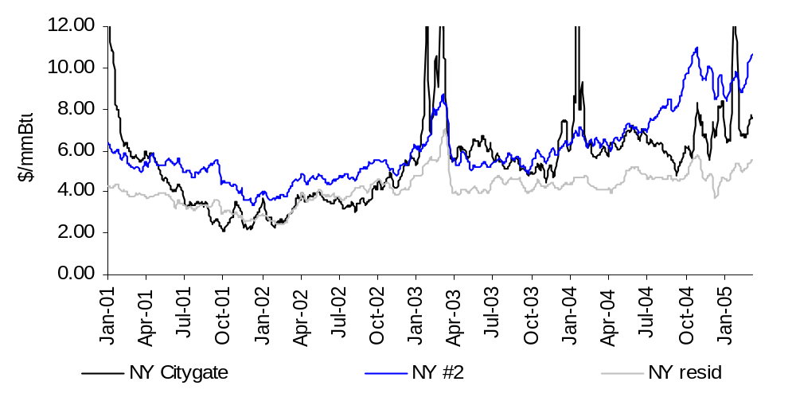
Natural gas vs distillate vs resid
… Clean fuels premium, gas against distillate not resid
Source: Bloomberg, Deutsche Bank

Slide 6
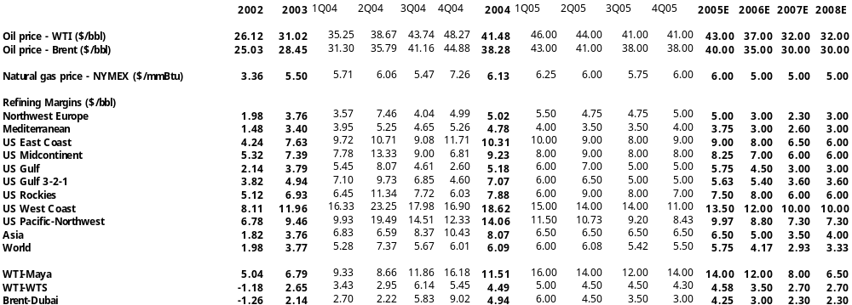
Deutsche Bank Macro Price Deck

Slide 7
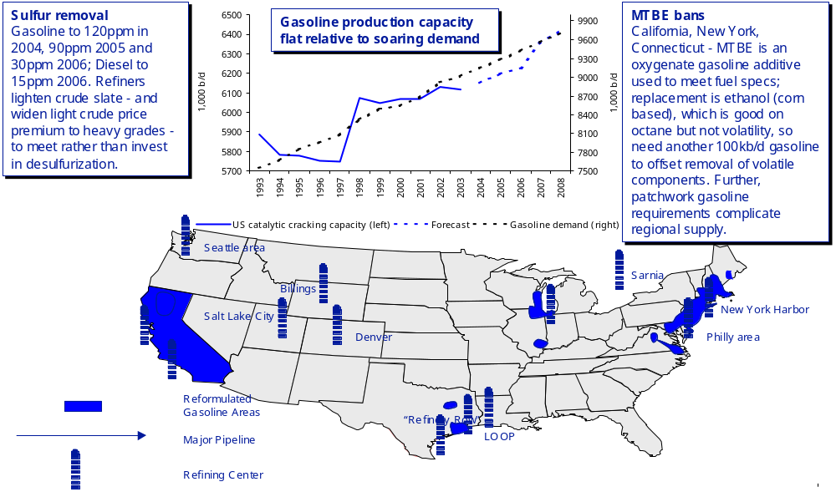
US Refining… Strong demand squeezes patchwork supply

Slide 8
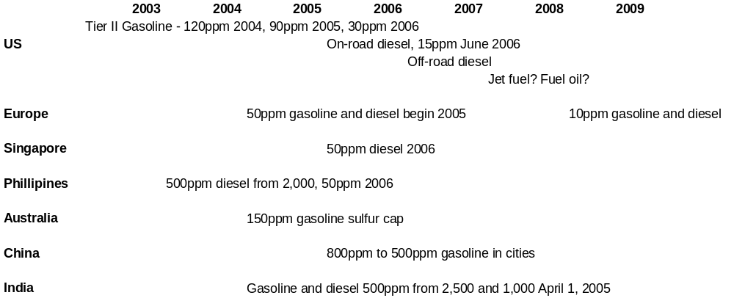
Sulfur specification timeline
...It’s global

Slide 9
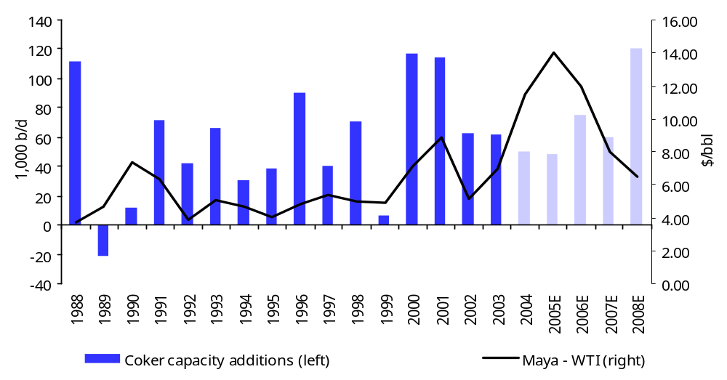
US Coker Additions vs Heavy/Light Spread
3-year investment cycle - and spread - extended, little plans for growth
Source: DOE, Deutsche Bank

Slide 10
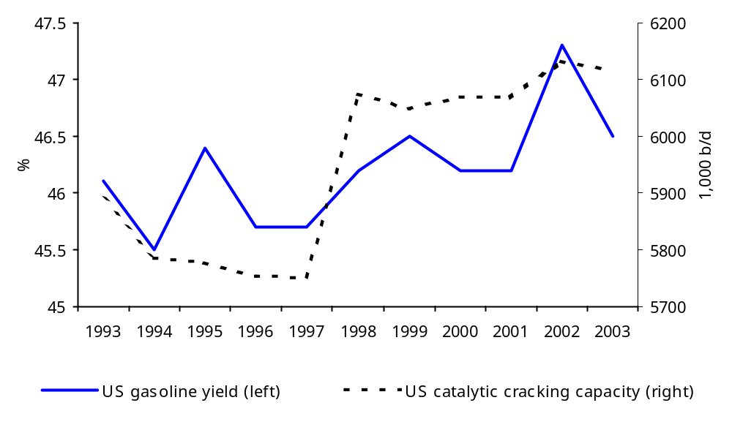
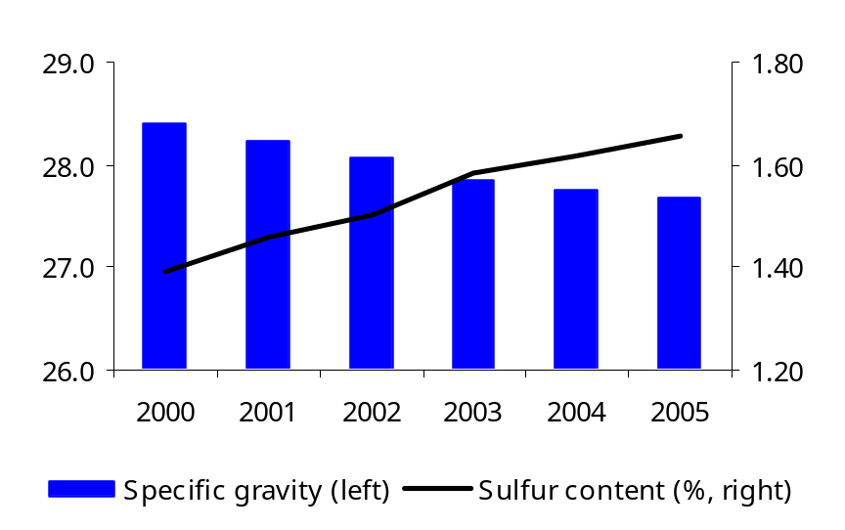
Underinvested US Refining Needs Sweeter Crude Slate
And increasingly heavy barrel further widens heavy discount
North American Crude Quality Declines
Source: Bloomberg, DOE, Deutsche Bank

Slide 11
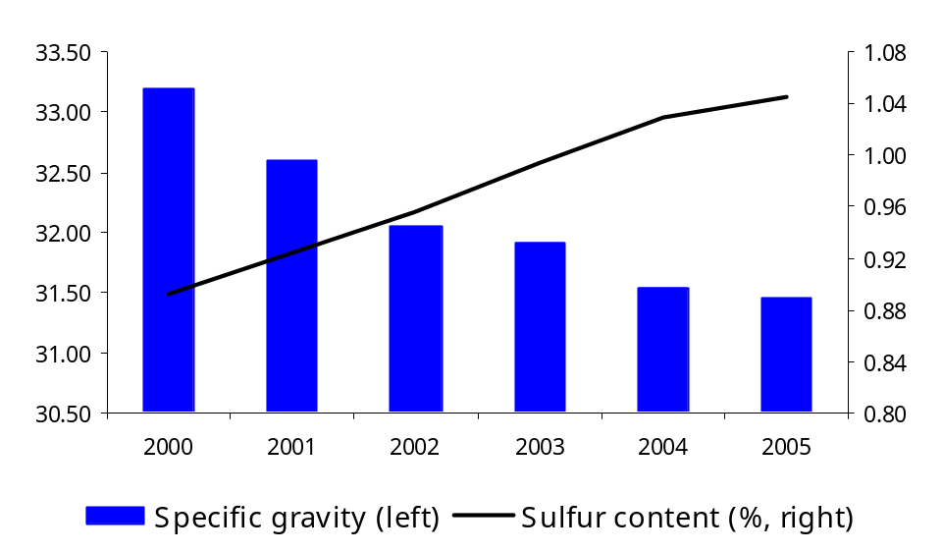
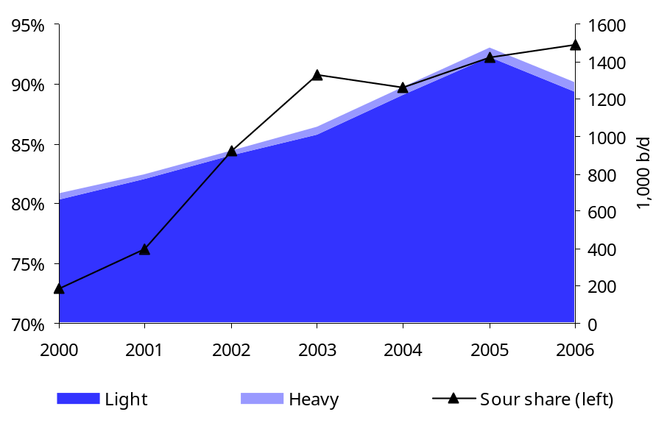
Drowning in Sour Crude
Non-OPEC, GOM crude quality deteriorating just as ridding world fuels of sulfur
Non-OPEC crude quality
Gulf of Mexico crude quality
Source: Wood Mackenzie, Deutsche Bank

Slide 12
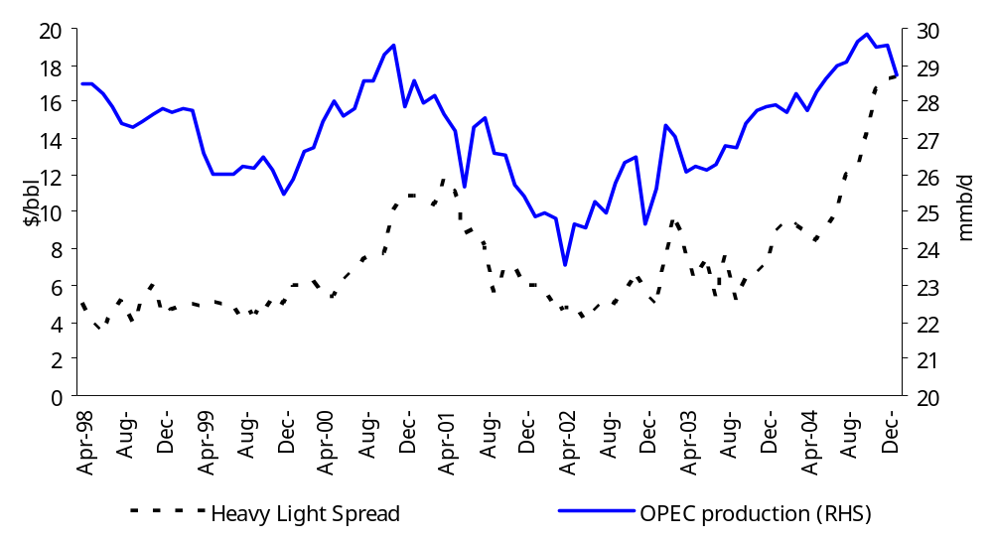
Heavy Crude Discount Moves with OPEC Production
Source: IEA, Bloomberg, Deutsche Bank

Slide 13
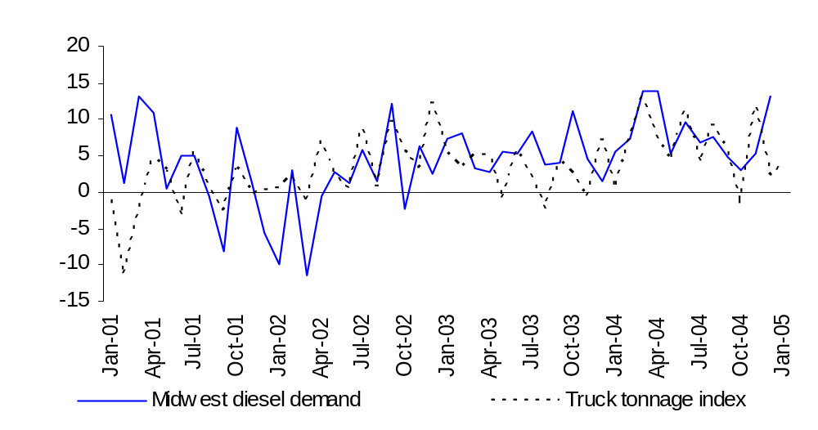
Diesel’s Truckin’
… Midwest diesel demand vs trucking activity
Source: ATA, DOE, Deutsche Bank

Slide 14
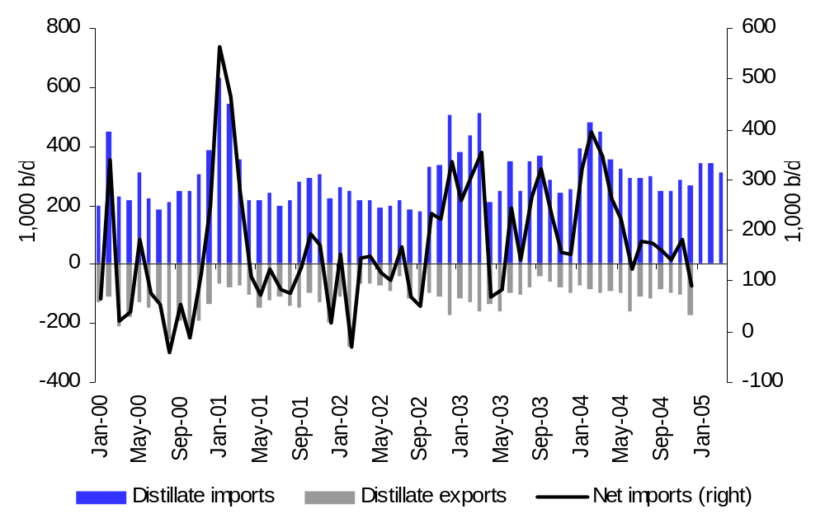
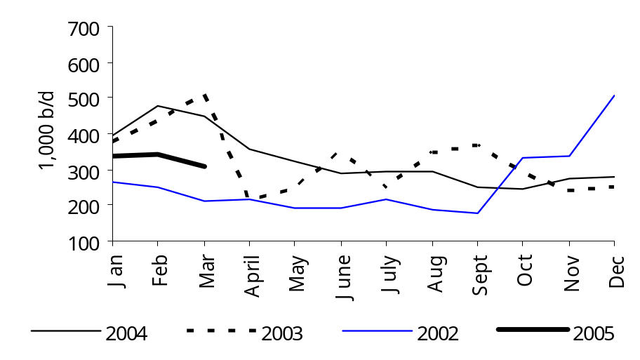
US Distillate Imports/Exports
… Rising exports to a tight Europe constraining US
Gross imports drop in Q4, Q1
Source: DOE/EIA, Deutsche Bank estimates

Slide 15
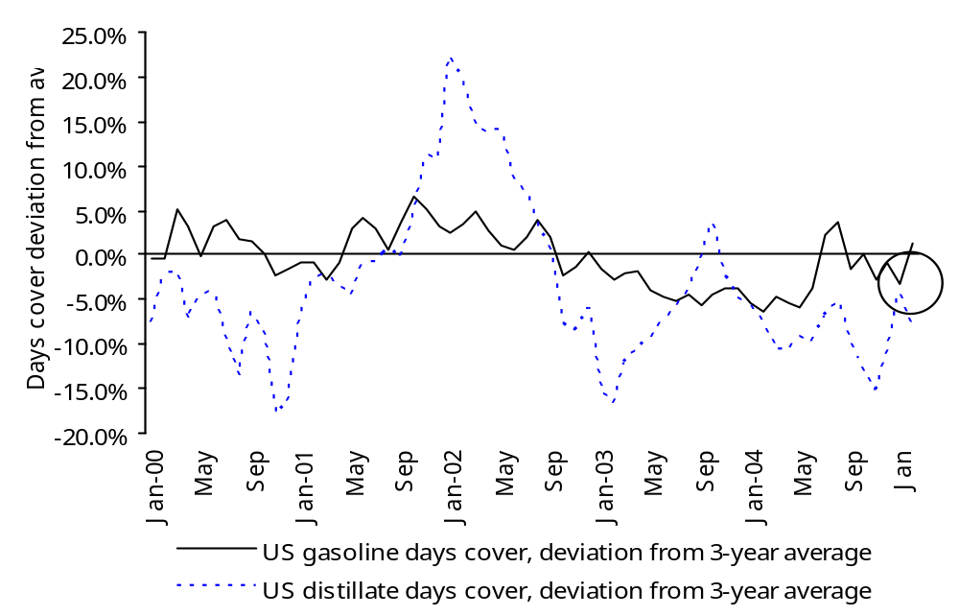
Demand Cover by US Gasoline and Distillate Inventories
… Looking a lot like 2000
Source: DOE, Deutsche Bank estimates

Slide 16
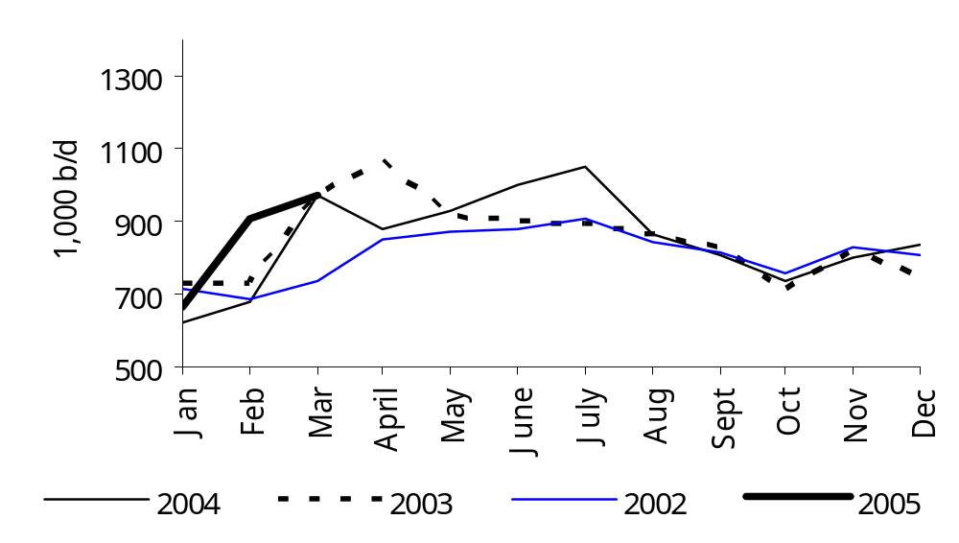
Flat US Gasoline Imports Supports Prices
… What’s going to fill the gap? Potentially yields but only in short term
Source: DOE, Bloomberg, Deutsche Bank

Slide 17
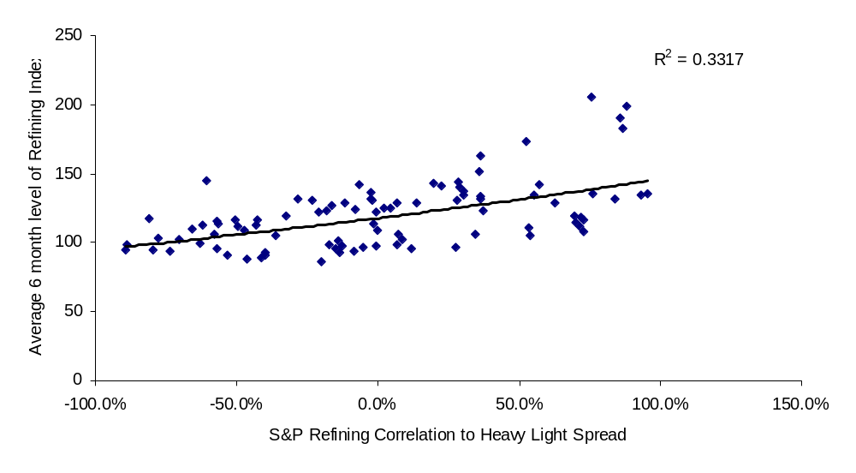
Refiners vs Heavy/Light spread
...Best fit - it matters!

Slide 18
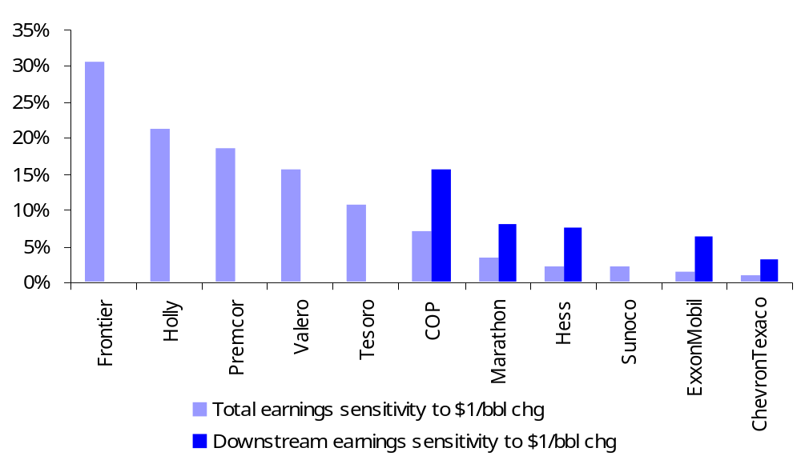
Heavy crude sensitivities
Frontier, Holly, Premcor, Valero, and Sunoco registers

Slide 19

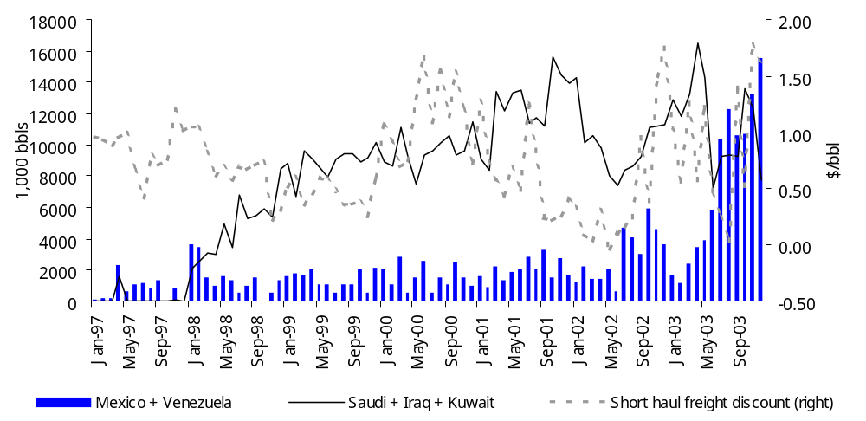
Valero’s Switch to Short-Haul Supply Saves on Freight
Source: US DOE, Worldscale, Deutsche Bank

Slide 20
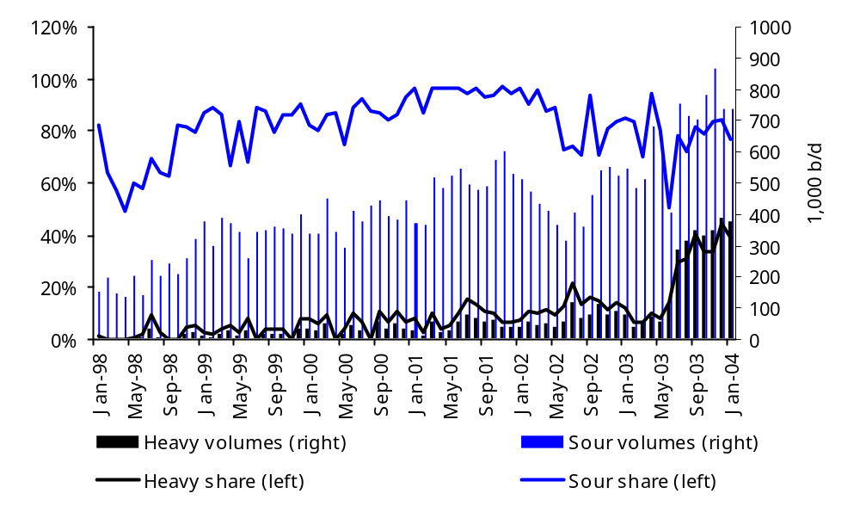
Valero Cheapens Crude Diet
Discounts increase with heavier slate

Slide 21
Additional Information Available upon Request
Deutsche Bank Securities Inc.
  For disclosures pertaining to recommendations or estimates made on a security mentioned in this report, please see the most recently published company report or visit our global disclosure look-up page on our website at http://equities.research.db.com.
The views expressed in this report accurately reflect the personal views of the undersigned lead analyst(s) about the subject issuers and the securities of those issuers. In addition, the undersigned lead analyst(s) has not and will not receive any compensation for providing a specific recommendation or view in this report.
Jay Saunders

Slide 22
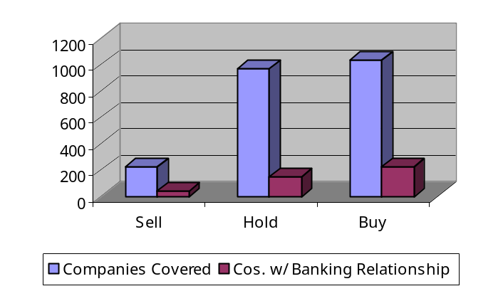
Deutsche Bank Securities Inc.
Rating Key
Rating Dispersion and Banking Relationships
  Buy: Total return expected to appreciate 10% or more over a 12-month period
  Hold: Total return expected to be between 10% to –10% over a 12-month period
  Sell: Total return expected to depreciate 10% or more over a 12-month period
Additional information available on request
The information and opinions in this report were prepared by Deutsche Bank AG or one of its affiliates (collectively “Deutsche Bank”). The information herein is believed by Deutsche Bank to be reliable and has been obtained from public sources believed to be reliable, but Deutsche Bank makes no representation as to the accuracy or completeness of such information.
Important Information Regarding Our Independence. The research analysts responsible for the preparation of this report receive compensation that is based upon, among other factors, Deutsche Bank’s overall investment banking revenues.
Deutsche Bank may engage in securities transactions in a manner inconsistent with this research report and with respect to securities covered by this report, will sell to or buy from customers on a principal basis. Disclosures of conflicts of interest, if any, are discussed at the end of the text of this report or on the Deutsche Bank website at http://equities.research.db.com.
Opinions, estimates and projections in this report constitute the current judgement of the author as of the date of this report. They do not necessarily reflect the opinions of Deutsche Bank and are subject to change without notice. Deutsche Bank has no obligation to update, modify or amend this report or to otherwise notify a reader thereof in the event that any matter stated herein, or any opinion, projection, forecast or estimate set forth herein, changes or subsequently becomes inaccurate, or if research on the subject company is withdrawn. Prices and availability of financial instruments also are subject to change without notice. This report is provided for informational purposes only. It is not to be construed as an offer to buy or sell or a solicitation of an offer to buy or sell any financial instruments or to participate in any particular trading strategy in any jurisdiction. The financial instruments discussed in this report may not be suitable for all investors and investors must make their own investment decisions using their own independent advisors as they believe necessary and based upon their specific financial situations and investment objectives. If a financial instrument is denominated in a currency other than an investor’s currency, a change in exchange rates may adversely affect the price or value of, or the income derived from, the financial instrument, and such investor effectively assumes currency risk. In addition, income from an investment may fluctuate and the price or value of financial instruments described in this report, either directly or indirectly, may rise or fall. Furthermore, past performance is not necessarily indicative of future results.
Unless governing law provides otherwise, all transactions should be executed through the Deutsche Bank entity in the investor’s home jurisdiction. In the U.S. this report is approved and/or distributed by Deutsche Bank Securities Inc., a member of the NYSE, the NASD, NFA and SIPC. In the United Kingdom this report is approved and/or communicated by Deutsche Bank AG London, a member of the London Stock Exchange. This report is distributed in Hong Kong by Deutsche Bank AG, Hong Kong Branch, in Korea by Deutsche Securities Korea Co. and in Singapore by Deutsche Bank AG, Singapore Branch. In Japan this report is approved and/or distributed by Deutsche Securities Limited, Tokyo Branch. Additional information relative to securities, other financial products or issuers discussed in this report is available upon request. This report may not be reproduced, distributed or published by any person for any purpose without Deutsche Bank's prior written consent. Please cite source when quoting.
Copyright © 2005 Deutsche Bank AG

