Slide 1
Prilosec for OTC
Ling Chin, M.D., M.P.H.
Daiva Shetty, M.D.
Division of OTC Drug Products

Slide 2
Actual Use Studies
All-comer studies
Minimal inclusion/exclusion criteria
Minimal health professional involvement/intervention
Notes:
First, a brief overview of Actual Use studies conducted in support of a switch Typically Actual Use Studies have the following characteristics:
- they are all-comer studies
- with minimal inclusion/exclusion criteria.
(i.e. most interested consumers would be enrolled without much screening)
There would also be minimal involvement and intervention by health care professionals in these studies, i.e. subjects are left pretty much on their own, to do as they see fit.
The purpose of Actual Use Studies would be to demonstrate that consumers are able to self-select and use the study drug under OTC conditions, as guided only by OTC labeling.
Actual Use Studies should give us a profile of the targeted consumers,
(who they are, their medical histories and conditions, and what medications they are taking)
and how they behaved during the study;
their ability to self-select appropriately,
how they used the product
what contact if any, with a health care professional, and
adverse events experienced

Slide 3
Prilosec Actual Use Studies
5 Studies under OTC-like conditions
Self-Selection and Usage Studies:
  Study 003
  Study 067
  Study 022
Marketing and Usage Studies:
  Study 014
  Study 091
Notes:
In support of the Prilosec switch, 5 studies were conducted under OTC-like conditions; these can be grouped as:
Self-Selection and Usage Studies which are Studies 003, 067, and 022
and
Marketing and Usage Studies 014 and 091

Slide 4
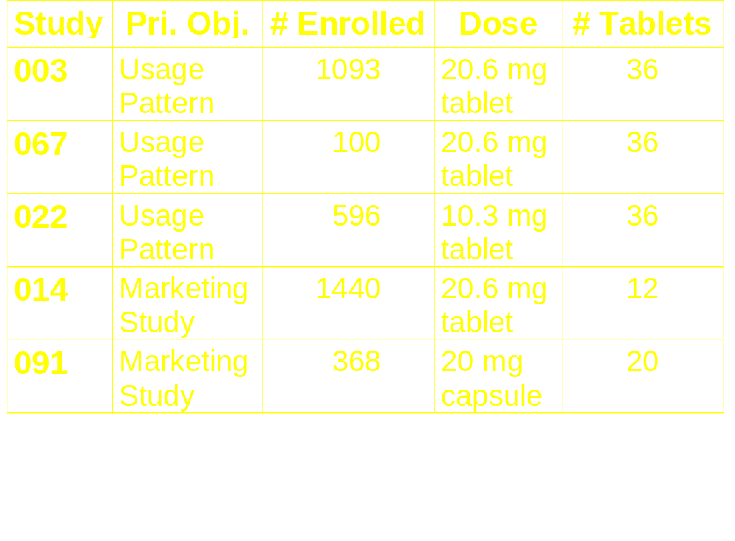
Prilosec Actual Use Studies
Notes:
This is a summary slide of the 5 studies
(- The primary objective in Studies 003, 067, and 022 were to characterize the usage patterns and dosing compliance)
- Studies 014 and 091 were marketing studies, (which included a description of the usage patterns and dosing compliance as well)
- The # of subjects enrolled ranged from 100 to almost 1500
- Different doses (10, 20 mg) in different formulations (Ome-Mg MUPS, Ome capsules) were studied.
The formulation targeted for OTC is the omeprazole-magnesium MUPS tablet.
- Limited # of tablets were dispensed, ranging from a total of 12 to 36.

Slide 5
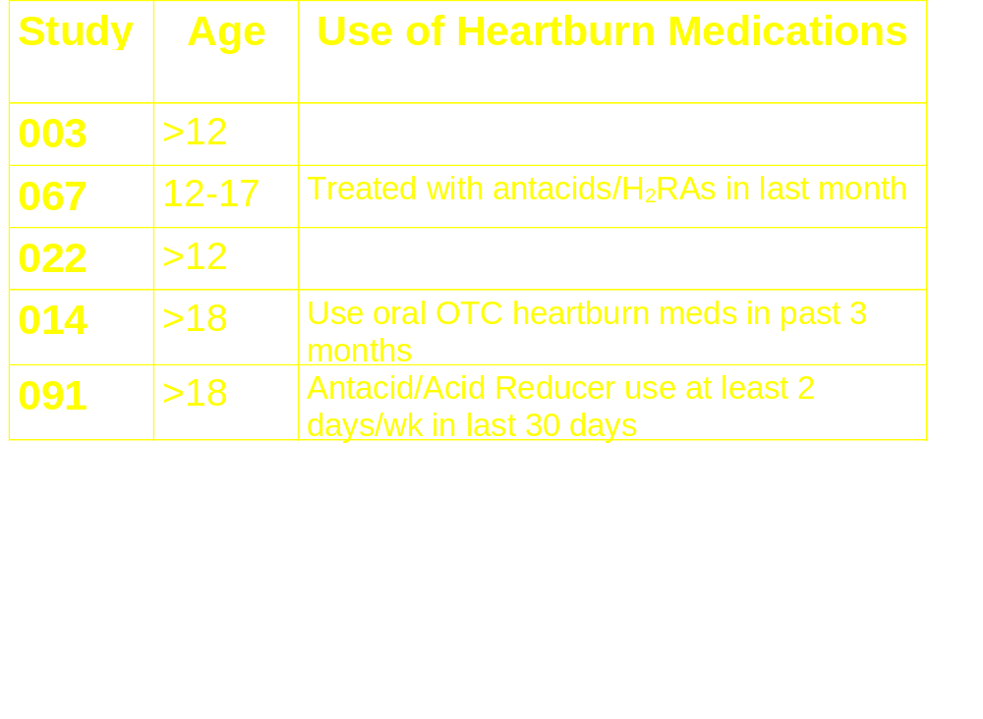
Inclusion Criteria
Notes:
An extensive list of inclusion and exclusion criteria were applied to the enrollees before they could participate in the actual studies. The ones of more relevance to this presentation include
- age limitations, and
- heartburn prerequisites
Study 067 recruited specifically for adolescents
In 067, adolescents had to be treated with antacids/H2s in the last month
In 014, subjects had to use oral OTC heartburn meds in past 3 months, and
In 091, subjects were required to have heartburn frequency at least 2 days/week

Slide 6
Exclusion Criteria:
Pregnant or lactating
Active PUD, on Rx H₂RAs or PPIs
Phenytoin, warfarin, diazepam, clarithromycin
Known hypersensitivity
Continuous abdominal pain >10 days
Dysphagia
Notes:
Almost all of the risk conditions, on the proposed label were screened out, including
- pregnancy,
- certain medical conditions, such as: PUD, continuous abdominal pain, dysphagia, known hypersensitivity to omeprazole, and
- these concomitant meds such as phenytoin, warfarin, diazepam, clarithromycin
Female subjects had to undergo 2 or 3 urine pregnancy tests before and during the study, and sign an agreement that they would use a reasonable contraceptive.
(Note, that the proposed label is different from the study label in that none of the 4 medications mentioned here were listed. Instead, only ketoconazole, itraconazole are listed in the warnings regarding drug-drug interactions, and neither of these drugs were listed in the exclusion criteria, or the study label.)

Slide 7
Self-Selection
Study 014, 091: no self-selection, willingness to participate, screened per inclusion/ exclusion criteria
Study 067: eligibility screening prior to participation
Study 003, 022: self-selection prior to inclusion/exclusion criteria
Notes:
A key feature of Actual Use Studies is the demonstration of the subject’s ability to self-select.
Note that subjects in Studies 014 and 091 did not determine for themselves if the product was appropriate for them to use.
If subjects were willing to participate, they were screened for eligibility prior to being enrolled into the study.
(Study 014: purchase intent prior to inclusion/exclusion criteria, willingness to participate
Study 091: screened, willingness to participate)
The only studies where subjects self-selected based only on the label prior to any screening by study personnel were Studies 003 and 022.
The rest of this presentation will therefore focus on studies 003, and 022, and 067 which provides information on use by adolescents.

Slide 8
Study Label: Uses
Prevention of heartburn, acid indigestion, sour stomach brought on by food, beverage, or associated with stress, hectic lifestyle, lying down, exercise
Relief of heartburn, acid indigestion, sour stomach
Notes:
This is a reminder of the proposed Uses for OTC Prilosec, which is for Prevention and for Relief

Slide 9
Study Label: Directions
Prevention of symptoms for 24 hours:
  anytime during the day, or
  1 hour before associated events
Relief of symptoms:
Do not take more than 1 tablet a day
Do not use for more than 10 days in a row unless directed by a doctor
Notes:
Directions were provided:
for Prevention of symptoms for 24 hours:
- for anytime during the day or
- for 1 hour before associated events (occasional heartburn, such as food and beverages, stress, hectic lifestyle, lying down, or exercise)
and for Relief of symptoms:
Regardless, of use, the directions also state:
- Do not take more than 1 tablet per day
- Do not use for more than 10 days in a row unless directed by a doctor

Slide 10
Study Objectives
Primary Objective: characterize usage patterns/dosing compliance under OTC conditions
Primary Endpoint: % subjects who:
  take only 1 tablet per dose
  take no more than 1 dose per day
  take no more than 10 consecutive days
Notes:
The Primary Objective of these studies are to characterize usage patterns and dosing compliance under OTC conditions.
which are determined by these endpoints:
the % of subjects who:
- take…
- take… and
- take…
In the determination of overall compliance, as you’ll see later, subjects would have to be complaint with all 3 dosing directions in order to be assessed as being compliant.

Slide 11
Demographics
Study 003: low literacy group (10%)
Study 003, 022:
  Black (7-14%)
  Hispanic (6-7%)
  Native American (1%)
  Asian (0-<1%).
Study 067: Caucasian (>96%)
All studies: about 60% females
Study 003, 022: 13-87 years, (mean: 46-47)
Notes:
Subjects were recruited from malls and shopping centers, in response to a question about stomach problems. (If they responded affirmatively to the question of whether or not they had stomach problems, they were invited to the research study about a proposed new OTC medication for stomach problems.)
Only Study 003 recruited for subjects with low literacy levels (10% of study population)
Only Study 003 and 022 had representation by other ethnic groups:
while Study 064 had predominantly Caucasian adolescents.
In all studies, about 60% of subjects were female
(Mean age of subjects in Study 003 and 022 was around 46 years (13-87), and 14 years (12-17) in Study 067)

Slide 12
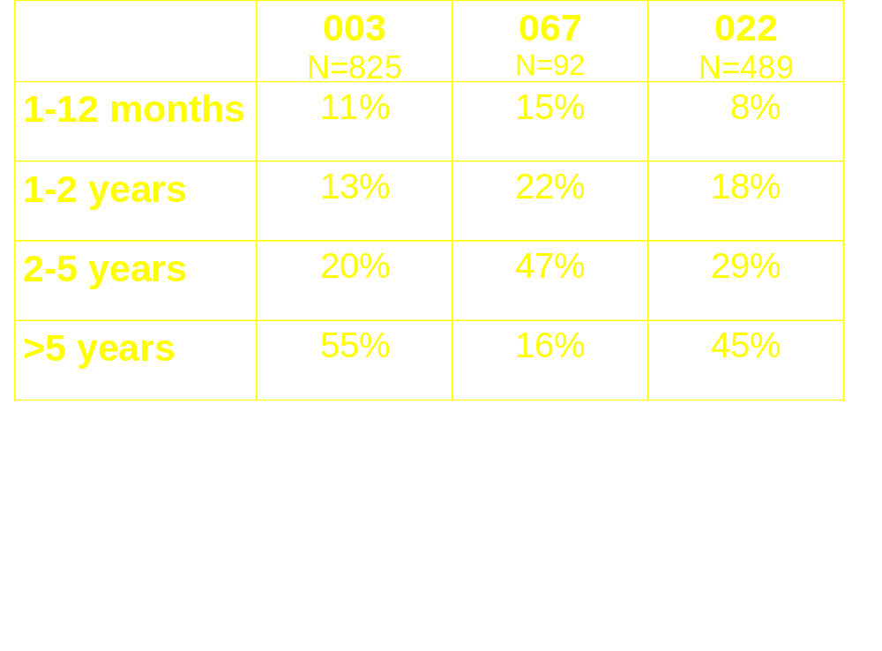
Heartburn History
Notes:
Most of the subjects in this study had heartburn of longstanding duration:
2/3 to 3/4 of the subjects had heartburn for more than 2 years
Another 13 to 22% had heartburn from 1-2 years
Only 8-15% had heartburn for less than 1 year
(In Study 003, only 6% had heartburn for less than 6 months)

Slide 13
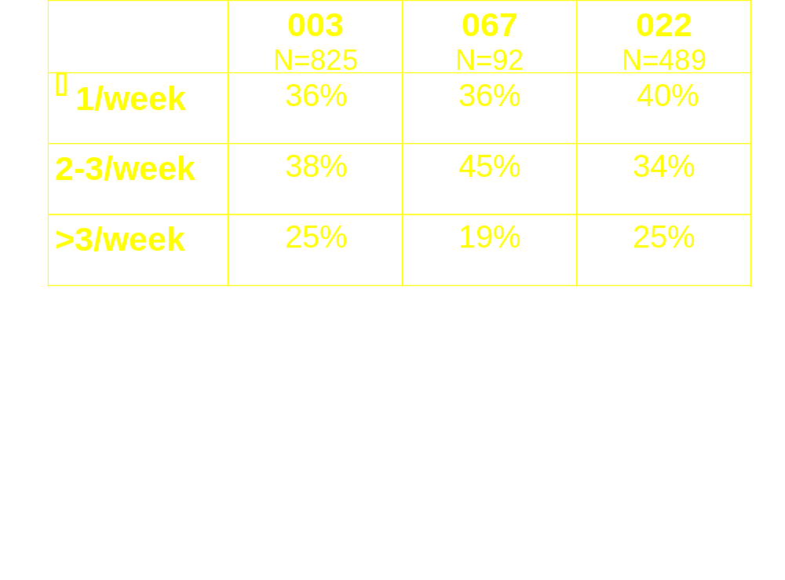
Heartburn History
Notes:
More than half of the subjects (59-66%) had heartburn at least 2 times per week.
About 1/3 of subjects had heartburn rarely or once a week.

Slide 14
Usage Patterns
Prevention Any Time
Prevention 1 Hour Before Only
Dual Prevention Only
Relief Only
Prevention and Relief
Notes:
Users were characterized by their use of the product:
All subjects were asked to fill in a Product Use Journal and record the reason for product use.
Subjects checked pre-specified boxes marked:
- Taken anytime during the day
- Taken 1 hour before event
- Taken for Relief of symptoms
These data were compiled resulting in the distribution of subjects by these 5 mutually exclusive usage groups:
Prevention Anytime, Prevention 1-Hr before, Dual Prevention (checked both prevention anytime and prevention 1-hr before), Relief Only, and Prevention & Relief

Slide 15
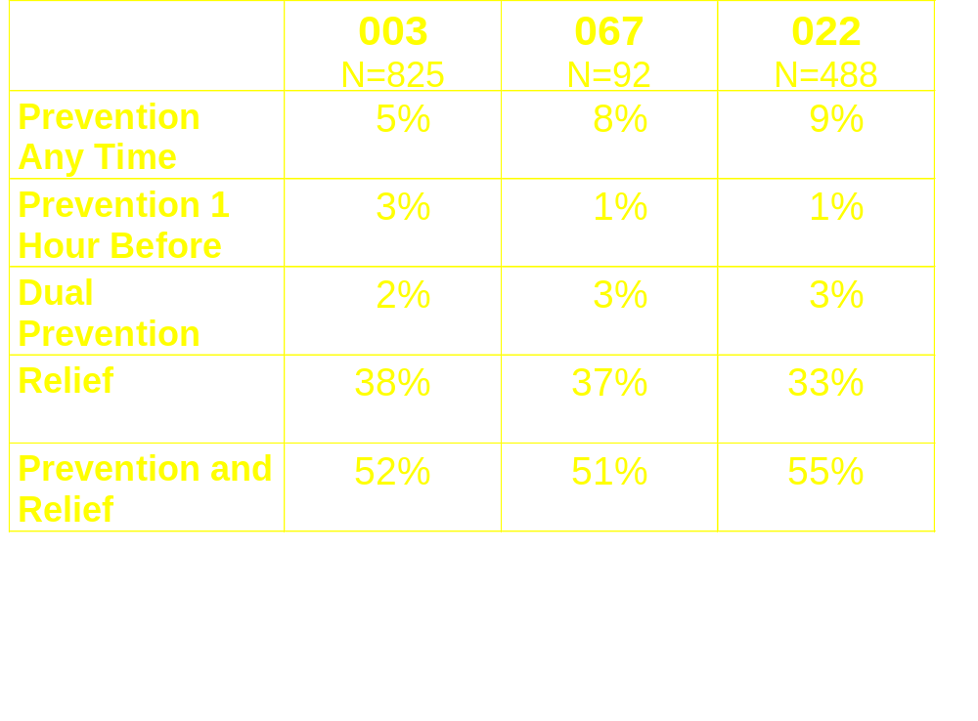
Usage Patterns
Notes:
Over half of the subjects used the product for prevention and relief
About a third of the subjects used it for relief only
10-12% across all 3 studies used it for prevention only
The numbers in these cells are too small to be considered separately, so from here onwards, subjects in these 3 categories will be considered together as one Prevention Only group

Slide 16
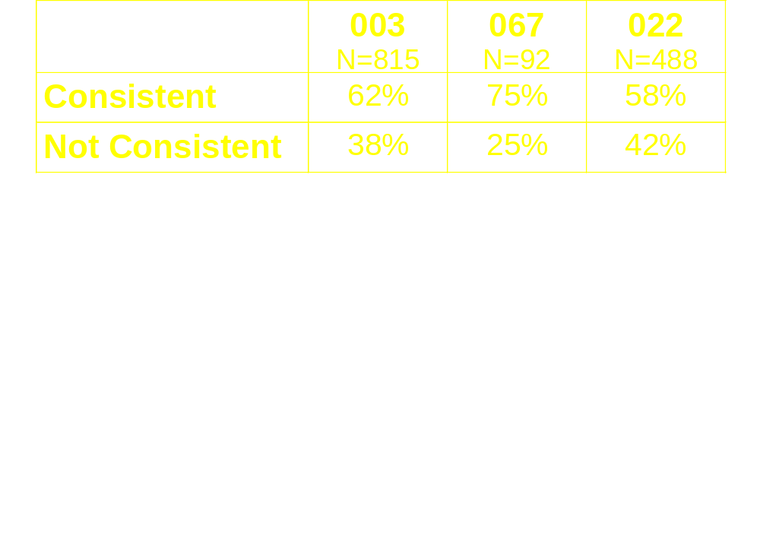
Results: Correct Use
  Take 1 tablet per dose
  Take 1 dose per day
  Take for no more than 10 consecutive days
Notes:
As a reminder, these are the 3 dosing directions
Across all 3 studies, overall consistency with all 3 dosing directions were <75%, ranging from 58% to 75%.
[These percentages are improved when the 3 dosing directions are considered separately, i.e., when examined only by each dosing occasion or each dosing day, the data showed that the subjects were consistent over 9% of the time;
- 91% of all dosing occasions
- 90% of all dosing days]

Slide 17
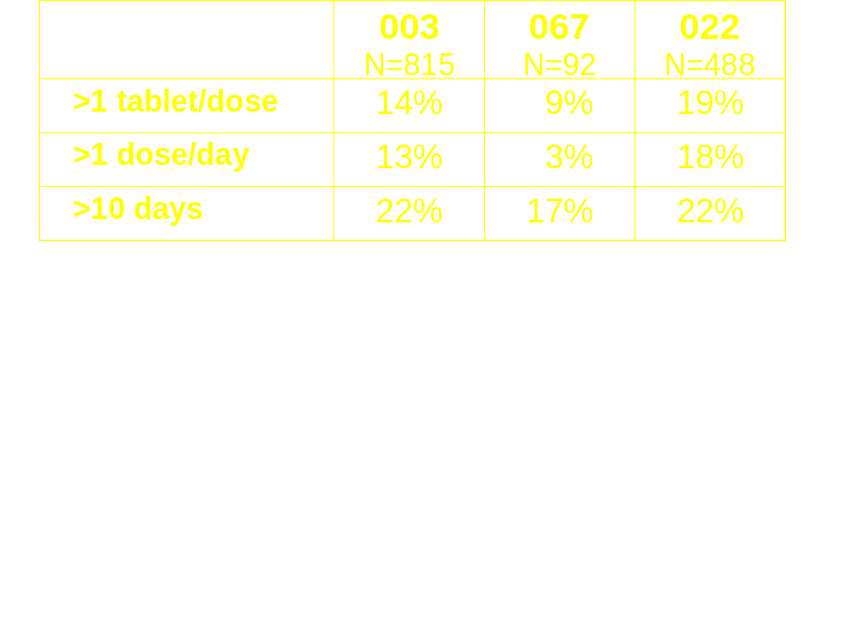
Results: Incorrect Use
Notes:
In all 3 studies, anywhere from 3 to 22% of subjects did not use correctly according to the 3 dosing directions.
Among these subjects, a much larger proportion exceeded the 10 consecutive day dosing limit than either the 1 tablet per dose or 1 dose per day limit.

Slide 18
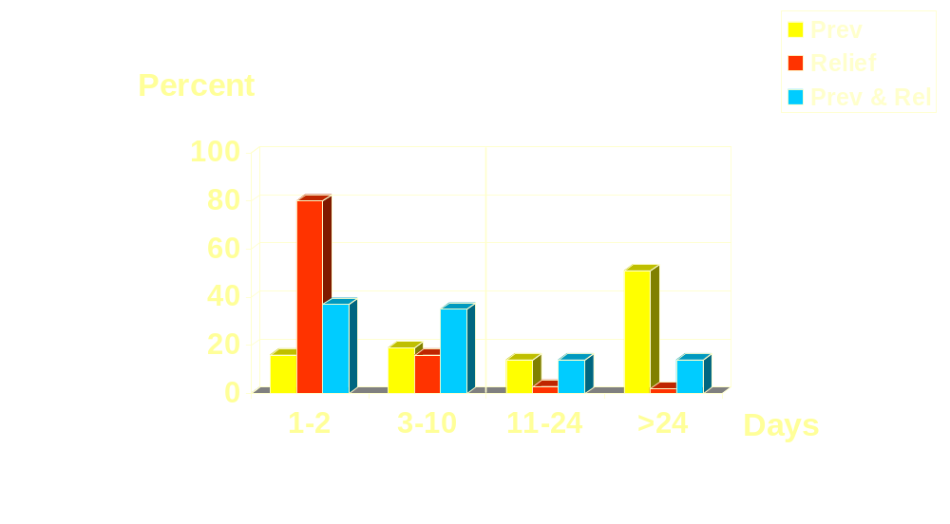
Maximum # Sequential Days
Notes:
In Study 003 a breakdown of participants by the maximum number of sequential days on which the study drug was used was provided.
As you can see graphically, there is a distinct pattern among Relief Only users (shown in orange) which is quite different from Prevention Only users (shown in yellow).
80% of the Relief Only users took drug for 1-2 sequential days, with greatly diminished percentages beyond 2 days.
Among Prevention Only users, the profile is reversed; over 51% took drug for more than 25 sequential days. (16% took it for 1-2 sequential days.)
This line shows the partition between allowed use up to 10 days and non-compliant use beyond 10 days. A total of 65% of Prevention Only users compared with <5% of Relief Only users, took drug past the 10 day limit (28% of Prevention & Relief users).
On this side, a total of 35% of Prevention Only users compared with 96% of Relief Only users, were compliant with the 10 day limit (72% of Prevention & Relief users).

Slide 19
Results: >10 days
Study 003, 067, 022:
  Prevention Only: 64%
  Relief Only: 0-4%
  Prevention and Relief: 19-28%
Use beyond 10-day limit:
Notes:
If we focus only on those who exceeded the 10-day limit,
- Across all 3 studies, 64% (49/77) of Prevention Only users consistently ignored the 10 day limitation.
- Those who used the product for Relief Only rarely exceeded the 10-day limit. (They were more likely to exceed the 1 tablet per dose or the 1 dose per day limit, but on a much smaller scale)
- Prevention and Relief uses were more likely than the Relief Only users to exceed the 10-day limit, but not to the extent that the Prevention Only users did. (Prevention and Relief users were more likely than the Relief Only users to exceed all 3 dosing directions)

Slide 20
Conclusions
58-75% of subjects in the 3 studies dosed according to all 3 dosing directions
Relief Only users were more compliant than Prevention Only Users
Prevention Only users were most non-compliant with the 10-day sequential use limit
Notes:
In summary, these are the specific conclusions from these studies:
-
-
-

Slide 21
Conclusions
Study participants had heartburn of frequent occurrence and longstanding duration
Study results may be biased:
  2-6% of subjects with a risk profile were excluded by criteria or study personnel
  another 18-25% of subjects excluded from ITT population
Notes:
- Study participants had heartburn of frequent occurrence and longstanding duration, and
- Study results may be biased, since:
2-6% of subjects with any risk associated with the use of the product were excluded by criteria or study personnel, and
another 18-25% of subjects who did not return or complete essential elements of the Product Use Journal were excluded from the ITT analysis.
(815/1093=25%, 489/596=18%)
One could postulate that the subjects who did not return or complete the Journal may be less motivated and may be more likely to be non-compliant, and if included in the ITT population, would have impacted on the overall consistency results negatively.

Slide 22
Implications
Overall compliance with all 3 dosing directions is not impressive (58-75%)
The direction to not exceed 10 days of consecutive use was the one direction that was most ignored, especially among Prevention Only users
Majority of Prevention Only users were using the drug beyond 10 days (>25 days)
Notes:
Given the possibility that study results may be overly optimistic, the overall compliance with all 3 dosing directions is not impressive
It is of concern that the direction to exceed 10 days of consecutive use was the one direction that was most ignored, especially among Prevention Only users,
the majority of whom were using the drugs beyond 25 days

Slide 23
Implications
OTC population may be GERD sufferers
Proposed label is inadequate for GERD
Concerns: chronic long term use OTC without benefit of learned intermediary
  misdiagnosis
  delay in diagnosis
  sub-optimal treatment
Notes:
The 24-hour anytime prevention claim, has, in essence, changed the nature of using this drug product for episode-linked prevention to prevention of any number of episodes of heartburn within a set time period.
Therefore, people using it for this purpose, may in fact, have more frequent and longstanding heartburn suggestive of GERD
Our concern is that if people were self-treating for GERD, the proposed label does not provide adequate information to guide the rational use of this drug OTC, for example:
in the patient information provided by the American College of Gastroenterology, consumers were told that they should see a doctor if they have heartburn frequency requiring OTC medications more than 2 times per week.
(heartburn not controlled with lifestyle modifications, symptoms remain unresolved)
The question is what potential harm, if any, may affect OTC consumers, from chronic long-term use without benefit of a learned intermediary,
in such areas as possible misdiagnosis, delay in diagnosis and treatment, and/or sub-optimal treatment of a chronic condition that may result in much more serious consequences

