Slide 1
WHITE HOUSE CONFERENCE ON AGING SOLUTIONS
Research into the Behavior, Social and Societal Trends and Needs
Barbara Boyle Torrey
Population Reference Bureau
September 22, 2005

Slide 2
RESEARCH HAS FOUND A LOT OF GOOD NEWS RECENTLY
We are living much longer than we think.
Our health in old age is improving.
Our improving health may result in cost savings.

Slide 3
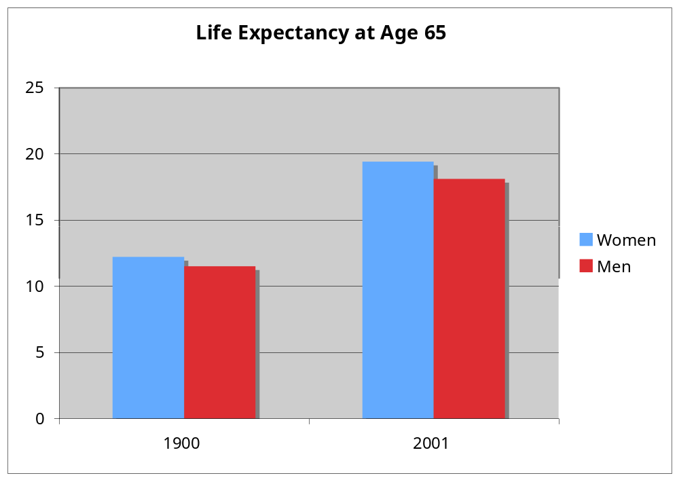
Americans Are Living Longer
Notes:
The most important retirement trend, one about which we are quote certain, is that there are a lot more retirees on the way. There are now about 36 million people aged 65 and over in the US. This number is expected to double in the next 25 years, as the large Baby Boom cohorts reach age 65.
The increase in both the number and percentage of older people predates the Baby Boom, though. For nearly 150 years, mortality rates have been declining at all ages.
In 1900, most people didn’t make it to age 65. The life expectancy at birth was less than 50 years. The minority who did make it to age 65 could expect on average to live another 12 years.
Now, the great majority of people make it to age 65, and even without further improvement in mortality rates, they can expect to live another 19.4 years (for women) and 16.4 years (for men.) [Why do women live longer?...]
You may have seen in the papers this month articles about a new study predicting that this long period of improvement is about to end, and that some time in the next few decades life expectancy will decline in this country. The argument is based on long-term impacts of the obesity epidemic of the last two decades, affecting people at all ages, even children. This is controversial; most other analysts see the obesity epidemic as serious but not outweighing all the other forces tending toward continuing improvement.

Slide 4
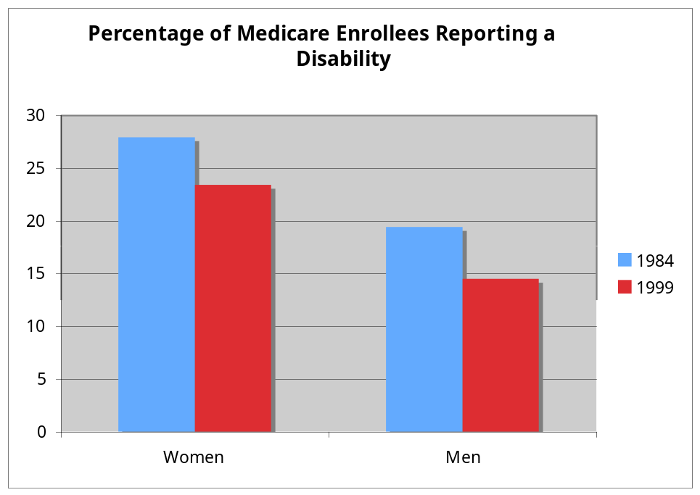
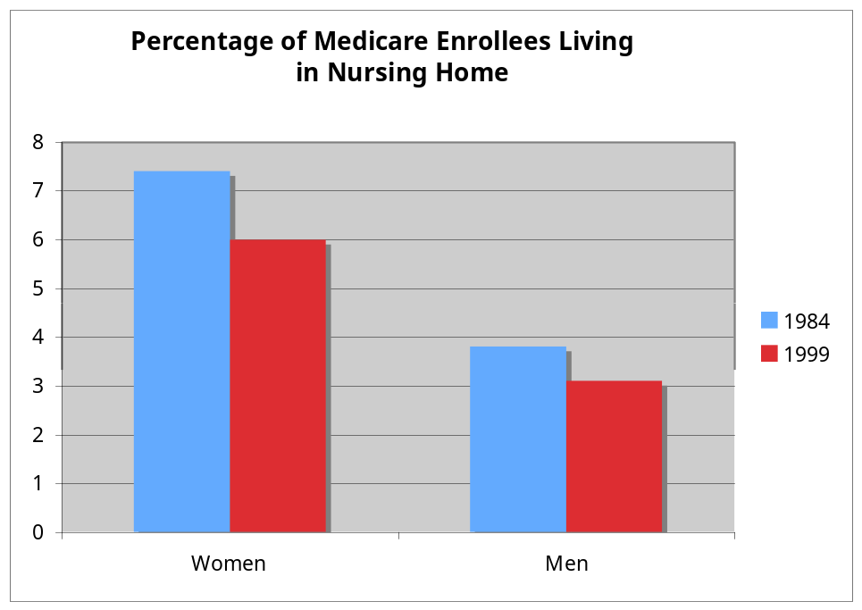
Not Only Living Longer, But Staying Healthier in Old Age
Source: Older Americans 2004
Notes:
So people are living more years after typical retirement ages – and these are mostly years of good health.
The graph on the left shows percentages of women and men eligible for Medicare who report that they have some type of disability affecting their ability to carry out tasks of daily living. These disability percentages declined from 28 percent for women in 1984 to 23 percent in 1999 (note: age-adjusted) and 19 to 14 percent for men.
This decline has been going on a long time – research using data on Union veterans.
[Why higher disability rates for women? Cite Anne Case – greater prevalence of debilitating but not fatal disease – autoimmune, arthritis, osteoporosis…. Not “men are too tough to complain”]]
On the right, we see a similar decline during the same years in the percentage of older people who live in nursing homes: from 3.8 to 3.1 percent for men, and 7.4 to 6.0 percent for women
Much of the improvement in recent years has been due to better care for people with heart diseases – not necessarily fewer people getting heart disease, but better treatment that prevents it from interfering with their daily activities.
Because there are more older people, the number of people with Alzheimer’s and other dementing diseases is increasing. But for any one person, the odds are decreasing. We don’t fully understand the causes of AD yet, but we do know that people with more education and people who have kept their brains “fit” in adult life have lower rates and later onset. So we could be reaping now the long-term health benefit of the great expansion of public education during the early decades of this century.
So one thing we can say with some confidence about the future of retirement is that there will be more of it, and most people will be healthy during most of their retirement years. In the long sweep of human history, this is a great time to be thinking about retirement.

Slide 5
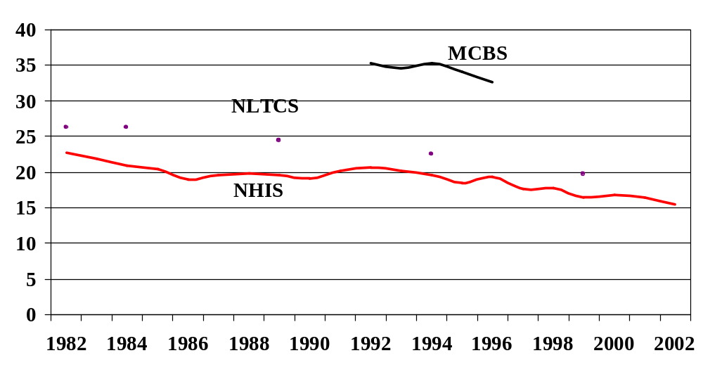
Trends in Old-Age Disability Rates Estimated in Three National Surveys
Sour
Source: Schoeni, Freedman and Martin, 2004

Slide 6
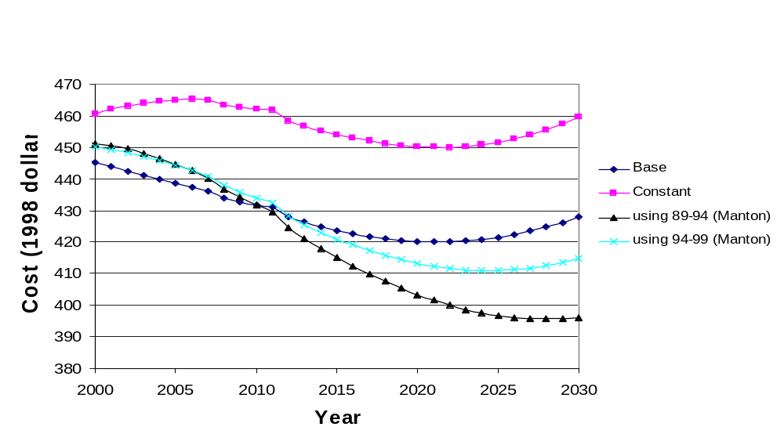
Impact of Disability Forecasts on Per Capita Medicare Costs
Source: Bhattacharya J, Cutler D, Goldman D, Hurd M, Joyce G, Lakdawalla D, Panis C, Shang B. “Disability Forecasts and Future Medicare Costs” in D Cutler and A Garber (eds.) Frontiers in Health Policy Research, Volume 7, National Bureau of Economic Research, pp. 75-94, 2004.

Slide 7
BUT RESEARCH HAS ALSO FOUND SOME ISSUES THAT NEED MORE ATTENTION
Disability is rising among the non-aged.
Medical expenditures are increasing faster than either the beneficiaries or the GDP.
Medical quality and spending are not directly related.
Old age entitlements as a % of GDP will more than double by 2050.

Slide 8
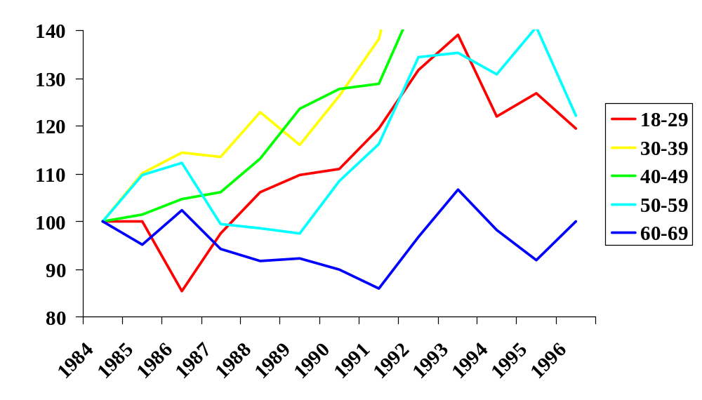
Disability Rising for the Young
Fraction
needing
help with
daily
activities
Note: Rates relative to 1984 (normalized to 100 for each group)
Source: Lakdawalla, Bhattacharya, Goldman, Health Affairs, 2004.
Notes:
Too early to conclude anything about the period from 1997 to 2001, which is so far the available data. However, it is clear that there has not been anything close to a wholesale retrenchment.

Slide 9
Public Medical Expenditures Consistently Growing Faster than GDP or Beneficiary Population
 | annual growth of enrollment, 1990-2003 | % annual growth of fed outlay per enrollee, 1990-2003
Medicare | 1.5 % | 5.6 %
Medicaid | 4.7 % | 6.0%
Source: CBO

Slide 10
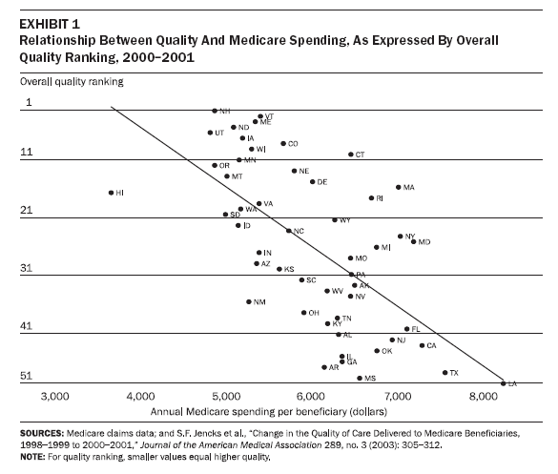

Slide 11
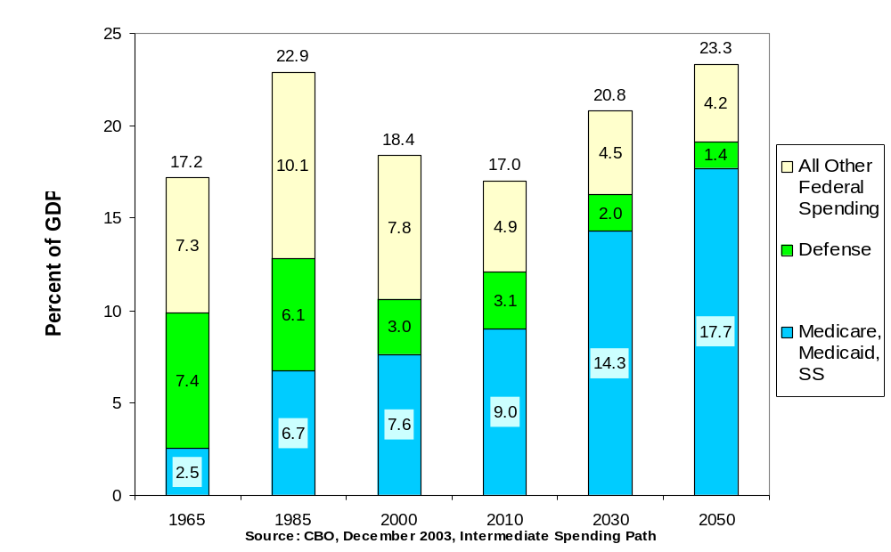
Even with very optimistic assumptions, old-age entitlements bound to grow as proportion of GDP
Notes:
Every two years or so, the Congressional Budget Office prepares long-range budget forecasts (the better known CBO forecasts are their annual 10-year ones). These are valuable not so much because anyone believes this is precisely the way things will work out, but because they show at least a highly plausible set of implications for current policies kept into the future.
These show that without significant change, the “big 3” entitlement programs -- Social Security, Medicare, and Medicaid, would expand more rapidly than GDP and take up just under 18 percent of GDP by the year 2050; roughly equivalent to the proportion of all federal spending today. Total federal spending would almost certainly have to be higher as a proportion of GDP than it has except for a few years during World War II.
These are based on some optimistic assumptions:
Don’t pay any attention at all to the “Other federal spending” and defense bars -- assumes that everything the federal government does, including us, and national security, and payments on the federal debt, will shrink as a portion of GDP. That has happened before, but not over such a sustained period.
This intermediate path assumes “excess Medicare and Medicaid cost growth” shrinks back to 1% more than GDP growth, and defense spending shrinks back to long-term pattern of slower than GDP growth.
Note this is not the same as the “when will trust funds be depleted?” discussion. Trust fund only applicable to OASDI and Medicare part A, leaves out Medicare part B and Medicaid. Also assumes automatic pilot -- so long as we have crammed enough IOUs into right-hand pocket, don’t ask whether this is what we want to be spending our money on, or how we want to be spending it.

Slide 12
WHAT ARE THE BENEFITS OF GOOD RESEARCH ON AGING?
It provides historical perspective about current dilemmas.
It lets us worry efficiently. We don’t need to worry about last year’s problem. We can focus on next year’s issue.
It, therefore, opens up ranges of options and future solutions for aging societies.

Slide 13
WHAT ARE THE BARRIERS TO GOOD RESEARCH ON AGING?
A short time horizon.
Longitudinal surveys are the only ones that can disentangle causation from correlation.
But longitudinal surveys are expensive and require a long term perspective.

Slide 14
WHAT ARE THE SOLUTIONS?
Invest in the future through longitudinal surveys today.
Integrate current surveys to maximize the knowledge from each investment.
Learn from the mistakes of other countries and adapt their successes.
Strengthen NIA’s leadership in the development of an integrated set of national and international surveys related to aging populations.

