Slide 1
NOvA APD Cooling Water Update
William Gilbert
University of Minnesota

Slide 2
Cooling System Zones & Dimensions
4 cooling zones along the length of the detector supplied by chilled water at 48 ºF supplied by FESS.
⇒ 3 zones of 8 sections + 1 zone of 7 sections.
12 rows
of detectors
each face
1 cooling loop per row,
per zone,
(water from heat exch to APDs)
12 row x 3 face x 4 zones
= 144 secondary loops

Slide 3
Pump Unit & Instrumentation
RS 485, E-NET
120 VAC
24VDC
PWR
Remote I/O System
Pump Control
Optional valve for
control of secondary
water temperature
Pump Confirm
Reservoir
Motor
Starter
Level
Switch
Primary
Chill
Water
HEAT
EXCH
PUMP
Secondary
Water
to APDs
Flow Switch
Temp
Probes
Auxiliary contact on pump starter relay gives pump status
Notes:
More detail on pump unit, showing instrumentation.

Slide 4
NOVA Cooling Manifold Section
~1” ID pipe
, ~12 ft long
2 versions needed
32 hoses detector top
16 hoses on sides
Serving 64 planes
1/4” hoses with valved
disconnect
Ball Valve
Union or other flush coupling
Notes:
Modular manifolds keep length in easy to ship range, which is important, since we want to have these contract manufactured.
Exact number of hoses(planes) needed is in flux. Since quick disconnect fittings are valved, unused hoses really aren’t a problem, we just need to make sure there are enough. A hose plus or minus doesn’t affect cost much.
Two versions of manifolds needed, 1 for detector top with about 30 hose taps, 1 for detector sides with about half that number.
Before downsizing this was 32/16. and we received estimates from two different suppliers with different construction materials & methods.
Both close to same cost. For the 32 tap manifolds about $780, 16 tap $580, including insulation.
Descriptions:
1) Georg Fischer, big industrial process piping supplier, using HD polyethylene pipe with hose fittings welded(ultrasonically?) in to manifold, using true union ball valves between coupling on ends. Good idea, since manifold can be disconnected on either side of valve, only one valve is needed between each section.
2) Tiger Tech, smaller hose product distributor and custom manufacturer. They would build from PVC pipe, drilled & tapped for 1/8” NPT metal hose barbs, with crimped hose attachments. they propose standard PVC ball valves on ends, with rubber sleeve & clamp couplings used to join sections.
Both suppliers have said anything smaller than 1 inch pipe would make these difficult to manufacture.

Slide 5
Single Loop Heat Calculations
5w per APD module x 217units = 1085w
Assume (guess) heat pickup in pipes, etc = 1085w
Total = 2170w
Loop delta T = Q(watts) / [263 x Flow(GPM)]
= 2170w / [263 x 6.87GPM]
= 1.2 degC
ITD = initial temp difference of fluids entering heat exchanger
= (APD water + del T) - FESS chilled water
= (15 degC + 1.2deg C) - 8.9 degC = 7.3 deg C
Q / ITD for this flow & load = 2170w / 7.3 degC = 297
Compare to high limit value from Lytron chart for this flow rate, 800
297 is much lower, so this is well within capacity of LL520!
Notes:
I this slide we perform a heat load calculation and check to see if it is in the range of the selected heat exchanger.
Formula for loop delta T is modified version of specific heat formula, Q = cm(dT).
Time units in top and bottom cancel out, units converted for input of watts and water GPM.
It appears that our total heat load could increase substantially and still be OK.
Since delta T, and thus bottom term ITD, increases along with heat load, Q/ITD rises slower.

Slide 6

Use Macroflow?
Innovative Research, Inc.
3025 Harbor Lane N, Suite 300
Plymouth, MN 55447, USA
Tel:(763) 519-0105
Notes:
Macroflow is a CAD tool that is written by Innovative Research in Plymouth, MN.
Company founded by a retired UMN ME professor, Suhas Patankar.
We have made preliminary contact with them last fall. Might be well worth our while to let them model our loop design before we prototype it, and alternate designs if necessary. Full license $5k, but lower cost short term license or fee based consulting also possible.

Slide 7
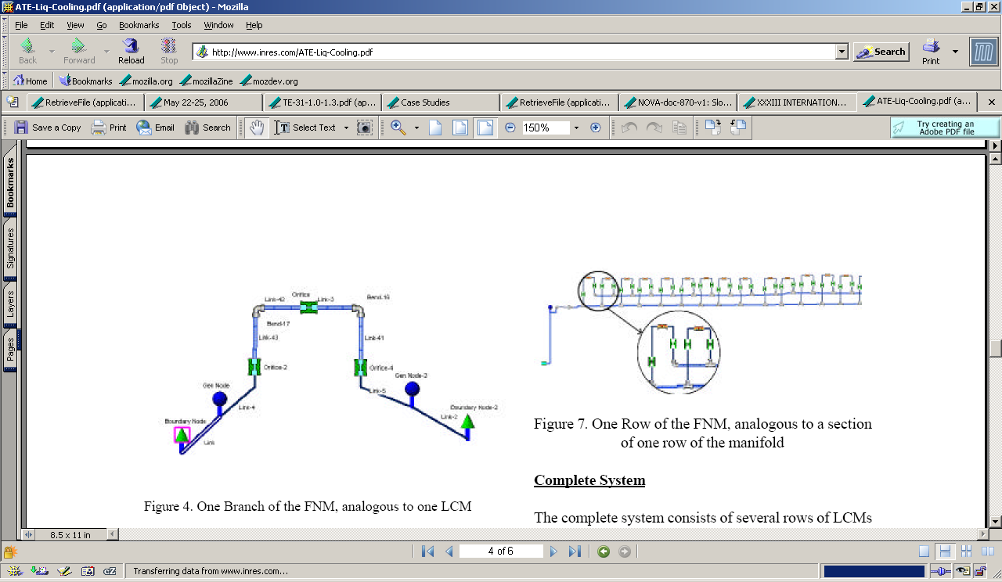
Macroflow example
Electronic cooling system via manifold distribution
30 elements X 4 rows, reverse return

Slide 8
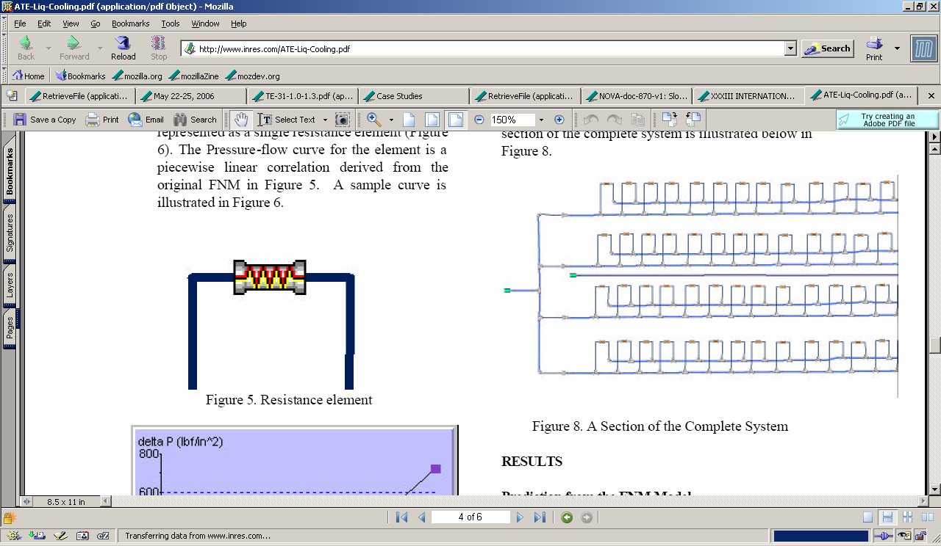
Macroflow example part 2
Looks very similar

Slide 9
Loop Volume
Using 1” dia manifolds, pipes, and 25k ton dimensions,
Single loop water volume = 2960 cu in
= 12.8 gal
= 107 lb
Weight of water system, guess at 2x this, ~200lbs
Total length of system is ~100 feet, so 2lbs/ft, 24lbs/span
But, it’s just plastic, so we will need several supports along the span,
probably every 3-4ft.
Total water volume, 144 loops, = 1843 gal
= 15400 lb
Notes:
Left out hoses and APD modules, but this gives us a ballpark figure.

Slide 10
Old Loop Cost Estimate
SWAG cost estimate for loops on detector top, side loops a bit lower:
1 Pump 1/25hp bronze cast $ 150 $ 150
1 Heat Exchanger (~LytronLL520) $ 200 $ 200
16 Top manifold assembly $ 830 $ 13280
1 Fluid Reservoir $ 50 $ 50
1 Fluid level switch(float, capacitive, other) $ 80 $ 80
2 Temp probes, RTD in welded SS fitting $ 50 $ 100
1 Flow switch (~Omega FST-211-SPST ) $ 160 $ 160
1 enclosure $ 200 $ 200
6 Remote I/O channels(2 temp, 1flow,
1 level, 1 pump status, 1 pump control) $ 200 $ 1200
x Misc pipe, wire, cable $ 100 $ 100
24 man-hours assembly:
mount 8 manifold sections
make 512 quick connects
mount & connect pump & other components
install wire duct, field wiring, fill, test etc. $ 50 $ 1200
Total $ 16720
Notes:
Previous estimate with truly WAG manifold cost, 30k ton dimensions

Slide 11
New Loop Cost Estimate
SWAG cost estimate for loops on detector top, side loops a bit lower:
1 Pump 1/6 hp bronze cast $ 300 $ 300
1 Heat Exchanger (~LytronLL520) $ 200 $ 200
14 Top manifold assembly $ 780 $ 10920
1 Fluid Reservoir $ 50 $ 50
1 Fluid level switch(float, capacitive, other) $ 80 $ 80
2 Temp probes, RTD in welded SS fitting $ 50 $ 100
1 Flow switch (~Omega FST-211-SPST ) $ 160 $ 160
1 enclosure $ 200 $ 200
6 Remote I/O channels(2 temp, 1flow,
1 level, 1 pump status, 1 pump control) $ 200 $ 1200
x Misc pipe, wire, cable $ 100 $ 100
24 man-hours assembly:
mount 8 manifold sections
make 512 quick connects
mount & connect pump & other components
install wire duct, field wiring, fill, test etc. $ 50 $ 1200
Total $ 14510
Notes:
Revised estimate using manifold estimate from G Fischer, higher power pump, and 25k ton dimensions.
Loop cost for detector sides is $11,710.
Illustrates the significant role of manifold cost.

Slide 12
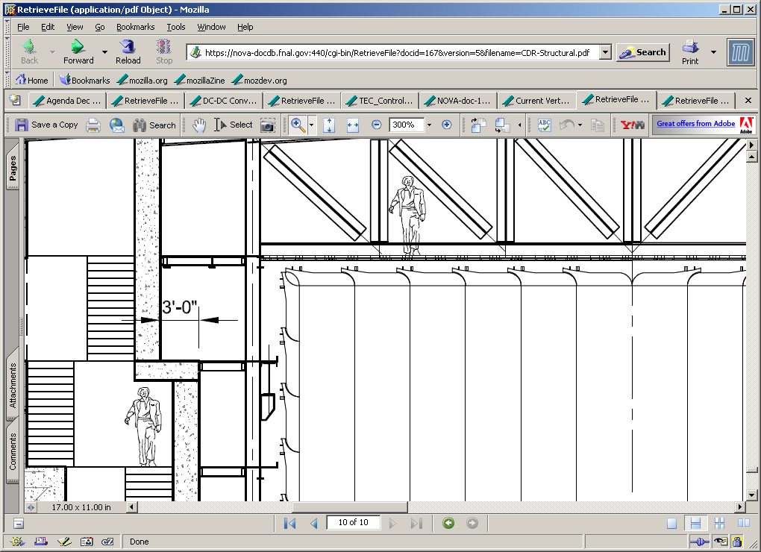
Utilities Version A

Slide 13
Caution – High Voltage

Slide 14
Power Backplane
Backplane with Cu bus bars

Slide 15
Top Power/Data
High Voltage
Low Voltage
Local redistribution
(1.7m avg. cable length)
Each Power Distribution Box powers 64 boxes
DAQ services along same route from neighbor box
~2”x6” Cable Tray along Detector
2 Blocks — 62 Planes — 409cm
12 modules – 1570cm
Power Distribution Box
APD readout box

Slide 16
Side Power/Data
High Voltage
Low Voltage
Local redistribution
(2.3m avg. cable length)
Each Power Distribution Box powers 60 boxes
DAQ services along same route
2 Blocks — 62 Planes — 409cm
12 modules high – 1570cm
Power Distribution Box
APD readout box

Slide 17
IPND Top Power
Distribution to 202 modules
202/64=4?
Can we drop 10 planes?
Better Distribution with 50/50/50/52
  Special channel map for DAQ
10 Planes — 66cm
64 Planes — 409cm
64 Planes — 409cm
64 Planes — 409cm
2 modules – 260cm

Slide 18
IPND Side Power
Distribution to 303 modules
303/64=5?
60/60/60/63
40 Planes — 264cm
40 Planes — 264cm
40 Planes — 264cm
41 Planes — 271?cm
3 modules – 390cm

Slide 19
Cable loading weights
Largest weight of cables
  DAQ 0.8lb/ft
  Power 1.5lb/ft
  TOTAL 2.3lbs/ft
Cable tray weight
  1.4lb/ft (for 2x12 wire mesh)
  Tray capacity 8.3lbs/ft
Hang H20 from cable trays?

Slide 20
Comments/Questions
Nothing here about readout box mounting
  Will be working with Tom Chase to define mounts, box and mounting procedures
  PLAN for box to fit within the plane of the module, avoiding interference issues
How much space between detector and steel
How much space around IPND/ND in ALL dimensions, top, side, front, back

