Slide 1
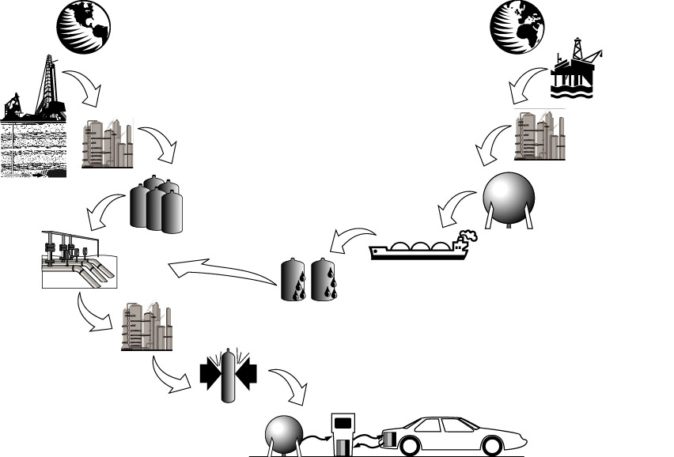
Infrastructure Requirements of Advanced Vehicles Using Natural-Gas-Based
Fuels
Marianne Mintz
Stephen Folga
John Molburg
Jerry Gillette
10th Annual NEMS/AEO Conference
March 12, 2002

Slide 2
This work was sponsored by the Department of Energy’s Office of Advanced Automotive Technologies. The authors acknowledge the support of Bob Kirk, Ed Wall, Pete Devlin and Steve Chalk.

Slide 3
Boundaries of This Presentation
Long term (2030)
Light-duty vehicles
Capital costs of fuel production and distribution infrastructure (excluding exploration)
Technically feasible propulsion systems with potential for substantial improvement over conventional ICE fuel efficiency (hybrids and fuel cells)
Natural-gas-based motor fuels (methanol, LNG, Fischer-Tropsch diesel (FTD) and hydrogen)

Slide 4
Cost Modeling Was Conducted Via a Five-Step Process
Define paths
  North American (NA) or non-North American (NNA) natural gas
  NG production, compression, storage and transport; conversion to alternative fuel, transport and dispensing
Determine “tank-in” fuel requirement
  Market penetration
  Vehicle and pathway efficiencies
Size pathway components
Estimate component costs
Calculate pathway costs (NICC model)

Slide 5
Natural Gas-Based Fuels Could Take Several Paths from “Well” to “Tank”

Slide 6
Six Pathways
Were Modeled
H₂ Storage
H₂ Transmission
Resource-Centered H₂ Production
NA NG Extraction
NG Purification
H₂ Fuel Station
H₂ Distribution
NG Transmission
Market-Centered H₂ Production
Decentralized
H₂ Production
NG Storage
NG Distribution
Compressed Natural Gas
NG Liquefaction
NNA NG Extraction
NG Purification
Regasification
GTL (Fischer-Tropsch)
Tanker Transport
Diesel Fuel Station
Oil Pipeline
Methanol Production
Methanol Fuel Station
Methanol Distribution

Slide 7
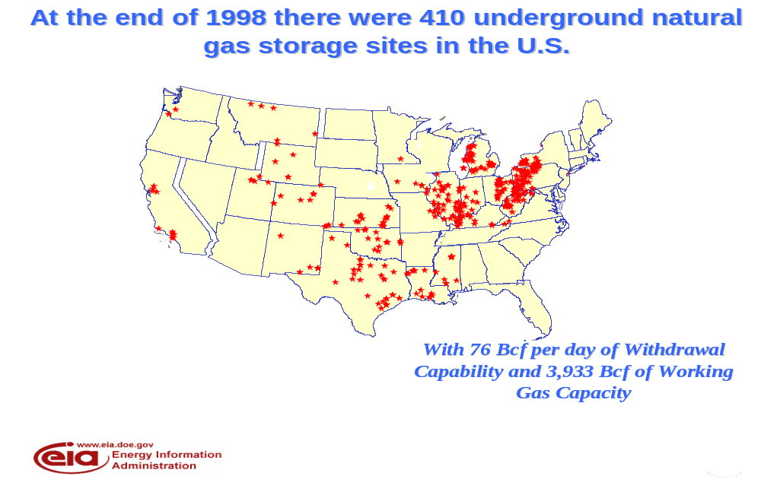
All Pathways Include Underground Storage

Slide 8

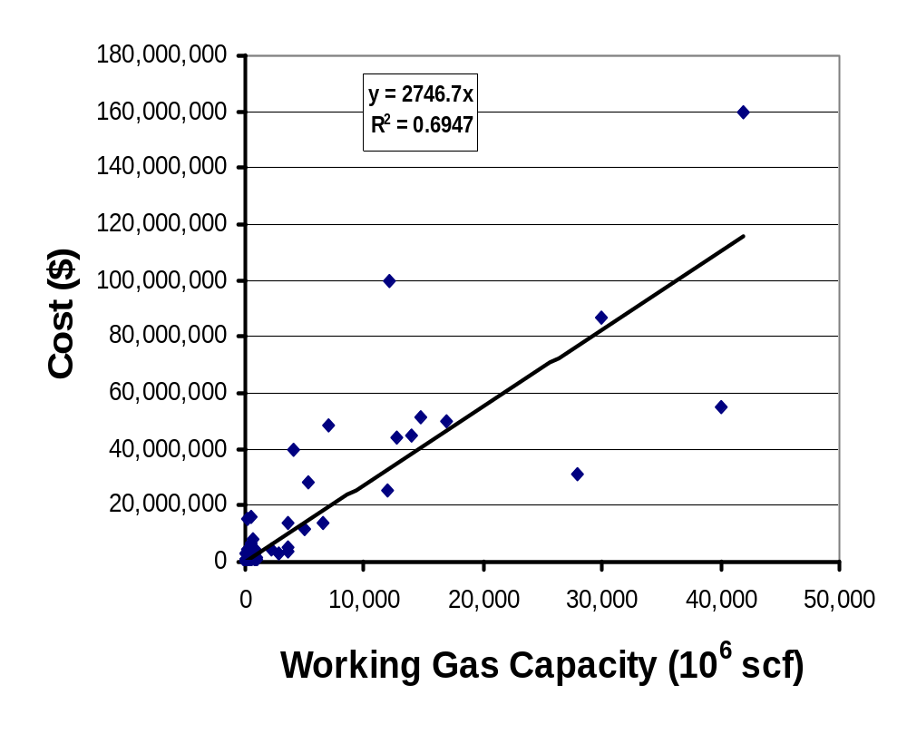
The Cost of Underground Storage of Natural Gas Is a Function of Working Gas Capacity
Linear relationship for underground storage (projects with 2001-04 completion, 1999$)
Working gas capacity per field: 5 x 10⁹ scf
Unit O&M cost: $0.224 per 10³ scf delivered (Young Storage Field, CO)

Slide 9
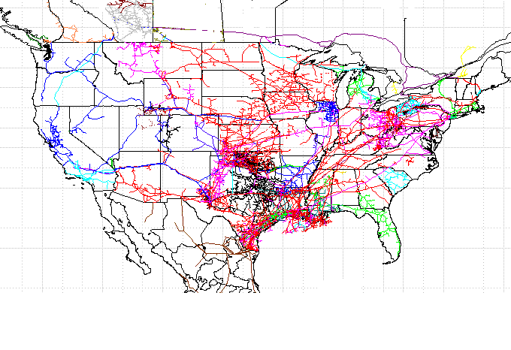
All Pathways Require Additions to the Existing Natural Gas Transmission Infrastructure
The US has an extensive
in-place NG transmission
infrastructure …………..

Slide 10
And a Track Record of Continually Expanding Transmission Capacity
New pipelines
Additional compression
Looping
All of the above

Slide 11
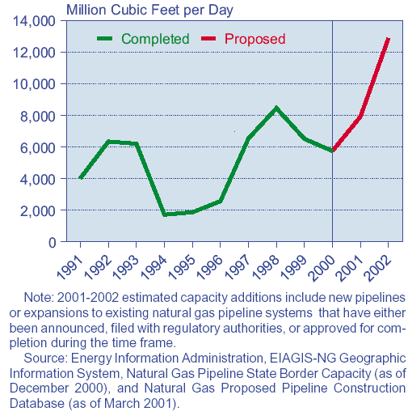
1991-2000 Annual Capacity Additions Averaged
> 4 x 10⁹scfd; Proposed Additions Are Higher

Slide 12
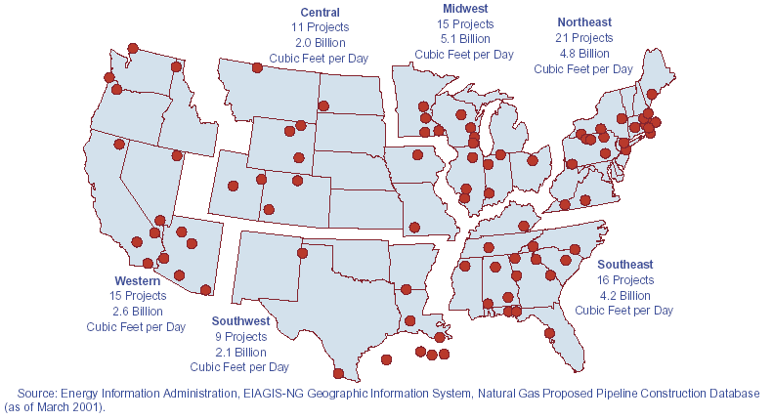
Yearly Capacity Additions Could Rise to 10 x 10⁹ scfd in 2001-2002

Slide 13
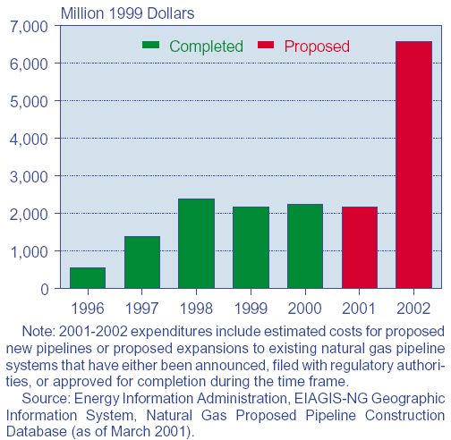
According to EIA, Over $6 Billion Will Be Spent on Pipeline Expansion in 2002
Source: Energy Information Administration, EAGIS-NG Geographic Information System,
Natural Gas Proposed Pipeline Construction Database (as of March 2001).

Slide 14
Expansion Reflects Shifts in the Structure of the Industry and Its Resource Base
Increased production in deep-water Gulf of Mexico and in western and offshore eastern Canada
Reduced production in mature provinces
Shippers seeking greater access to alternate sources of supply
Producers seeking greater access to non-traditional markets (market integration)
Increased use for power generation with resulting shifts in seasonal demand patterns

Slide 15
But Given the Scale of Motor Fuel Demand, Is It Reasonable to Expect Additional Expansion?
NG System Component | Capacity Additions | Unit Cost (10⁶) | Capital Cost (10⁹)
Pipelines Transmission Distribution | 6000 mi 630,000 mi | $1.5/mi $0.1-0.2/mi | $9 $85
Underground Storage | 185 | $13.7 | $2.5
Compressor Stations | 38 | $12 | $0.5
NG Throughput | 6 x 10¹² scf | NA | NA

Slide 16
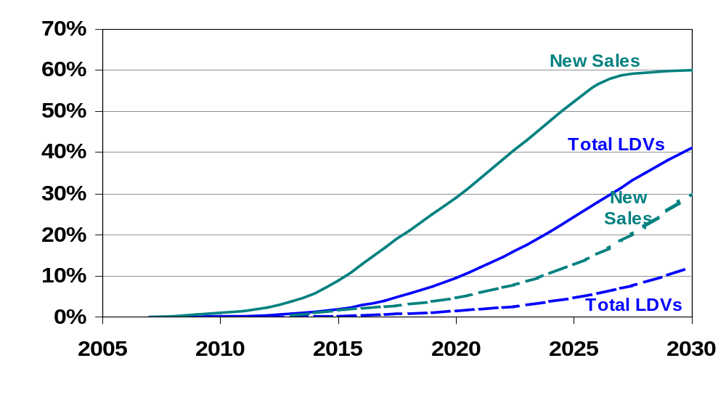
Two Market Penetration Cases Were Modeled

Slide 17
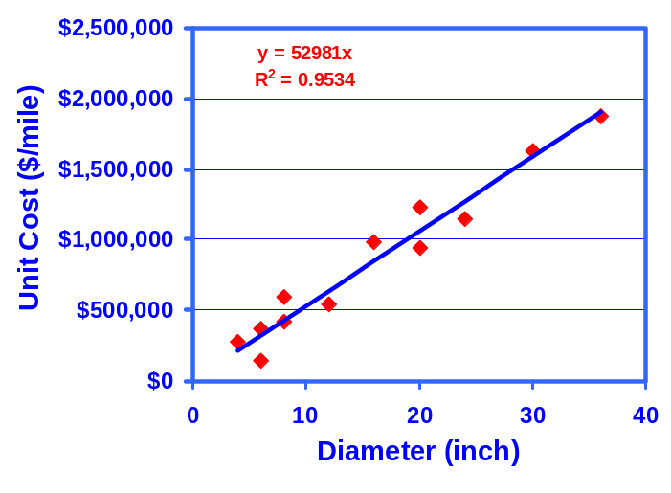
Unit Cost of Natural Gas Transmission Pipelines Is a Function of Diameter

Slide 18

Conceptual Representation of Hydrogen Pipeline Loop Supporting Local H₂ Delivery
Hydrogen Production
Distribution Main
Refueling Stations

Slide 19
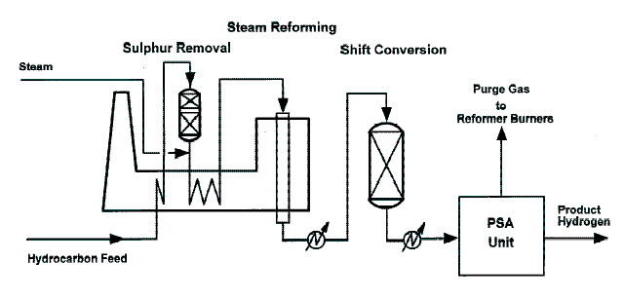
Steam Reforming Inputs Are Water and Hydrocarbon Feedstock; Outputs Are Hydrogen and Purge Gases

Slide 20
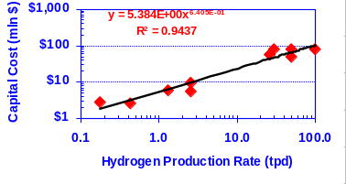
Current SMR Plants Have Large Economies of Scale

Slide 21
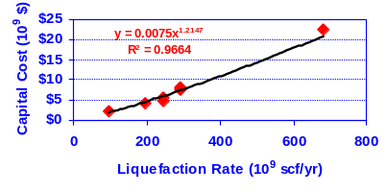
Capital Cost of LNG Liquefaction Is a Function of Liquefaction Rate

Slide 22
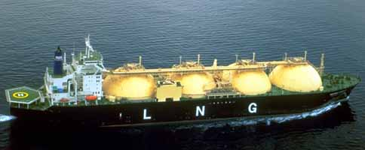
Once Liquefied, Non-North American Natural Gas Is Shipped to LNG Terminals
Capacity of 138,000 m3 with four independent spherical tanks
Effective lifespan 30-40 years

Slide 23
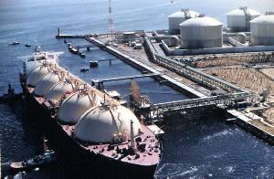
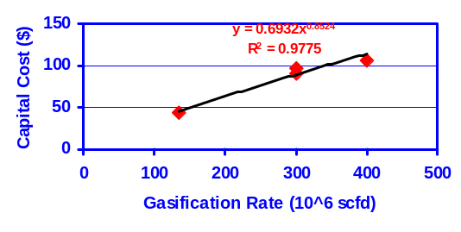
Characteristics of LNG Terminals
Capital Cost: $127,000,000
Annual Capacity Factor: 90%
Capacity: 450 x 10⁶ scfd
Unit O&M Cost: $0.30/10⁶ Btu

Slide 24
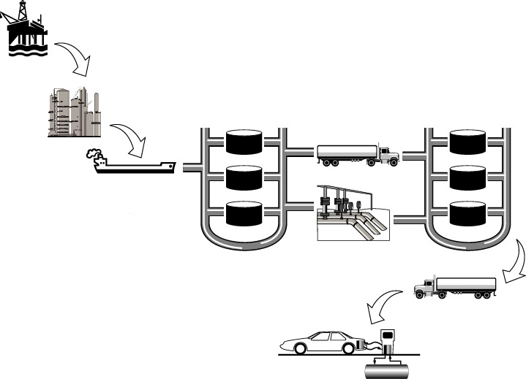
Methanol and FTD Move by Truck or Pipeline from Ports to Terminals and Refueling Stations

Slide 25
“Tank-In” Fuel Requirement Is a Function of MPGE and Market Penetration
Pathway | Engine Technology | MPGE | High Penetration
Hydrogen | FCV (on-board H₂) | 55 | 4.8 x 10⁹ GJ (4.5 Q)
LNG | ICE | 27.5 | 9.5 x 10⁹ GJ (9.0 Q)
Methanol | FCV (on-board reforming) | 41.2 | 6.4 x 10⁹ GJ (6.1 Q)
FTD | Hybrid | 38.5 | 6.8 x 10⁹ GJ (6.4 Q)

Slide 26
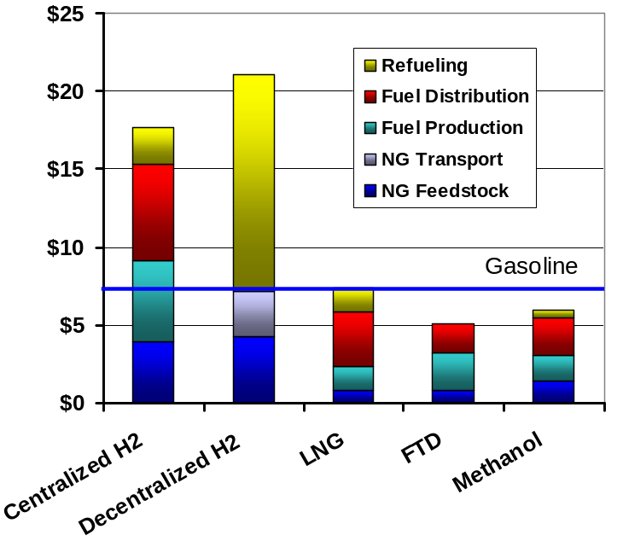
Excluding Profit and Taxes, Unit Cost of NG-Based Fuels Varies from $5 to $21/GJ
For all pathways, hydrogen is far more costly than LNG, FTD or methanol ($2.00 vs.$0.60-0.80/GGE)
FTD is the lowest cost alternative, largely because it requires the least infrastructure
Low-cost, non-North American feedstock makes LNG, FTD and methanol less costly
Reformers and pipelines further increase hydrogen cost

Slide 27
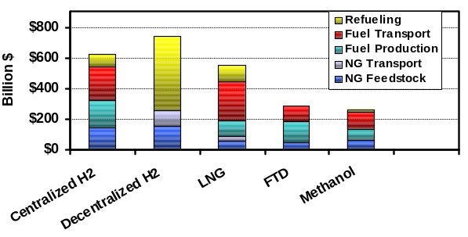
Total Infrastructure Costs Are Highest for Hydrogen; Lowest for FTD and Methanol
Relatively lower mpge, LNG delivery volumes and infrastructure cost.
Higher relative efficiency of hydrogen-fueled vehicle reduces ratio of total cost relative to unit cost to about double
For all three hydrogen pathways, total cost is $600-$700 billion; FTD and methanol are about half.

Slide 28
Some Conclusions:
With current technologies, on a well-to-tank basis, the unit cost of hydrogen is likely to be 2-3 times that of gasoline.
To offset this, the mpge of hydrogen-fueled vehicles must be more than double gasoline.
With current technologies, the hydrogen delivery infrastructure to serve 40% of the light duty fleet is likely to cost over $600 billion.
With low-cost feedstock and use of in-place infrastructure, FTD is competitive with gasoline.

Slide 29
Conclusions (cont’d)
With current technologies, scale economies are large for centralized hydrogen production; small for decentralized
H₂ transport and production are the largest components of all paths examined, hence appropriate focus for cost reduction.

Slide 30
Marianne Mintz
mmintz@anl.gov

Slide 31
Next Steps: Several Additional Technologies and Fuel Options Should Be Examined
Additional LNG alternatives, including station reforming and hybrid vehicles.
Mixed cases, incorporating more than one pathway and targeted to market niches that exploit relative advantages.
Additional hydrogen production options, including high-temperature thermochemical water splitting, methane pyrolysis and coal gasification
Transition issues

