Slide 1
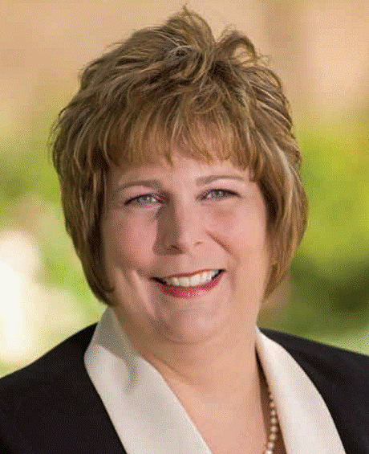
Palliative Care Issues
Marianne Matzo, Ph.D., APRN, BC, FAAN
  Professor, Palliative Care Nursing
  University of Oklahoma College of Nursing

Slide 2
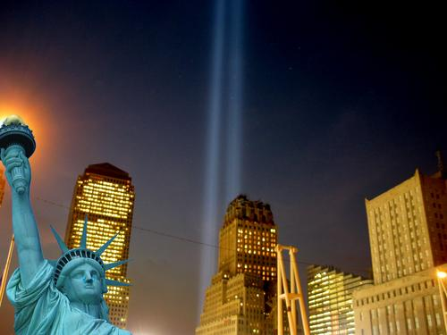
Palliative care is care provided by an interdisciplinary team
Focused on the relief of suffering
Support for the best possible quality of life

Slide 3
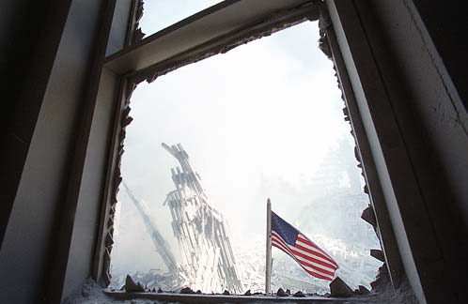
Catastrophic Mass Casualty Palliative Care
Palliative Care is:
  Evidence-based
  medical treatment
  Vigorous care of
  pain and symptoms throughout illness
  Care that patients
  want
Palliative Care is not:
  Abandonment
  The same as hospice
  Euthanasia
  Hastening death

Slide 4
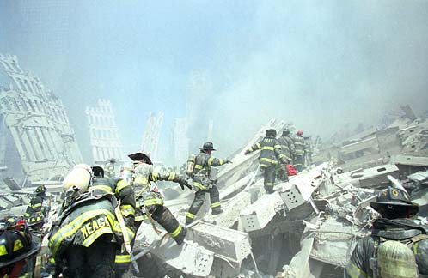
Good palliative care occurs wherever the patient is.
The community should be prepared about the principles of palliative care in a disaster situation.

Slide 5
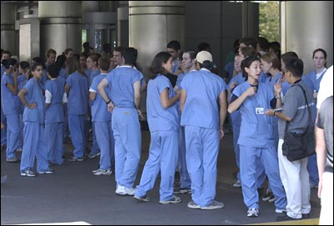
The minimum goal: die pain and symptom free.
Effective pain and symptom management is a basic minimum of service.

Slide 6
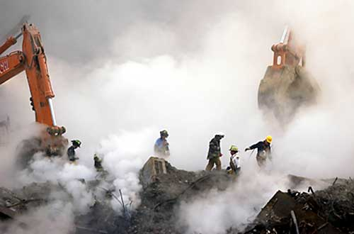
Adequate and aggressive palliative care services should be available to everyone.
Palliative care under circumstances of a mass casualty event is aggressive symptom management.

Slide 7
Catastrophic MCE
Prevailing circumstances
Triage + 1st response
Receiving disease modifying treatment
Existing hospice and PC patients
The too well
The optimal for treatment
The too sick to survive

Slide 8
Catastrophic MCE and Large Volume
The too sick to survive *
Initially left in place
Then:
Transport
Other than active treatment site
*
Those exposed who will die over the course of weeks
Already existing palliative care population
Vulnerable population who become palliative care due to scarcity

Slide 9
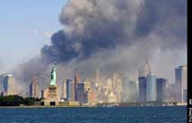
Clinical Services After Triage
Resources:
  Personnel
  Coordination
  Supplies

Slide 10
Clinical Process Issues
  Symptom management, including sedation near death
  Spirituality/meaningfulness
  Family and provider support – mental health
  Family and provider grief and bereavement
  Event-driven protocols and clinical pathways

Slide 11
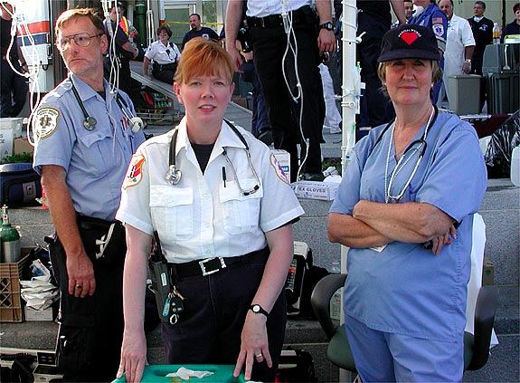
Preparation For The Future
“Many of us discussed the need to evaluate what happened and learn how to be better prepared for the future.”
“You’re expected to know how to do mass casualty…. You must train for the worst and hope for the best.”

