Slide 1
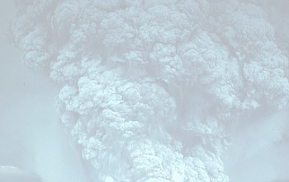
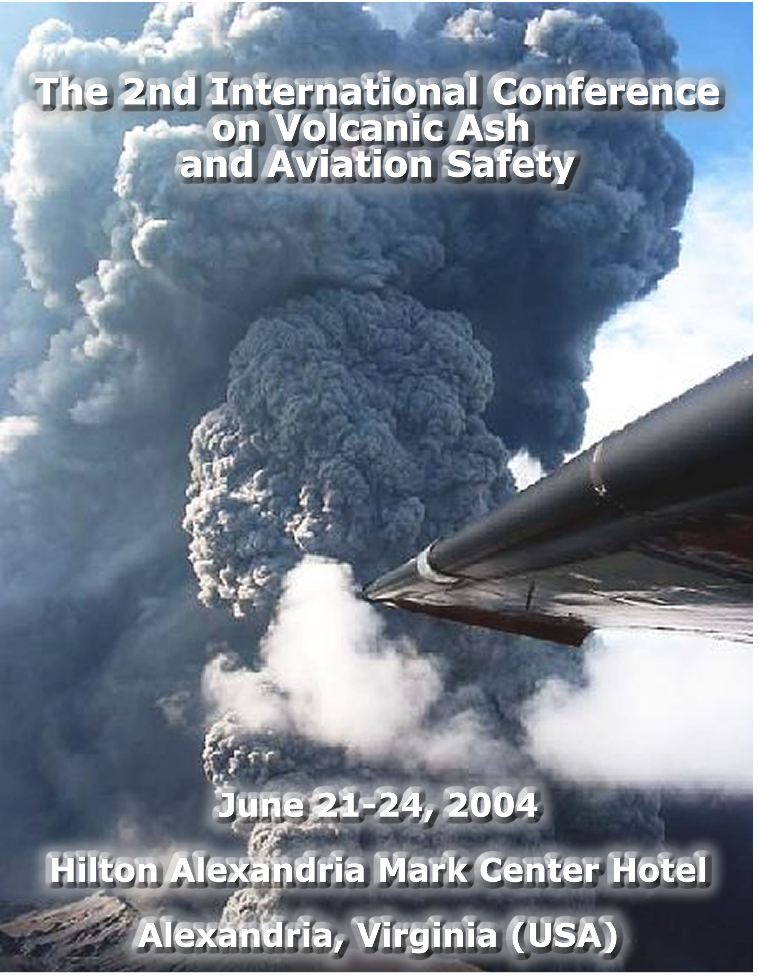

Slide 2
Closing Remarks
Mr. Samuel P. Williamson
Federal Coordinator for Meteorological Services and Supporting Research

Slide 3
A Big Thanks to
Our Sponsors
  Office of the Federal Coordinator for Meteorological Services and Supporting Research (OFCM)
  United States Geological Survey (USGS)
  Federal Aviation Administration (FAA)
  National Oceanic and Atmospheric Administration (NOAA)
  National Aeronautics and Space Administration (NASA)
  Smithsonian Institution (SI)
  Air Line Pilots Association (ALPA)
  Meteorological Service of Canada/Environment Canada (MSC/EC)
  International Association of Volcanology and Chemistry of the Earth's Interior (IAVCEI)
  Tenix Corporation
  World Meteorological Organization (WMO)

Slide 4
A Very Special Thanks to Everyone!!
Thanks to everyone who helped make sure The 2nd International Conference on Volcanic Ash and Aviation Safety was a success!
  National Aviation Weather Program Council
  Members of the Office of the Federal Coordinator for Meteorology staff
  Science and Technology Corporation
  Exhibitors
  Interagency Working Group for Volcanic Ash
  Key Speakers
  Chairpersons
  Panelists
  Moderators
  Presenters
  Rapporteurs and Timers
  A Very Special “Thank You” to the participants of the conference, who are instrumental in making this conference a success

Slide 5
Great Speakers From
Start to Finish
Mayor William “Bill” Euille, Alexandria, VA
The Honorable Ted Stevens, U. S. Senator from Alaska (Invited)
Dr. James R. Mahoney, Assistant Secretary of Commerce for Oceans and Atmosphere and NOAA Deputy Administrator
Dr. Charles G. Groat, Director, USGS
RADM. James P. Schear, Vice President for Safety, FAA
Mr. Ronald J. Birk, Director of the Earth Science Applications Division, Office of Earth Science, NASA
Mr. Gianni Semenzato, Senior Flight Inspector, Ente Nazional per L’Aviazione Civile (Italian Civil Aviation Authority)
Luncheon Speaker: Captain Eric Moody
Mr. William Voss, Director, Air Navigation Bureau, ICAO (Mr. Raul Romero)

Slide 6
Super Panels
Panel 1: Airborne Volcanic Ash: Perspectives, Challenges, and Opportunities
Moderator: Dr. Elbert W. (Joe) Friday
Panelists:
  Dr. Thomas P. Miller
  Dr. Louis W. Uccellini
  Ms. Gloria Kulesa
  Mr. Alan Shaffer
  Mr. Peter Chen

Slide 7
Super Panels
Panel 2: Education, Training, and Outreach
Moderator: Dr. Gregory S. Forbes
Panelists:
  Ms. Cyndie Abelman
  Captain Albert M. Beerley
  Mr. John O’Brien
  Mr. Saburo Onodera
  Professor Eric Doten

Slide 8
Great Sessions
Session 1: Encounters, Damage, and Socioeconomic Consequences
  Session Chairs: Mr. Edward Miller and Mr. Leonard Salinas
Session 2: The Volcanic Source - Eruption Monitoring and Reporting
  Session Chairs: Ms. Marianne Guffanti and Dr. Steven McNutt
Session 3: Ash Cloud Observations, Modeling, and Forecasting
  Session Chairs: Dr. William Rose, Ms. Barbara Stunder, and Mr. Andrew Tupper

Slide 9
Great Sessions
Session 4: VAAC Operations and Capabilities
  Session Chairs: Ms. Grace Swanson and Mr. Rene Servranckx
Session 5: Aviation Industry Perspectives
  Session Chairs: Mr. Steven R. Albersheim and Mr. John Murray

Slide 10
Excellent Breakout Sessions
Breakout Session 1: Improving Volcanic Ash Cloud Detection
  Session Moderators: Dr. David J. Schneider and Dr. Steven Ackerman
Breakout Session 2: Improving Modeling Capabilities
  Session Moderators: Mr. Rene Servranckx and Ms. Barbara Stunder
Breakout Session 3: Understanding the Socioeconomic Consequences
  Session Moderators: Mr. Floyd Hauth and Mr. Peter Lechner
Breakout Session 4: Improving Volcanic Eruption Reporting
  Session Moderators: Ms. Christina Neal and Ms. Cynthia Gardner

Slide 11
Excellent Breakout Sessions
Breakout Session 5: Technology Transfer from Research into Operations
  Session Moderators: Mr. Mark Andrews and Ms. Debi Bacon
Breakout Session 6: Improving VAAC Operational Capabilities
  Session Moderators: Mr. Raul Romero and Ms. Grace Swanson
Breakout Session 7: Meeting Aviation Needs
  Session Moderators: Mr. William Phaneuf and Mr. Richard Heuwinkel

Slide 12
Excellent Breakout Sessions
Breakout Session 8: North Asia Pacific (e.g., Alaska, Russia, Japan)
  Session Moderators: Mr. Christopher Strager and Ms. Terry Keith
Breakout Session 9: The Americas and the Caribbean (excluding Alaska)
  Session Moderators: Dr. Patricia Mothes, J. Armando Saballos, and Richard Hernandez
Breakout Session 10: Europe, Africa, and the Middle East
  Session Moderators: Dr. Gerald Ernst and Mr. Jean-Philippe Desbios
Breakout Session 11: South Asia Pacific (e.g., Indonesia, the Philippines, Australia, New Zealand)
  Session Moderators: Mr. Rodney Potts and Capt. David Innes

Slide 13
Thanks for the Great Support
Hilton Alexandria Mark Center
Mr. Gregg Morgan

Slide 14
Thanks for the Great Assistance!
Ms. Erin McNamara--Conference Coordinator for Logistics
Ms. Mary Cairns and Marianne Guffanti (USGS)--Conference Coordinators for Agenda
Ms. Dawn Erlich--Registration Assistance
Mr. Kent P. LaBorde and Mr. Greg Romano (NOAA Public Affairs)--Arranging for Media Events
Lt. Col. Frank Estis--Protocol and Coordinator for Media Events
Mr. Ken Barnett and Ellis Godfrey--Audio/Visual Assistance
Ms. Linda Huey (USGS)--Assistance in many areas

Slide 15
A Super-Big Thanks:
Great Wrap-up and Look Ahead!
Conference Highlights
  Ms. Marianne Guffanti
  Mr. Andrew Tupper
Building on Our Successes in Aviation Safety for the Next Decade
  Dr. Elbert W. (Joe) Friday
  Dr. Paul D. Try

Slide 16

Conference Expectations Achieved?
One…identify new operational needs/requirements and the research and development needed to satisfy those requirements.
Two…where possible, match operational and research and development needs/requirements to ongoing programs/projects to maximize partnership efforts.
Three…develop a roadmap for improved volcanic ash-related education, training, outreach, and decision tools.
And four…develop a framework for improved partnerships within the international volcanic ash community to leverage resources and capabilities across the spectrum of operations and research & development.

Slide 17
NEXT STEPS
KEEP THE MOMENTUM GOING!
  Please submit any additional session summary information to Ms. Mary Cairns by July 1 at mary.cairns@noaa.gov
  A high-level conference summary will be published within 10 days
U.S. Volcanic Ash Working Group will take action on the conference action items and recommendations
  Seek help, input and advice from international partners and ICAO
  Sort action items and recommendations into short- (0-12 month), mid- (1-4 year), and long-term (4-10 year) actions and prioritize them
  Develop and gain approval of a Volcanic Ash Implementation Plan, outlining program goals, operational needs/requirements, R&D needs and priorities, within the next 12 months
Hold a follow on meeting within 18-24 months

Slide 18
Conference Proceedings
Conference high-level summary and presentations on-hand will be posted to the OFCM Web Page within two weeks
  http://www.ofcm.gov
Conference papers are due by 30 July
Conference proceedings will be available in the fall

Slide 19
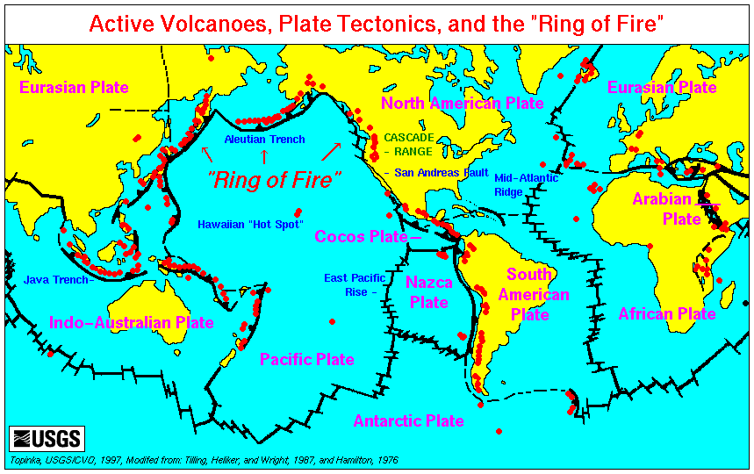
THANKS and
HAVE A SAFE TRIP HOME!

