Slide 1
Department of Education
“Distance Education Demonstration Program”
Marianne R. Phelps
Special Assistant
Office of Postsecondary Education

Slide 2
Background
1992 HEA Fraud and Abuse Amendments
  Correspondence schools
  Quality
    Program length
    Accrediting agency recognition
Aid requirements structured around traditional concepts of higher education

Slide 3
1998 Higher Education Amendments
Distance Education Demonstration Program
  Clear trend toward Distance Education
  Continued concern about possibilities for fraud and abuse
    Requires strict monitoring
    Administrative capability criterion

Slide 4
Statutory Purposes of Program
Test quality and viability
Increase access
Help determine:
  Most effective means of delivering Distance Education
  Statutory and regulatory changes needed
  Appropriate level of student assistance

Slide 5
Program Structure
15 Participants
Additional 35 3rd Year
Statutory waivers
  50% Rules
  30week academic year
Regulatory waivers – general provisions

Slide 6
Participants
9 single institutions
6 consortia
99 institutions total
5 public
5 private
2 public and private
3 proprietary

Slide 7
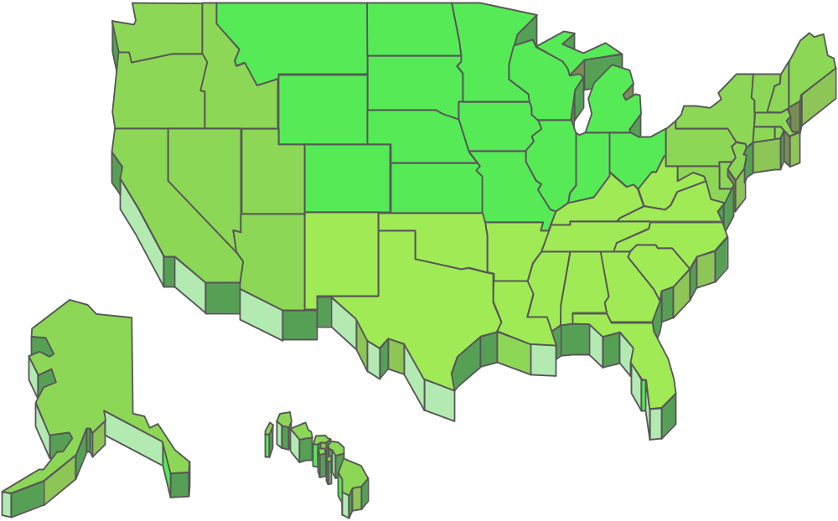
Distribution of Participants by State
1
1
1
1
1
1
1*
2
1
1
1
1
1*
1
* Multi state

Slide 8
Some Ideas Participants are Testing
BA/BS completion programs
Course sharing
Increasing capacity to meet student needs
Enriching on-campus offerings with distance education courses
New methods of enrollment tracking
Excluding living expenses from the calculation of cost of attendance
Multiple Disbursements/Just in Time Delivery

Slide 9
List of Waivers
Set 1 50% Rules
  Courses
  Students
  Telecommunications student/correspondence student
Set 2 Time Requirements
  30 week academic year
  Definition of a week of instruction

Slide 10
List of Waivers (cont.)
Set 3 - Correspondence student/halftime only
Additional waivers for Western Governors University

Slide 11
Schedule for 2001 Application Cycle
Federal Register Notice – September 15
Technical Assistance Workshops (proposed)
    Washington, DC - October 18 (firm)
    Albuquerque, NM (WCET) - November 1 (firm)
    Chicago, IL - November 8 or 9
    Seattle, WA - November 28 or 29
Technical Assistance to Potential Applicants -- On–going
Application Due Date – February 15

Slide 12
Schedule for 2001 Application Cycle (cont.)
Applicant Screening - March 1 – 15
Reader Recruitment and Selection – February 15 – March 15
First Reading – April 1 – 15
Second Reading – May 1 –2
New Participants Announced – May 15

Slide 13
Thoughts for Potential Applicants
Examine Current Uses of Technology in Your Curriculum
Consider How Distance Education Relates to Your Mission
Examine Your Business Plan
Develop Clear Goals
Analyze Where You Are
Obtain Active Support from CEO
Establish Team to Develop Application

Slide 14
Additional Thoughts for Consortia
Obtain Agreement from CEO’s of All Institutions
Determine Which Institutions Are the Most Committed
Develop Team of Personnel from Committed Schools

Slide 15
The Ideal Application -
Characteristics
Well Written
Clear Description of Distance Education Program(s)
Understanding of USDE Waiver Authority
Specific Plan for Administration of Aid

Slide 16
The Ideal Application -
Characteristics (cont.)
Promise of Contributing to the Purposes of the Distance Education Demonstration Program
Well formulated quantitative and qualitative goals

Slide 17
Significance in Comparison with Other Applications
of Distance Education Program(s)
of Issues Project Poses to Student Aid
of the Opportunity for ED to Learn from Applicant’s Participation

Slide 18
Be Prepared If You Are Selected
To Submit the Required Data Collections
To Attend One or More Participant Meetings per Year
To Work in Partnership with ED Staff
FOR A GREAT LEARNING EXPERIENCE!

Slide 19
Department of Education
Distance Education Demonstration Program
Email: OPEDistanceDemo@ed.gov http://www.ed.gov/offices/OPE/PPI/DistEd/
Learning Anytime Anywhere Partnerships http://www.ed.gov/offices/OPE/FIPSE/LAAP

