Slide 1

2004 FDA Workshop on
Pre-clinical Testing ^{for} AAA Endovascular Grafts
Dorothy B. Abel
FDA/CDRH/DCD/PVDB

Slide 2
Acknowledgements
Organizers
  Dorothy Abel
  Angie Smith
  Marianne Grunwaldt
Scientific Advisory Committee
  Matt Waninger
  Stuart Rodger
  Mark Dedashtian
  Lou Smith
Notes:
I think you need to have your name as one of the organizers !!!!!

Slide 3
Introduction
Describe the purpose of pre-clinical testing, beyond trying to predict clinical performance
Identify the basic design requirements for endovascular grafts which will be the focus of the workshop
Describe the workshop game-plan

Slide 4
Purpose of Pre-clinical Testing
Provide initial data on the device function, on the bench and in animals, prior to initiating a clinical study
Anticipate the longer-term clinical performance of the device, given the relatively short term clinical results available at the time of approval
Notes:
My version is red – yours is green

Slide 5
Purpose of Pre-clinical Testing
Characterize the device in order to identify the root cause of any subsequent failures
Characterize the device so if changes are made it is possible to compare important parameters between the original and modified device
  Helps in identifying testing needed to be repeated or added
  May be useful in determining the root cause of failures observed in either design
Notes:
Again, my version in red – yours in green.

Slide 6
Assessment of Pre-clinical Testing for Endovascular Grafts
Evaluating performance – not terrible, but there is a long list of clinical events that were not predicted by the pre-clinical testing
Predicting longer-term clinical performance – about as good as evaluating performance
Characterizing the device or modified device – pretty good, but inconsistent between manufacturers
There is room for improvement!
Notes:
I highlighted the 3 categories and the last sentence for clarity.

Slide 7
Hence this workshop.

Slide 8
Basic Design Requirements for AAA Endovascular Grafts
Get a grip
  Patient selection
  Delivery and deployment
Hold on! (have adequate attachment strength)
  “Active” fixation, such as hooks or barbs
  Radial force
No leaking (have adequate sealing)
  Radial force
  Other sealing mechanisms or enhancements
  Conformance to vessel wall

Slide 9
Basic Design Requirements
Maintain strength
  Device integrity
Maintain performance under changing physiologic conditions
  Enlarging necks
  Aneurysm shape changes
  Changes in relative pressures

Slide 10
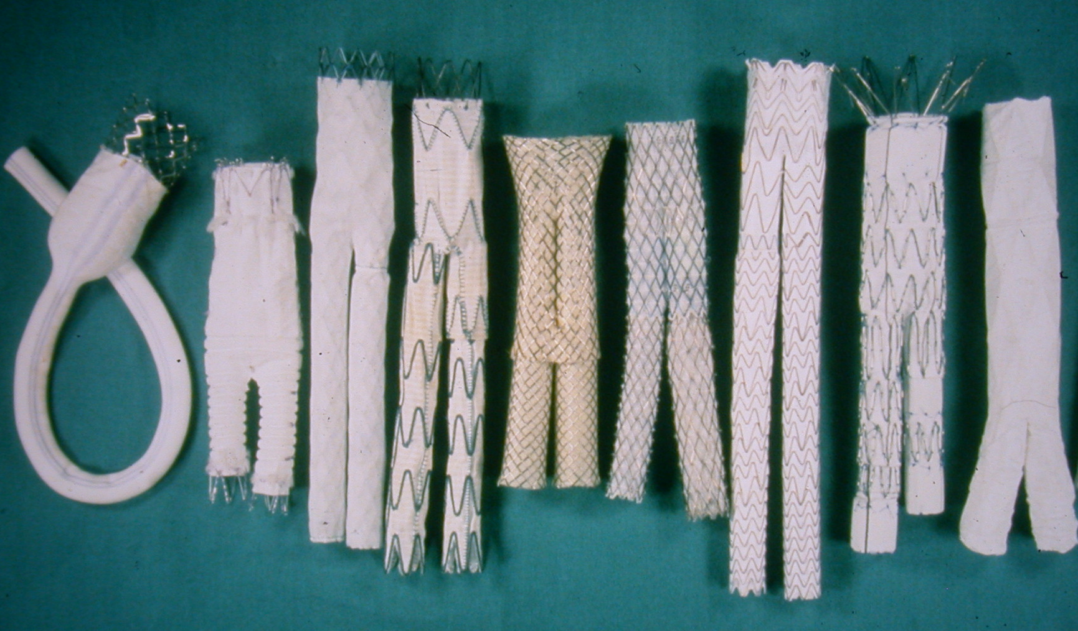
AAA Endovascular Grafts

Slide 11
Topics for Discussion
Session 1 - Animal Studies: A Retrospective and Prospective Evaluation
Session 2 - Sealing and Fixation Effectiveness
Session 3 - Device Integrity, Fatigue and Durability
Session 4 - Clinical and Preclinical Performance: Past, Present and Future

Slide 12
The Approach
Look at what has been done in the past
Identify the clinical failure modes that could and should be evaluated in animal testing or specific tests to evaluate sealing and fixation effectiveness or implant integrity
Identify modifications required in test methods
Determine additional information needed to improve testing parameters

Slide 13
Session Structure
Presentation(s) in effort to stimulate discussion
Summary of our goals for the session
Discussion with scheduled audience participation, with real time documentation

