Slide 1
Alliance to Identify and Manage Chemical Reactivity Hazards
Dorothy Kellogg
American Chemistry Council
June 7, 2004 --- 1:30 p.m.

Slide 2
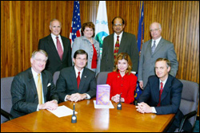
Who Are These People?

Slide 3
Reactive Chemical Incident
A sudden event involving an uncontrolled chemical reaction with significant increases in temperature and/or pressure that has the potential to or has caused serious harm to people, property or the environment.

Slide 4
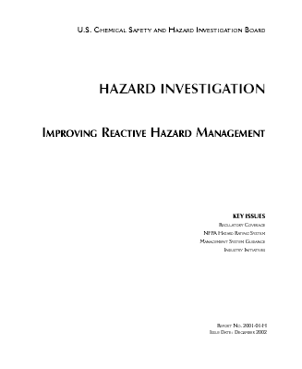
CSB Study & Report
Findings
167 incidents in 21 years
108 fatalities
Significant property damage
In over 90% of all incidents studies, the information necessary to have prevented the incident was documented and publicly available.

Slide 5
CSB Recommendations

Slide 6
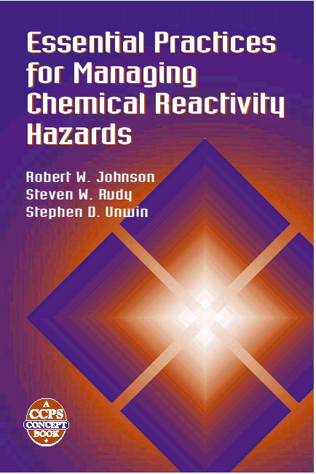

Slide 7
Why an Alliance?
Build on great CCPS work
Response to CSB finding – problem not availability of information but tools for getting it and using it
Immediate positive impact – get resources out to those who need them
“Test drive” CCPS logic

Slide 8
Parties to the Alliance
Occupational Safety & Health Administration
Environmental Protection Agency
American Chemistry Council
Center for Chemical Process Safety
Mary Kay O’Connor Process Safety Center
National Association of Chemical distributors
Synthetic Organic Chemical Manufacturers Association
The Chlorine Institute

Slide 9
Purpose of the Alliance
Provide information, guidance, and access to training resources to members, customers, contacts and others involved in the manufacture, distribution, use and storage of chemicals
Protect communities and employees
health and safety
Improve identification and
management of CRH

Slide 10
Aims of the Alliance
Increase awareness of the need to identify and manage CRH among those who manufacture, distribute, use and store chemicals;
Provide CRH management information, methods and tools to a variety of audiences in meaningful and useful forms to those audiences; and
Gain experience in the use of methods and tools to continuously improve identification and management of CRH.

Slide 11
Goals of the Alliance
Training & Education
Outreach & Communications
Promoting National Dialogue

Slide 12
Training & Education
Jointly develop and deliver training addressing chemical reactivity hazards, to be delivered in conferences, meetings, OSHA Training Institute (OTI) Education Centers, or through distance learning. Examples:
Electronic assistance resources (e.g., interactive software e-Tools, technology-based training)
Training and materials for OSHA & EPA staff
Customized tools for specific sectors, such as SMEs.

Slide 13
Outreach & Communication
Develop and disseminate information through print and electronic media
make Essential Practices available in the open literature
disseminate and encourage the use of Essential Practices to members and their value chains.
Collaborate with other Alliances & parties on specific issues and projects as appropriate
Deliver presentation at signatories conferences, meetings, events as appropriate

Slide 14
Presentation Venue Examples
ACC Responsible Care® Regional Meetings
2004 TCC EHS Seminar 
AIChE Loss Prevention symposium
CCPS International Conference
SACHE Workshops
NACD Operations Seminar & Trade Show
SOCMA annual & regional meetings
Chlorine Institute annual meetings
MKOPSC annual symposium & short courses
MKOPSC engineering seminars/course work

Slide 15
National Dialogue
Convene or participate in forums, round table discussions, or stakeholder meetings
CCPS Reactives Roundtable
Ongoing CSB dialogues
Other

Slide 16
Questions?

Slide 17
So, Who Are These People?

Slide 18
So, Who Are These People?
Back row L-R:
James Kolstad, DACD
Kathleen Shaver, Chlorine Institute
Dr. Sam Mannan, Mary Kay O'Connor Process Safety Center
Joseph Acker, SOCMA
Front row L-R
Greg Lebedev, ACC
John Henshaw, OSHA
Marianne Horinko, EPA
John Sofranko, AIChE

