Slide 1

Efficacy of Acamprosate: Clinical Issues
Celia Jaffe Winchell, M.D.
Medical Team Leader
Addiction Drug Products
Notes:
I’m Celia Winchell from the FDA, and I’m going to speak to you this morning about the clinical review of the efficacy of acamprosate.
I want to let you know that we approached this data hopefully. We knew before the application came in that the American trial hadn’t worked out, but it isn’t unusual for an application to contain some trials that worked and some trials that weren’t able to show a difference from placebo. But this time, we had some older, less rigorous, foreign studies that worked, against a recent, domestic, and REALLY GOOD study that didn’t. It was hard to overlook that.
We had some reservations about the conduct of the European trials but we looked at them in a few different ways and were able to find encouraging results. And then both the statistical reviewer, Dr. Wang, and I dug into the American trial data. We really hoped there would be some explanation for the outcome that would have some face validity and that could tell us something about the circumstances in which Acamprosate works and the circumstances in which it doesn’t, and that would give us confidence that we could accept the European studies.
For about the next half-hour, I’m going to take you through the process of looking at the efficacy data and show you where it led us.

Slide 2
Questions
How can the discrepant results between the older, European studies and the more recently conducted American study be reconciled?
Do the data support any conclusions regarding subgroups of patients more likely to benefit from acamprosate?
Given the conflicting results, is there sufficient evidence of the efficacy of acamprosate in the treatment of alcoholism to warrant approval?
Notes:
The questions on the slide are the ones you’ve been asked to consider this morning. You’ve heard some comments from Lipha on the matter. Before I begin, I’ll point out that there are two ways of casting the questions. It’s been suggested that the reason the European trials were able to demonstrate the effect of acamprosate and the American trial wasn’t is that the populations differed. The European subjects were all randomized to treatment after completing an inpatient detox. There were few polysubstance abusers in the Eurpean studies. And the European studies either assumed or required a high level of motivation for abstinence. Lipha was able to identify a subset of the American population that they felt was most like the European subjects, and they feel this group did demonstrate the effect of acamprosate.
So, one could put it the questions on this slide this way:
“Given the positive findings throughout Europe, how should we weigh the results of the U.S. trial, upon consideration of our explanatory analyses based on population differences?”
On the other hand, I found a number of aspects of the European data that gave me pause during my review, and I was completely unable to find a way to explain the results of the American trial. As you saw in the materials provided in the backgrounder, I defined a number of population subsets that I thought could account for the differences. For statistical reasons, I restricted myself to the use of pre-randomization characteristics. And no matter how I sliced it, there was no treatment effect of acamprosate at the proposed dose. And it was not a matter of “failure to reach statistical significance” due to the small sizes of the samples. There was really NO difference, or, occasionally, there were differences that trended in the direction of favoring placebo. I would be inclined to put the questions this way:
“In view of the failure of the carefully-conducted American trial, which we are unable to explain through analyses directed at various sub-populations, can we accept the findings from the European studies, knowing that the data was collected much less systematically?”

Slide 3
Overview
Why CAD is not persuasive in European trials
Conclusions supported by European trials
Exploratory analysis of American trial
Notes:
In the next few minutes, I’m going to lead you through the review of the efficacy data submitted to the FDA for review. I’ll cover how we concluded that the primary outcome variable identified by the sponsor for the European pivotal trials, the cumulative abstinence duration, could not be viewed with confidence. Then I’ll give you the good news about what we were able to make out of those trials. Then I’ll walk you through the American trial, which was not able to show an effect of acamprosate, and our attempts to resolve the discrepancies between these bodies of data.

Slide 4
What is the Problem with CAD
In These Studies?
No systematic capture of drinking data day-by-day
Retrospective reconstruction of large periods of time
Mathematical imputation based on extensive assumptions
Notes:
So, first, what is the problem with cumulative abstinence duration?
The primary outcome variable analyzed by the sponsor in the European pivotal trials was cumulative abstinence duration, measured in days, or what was called “corrected” cumulative abstinence duration, which amounts to percent days abstinent. In your briefing book, you read that we rejected this variable on review. I should remind you that these studies were complete at the time the IND was opened--we never discussed the design and analysis of these trials prospectively, so there was not an opportunity to comment prior to the NDA review.
Now, let me say that I have no problem with these measures in theory. They are attractive because they capture the picture of drinking behavior even for those subjects who don’t abstain for the entire observation period, which we know is most of them. The problem with the use of these measures in the European studies is that they amount to a false precision. These studies collected the drinking data in a non-systematic way at widely-spaced visits and used various data handling rules to convert the data so collected into numbers of days of abstinence and days of drinking. Upon examining the protocols, the case report form fields, and the data handling rules, I concluded that the CAD in the three pivotal European studies (and in all the European studies other than the British study, for that matter) was a highly imputed value that went beyond the precision of the data actually collected. I’ll walk you through the three pivotal studies to show you what I mean.

Slide 5
Pelc-II
7 visits over 90-day treatment period
  Intervisit interval NMT 15 days
Outcome measure: Fields calling for “Avg daily consumption” and “Avg frequency of alcohol consumption”
  subjects with “zero” = abstinent
Conservative imputation of non-abstinence for all days in inter-visit interval
Obscures differences between one drinking day and many
Notes:
The first study, known as Pelc-II, was a short-term study involving 90 days of treatment. This study had 7 visits on-treatment, with visits occurring every one to two weeks. However, at each visit, the investigator was asked to estimate the subject’s “average daily consumption” on drinking days, and “average frequency of consumption.” There wasn’t a systematic approach, like the time-line follow-back method, used to reconstruct this information. The real problem, though, is the data handling rules. Anyone who had any number other than zero listed for frequency and amount was considered to have been drinking during the entire inter-visit interval. So any number between 1 drinking day and 15 drinking days was transformed to 15 drinking days. If a visit was missed, drinking days were imputed all the way back to the previous visit. This method collapses a fairly wide range of responses into two possibilities--zero or 15. I find this troubling when the result is then mathematically summed and a mean is calculated to the tenths place and compared statistically.

Slide 6
Paille
9 visits over 1 year of treatment
  Intervisit interval
    30 days for on-treatment visits 1-6
    60 days for on treatment visits 7-9
Outcome measure: physician estimate
CAD calculated by subtracting physician’s estimate of non-abstinent days and summing remaining days
Relies on nonsystematic reconstruction of as much as 60 days of drinking data
Notes:
Now, the Paille study was more problematic. This study had a one-year treatment period but there were only 9 visits on-treatment. The interval between visits was as much as 60 days. At these visits, the investigator was again expected to come up with an estimate of the number of days of non-abstinence and the drinks per drinking day without a systematic technique for reconstructing the data. But unlike the Pelc study, which used a very conservative approach, the Paille study data handling rules just took that estimate on its face and put it into the calculations of CAD. I’m skeptical about the precision of these numbers.

Slide 7
PRAMA
6 visits over 48 weeks of treatment
  Inter-visit interval
    4 weeks for OT visits 1, 2, and 3
    12 weeks for OT visits 4, 5, and 6
Outcome measure “physician’s global assessment” of abstinence
Complex mathematical reconstruction of number of days drinking/abstinent
Strains credibility of calculated CAD
Notes:
The PRAMA study had only SIX visits over 48 weeks of treatment, and for half the visits, the inter-visit interval was three months. At these visits, there was a “global assessment” by the physician, and the physician was also supposed to try to determine if a relapse occurred, and classify it as short-term or long-term. The data handling rules for the calculation of CAD are so complex that I have had to put them on a separate slide, which I know is still too small to read.

Slide 8
Calculation of CAD: PRAMA
    If the physician’s global assessment indicated success, then all days since the previous visit were considered abstinent. When failure was indicated, then the number of abstinent days was determined using the patient’s and relative’s report on drinking, where the higher category was used if there was a difference between the two and the patient’s report if the categories reported were the same. When there was no reported category of relapse, then half of the days between visits were considered abstinent. When the relapse was considered to have started as a continuous relapse between visits, all days between visits were considered non-abstinent. The number of brief relapses plus three times the number of longer relapses were subtracted from the number of days since the previous visit if either type of relapse was indicated; if either type of relapse was indicated and no numbers were provided, it was assumed that the patient was abstinent for half of the days.
    Several methods of determining the number of abstinent days were used when there was no physician global assessment provided. In cases where there were two consecutive post-baseline visits with the assessment missing but there was a nonmissing assessment later, then both time visit intervals were considered abstinent if either the prior or next visit was indicated as a success by the physician’s global assessment; both visit intervals were considered non-abstinent if both visits were indicated as failures by the physician’s global assessment. When no assessment was made for Visit 1, the patient was assumed to have been abstinent half of the days. For all other cases, a missing global assessment following a successful one was considered to indicate abstinence for half the period, while a missing global assessment following a successful one was considered to indicate abstinence for half the period, while a missing global assessment following a missing or failure was considered to indicate non-abstinence for the period.”
Notes:
Here it is. I know you can’t read it. I’m just trying to make the point that there is a very complicated set of mathematical rules here that transforms a rough estimate of what’s happened over the past three months into specific number of days of drinking vs. abstinence. I just feel that this is a false precision that goes beyond what was really known.

Slide 9
What CAN we make out of the European studies?
Continuous Abstinence Throughout Treatment
Non-Continuous Abstinence: number of visits at which subject was assessed as abstinent
Notes:
So, that’s the bad news. But there is good news. I looked at the datasets and tried to see what I could conclude based on the data collected. I considered how many people were assessed by the investigator as continuously abstinent, but I realize this is a very high standard and doesn’t really capture all of the clinical effect that might be considered relevant. So I wanted a way, other than CAD, to look at periods of abstinence, even if they were interrupted by periods of drinking. Each study called for an assessment of drinking vs abstinence at each visit. So I went through and counted how many people had 0 visits at which they were assessed as abstinent, how many had 2, and so on, and compared across treatment groups. I realize that with an inter-visit interval of 90 days, the binary assessment of abstinence vs. non-abstinence is still a little suspect, but I think it does mean something if the subject can convince the investigator he hasn’t had a drink in three months.

Slide 10
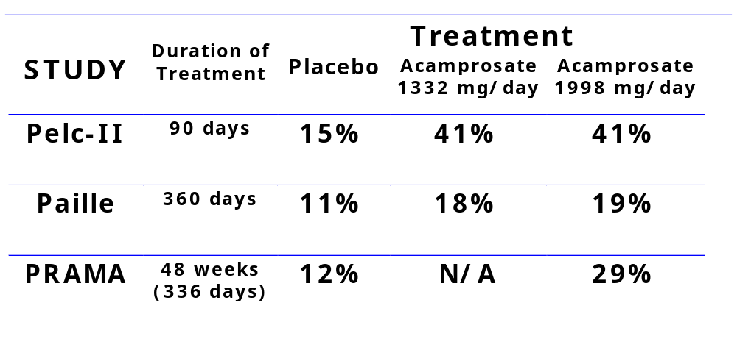
Results: Continuous Abstinence
Notes:
Here, I have laid out the results of the continuous abstinence analysis. This lists the number and percent of subjects in each treatment arm who were assessed as continuously abstinent throughout the treatment period.
In each of these studies, Acamprosate was superior to placebo, and the differences were statistically significant.

Slide 11
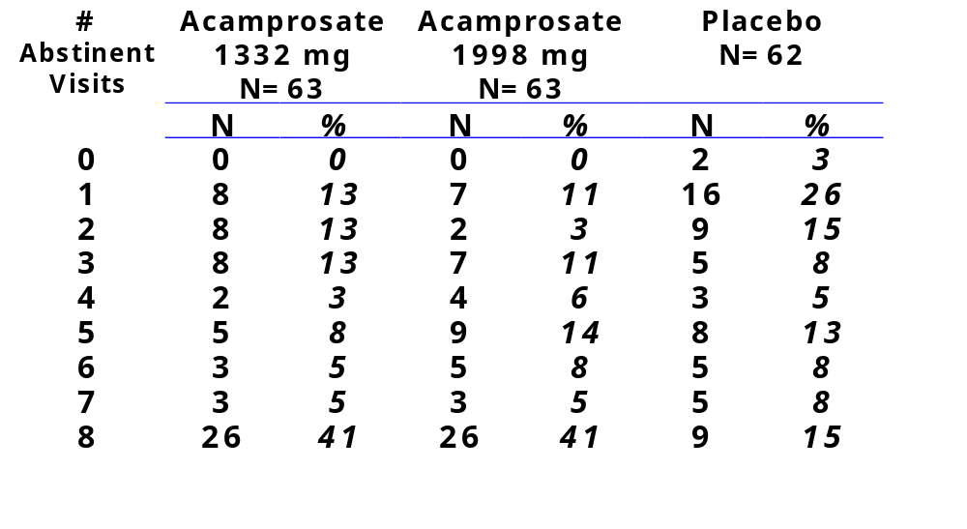
Results: Non-Continuous Abstinence
Pelc-II
Notes:
I also wanted to look at results that included non-continuous abstinence as clinically relevant. So I tabulated for each study how many subjects were assessed by the investigator as abstinent at zero visits, one visit, two visits, and so on. I’ll show the tables for each study one by one on the next few slides. The differences are statistically significant in favor of acamprosate 1998 mg in all the studies. If you look very closely, it seems that for the most part the superiority of acamprosate is driven primarily by the subjects who were continuously abstinent. There may be a little greater tendency for the placebo subjects to very few abstinent visits.
Here are the results from Pelc-II. Now, there were supposed to be 9 visits but for some reason there are no subjects with 9 abstinent visits and the numbers who had 8 abstinent visits match up with the continuous abstinence numbers. I haven’t really been able to explain this. You’ll see there was a tendency for more of the placebo subjects to have 0, 1, or 2 visits where they were assessed as abstinent. And, of course, consistent with the results on the continous abstinence analysis, there are a lot more acamprosate treated subjects with 8 visits at which they were assessed as abstinent.

Slide 12
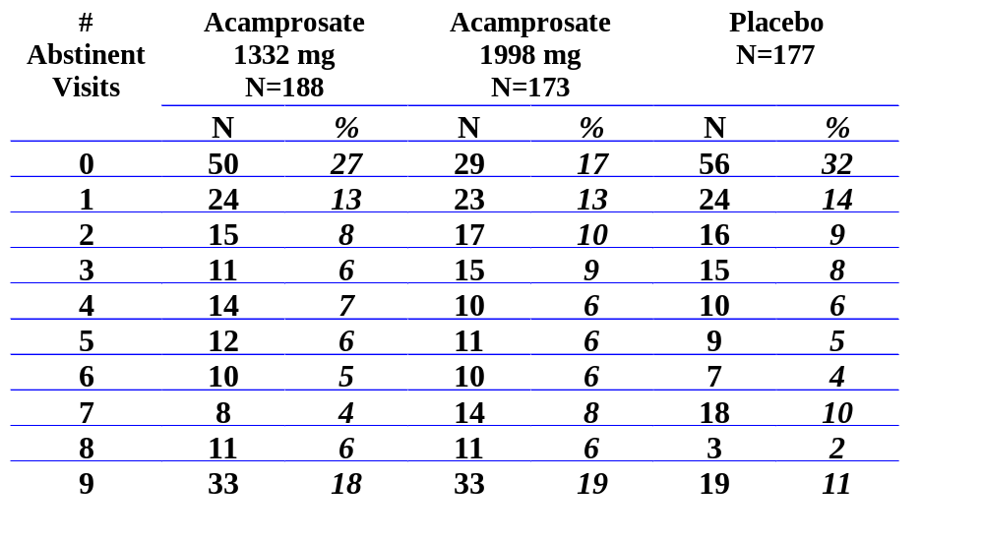
Results: Non-Continuous Abstinence
Paille
A t-test shows a statistically significant difference between acamprosate 1998 mg and placebo.
Notes:
Here is the analysis for the Paille study. There were 9 visits, and the 85 continuously abstinent subjects are shown here as having 9 visits assessed as abstinent. This was the study that had the most marginal result on the continuous abstinence measure. You can see that if you added in the subjects with 8 visits assessed as abstinent, the finding is strengthened, with 44 in each acamprosate group (that’s 24-25%) having 8 or 9 abstinent visits, vs 22 in the placebo group, or 12%. At the other end of the spectrum, the difference is less obvious, with 54% of the placebo group having 2 or fewer abstinent visits, as compared to 47% of the acamprosate low-dose group and 40% of the acamprosate 1998 mg/day group.

Slide 13
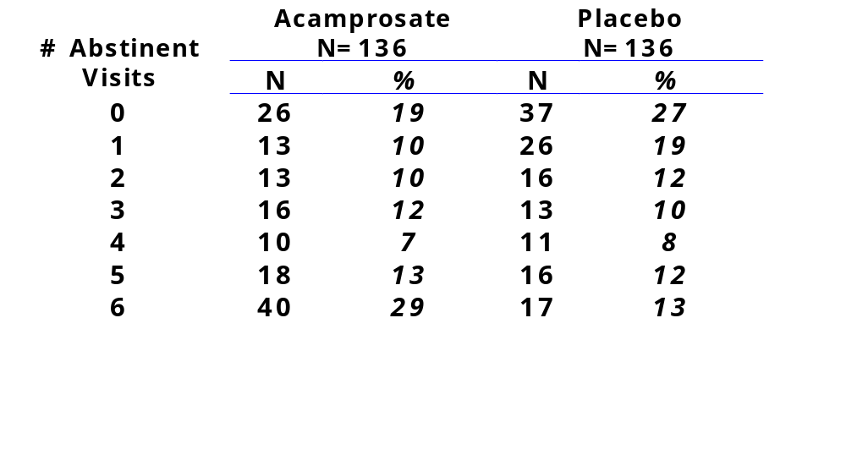
Results: Non-Continuous Abstinence PRAMA
A t-test of this data shows that the groups are different at a level of p < 0.0003
Notes:
Here is the data from PRAMA. There were only 6 visits in this one-year study, and, as Dr. Wang will discuss, there were many dropouts and dropout occurred at different rates across treatment groups. Since missing visits could not be assessed as abstinent visits, this analysis is vulnerable to the dropout problem. Understanding that many fewer placebo subjects attended 6 visits, acamprosate subjects had more opportunities to be assessed as abstinent. Therefore, some caution is in order in examining this data. The superiority of acamprosate over placebo at the most successful end of the spectrum is clearly driven by subjects with continuous abstinence, or 6 abstinent visits--there is no difference across groups in the number being assessed as abstinent at 4 or 5 visits. However, the difference between treatments is also apparent at the other end of the success spectrum. 63 subjects, or 46%, in the placebo group, had zero or ONE visit at which they were assessed as abstinent, as compared to 39, or 29% in the acamprosate group.

Slide 14
Evidence of Efficacy from European Studies
Continuous Abstinence
Non-Continuous Abstinence
  Number of visits where subjects were assessed as abstinent
Notes:
So, in summary, it does look as if the three European studies demonstrate an effect of acamprosate in maintaining abstinence after detoxification.

Slide 15
Study US 96.1
500 mg tablet
6 months of treatment
8 on-treatment visits, ≤ 4 weeks apart
TLFB reconstruction of drinking data at each visit
  patient diaries
  collateral informant interviews
  BAC,
  “Worst case” chosen
Standardized, manual-guided social tx
Notes:
Let’s turn to the American study. As you’ve already heard, this was a multicenter study involving 601 subjects at 21 centers throughout the U.S. 260 subjects were randomized to placebo, 258 to acamprosate 2000 mg/day, and 83 to acamprosate 3000 mg/day. This study used a different formulation from the one in the European trials. In those studies, a 333 mg tablet was used, with subjects taking two tablets three times daily with meals. In this study, a compositionally proportional 500 mg tablet was tested, with subjects taking two tablets on arising and at bedtime. Lest you be concerned about the effect of the dosing regimens, this is a very long half-life drug, and t.i.d. dosing was employed only because it is apparently easier to get people to take two tablets at once than to take three. Neither b.i.d nor t.id dosing is needed for maintenance of steady-state. Furthermore, although there is a food effect in single dose studies, the effect of food is to lower systemic exposure, so if anything the dosing in the American study should have exposed subjects to a higher total daily dose, even though the nominal doses, 2 g and 1998 mg, are essentially the same.
This was a carefully-conducted and closely monitored study. The features included 6 months of treatment with 8 on-treatment visits, most of which were at 4 week intervals. Subjects brought drinking diaries to each visit which were used to help reconstruct day-by-day drinking data using the Time-Line Follow-Back method. Breath alcohol was measured at each visit, and collateral informant data was also collected at intervals, and this information was used to modify the drinking data when it conflicted with the subject’s information. Subjects received a standardized brief psychosocial therapy that was oriented to reinforcing medication compliance.

Slide 16
Corrected Cumulative Abstinence Duration (% Days Abstinent) Calculation
Timeline Follow Back (TLFB)
Missing data on the TLFB (prior to discontinuations or loss to follow-up) was assigned the average of the previous 7 days of non-missing data as follows: the number of days with missing data was multiplied by the percent of the previous 7 days that were non-abstinent
Denominator for % Days Abstinent:
  Completers: total treatment duration
  Premature d/c associated with EtOH per blinded rating panel: anticipated duration of the treatment phase (the “uncensored” duration)
  Premature d/c not associated with EtOH: actual time the patient participated in the treatment phase (the “censored” duration)
Notes:
The primary outcome measure was the percent of study days which were non-drinking days, referred to here as the corrected cumulative abstinence duration. The number of non-drinking days was calculated from the time-line follow-back data as modified by other information such as BAC and collateral informant data, and there was an algorithm for assigning values to missing days that occurred prior to discontinuation or loss to follow-up. A fairly rigorous protocol for locating subjects was in place to minimize the amount of data that had to be imputed. Discontinuations were evaluated by a blinded panel of raters to determine if they were related to drinking or not. If they were related to drinking, all the days after discontinuation were considered drinking days but if the discontinuation was not considered related to drinking, the denominator was adjusted so that the days after dropout weren’t considered in the calculation of percent days abstinent.

Slide 17
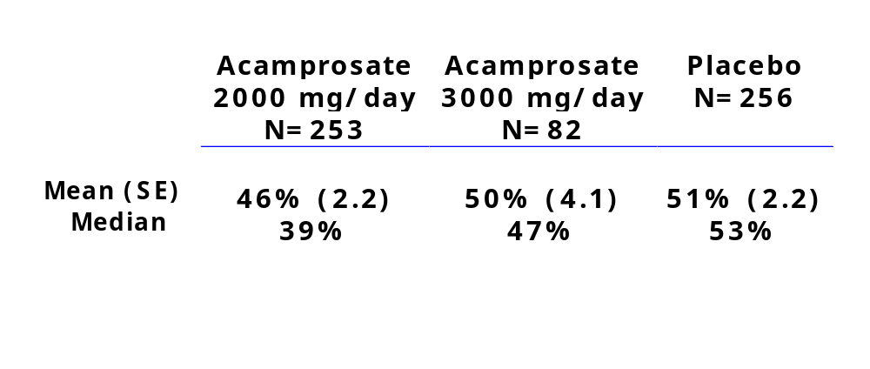
Results: Intent-to-Treat Population
Percent Days Abstinent
Table prepared by reviewer from datasets US_CAD and US_POP using CCADTX
Notes:
Here are the results that I get from the sponsor’s datasets submitted to us for review. Considering the entire ITT population, the mean percent days abstinent for the placebo group was 51%. The small group that was randomized to 3000 mg/day had about the same result, at 50%. The group that got the recommended dose of acamprosate, 2000 mg/day, had a mean percent days abstinent of 46%. Looking at the medians, placebo also outperformed acamprosate.
So, why did this happen? If acamprosate worked in the European studies, why didn’t it seem to work here?

Slide 18
Potential Explanations
European studies required abstinence at baseline
European subjects assumed to have a high level of motivation (required for entry in some studies)
European populations have a low prevalence of polysubstance abuse
Notes:
Here were the simplest and most attractive explanations.
First, the European subjects had been detoxed and were abstinent at baseline, but the American subjects were not required to undergo detox and, probably as a consequence of the current climate in our medical care delivery system, only about 10% of them got it. Furthermore, by the time study medication treatment begain, about half the subjects were actively drinking. So the first idea that springs to mind is that maybe acamprosate is just a relapse prevention agent of some kind--it keeps alcoholics from taking the first drink, but it can’t seem to put the brakes on if someone is actively drinking. So of course, I looked at the subset that was abstinent at baseline, which is about half the subjects.
The second difference was in level of motivation. Some of the European studies actually required as a condition of entry that the subject be committed to abstinence. Others did not, but it’s been assumed that the subjects must have been motivated because they were willing to go through inpatient detox. I’m not sure about that because I don’t know about the health care delivery system in Europe, either now or at the time these studies were done over 10 years ago, and it’s possible that inpatient detox was pretty standard and readily available and that willingness to go into the hospital for three days wasn’t really a marker for high levels of motivation, but let’s say it was. In the American study, subjects were asked to indicate at screening what their goal was for treatment. They could choose from a list that ranged from “total abstinence” to “no goal,” and it included things like “temporary abstinence” and “controlled drinking.” According to Lipha, “most” of the patients were unmotivated because they didn’t choose “total abstinence.” But there was another option on there-- “total abstinence, but I realize a slip is possible,” which I regard as just as motivated as identifying a goal of “total abstinence,” but just a little more realistic. So I put those two together, and that includes 72% of the subjects.
Finally, the high rate of polysubstance abuse in the American trial was striking, given that a positive urine tox for anything other than marijuana was exclusionary. Only PRAMA gives information about other substance abuse history in the subjects--in PRAMA, 20% of the subjects had any history of other drug use. In the U.S. population, only 20% did NOT have a history of illicit drug use of any kind.

Slide 19
Sponsor-Defined Population “Motivated Efficacy Evaluable”
All randomized patients who:
  took double-blind study medication for at least 7 days,
  returned for at least one post-baseline visit,
  did not have a positive urine test for a drug of abuse at any time after randomization,
  were at least 75% compliant for the duration of the treatment phase,
  a had a treatment goal of “complete abstinence”
Includes <30% of randomized population
% days abstinent: 70% acamprosate vs. 63% placebo
Notes:
As you’ve heard, Lipha was able to find a subset that they thought resembled the European population. This population is defined by post-randomization compliance with visits and medication, as well as a treatment goal of “complete abstinence.” In this group, the acamprosate arm had 70% days abstinent and the placebo group had 63%.
The problem here is that this appears to be the only population that demonstrates an effect of acamprosate, and it is defined primarily by post-randomization behavior such as medication compliance and observed use of substances. All post-hoc analyses make us a little uncomfortable, because if you do enough of them, you are bound to find one that comes out significant--which actually makes it particularly worrisome that we couldn’t. But subset analyses, whether post-hoc or plannes, that rely on groups defined by post-randomization factors are particularly troubling. Finding that a drug was particularly effective in a group with a certain set of post-randomization behaviors really doesn’t give us any information we can use for patient selection.
Furthermore, this population definition doesn’t even take into account the issue of abstinence at baseline, which he proposed label indication now indicates is the important feature of patient selection. So I am neither convinced by this finding nor happy with this population definition. As you read, I conducted a series of subset analyses of my own, using populations that seemed to make sense.

Slide 20
Reviewer-Defined Populations:
Based on pre-randomized variables
Abstinent at baseline
Motivated: identified goal of “total abstinence” or “total abstinence but I realize a slip is possible”
Non-polysubstance abusing
  Several definitions possible
  No drug use past year/no drug use past year other than marijuana most useful for analysis
Subjects meeting all three criteria comprise less than 20% of randomized population
Notes:
So these are my analysis populations.
I analyzed the subset of subjects that were abstinent for at least 5 days at baseline, the subset that identified a goal of abstinence, whether or not they indicated that they realized a slip was possible, and I tried to figure out the best way to define the non-polysubtance abusing population. There was something called an “illicit drug use index” calculated for each subject--if they had no history whatsoever of illicit drug use, that was 0. So I looked at that group but it was very small--about 20% of the randomized population. I decided that past year drug use was probably a reasonable indicator of current polysubstance abuse, so I looked at the group with no illicit drugs in the past year. This enlarged the subset to about 40% of the randomized population. But because subjects were excluded for tox screens positive for anything other than marijuana, looking at the group that had no past-year use of anything EXCEPT marijuana gave me 80% of the randomized population. I should note that we asked Lipha to broaden the inclusion criteria to allow for a positive tox for marijuana at entry, because we were concerned that the actual target population probably had a pretty high prevalence of polysubstance abuse. And I guess we were right. People were screened out for current dependence on any substance other than alcohol, and for urines positive for anything else, and despite this, we have a population where 14% had a history of opiate use and 49% had a history of cocaine use.
I also looked at the results of the urine toxes done during the study, but I am not very convinced that is useful. With monthly study visits, tox screens are unlikely to pick up all the illicit drug use in the study. Furthermore, nothing can be predicted about the results of urine tox screens that were not done because subjects dropped out of the study. Therefore, selecting subjects who lacked urine tox evidence of drug use does not necessarily select a population that did not use drugs during the study or was not prone to do so after study discontinuation. In addition, urine tox data is only included for 525 subjects.
Ultimately, I decided to focus on the subjects whose only illicit drug use in the past year had been marijuana. From now on, when I say, “no past year illicit drug use,” I’m actually going to be referring to subjects who used no illicit drugs OTHER THAN MARIJUANA.
And then I put together the subset that was abstinent at baseline, motivated, and had no past year illicit drug use, which was a small group.

Slide 21
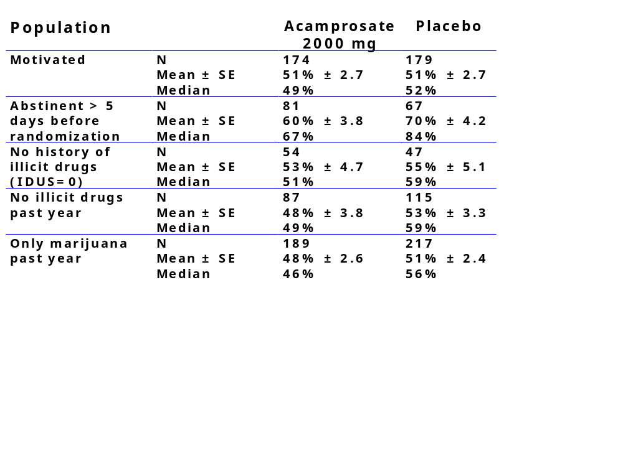
Results: % Days Abstinent
No Explanation Based on Pre-Randomization Variables
Notes:
And here are my results. You’ll see that no subset I analyzed demonstrated a better result on percent days abstinent for the acamprosate group than the placebo group. These are actually all going in the wrong direction. I have to say that going into this I was really hoping that the rubber was going to meet the road somewhere--that I was going to be able to say, “Aha! It only works in pure alcoholics!” Or “See, as long as you’re abstinent at baseline, it works.” Unfortunately, these analyses just don’t bear out any conclusion about patient selection that suggest why acamprosate didn’t work in this study.

Slide 22
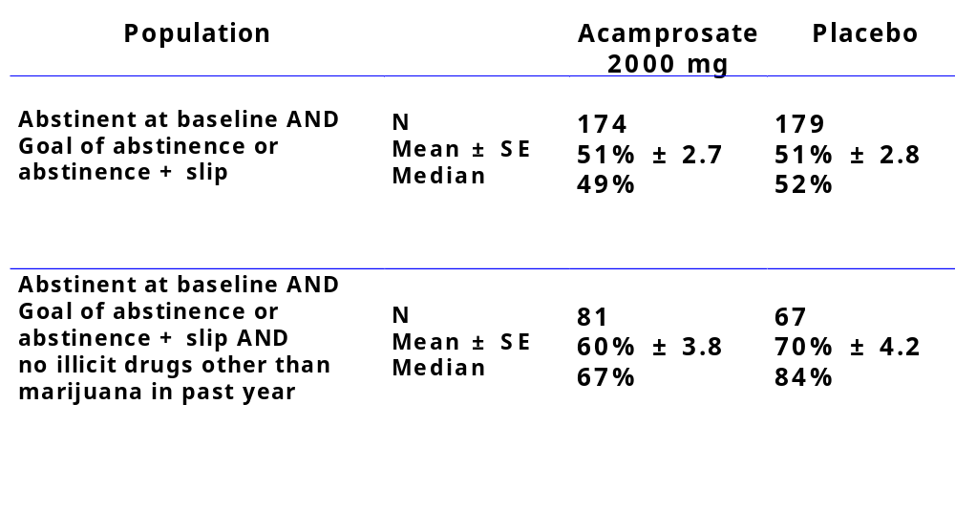
Results: No Explanation in Motivated/Abstinent Subsets
Notes:
And looking at the subset that was abstinent AND motivated, and the subset that was abstinent, motivated AND had no past year illicit drug use, I still could not find an effect of acamprosate.

Slide 23
Other Measures
Complete Abstinence
Categorical Analysis of “Good Response”
Notes:
I looked at a few other measures, too. Complete abstinence was not very useful because there were so few subjects--33, to be exact--who were abstinent for the entire trial--and 20 of them were on placebo. A categorical analysis of “good response, which looked at how many subjects had at least 90% days abstinent was interesting, because the sponsor-defined motivated ITT population showed the acamprosate group coming out the same as the placebo group, and the sponsor-defined motivated efficacy-evaluable population actually showed acamprosate BEATING placebo, but as it turned out, my analysis populations didn’t fare as well. The placebo group did better than the acamprosate group in all the populations I tried.

Slide 24
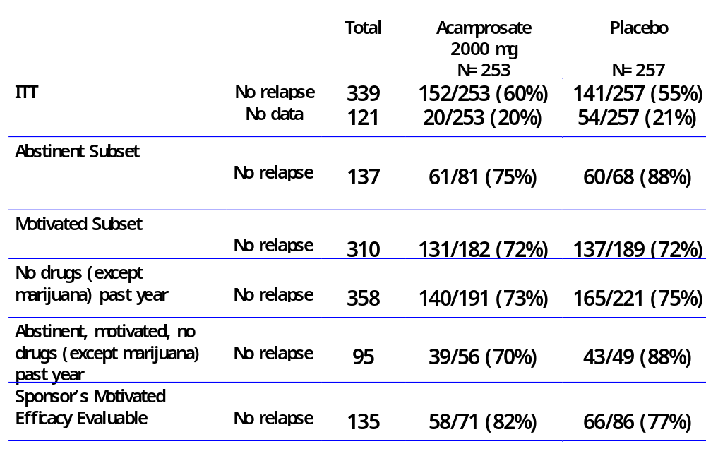
Abstinence From Sustained
Heavy Drinking
Table prepared by reviewer from datasets US_RELAP, US_POP
Notes:
.
So next I looked at a fairly liberal definition of success. There was a dataset in which relapse was flagged “if the patient relapsed into having at least 5 drinks a day for 5 of the next 7 days.” So I took a look at how many subjects never had a relapse as so defined. Success by this criterion is fairly common. In this slide, you’ll see that the ITT population looks slightly promising, but neither the abstinent subset, the motivated subset, the no past year illicit drugs subset, nor the group that met all three criteria show an effect of acamprosate on this measure. It is interesting to note that the sponsor-defined motivated efficacy evaluable population does, though.

Slide 25
Other Explorations
Drinking History: Very Heavy Drinkers
Drinking History +
  motivation
  baseline abstinence
  no past year illicit drug use
Notes:
Just in case I missed something, I pored over the demographics from the different trials to find another explanation.
I looked at drinking history, and I noted that the duration of alcohol dependence was not terribly dissimilar across studies, but the American population contained many fewer people in the >10 drinks/drinking day category. About 30% of the subjects were in this category in the American study, while in the European studies, the very heavy drinkers in the various treatment groups ranged from a low of 64% to a high of 87%, and all three European studies had a similar number. But whether I looked at all the very heavy drinkers, or the motivated ones, or the ones who were abstinent at baseline, or the ones who were motivated, abstinent, and had no past year illicit drug use, there was no effect of acamprosate on the percent days abstinent.

Slide 26
Summary
European studies indicate effect of acamprosate on continuous or non-continuous abstinence
U.S. study data does not demonstrate efficacy of acamprosate in any subset defined by pre-randomization variables meaningful for patient selection
Notes:
In summary, the European studies indicate an effect of acamprosate on either continuous abstinence or non-continuous abstinence, while the American study data does not demonstrate the efficacy of acamprosate in any subset defined by pre-randomization variables that would be useful for patient selection.

Slide 27
Questions
Can the discrepant results between the older, European studies and the more recently conducted American study be reconciled?
Do the data support any conclusions regarding subgroups of patients more likely to benefit from acamprosate?
Given the conflicting results, is there sufficient evidence of the efficacy of acamprosate in the treatment of alcoholism to warrant approval?
Notes:
So I’ll put the questions back up here. I’ve gone through some of the concerns about the data from the European trials--the non-systematic data collection, the low frequency of study visits, and some of the ways in which the European trial populations differed from the American population. Then I went through the exploratory analyses I undertook to try to select a subgroup from the American study who resembled the European subjects on important measures such as level of motivation, baseline drinking status, and polysubstance abuse. And I showed you that I was not able to identify any population that demonstrated an effect of acamprosate on measures of percent days abstinent, categorical “good” response, or even the fairly low bar of surviving the trial without 5 heavy drinking days in a single week.
So I’ll reiterate my way of looking at the questions we’ve posed to you:
“In view of the failure of the carefully-conducted American trial, which we are unable to explain through analyses directed at various sub-populations, can we accept the findings from the European studies, knowing that the data was collected much less systematically?”

