Slide 1
SMD Research Program
-- Science AOs and Grants --
Paul Hertz
Chief Scientist
Science Mission Directorate
Planning Conference
Science Subcommittees, NASA Advisory Council
May 3-4, 2006

Slide 2
Research Program
Research is a part of everything we do, and it is a part of every budget line
Research and Data Analysis (R&DA)
  Research and Analysis (R&A)
  Supporting Research and Technology (SR&T)
  Suborbital Investigations (Aircraft, Balloon, Sounding Rocket)
  Data Analysis (DA) (includes General Observers - GO)
Missions
  Development (including PI-led mission development and PI-led instrument development)
  Operations (including science operations and data processing)
  Science Teams (including Participating Scientists and Interdisciplinary Scientists)

Slide 3
Principles for the Research Program
Scientific merit through peer review
  Use scientific merit, as determined through community and peer review, as the primary criterion for science program planning and resource commitment.
Timely availability of data
  Ensure vigorous and timely interpretation of mission data, requiring that data acquired be made publicly available as soon as possible after scientific validation.
Community participation
  Ensure the active participation of the research community outside NASA, which is critical to success.
Maintain NASA capabilities
  Maintain essential technical capabilities at the NASA Centers.

Slide 4
Solicitations - AOs
Announcements of Opportunity
  Used to solicit science investigations requiring the development of flight hardware up to and including a complete mission from formulation through operation and data analysis
  Used when NASA is requesting science investigations rather than instruments meeting specific technical specifications
    Otherwise use Request for Proposals (RFP)
  PI-led mission AOs (investigations involving complete missions)
    Explorer, Discovery, ESSP, Mars Scout, New Frontiers
  Instruments for Strategic Missions (investigations involving instruments and science team members)
    Lunar Reconnaissance Orbiter Instruments
    Mars Science Laboratory Instruments
    Radiation Belt Storm Probes Instruments

Slide 5
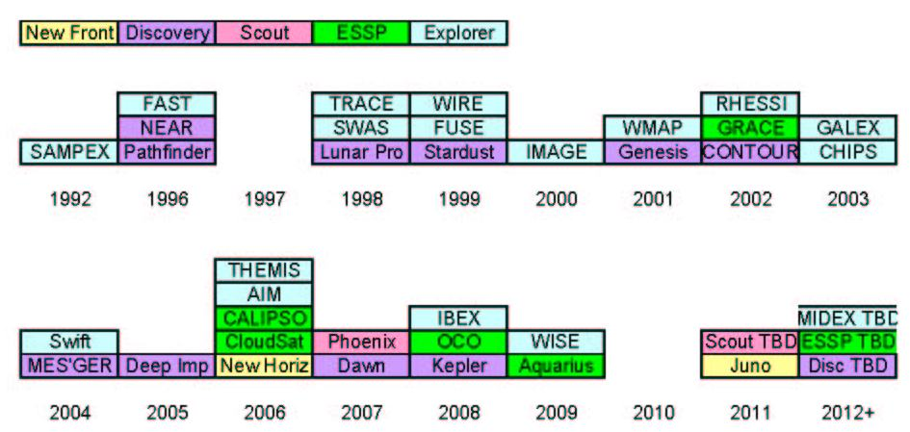
PI-led Mission Launches

Slide 6
PI-led Mission AOs
Discovery
  Budget includes development, operations, and competed data analysis program (Discovery DAP)
  Budget approx $270M per year (through FY08) growing to $310M per year (in FY11)
  2006 AO closed April 5, cost cap $425M (FY06)
Explorer
  Budget includes development and prime mission operations
  Budget approx $210M per year (FY05-FY06), $150M per year (FY07-FY09), rebounding to $190M per year (in FY11)
  Next AO (MIDEX) no earlier than FY2008

Slide 7
PI-Led Mission AOs
ESSP
  Budget includes development and operations
  Budget approx $120M per year (through FY09) growing to $200M per year (in FY11)
  Next AO no earlier than FY2008
Mars Scout
  Budget a component of overall Mars Exploration budget
  AO released on May 1, proposals due on August 1, cost cap $475M (FY06)
New Frontiers
  Budget includes development and operations
  Budget approx $155M per year (through FY08) growing to $250M per year (in FY10)
  Next AO no earlier than FY2008

Slide 8
Solicitations - NRAs
NASA Research Announcements
Research Opportunities in Space and Earth Sciences
  SMD’s Omnibus NRA
  Used to solicit virtually all non-flight opportunities
  ROSES-06 has 64 program elements (so far)
Solicit R&DA plus science teams
  R&A (e.g. Solar and Heliospheric Physics)
  SR&T (e.g. Advanced Component Technology)
  Suborbital (e.g. Atmospheric Composition TC4)
  DA (e.g. Cassini Data Analysis)
  GO (e.g. GALEX Guest Investigator)
  Science Teams (e.g. MRO Participating Scientists)
  Multi-mission science integration (e.g. Earth System Science Research using Data Products from EOS Satellites)
  Earth science applications (e.g. Decision Support)

Slide 9
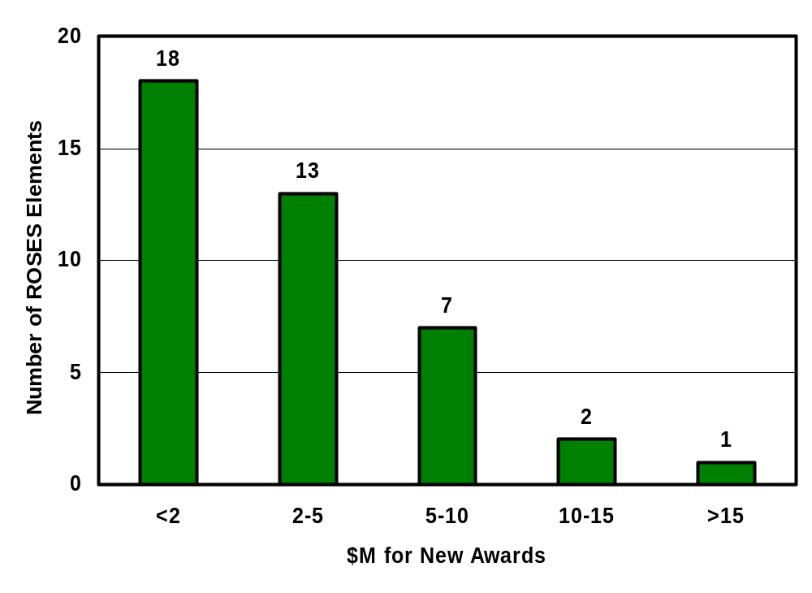
ROSES Funding Available
Total: ~$150M
(41 program elements)

Slide 10
Research Budget
Research is part of everything we do, and it is a part of every budget line
  Budget is distributed as a component of every program and every project
  Different divisions bookkeep their research budgets in different ways
    E.g. Science teams can be embedded in individual flight projects or funded from a research project – some are R&A, some are not
    E.g. Data analysis can be embedded in individual flight projects or funded from a research project – some are R&A, some are not
Research is a “program line” in the NASA budget
  R&A is only one “project” in the “program”
  Mission operations
  Data analysis
  Suborbital projects
  Data archives
  Etc.

Slide 11
Research Budget
The following budget chart aggregates the competed SMD research budget excluding flight hardware development
Traditional R&A
  R&A project (each Division has one)
  R&A embedded in flight programs (e.g. Mars, Living With a Star, Beyond Einstein)
  Technology distributed
Data analysis (other than traditional R&A)
  General Observer/Guest Investigator programs
  Archival data analysis programs
  Mission or program specific data analysis programs
  Data archive, virtual observatory, etc.
Science Teams (other than traditional R&A)
  PI teams for missions and instruments selected through AO
  Additional team members selected through competition
    Participating scientists, interdisciplinary scientists, science working group members, etc.

Slide 12
Research from Flagship Missions
Development and operation of “Flagship Missions”
  Flagship missions enable NASA to meet science objectives
  Significant community funding is associated with large missions
    Hubble Space Telescope: Development of instruments provided over $1.2B to 10 instrument teams; Observing enabled 6510 GO grants over 15 years providing $283M to 4138 investigators, 1323 postdocs, 1852 grad students.
    Earth Observing System missions provided $1.6B in funding over 14 years to 781 investigators, 112 postdocs, 159 grad students for algorithm development, IDS investigations, cal/val investigations.
    Spitzer Space Telescope: Science operations provided $100M to 318 investigators over 6 years for science team and general observers.
    Cassini: Science operations provided $200M over 9 years to 125 investigators, 120 postdocs and grad students for science development and data analysis.
  All funding is peer reviewed and selected through AOs, NRAs, Calls for Proposals (observing), or unsolicited but peer reviewed proposals.

Slide 13
SMD Research Budget
"Standard" R&A | FY05 | FY06 | FY07 | FY08-11 (average per year)
Astrophysics | 60 | 60 | 50 | 50
Heliophysics | 30 | 30 | 30 | 30
Planet Sci (w/ astrobiology) | 150 | 130 | 100 | 110
Earth Science | 200 | 170 | 160 | 180
Other R&DA (w/ science teams)
Astrophysics | 170 | 170 | 150 | 120
Heliophysics | 80 | 90 | 120 | 100
Planetary Sci (w/ Mars) | 130 | 140 | 150 | 130
Earth Science | 270 | 270 | 290 | 310
SMD Total | 1090 | 1060 | 1050 | 1050
Notes
  Totals are approximate and illustrative only
  Only “Standard” R&A was reduced by 15%
  Does not include development (missions, instruments)
  Out year (FY07-FY11) “Other R&DA” budgets are incomplete due to (a) missions that have not yet been extended, (b) unselected missions

Slide 14
Science Enabled by Exploration
The NASA human space exploration program will create science opportunities
  Near-term: Robotic lunar exploration
  Next decade: Human sorties to the Moon
  Long-term: Extended human lunar missions, human missions to Mars and other destinations
SMD will fund science enabled by the Exploration program using established principles
  Execute the most compelling and highest priority science
  Take advantage of all appropriate opportunities
  Prioritized in the context of the existing science program
    since the funds come from the same pool
  Set priorities jointly with the science community
    through strategic planning and peer review
  Use open competition and peer review

Slide 15
Space Studies Board Lunar Study
SMD has asked the NRC Space Studies Board to undertake a study on lunar science priorities
  Study serves as statement of community interest in lunar science
  Provides a comprehensive, well-validated, and prioritized set of scientific research objectives for the Moon
  Anticipates science value in the context of the rest of the SMD science portfolio
  Interim release by August 2006 to support ongoing activities
  Final report by May 2007
Study will provide long range science objectives to frame decisions on lunar enabled opportunities
  In the context of established science priorities

Slide 16
“Suitcase Science”
First opportunities enabled by human lunar exploration will be small, autonomous experiments deployed by astronauts during first lunar sorties
  Resource constrained
  Analogous to ALSEP – Apollo Lunar Surface Experiment Package
  AKA “Suitcase science”
SMD is planning to solicit concept studies this year for suitcase science investigations
  Science priorities set by decadal surveys & NASA roadmaps
  Concept study would identify resource requirements -- potentially provide input to exploration architecture
  Concept study would identify technology or other R&D required

Slide 17
“Suitcase Science”
SMD is planning to solicit concept studies this year for suitcase science investigations
  Evaluation criteria would include
    Compelling nature of science in context of national science priorities
    Justification of need for human deployment and lunar surface location
    Reasonableness of estimated resource requirements
    Relevance to NASA
  Select 5-10 investigations for 1 year
Solicitation will be issued as a ROSES program element
  Draft solicitation ready to go
  Reasons to go:
    Potential impact on lunar architecture
    Engage science community in thinking about high priority science on the Moon
  Reasons to delay:
    SSB study pending

Slide 18
Backup

Slide 19
Near Term AO Schedule
2005
  Radiation Belt Storm Probes (instruments)
2006
  Discovery (missions)
  Mars Scout (missions)
2007 or later
  Explorer (MIDEX missions)
  ESSP (missions)
  New Frontiers
  Other opportunities

Slide 20
Research & Data Analysis
R&DA includes basic and applied supporting research and technology in space and Earth sciences, including
  theory, modeling, and analysis of data;
  aircraft, stratospheric balloon, and suborbital rocket investigations;
  development of experiment techniques suitable for future missions;
  development of concepts for future missions;
  development of advanced technologies relevant to missions;
  development of techniques for and the lab analysis of both extraterrestrial and terrestrial samples that support missions;
  determination of atomic and composition parameters needed to analyze space data as well as samples from the Earth or space;
  Earth surface observations and field campaigns that support missions;
  development of integrated Earth system models;
  development of systems for applying Earth science research data to societal needs; and
  development of applied information systems applicable to SMD objectives and data.

Slide 21
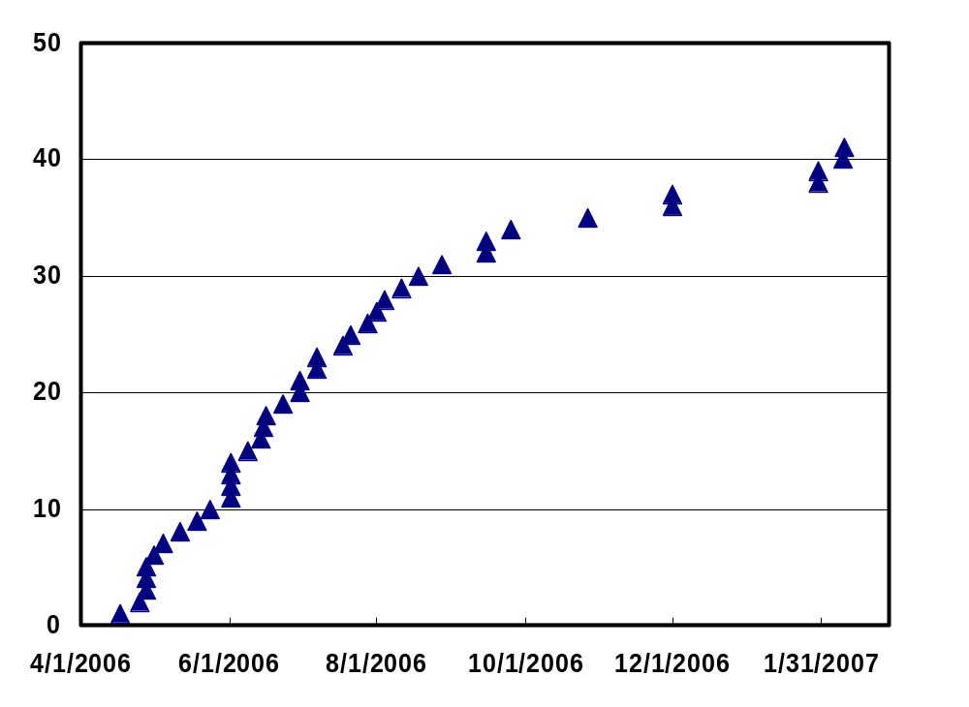
ROSES Due Dates

