Slide 1
Tax Year 2007
Volunteer Training
Introduction &
Administrative
Guidelines
Notes:
This lesson contain information for all courses and has been updated for Tax Year 2007.
References:
Publication 678, Student Kit (content)
Publication 678W, Student Practice Problems
Form 13614, Intake and Interview Sheet
Form 13615, Volunteer Agreement/Standards of Conduct
Form 13645, Wallet Card
Publication 17, Guide to Federal Taxes for Individuals
Publication 4012, Volunteer Reference Guide
Volunteer Protection Act
Forms and Instructions for 1040, 1040A, and 1040EZ
Table of Contents (Publication 678)
Publication 4475 (DVD/VHS)—Interview Techniques (An AICPA and IRS 2006 Production)
Publication 4299, Privacy & Confidentiality Booklet
Publication 1915, Understanding Your IRS ITIN
Tell the students what will be discussed in this lesson:
An introduction to the course and lesson features
VITA/TCE process
Your rights, responsibilities, and resources
Progress to the next slide.

Slide 2
VITA/TCE Course Objectives
Solicit appropriate information from taxpayers to complete an accurate return
Determine if the taxpayer should/must file
a return
Complete and file returns accurately (including worksheets and schedules) within the scope of VITA/TCE
Respond accurately to taxpayer inquiries
Test and become a certified return preparer
Notes:
State the objectives listed on the slide.
Progress to the next slide.

Slide 3
Course Introduction
The VITA/TCE Courses
    Basic
    Intermediate
    Advanced
    Military
    International
Notes:
Describe the different levels of instruction.
Point out that learning can be reinforced by using Link & Learn Taxes.
Progress to the next slide.

Slide 4
Training Kit
Publication 678
Publication 678W
Publication 6744 – Test/Retest
Publication 4012 – Volunteer
Resource Guide
Form 13222 – Evaluation
Notes:
Offer overview of importance of each component.
Progress to the next slide.

Slide 5
Draft Copies
Forms in Publication 678 are “draft copies”
Final copies—www.irs.gov
Note: Final forms may differ—make sure you understand the reasons for the changes before helping taxpayers
Notes:
Explain that the forms in the lessons are drafts as of the date shown in the watermark, when the training material went to print. The official products, including forms and instructions, are available now on www.irs.gov.
Progress to the next slide.

Slide 6
Lesson Features
Objectives
Interview, Quality Review, and Reference Tools
Sidebars – Alerts and Pitfalls
Problems, Exercises, and Exhibits
Summing Up the Lesson
Notes:
Explain the components that make up each lesson.
Progress to the next slide.

Slide 7
Volunteer Testing
& Certification
“Assist only with returns, supporting schedules, and forms
in the scope of your training
and certification.”
Notes:
Reintroduce the test/retest booklet (Form 6744 in their kit).
Explain to students that preparing returns beyond their training and certification may result in errors and cause difficulties for those they wish to help—delayed returns, audits, time-off from work, etc.
Encourage students to refer taxpayers with difficult returns with issues beyond their training and certification to the site coordinator and/or a paid preparer.
Explain that “trained and certified” means they have met the training requirements to be a volunteer return preparer, passed the required test, and their signed Volunteer Agreement/Standards of Conduct—Form 13615—is on file with their sponsor/site coordinator.
Introduce the students to the on-line test options on Link & Learn Taxes.
Share your plans for administrating the test at this time.
Progress to the next slide.

Slide 8
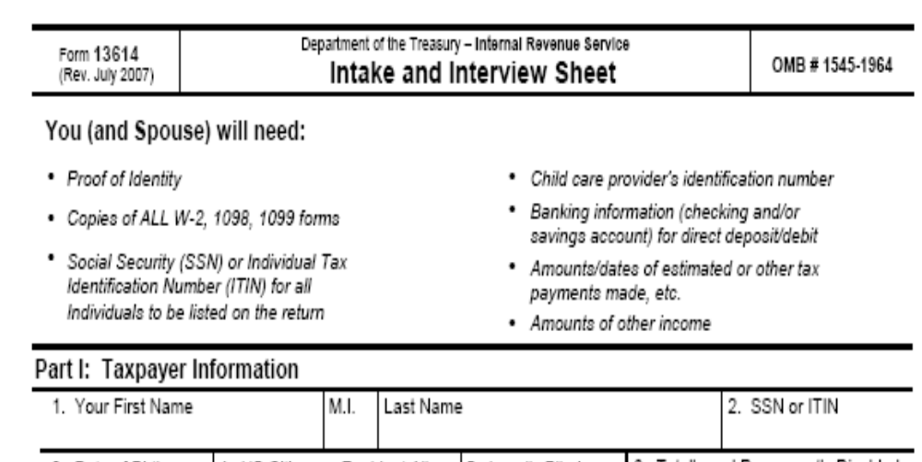
Screening & Probing Interviews
Notes:
Reintroduce Form 13614 in Publication 4012.
Form 13614 or equivalent should be the beginning of your collaboration with your taxpayer in building an accurate quality return.
The taxpayer will complete the first page and together you will complete the second page.
Never assume; always ask. Listen, probe, and follow up.
You are encouraged to use the Publication 4012 decision trees, interview tips, and other information to accurately complete the return.
Progress to the next slide.

Slide 9
Five-Step Interview Process
Put the Taxpayer at ease
Use Active Listening
Explain the Return Preparation Process
Engage around the Intake Sheet
Be alert to next steps—
  Quality Review, Filing, Records, etc.
Notes:
Discuss the Five-Step Interview Process.
Explain and demonstrate how the information in Publication 4012 and Form 13614 contribute to a successful interview and a quality return.
Show the Interviewing Techniques DVD—Publication 4475. (Contact your IRS coordinator for information about this video produced by the AICPA and IRS.)
Summarize the intake and interview process using the information in the text.
Note: You might do your own role-play activity.
Discuss the return prep process including filing, quality review, record keeping, etc.
Progress to the next slide.

Slide 10
Screening & Probing Interview
Involve the taxpayer
Ask questions to clarify responses
Listen
Use decision trees
Use reference materials
Verify
Notes:
Restate the importance of getting accurate and appropriate information from the taxpayer.
Ask the students to state some of the tools available to accomplish this task.
Inform students that it is also important to provide accurate information to the taxpayer.
Reintroduce some of the key technical sources of information at the site ( i.e., the site coordinator, returning volunteers, Publications 17, 4012, etc.).
Progress to the next slide.

Slide 11
Critical Intake Documents
Taxpayer Identity
Income Reporting
Taxpayer Identification Numbers (TIN)
Notes:
Explain the importance of this documentation.
Explain alternative steps if the documentation is not available.
Progress to the next slide.

Slide 12
Quality Review
All returns prepared should have a Quality Review. The review can be:
Self review
Peer review
Designated reviewer
Notes:
Explain the importance of the Quality Review process.
Explain how the three types of review work.
Progress to the next slide.

Slide 13
Scope of Program
Returns should only be prepared that are
Within the scope of the VITA/TCE program, and
Within the certified competence of the volunteer.
Notes:
Emphasize the need to conform to the
Scope of the program
Level of training and certification received
Progress to the next slide.

Slide 14
Rights and Responsibilities
Volunteer Protection Act
Standards of Conduct
Privacy and Confidentiality
Program Integrity
Volunteer Site Credentials
Site Identification Number
Notes:
Explain to the students the provisions and scope of the Volunteer Protection Act. Caution the students to gracefully decline any token of appreciation offered by a taxpayer while acknowledging the generous intention.
Note that the Standards of Conduct will be discussed in detail on the next slide.
Refer students with privacy questions to Publication 4299, Privacy and Confidentiality.
Refer student to their site coordinator on issues involving Program Integrity.
Discuss the wallet cards.
Explain the importance of the SIDN.
Progress to the next slide.

Slide 15
Standards of Conduct
Treat taxpayers professionally
Protect and use equipment
and supplies (as prescribed)
Do not accept payment
Do not solicit funds
Notes:
Introduce the Volunteer Agreement/Standards of Conduct in Form 6744.
Explain to students that all volunteers must sign Form 13615 (even those who do not prepare returns).
Discuss each standard and seek comments and understanding from the class.
Advise students that no one (volunteers or taxpayers) can be subject to discrimination or denied services because of race, color, sex, national origin, disability, reprisal, or age.
Seek comments regarding the potential ramifications of the action taken by the VITA/TCE volunteer in the alert.
Progress to the next slide.

Slide 16
Resources
E-File software—TaxWise®
Publications 4012 and 17
Intake and Interview Sheet
Volunteer Hotline and Quality Alerts
Instruction booklets and worksheets
Equipment and supplies
Notes:
Provide a description of each of the resource tools available to the volunteer and indicate where they would find any and all of the following:
• TaxWise—Software Edits and Diagnostics
• Publication 17—Tax Law with examples of taxpayer situations
• Publication 4012—Decision Trees, Interview Tips, Eligibility & Limitation Charts
• Intake & Interview Sheet—begins the collaboration with the taxpayer in preparing the return
• Volunteer Hotline—1-800-429-8482—for volunteers ONLY
• Quality Alerts—Tax Law Highlights on Key Topics
• Instructions & forms—detailed information about completing forms & schedules
• Equipment & supplies—computers, forms, and other supplies provided by the local IRS SPEC office
Progress to the next slide.

Slide 17
Summary
Your rights and responsibilities
Taxpayers’ rights and expectations
Stay in scope
Don’t assume—interview and probe
Review quality
Utilize all of your resources
Notes:
Note: The information in this lesson sets the stage for the course.
Explain: Volunteers should understand the importance of the services they provide and that there are ramifications for intentional misdeeds as a VITA/TCE volunteer.
A quality return is complete and accurate. To achieve this goal, each return should receive a quality review and all the information should be confirmed with the taxpayer—DON’T ASSUME.
Progress to the next slide.

