Slide 1

South Central California Coast Steelhead DPS Recovery Workshop
Carmel – April 25 & 26, 2007

Slide 2
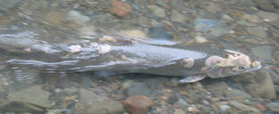
Welcome & Introduction
Topic: Recovery of Threatened South-Central California Coast Steelhead
Introduction of NOAA Fisheries Southwest Region Staff

Slide 3
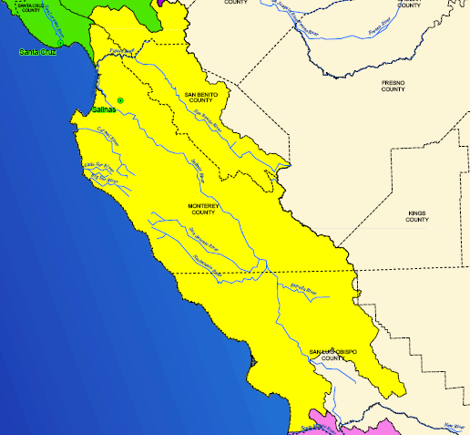
Recovery Workshops
Twelve workshops between April 4 and late July
3 each at Carlsbad, Ventura, San Luis Obispo, and Carmel
Workshop topics:
  #1 TRT products/Threats Assessment
  #2 Recovery Actions
  #3 draft Recovery Plan

Slide 4
Recovery Planning
Phase I = Scientific Inquiry Process
(1) Technical Recovery Team
(2) Historic Population Characterization
(3) Viability Report (comments due 4/30)
Phase II = Use Phase 1 results to develop Recovery Plan
(1) Limiting Factors/Threats
(2) Recovery Actions
(3) Recovery Plan

Slide 5
Workshop Objectives
Share information about the Technical Recovery Team’s scientific findings and recommendations
Explain Recovery Planning process
Solicit your feedback on known or suspected threats to steelhead
Solicit your feedback on prioritization of the threats to steelhead
.

Slide 6
Recovery Planning Goals
Defining population and range-wide viability
Completing an analysis of threats to the species
Identifying site-specific management actions
Establishing measurable criteria to ensure actions reduce or eliminate the identified threats sufficiently to recover the fish so they no longer require the protection of the ESA

Slide 7
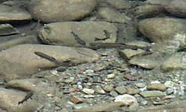
Goal of This Workshop
Confirm the threats faced by steelhead in this area
This afternoon – TRT product presentation and discussion
Tomorrow 9am - 4pm focus on the threats to steelhead

Slide 8
What This Workshop Is Not
Opinions on ESA
Whether steelhead should be listed or not
NOAA’s role in enforcement of the ESA
Specific interactions NOAA Fisheries has with each stakeholder

Slide 9
Process & Format (agenda)
Day 1
Recovery Planning
TRT Viability Report and Recommendations
Questions and Answers
Day 2
Threats Assessment Process
Breakout Sessions on Threats
Plenary on Threats and Follow up

Slide 10
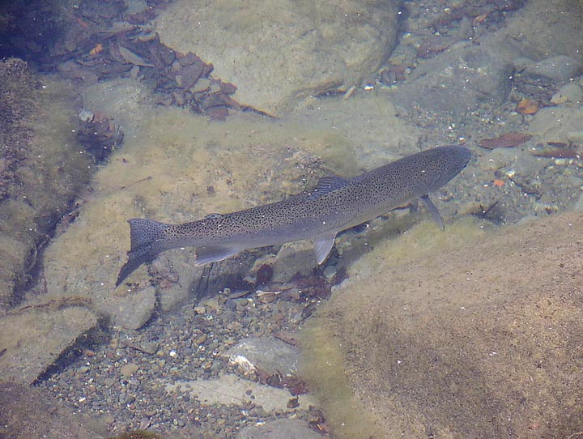
Comments & Feedback
Workshop Participation – recording questions
Workshop Comment Cards
Regular Mail
E-mail
Public comment period once draft Plans are out

Slide 11
Importance of Your Participation
Plan with broad public support has the greatest likelihood successful implementation
Increase certainty to interested parties by providing information useful for organizational planning, timelines, and cost estimates for recovery actions
A broadly supported plan is likely to be more competitive for limited public funding than a plan serving narrow interests

Slide 12
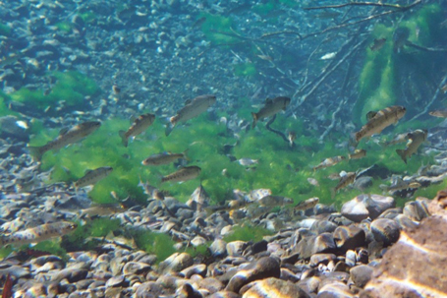

Slide 13
Ground Rules/Process Agreements
Honor the meeting agenda or change by agreement
Listen carefully to speakers (mute cell phones)
Focus on issues, not people
Be recognized before speaking
Monitor your speaking time to allow others a chance to speak
Avoid side conversations (please leave the room)
During the Q & A sessions, we’ll take follow-up questions once all participants have had a chance to ask their initial question

