Slide 1


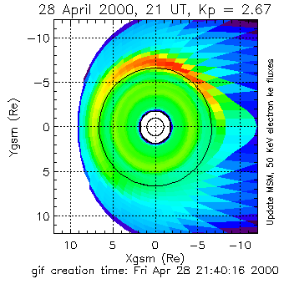
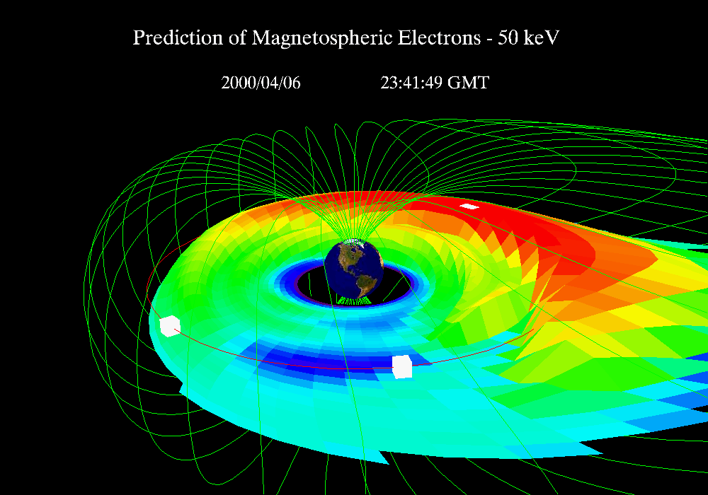
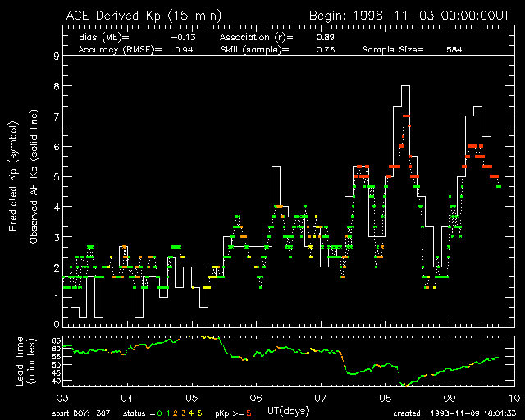
Rapid Prototyping Center
Terry Onsager, Kent Doggett, Kelly Prendergast, Susan Sahm, Jim Vickroy
NOAA Space Environment Center
Operational Nowcast of the Magnetosphere
Abstract
Some Key Issues
Models Currently Under Consideration
The Rapid Prototyping Center (RPC) consists of software, hardware, and procedures for software development and testing that strive to make new models and data available for Space Weather Operations in an efficient and easily maintainable way. The RPC process includes multiple stages, ranging from the selection of new models/data from numerous candidates, to the testing of new products in an operational environment, and then the final transition to fully supported operational execution. Current activities at SEC include models/data at all stages of this progression from research to operations.
Need to handle many models and data streams
Want a software framework with the functionality models need, into which new models can be inserted
Want to isolate model execution from the details of databases, visualization, and verification
Need to have confidence that operational software is tested, robust, and easily maintainable
Want to insure that the effort devoted to each new model improves the efficiency for future models
Magnetospheric Specification Model
Rice University/USAF
Background Solar Wind (Wang-Sheeley/Arge & Pizzo)
Magnetopause Location (Shue/Detman)
Auroral Electrojets (Real-time AMIE)
Solar Spectrum (SOLAR2000)
Storm-time Electron Density
Coupled Thermosphere/Ionosphere
Inputs:
Kp (USAF)
Availability:
External Web
Cadence:
Three Hours
Target Space Weather Models
Prediction of Magnetospheric Electron Flux
Estimated Effort to Transition New Models
Goals of the RPC Project
Solar Activity
Magnetosphere
Atmosphere
Maintain and extend software environments (2 FTE’s)
- Manage and extend development and operational
environments
- Implement new models (approximately 2 per year)
Administer selection/transition process - RPC staff: (0.25 FTE among 6 people)
- Solicit questionnaire
- Determine cost versus value of proposed models and prioritize
- Define initial concepts of operations
- Identify internal participants
- Draft proposal to Management Team
- Monitor progress and insure completion
Solar Protons
Solar Wind
Ionosphere
Magnetospheric Specification Model
Rice University/USAF
Make new models and data available for Space Weather Operations - in an efficient and easily maintainable way
Establish and continually improve our software and hardware framework to ingest, test, and graduate new models and data into operations
Follow a process for software development
Follow a process for model selection and graduation to operations
Background Solar Wind
Inputs:
Predicted Kp
Availability:
External Web
Cadence:
One hour
CME Propagation
Ring Current/Radiation Belts
Geomagnetic Indices
Electrojet Currents
Global Magnetospheric Simulations
Ionospheric HF Absorbtion
Coupled Thermosphere -Ionosphere
Neural Network Prediction of Kp from Solar Wind
Responsibilities of internal participants (level of effort model dependent - estimate to be provide in proposal to management team)
- Work with external researchers, if required
- Assist in bring the model up on our computers
- Provide the model validation based on archived data
- Define and evaluate operational validation – i.e.,
continuous measures of performance
- Define concept of operations
- Recommend graduation or other action
- Provide documentation and user manual
Motivation
Internal Process for Selecting New Models
There is interagency consensus that the transition of research models into operations is critical and timely, and that SEC will have a important role in this effort. Many international and interagency programs are developing models for transition to operations.
Kirt Costello, Rice University
Inputs:
Vsw, B, Bz (ACE)
Availability:
External Web
Cadence:
15 minutes
Solicit questionnaire from modeler – available on Web
Internal evaluation of models based on three main categories:
- Strategic Importance to SEC
- Operational Significance
- Implementation Readiness
Estimate cost/benefit to transition to operations
Make recommendation to management for selection
Develop test product and being long-term validation
Evaluate for final transition to operations
National Space Weather Program
“Success of the National Space Weather Program requires that models generated by the research community be incorporated into operational models of use to forecasters and/or external customers.”
National Security Space Architecture Study
Community Coordinated Modeling Center
NOAA’s view: space weather services will improve as numerical guidance is increasingly used
- Data assimilation, large-scale global models, neural networks, empirical algorithms, ...

