Slide 1
NWS Performance Management System
DRAFT PLAN
FY06 Q2

Slide 2
Introduction
Needed: comprehensive performance management system for products and services.
System should provide for:
Development, reporting, and interpretation of key measures and indicators related to the quality, timeliness, accuracy, and usefulness of products and services.
Identification of significant performance trends to find successes and address deficiencies.
3. Useful and meaningful information and feedback for forecasters, managers, partners, and customers.

Slide 3
National Performance Management Committee
NWS has been successful at measuring and reporting on some mission-critical program elements, however, we can improve. We need:
  A performance improvement system to adequately analyze trends and identify causative factors for changes in performance at the operations level.
  A framework for better management decisions at the strategic level and a foundation for true performance improvement at the job level.
To assist in the planning and executing of these improvements, the National Performance Management Committee (NPMC) was chartered.

Slide 4
NPMC Mission
To establish a focused process to:
Identify needs in verification/monitoring/evaluation
Validate those needs as agency requirements
Plan projects to meet those requirements
Manage related projects effectively (scope, time, cost)
Implement results in a proactive way to keep performance management in step with growth and change in NWS products and services.

Slide 5
NPMC Vision
To foster the development of a system to verify all sensible weather elements forecast in order to measure forecast and service performance.
Identify and bridge performance gaps and capitalize on successes.
Provide meaningful information and feedback for forecasters, managers, and other users.

Slide 6
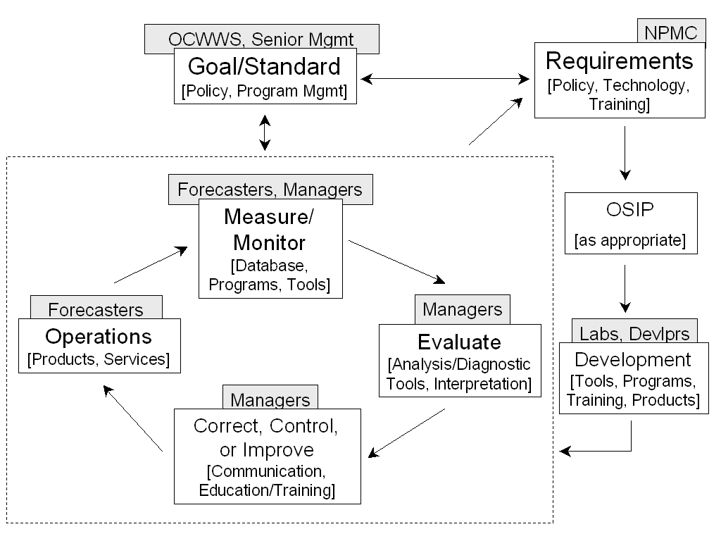
NPMC Concept: A Model for
Continuous Improvement

Slide 7
NPMC Functions
Solicit requirements for verification, monitoring, and evaluation needs.
Coordinate requirements with the service branch (or other appropriate authority) for validation.
Develop project plans to address requirements.
Prioritize projects.
Assist in the development of OSIP documents.
Participate in project prototyping.
Monitor progress of projects through implementation.
Solicit feedback on completed projects.

Slide 8
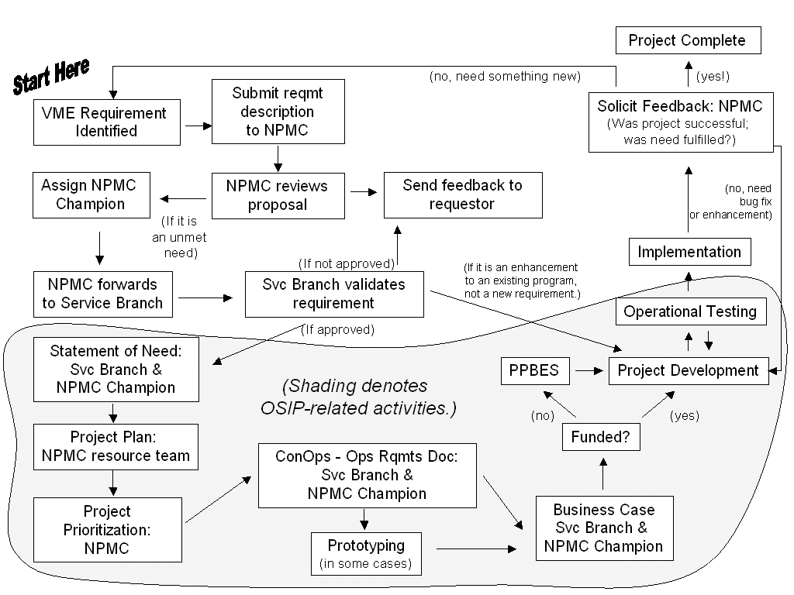
NPMC Operating Process

Slide 9
Addressing our current needs
Growth in the suite of products and services offered by the NWS has not been met with a proportional level of verification-related development.
Our process will provide a mechanism for bridging the existing gaps.
To move past the current state, the NMPC is establishing a collective working knowledge of the existing verification and performance management system in the NWS in order to properly evaluate and prioritize future needs.

Slide 10
Performance Management Plan Objectives
Improve performance assessment system for NDFD
Improve performance assessment system for watches, warnings, and high impact events
Improve use and understanding of performance information
Improve service evaluation/assessment activities
Operate and maintain existing verification systems until they are replaced by new systems/technology
Provide performance information to partners and users

Slide 11
Performance Management Plan
Objective #1: Improve performance assessment system
for NDFD.
Add operational and experimental elements
Provide access to data files for local analysis
Incorporate additional gridded fields for comparison
Improve marine verification program
Implement forecast feedback tool at WFOs
Provide individual forecaster verification

Slide 12
Performance Management Plan
Objective #2: Improve performance assessment system
for watches, warnings, and high impact events.
Provide near real-time warning verification from local storm reports
Automate winter storm, non-precip, and coastal flood watch and warning verification
Automate flood watch/warning verification
Modernize Stats on Demand
Modernize StormData and incorporate GIS
Implement polygon warning verification

Slide 13
Performance Management Plan
Objective #3: Improve use and understanding of
performance information.
Develop assessment tools
Develop training for managers and forecasters
Enhance communication and collaboration

Slide 14
Performance Management Plan
Objective #4: Improve service evaluation/
assessment activities.
Investigate techniques for quantifying or otherwise measuring impacts
Investigate feasibility of applying root cause analysis techniques for service assessments
Implement comprehensive outreach reporting/tracking system
Implement measures for customer satisfaction

Slide 15
Performance Management Plan
Objective #5: Operate and maintain existing systems
until they are replaced by new systems/technology.
Enhance point-based marine verification
Enhance TAF Verification
Enhance River Verification
Update PFM Verification
Transition RTVS to NWS

Slide 16
Performance Management Plan
Objective #6: Provide performance information to
partners and users.
Update public NDFD Verification Site
Implement Fire Weather NFDRS Verification
Develop new measures and goals (Corporate and GPRA)
Publish additional performance results as appropriate
Enhance RTVS

