Slide 1
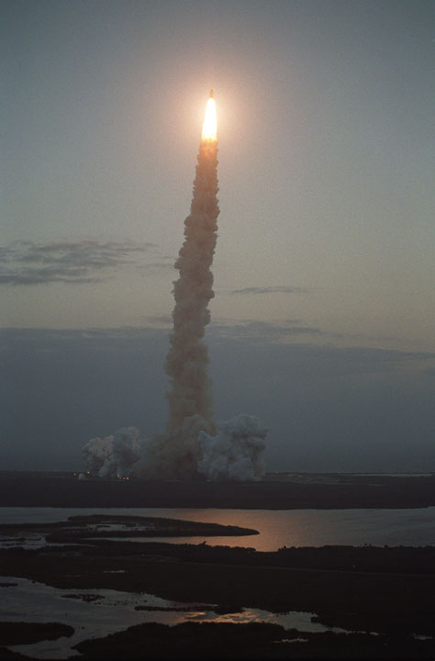
The Spaceport Enterprise
Defining and Developing the Concept
Kevin Brown
Command and Control Technologies Corp.
Advanced Spaceport Technology Working Group
January 16, 2002
321.264.1193
PI-ASTWG-Enter-010902

Slide 2
Objectives
Suggest common framework for defining a spaceport
  Solicit subgroup feedback on value and organization of the framework and its elements
  Draw on diverse perspectives to develop a common understanding of the “spaceport” concept
  Use this common foundation to formulate a vision for the future of the spaceport industry
Help spaceports develop strategic plans
  And be more responsive to future siting opportunities
Influence design of flight systems
  Key ASTWG objective

Slide 3
Agenda
Enterprise: Introduce the 6 key strategic areas of spaceport development
  Comprises a common framework for further discussion
Planning: Reflect on strategic planning
  Putting the framework to work
ASTWG: Encourage dialogue at the sub-group level

Slide 4
6 Key Strategies
A Notional Spaceport Enterprise Plan
1 Business Model
Vision and Planning
Market Analysis
First Flight
Phasing
Marketing
2
Environmental
License Granted
Regulatory
Safety
Stewardship
3 Economic Dev.
Workforce Development
Tourism
Business Expansion
Commercial Operations
4
Concept of Operations
Architecture
Design
Construction
Operations
5 Education
K-12 Payloads Launch Viewing
University Research
6
Politics

Slide 5

Common Framework
Mission
Location
Scope
Phasing
Orbit Service
Payload Specialties
Business Plan
Marketing
Business Model
Regulatory and Licensing
Economic Development
Architecture, Infra-structure & Operations
Educational & Tourism Opportunities
Political Strategy

Slide 6


Common Framework
Environmental
  Toxic/Hazardous Material
  Natural Resources
  Geological
  Biological
  Cultural
  Acoustic
Safety & Licensing (U.S.)
  Geographic characteristics
  Flight paths and impact areas
  Casualty probabilities
  Site operations
  Hazard analysis/mitigation
  Air and marine traffic hazards
  Safety policies
  Facility access and security
  Emergency response plan
  Accident investigation plans
Business Model
Regulatory and Licensing
Economic Development
Architecture, Infra-structure & Operations
Educational & Tourism Opportunities
Political Strategy

Slide 7

Common Framework
Business Model
Economic Impact
Business Recruiting
Socio-Economic Factors
  Including early community support
Industrial Resources
Workforce Development
Regulatory and Licensing
Economic Development
Architecture, Infra-structure & Operations
Educational & Tourism Opportunities
Political Strategy

Slide 8
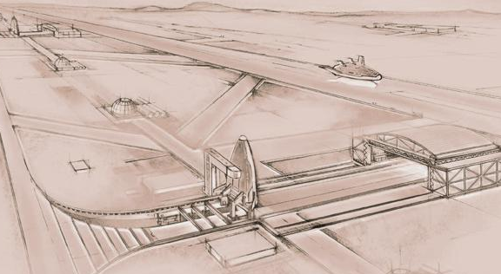
Common Framework
Requirements
Concept of Operations
Architecture
  Transportation and assembly
  Air/space traffic control
  Vertical/horizontal processing
  Launch, flight and return modes
  Hazardous operations
  Logistics support
Master Planning
  Site Planning
  Transportation
  Security
  Utilities
Operations
  Mission planning
  Traffic control (range operations)
  Launch and payload processing
  Mission operations
  Landing and turnaround
  Hazardous operations
Business Model
Regulatory and Licensing
Economic Development
Architecture, Infra-structure & Operations
Educational & Tourism Opportunities
Political Strategy

Slide 9

Common Framework
Business Model
Regulatory and Licensing
Community Outreach
Primary & Secondary Education
  Math & science projects
University
  Payload programs
  Technology research
Public Launch Viewing
Economic Development
Architecture, Infra-structure & Operations
Education & Tourism
Political Strategy

Slide 10

Common Framework
Business Model
Regulatory and Licensing
Economic Development
Public Policy
  Foster competitiveness
  Facilitate investment
  Support national interests
  Ref: OSTP Report*
New Legislation
  Elected official support
  Stimulate expansion of commercial space launch capabilities
Public Support/Communication
Public Financing
Architecture, Infra-structure & Operations
Educational & Tourism Opportunities
Political Strategy
* See http://www.cctcorp.com/range_studies.html

Slide 11
6 Key Strategies
A Notional Spaceport Enterprise Plan
1 Business Model
Vision and Planning
Market Analysis
First Flight
Phasing
Marketing
2 Regulatory
Environmental
License Granted
Safety
Stewardship
3 Economic Dev.
Workforce Development
Tourism
Business Expansion
Commercial Operations
4 Architecture
Concept of Operations
Design
Construction
Operations
5 Education
K-12 Payloads Launch Viewing
University Research
6 Politics

Slide 12
Business Model
There are 4 primary considerations in developing your spaceport business model. These inter-related considerations, taken in aggregate, drive the market analysis and development of your spaceport enterprise.
Mission
Location
Scope
Phasing/Teaming

Slide 13
Business Model
Mission
Location
Scope
Phasing/Teaming
Mission
Location
Scope
Phasing/Teaming
Organization
  Commercial
  Civil
  Military
Purpose/Economics
  Commercial profit
  Economic development
  Transportation
  Defense
“Center of Excellence”
  Payload specialties
    Biomedical research
    Upper atmosphere sensors
    Remote sensing payloads
  Freight/cargo
  Military applications
Mission
Location
Scope
Phasing/Teaming

Slide 14
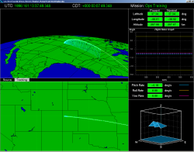
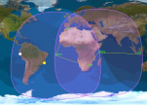
Business Model
Mission
Location
Scope
Phasing/Teaming
Geography
  Overflight restrictions drive:
  Trajectories, which drive:
  Orbit Service
Accessibility
Climate
Geology/Environment

Slide 15








Business Model
Mission
Location
Scope
Phasing/Teaming
Vertical span
  Spaceport Host
  Manufacturer
  Operator
  Payload
Vehicle class
  RLV
  ELV
  Suborbital
Spaceport Operations
Spaceport
Manufact.
Operator
Payload
Airport Operations
Airport
Aircraft
Airline
Passengers
Distinguishing the spaceport enterprise from vehicle-specific manufacturing and operations:
Multi-vehicle scope (I.e., multi-tenant)
Independence of spaceport mission and vehicle mission

Slide 16
Business Model
Mission
Location
Scope
Phasing/Teaming
1 Business Model
Development Phases
  From site assessment to first flight
Growth Strategies
  Sub-orbital rocket program
  Academic applications
  Military and commercial programs
Partners and Suppliers
  Higher educational institutions
  Economic development agencies
  Launch vehicle manufacturers
  Investors & other private firms
2
Regulatory
3 Economic Dev.
4
Architecture/Conops
5 Education

Slide 17
Spaceport Architecture
A Conceptual Model
of Generic Spaceport Functions
Processing
Space Transportation System architecture: Flight and Ground -
A Total System
Cross influence between ground and flight system designs
Design for operability
Landing/ Recovery
Launch
Infrastructure

Slide 18
Strategic Planning
Spaceport Strategic Plan
Putting the Framework to Work
6 Key Strategies
Business Model
Regulatory
Economic Development
Architecture/Operations
Education
Politics
Plans & Analyses
Site Assessment
Business Plan
Environmental Study
Strategic Development Plan
Economic/Infrastructure Analysis
Land Use Studies/Master Plan
Concept of Operations
Ground & Flight Safety Analysis
Facility Planning
Projects
Permitting & Site Prep
Organization Formulation
Facility Construction
Systems Installation
Site Marketing
Operations
Rockets for Schools
Research & Technology
Payload Processing
Mission Operations
Military Support

Slide 19
Objectives
Suggest common framework for defining a spaceport
  Solicit subgroup feedback on value and organization of the framework and its elements
  Draw on diverse perspectives to develop a common understanding of the “spaceport” concept
  Use this common foundation to formulate a vision for the future of the spaceport industry
Help spaceports develop strategic plans
  And be more responsive to future siting opportunities
Influence design of flight systems
  Key ASTWG objective

