Slide 1

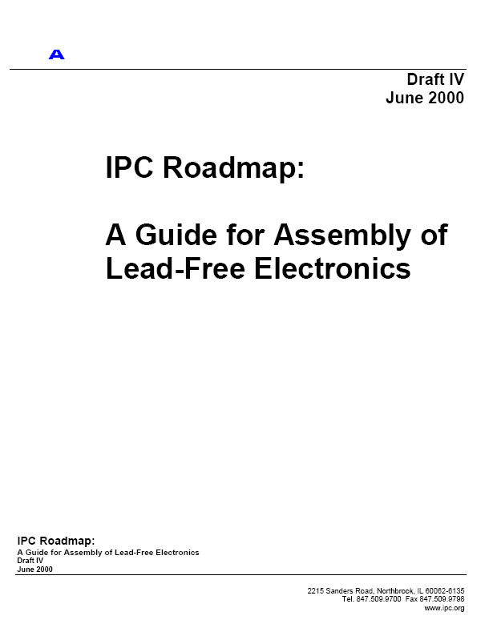

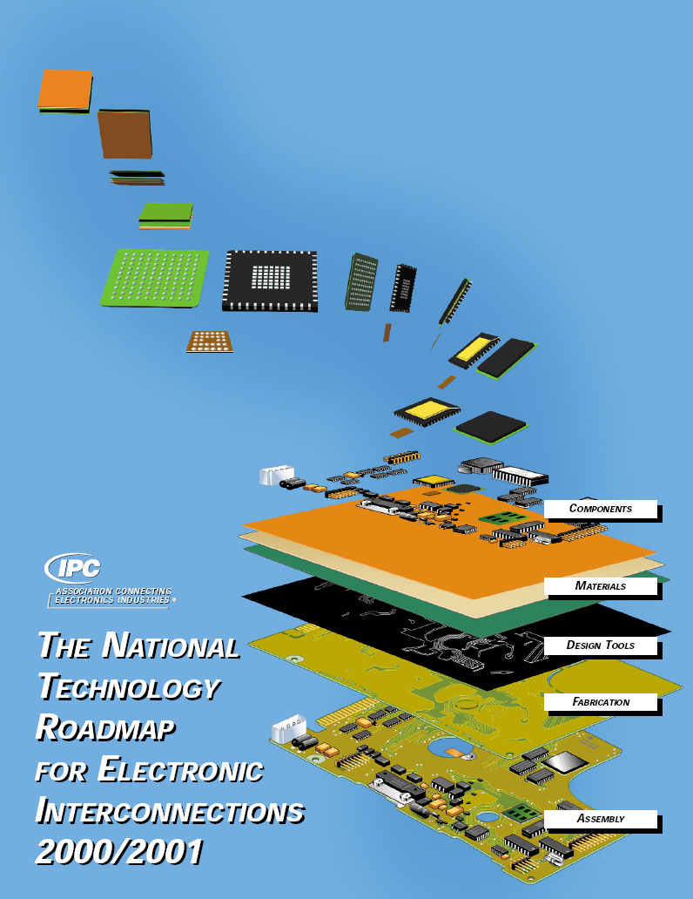
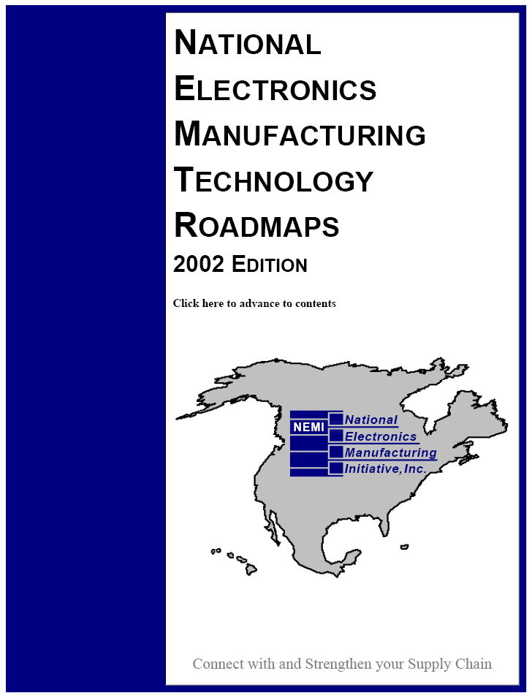
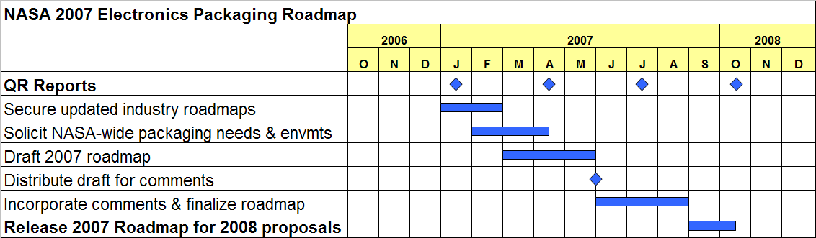
NASA 2007 Electronics Packaging Roadmap
PCK-0
Description:
The packaging of electronics has become the limiting element in system cost and performance. This is a universal phenomenon that crosses commercial and high-reliability sectors. The main factor that distinguishes high-reliability sectors from commercial sectors is the environment in which the product must perform. Reliable performance is required in automobiles, heavy-duty trucks, satellites, missiles, gun mounts, oil rigs, etc. Many of the attributes, such as cost, density, and components, overlap into the other sectors. High reliability military and aerospace products are typically in the upper cost, high reliability, high density and low volume categories. However, high reliability electronics are only a small portion of the electronics industry in relationship to computers, communications, and consumer electronics. The challenge for the high reliability sector is to adapt other sectors’ technologies to meet the extreme temperature, environmental and reliability requirements cost- effectively. This task will produce a NASA-wide electronics packaging roadmap that will utilize industry roadmaps and with inputs from the NASA community, develop a 5-year roadmap for NASA usage. It will include a framework for future packaging test and evaluations, guidelines for insertion into project usage and qualification/risk-reduction matrices.
Plans:
Secure updated industry roadmaps
Solicit NASA-wide packaging needs
Identify NASA-wide operating environments
Draft 2007 roadmap
Distribute draft for comments
Incorporate comments and finalize roadmap
Release 2007 Roadmap for 2008 proposals
Schedule/Costs:
Deliverable:
NASA 2007 Electronics Packaging Roadmap
NASA & Non-NASA Organizations/Procurements:
N/A
Lead Center/PI: JPL/Zulueta

