Slide 1

Public Safety Interoperable Communication (PSIC) Grant Program
Focus Group Meeting
May 17, 2007
Notes:
All levels of government have a shared stake and a shared responsibility in homeland security.
An important part of that shared responsibility is national preparedness --collectively achieving and sustaining the capability to prevent terrorism, to protect against its effects, and to respond and recover effectively from attacks and natural disasters that do occur.
A concerted effort is now underway to broaden the focus of preparedness efforts to a larger National Preparedness mission that encompasses prevention, protection, response and recovery.
National preparedness efforts and activities will focus on building core capabilities to manage a range of potential threats and meet identified national priorities in a resource-constrained environment.
The ongoing threat of terrorist attacks and natural disasters requires a national preparedness system in which Federal, State, local and tribal entities have requisite capabilities in place, communicate easily, and coordinate resources effectively.
A key concept for the development and sustainment of capabilities in a common approach is a process called capabilities-based planning. Let me tell you all about it…

Slide 2

Focus Group Objectives
To solicit State and local feedback on the overall FY 2007 PSIC Grant Program
To discuss key issues and obtain input
To outline considerations for the overall process and program guidance

Slide 3
Agenda
PSIC Grant Program Overview
Grant Guidance working session
  Discussion of program and application requirements, allowable and unallowable costs
Investment Justification working session
  Discussion of Investment Justification and template, assessment criteria, template upgrades, and performance measurement
The funding formula and allocations are outside of the scope of the day and cannot be discussed
Notes:
Facilitators, notetakers, parking lots for issues
Post-conference report

Slide 4
PSIC Background
The Deficit Reduction Act of 2005 provided the National Telecommunications and Information Administration (NTIA) the authority to establish a $1 billion grant program for public safety interoperability communications
The funds are borrowed from the anticipated auction proceeds of the 700 MHz spectrum
The Call Home Act of 2006 requires all funding to be awarded by September 30, 2007
Through an MOU, NTIA partnered with DHS (NPD)
  DHS will provide grants-related administrative services and expertise
  NTIA retains approval authority
Total of $958.9 million in funding is available for grant awards

Slide 5
PSIC Goals and Objectives
The program will not dictate a technology or an approach for interoperability solutions. However, we are considering two goals and five objectives for the PSIC Grant Program
Goals
  Achieve meaningful and measurable improvements in the state of interoperability for public safety communications; and
  Fill interoperability gaps identified in the Statewide Plans
Objectives
Technological
    Adopt advanced technological solutions
    Improve spectrum efficiency
    Use cost-effective measures
  Geographical
    Improve communications in areas at risk for natural disasters
    Continue to improve interoperability efforts in urban and metropolitan areas

Slide 6
Key Features of PSIC Grant Program
Awardees: Funding will be awarded through the 56 State and Territory Administrative Agencies (SAA)
Period of Performance: PSIC grants will be awarded no later than September 30, 2007 and the period of performance will end on September 30, 2010
Statewide Planning: Up to 5 percent of the total funds allocated to a State or territory will be available at the time of the award to support the completion of the Statewide Communications Interoperability Plans (Statewide Plan)
Technical Assistance: DHS technical assistance will support grantees with planning and implementation of PSIC awards
Technical Review: Remaining funds (95 percent) will be contingent upon submission, technical review, and approval of a Statewide Plan
and Investment Justifications
Use of Funds: Funding can be used for “acquisition of, deployment of, or training on” interoperable communications systems that use or enable use with the 700 MHz frequency band
Match: PSIC includes a statutory requirement of not-less-than 20 percent match

Slide 7
Current Timeline of PSIC Activities to Meet Call Home Act Requirements
April through September 2007
Week 1 – 4
Continue development of Grant Guidance Package
Week 8 – 9 Incorporate Focus Group Comments
Week 14
Brief Grant Guidance Package to the Hill
Week 16
Release Grant Guidance Package and Funding Allocation
Week 21 – 26
Review States’ and Territories’ SF-424 Forms and Narratives, and Award Funds
Week 1 – 4
Continue Development of Grant Guidance Package
Week 8 – 9 Incorporate Focus Group Comments
Week 17 – 20
Receive States’ and Territories’ SF-424 Forms and Narratives
April
May
June
July
August
September
April
May
June
July
August
September
1
2
3
4
5
6
7
8
9
10
11
12
13
14
15
16
17
18
19
20
21
22
23
24
25
26
Week 5 – 7
Initial review of Grant Guidance Package and Collect Stakeholder Comments
  DHS: May 17 Focus Group Meeting
Week 10 – 13
Complete Commerce and DHS Review and Approval
Week 15 - 16
Incorporate Comments from the Hill
Week 17 – 20
Receive States’ and Territories’ SF-424 Forms and Narratives
Week 5 – 7
Initial review of Grant Guidance Package and Collect Comments
  DHS: May 17 Focus Group Meeting
Week 10-16
Review and Clearance of Grant Guidance
  NTIA: Early June public meeting
Week 21 – 26
Review States’ and Territories’ SF-424 Forms and Narratives, and Award Funds by September 28

Slide 8
Statewide Plans and PSIC
FY 2007 HSGP requires States to develop and adopt a Statewide Plan
Proposed PSIC projects to receive funds should align with the goals and gaps identified in the Statewide Plan
Statewide Plans must incorporate the three PSIC criteria:
  Description of how public safety agencies operate on or interoperate with the 700 MHz frequency band, via voice, data, and/or video signals;
  Description of how local and tribal government entities’ interoperable communications needs have been included in the planning process and how their needs are being addressed, if applicable; and
  Description of how nongovernmental organizations’ interoperable communications needs have been included in the planning process and how their needs are being addressed, if applicable
This criteria was released to State teams at the Statewide Planning Workshop sponsored by the National Governors Associations (NGA) and DHS on March 21, 2007

Slide 9
Urban/Metropolitan Areas and PSIC
One of five key objectives of the PSIC Grant Program is to continue to improve interoperability efforts in urban and metropolitan areas
Statewide Plans should address the expansion and improvement of these areas’ existing Tactical Interoperable Communications Plans (TICP)
The recommendations of the TICP initiative (e.g., after action reports, scorecards) are to be considered and addressed in any investment justifications submitted for PSIC funding to those areas

Slide 10
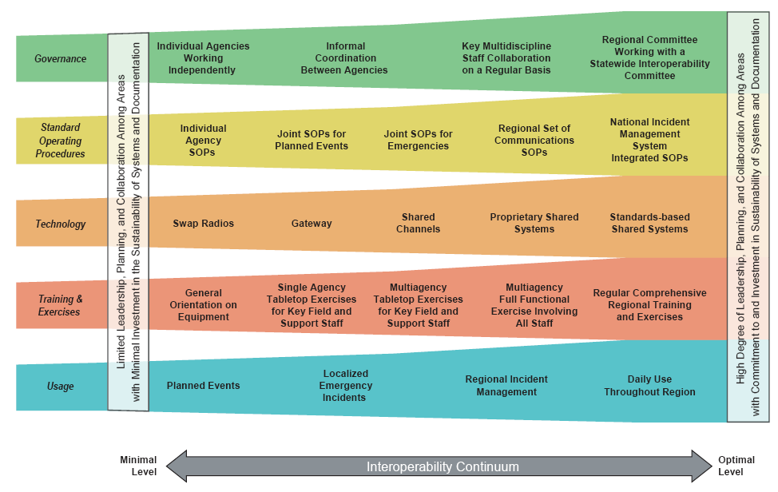
SAFECOM Interoperability Continuum

Slide 11
Continuum Alignment to Statutory PSIC Requirements
ACQUISITION
DEPLOYMENT
TRAINING
Description | Acquisition requires that technical and financial planning, as well as procurement and system design activities, occur to ensure that the interoperable communications systems and equipment (e.g., swap radios, gateways, shared systems) being acquired meets the needs of public safety agencies. | Deployment requires that communications equipment is built out, standard operating procedures are developed for its use, and service level agreements are developed for the interoperable communications equipment. | Training requires that public safety agencies understand how to use the interoperable communications equipment, and that exercises and drills take place to validate the effectiveness of the communications system to ensure efficient and effective interoperable communications is in place.
Continuum Alignment | Governance Technology | Governance SOPs Technology | Training and Exercises Usage SOPs
Achieving interoperability requires an understanding of interrelated and critical activities that must be completed to successfully deploy and use new communications equipment
Such support activities align with the lanes of the Interoperability Continuum and provide broader context for understanding the complexities associated with the technology acquisition, deployment, and training

Slide 12
Grant Guidance Working Session

Slide 13
Guidance Structure
  PSIC guidance uses the structure of the federal funding opportunity (FFO) announcement structure, which is different from the previous HSGP guidance documents
    Program Description
    Award/Funding Information
    Eligibility Information
    Application and Submission Information
    Application Review Information
    Award Administrative Information
    Allowable and Unallowable Cost Guidance
    Other Information

Slide 14
Program Guidance and Application Kit
Questions for consideration to ensure that important information is easily understood in the guidance
  What challenges have you had in understanding previous guidance?
  What are the top three information points when you first read grant guidance?
  How can the guidance be structured to be user-friendly and easier to understand?
  Are the Program Funding Goals (Technology/Geography) clear?
  Is the Limitation on Project Scope clear?

Slide 15
Eligible Applicants Section
The PSIC grants will be awarded to the 56 States and Territories
The Governor of each State has designated a State Administrative Agency (SAA) to apply for and administer the funds under the PSIC Grant Program
The SAA is the only agency eligible to apply for PSIC funds. The SAA is responsible for obligating PSIC funds to eligible pass-through public safety agencies

Slide 16
Eligible Applicants Discussion
Gaps
Issues
Suggestions

Slide 17
Match Requirements Section
The public safety agency receiving the PSIC project funds is required to meet the 20 percent match requirement
The SAA is required to document the 20 percent match requirements for each individual project that receives PSIC funds
The documentation must demonstrate that matching funds are from non-federal sources
The only exception to this previous statement is that funds used for training activities do not require a 20 percent match
Issue: match requirement through cash or in-kind source (in-kind sources are defined in Federal OMB Circular A-87)

Slide 18
Match Requirements Discussion
Gaps
Issues
Suggestions

Slide 19
Pass-Through Requirements Section
Each State will make no less than 80 percent of the total award amount available as a pass-through to local government, tribal government entities, or nongovernmental public safety agencies
    District of Columbia, Guam, American Samoa, U.S. Virgin Islands, and the Commonwealth of the Northern Mariana Island have no pass-through requirements
    Puerto Rico has a 50 percent pass-through requirement
However, each State and Territory may retain some or all of the pass-through for expenditures made by the State on behalf of the pass-through local entities through a formal Memorandum of Understanding with local entities that specifies the amount and intended use of the funds

Slide 20
Pass-Through Requirements Discussion
Gaps
Issues
Suggestions

Slide 21
Allowable and Unallowable
Cost Guidance
Allowable costs must align to the statutory requirements of acquisition, deployment, and training
Specific allowances that we are reviewing today address
  Technology requirements
  Management and Administration (M&A)
  Operations and Maintenance (O&M)
  Training
Unallowable costs to be reviewed include
  Hiring of public safety personnel
  Certain construction and renovation

Slide 22
Technology Requirements
What are the impacts of technology requirements on construction?
How can the guidance better emphasize adoption of emerging technologies?
What are the important SAFECOM Grant Guidance technical concepts that should be specifically emphasized in the PSIC guidance?

Slide 23
Technology Requirements Discussion
Gaps
Issues
Suggestions

Slide 24
Management and Administrative (M&A) Section
PSIC has allowable M&A costs for States and Territories
Issue: percentage of total allocation that the States and Territories can retain to use for M&A
These State and Territory M&A funds would be included when accounting for the total funds retained by the State and Territory

Slide 25
M&A Discussion
Gap
Issues
Suggestions

Slide 26
Operations and Maintenance (O&M) Section
What types of operating expenses and maintenance costs should be considered for the allowable versus unallowable categories?
How should applicants demonstrate the sustainability of operating expenses beyond the grant period?

Slide 27
Operations and Maintenance (O&M) Discussion
Gap
Issues
Suggestions

Slide 28
Investment Justification Working Session

Slide 29
Investment Justification Overview
All States and Territories will be required to develop Investment Justifications to request FY 2007 PSIC funding
The Investment Justification provides a template for applicants to outline which initiatives, identified in their Statewide Plan, they wish to address in the near-term using FY 2007 PSIC funding
Issue: number of Investment Justifications that the States and Territories will be allowed to submit

Slide 30
PSIC Investment Justification
The Investment Justification Template may ask for the following project information/metrics:
IJ Component Review Criteria
Project Narrative Problem, proposed solution, expected outcomes
Baseline Historical funding, description of need, stakeholder involvement
Strategy Consistency with Statewide Plan, consistency with PSIC technological and geographical objectives
Funding Plan Estimated costs, concurrent funding sources, and matching funds
Milestones Specific project milestones
Project Management Proposed management structure, contract management approach, roles and responsibilities
Investment Challenges Up to 5 expected challenges, level of impact, mitigation strategy
Impact Specific outcome metrics, cost-effective measures, long–term sustainability approach
Notes:
Technical Assistance: ICTAP the technical assistance program is currently budgeted through G&T to support Urban Areas in fulfilling scorecard recommendations. Therefore, this assistance cannot begin until the funding is released by Commerce. Based on the response from States at last week’s planning conference, we expect the majority of States to request some level of technical assistance.
Use of Funds: In testimony before Congress, Assistant Sec. Kneuer has stated that they will agree to a broad interpretation of the 700MHz requirement which would allow cities like New York to build on their existing infrastructure outside of that frequency band, as long as they can “interoperate” through the use of a gateway or other device.
Match: Commerce has agreed to make this an “in-kind” match requirement, using the guidelines in Federal OMB Circular A-87 (Any non-federal grants or cash donations from non-federal third parties, as well as the value of in-kind contributions provided by any of the organizations involved).

Slide 31
Investment Justification (IJ) Template
Questions for consideration:
Does the investment justification clearly align to the PSIC goals (i.e., technological and geographical)?
Is the IJ layout/format used in HSGP user-friendly? How can it be improved/modified for PSIC?
Does the template enable you to effectively convey your need?
Should Investments be prioritized?
What additional instruction is needed for SAAs to collect IJs from local entities?

Slide 32
IJ Discussion
Gaps
Issues
Suggestions

Slide 33
DHS and NTIA
Note of Appreciation
A special note of thanks to acknowledge our participants in today’s focus group who volunteered their time and expertise

Slide 34

NATIONAL TELECOMMUNICATIONS AND
I NFORMATION ADMINISTRATION

