Slide 1

The New 5-Year Plan 2007-2012
Renee Orr
Chief, Leasing Division
February 21, 2007

Slide 2
The OCS Leasing, Exploration, and Development Process
Pre-lease
Develop 5-Year Program
Draft
Proposed
Program
Published
Proposed
Program
Proposed
Program
Proposed
Final
Program
60-Day
Period
for
Congress
Final 5-Year
Program
Announced
Solicit
Comments
45-day
Comment
Period
60-Day
Comment
Period
90-Day
Comment
Period
Draft EIS
Published
Draft EIS
Published
Final EIS Published
Planning for Specific Sale
Final EIS
Published
30-Day Comment
Period
60-Day Comment Period
90-Day Review
Call for
Information
Published
Define
Sale
Area
Draft EIS
Published
Final Notice
of Sale
Published
Leases
Issued
45-Day
Comment
Period
45-Day
Comment
Period
30-Day
Period
Sale
Proposed
Notice
CD Sent to
States
Post Lease
Exploration Plan Approval
Exploration
Plan
Submitted
90-Day
CZM
Review
Exploration
Plan
Review
APD
Decision
Exploration
Drilling
Starts
First
Exploration
Well (s)
Completed
Delineation
Well
Drilling
Environmental
Assessment
Permits
Granted
Development and Production Plan Approval
Development
& Production
Plan Submitted
Company
Submits CZM
Consistency
Certification
MMS
Prepares
NEPA
Analysis
CZM Consistency
Concurrence from State
First
Oil/Gas
Production
Production
Well
Application
Then Development and
Production Plan Decision
Abbreviations: ADP, Application for Permit to Drill; CD, Consistency Determination; CZM, Coastal Zone Management; EIS, Environmental Impact Statement;
NEPA, National Environmental Policy Act

Slide 3
What has Happened
Request for Comments/Intent to Prepare an EIS published on August 24, 2005, with 45-day comment period.
Draft Proposed Program published on February 10, 2006, with 60-day comment.
Proposed Program and Draft EIS published on August 25, 2006, with 90-day comment period.
Notes:
What has happened so far…also additional 45-day comment period to 12/29/06 to proposed revision to expand Sale 205 to all available acreage in CGOM.

Slide 4
Comments Received from all parties
Request for Information/Notice of Intent …11,500
Draft Proposed Program………………………..39,500
Proposed Program………………………………..73,700
Total………………………………………………124,900
Citizens sent over 99% of the comments of which about 75% in favor of some level of access

Slide 5
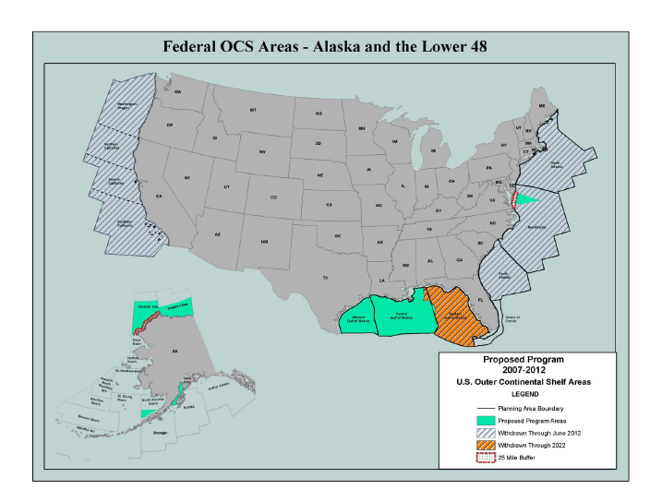
PP & Withdrawn Areas

Slide 6
Alaska Proposed Program Areas
Beaufort and Chukchi Seas
  multiple sales in both areas
  25-mile buffer in Chukchi
North Aleutian Basin
  Sale 92 Area only
  Presidential withdrawal modified January 2007
Cook Inlet – special interest sale(s)
  Sale will be held only if sufficient interest after a call for nominations, and after consideration of comments and analyses

Slide 7
Gulf of Mexico Proposed Program Areas
Central and Western Gulf of Mexico – annual areawide sales
Additional 2007 Sale in all available areas of Central Gulf (March 2007 sale cancelled)
181 South Area of Central Gulf: Presidential withdrawal modified January 2007 and congressional moratorium lifted December 2006. After NEPA review, scheduled for 2009 sale

Slide 8
Eastern Gulf of Mexico
Gulf of Mexico Energy Security Act of 2006 mandated sale in portion of 181 in reconfigured Eastern GOM—more than 125 miles from Florida and west of military mission line.
Sale scheduled for 2008 after NEPA review (not subject to section 18)
Established moratorium in Eastern and portion of Central GOM to 2022.

Slide 9
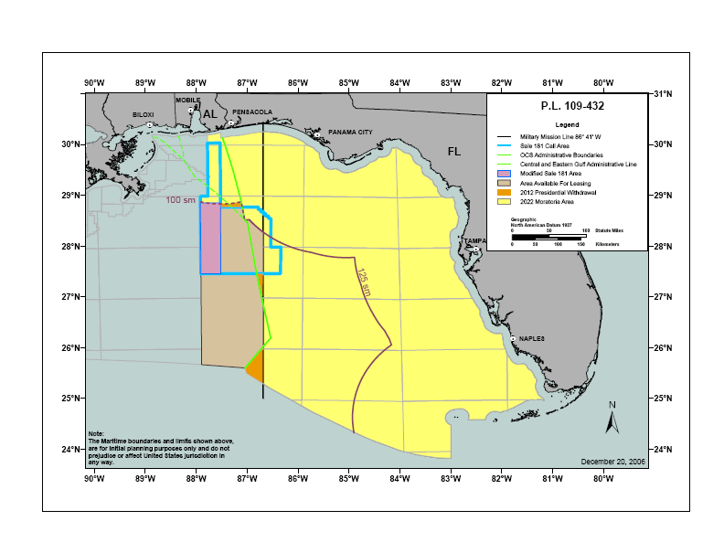
GOMESA

Slide 10
Atlantic Proposed Program Area
Mid-Atlantic
  Area off Virginia with 25-mile buffer and no-obstruction zone off Chesapeake Bay
  Presidential withdrawal remains in place; area currently under annual Congressional moratorium
  Will coordinate with DOD about military issues and concerns
North and South Atlantic, Straits of Florida
  No sales

Slide 11
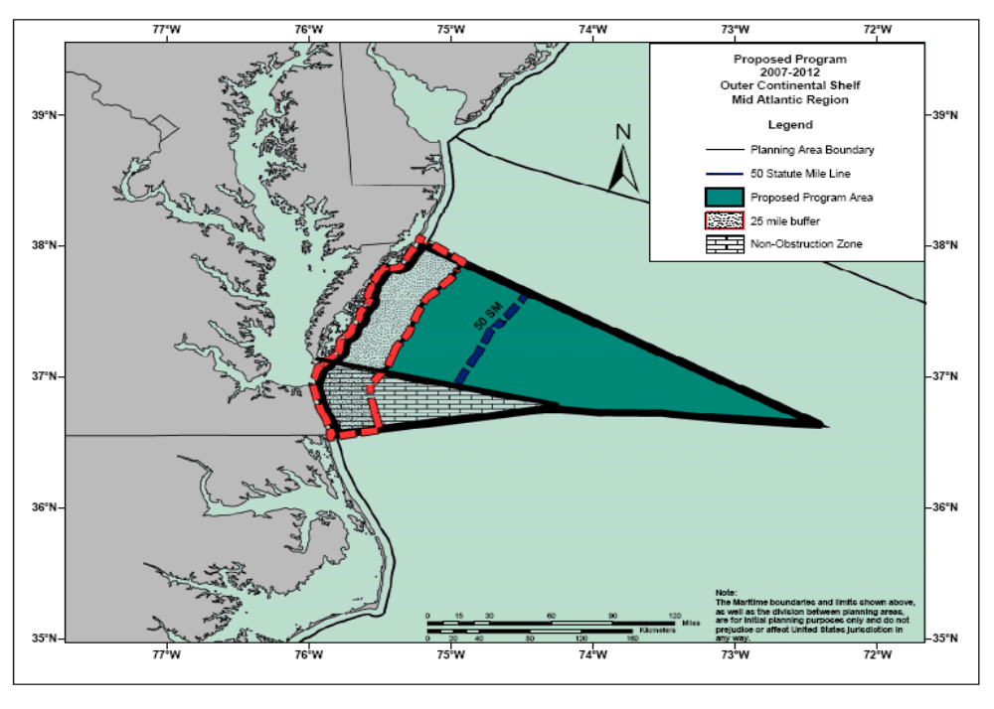
Atlantic Proposed Program Area

Slide 12
Next Steps in 5-year Preparation
Proposed Final Program/Final EIS are scheduled to be announced in late April 2007, with a 60-day period after submission to the President and Congress.
New Program begins July 1, 2007.

