Slide 1

Customer Perspective: STORET / WQX
Kristen Gunthardt
Environmental Protection Specialist
EPA Office of Water

Slide 2
Agenda
Overview of the STORET / WQX System
SRS support of STORET / WQX System
  Data standardization
  Data maintenance
Mechanics of SRS and STORET / WQX interaction
Notes:
-- SRS standardization is standardization across the whole agency, thus we are adopting the EPA standard for naming substances – Egov strategy of standardizing names for exchange with outside agencies… work with NWIS?
-- The process for naming substances is also very helpful to our program as the research, chemical id validation, and direct consultation among field experts provides a solid scientific base for our substance list.

Slide 3
The STORET / WQX System
The STORET / WQX system houses water quality monitoring data
The WQX schema is an implementation of the ESAR (Environmental Sampling, Analysis and Results) data standard
  1st phase – physical, chemical and fish tissue data
  2nd phase – biological and habitat data
The STORET Warehouse serves as a national repository for water quality monitoring data
  Over 45 million results from states, tribes, other orgs
  Publicly accessible : www.epa.gov/storet
  WQX data will flow into the Warehouse

Slide 4
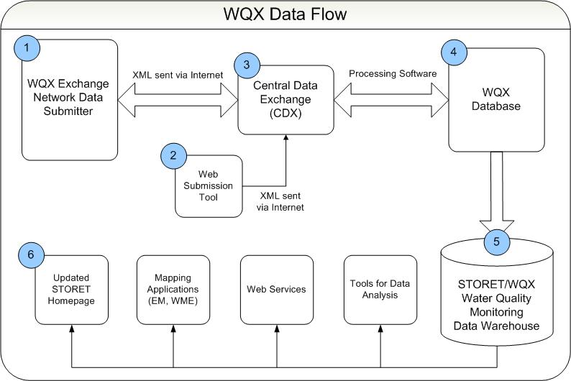
STORET / WQX Data Flow
SRS
Notes:
Highlight that the XML is in the format of the WQX schema : outlined on the next slide

Slide 5
WQX Schema Concepts
Organizations own / steward water quality monitoring data
  Projects define the context / why the data is being collected
    Monitoring Locations tell where samples, measurements or observations are being made
      Activities are performed at monitoring locations and have associated methods for sample collection or preparation
        Results give the measure value of a certain substance being analyzed or measured
Notes:
SRS supports the WQX business need for exchanging meaningful (standardized) water quality monitoring result data

Slide 6
SRS Support of WQX
Standardization of WQX Characteristics list
  WQX will use the EPA Chemical Registry Name as the naming standard for reporting characteristic results
  Data submitters will need to align with standardized WQX characteristics list for successful submittal
Maintenance of WQX Characteristics list
  New data steward application for maintaining existing or requesting new substances within WQX program subset of SRS
  Web service interaction to synchronize WQX reference data content with WQX program subset of SRS
Notes:
2 main ways WQX uses SRS / will be supported by SRS

Slide 7
STORET / WQX Data Flow
SRS
Notes:
The back end db will interact with SRS for reference content synchronization
The back end db will also serve up the characteristics list to data submitters: Query and Solicit services.
Certain substances will only be STORET / WQX substances (RBP’s, etc.)

Slide 8
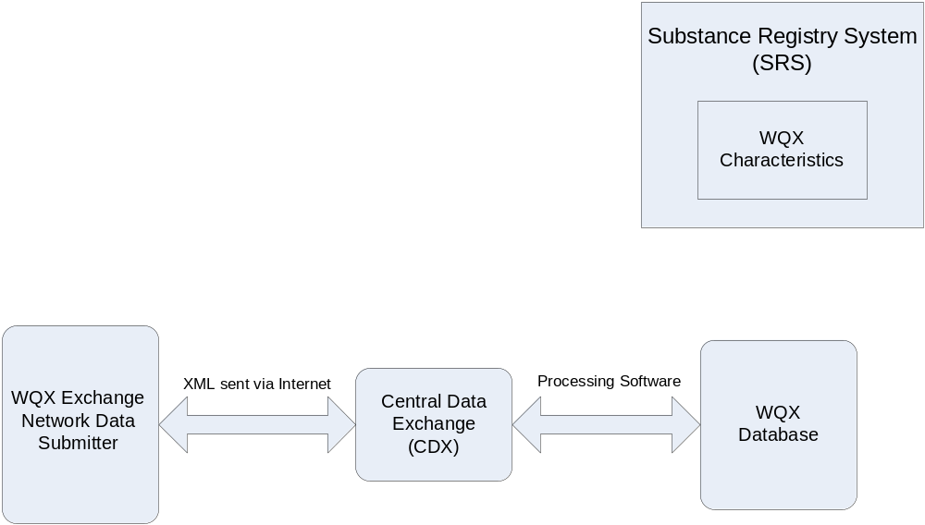
Basic SRS / WQX Interaction
WQX Data Submitter can
call Query or Solicit service
through CDX to retrieve Characteristic
reference data content from
backend WQX database
WQX periodically
synchronizes with SRS
Notes:
Basic mechanics of how WQX will interact with SRS, and also how our customers will be a part of this communication loop
WQX will periodically sync with SRS (automated, regular adoption of current SRS snapshot)
When a substance is in SRS but not in WQX : web service from P&L software (on-demand adoptions)

Slide 9
New Substance Stewardship
WQX submits new
substance request to SRS;
progress tracked on EPA Portal
State or Tribe submits new
substance request to WQX
Notes:
Discuss SRS process for adding a new substance to the registry – pending to final status

Slide 10
WQX Schedule
WQX production flow for physical, chemical and fish tissue data exchange
  Testing – December 2006
  Implementation – January 2007
WQX biological data flow
  Pilot – early 2007
  Implementation – early 2008
Notes:
What do we want to say about SRS and the standardization of the bio piece?
Plan to sync with SRS for bio piece. Have been using IT IS…

Slide 11


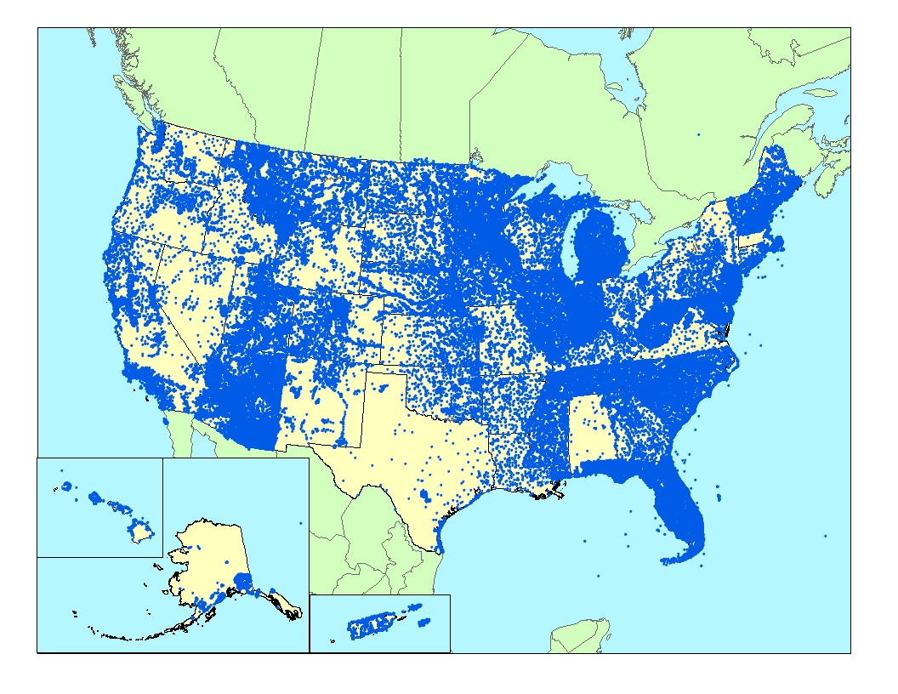
Questions?
Dwane Young, young.dwane@epa.gov
Kristen Gunthardt, gunthardt.kristen@epa.gov

Slide 12



