Slide 1
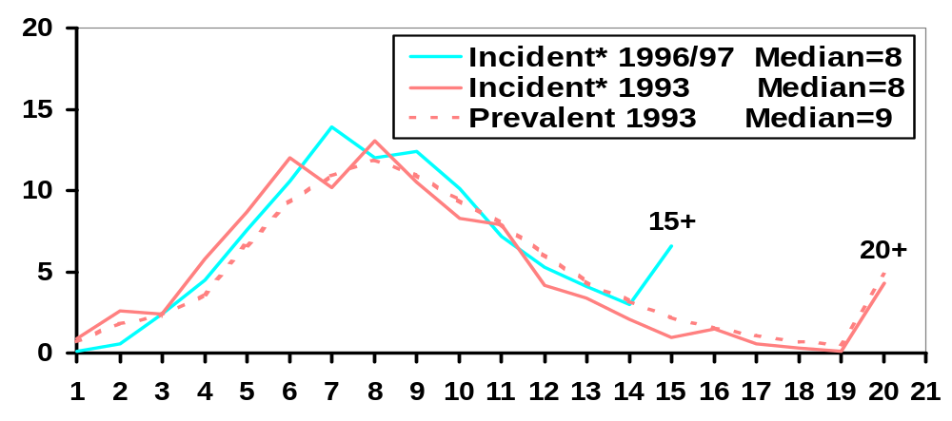
Distribution of the Number of Medications among Hemodialysis Patients, 1993 - 1996/97
Percent of Patients
Number of Medications
*Incident = at 2 Months (0-4); + > 15 or > 20; Range 1- 22

Slide 2
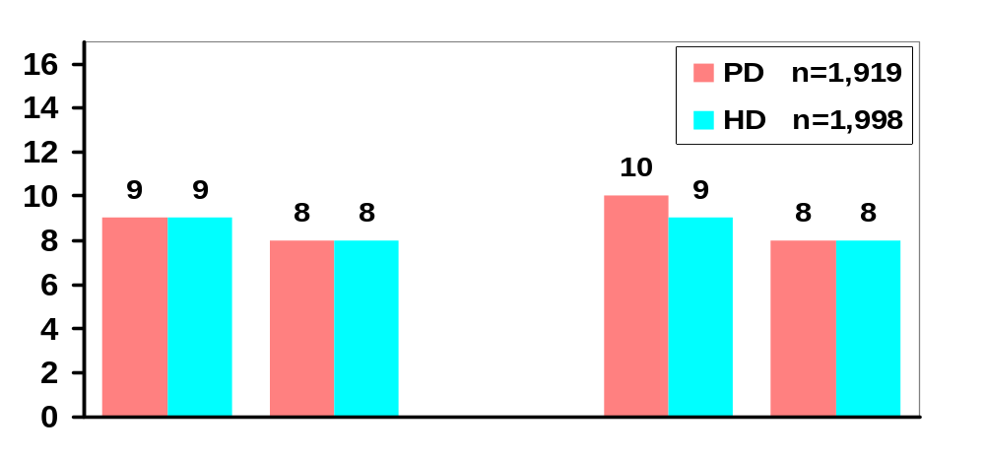
Median Number of Medications among Incident* Patients by Modality, DM, and Age Group, 1996/97
Median # of Medications**
DM NonDM DM NonDM
Age < 65 Age 65+
*Incident = at 2 Months; **Range 1-17

Slide 3
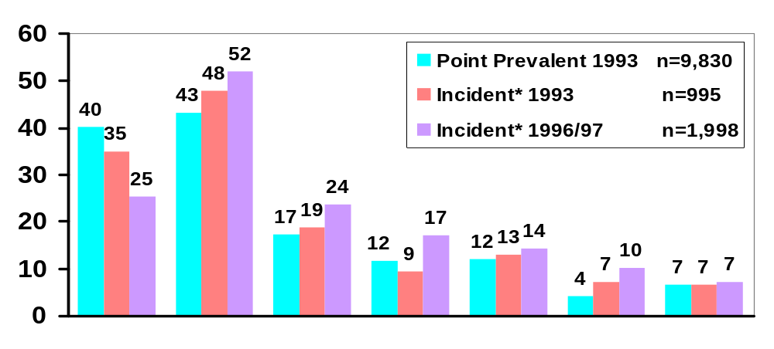
Use of Specific Antihypertensives
among Hemodialysis Patients
Percent of Patients
None** Ca-Chann ACE Beta Central Periph Other**
Blocker Inhib. Blocker Acting Blocker
*Incident = at 2 Months (0-4); ** Diuretics are not included

Slide 4
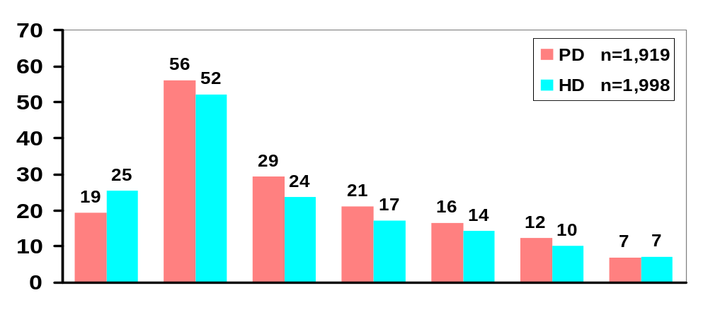
Use of Specific Antihypertensives among Incident* Peritoneal versus Hemodialysis Patients, 1996/97
Percent of Patients
None** Ca-Chann ACE Beta Central Periph Other**
Blocker Inhib. Blocker Acting Blocker
*Incident = at 2 Months; ** Diuretics are not included

Slide 5
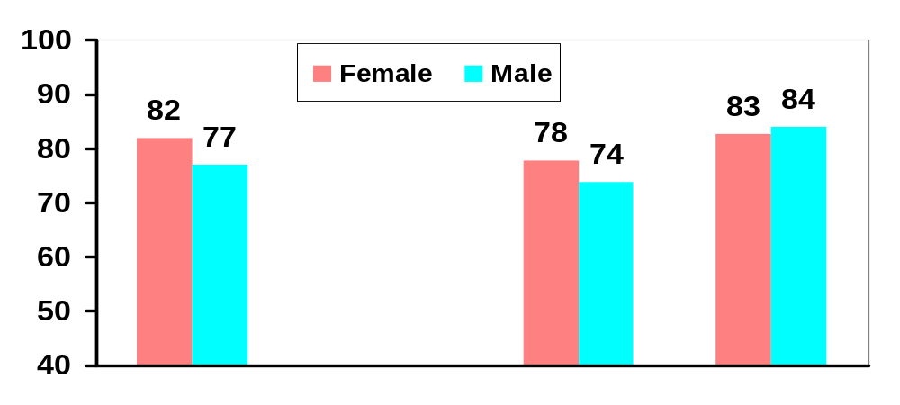
EPO Therapy among Incident* Patients by Modality and Sex, 1993-97
Percent of Patients
HD PD HD
1993 1996/97
*Incident = at 2 Months (0-4)

Slide 6
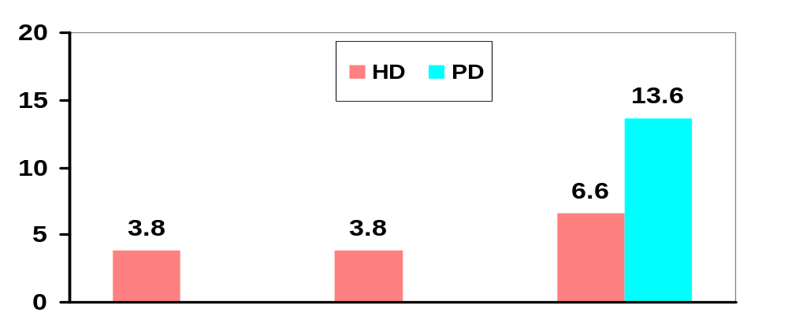
Estrogen Use in Female Dialysis Patients over Age 50
Percent of Patients
n= 364 3518 748 553
Incident* 1993 Point Prevalent Incident*
1993 1996/97
* Incident = at 2 Months (0-4)

