Slide 1
Candesartan Support Slides

Slide 2
Baseline Beta-Blocker
Charm Added
65
β-blocker | Of patients on β-blockers | Mean daily dose of β-blocker
 |  | Candesartan | Placebo
Metoprolol | 50% | 89 mg | 84 mg
Carvedilol | 31% | 29 mg | 28 mg
Atenolol | 8% | 44 mg | 47 mg
Bisoprolol | 5% | 6 mg | 5 mg
Other | 6% | – | –

Slide 3
Death and CV Death in Patients on
ACEi and β-blocker
CHARM Added Compared to Val-HeFT
37
CHARM FDA questions.ppt
 | Patients, n (%)
 | Val-HeFT n = 5010 | CHARM Added n = 2548
All patients
Deaths | 979 (19.5) | 789 (26.2)
CV deaths | 846 (16.9) | 649 (25.5)
Patients on ACEi and β-blocker | n = 1610 | n = 1413
Deaths | 226 (14.0) | 370 (26.2)
CV deaths | 201 (12.5) | 307 (21.7)

Slide 4
Discontinuation† by
Baseline Estimated GFR
CHARM Added
AZ BD T 40 P 75
 | Placebo n = 464 |  |  | Candesartan n = 465
 | eGFR, mL/min/1.73 m² |  |  | eGFR, mL/min/1.73 m²
 | < 60 | 60 - < 90 | ≥ 90 | < 60 | 60 - < 90 | ≥ 90
Patients in each stratified group, n | 153 | 203 | 108 | 153 | 206 | 106
Discontinuation in each stratified group, n (%) | 46 (30.1) | 33 (16.3) | 13 (12.0) | 63 (41.2) | 60 (29.1) | 12 (11.3)
† Calculated by Modification of Diet in Renal Disease formula. North American sites.

Slide 5
Outcomes in Patients Discontinued for Renal Dysfunction
CHARM Added
62
Outcome_data.ppt
 | Patients, n/N (%)
Alive at end of study | Placebo | Candesartan
Renal dysfunction | 20/53 (38) | 58/105 (55)

Slide 6
Estimated GFR† Over Study Time
CHARM Added
59
SAS pgm: box_wisher_gfr_006
95%
Placebo
75%
Candesartan
140
Median
140
25%
120
5%
120
100
100
80
80
eGFR, ml/min/1.73 m²
eGFR, ml/min/1.73 m²
60
60
40
40
20
20
0
0
Baseline
Wk 6
Mo 14
Mo 38
LOCF
Baseline
Wk 6
Mo 14
Mo 38
LOCF
n =
464
424
365
255
447
n =
465
412
359
234
436
LOCF = Last observation carried forward.
† Calculated by Modification of Diet and Renal Disease formula. North American sites.

Slide 7
CV Mortality or CHF Hospitalization
Subgroup Analysis
CHARM Added
20
DV CSR SH-AHS-0006 T 101, 102
 |  | Patients, n/N
 |  | Placebo | Candesartan
Age | < 65 | 211/636 | 192/632
 | ≥ 65 < 75 | 193/391 | 176/432
 | ≥ 75 | 134/245 | 115/212
Gender | Male | 427/1000 | 387/1006
 | Female | 111/272 | 96/270
NYHA | II | 104/302 | 93/312
 | III / IV | 434/970 | 390/964
LVEF | < 25 | 203/382 | 186/388
 | ≥ 25 | 335/890 | 297/888
Medical history
Diabetes | No | 334/890 | 291/900
 | Yes | 204/382 | 192/376
Hypertension | No | 261/653 | 248/667
 | Yes | 277/619 | 235/609
Previous MI | No | 224/569 | 188/562
 | Yes | 314/703 | 295/714
Atrial fibrillation | No | 375/931 | 335/929
 | Yes | 163/341 | 148/346
Diuretic | No | 27/126 | 26/128
 | Yes | 511/1146 | 457/1148
Digitalis | No | 185/519 | 172/541
 | Yes | 353/753 | 311/735
Aspirin | No | 264/613 | 240/624
 | Yes | 274/659 | 243/652
Lipid lowering | No | 336/751 | 294/748
 | Yes | 202/521 | 189/528
US | No | 410/970 | 355/981
 | Yes | 128/302 | 128/295
All patients (N = 2548) |  | 538/1272 | 483/1276
Interaction
p value
Candesartan better
Placebo better
0.115
0.6
0.7
0.8
0.9
1
1.1
1.2
1.3
1.4
1.5
1.6
Hazard ratio (95% CI)

Slide 8
CV Death or CHF Hospitalization by Country
CHARM Added
46
US-<number>
Interaction
p value
 | Patients, n
Sweden | 64
Norway | 97
Denmark | 207
Finland | 14
Iceland | 21
Italy | 14
Spain | 17
Portugal | 19
The Netherlands | 128
France | 70
Czech Republic | 71
Poland | 79
Hungary | 69
Switzerland | 25
Belgium/Luxembourg | 82
Malaysia | 38
Singapore | 21
United Kingdom | 89
Germany | 346
Canada | 357
US | 597
Australia | 76
South Africa | 32
Russia | 15
All patients | 2548
0.557
>
>
>
>
>
0
1
2
3
4
5
Hazard ratio (95% CI)

Slide 9
US vs Non-US Patients
CV Death or CHF Hospitalization
CHARM Program
 | Patients, n/N |  |  | p value for interaction
 | Placebo | Candesartan
CHARM Added
US | 128/302 | 128/295 |  | 0.115
Non-US | 410/970 | 355/981
All patients | 538/1272 | 483/1276
CHARM Alternative
US | 99/238 | 82/232 |  | 0.675
Non-US | 307/777 | 252/781
All patients | 406/1015 | 334/1013
CHARM Preserved
US | 105/361 | 95/373 |  | 0.733
Non-US | 261/1148 | 238/1141
All patients | 366/1509 | 333/1514
2 Low LVEF trials pooled
US | 227/540 | 210/527 |  | 0.138
Non-US | 717/1747 | 607/1762
All patients | 944/2287 | 817/2289
CHARM—3 trials pooled
US | 332/901 | 305/900 |  | 0.272
Non-US | 978/2895 | 845/2903
All patients | 1310/3796 | 1150/3803
Candesartan
better
Placebo
better
SH-AHS-0006 T101, 102, 12.1.9.11.1, 2, 3; SH-AHS-0003 T106, 107, 12.1.9.11.1, 2, 3; SH-AHS-0003, 0006 - 12.1.9.4.126, 87, 12.1.9.11.4, 5, 6; SH-AHS-pooled T 12.1.9.4.1; 12.1.9.11.1, 12.1.9.11.2,12.19.94.40,
DV
0.6
0.8
1.0
1.2
1.4
Hazard ratio (95% CI)

Slide 10
CV Death or CHF Hospitalization by
US and Non-US Patients
CHARM Program
 | Patients, n/N |  |  | p value for interaction
 | Placebo | Candesartan
CHARM Added
US | 128/302 | 128/295 |  | 0.115
Non-US | 410/970 | 355/981
All patients | 538/1272 | 483/1276
CHARM Alternative
US | 99/238 | 82/232 |  | 0.675
Non-US | 307/777 | 252/781
All patients | 406/1015 | 334/1013
2 Low LVEF trials pooled
US | 227/540 | 210/527 |  | 0.138
Non-US | 717/1747 | 607/1762
All patients | 944/2287 | 817/2289
CHARM Overall—3 trials pooled
US | 332/901 | 305/900 |  | 0.272
Non-US | 978/2895 | 845/2903
All patients | 1310/3796 | 1150/3803
Candesartan
better
Placebo
better
DV
0.6
0.8
1.0
1.2
1.4
Hazard ratio (95% CI)

Slide 11
Baseline Medications
CHARM Added
50
CSR SH-AHS-0006 T 20; 12.1.9.3.1
 | Patients, %
 | US n = 597 | Non-US n = 1951
Baseline therapy, %
ACE inhibitor | 100 | 100
Recommended dose | 59.1 | 48.1
β-blocker | 56.6 | 55.1
Diuretic | 91.1 | 89.7
Spironolactone | 15.2 | 17.7
Digitalis | 75.0 | 53.3
Aspirin | 51.8 | 51.4
Lipid-lowering | 48.1 | 39.1

Slide 12
Baseline Medical History
CHARM Added
CSR SH-AHS-pooled T 81, S1; CSR SH-AHS-0007 T 80, S1; CSR SH-AHS-0003 T 85, S1; CSR SH-AHS-0006 T 80, S1
 | US n = 597 | Non-US n = 1951
Medical history, %
Myocardial infarction | 51.3 | 56.9
Diabetes | 38.4 | 27.1
Hypertension | 67.0 | 42.4
Atrial fibrillation Coronary artery bypass graft PCI ICD Pacemaker | 25.8 32.2 19.4 8.5 13.9 | 27.3 22.1 13.3 2.5 7.6

Slide 13
Most Common† Adverse Events Leading to Treatment Discontinuation
CHARM Added
 | Patients, n (%)
 | North America |  | Rest of world
 | Placebo n = 477 | Candesartan n = 477 | Placebo n = 795 | Candesartan n = 799
Abnormal renal function‡ | 30 (6.3) | 46 (9.6) | 23 (2.9) | 59 (7.4)
Cardiac failure | 32 (6.7) | 28 (5.9) | 49 (6.2) | 41 (5.1)
Hypotension | 17 (3.6) | 28 (5.9) | 27 (3.4) | 41 (5.1)
Hyperkalemia | 8 (1.7) | 21 (4.4) | 3 (0.4) | 28 (3.5)
Acute renal failure | 8 (1.7) | 5 (1.0) | 6 (0.8) | 10 (1.3)
† Five leading reasons.
‡ Renal function abnormal/aggravated.

Slide 14
CV Death or CHF Hospitalization by
Black and Non-Black Patients
CHARM Overall
 |  | Patients, n/N
CHARM |  | Placebo | Candesartan
Alternative | Non-black | 387/970 | 328/985
 | Black | 19/45 | 6/28
Added | Non-black | 509/1210 | 459/1211
 | Black | 29/62 | 24/65
Preserved | Non-black | 355/1452 | 317/1445
 | Black | 11/57 | 16/69
3 Pooled | Non-black | 1251/3632 | 1104/3641
 | Black | 59/164 | 46/162
All patients |  | 1310/3796 | 1150/3803
Candesartan
better
Placebo
better
0.2
0.4
0.6
0.8
1
1.2
1.4
1.6
Hazard ratio (95% CI)

Slide 15
Time to First All-Cause Hospitalization
 | 1 mo | 6 mo | 12 mo
Candesartan | 69 | 297 | 458
Placebo | 80 | 304 | 485

Slide 16
Primary Outcome
CV Death or CHF Hospitalization
CHARM Added
50
Placebo
538 (42.3%)
40
483 (37.9%)
30
Candesartan
%
20
15% risk reduction
10
HR 0.85 (95% CI: 0.75, 0.96), p = 0.011
Adjusted HR = 0.85, p = 0.010
NNT = 23
0
0
1
2
3
3.5
Time, yr
At risk, n
Placebo 1272 1017 852 736 338
Candesartan 1276 1074 914 793 395

Slide 17
Investigator-Reported HF Hospitalizations for the Individual CHARM Trials and
Overall Program
2500
Placebo
p < 0.001†
Candesartan
2010
2000
1500
1454
p < 0.001†
p = 0.002†
p = 0.013†
Total hospitalizations for CHF
1000
836
608
607
566
500
445
402
0
Alternative
Added
Preserved
3 pooled
† Wilcoxon Rank Sum Test based on number of hospitalizations/follow up time.

Slide 18
Total Number of Hospitalizations
CHARM Overall—3 Trials Pooled and
CHARM Added
7500
7178
Placebo
6690
Candesartan
6000
4500
Total number of hospitalizations
3000
2798
2462
1500
0
CHARM Overall
CHARM Added

Slide 19
Doses of Most Common ACE Inhibitors at Selected Study Visits
CHARM Added
Attachment A, 28 Jan Addendum to Jan Briefing Doc
 |  | Mean ACEi dose, mg/d
 | Patients at baseline, % | 1 Baseline | 4 6 wk | 5 6 mo | 7 14 mo | 10 26 mo | 13 38 mo | 19 Closing visit
Enalapril | 26.7 P C | 17.2 16.8 | 17.3 16.3 | 17.6 16.6 | 17.2 15.7 | 16.9 16.4 | 16.4 17.2 | 16.5 15.8
Lisinopril | 19.1 P C | 17.7 17.7 | 17.3 17.6 | 17.7 17.5 | 17.6 17.1 | 17.9 17.6 | 17.5 17.5 | 19.4 18.1
Captopril | 16.8 P C | 82.7 82.2 | 80.7 81.1 | 81.4 79.4 | 81.1 76.8 | 82.7 72.8 | 82.8 72.4 | 77.2 69.4
Ramipril | 11.0 P C | 7.3 6.8 | 7.5 6.7 | 7.5 6.7 | 7.8 6.7 | 8.7 6.7 | 7.9 6.8 | 7.9 7.2

Slide 20
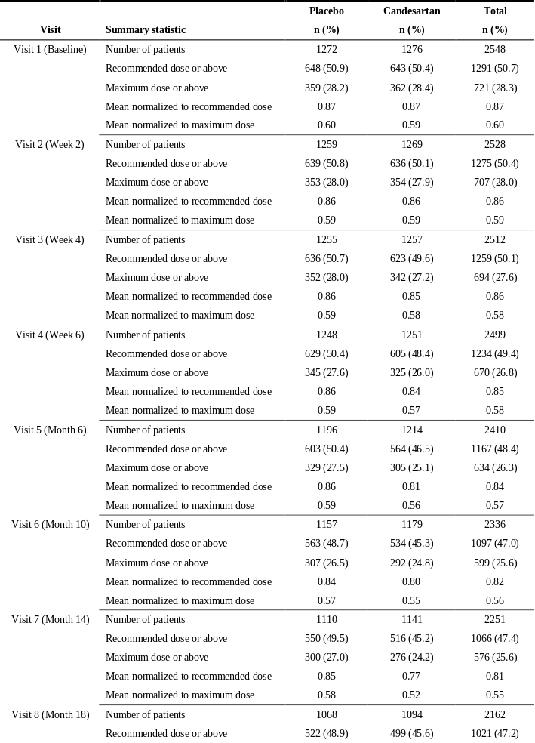
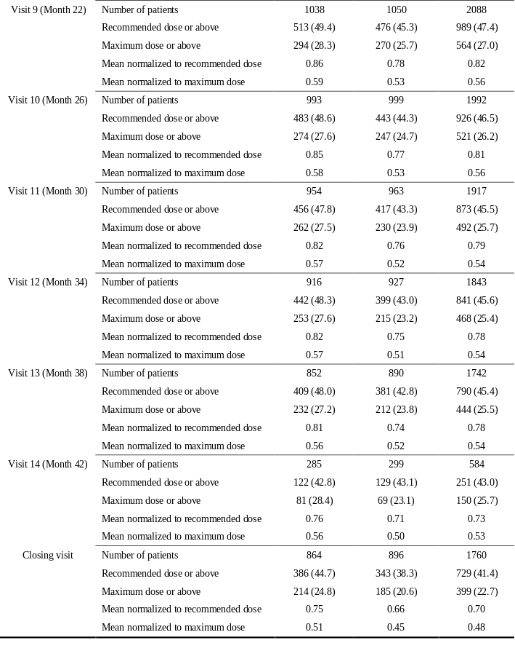
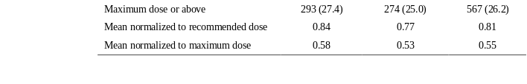
BD Table 48—Summary Table of Concomitant ACE Inhibitor Use
(CHARM-Added)

Slide 21
Endpoint Analyses Based on Recommended or Maximum† ACEi Doses During Study
CHARM Added
36
Peter Johanson ACE analyses to US T 11 – T 20
Candesartan better
Placebo better
 |  | Patients, n
CV death or CHF hospitalization
Recommended dose of ACEi | No | 1012
 | Yes | 1535
Maximum dose of ACEi | No | 1788
 | Yes | 759
All-cause mortality or CHF hospitalization
Recommended dose of ACEi | No | 1012
 | Yes | 1535
Maximum dose of ACEi | No | 1788
 | Yes | 759
CV death or CHF hospitalization or nonfatal MI
Recommended dose of ACEi | No | 1012
 | Yes | 1535
Maximum dose of ACEi | No | 1788
 | Yes | 759
All-cause mortality
Recommended dose of ACEi | No | 1012
 | Yes | 1535
Maximum dose of ACEi | No | 1788
 | Yes | 759
† FDA communication 12-17-04.
0.6
0.7
0.8
0.9
1
1.1
1.2
1.3
Hazard ratio (95% CI)

Slide 22
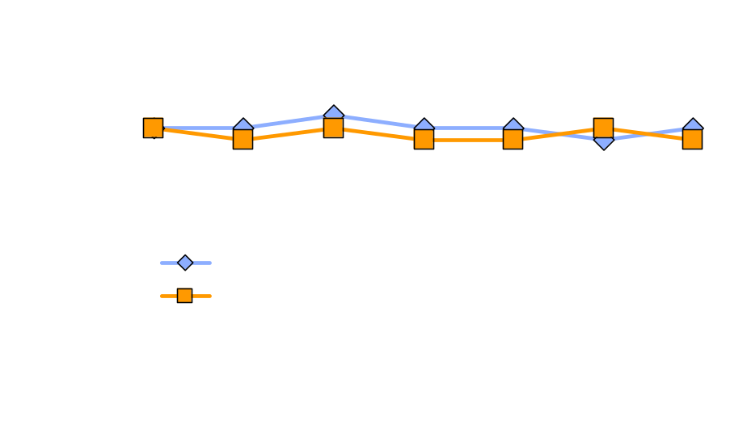
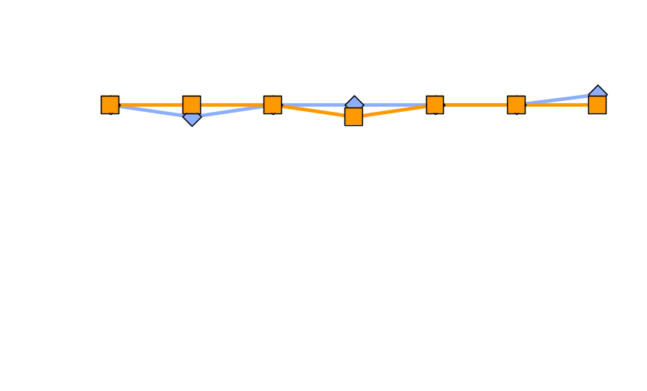
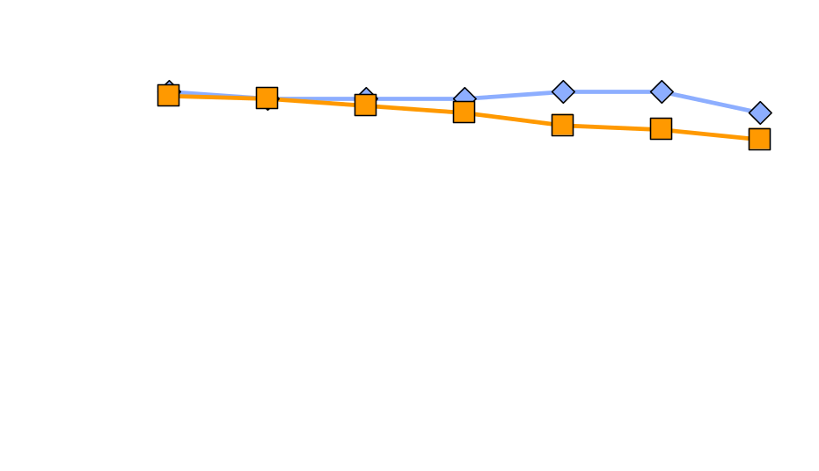
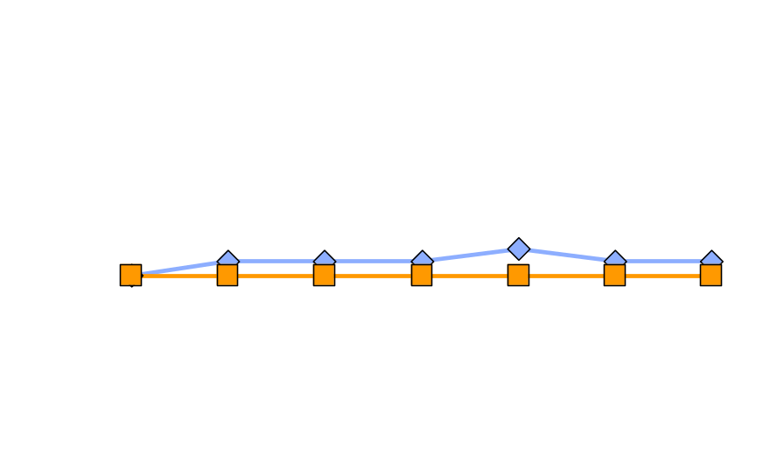
Doses of Most Common ACEi at
Selected Study Visits
CHARM Added
Enalapril (27%)
Lisinopril (19%)
Baseline
Closing
Baseline
Closing
Captopril (17%)
Ramipril (11%)
Baseline
Closing
Baseline
Closing
6 wk
6 mo
14 mo
26 mo
38 mo
6 wk
6 mo
14 mo
26 mo
38 mo

