Slide 1
Recycling Psychiatric Medications for
Smoking Cessation
John Hughes, M.D.
University of Vermont
john.hughes@uvm.edu

Slide 2


Slide 3
Rationales for Use of
Psychiatric Medications for
Smoking Cessation
Substitution of beneficial effect
Self-medication
Anti-craving
Combat withdrawal

Slide 4
References
Hughes JR, Stead LF, Lancaster T. Anxiolytics for smoking cessation. The Cochrane Library, Issue 4, 2000 Oxford
Hughes JR, Stead LF, Lancaster T.
Antidepressants for smoking cessation, 2003 update. The Cochrane Library, in press

Slide 5
Outcomes of Clinical Trials
Antidepressants Some effective
Antipsychotics Not tested
Anticonvulsants Not tested
Anxiolytics Some effective
BZD blocker Not tested
Dopaminergic Not well-tested
Lithium Not tested
Opioid agonset Not tested
Opioid blocker Not well-tested
Sedatives Not helpful
Serotonin antagonists Not tested
Stimulants Not well-tested
THC blocker Not tested

Slide 6
Antidepressant Treatments and Neurochemical Actions
Dopaminergic Adrenergic Serotonergic
Effective
Bupropion (20) + + + + + + --
Nortriptyline (5) + + + + + --
Not clear
MAOIs (4) + + + --
Doxepin (1) + + + + +
Not effective
SSRIs (6) -- -- + + +
Imipramine (1) + + + + +
Venlafaxine (2) + + + + --

Slide 7
Percent abstinent at 1 Month in Buspirone Trial
(Cinciripini, 95)
Placebo Buspirone
Low anxiety 89% 60%
High anxiety 61% 88%

Slide 8
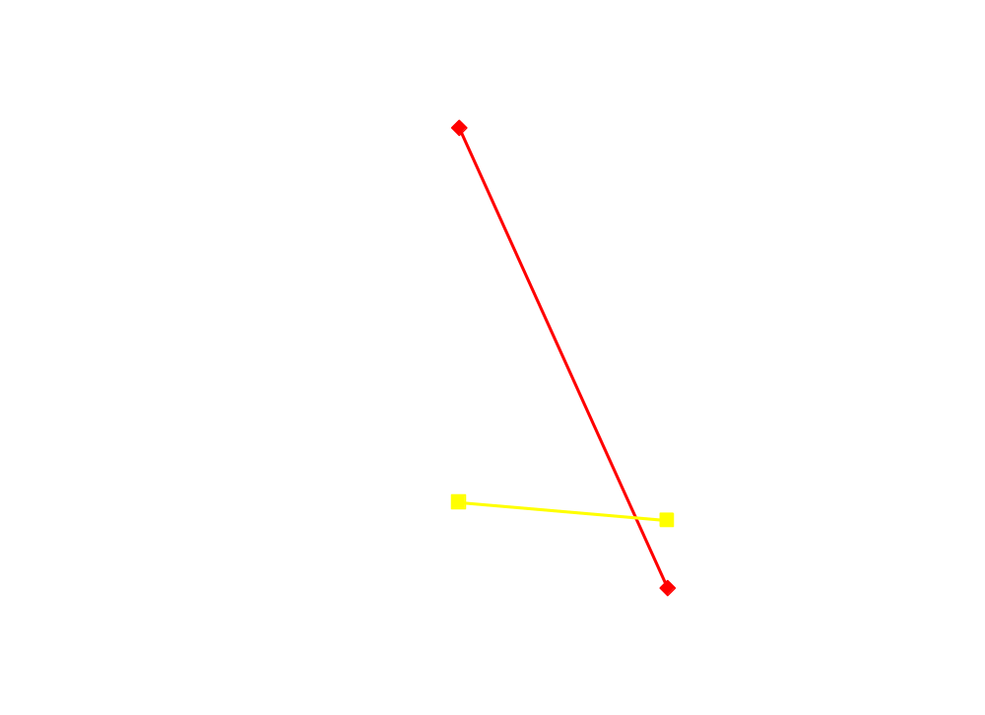
Relapse Off Drug in Buspirone Study
Buspirone
Placebo
On
Drug
Off
Drug

Slide 9
Possible Mechanisms of Action
Decrease craving
Decrease withdrawal
Decrease stimulus control
Decrease abstinence to lapse
Decrease lapse to relapse
Drug less efficacious via tolerance or blockade
Drug more aversive

Slide 10
Possible Proxy Variables
Nonhumans
Increased/decreases rate of self-administration,
breaking point, unit price
Reduces reinstatement
Reduces ability of cues to maintain responding
Blocks nicotine effects on ICSS
Withdrawal reduction
Substitutability as DS
Blocks nicotine DS

Slide 11
Extinction Models for Screening
Non Humans
Increases sensitivity to punishment
induced or alternate reinforcer-induced
extinction
Decreases extinction responding
Decreases post-extinction reinstatement

Slide 12
Types of Extinction
Remove lever = Hospitalization
Nonresponsive lever = Nicotine free cigarettes
Punish responding = Tobacco policy
Competing reinforcer = Psychosocial treatment

Slide 13
Possible Proxy Variables
Humans
Increased/decreased tobacco use
Break point in PR
Shift in unit price
Block drug-induced craving
Block stimuli's-induced craving
Craving suppression
Withdrawal
Short term abstinence

Slide 14
Possible New Models for Screening in Humans
Decreasing monetary payments for
abstinence
Decreased ability of stimuli to prompt
drug use
Self-reported ease of abstinence

Slide 15
“Proof of Concept” Trials
Pilot studies on best dose
Titrate to tolerable dose
Pick sample most likely to respond based
on prior quit experience
Short term abstinence (e.g., 2 wks)
Exit interviews to determine mechanism
of action

Slide 16
Final Words
Important to distinguish between well tested
negative results and not well tested results
Smokers tolerance for adverse events is very
low
Use optional conditions for first tests; especially
subjects, compliance, dose, duration of tx

