Slide 1
Spotlight Case November 2006
Getting a Good Report Card: Unintended Consequences of the Public Reporting of Hospital Quality

Slide 2
Source and Credits
This presentation is based on the November 2006
AHRQ WebM&M Spotlight Case
See the full article at http://webmm.ahrq.gov
CME credit is available through the Web site
  Commentary by: Peter Lindenauer MD, MSc; Baystate Health and Tufts University School of Medicine
  Editor, AHRQ WebM&M: Robert Wachter, MD
  Spotlight Editor: Tracy Minichiello, MD
  Managing Editor: Erin Hartman, MS

Slide 3
Objectives
At the conclusion of this educational activity, participants should be able to:
Understand the rationale for public reporting of hospital quality
List the current measures set being used nationally
Describe unintended consequence of public reporting and interventions to prevent these

Slide 4
The Case
A 55-year-old woman with end stage renal disease requiring hemodialysis and coronary artery disease (status post coronary artery bypass grafting and placement of a St. Jude prosthetic valve) was admitted to the medical service with palpitations and chest pain. She reported missing her scheduled hemodialysis session and her symptoms resolved with prompt inpatient hemodialysis.

Slide 5
The Case
The work-up revealed that the patient’s anticoagulation with warfarin was subtherapeutic, and a heparin drip was initiated to bridge her until the INR was in the therapeutic range.
Mostly in response to increasing pressure from the hospital's administration to improve compliance with publicly reported quality measures, the attending physician recommended pneumococcal vaccination and it was administered.

Slide 6
Public Reporting of Hospital Quality
Viewed with skepticism, but demand at all-time high
Public reporting initiatives underway throughout the United States and Europe, and at the local, national, and international levels

Slide 7
Goals of Public Reporting
Improves transparency in health care and can empower patients to make better choices about where to seek treatment
Increases hospital accountability for quality of care and provides a stimulus to improve for fear of losing market share to local competitors
Performance over time can be tied to compensation through "pay-for-performance" contracts
Marshall MN, et al. JAMA. 2000;283:1866-1874.
Notes:
1. Marshall MN, Shekelle PG, Leatherman S, Brook RH. The public release of performance data: what do we expect to gain? A review of the evidence. JAMA. 2000;283:1866-1874. http://www.ncbi.nlm.nih.gov/entrez/query.fcgi?db=pubmed&cmd=Retrieve&dopt=Abstract&list_uids=10770149

Slide 8
Hospital Quality Alliance (HQA)
A national public-private collaboration established to encourage hospitals to voluntarily collect and report hospital quality performance information
Achieved participation rates > 98% because linked to annual payment update by Centers for Medicare & Medicaid Services
Hospital Quality Alliance Web site.
Notes:
2. Hospital Quality Alliance Web site. Available at: http://www.aha.org/aha_app/issues/HQA/index.jsp.

Slide 9
Hospital Quality Alliance (HQA)
Began in 2003 with 10 quality measures spread across 3 clinical conditions: heart failure, acute myocardial infarction, and pneumonia
By 2006, the program had expanded to include 21 measures including those focused on quality of surgical care
Hospital Quality Alliance Web site.
Notes:
2. Hospital Quality Alliance Web site. Available at: http://www.aha.org/aha_app/issues/HQA/index.jsp.

Slide 10
HQA: Current Measure Set
Heart Attack (Acute Myocardial Infarction or AMI)
  • Aspirin at arrival
  • Aspirin at discharge
  • ACE Inhibitor or ARB for left ventricular systolic dysfunction
  • Beta Blocker at arrival
  • Beta Blocker at discharge
  • Thrombolytic agent within 30 minutes of hospital arrival
  • Percutaneous Coronary Intervention (PCI) within 120 minutes of hospital arrival
  • Smoking cessation advice/counseling
US Dept. of Health and Human Services Hospital Compare Web site.

Slide 11
HQA: Current Measure Set (cont.)
Heart Failure
  • Assessment of left ventricular function
  • ACE inhibitor or ARB for left ventricular systolic dysfunction
  • Discharge instructions
  • Smoking cessation advice/counseling
US Dept. of Health and Human Services Hospital Compare Web site.

Slide 12
HQA: Current Measure Set (cont.)
Pneumonia
  • Oxygenation assessment
  • Initial antibiotic timing
  • Pneumococcal vaccination
  • Influenza vaccination
  • Blood culture performed prior to first antibiotic received in hospital
  • Smoking cessation advice/counseling
  • Appropriate initial antibiotic selection
US Dept. of Health and Human Services Hospital Compare Web site.

Slide 13
HQA: Current Measure Set (cont.)
Surgical Infection Prevention
• Prophylactic antibiotic received within 1 hour prior to surgical incision
• Prophylactic antibiotics discontinued within 24 hours after surgery end
US Dept. of Health and Human Services Hospital Compare Web site.

Slide 14
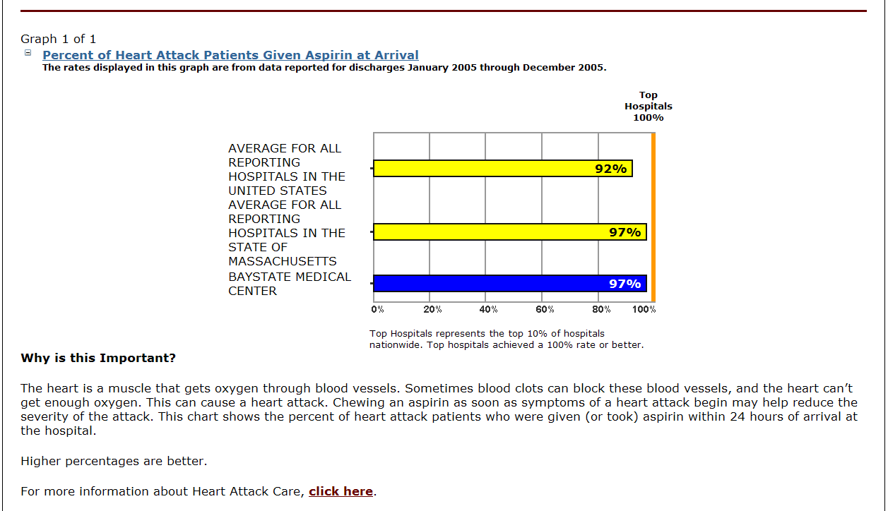
Example Screenshot of HQA Data Available to Public on the Hospital Compare Web Site
http://www.hospitalcompare.hhs.gov/

Slide 15


Impact of Public Reporting
Little known about actual impact on quality of care or patient outcomes
No evidence that public reporting affects patients' decisions on where to receive care
Case of New York state and Wisconsin
Hibbard JH, et al. Health Aff (Millwood). 2005;24:1150-1160.
Notes:
5. Hibbard JH, Stockard J, Tusler M. Hospital performance reports: impact on quality, market share, and reputation. Health Aff (Millwood). 2005;24:1150-1160.
http://www.ncbi.nlm.nih.gov/entrez/query.fcgi?db=pubmed&cmd=Retrieve&dopt=Abstract&list_uids=16012155 Speaker notes:
New York:
After New York State began publicly reporting hospital specific mortality following coronary bypass surgery, rates were observed to fall, but the mechanism through which this occurred continues to be debated.
Wisconsin: A report on the impact of the Quality Counts program in Wisconsin found that hospitals involved in public reporting of risk-adjusted outcomes engaged in more quality improvement activities and were more likely to show improved outcomes than control institutions.

Slide 16
The Case (cont.)
Later that day, the patient complained of pain over her right upper arm. The attending told her that this was common after immunization and that it would resolve. The next day, the patient reported that her pain was worse, and the team noted an 8 cm hematoma within the muscles of her upper arm. The hematoma resolved spontaneously. There was no permanent harm.

Slide 17
Concerns About Public Reporting
Are the measures being reported valid?
  Field of quality measurement in health care is still in its infancy
  Only a small number of measures based on sound evidence
  Measures validated for one purpose sometimes used inappropriately
See Notes for complete references.
Notes:
Note for speaker:
Example of measures validated for one purpose used for another: patient safety indicators derived from administrative data sources can be valuable tools for case identification and the monitoring of rates at a single organization, but should not used to compare rates across hospitals.
7. Eddy DM. Performance measurement: problems and solutions. Health Aff (Millwood). 1998;17:7-25.
http://www.ncbi.nlm.nih.gov/entrez/query.fcgi?db=pubmed&cmd=Retrieve&dopt=Abstract&list_uids=9691542
8. Epstein AM. Rolling down the runway: the challenges ahead for quality report cards. JAMA. 1998;279:1691-1696.
http://www.ncbi.nlm.nih.gov/entrez/query.fcgi?db=pubmed&cmd=Retrieve&dopt=Abstract&list_uids=9624015
9. Casalino LP. The unintended consequences of measuring quality on the quality of medical care. N Engl J Med. 1999;341:1147-1150.
http://www.ncbi.nlm.nih.gov/entrez/query.fcgi?db=pubmed&cmd=Retrieve&dopt=Abstract&list_uids=10511617
10. Werner RM, Asch DA. The unintended consequences of publicly reporting quality information. JAMA. 2005;293:1239-1244.
http://www.ncbi.nlm.nih.gov/entrez/query.fcgi?db=pubmed&cmd=Retrieve&dopt=Abstract&list_uids=15755946
11. Wachter RM. Expected and unanticipated consequences of the quality and information technology revolutions. JAMA. 2006;295:2780-2783.
http://www.ncbi.nlm.nih.gov/entrez/query.fcgi?db=pubmed&cmd=Retrieve&dopt=Abstract&list_uids=16788133

Slide 18
Concerns About Public Reporting
  Comparing outcomes across institutions hampered by real and perceived challenges of carrying out risk adjustment and by limited statistical power when studying rare events
  Shift towards the use of process measures (what was done) instead of outcomes (what happened to the patient), but may fail to result in actual improvements in the outcomes of care
Notes:
Pitfalls of using process measures instead of process outcomes: if the association between the process measure and the desired outcome is weak, or if there is improvement in the documentation of the process but not in the actual process itself.

Slide 19
Unintended Consequences: Direct Harm
Development of allergic reaction following medication administration in patient not previously known to have an allergy
Administration of a beta blocker to a patient with heart block
Provision of multiple influenza vaccinations to a patient during a single hospitalization
Development of bleeding from venous thromboembolism prophylaxis that did not adequately outline contraindications to the use of heparins

Slide 20
Unintended Consequences: Indirect Harm
Important health care matters neglected when physicians or nurses shift their attention to those aspects of care for which they are being asked to report publicly
  Achieving optimal glycemic control during the hospitalization of a diabetic while failing to intervene to correct untreated hyperlipidemia

Slide 21
Unintended Consequences: Indirect Harm
Hospitals may reallocate valuable resources to excel in public measures while overlooking more pressing opportunities to improve care
  Hospitals may decide to hire additional clinical personnel to improve performance from 98% to 100% on a measure, such as the use of aspirin in myocardial infarction, while the quality of care for patients with stroke or COPD is neglected

Slide 22
Unintended Consequences: Indirect Harm
Hospitals may turn away high-risk patients who might tarnish their scores
  When outcomes such as mortality or complications are being compared, hospital will have higher scores with lower-risk population

Slide 23
Unintended Consequences: Indirect Harm
Patients and payers may misinterpret quality performance information and make poor choices about where to seek care or direct patients
  Limited number of clinical areas for which public reporting has been implemented; performance in one area does not predict high performance in other clinical areas
Jha AK, Li Z, et al. N Engl J Med. 2005;353:265-274.
Notes:
13. Jha AK, Li Z, Orav EJ, Epstein AM. Care in U.S. hospitals--the Hospital Quality Alliance program. N Engl J Med. 2005;353:265-274.
http://www.ncbi.nlm.nih.gov/entrez/query.fcgi?db=pubmed&cmd=Retrieve&dopt=Abstract&list_uids=16034012

Slide 24
Reducing the Burden of Unintended Consequences
Acknowledge that unintended consequences are bound to occur following any effort to implement change
Educate staff about the change
Implement failure mode effects analysis (FMEA)
  Systematic, proactive, method for evaluating a process to identify where and how it might fail, and to assess the relative impact of different failures

Slide 25

Reducing the Burden of Unintended Consequences
Minimize reliance on human vigilance
Implement checklists, protocols, and forcing functions
  Electronic order entry systems to prevent administration of medications to patients with specific contraindications
  Medication dispensing and administration system can be designed to require the nurse to document a heart rate before releasing a beta blocker for administration

Slide 26
Reducing the Burden of Unintended Consequences
Monitoring
  Automated detection can be used to measure how often patients with heart failure receive treatment with antibiotics intended for treatment of pneumonia

Slide 27
Reducing the Burden of Unintended Consequences
Reasonable expectations by payers
  Set and communicate realistic goals: a goal of 100% is not possible without resulting in unintended effects
  Institute a broad range of measures, rotating them frequently, without announcement to prevent hospitals from gaming the system
  Consider incorporating predictable unintended events into standard public reporting measure sets

Slide 28
The Case: Revisited
“A 55-year-old woman with end stage renal disease requiring hemodialysis and coronary artery disease..”
  Current immunization measures apply only to patients with pneumonia
  Patient may have benefited but there was no such reporting requirement
  The attending physician was not correct that failure to immunize would have affected the hospital’s performance

Slide 29
The Case: Revisited
“…a heparin drip was initiated…pneumococcal vaccination was administered…the team noted an
8 cm hematoma within the muscles of her upper arm”
  Anticoagulation is not considered a contraindication to the administration of immunization
  Best viewed as a non preventable case of direct harm that occurred while following clinical guidelines

Slide 30
The Case: Revisited
“…a heparin drip was initiated…pneumococcal vaccination was administered…the team noted an
8 cm hematoma within the muscles of her upper arm”
  Regulatory agencies must be willing to modify problematic measures
  Clinicians need to report unintended consequences to regulatory agencies to allow these measures to be modified

Slide 31
Take-Home Points
Reporting policies may improve transparency in health care, increase hospital accountability for quality of care, and facilitate "pay-for-performance"
Providers should be familiar with current measures being reported and the resources to keep updated
Improving compliance with reported measures may entail unintended consequences
Systems should be in place for monitoring, prevention, and reporting

