Slide 1

Clinical Guidelines: Building Blocks for Effective Chronic Illness Care
Jean Slutsky, P.A., M.S.P.H.
Director, National Guideline Clearinghouse
Project Director, US Preventive Services Task Force
U.S. Agency for Healthcare Research and Quality
Notes:
“Slutsky intro”

Slide 2
Finding the Evidence
Approximately 8,000 completed references are added to MEDLINE each week (over 400,000 added per year)
Too much for any one person to evaluate
Uncertainty results in:
  variations in care
  under and over utilization of services
Notes:
“evidence”

Slide 3
Putting Evidence into Practice
It may take as long as 17 years for original research to be put into routine clinical practice
Source: Balas EA, Boren SA. Managing Clinical Knowledge for Health Care Improvement. Yearbook of Medical Informatics. Schattauer, 2000: 65-70.
Notes:
“Evidence-practice”

Slide 4

Documented Variation in Treatment of Congestive Heart Failure
69 hospitals in 5 states;
2077 patients with CHF
Source: Effective Clinical Practice, March/April 2000
Notes:
“variation”

Slide 5
Under-use of Beta-blockers
Despite strong evidence that use of beta-blockers following acute myocardial infarction (AMI) decreases morbidity and mortality, they are substantially under used in the elderly.
Beta-blocker prophylaxis after AMI is one of the most scientifically substantiated, cost-effective medical services. Their use decreases cardio-vascular mortality and reinfarctions, and increases survival by 20% to 40%.
Under use leads to excess 2-year mortality and re-hospitalization for cardiovascular disease.
Source: JAMA January 8, 1997; 277: 115-121
Notes:
“beta-blockers”

Slide 6
Under-use of Beta-blockers (cont’d)
Only 21% of eligible New Jersey Medicare beneficiaries received beta-blocker therapy following their heart attack.
Calcium channel blockers were used almost 3 times as often despite a lack of evidence that they decreased mortality.
Patients on beta-blockers were re-hospitalized 22% less often and their mortality rate was 43% lower than non-recipients.
Patients receiving calcium channel blockers instead of beta-blockers doubled their risk of death
Source: JAMA January 8, 1997; 277: 115-121
Notes:
“under-beta”

Slide 7
Examples of Quality of
Chronic Health Care
52% of elderly adults received a flu shot in 1993
33% of hospitalized elderly discharged on an anti-depressant were on a dose below recommended level
49% of diabetic adults had dilated eye exam in past year
43% of patients who should have received coronary angiography received it within 3 months
Source: M.A. Schuster et al., Milbank Q, 1998; 76:517-563
Notes:
“examples”

Slide 8
Chronic Care Management
Do the RIGHT thing to the RIGHT patient at the RIGHT time.
Notes:
“CCMgmnt”

Slide 9
Guidelines Can Improve
Clinical Decisions
Clinical guidelines based on critical appraisal of scientific evidence (evidence-based guidelines) clarify which interventions are of proven benefit and document quality of supporting data.
  Alert clinicians to interventions unsupported by good science
  Reinforce the importance and methods of critical appraisal
  Call attention to ineffective, dangerous, and wasteful practices
Source: BMJ 1999;318:527-530 ( 20 February )
Notes:
“guidelines”

Slide 10
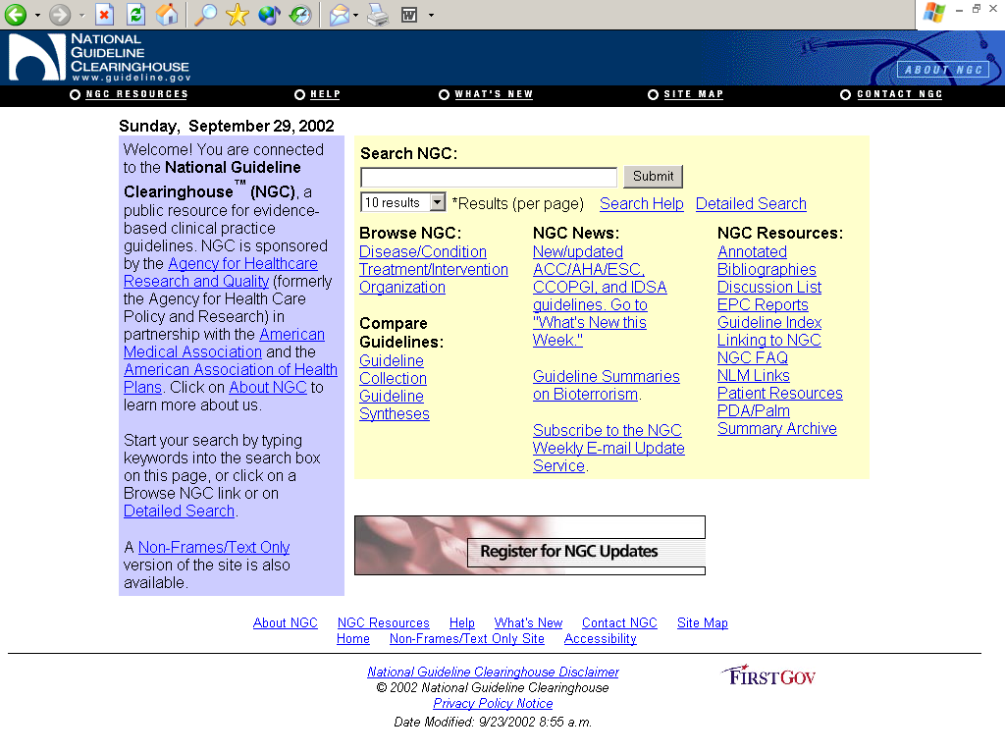
Notes:
“NGCweb1”

Slide 11
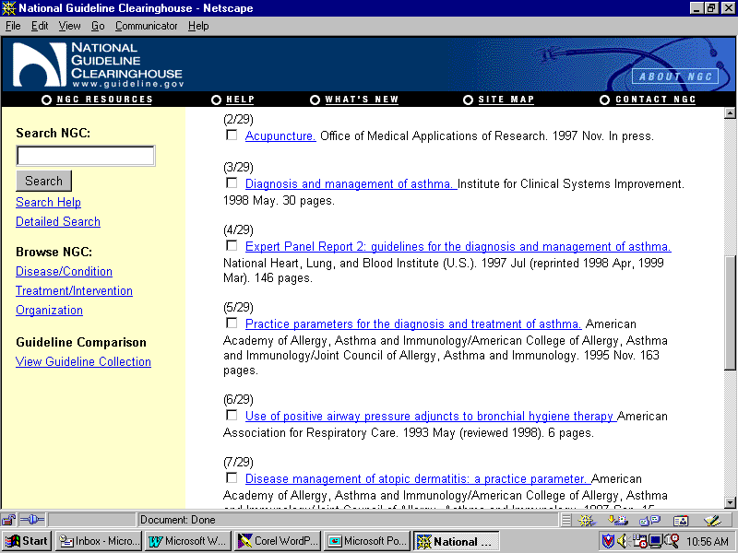
Notes:
“NGCWeb2”

Slide 12
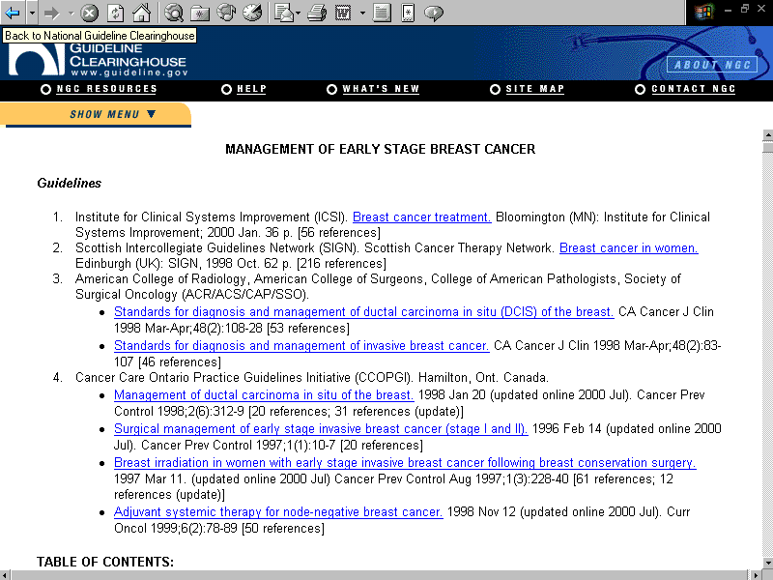
Notes:
“NGCWeb3”

Slide 13
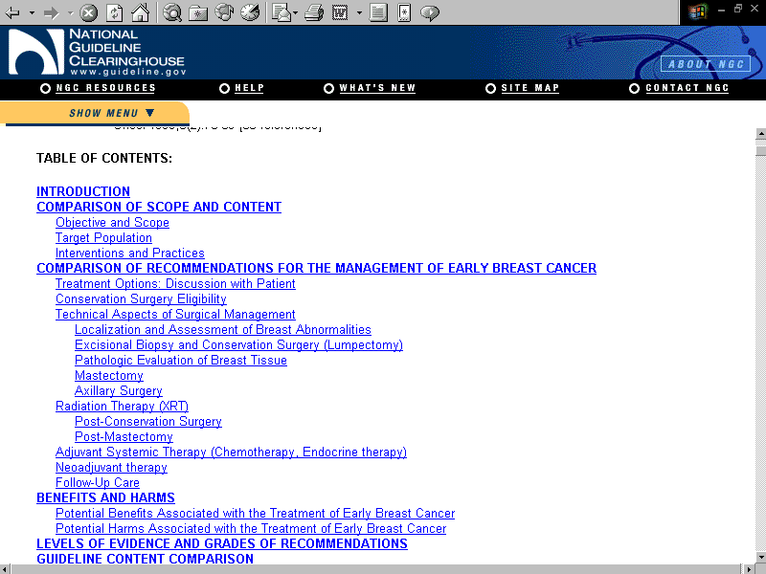
Notes:
“NGCWeb4”

Slide 14

In Summary
Chronic illness care should be based on the best available evidence
“Stop, look, and listen” and make sure that you know what you are using: who developed it, how good is the information, and is it current
www.guideline.gov provides access to evidence-based guidelines
Notes:
“Summary”

