Slide 1



Preventive Cardiology Pharmacotherapy Update
Joseph J. Saseen, Pharm.D., FCCP, BCPS
Associate Professor
Clinical Pharmacy and Family Medicine
University of Colorado Health Sciences Center
joseph.saseen@uchsc.edu

Slide 2
Objectives
Compare and contrast recent evidence evaluating hypertension pharmacotherapy, and dyslipidemia pharmacotherapy with contemporary consensus guidelines
Describe antihypertensive classes that have proven benefits in reducing CV events
Identify the benefit of intensive LDL lowering in patients with diabetes and/or established CHD

Slide 3
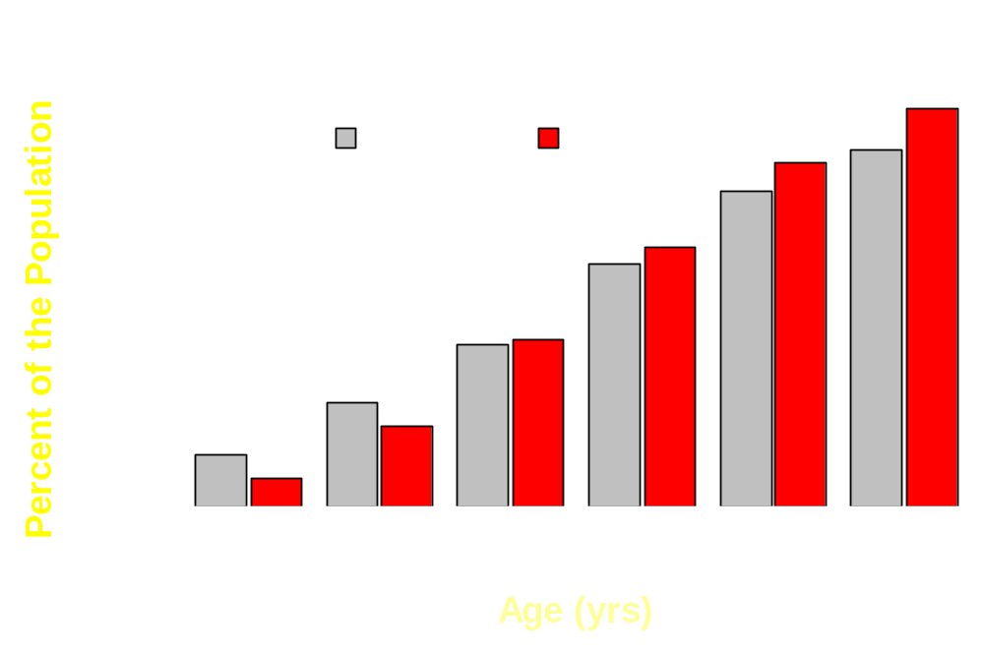
Cardiovascular Disease (CVD) in the U.S. (1999-2000)
American Heart Association. Heart Disease and Stroke Statistics — 2005 Update.

Slide 4
2004 Top Prescribed Drugs (#)
Hydrocodone/APAP 92,719,975
Lipitor 69,766,431
Lisinopril 46,206,563
Atenolol 44,162,229
Synthroid 44,056,176
Amoxicillin 41,393,538
HCTZ 41,345,733
Zithromax 37,171,754
Furosemide 36,508,251
Norvasc 34,729,004
Toprol XL 2,794,562
Alprazolam 32,404,743
Albuterol 31,219,862
Zoloft 29,877,707
Zocor 27,234,005
Metformin 25,472,580
Ibuprofen 25,188,051
Triamterene/HCTZ 24,616,014
Ambien 24,494,669
Cephalexin 23,665,172
http://www.rxlist.com/top200.htm

Slide 5
Major Cardiovascular Risk Factors
Age (> 55 for men, 65 for women)
Hypertension
Cigarette smoking
Dyslipidemia
Diabetes mellitus
Family history of premature CVD (men <55 or women <65)
Obesity (BMI >30 kg/m²)
Physical inactivity
Microalbuminuria or estimated GFR <60 mL/min
Hypertension 2003;42:1206.

Slide 6
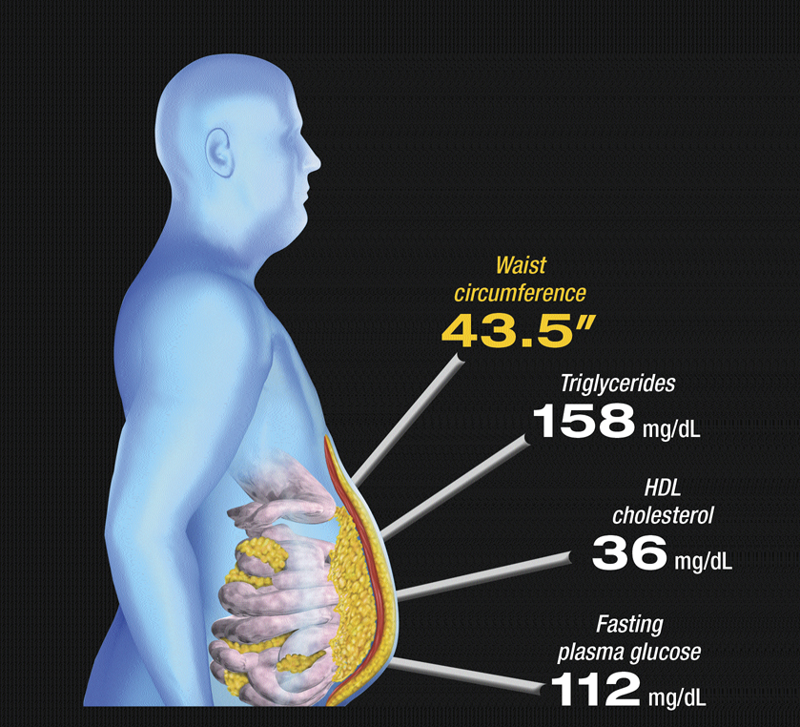
AHA/NHLBI Scientific Statement
Diagnosis and Management of the Metabolic Syndrome
An American Heart Association/National Heart, Lung, and Blood Institute
Scientific Statement
Executive Summary
AHA/NHLBI Scientific Statement
Blood Pressure
136/88 mm Hg
Circulation. 2005;112:e285-e290

Slide 7
AHA/NHLBI Scientific Statement
Metabolic Syndrome Diagnostic Criteria
Measure (3 of 5 constitutes diagnosis) | Categorical Cut Points
Elevated waist circumference (in) | ≥ 40 (men), ≥ 35 (women)
Elevated TGs (mg/dL) | ≥ 150 or drug therapy
Reduced HDL-C (mg/dL) | < 40 (men), < 50 (women) or drug therapy
Elevated BP (mm Hg) | ≥ 130/85 or drug therapy
Elevated fasting glucose (mg/dL) | ≥ 100 or drug therapy
Circulation. 2005;112:e285-e290

Slide 8
Risk for CHD and Diabetes Based on Number of Metabolic Syndrome Criteria
No. of factors:
25
24.40
0
1
2
3
4 or 5
20
Hazard Ratio
15
10
7.26
5
3.65
4.50
2.25
3.19
2.36
1
1.79
1
0
CHD
Diabetes
Circulation 2003;108:414-419

Slide 9
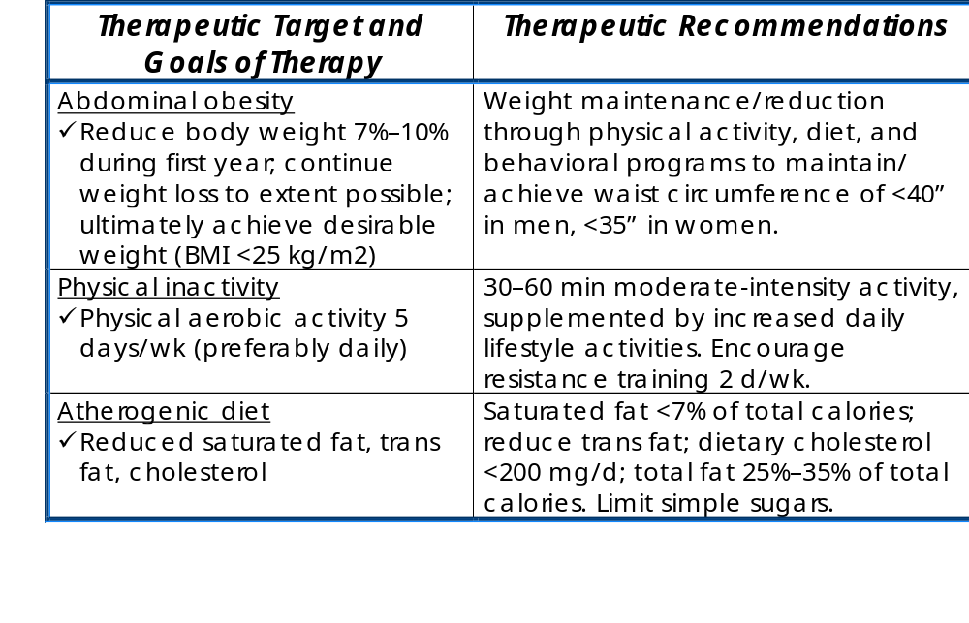
AHA/NHLBI Scientific Statement
Lifestyle Modifications
Circulation. 2005;112:e285-e290

Slide 10
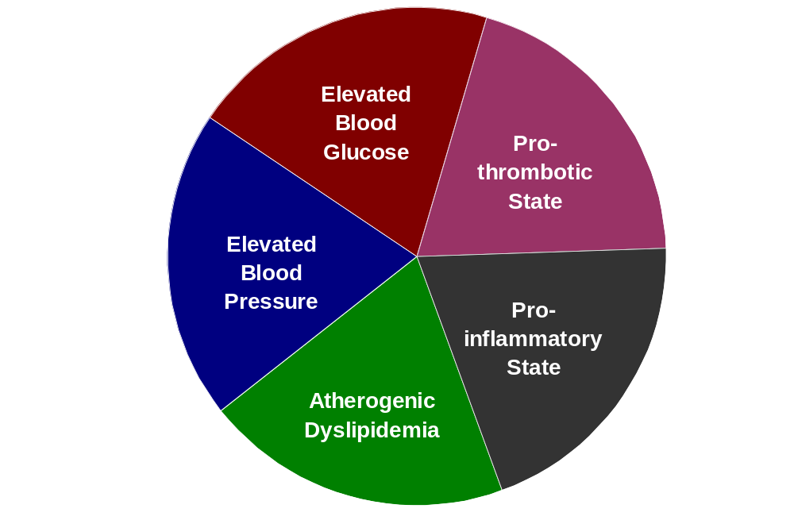
AHA/NHLBI Scientific Statement
Components that may be targeted with pharmacotherapy:
Circulation. 2005;112:e285-e290

Slide 11


Seventh Report of the Joint National Committee on Prevention, Detection, Evaluation, and Treatment of High Blood Pressure (JNC 7)
Primary Goal: ↓ morbidity and mortality
  Target organ disease
    Heart, brain, kidney, periphery, eyes
Surrogate Goal: Treat to a target BP
  <140/90 mm Hg for most
  <130/80 mm Hg for Diabetes or Chronic Kidney Disease (CKD)
Hypertension. 2003;42:1206–1252

Slide 12
Antihypertensive Agents
Primary Agents
  Supported by Outcomes data:
    Diuretics
    ACE Inhibitors
    Angiotensin Receptor Blockers (ARBs)
    Calcium Channel Blockers (CCBs)
    Beta-blockers
Alternative Agents
    Alpha-blockers, Arterial vasodilators, Centrally acting agents, Reserpine

Slide 13
Algorithm for Hypertension
Initial Drug Choices
Without Compelling
Indications
With Compelling
Indications
Stage 1 Hypertension
(SBP 140–159 or DBP 90–99 mmHg)
Thiazide-type diuretics for most.
May consider ACEI, ARB, BB, CCB,
or combination.
Stage 2 Hypertension
(SBP >160 or DBP >100 mmHg)
2-drug combination for most (usually thiazide-type diuretic and
ACEI, or ARB, or BB, or CCB)
Drug(s) for the compelling indications
Other antihypertensive drugs (diuretics, ACEI, ARB, BB, CCB)
as needed.
Hypertension. 2003;42:1206–1252

Slide 14
Antihypertensive and Lipid-Lowering Treatment to Prevent Heart Attack Trial
ALLHAT
Objective: Compare amlodipine, doxazosin and lisinopril to chlorothalidone
Prospective, double-blind, randomized trial
42,448 patients with hypertension for 4 to 9 yrs
Mean age was 67 yrs
Atenolol, reserpine, or clonidine allowed as add-on if BP was not controlled, then hydralazine
Primary Endpoint: nonfatal MI + CHD death
JAMA 2002;288:2981-97

Slide 15
Results
ALLHAT
Primary Endpoint: Nonfatal MI + CHD death
Secondary Endpoints:
 | 6-yr event rate (%) | RR (95% CI)
Chlorthalidone | 11.5 | --
Lisinopril | 11.4 | 0.99 (0.91-1.08)
Amlodipine | 11.3 | 0.98 (0.90-1.07)
 | RR (95% CI)
 | Heart Failure | Stroke
Lisinopril vs Chlorthalidone | 1.38 (1.25-1.52) | 1.15 (1.02-1.30)
Amlodipine vs Chlorthalidone | 1.19 (1.07-1.31) | 0.93 (0.82-1.06)
JAMA 2002;288:2981-97

Slide 16
ASCOT-Blood Pressure Lowering Arm
Objective: Compare atenolol +/- bendroflumethiazide vs. amlodipine +/- perindopril
Prospective, double-blind, randomized trial
19,257 patients with hypertension and 3 other CV risk factors treated for 5.5 yrs
Mean age was 63 yrs
Primary Endpoint: nonfatal MI + CHD death
Lancet 2005; 366: 895–906

Slide 17
ASCOT-Blood Pressure Lowering Arm
Amlodipine-based
Atenolol-based
20
p=0.007
15
p=0.11
Rate per 1000
p=0.0003
10
5
0
Primary: Non-fatal MI
Secondary: All
Secondary: Stroke
+ fatal CHD*
Coronary Events
*includes silent MI
Lancet 2005;366:895–906

Slide 18
ASCOT-Blood Pressure Lowering Arm
 | Mean SBP (mmHg) | Mean DBP (mmHg)
Amlodipine-based | 136.1 | 77.4
Atenolol-based | 137.7 | 79.2
p<0.0001
p<0.0001
After multivariate adjustments for BP and other differences (e.g., cholesterol):
  No statistical difference in all coronary events
  No statistical difference in stroke
Lancet 2005;366:907–13

Slide 19
Beta-Blockers for “Primary Hypertension”
In 2004, a meta analysis of 9 atenolol-based clinical trials demonstrated no decrease in all cause mortality, CV mortality or MI
In 2005, a newer meta analysis evaluated:
  13 randomized controlled trials (n=105,951) comparing beta-blockers to other agents
  7 randomized controlled trials (n=27,433) comparing beta-blockers to placebo
Lancet 2004;364:1684–1689
Lancet 2005;366:1545-1553

Slide 20
2005 Meta Analysis Results
 | Relative Risk (95% CI)
 | Beta-Blocker vs placebo | Beta-Blocker vs other agents | Atenolol vs other agents
Stroke | 0.81 (0.71-0.93) | 1.16 (1.04–1.30) | 1.26 (1.15-1.38)
MI | 0.93 (0.83-1.04) | 1.02 (0.93–1.12) | 1.05 (0.91-1.21)
Total Mortality | 0.95 (0.86-1.04) | 1.03 (0.99–1.08) | 1.08 (1.02-1.14)
Authors Interpretation:
  Beta-blockers should not remain first choice in the treatment of primary hypertension
Lancet 2005;366:1545-1553

Slide 21
Comparison of Beta-Blockers
 | Daily Frequency | Half life (hr) | Lipid Solubility | Cardio-selectivity | Alpha Blockade
Atenolol (generic) | 1-2 | 6-7 | Low | Yes | No
Carvedilol (Coreg) | 2 | 6-10 | High | No | Yes
Metprolol Succinate (Toprol XL) | 1 | n/a | Moderate to High | Yes | No
Metoprolol Tartarate (generic) | 2 | 3-7 | Moderate to High | Yes | No

Slide 22
JNC 7: Compelling Indications
Heart
Failure
Post
Myocardial
Infarction
High
Coronary
Disease
Risk
Recurrent
Stroke
Prevention
Diabetes
Chronic
Kidney
Disease
Goal BP
<140/90 mmHg
<130/80 mmHg
Diuretic with
ACE Inhibitor
Beta-Blocker
Beta-Blocker
Diuretic with
ACE Inhibitor
ACE Inhibitor or
ARB
ACE Inhibitor or
ARB
First-line
ACE Inhibitor
Beta-Blocker
Aldosterone Antagonist
ACE Inhibitor or CCB or
Diuretic
Diuretic
Second-line
ARB or Aldosterone Antagonist
Beta-Blocker or
CCB
Third-line

Slide 23
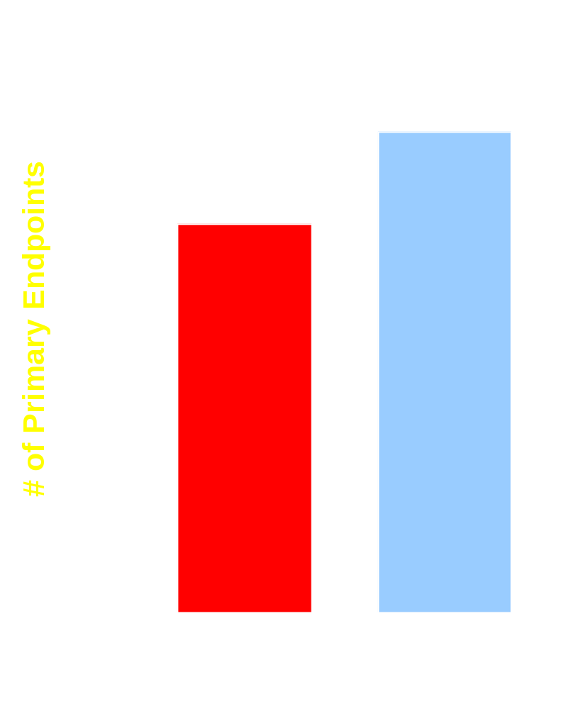
Morbidity and Mortality after Stroke (MOSES)
1405 patients with cerebrovascular disease
Randomized to eporsartan or nitredipine regimens for 2.5 yrs
Primary end point:
  Composite of total mortality and all vascular events
BP decreases:
  Eprosatan 151/84 to 138/81
  Nitrendipine 152/87 to 136/80
p=0.014
Stroke 2005;36:1218-1226

Slide 24
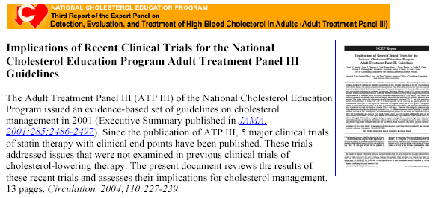
NCEP Report:
July 2004 Update

Slide 25


ATP III: 2004 Update
Risk Category | LDL-C Goal (mg/dL) | Initiate TLC (mg/dL) | Drug Therapy (mg/dL)
High CHD or equivalents (10 yr risk > 20%) | < 100 (Therapeutic Option, < 70) | ≥ 100 | ≥ 100 (<100: drug optional)
Moderately-High 2+ risk factors (10 yr risk 10-20%) | < 130 (Therapeutic Option, < 100) | ≥ 100 | ≥ 130 (100-129: drug optional)
Moderate 2+ risk factors (10 yr risk < 10%) | < 130 | ≥ 130 | ≥ 160
Lower 0 to 1 risk factors | < 160 | ≥ 160 | ≥ 190 (160-189: drug optional)
Circulation 2004; 110:227-239

Slide 26
AHA/NHLBI Scientific Statement:
Metabolic Syndrome Goal Values
Primary target: LDL-C goal
Secondary target: Non-HDL-C goal
    Only if LDL-C goal met and if TG ≥ 200 mg/dL
    Always 30 mg/dL higher than LDL-C goal
Tertiary target: HDL-C
    Only after LDL-C and non-HDL-C goals are met
    Raise to extent possible with standard therapy, ≥ 40 mg/dL (men), ≥ 50 mg/dL (women)
Circulation. 2005;112:e285-e290

Slide 27
ATP III: 2004 Update
Standard Statin Doses to
Attain 30-40% LDL-C Reductions
Drug | Dose (mg/d) | LDL-C reduction (%)
Atorvastatin | 10 | 39
Lovastatin | 40 | 31
Pravastatin | 40 | 34
Simvastatin | 20-40 | 35-41
Fluvastatin | 40-80 | 25-35
Rosuvastatin | 5-10 | 39-45
Circulation 2004; 110:227-239

Slide 28
Lipid-Lowering Therapies
 | LDL-C | HDL-C | TG
Statins (atorvastatin, fluvastatin, lovastatin, pravastatin, rosuvastatin, simvastatin) | ↓ 18-63% | ↑ 5-15% | ↓ 7-30%
Bile Acid Sequestrants (colesevelam, cholestyramine, colestipol) | ↓ 15-30% | ↑ 3-5% | 0 or ↑
Nicotinic Acid | ↓ 5-25% | ↑ 15-35% | ↓ 20-50%
Fibric Acid Derivatives (gemfibrozil, fenofibrate) | ↓ 5-20 or ↑ | ↑ 10-20% | ↓ 20-50%
Cholesterol Absorption Inhibitor (ezetimibe) | ↓ 18% | ↑ 1% | ↓ 7%
JAMA 2001;285:2486. Zetia [package insert] Merck-Shering-Plough Pharmaceuticals; 2003.
Crestor [package insert] Astra-Zeneca; 2003
Notes:
NCEP ATP III guidelines recommend therapeutic lifestyle changes (TLC) as an essential component of lipid-lowering.
Diet
Reduced intake of saturated fat (<7% of total calories)
Reduced intake of cholesterol (<200 mg/d)
Use of plant stanols/sterols
Use of soluble fiber
Weight reduction
Increased physical activity
Patients at high risk are likely to require both TLC and pharmacologic therapy.
Statins
Fibrates
Niacin
Bile acid sequestrants
These agents target different aspects of lipid metabolism and have been shown to reduce the risk of CAD.
Executive Summary of the Third Report of the National Cholesterol Education Program (NCEP) Expert Panel on Detection, Evaluation, and Treatment of High Blood Cholesterol in Adults (Adult Treatment Panel III). JAMA. 2001;285:2486-2497.

Slide 29
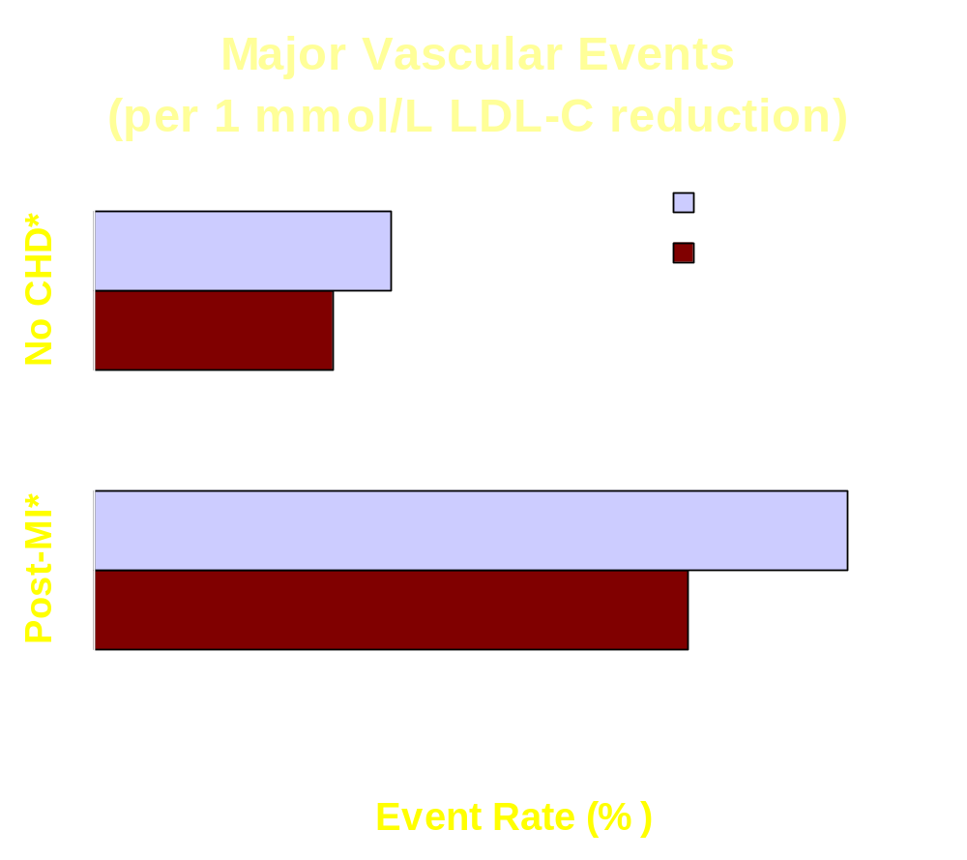
Cholesterol Treatment Trialists’ Collaborators
Meta-analysis,14 randomized controlled trials (n=90,056)
Cancer incidence
  RR 1.00 (0.95-1.06)
Rhabdomyolysis
  Statin: 9 of 39,884 (0.023%)
  Control: 6 of 39,817 (0.015%)
  P=0.4
*p<0.001
Lancet 2005;366:1267-1278

Slide 30
Collaborative AtoRvastatin Diabetes Study (CARDS)
2838 primary prevention patients with type 2 diabetes randomized to placebo or atorvastatin 10 mg daily for 3.9 yrs
Mean baseline LDL 118 mg/dL decreased to 77 mg/dL
37% reduction
Placebo
Primary Endpoint: Major CV Event (%)
p=0.001
ARR = 3.2%
NNT = 31
Atorvastatin 10 mg
Lancet 2004;364:685-696

Slide 31

Treat to New Targets (TNT) Trial
10,001 patients with CHD and LDL-C <130mg/dL randomized to atorvastatin 10 mg or 80 mg daily for 5 yrs
22% reduction
10 mg atorvastatin
Mean LDL = 101 mg/dL
p<0.001
ARR = 2.2%
NNT = 45
80 mg atorvastatin
Mean LDL = 77 mg/dL
*includes stroke
N Engl J Med. 2005;352:1425-1435

Slide 32
Incremental Decrease in Clinical Endpoints Through Aggressive Lipid Lowering (IDEAL)
Atrovastatin 80 mg/d
8888 patients with a past history of MI
Randomized, to open-label high dose atorvastatin or standard dose simvastatin x 4.8 yrs
Blinded endpoint evaluations
Mean LDL-C (mg/dL):
  Simvastatin 104
  Atorvastatin 81
40
Simvastatin 20 mg/d
p=0.02
p<0.001
30
Incidence of Endpoint (%)
20
p=0.07
10
0
Primary:
Secondary:
Secondary:
Major
Major CV
Any CV Event
Coronary
Event
*does not include stroke
Event*
JAMA 2005;294:2437-2445

Slide 33
Dyslipidemia Combination Therapy
Combination therapy often used in diabetes
3,339 case reports of rhabdomyolysis with statins from 1990-2002; 38% were associated with concurrent fibrate therapy
Statin/Fibrate:
  Controlled clinical trials (n=600): 1% incidence of elevated CK (>3 x ULN); no cases of rhabdomyolysis
  Interaction most problematic with gemfibrozil
Statin/Niacin:
  Lower risk for myopathy than statin/fibrate
JAMA 2003;289:1681-1690
J Am Col Cardiol 2002;40(3):568-579

Slide 34
Statin/Fibrate Interaction
Facts about gemfibrozil:
  Known to ↑ risk of rhabdomyolysis with statins
  Inhibits hepatic glucuronidation of certain statins
  Reduced maximum statin dose in combination:
    Lovastatin 20 mg daily
    Rosuvastatin 10 mg daily
    Simvastatin 10 mg daily
Fenofibrate does not inhibit glucuronidation
JAMA 2003;289:1681-1690

Slide 35

Fenofibrate Intervention and Event Lowering in Diabetes (FIELD)
9795 patients with type 2 diabetes
Randomized, double-blind to placebo or micronized fenofibrate 200 mg daily x 5 yrs
Primary endpoint:
  CHD death +nonfatal MI
Baseline values:
  LDL-C 119 mg/dL
  TG 184 mg/dL
  HDL 42 mg/dL
p=0.35
p=0.16
*Total CV events
Lancet 2005; 366: 1849–1861

Slide 36
Conclusions

