Slide 1


TRANSLATING VISITS INTO PATIENTS USING AMBULATORY VISIT DATA
(Hypertensive patient case study)
by Esther Hing, M.P.H. and Julia Holmes, Ph.D
U.S. DEPARTMENT OF HEALTH AND HUMAN SERVICES
Centers for Disease Control and Prevention
National Center for Health Statistics

Slide 2
Outline of talk
Source of data
Two hypertension definitions compared
Methodology translating visit to patients
Accuracy of estimates assessed
Example of analytic use of patient estimates

Slide 3
Sources of data
Split-panel study of 2001 NAMCS and Outpatient Department (OPD) component of 2001 NHAMCS
Study tested effects of form length on response rates and reporting levels
  Half of sample randomly assigned short form
  Half of sample randomly assigned longer form
  Data for each half sample weighted to reflect estimates for the nation.
  Data across both half samples also weighted to reflect national estimates

Slide 4
Estimating hypertensive patients
18 years and older
Visits limited to selected specialties and clinics where hypertensive patients more likely to be treated and to avoid multiple visits to different providers by same patient:
  cardiologists, primary care physicians (family or general practice, internal medicine, pediatrics, obstetrics and gynecology).
  selected hospital OPD clinics (general medicine, pediatric, obstetrics and gynecology).

Slide 5
Hypertension definitions
 | Full sample estimate | Half sample estimate
Diagnoses | X | X
Reason for visit | X | X
Hypertension check box |  | X

Slide 6

Number of adult visits with hypertension indicated by type of estimate: 2001 NAMCS/NHAMCS

Slide 7
Methodology for translating visits to patients
Information on past visits only collected for established patients previously seen by physician in office practice or hospital OPD

Slide 8
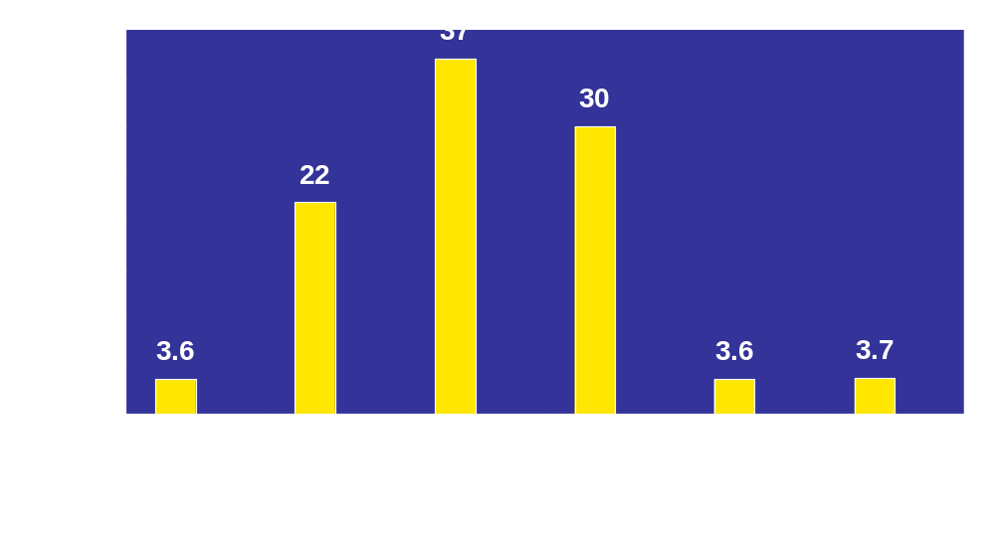
Full sample distribution of visits to physician offices and hospital OPDs made by hypertensive adults during past 12 months: 2001 NAMCS/NHAMCS

Slide 9
Assumptions
Current visit assumed to be the only visit for new patients.
Established patients with unknown number of visits during past 12 months were assumed to have same category of visits as most frequent category (4-6 visits).

Slide 10

Distribution of visits by number of physician visits after re-assignment of new patients and established patients with unknown number of visits

Slide 11
Translating visits to patients
Visits by patients known to have multiple visits during past 12 months are re-weighted by dividing the sampling weight by the midpoint of number of visit of visit category; e.g., midpoint of 4-6 visits category is 5.
Re-weighting assumes that characteristics of the sampled visit are similar to previous visits made by the patient to this provider during the past 12 months.

Slide 12
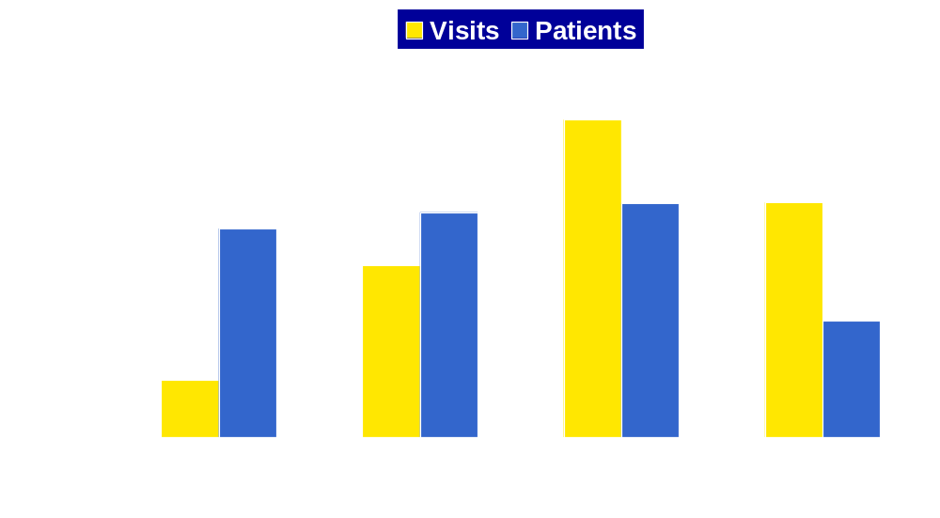
Full sample distribution of hypertensive visits and estimated patients by number of physician visits during past 12 months: 2001 NAMCS/NHAMCS

Slide 13
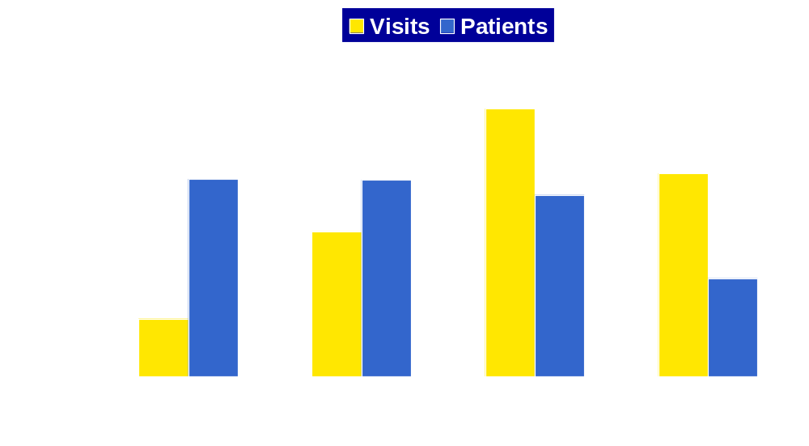
Half sample distribution of hypertensive visits and estimated patients by number of physician visits during past 12 months: 2001 NAMCS and NHAMCS Split-panel study

Slide 14
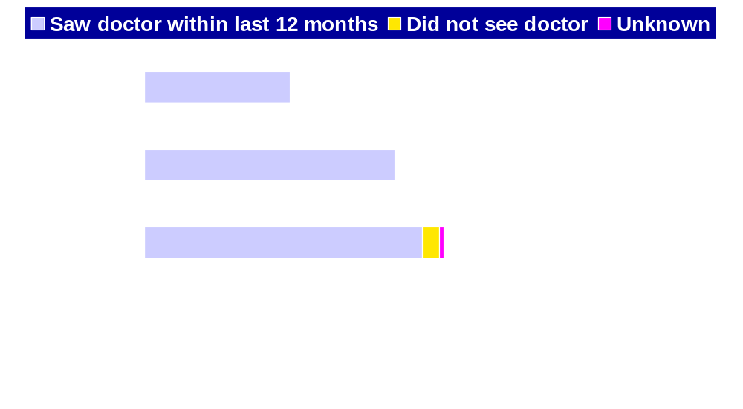
Estimated number of adults with diagnosed hypertension from NAMCS/NHAMCS and NHIS: United States, 2001
NOTE: NHIS is the National Health Interview Survey

Slide 15
Patient estimates derived from NAMCS/NHAMCS visit data differ from household survey (NHIS) estimate because of:
  Respondent reporting differences
  Household survey estimate includes persons not seen by a physician during last 12 months
  Household respondents could report for providers outside of scope of NAMCS/NHAMCS
  Other reasons

Slide 16
Example of how derived patient estimates can be used
Percent of hypertensive patients receiving recommended (evidence-based) drug therapy
Guideline: 6th Joint National Committee on Detection, Evaluation and Treatment of High Blood Pressure (JNC VI), 1997.
Recommendations vary by presence or absence of co-morbidities:
  Essential hypertension without co-morbidities
  Hypertension and diabetes
  Hypertension and ischemic heart disease

Slide 17
Anti-hypertensives used in this study
Antihypertensive treatment defined as a prescription for the following therapeutic drug classes:
  Diuretic
  Beta blocker
  Calcium channel blocker
  Angiotensin-converting enzyme (ACE) inhibitor
  Other antihypertensive drugs
Combination drugs were disaggregated and allocated to the applicable therapeutic drug class.

Slide 18
Recommended first-line anti-hypertensives (JNC VI)
Diuretics or beta blockers for patients with essential hypertension and no co-morbidities
ACE inhibitors for hypertensive patients with diabetes
Beta blockers for hypertensive patients with ischemic heart disease

Slide 19
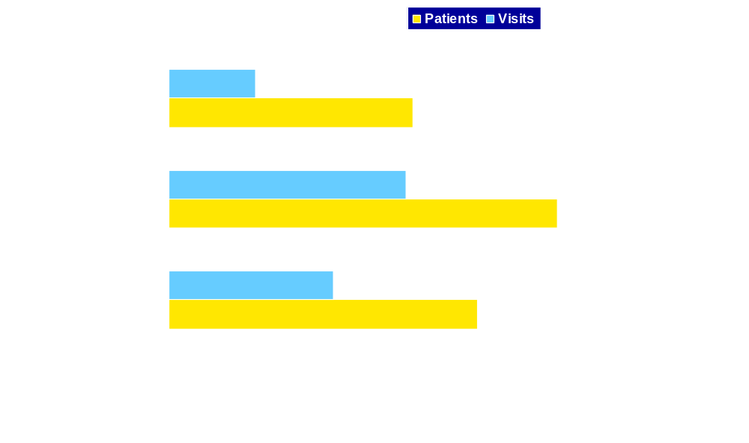
Half sample percent of adult hypertensive patients and visits prescribed first-line anti-hypertensives by presence or absence of selected co-morbidities: 2001NAMCS/NHAMCS Split-panel study

Slide 20
Anti-hypertensive prescribing pattern
Percent prescribed diuretics or beta blockers for hypertension without co-morbid diabetes or ischemic heart disease varies by definition used
  Full sample estimate defined by diagnoses and reason for visit was 40.8 percent
  Half sample defined by check box, diagnoses and reason for visit was 48 percent

Slide 21

Comparison of percent of adults with essential hypertension prescribed first-line anti-hypertensive medications (diuretic or beta blockers) by survey
MEPS=Medical Expenditures Panel Survey

Slide 22
Conclusions
Patient estimates vary by data items used to define patients
Inclusion of the hypertension check box in the definition resulted in a 72 percent higher estimate of hypertensive patients (34.9 million) than the estimate defined by diagnoses or reason for visit (20.3 million)

Slide 23
Conclusions
The outcome variable (percent of patients with hypertension prescribed diuretics or beta blocker) also varied by definition of hypertensive patients
Half sample estimate similar to estimate based on BCBSM administrative data

Slide 24
Implications for Data Users
Translation of visits to patients produced valid estimates in this case study, but users need to assess applicability of assumptions used for user’s research
Two definitions of hypertensive patients presented
  Information on hypertension check box not released on the 2001 public use files (PUF) for NAMCS and OPD component of 2001 NHAMCS, but will be included in 2005 surveys
  Diagnoses and reason for visit always available in PUF files
  Users need to be aware of differences in estimates and outcome variables associated with varying definitions of patients

Slide 25
Limitations
Estimates of drug prescribing patterns may includes cases where first-line therapy was already tried and the medications recorded reflect a newer treatment
Estimated number of patients are rough approximations and may overestimate if established patients visited multiple sample physicians or hospital OPDs during the past 12 months.

