Slide 1

An Analysis of the Quality of Care Provided to Men and Women
in the VA Health Care System
Steven M. Wright, PhD
Director of Epidemiology
Office of Quality and Performance

Slide 2
VA vs. Private Sector
CLINICAL PERFORMANCE INDICATOR | VA FY 07 | VA FY 06 | HEDIS Commercial 2006 | HEDIS Medicare 2006 | HEDIS Medicaid 2006
Breast cancer screening | 86% | 85% | 69% | 70% | 49%
Cervical cancer screening | 91% | 91% | 81% | NA | 66%
Colorectal cancer screening | 78% | 76% | 55% | 53% | NA
LDL Screening after AMI, PTCA, CABG | 93% | 92% | 87% | 88% | 76%
LDL Cholesterol < 100 after AMI, PTCA, CABG | 62% | 60% | 57% | 56% | 36%
Beta blocker on discharge after AMI | 98% | 98% | 98% | 94% | 88%
Diabetes: HgbA1c done past year | 97% | 96% | 88% | 87% | 78%
Diabetes: HbA1c > 9.0% (lower is better) | 16% | 17% | 27% | 27% | 49%
Diabetes: Cholesterol (LDL-C) Screening | 92% | 96% | 83% | 85% | 71%
Diabetes: Cholesterol (LDL-C) controlled (<100) | 64% | 61% | 43% | 47% | 31%
Diabetes: Good Control HbA1c <7 | 48% | 47% | 42% | 46% | 30%
Diabetes: Eye Exam | 85% | 85% | 55% | 62% | 51%
Diabetes: Renal Exam | 91% | 66% | 80% | 85% | 75%
Diabetes: BP < 140/90 (VA 06 & 07 data is </=) | 77% | 78% | 61% | 58% | 57%
Hypertension: BP < 140/90 most recent visit | 76% | 75% | 60% | 57% | 53%
Smoking Cessation Counseling | 83% | 80% | 74% | 44% | 43%
Immunizations: influenza | 72% (age 50-64) | 71% (≥65r or high risk) | 46% | NA | 69.6% (≥65 or high risk)
Immunizations: pneumococcal, | 90% (all ages at risk) | 89% (all ages at risk) | Not Reported | Not Reported | 67%

Slide 3
Methods
EPRP FY07 Data Sources
NEXUS Outpatient Clinics
  Random sample all ages (~ 6% women)
Women Augmented Sample
  Outpatient clinics (12K, ages 50-65)
Inpatient cohorts
  AMI, CHF, CAP, Surgical
  Low number of women

Slide 4
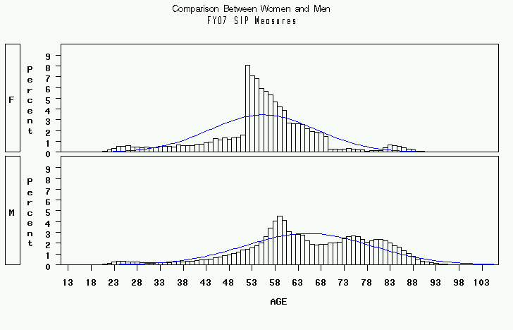
Age distribution or Women and Men in EPRP Sample FY07
Women
Men

Slide 5
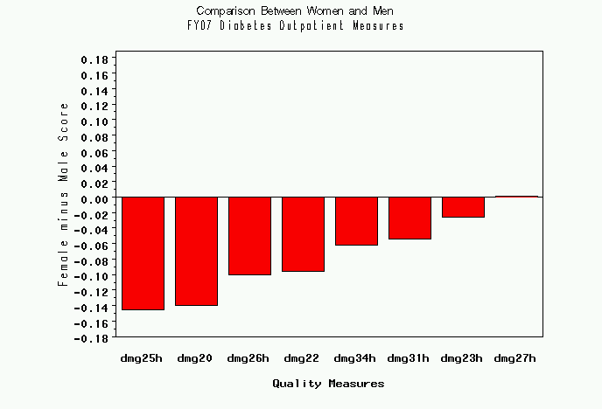
FY07 Diabetes Outpatient Measures
Difference Between Women and Men
dmg25h LDL-C <100 (HEDIS)
dmg20 ASA included in current meds
dmg26h LDL-C <130 (HEDIS)
dmg22 ACEI/ARB in current meds
dmg34h Renal testing (HEDIS)
dmg31h Retinal exam, timely by (HEDIS)
dmg23h HbA1C>9 or not done past yr (HEDIS)
dmg27h BP ≤140/90
Measures with higher score for women
Measures with lower
score for women

Slide 6
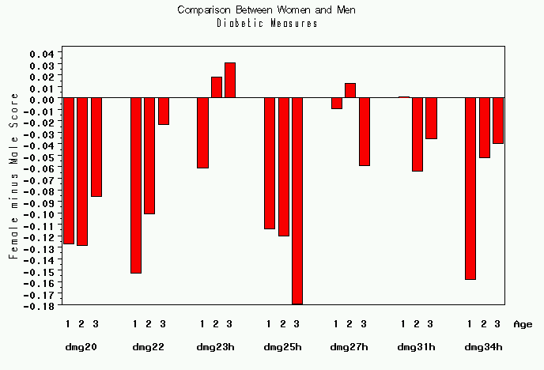
FY07 Diabetes Outpatient Measures by Age
Difference Between Women and Men
ACEI/ARB RX
LDL-C <100
BP ≤140/90
Renal testing
ASA RX
HbA1C>9 or not done past yr
Retinal exam timely
1 (≥50) 2 (51 to ≤65) 3 (>65)

Slide 7
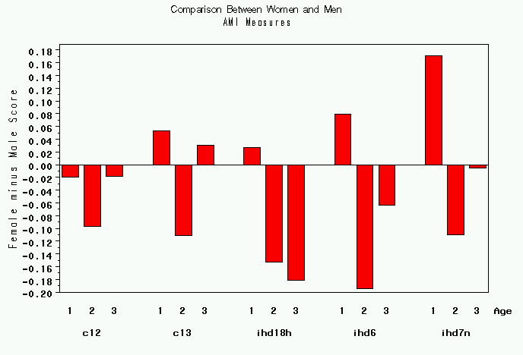
AMI Outpatient Measures by Age
Difference Between Women and Men
ASA Beta Blocker LDL<100 H LVEF<40 Tobacco Use

Slide 8
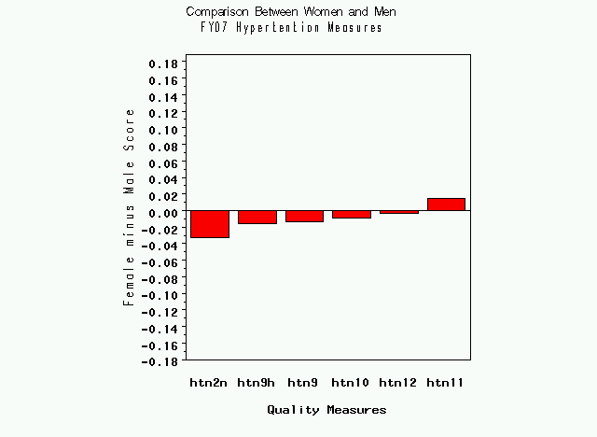
FY07 Hypertension Measures
Difference Between Women and Men
No Difference:
htn9h BP ≤ 140/90 (HEDIS) – DX HTN
Htn9 BP ≤ 140/90 (HEDIS) – No DX HTN
Favoring Women:
htn11 BP ≤140/90 - No Dx of HTN
Favoring Men:
htn2n Smoking past 12 months - HTN
htn10 BP ≥160/100 or not recorded – DX HTN
htn12 BP ≥160/100 or not recorded – No DX HTN

Slide 9
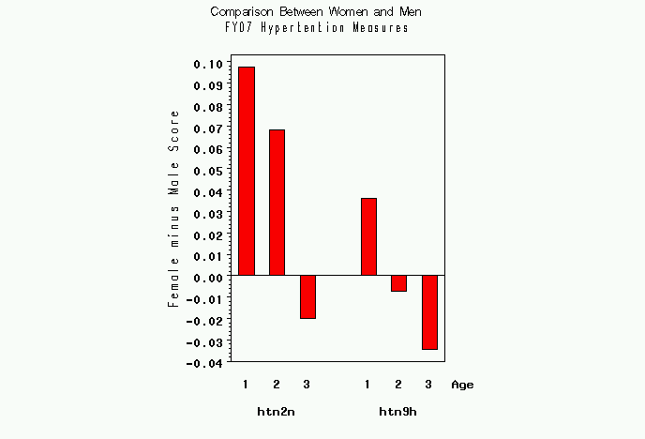
FY07 Hypertension Measures by Age
Difference Between Women and Men
Tobacco BP w/Dx_H
Use <=140/90

Slide 10
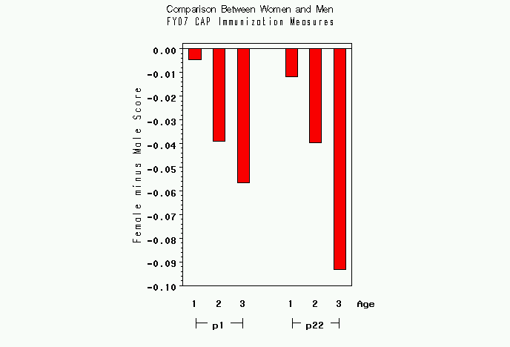
Immunization by Age
Difference Between Women and Men
Pneumococcal Influenza
Nexus Nexus

Slide 11
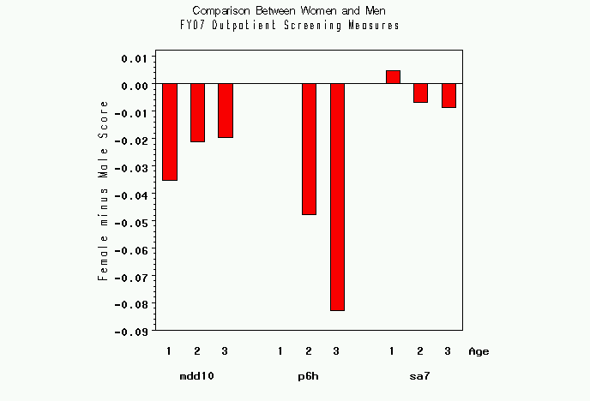
Screening Measures by Age
Difference Between Women and Men
Depression Colorectal Alcohol
Cancer

Slide 12
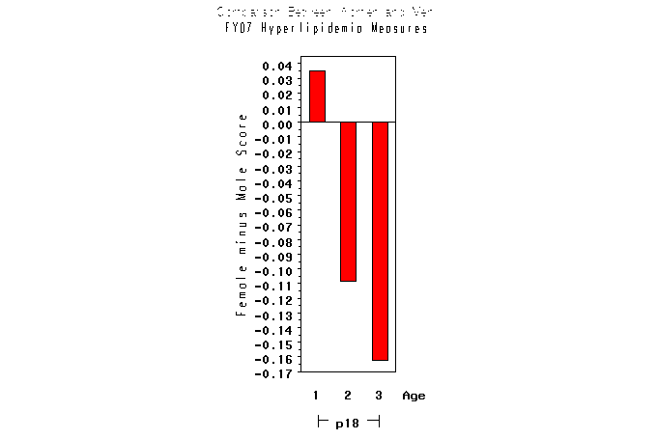
Hyperlipidemia Measure by Age
Difference Between Women and Men
Non DM, Non AMI pts with LDL≥120

Slide 13
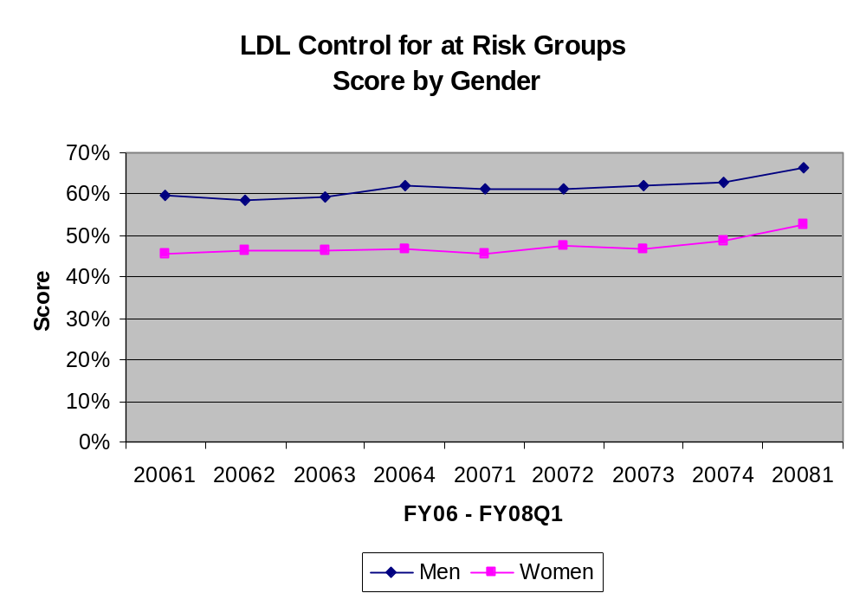

Slide 14
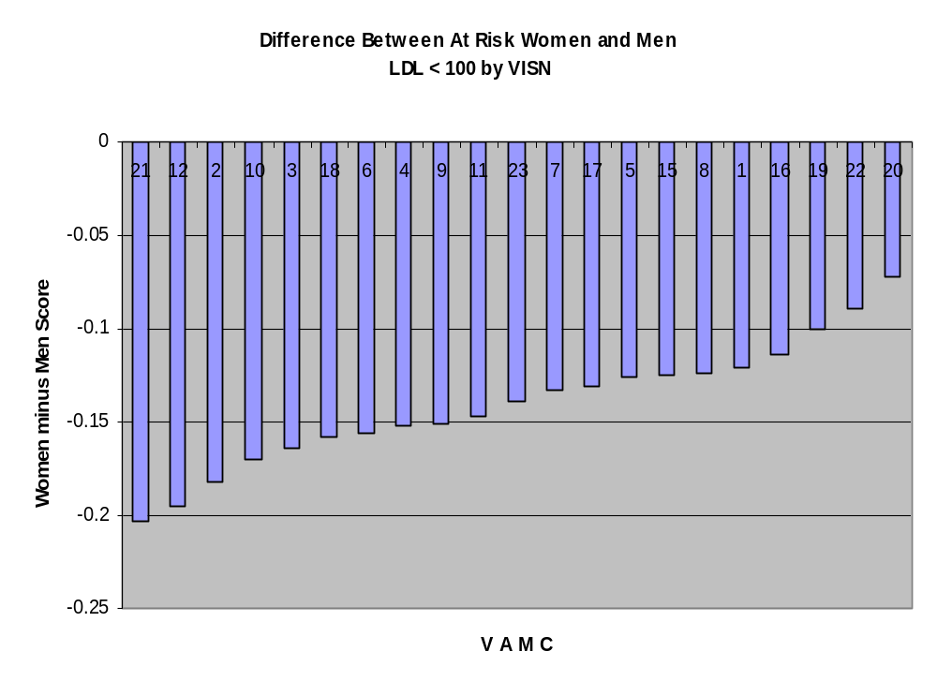
Difference Between at Risk Women and Men
LDL < 100 by VISN FY06-08Q1

Slide 15
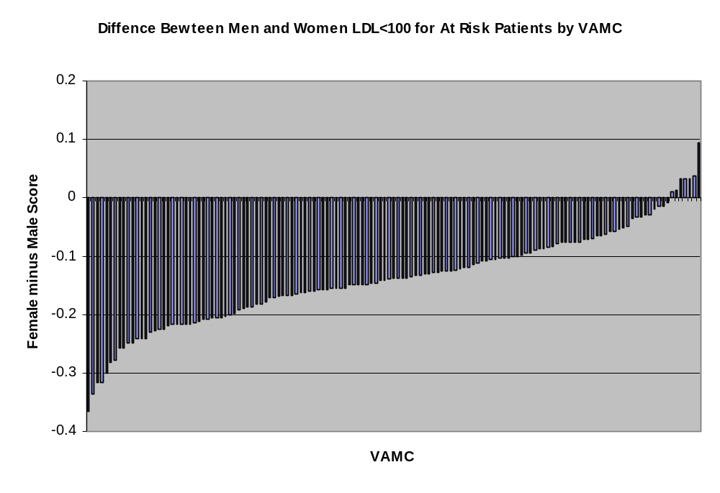
Difference Between at Risk Women and Men
LDL < 100 by VAMC FY06-08Q1

Slide 16
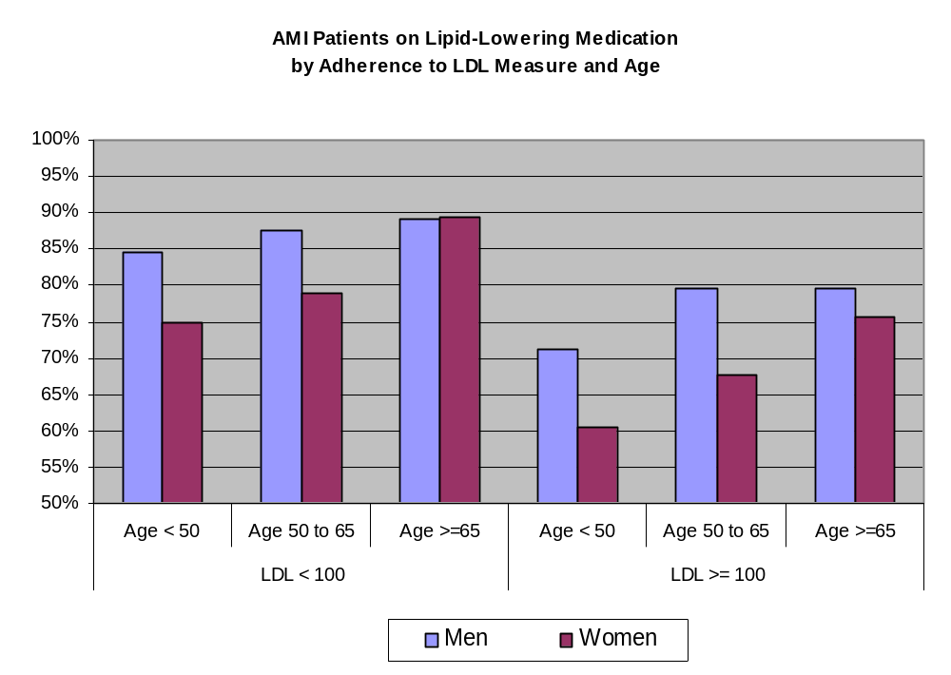
AMI Patients on Lipid Lowering Medication by Adherence to LDL Measure by Age and Sex

Slide 17
Relationship to Women’s Program
Presence of designated women’s health providers in general primary care clinics not significantly associated with absence of a disparity between men and women on 38 measures.
  Single exception: women veterans over 65 years of age less likely to receive pneumococcal vaccination (69% vs 51%).

Slide 18
Conclusions
Generally quality of care for women quite high
Significant (up to 20%) and durable gaps in outpatient care for women in relationship to:
  Management of cardiovascular risk factors including those with diabetes, HTN, IHD
  Colorectal cancer screening
  Immunization
  Depression Screening
Age an important effect modifier
Remarkable differences across VISNs and facilities
No association with presence of designated women's health providers

