Slide 1
Optical Technology
Bill Banyai banyai@glimmerglass.com
13 September 2005

Slide 2
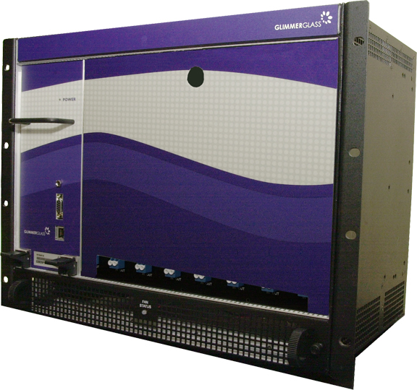
MEMS-Based Transparent NxN Switching
Non-Blocking Architecture
3 dB Insertion Loss
10 ms Switching Time
16x16 - 160x160 ports
15 Minute Install
GUI & TL1 Interface
FIT < 1000
Future
Higher Port Counts
Network Security
Notes:
Additional ripple < 0.1 dB. Need only 0.1 dB DC drop for detection SNR

Slide 3

Wavelength Selective Switching
Wavelength Blocker
Wavelength Combiner
Wavelength Router
λ₁, λ₂, …, λ₄₀
λ₉, λ₁₄, λ₂₈, …
λ₁, λ₂, …, λ₄₀
λ₁, λ₂, …, λ₄₀
λ₁, λ₂, …, λ₄₀
λ₁, λ₂, …, λ₄₀
λ₁, λ₂, …, λ₄₀
λ₁, λ₂, λ₁₇, …
λ₁, λ₂, …, λ₄₀
λ₃, λ₄, λ₃₂, …
λ₉, λ₁₄, λ₂₈, …
λ₁₅, λ₂₇, λ₃₃, …

Slide 4
Disruptive Technology
Problem
  Transparent networking with wavelength selective switching will result in polarization mode dispersion and chromatic dispersion varying on a per wavelength basis
Solution
  Electronic dispersion compensation will effectively eliminate inter-symbol interference across an arbitrary span for 10G data rates

