Slide 1

Endocrine Disruptor Screening Program:
Male and Female Pubertal Assays
Ralph L. Cooper
Endocrinology Branch
Reproductive Toxicology Division
NHEERL, U.S. EPA

Slide 2

Puberty
Puberty is a period of dramatic neuroendocrine development that culminates in reproductive maturation.
Requires extensive interplay between a variety of hormones, organs and tissues.
Period of increased sensitivity to environmental agents.

Slide 3
Pubertal Assays for Endocrine
Disrupting Chemicals
Many endpoints have been standardized
Many endpoints are currently being used in EPA testing
Large Toxicology database
Female Protocol is recommended
Male Pubertal is alternate

Slide 4
Objectives
EDSP Pubertal Protocols
  Review Protocols for Male and Female Rat
  Discuss data from a variety of sources indicating the ability of these protocols to detect EDCs
  Discuss advantages and potential problems

Slide 5
Assessment of Pubertal Development and Thyroid Function in Juvenile Female Rats

Slide 6
Assessment of Pubertal Development and Thyroid Function in Juvenile Female Rats
Purpose
The purpose of this protocol is to quantify the effects of environmental compounds on pubertal development and thyroid function in the intact juvenile female rat.

Slide 7
Assessment of Pubertal Development and Thyroid Function in Juvenile Female Rats
Applicability
This assay detects agents that display anti-thyroid, estrogenic, anti-estrogenic [estrogen receptor (ER)] or steroid enzyme mediated activity, or alter luteinizing hormone (LH), follicle stimulating hormone (FSH), prolactin, growth hormone (GH) secretion or hypothalamic function.

Slide 8
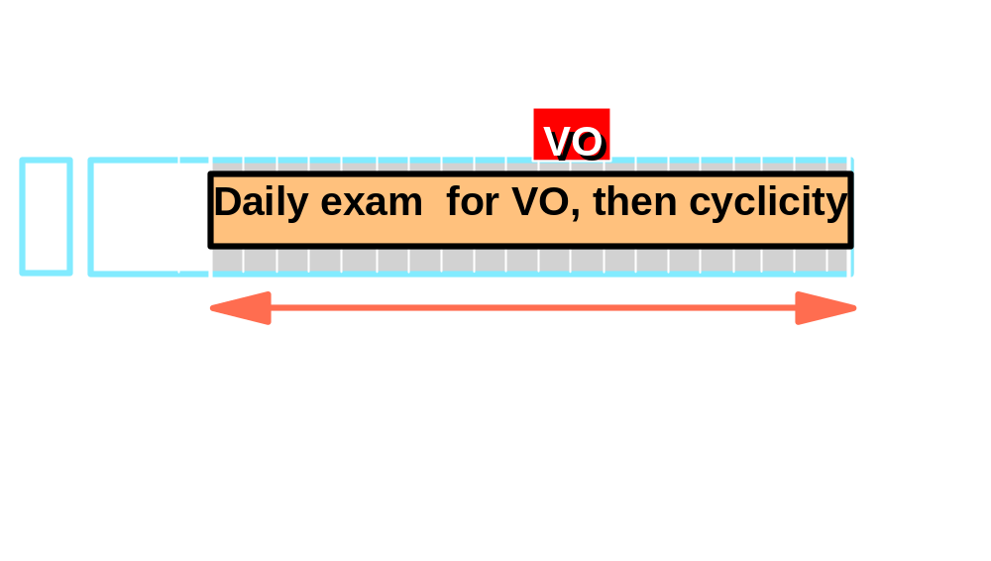
Female Pubertal Protocol

Slide 9

Required Endpoints
(Female pubertal assay)
Growth (body weight)
Age and weight at vaginal opening
Serum thyroxin (T4) and thyroid stimulating hormone (TSH)
Liver, kidney, pituitary and adrenal weight
Thyroid histology
Uterine and ovarian weights and histology
Vaginal cytology

Slide 10
Optional Measures
(Female pubertal assay)
Serum estradiol, Prolactin and tri-iodothyronine (T3)
Thyroid weight
Liver, kidney, pituitary, adrenal & vaginal histology
Ex-vivo ovary and pituitary hormone production
Hypothalamic neurotransmitter concentration
Estrous cycle in adulthood

Slide 11
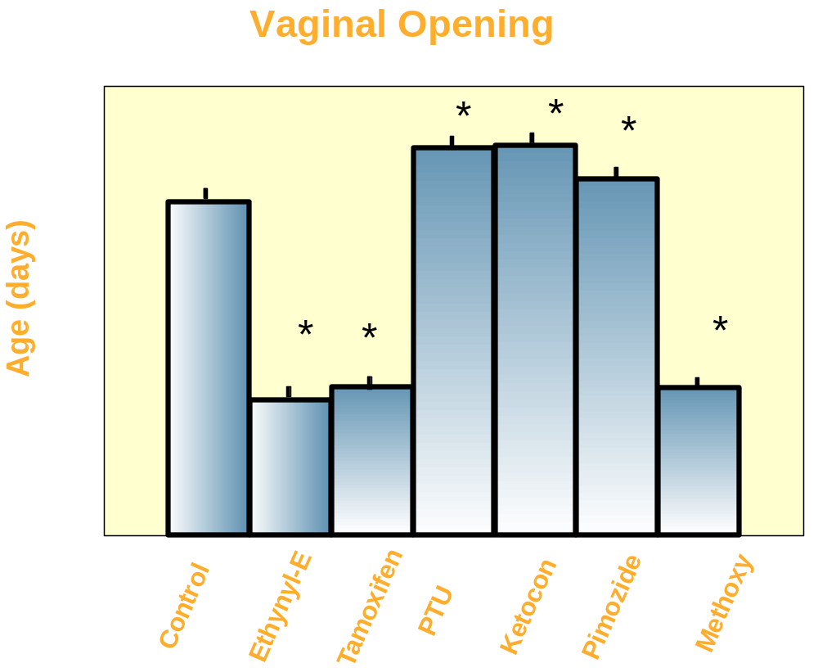

Slide 12
Summary of Significant Effects on Major Endpoints in
Female Sprague-Dawley and Long-Evans rats
Treatment | Mode of Action | Age at VO | Age at First E | Histo-pathology | TSH | T4
Ethynyl Estradiol 0.005 mg/kd | ER agonist |  |  |  | = | =
Tamoxifen 10 mg/kg | ER antagonist Partial agonist |  |  |  | SD
Propylthiouricil 240 mg/kg | Inhibits T4 Synthesis | SD | SD | 
Ketoconozole 100 mg/kg | Inhibits Steroidogenesis | SD |  |  | =
Pimozide 30 mg/kg | DA receptor blocker |  | = |  | LE
Methoxy-chlor 100 mg/kg | ER agonist |  |  |  | LE | =

Slide 13
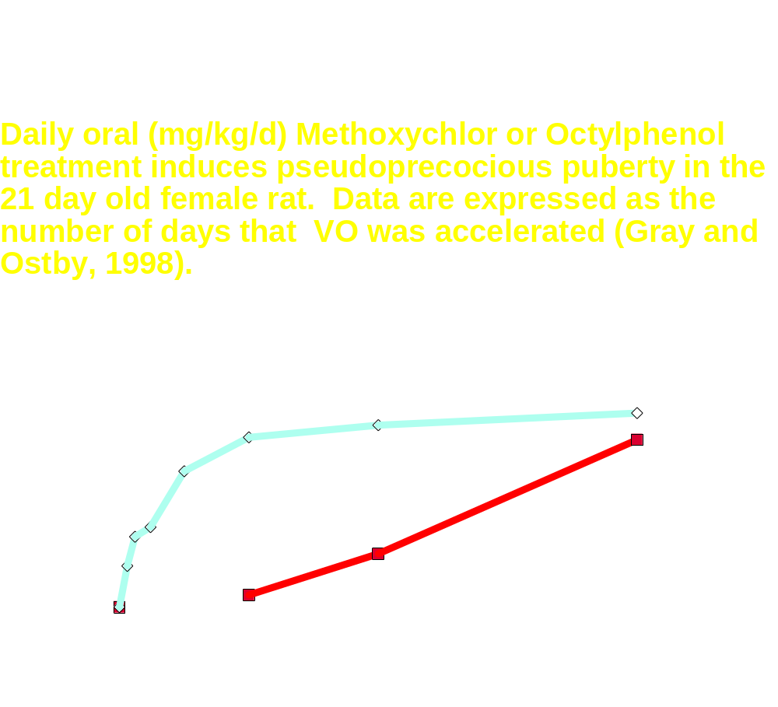

Slide 14
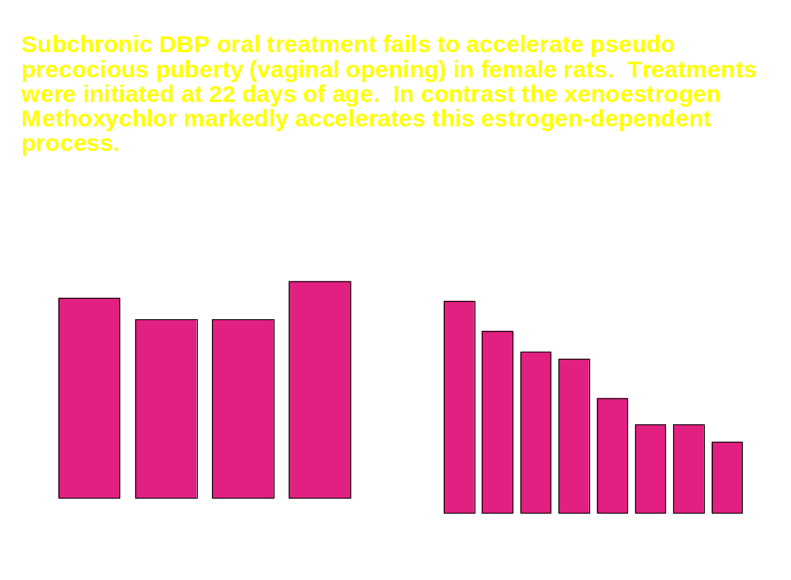
Gray et al., 1999

Slide 15
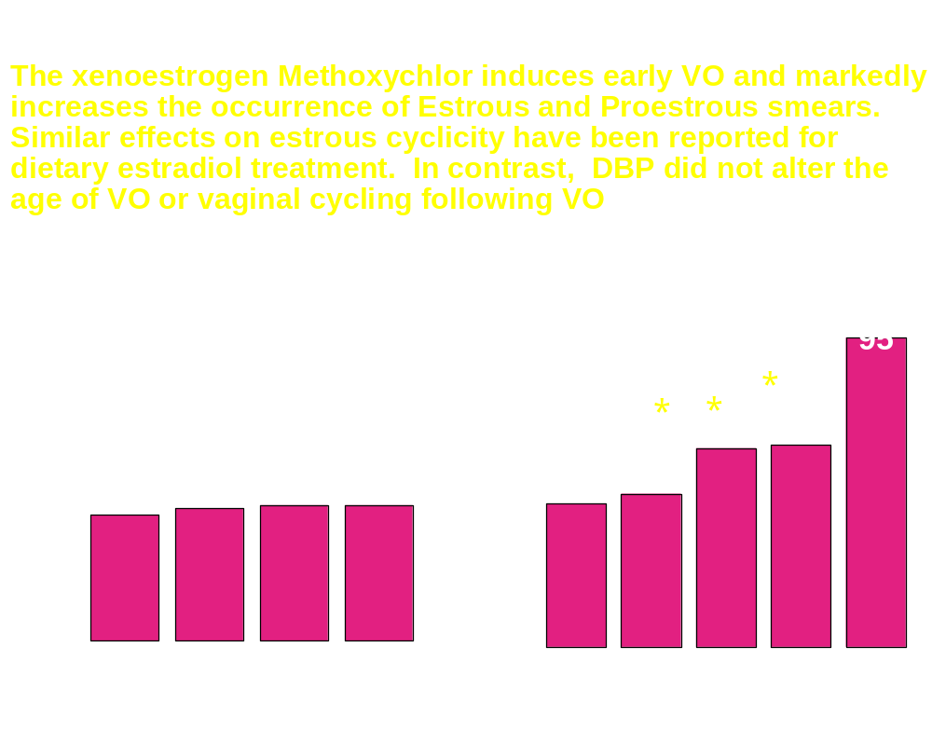
Gray et al., 1999

Slide 16
Effect of Chlorotriazines on Puberty
Atrazine Alters Neuroendocrine Control of gonadal Function
  GnRH pulses, LH and prolactin surges decreased
  Hypothalamic catecholamines decreased, GABA neurotransmission altered
Hypothesis: Atrazine will alter onset of puberty in male and female
  Dose response using pubertal protocol
  Evaluated Wistar strain
Cooper et al., 2000

Slide 17
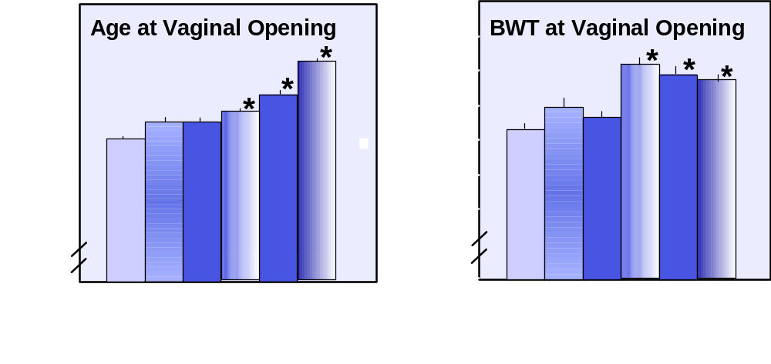
Effect of Atrazine on Puberty in Female Wistar Rats
Laws et al., 2000

Slide 18
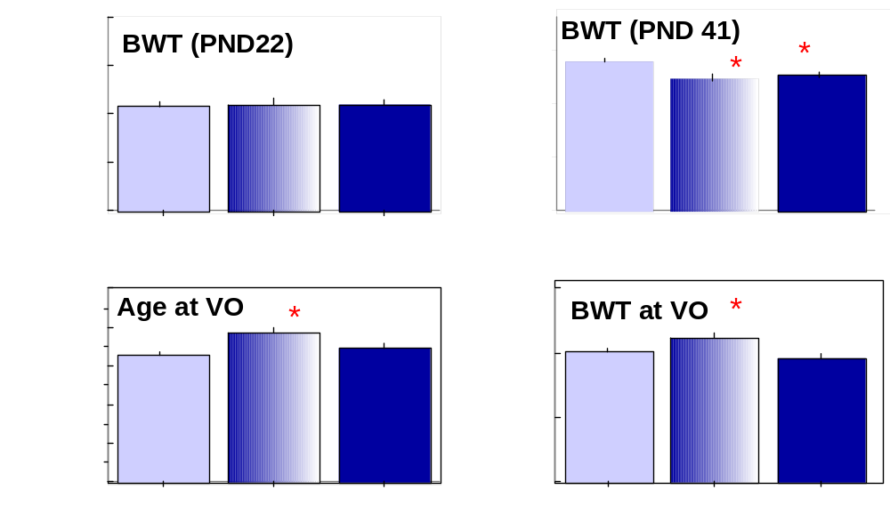
Effect of Atrazine on Puberty in Female Wistar Rats
Laws et al., 2000

Slide 19
Assessment of Pubertal Development and Thyroid Function in Immature Male Rats

Slide 20
Assessment of Pubertal Development and Thyroid Function in Immature Male Rats
Purpose
The purpose of this protocol is to quantify the effect of environmental compounds on pubertal development and thyroid function in the intact juvenile/peripubertal male rat

Slide 21
Assessment of Pubertal Development and Thyroid Function in Immature Male Rats
Applicability
This assay detects compounds that display anti-thyroid, estrogenic, androgenic, anti-androgenic [androgen receptor (AR)] or steroid enzyme mediated activity or alters puberty via changes in follicle stimulating hormone (FSH), luteinizing hormone (LH), prolactin, growth hormone (GH) or hypothalamic function.

Slide 22
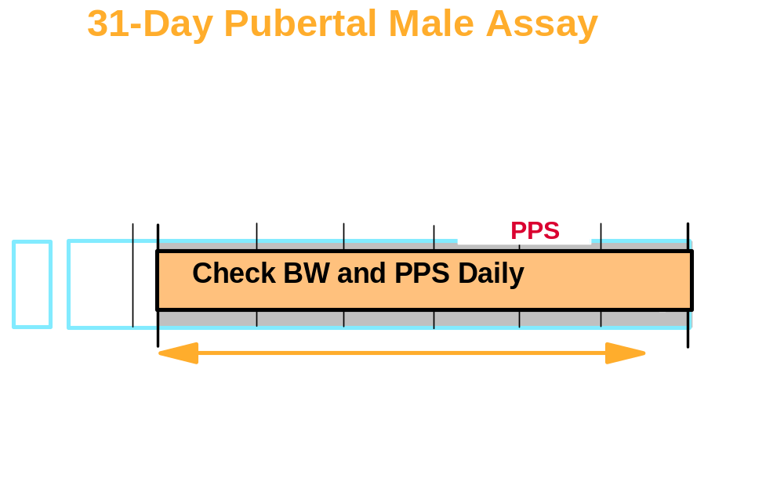

Slide 23
Required Endpoints
(Male pubertal assay)
Growth (body weight)
Age and weight at preputial separation
Serum thyroxin (T4) and thyroid stimulating hormone (TSH)
Thyroid histology
Seminal vesicle plus coagulating gland (with and without fluid)
Liver, kidney, adrenal, pituitary and ventral Prostate weight
Levator ani plus bulbocavernosus weight
Epididymal and testis weight & histology

Slide 24
Optional Measures
(Male pubertal assay)
Serum testosterone, estradiol, LH, prolactin and tri-iodothyronine (T3)
Liver, kidney, adrenal, pituitary histology
Ex-vivo testis and pituitary hormone production
Hypothalamic neurotransmitter concentrations

Slide 25
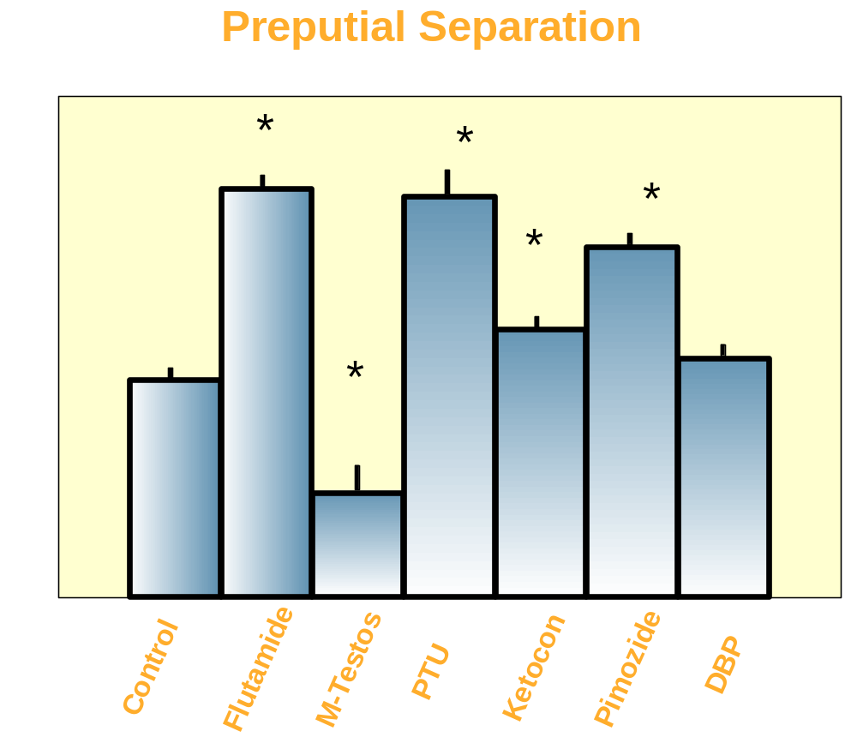


Slide 26
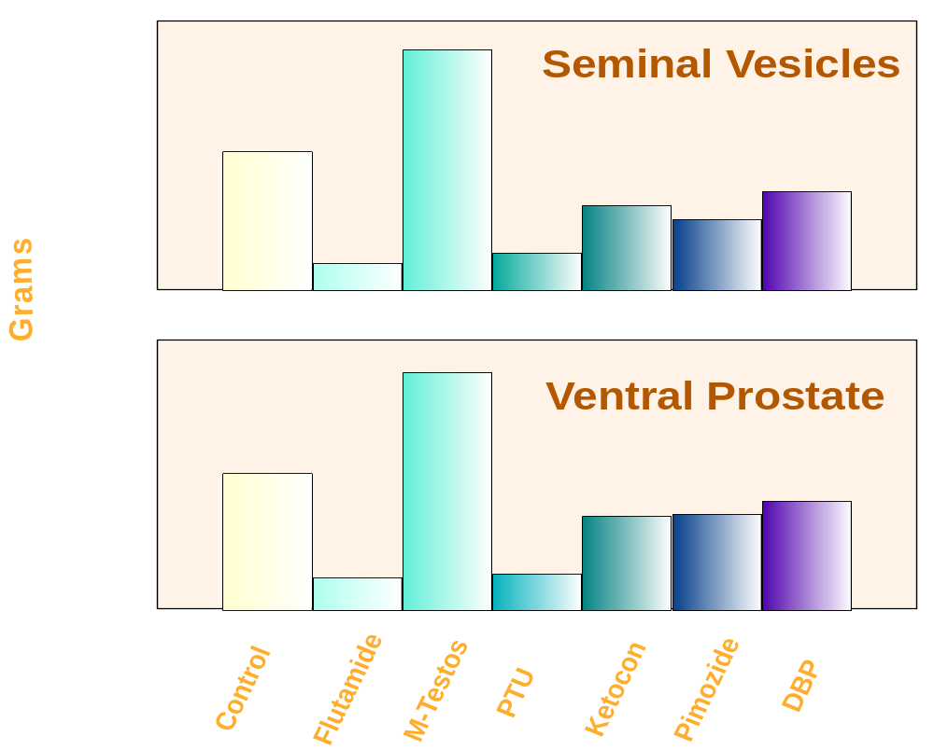

Slide 27
Summary of Significant Effects on Major Endpoints in
Male Sprague-Dawley and Long-Evans rats
Treatment | Mode of Action | Age at Preputial Separation | Histo- pathology | TSH | T4
Fluatamide (50 mg/kg/d) | AR Antagonist |  |  | = | =
Methyl Testosterone 80 mg/kg/d | AR Agonist |  |  | = | =
Propylthiouracil 240 mg/kg/d | Inhibits T4 synthesis |  | 
Ketoconozole 100 mg/kg/d | Inhibits Steroido- genesis |  | = | = | =
Pimozide 30 mg/kg/d | Dopamine Receptor Blocker |  | LE | = | =
Dibutylphthalate 1000 mg/kg/d | Anti-androgenic | LE | LE | = | LE

Slide 28
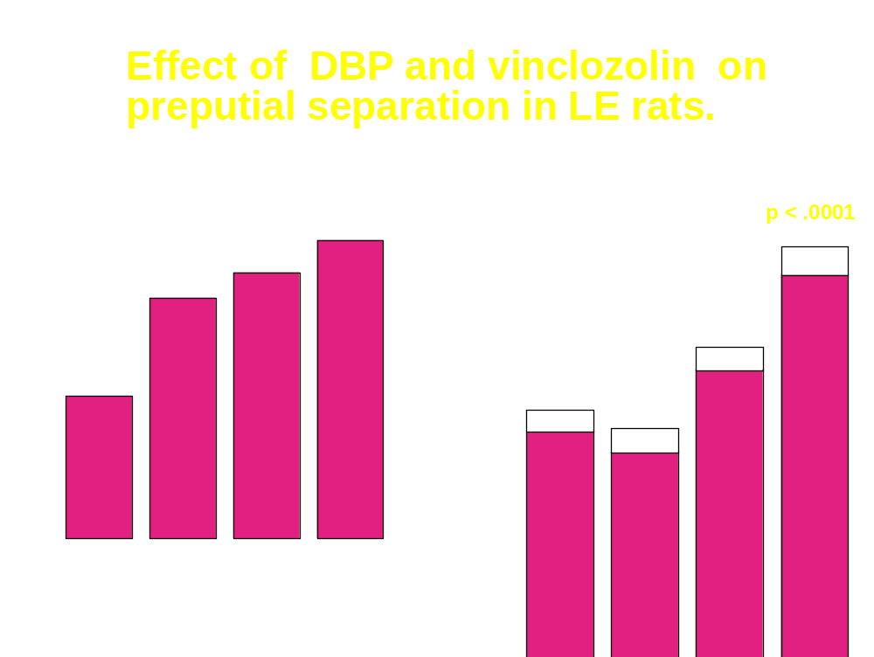
Monosson et al., 1999

Slide 29
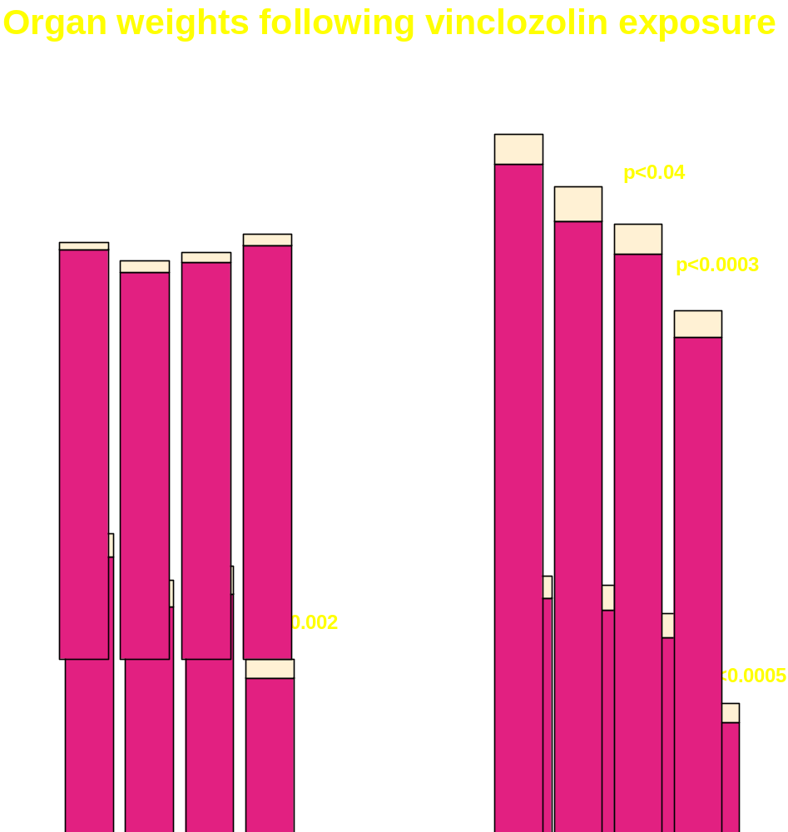
Monosson
et al., 1999

Slide 30
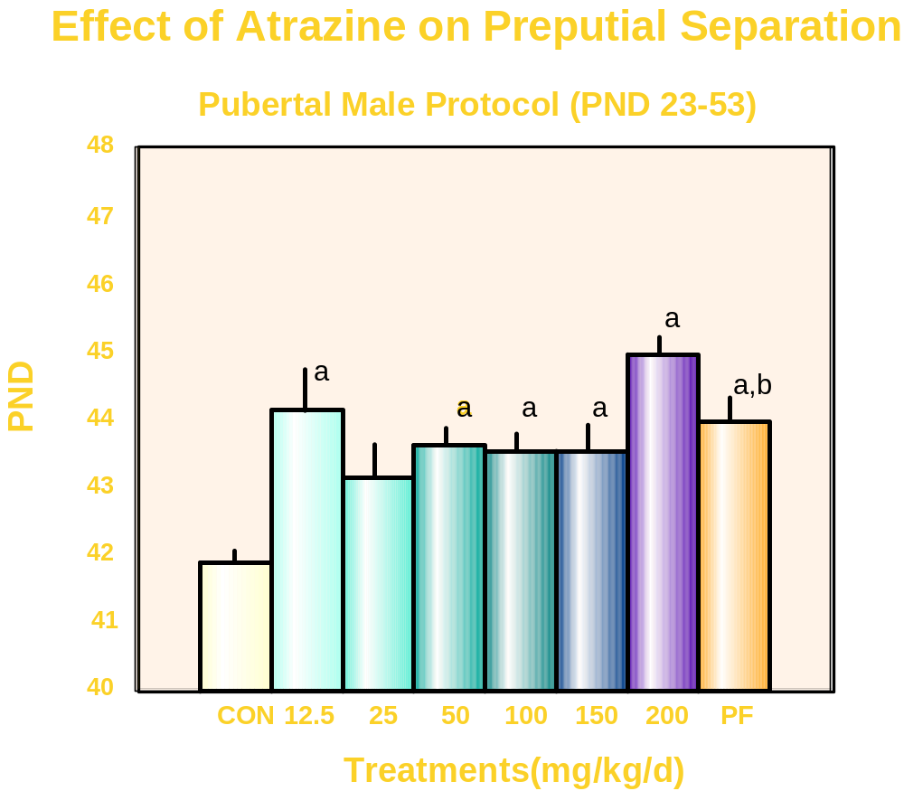
Stoker et al., 2000

Slide 31
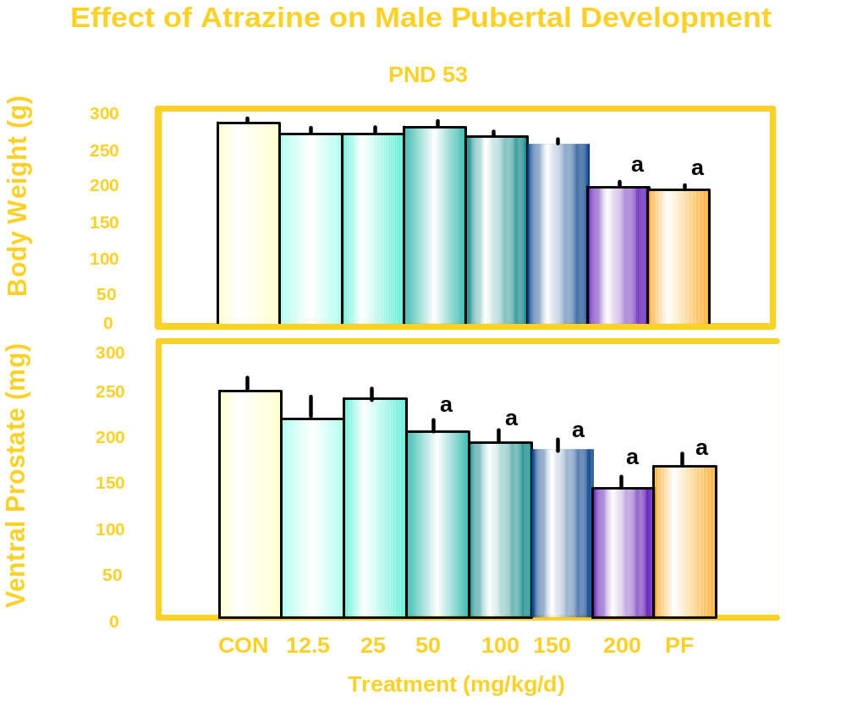


Slide 32
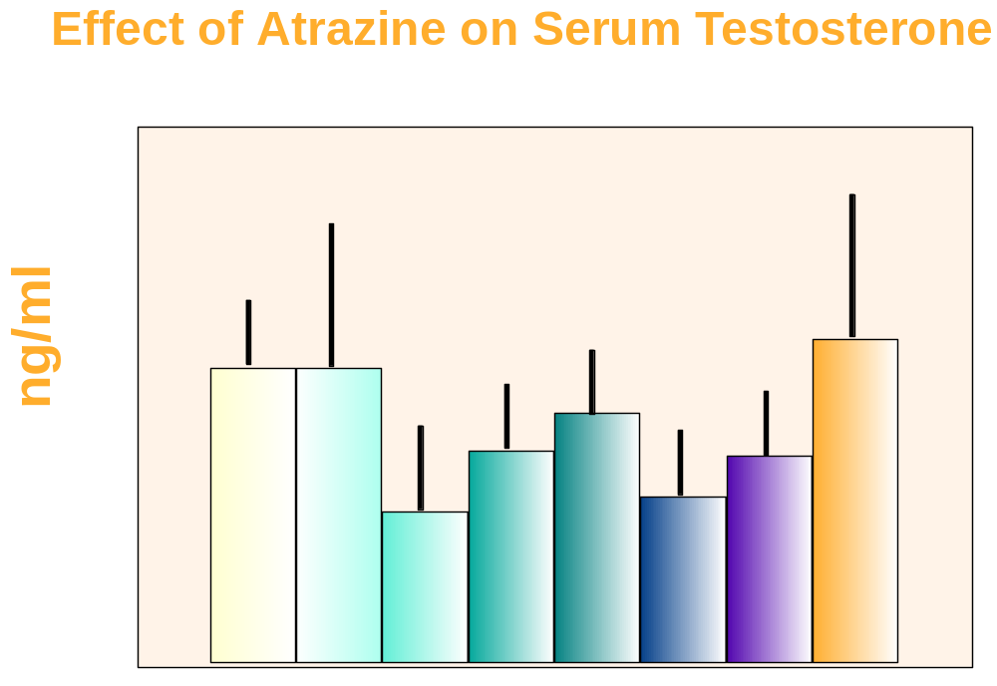

Slide 33
Summary
Pubertal protocols detect a wide variety of EDCs
Advantages
    Tests are apical
    Dose response information, metabolism, dose individual rats
    Provide information for MOA and mechanistic studies
    Appear to be robust across strains
    Protocols involve relatively simply procedures

Slide 34
Summary
Pubertal protocols detect a wide variety of EDCs
Difficulties/drawbacks
    Precise measures of hormones
    Body weight issues
    Dosing not done during organogenesis (i.e., not a transplacental assay)
    Length of assay
    Cost

Slide 35
Single Dose Study
Discrepancy between the ages of preputial separation identified in the two strains of rats.
Large degree of variation associated with the means of the fluid-filled and small tissue weights

Slide 36
Single Dose Study
Improve descriptive text in protocols such that every key step is clear.
Establish performance criteria for inclusion into the protocols
Evaluate lower limits of detection of protocols by examining dose response for weaker EDCs
Should strain be recommended?

Slide 37
Collaborators
Endocrinology Branch, Reproductive Toxicology Division, NHEERL
L. Earl Gray Jr., Ph.D.
Susan C. Laws, Ph.D.
Tammy Stoker, Ph.D.
Jerome M. Goldman, Ph.D.
Robert J. Kavlock, Ph.D.
Office of Science Coordination and Policy
OPPTS
Jim Kariya
Gary Timm

