Slide 1


Business Health and Cardiovascular Health
Eileen Ciccotelli, MPM
Vice President for Strategic Development
Virginia Business Coalition on Health
Wednesday, September 19, 2007

Slide 2
Presentation Outline
The Business Case
National Business Coalition on Health
  Background and Overview
  Cardiovascular Health
Virginia Business Coalition on Health
  Background and Overview
  Cardiovascular Health Improvement Projects
Working with Coalitions and Employers
Notes:
Good morning. I will be discussing cardiovascular health from the perspective of the business sector represented by NBCH and VBCH. I will provide you with the context for the interest by the business sector as well as background and examples.

Slide 3
Presentation Objectives
Provide information about NBCH and VBCH to add to your understanding of business coalitions and their role
Describe specific projects to show the breadth of business involvement with improving cardiovascular health
Provide insight into effective ways for public health and business to collaborate
Notes:
My objectives for this presentation are to provide you with information about the business sector—specifically business coalitions on health—and to describe specific projects that demonstrate the breadth of business interest in cardiovascular health. These interests also apply to other health conditions and primary care and prevention. Overall, I hope to provide you with insight to help you to effectively use your expertise in collaboration with business to improve health and health care.

Slide 4
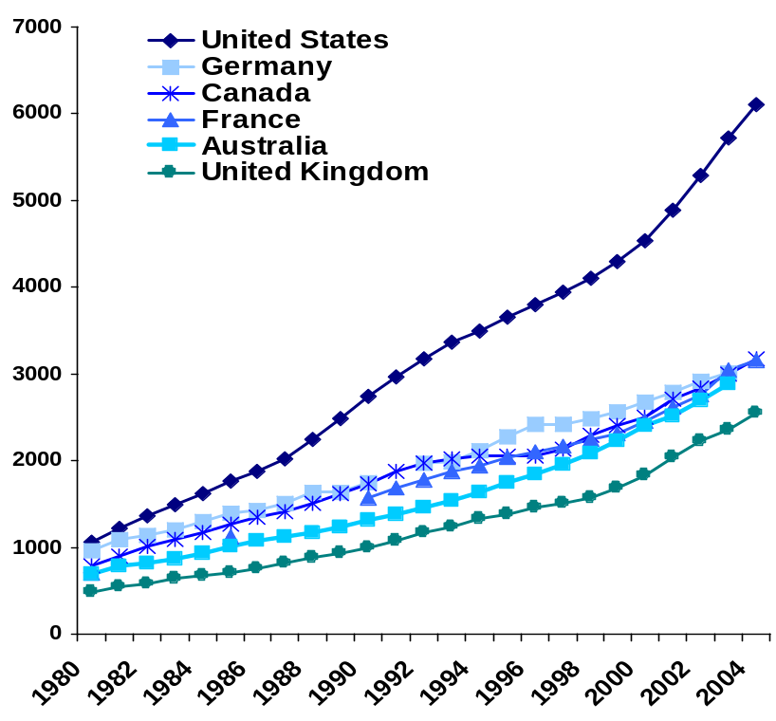
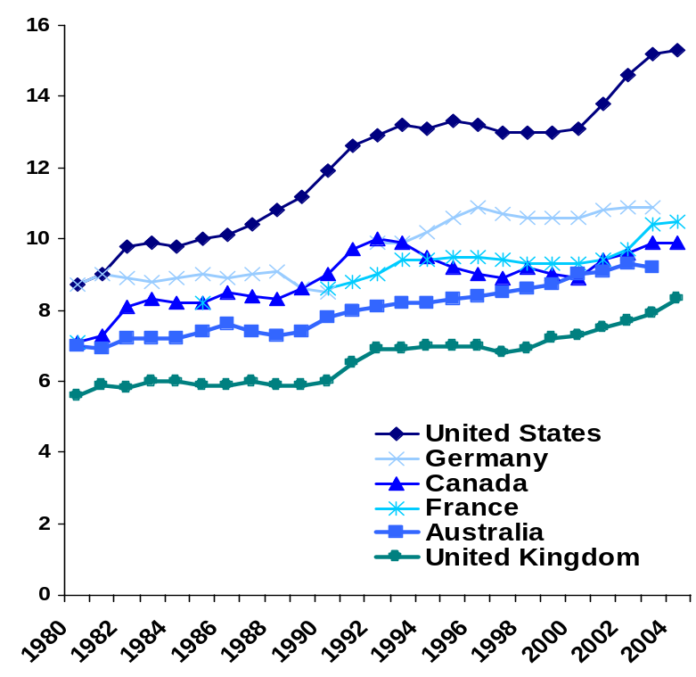
The Business Case
Efficiency - Health Care Costs in US Markedly Exceed that of Other Countries
Average spending on health
per capita ($US PPP)
Total expenditures on health
as percent of GDP
Notes:
This chart from the Commonwealth Fund shows the average per capita and the total health expenditures for 6 countries with the United States represented by the top line in both charts. Other countries in the comparison are Germany, Canada, France, Australia, and the United Kingdom. Yet we know from mortality and other data that the US ranks way below these countries. This suggests that we do not spend our money appropriately to achieve population health.

Slide 5
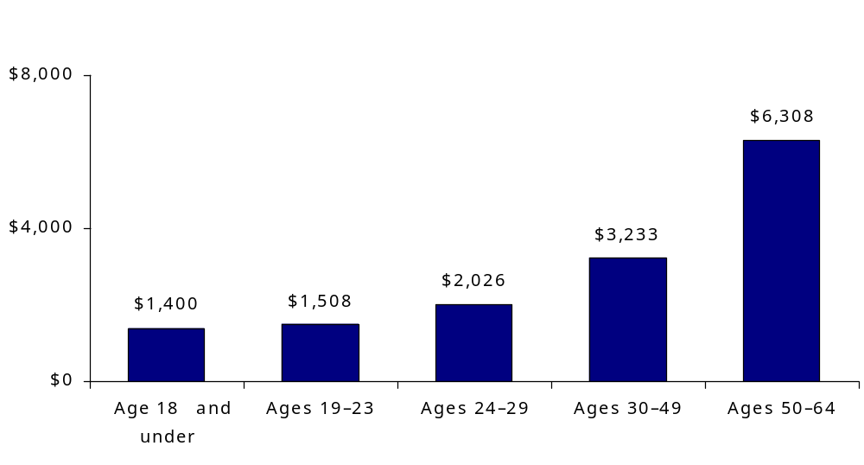
The Business Case
Annual Per Capita Total Health Expenditures by Age Group, 2007*
Dollars
Source: Analysis of the 2004 Medical Expenditure Panel Survey by S. Glied and B. Mahato for The Commonwealth Fund.
* Inflated to 2007 dollars using actual and estimated annual growth rates in national health expenditures.
Notes:
The Commonwealth Fund has provided access to data that includes the annual per capital health care expenditures by age group for the United States based upon 2004 medical expenditure survey with the dollars inflated to estimate 2007 costs. You can see that most of the expenditures are for the older population—and end of life care—and fall under the Medicare population. This does not mean that the spending is appropriate.

Slide 6
National Business Coalition on Health
Our identity: National, non profit association of nearly 70 business and health coalitions,
Our vision: Market-based reform, through value based purchasing, community by community
Our primary mission: To build coalition leadership capacity in value based purchasing
Our primary strategic goal: To be a catalyst, Technical Advisor, and distribution network for best practices in value based purchasing
Notes:
NBCH is a national non profit association of 80 business and health coalitions with a vision to market based health care reform through value based purchasing principles application community by community. NBCH seeks to build the leadership capacity of coalitions to achieve this vision by being a catalyst, technical advisor, and distribution network of best practices and tools for value based purchasing.

Slide 7
Coalition Common Mission
To advance high quality, affordable health care
With a community focus
And through collective employer action
Using evidence-based information and best practices
Notes:
The common strategy used by these coalitions is to address the DEMAND side of the “supply and demand” equation for “value based purchasing”. VBP means using purchaser influence to promote safe, efficient, high-quality health care and the improved health status of the American population. The four pillars for VBP are standardized performance measurement (“you cannot improve what you cannot measure”), transparency of information and public reporting, reform of the payment system, and engaged informed patients/consumers.

Slide 8
Coalition Common Strategy
The demand side strategy of Value Based Purchasing:
Standardized performance measurement
Transparency and public reporting
Payment reform
Consumer activation/informed consumer choice
Purchaser Leadership and Action
Accelerating the Pace to the Goal:
Health and Health Care Improvement
Notes:
The common strategy used by these coalitions is to address the DEMAND side of the “supply and demand” equation for “value based purchasing”. VBP means using purchaser influence to promote safe, efficient, high-quality health care and the improved health status of the American population. The four pillars for VBP are standardized performance measurement (“you cannot improve what you cannot measure”), transparency of information and public reporting, reform of the payment system, and engaged informed patients/consumers.

Slide 9
Coalitions in Different Markets
Of the 70 Coalitions, here are some examples
Buyers Health Care Action Group New York Business Group on Health
Greater Detroit Area Health Council
Memphis Business Group on Health
Midwest Business Group on Health
New York Business Group on Health
Pacific Business Group on Health
Puget Sound Health Alliance
Virginia Business Coalition on Health
Notes:
Coalitions across the US and members of NBCH include the following:
Buyers Health Care Action Group (Minnesota)
Greater Detroit Area Health Council
Memphis Business Group on Health
Midwest Business Group on Health (Chicago)
New York Business Group on Health
Pacific Business Group on Health (California)
Puget Sound Health Alliance (Seattle)
Virginia Health Care Coalition

Slide 10
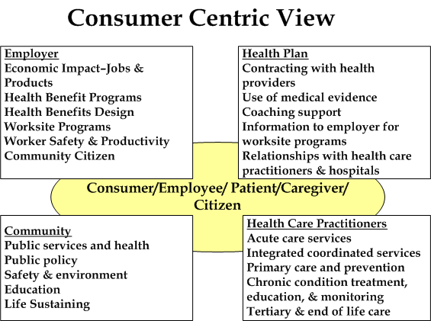
Vision for Community Collaboration
Notes:
Putting this in the context of the consumer or employee—the real “customer” in the equation, we can think of the major roles of stakeholders including employers, health plans—since except for the uninsured which I will not be addressing today—we generally operate our health coverage through health plans, community—including government and public health at all levels—and health care practitioners. This consumer centric view is an important element in thinking how to address the “consumer”.

Slide 11
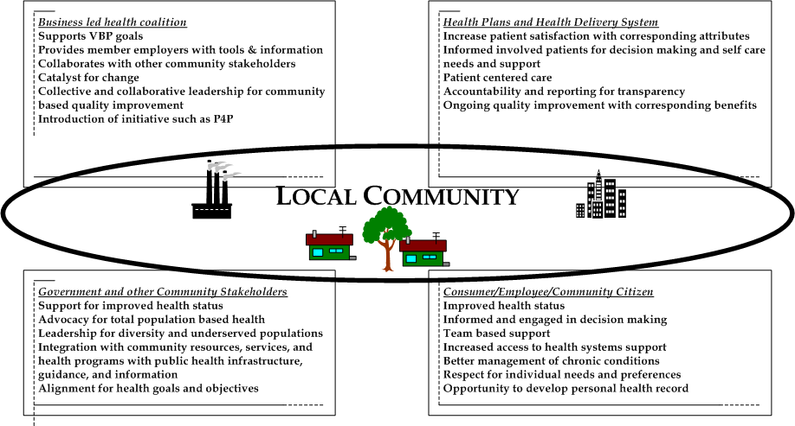
Vision for Community Collaboration
Notes:
This provides an vision for community health collaboration showing the roles for each major stakeholder sector—business (both private and public sector purchasers and employers), health plans and the health delivery system, government—including public health—and other community stakeholders, and the consumer aka employee, citizen, individual decision maker, etc. This vision brings together these stakeholders with a common goal for improving community health—and health care.

Slide 12
Advancing the Mission:
NBCH Major Program Priorities
Tools and information to support value based purchasing
  eValue8^{TM -} common RFI for health plans
  Bridges to Excellence
  Leapfrog Group strategic alliance
  HealthMap RX
College for Advanced Management of Health Benefits
Educational Conference, Workshops and Seminars
Member Learning Networks/ Affinity Groups
Public Policy Advocacy
Notes:
The common mission of these coalitions is:
To advance high quality, affordable health care with a community focus and through collective employer action—using evidence based information and best practices.

Slide 13
Some Findings from eValue8
CVD-Related content
  Prevention
    Child risk education
    HRA content and use
    Smoking cessation
    Obesity programming
  Chronic Disease Management
    Member identification
    Member interventions
    Physician support
    Outcomes
Notes:
eValue8 is used by employers to evaluate health plan performance and drive improvement.
The eValue8 Request for Information has content related to CVD and plan responses are verified and scored against expectations that hold the plan accountable for doing its part in improving health and health care for purchaser employees and their dependents.
The CVD content includes some elements of prevention and disease management, some of which are listed here
eValue8 establishes the expectation that plans will educate members, especially children and caregivers about the risk factors leading to chronic disease
It is expected that plans will offer smoking cessation and obesity programming.
For those who have Cardiovascular disease, it is expected that plans will
have a method of identifying them (through claims, pharmacy fills, HRAs and other sources)
Offer a variety of interventions from reminders to coaching
Support physicians by identifying gaps in care for patients under their care
Measure outcomes of program success

Slide 14
Some Findings from eValue8
HRAs
  High availability (98%)
  Low completion (mean 12.5% over 2 years)
  Middling follow up
    Only half (49%) use results to channel members to Wellness or CDM programs
    The proportion drops to 24% if filled out at the worksite
Notes:
While the vast majority of plans (98%) report using HRAs and most plans (82%) report making them available to all commercial members, the mean percentage of members completing an HRA in the past two years was 12.5% with many plans (and virtually all of the national carriers) reporting completion rates under 1%.

Slide 15
Some Findings from eValue8
Smoking
  In 2007, plans reported that approximately 20% of smokers are identified
  Most plans offer a cessation program (90%)
  Slow improvement on physician advice to quit (mean 71%, up only 7% points in 4 years- 2004-2007)
Notes:
Because the vast majority of plans (73%) rely on self referral to identify smokers, they are under-identified (20%). (Group plans with EMR can identify close to 100% of the smokers)
Most plans offer cessation programs and this will sometimes be an option to purchase, especially if the benefit is self-insured by the employer (the benefit from the program resides with the risk-taker)
Progress is slow on the oldest HEDIS indicator: physicians advising smokers to quit.

Slide 16
Some Findings from eValue8
Obesity
  HMOs are have moved slightly faster on programming than PPOs (2007 eValue8 score of 51% vs. 45%)
  Coalition reviewed plans scored better than other plans (2007 eValue8 score of 64% vs. 28%)
  Low identification relying almost universally on CDM outreach to discover condition
  Most offer weight management (e.g. Weight Watchers), self management tools, education (89-94%)
  Fewer cover weight loss pharmaceuticals (37%) or counseling (26%)
Notes:
Obesity programming is in its infancy with plans (except for group plans with EMR = 3%) virtually unable to identify members needing assistance and relying on the very small numbers discovered through disease management telephonic outreach.

Slide 17
Some Findings from eValue8
Coronary Artery Disease
  Great variability in 2007 identification rates (mean 2.6%, range >0.01-35%)
  Mean identification rate for VA plans: 1.3% (range, .01% to 4.3%)
  Similar variability in program involvement
  Concomitant conditions
    60% check and target smoking
    93% check and target depression
Notes:
There is great variability in the degree to which plans identify candidates for CAD programming
Having identified candidates there is further enormous variability in the actual involvement in CAD programming (xx%-YY% are involved in coaching)

Slide 18
Some Findings from eValue8
Controlled High Blood Pressure HEDIS Rate Reported in 2007: | Mean: 71.0% Range: 26 points Top Plan: BCBS CT- 82% VA Mean Rate: 73.5% Four Year National Trend: ↑ 13.8 points
Beta Blocker Usage HEDIS Rate Reported in 2007: | Mean: 93.7% Range: 50 points Top Plan: 31 plans scored 100% VA Mean Rate: 95.5% Four Year National Trend: ↑ .8 points
Notes:
Use of beta blockers after AMI has reached a level where eValue8 no longer assigns credit
Persistent use of Beta blockers and LDL levels, on the other hand provides a good gage of performance, differentiating plans quite well.
These measures are not, however, as complete as the seven diabetes indicators where eValue8 will grant full credit for diabetes (for all of the non-HEDIS process measures) if a plan performs in the 90th percentile for all seven.

Slide 19
Some Findings from eValue8
Persistence of Beta Blocker HEDIS Rate Reported in 2007: | Mean:71.2% Range: 46 points Top Plan: BCBS WNY- 89% VA Mean Rate: 69.9% Two Year National Trend: ↑ 2.3 points
LDL Screen HEDIS Rate Reported in 2007: | Mean: 77.5% Range: 54 points Top Plan: MVP NY- 96% VA Mean Rate: 80.2% Four Year National Trend ↓ .04 points
Notes:
The common mission of these coalitions is:
To advance high quality, affordable health care with a community focus and through collective employer action—using evidence based information and best practices.

Slide 20
Some Findings from eValue8
LDL Level < 130 HEDIS Rate Reported in 2007: | Mean: 63.0% Range: 79 points Top Plan: KP CO-85% VA Mean Rate: 64.3% Four Year National Trend: ↓ .03 points
LDL Level < 100 HEDIS Rate Reported in 2007: | Mean: 47.7% Range: 70 points Top Plan: Kaiser CO- 75% VA Mean Rate: 51.9% Two Year National Trend Data: ↓ 3.7 points
Notes:
The common mission of these coalitions is:
To advance high quality, affordable health care with a community focus and through collective employer action—using evidence based information and best practices.

Slide 21
NBCH Members Cardiovascular Health
Savannah Business Group on Health
  Care Cost Management: Intervention program for eight measurable risk factors resulting in 15.4% reduction in participant’s risk of developing coronary heart disease within the next 10 years
Texas Business Group on Health
  Hospital data report using Texas, Leapfrog, CDC information for 5 types of heart care
Tri Rivers Employers Healthcare Coalition (Ohio)
  Hospital performance report card including coronary artery bypass surgery, congestive heart failure, chronic obstructive pulmonary disease, & acute myocardial infarction
Virginia Business Coalition on Health (VBCH)
Notes:
Examples of work that members have done specifically related to cardiovascular health include the Savannah Business Group work with their employers and a provider network that focused on interventions for eight measurable risk factors (Systolic blood pressure reduced 17mm Hg. Diastolic blood pressure reduced 10mm Hg
Total cholesterol reduced 26 mg/dl
LDL cholesterol reduced 13 mg/dl
HD cholesterol increased 5 mg/dl
Triglycerides decreased 57 mg/dl
Weight decrease 3 pounds
Blood glucose decrease 27 mg/dl
Texas Business Group developed a data report on hospital performance that can be viewed on their web site.
In Ohio, the TriRivers Coalition also developed a hospital report card. In Virginia, we developed and implemented a program to reduce risk for cardiovascular health problems.

Slide 22
VBCH and Cardiovascular Health
Our identity: Virginia-wide, non profit 501(cc)(3) association of 60 member stakeholders (purchasers and providers)
Our vision: to be a unified purchaser voice to promote best practices for high-quality, cost–effective health care and a healthy and productive workforce
Our primary mission: to provide superior membership service and to build the capacity of the VBCH membership to advance value-based purchasing
Our primary strategic goal: members having a healthy workforce, strong and unified voice, educated on best practices, making benefit selection and measurement based on solid data and design.

Slide 23
VBCH and Cardiovascular Health
HeartBiz
How’s Your Health Virginia?
CVD Research Project
Virginia Department of Health
NBCH’s eValue8 RFI Tool
The Leapfrog Group Hospital Quality & Safety Survey
Hospital Report Cards
HOSPITALpick
Proposed: HealthMapRX Diabetes program

Slide 24
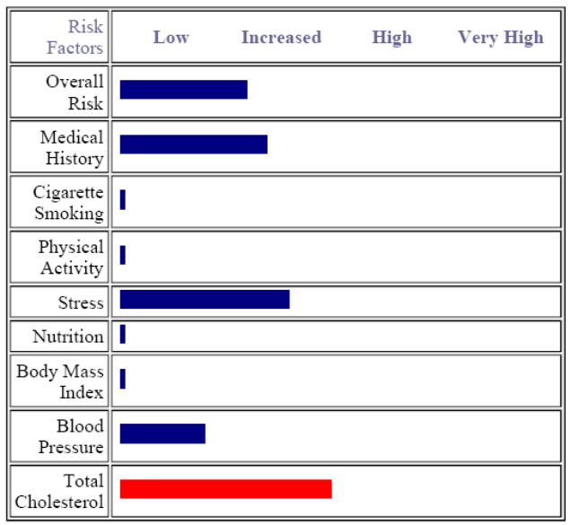
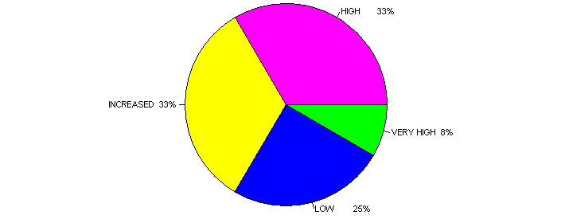
VBCH and Cardiovascular Health
HeartBIZ
  Cardiovascular Risk-Assessment (CRA) and risk-reduction
  Online tool with the Stanford Heart Network (ongoing)
  Participant Employers: Virginia Beach City Public Schools, Virginia Beach City, and Norfolk Southern Corporation, and others
  CRA Risk Level 2006

Slide 25
VBCH and Cardiovascular Health
How’s Your Health Virginia?
  Online – 10 minutes to complete
  Free health risk assessment for ages 2-99
  In English and Spanish
  Instant health report
  No ads or pop-ups
  Confidential
  Bridges the communication gap between patient and physician (group)
  Community ‘Outcomes” report available – search by zip code, organization, employer
  Ongoing at www.howsyourhealth.org
  Created by Dr. John Wasson and Regina Benjamin of Dartmouth Medical College

Slide 26
VBCH and Cardiovascular Health
CVD Research Project - with large employer (2003-04)
Total 328 individuals participated in the study (meeting 2 of 6 risk factors); Risk Factor information collected on all “healthy & eligible” participants
272 participants eligible.
  59 participated on online CRA
  98 participated in baseline clinical session
    46 participated through final (3-month F/U) clinical session
      Some clinical measure improved; some did not improve.
      100% of reported an understanding of CVD risk at the final
      The number of participants following-up with their physician increased from 49% to almost 73%
      Over 90% of participants at both the entry and final clinical sessions would recommend the program to others

Slide 27
VBCH and Cardiovascular Health
Virginia Department of Health
  2007 Award
    To create awareness of heart attack and stroke
    Disseminate heart attack and/or stroke education, emergency protocol, and “9-1-1” pamphlets, posters, keycards, videos, etc. Kit included cover letter from VBCH and Virginia Department of Health.
    Target population:
      80 Coalition members; 6,000 SHRM Virginia members; 900 Virginia Chamber of Commerce Members
  2007-2012 Award
      2007-08 Planning year.
        Worksite prototype and components: “A Six-Step Guide for Employers” (CDC); Evaluating employer’s health plan benefits, via Guide and eValue8
      2008-2012 Implementation Year: Worksite replication
Notes:
State programs, such as the Virginia Department of Health, focus on promoting policy, environmental, and system changes and on providing education to improve cardiovascular health and prevent heart disease and stroke in populations. With this grant, VBCH addresses these priority areas: (1) health care benefit includes primary and secondary prevention services addressing heart disease and stroke, as well as rehabilitation services for heart attack and stroke survivors; assuring detection and follow-up services with employees at the worksite to control high blood pressure and cholesterol; promoting adequate cost coverage or reimbursement for prescription drugs required for secondary prevention of heart disease and stroke; implementation of policies that support employee training and education on signs and symptoms of heart attack and stroke, and the importance of calling “9-1-1,” cardiopulmonary resuscitation (CPR) methods, and the use of automated external defibrillators (AEDs)

Slide 28
VBCH and Cardiovascular Health
NBCH’s eValue8 RFI Tool
  Influence employers to buy prevention-related benefits for cardiovascular health (CVH), believing that certain health plan benefits and worksite programs can improve the health of employees, prevent heart disease and stroke, and produce cost savings.
  Evaluates health plans on specific disease prevention, such as:
    management and control of blood pressure and cholesterol
  provides sustainability for Heart Attack and Stroke grants
  Promotes Community Collaboration between coalition, employers and other stakeholders such and providers/health plans
  In Virginia: 2 years of data on 9 health plans: Anthem HMO; Anthem PPO; Cigna HMO; Optima HMO; Optima PPO; United Healthcare; Aetna; Kaiser Permanente; and Care First

Slide 29
VBCH and Cardiovascular Health
The Leapfrog Group – VBCH is Regional Roll-out Leader for Virginia since 2003
Hospital Quality & Safety Survey
  4 Years of data in Virginia on: (1) coronary artery bypass graft (CABG); (2) percutaneous coronary intervention (PCI); (3) abdominal aortic aneurysm (AAA) repair; and (4) aortic valve replacement
Leapfrog Health Plan User’s Group – Scorecard
  Provides a common framework for assessing, discussing, and coordinating efforts to improve the quality and efficiency of health care and is organized around five core pillars of quality improvement and efficiency: (1) Transparency of quality and efficiency or cost information; (2) Standardized measures and practices; (3) Incentives and rewards; (4)The Leapfrog opportunity rate; (5) External collaboration

Slide 30
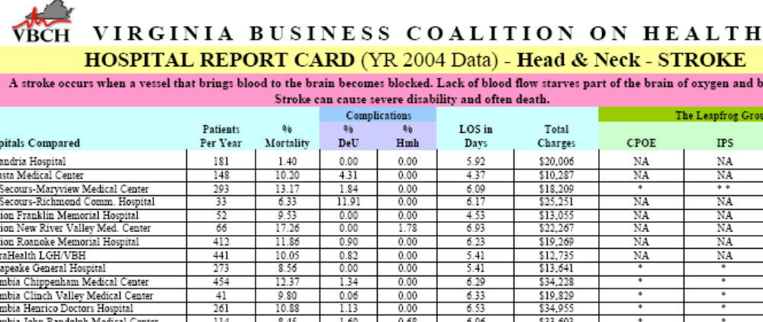
VBCH and Cardiovascular Health
Hospital Report Cards on CABG and Stroke, and others (total 11)

Slide 31
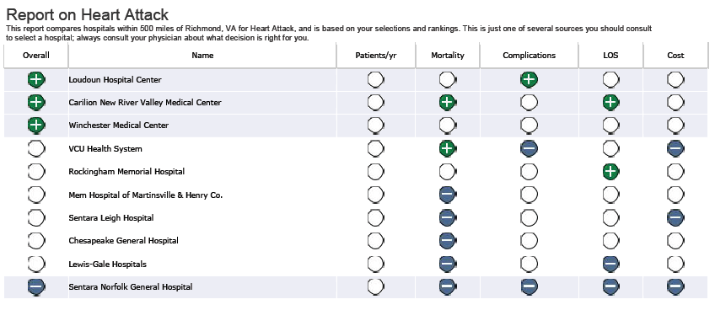
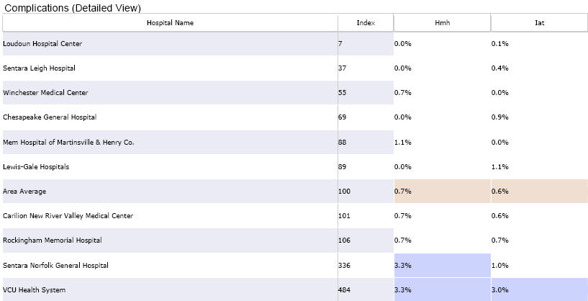
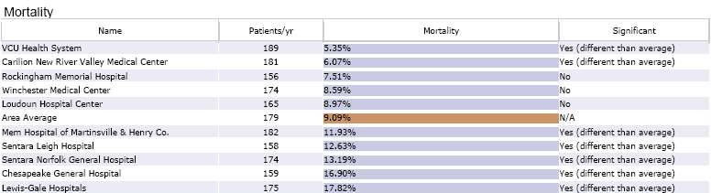
VBCH and Cardiovascular Health
HOSPITALpick Consumer Decision Support Tool – live online 165 procedures including heart attack, stroke, etc.

Slide 32
VBCH and Cardiovascular Health
  HealthMapRX – (formerly the Ashville Diabetes Model) Rollout proposed for 2008 start-up, with meeting occurring in Fall/Winter 2007. Multiple meetings have taken place to-date, which includes two formal programs on the Ashville Model with John Miall and Dan Garrett, R. Ph., and includes other stakeholders as collaborators.
  Bridges to Excellence….for example, “Cardiac Care Link”….we would love to have an employer or health plan champion this initiative in Virginia.

Slide 33
VBCH and Cardiovascular Health
Coalition’s relationship with it’s Members
  Respect, trust, accountability for quality of work, completion and within budget, confidentiality
  Coalition serves it members
  Education (ongoing) and consensus building
Working with employers through Coalitions
  Bring sufficient resources to the table (opportunity costs; limited financial & human resources)
  Demonstrate need and ROI
  Flexibility in the contract document and workplan

Slide 34
Employers and Cardiovascular Health
Working with Employers Where No Coalition Exists
  Assess need/interest for worksite program; do your homework
  Identify contact person to develop relationship with
  Present a few ideas for improving cardiovascular health in a simple, concise manner
  Establish resource sources for planning, implementation and evaluation
  Be flexible
  //////more here

Slide 35
Questions and Conversation
Questions about the roles of coalitions, NBCH, VHCC?
How can NBCH and VHCC collaborate with public health?
What are the common goals for business coalitions and public health for cardiovascular health and health improvement?

Slide 36
Business Health and Cardiovascular Health
Thank you!
Eileen Ciccotelli
757.552.0913
eciccotelli@myVBCH.org

