Slide 1
Testing BIOS Interrupt 0x13 Based Software Write Blockers
Paul E. Black, Ph.D.
James R. Lyle, Ph.D.
National Institute of Standards and Technology
http://www.nist.gov/

Slide 2
DISCLAIMER
Certain trade names and company products are mentioned in the text or identified. In no case does such identification imply recommendation or endorsement by the National Institute of Standards and Technology (NIST), nor does it imply that the products are necessarily the best available for the purpose.

Slide 3
Outline
Computer Forensics at NIST
Software Write Block Programs
Hardware Write Block Devices
Results

Slide 4
NIST Computer Forensic Goals
Establish methodology for testing computer forensic tools (CFTT)
  Hard drive imaging tools
  Software & hardware hard drive write blockers
  Deleted file recovery
  String searching
Provide international standard reference data for files (NSRL)
  Operating system files
  Common applications
  Voting software

Slide 5
Hard Drive Write Protect
Can be done either with hardware or software
Software write protection is limited to specific environment: BIOS access or device driver
Hardware write protection is more general

Slide 6
Computer Forensics at NIST
Software Write Block Programs
Hardware Write Block Devices
Results

Slide 7
SW Write Blocker Requirements
Informal
  No change allowed to a drive that contains evidence
  Must allow the entire drive to be read
More Formally
  (1) The tool shall block any commands to a protected disk in the write, configuration, or miscellaneous categories.
  (2) The tool shall not block any commands to a protected disk in the read, control, or information categories.

Slide 8

Disk access via BIOS Int 0x13
Application program
BIOS Int 0x13
issue cmd to drive
return

Slide 9
Disk access with SWB program
Application program
SWB program
block
return
allow
BIOS Int 0x13
issue cmd to drive
return

Slide 10
Flow to test SWB program
Test harness
issue 0x13 cmd
query result
SWB program
block
return
allow
Int 0x13 monitor
block
count
report count
allow
BIOS Int 0x13
issue cmd to drive
return

Slide 11
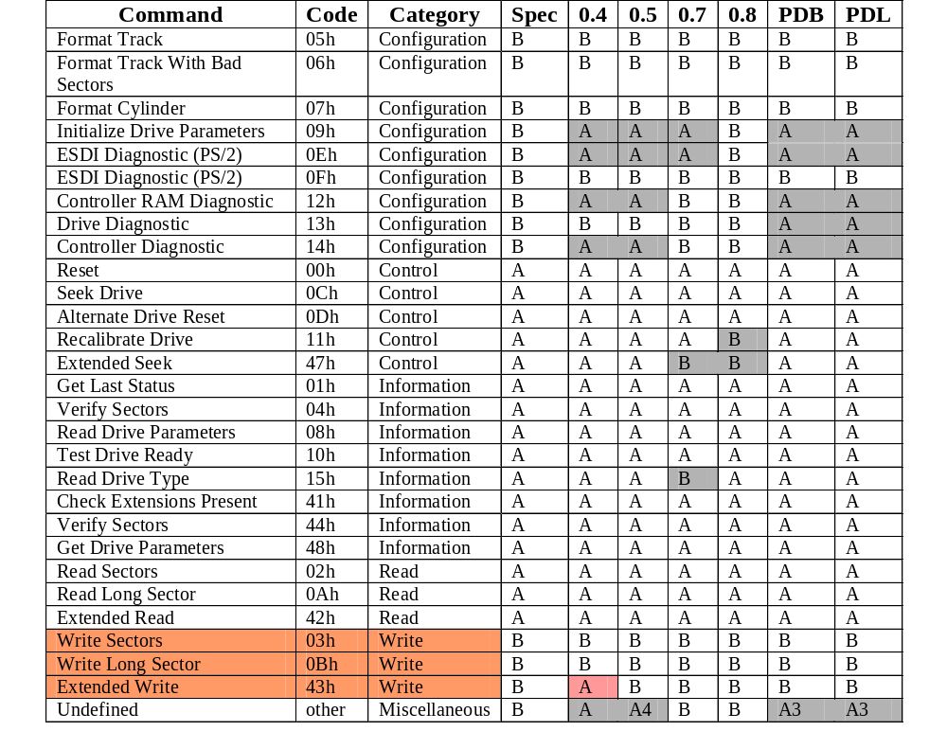
RCMP HDL & Pdblock
Notes:
0.4 – 0.8 are RCMP HDL versions
PDB = pdblock, PDL = pdb_lite
Note HDL 0.4 was written before the 43h command was implemented. 0.4 is safe on a legacy BIOS machine without a SCSI card (The SCSI card might add the 43h cmd to the BIOS).

Slide 12
Computer Forensics at NIST
Software Write Block Programs
Hardware Write Block Devices
Results

Slide 13
Disk access via BIOS Int 0x13
Application program
BIOS Int 0x13
issue cmd to drive
return

Slide 14
Disk access, detailed view
driver

Slide 15
Disk access with HWB
driver
allow
block
return

Slide 16
Flow to test HWB device
Test harness
issue commands
record result
driver
allow
block
return
Protocol
Analyzer
Protocol
Analyzer

Slide 17
Computer Forensics at NIST
Software Write Block Programs
Hardware Write Block Devices
Results

Slide 18
Impact
Release 18 (Feb 2001) - A US government organization was doing some testing and uncovered an issue under a specific set of circumstances.
Linux doesn’t use the last sector if odd
Several vendors have made product or documentation changes
CFTT cited in some high profile court cases

Slide 19
Specifications
Available
  Hard Drive Imaging (e.g., Safeback, EnCase, Ilook, Mares imaging tool)
  Revised Hard Disk Imaging (Digital Data Acquisition)
  Software Write Block Programs (e.g., RCMP HDL, Pdblock, ACES)
  Hardware Write Block Devices (A-Card, FastBlock, NoWrite) – posted for public review
  Deleted File Recovery
Under Development
  Revised Hard Disk Imaging – Test Plan
  Deleted File Recovery – Test Plan
  String Searching

Slide 20
Test Reports
Available
  Sydex SafeBack 2.0
  NTI Safeback 2.18
  EnCase 3.20
  GNU dd 4.0.36 (RedHat 7.1)
  FreeBSD 4.4 dd
  RCMP HDL V0.4, V0.5, V0.7, & V0.8
In Progress
  Pdblock 2.0
  Pdblock 2.1
  Pdblock lite

Slide 21
Contacts
Jim Lyle Doug White
www.cftt.nist.gov www.nsrl.nist.gov
cftt@nist.gov nsrl@nist.gov
Mark Skall
Chief, Software Diagnostics & Conformance Testing Div.
www.itl.nist.gov/div897 skall@nist.gov
Sue Ballou, Office of Law Enforcement Standards
Steering Committee Rep. For State/Local Law Enforcement
susan.ballou@nist.gov

