Slide 1
Procedure for Obtaining & Comparing Land and Water Temperature data Using
MY NASA DATA’s
Live Access Server

Slide 2
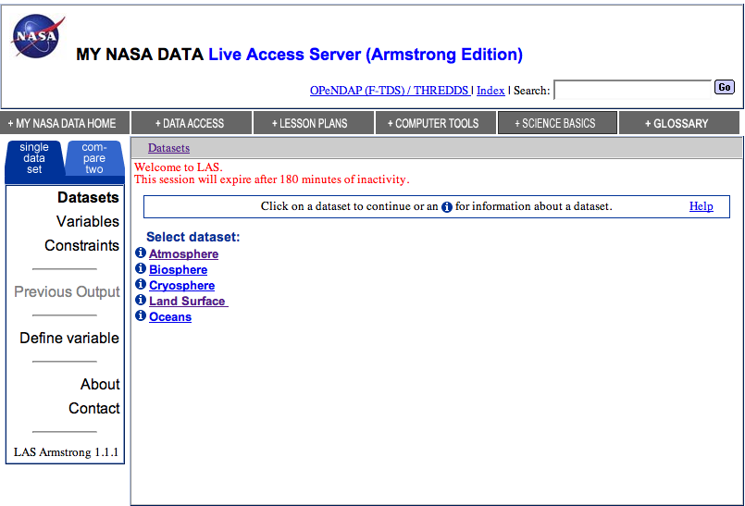
Step 1
On the main web page, under Create Your Own Microsets, click link Live Access to Data, then click Live Access Server (Armstrong)
Click on Land Surface

Slide 3
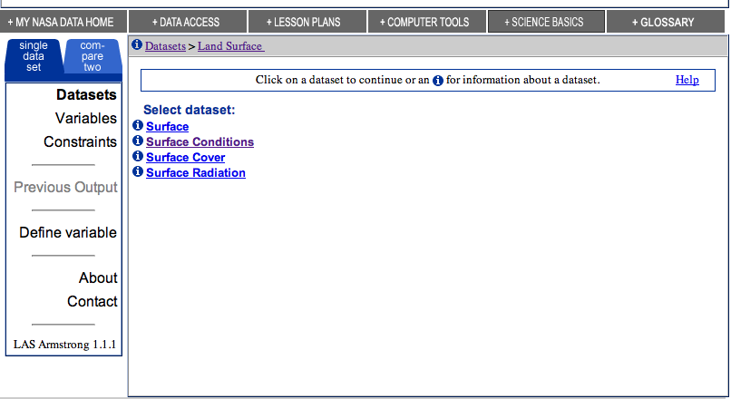
Step 2
Click on Surface Conditions

Slide 4
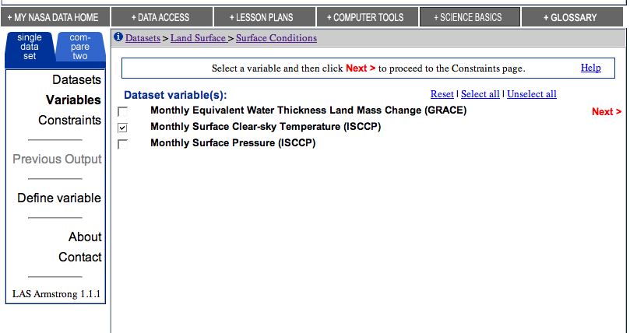
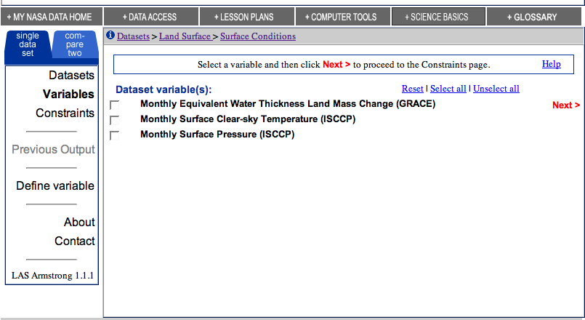
Step 3
Select the box for Monthly Surface Clear-sky Temperature (ISCCP)
Click on NEXT (this is located to the right of the page in red)

Slide 5
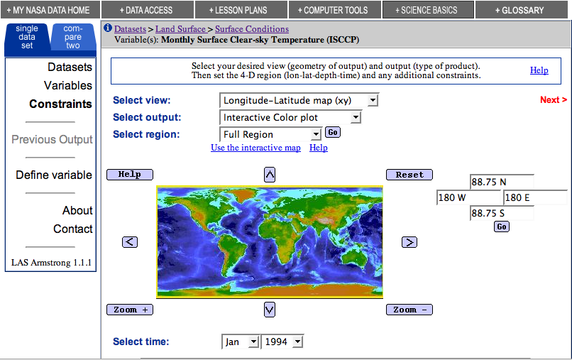
Step 4
On the left side menu, there are two tabs. Select the tab “compare two”
This will allow the LAS to compare two datasets

Slide 6
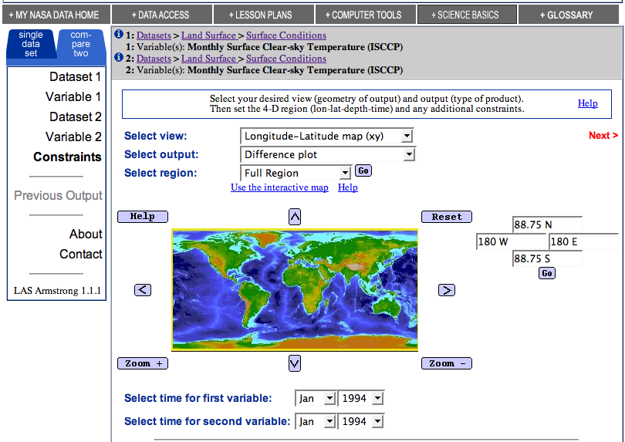
Step 5
After clicking on the “compare two” tab this is the screen you should see
By default the second dataset is the same as the first one
Click on “Use Interactive Map” located above the map

Slide 7
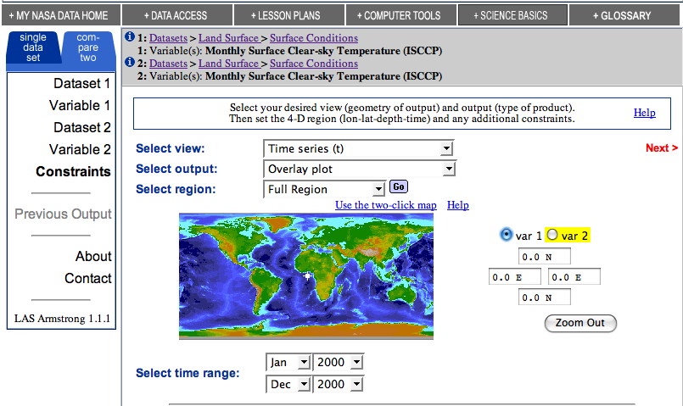
Step 6
In the Select View drop-down menu, highlight Time Series
In the Select Output drop-down menu, highlight Overlay Plot
In the Select Region drop-down menu, highlight Full Region (default)
Select Time: Set the time range so that the time period is from Jan 2000 to Dec 2000
.

Slide 8
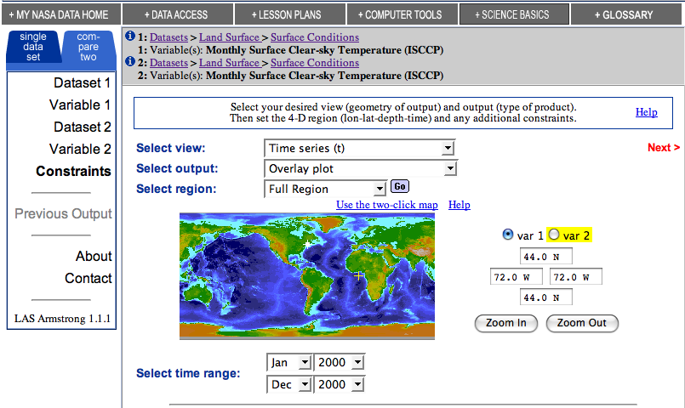
Step 6
There are two radio buttons for variables. Click the radio button for “var 1”
The coordinates' box is shaped like a compass.
  In the North position's box, type 44 N. This sets the northern boundary for the plot.
  In the East position's box, type 72 W then click in the box for the west position. This will automatically set the corresponding West position's box with the same value.
  This point is over land.

Slide 9
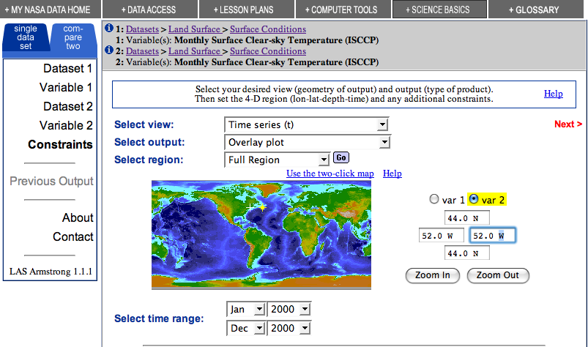
Step 7
Click on the radio button for “var 2”. The view, output, region, and time range should remain the same as they were for Variable 1
In the north box, enter 44 N and in the eastern box enter 52 W since we want to compare the land data with a water location
Click on NEXT (this is located to the right of the page in red)

Slide 10
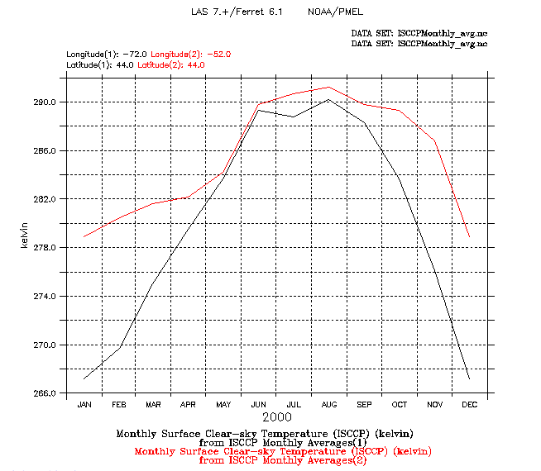

Step 8
The graph will appear in a pop-up window. Note: some browsers have a pop-up blocker. Be sure pop-ups are enabled for this site or press and hold the Ctrl key and click Next.

