Slide 1
High Gradient RF Issues and 88 MHz test results
M. Vretenar for the 88 MHz team:
R. Garoby, F. Gerigk, J. Marques, C. Rossi, M. Vretenar
The 88 MHz test cavity
The test stand
Conditioning results
High gradient experience at CERN
Some conclusions

Slide 2
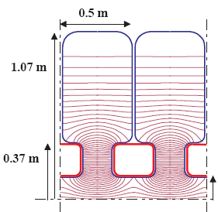
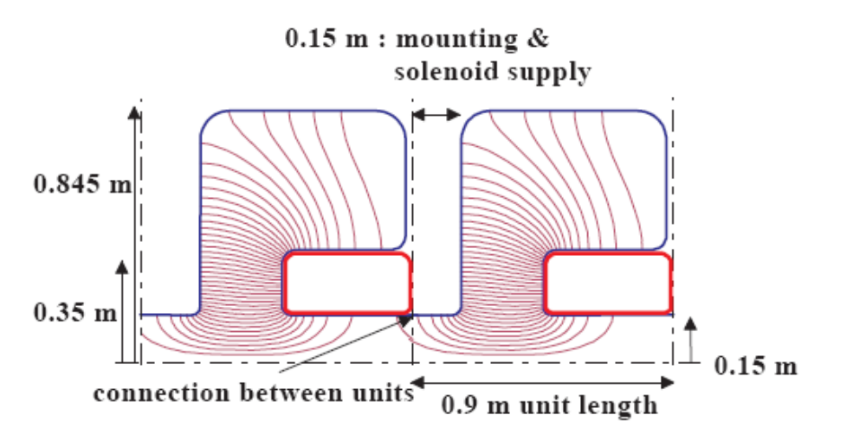
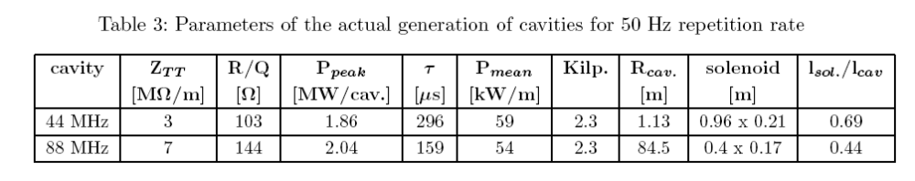
Cavity design for the CERN muon channel
CERN Muon Cooling Channel scheme (2000): 44 MHz + 88 MHz cavities
88 MHz cavity designs
(“old” and “new” schemes)
88 MHz cavity requirements:
Real estate gradient 4 MV/m
Peak RF power > 2 MW

Slide 3
Challenges of muon cavities
Challenges of muon cavities in CERN (and other) schemes:
Low frequencies
High gradients
Poor RF power efficiency (ZT²)
Presence of high B-field
High gradients in a frequency range with little experience
Construction and operation of large RF amplifiers with high peak power
Need to start as soon as possible an experimental programme to assess the technological challenges.

Slide 4
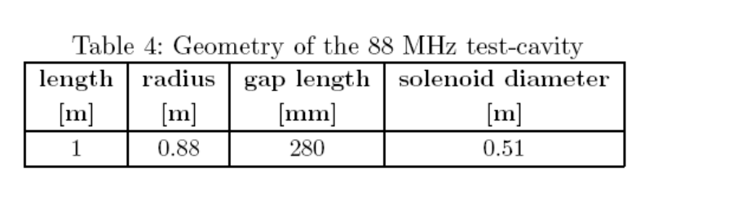
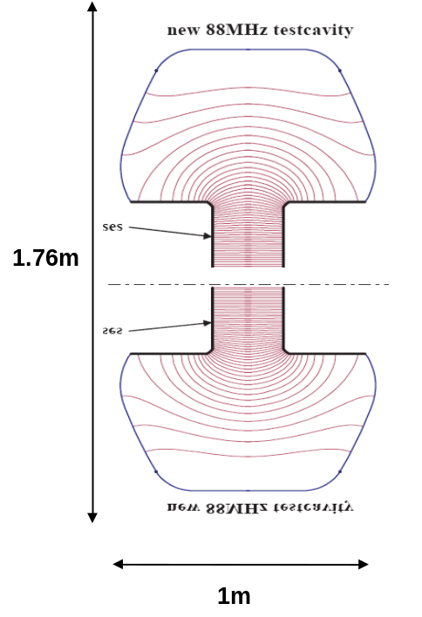
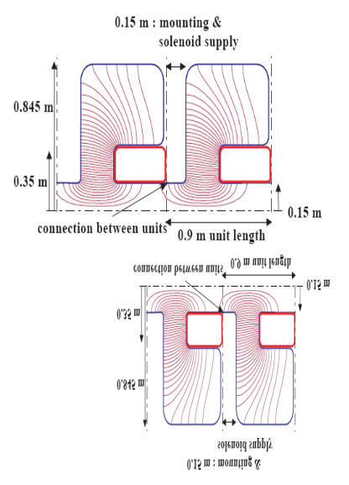
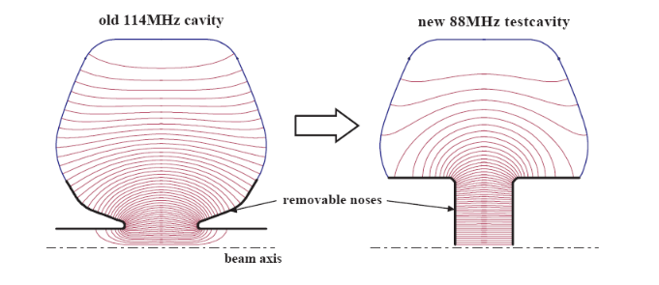
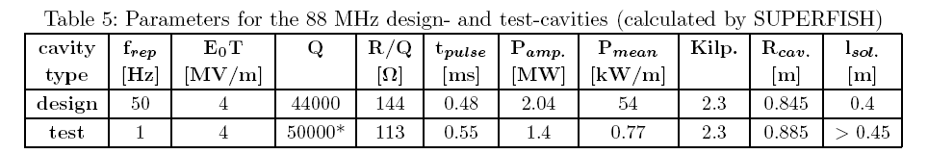
The 88 MHz Test Cavity
Idea to put together a test stand using an old PS 114 MHz cavity (used for leptons), modified for 88 MHz, fed by an upgraded 200 MHz Linac amplifier, and driven by a modified 80 MHz PS amplifier.
New “gap” inserted in the old PS cavity
Main parameters are equivalent to muon cavity
0.9m
R. Garoby, F. Gerigk, CERN-NUFACT-Note-87

Slide 5
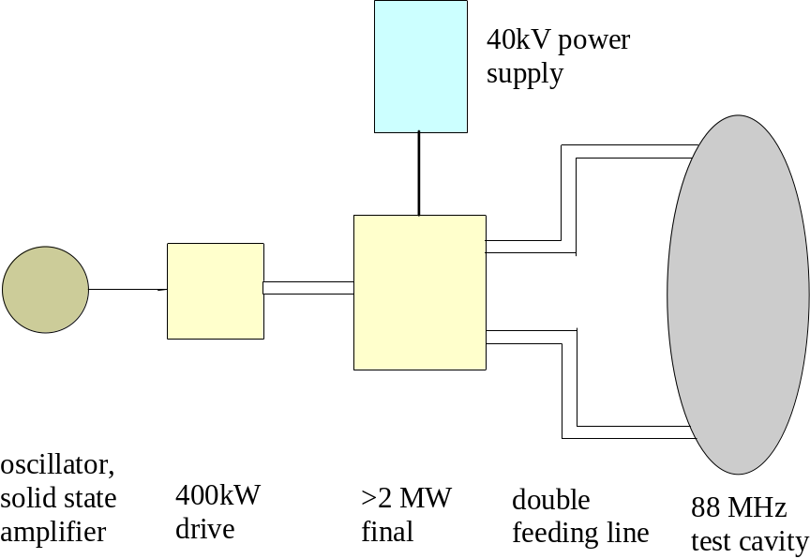
The 88 MHz Test Stand
Generation and transport of > 2 MW power to the test cavity is a delicate task, requiring a large size installation.
Main challenges:
high drive power (>400 kW),
high anode voltage (40 kV),
large power and voltages (during reflection)
in the final amplifier,
large peak voltages
in the transmission line.
Due to lack of resources after 2001, the test stand preparation has progressed very slowly.
Infrastructure preparation very time consuming.
Results only in 2005.

Slide 6
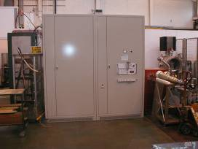
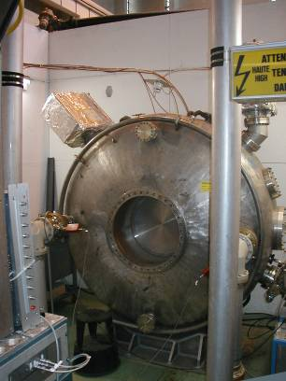
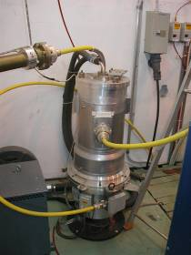
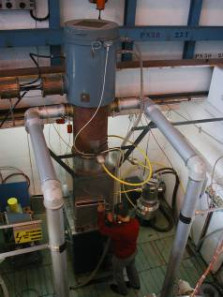
88 MHz Test Stand

Slide 7
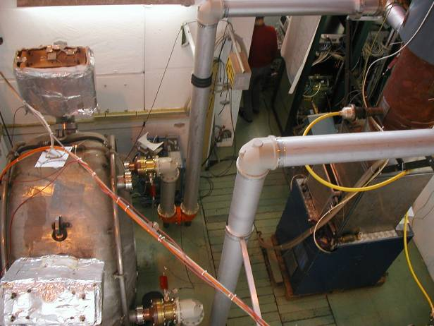
88 MHz Test Stand

Slide 8
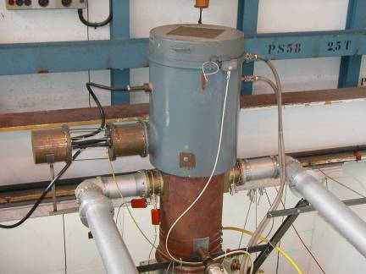
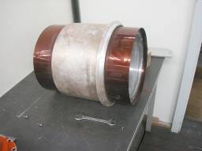
88 MHz Final Amplifier
Old Linac1 (1958) 200 MHz amplifier, rated for 2 MW, equipped with tube TH170R (max. power 2.5 MW)
Improved for higher power:
Kapton capacitor (anode blocker)
Revised neutralization
New output resonator (88 MHz)
New (low-cost) filter
Double coaxial output (~1 MW/arm).

Slide 9
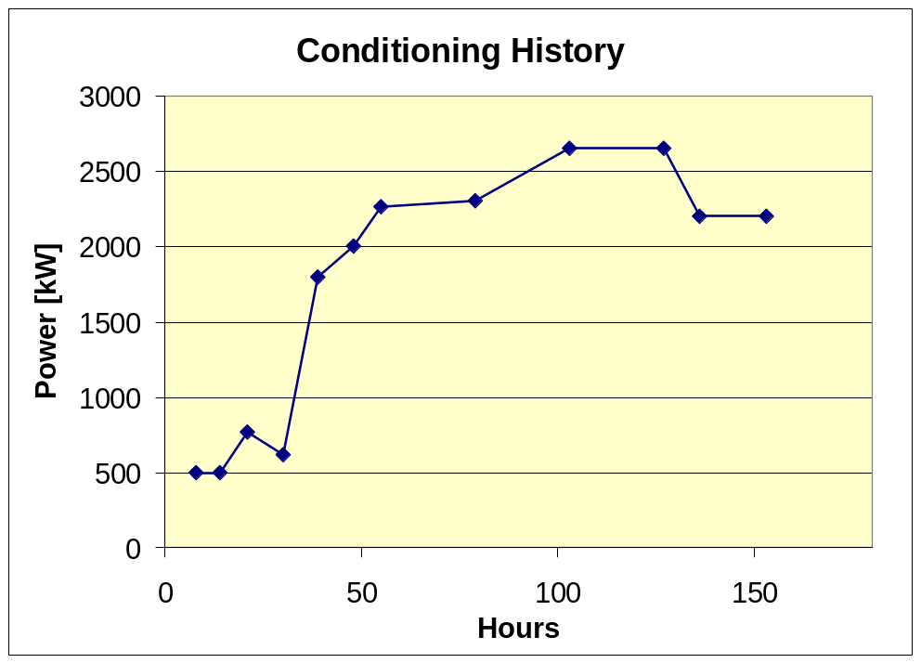
88 MHz Cavity Conditioning
Preparation of test stand finished end July 2005.
Conditioning started on August 16th and continued until September 6th.
About 160 hours of effective conditioning time at 1 Hz
Maximum power out of final amplifier 2.65 MW reached after about 100 hours of conditioning
Increasing pulse length during test. Filling time ~250 μs
Test stopped due to failure of anode supply with 300 μs pulse length (now repaired).
Tests will be restarted soon but we are limited by sparking in the final amplifier and there is no need for longer pulses.
250 μs
300 μs

Slide 10
Conditioning results
Sparking in the output amplifier cavity (designed for 2 MW!) limited at 2.65 MW the power that could be sent to the test cavity.
At this power level, all test stand components were close to their limit (HV supply, driver and cavity).
Measured gradient in the test cavity at this power was 4.1 MV, slightly higher than the design value (4 MV/m).
At this field level, there were occasional remaining breakdowns in the cavity, causing loss of few % of the pulses. Further conditioning could reduce this breakdown rate
Although the gradient was limited by the final amplifier, the conditioning experience shows that we were about at the highest gradient achievable in the cavity for reliable operation.

Slide 11
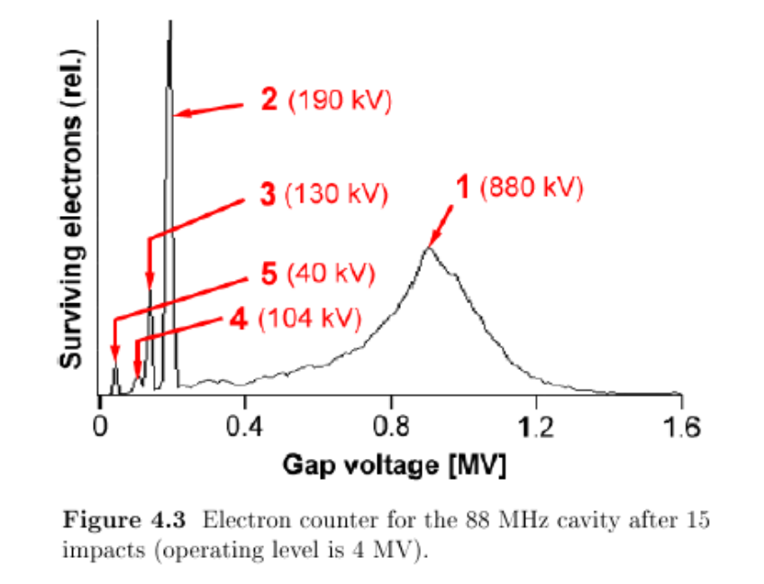
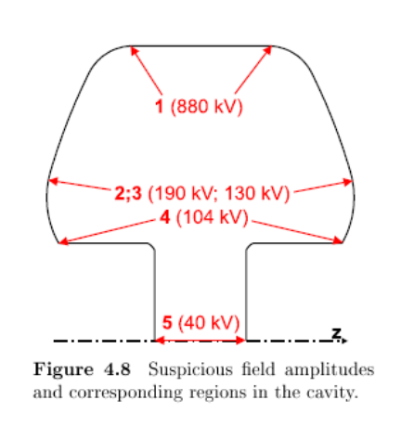
Experience with multipactoring
3D computations of multipactoring up to 3rd order in the 88 MHz cavity were performed with the code MultP by C. Schulz (TU Berlin, Diploma Thesis, 2004).
No significant electron activity was observed by the code at V > 1.6 MV.
5 multipactoring levels were foreseen at V < 1 MV
Experimental result:
Some multipactoring activity was observed at gradients < 1 MV
A disturbing multipactoring level was observed at 3.1 MV, not predicted by simulations !
Simulations were not extended to the power coupler…

Slide 12
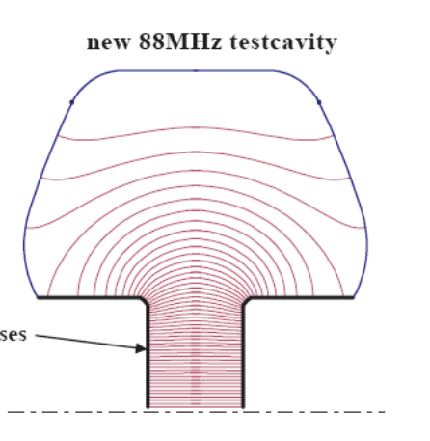
Limit values during test
Highest field level reached during conditioning:
4.1 MV/m E-field gradient
14.7 MV/m gap field
25.9 MV/m peak field (=2.4 Kilpatrick)
2.65 MW output power
1 Hz repetition frequency
170 μs pulse length
Peak field
Gap field
Computed Q=50’000 (Superfish)
Measured Q=33’300 (67%)

Slide 13
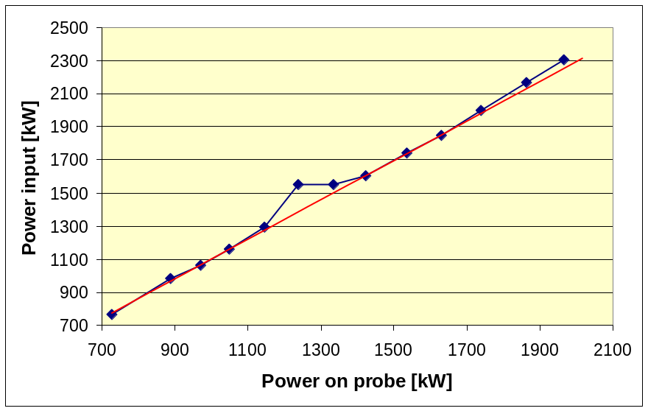
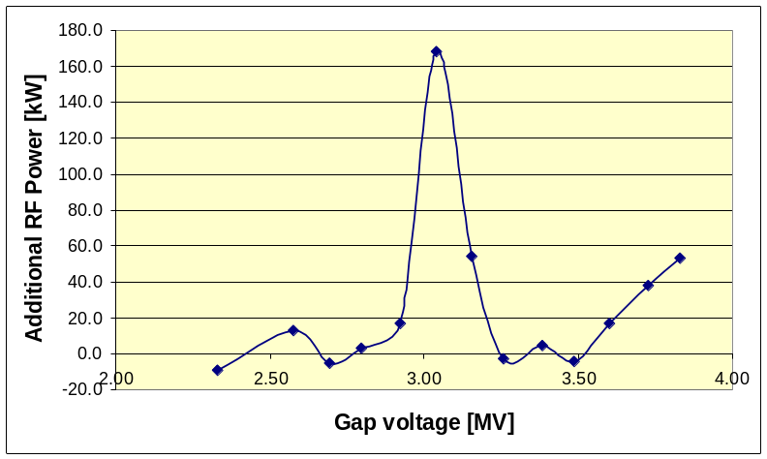
Field emission at high gradient
The amount of available power is limited by dark current. Field emission at high gradient generates electron current that absorbs power from the generator.
Electrons generated by multipactoring
Electrons generated by field emission at high gradient

Slide 14
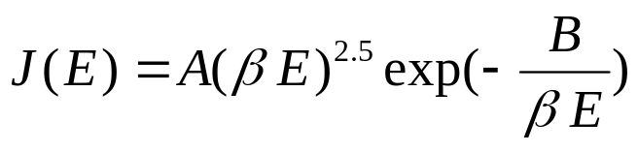
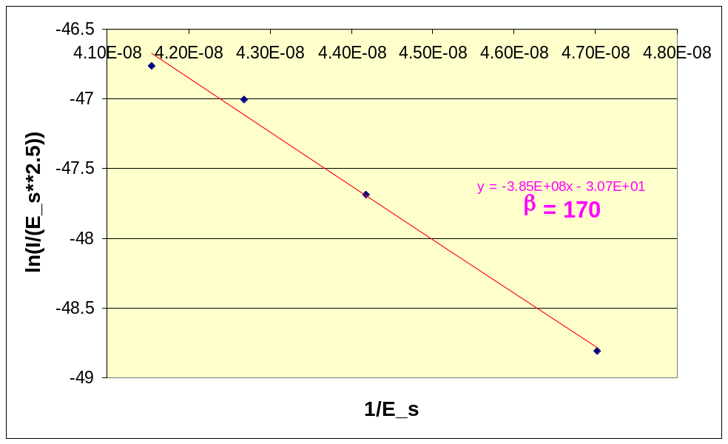
Field emission measurements
Fowler-Nordheim plot
Field emission current is computed from the “additional power” going to the cavity at high gradient.
F.E. current follows the Fowler-Nordheim formula
Plotting ln(I/E_s**2.5) = f(1/E_s), the slope of the straight line gives the field enhancement factor β, depending on surface conditions.
Fowler-Nordheim plot of field emission current for 88 MHz cavity.
Enhancement factor β=170, quite normal for copper plated cavities out of the workshop, without particular cleaning procedures.

Slide 15
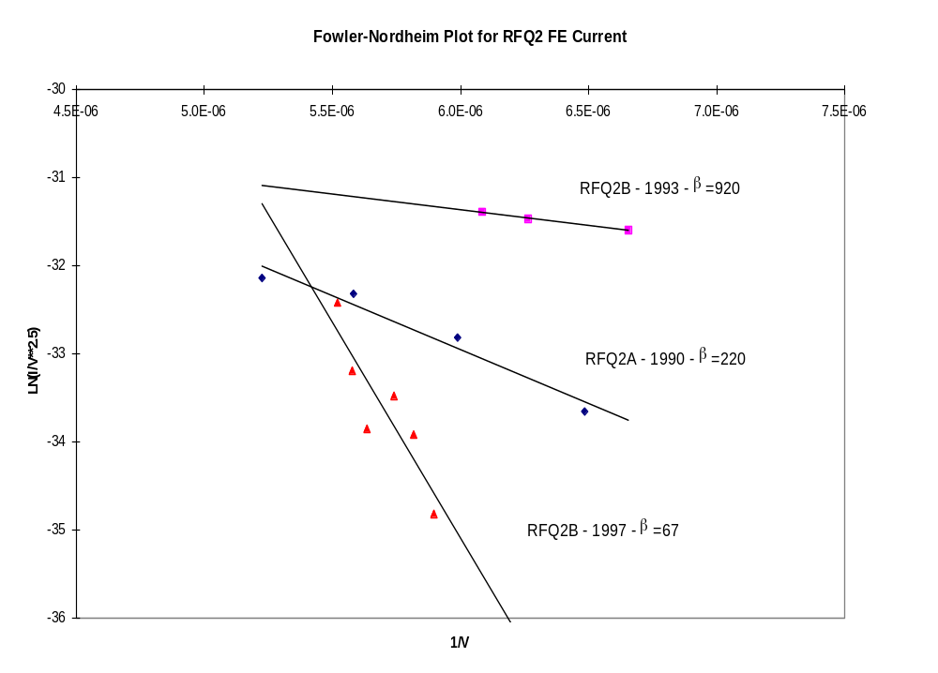
Experience with the CERN RFQ2
Enhancement factor β can greatly affect voltage holding and maximum gradient.
It is increased by dielectric impurities on the electrodes.
It decreases slowly with steady operation.
CERN RFQ2 operates at high gradient (35 MV/m peak field) injecting into Linac2.
Original (from workshop) β=220
After an oil pollution from the vacuum system β=920
After slow reconditioning and 4 years of operation β=67.

Slide 16
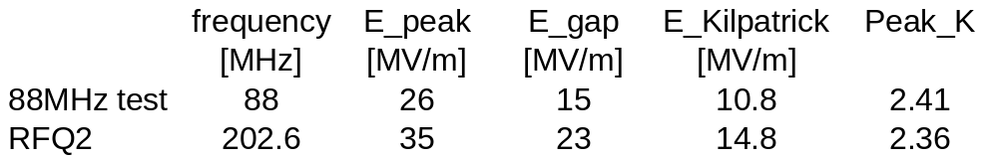
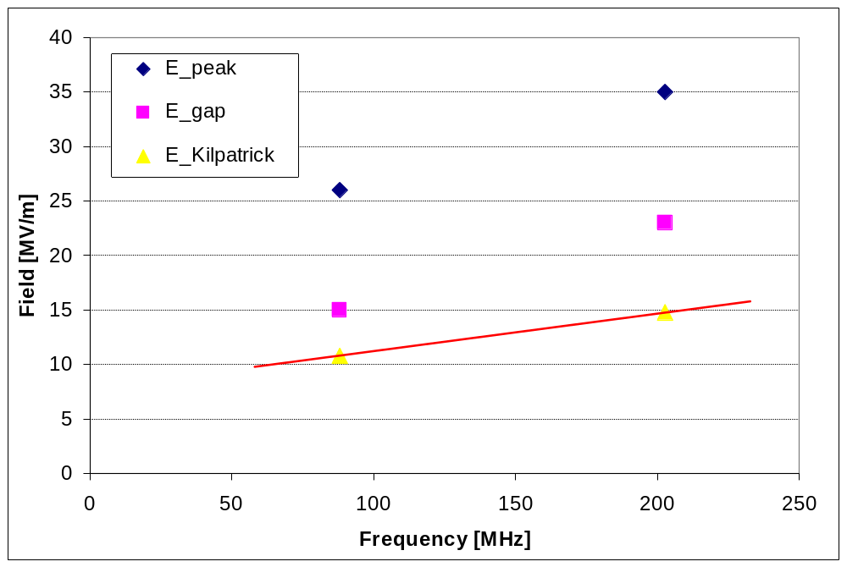
Maximum gradients achieved at 88 and 200 MHz w.r.t. Kilpatrick limit
In terms of conditioning time and residual breakdown rate, the levels reached by RFQ2 and 88 MHz cavity are comparable (as for repetition rate and pulse length).
Conclusion is that peak and operating field seem to follow Kilpatrick law (square root of frequency).

Slide 17
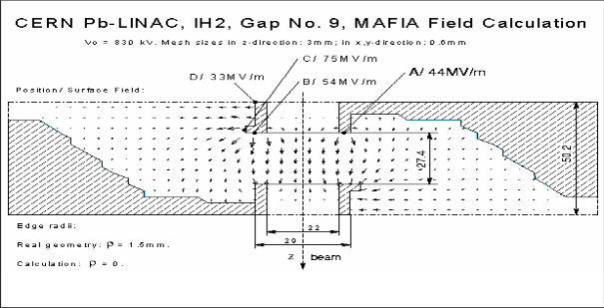
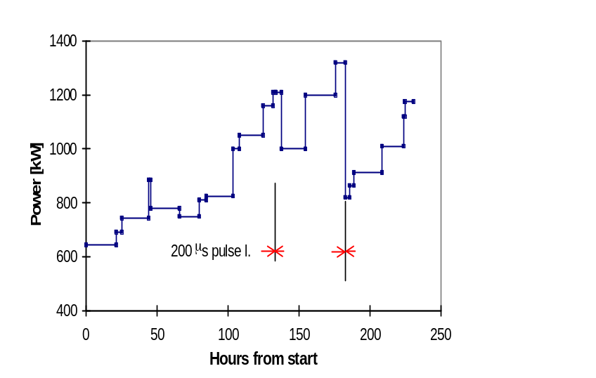
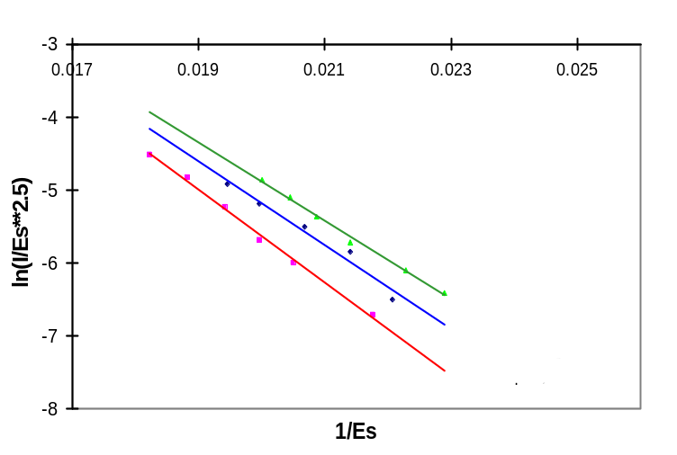
Another high gradient experiment at 200 MHz – the IH2
Steady operation cleans the electrodes and improves field enhancement factor:
  A conditioning test was done in 1997 on the 200 MHz Interdigital-H Tank2 at Linac3, which had been in operation (1’500 hrs/yr) since 1994.
After 240 hours of conditioning, fields >50 MV/m (~3.5 times the Kilpatrick level) were reached on the drift tube face (∼ 6 cm2 per tube) in more than 20 gaps. Local field maxima were as high as 75 MV/m (on ∼ 0.5 cm2 per tube).
Measured β was about 100.
Reasons for the very high field: small high field regionelectrodes, cleaned by 6’000 hrs of operation.

Slide 18
Some conclusions
Field gradients of 15 MV/m (and real estate gradients of 4 MV/m) are achievable at 88 MHz, with peak fields exceeding 2.4 Kilpatrick.
At low repetition rate and pulse length, effective conditioning times of about 200 hours are sufficient to reach the field limit.
Cleaning procedures for electrodes (similar to what is done for SC cavities) or long-term conditioning by the RF could possibly improve the field enhancement factor and allow reaching higher gradients – but then the limitation would be in size and reliability of the RF system !
Maximum field as function of frequency seems to scale accordingly to a Kilpatrick-like law (number of emitting impurities proportional to surface and inversely proportional to frequency?).
Multipactoring calculations tend to be unreliable (phenomena probably occur in the regions more difficult to simulate).
No conclusion can be drawn on the effect of magnetic fields on high field operation.

