Slide 1


Technology Tools for Prevention
Steps to a HealthierUS: Putting Prevention First
Veterans Health Administration
Frances M. Murphy, M.D., M.P.H.
Deputy Under Secretary for Health
For Health Policy Coordination
April 16, 2003

Slide 2
Quality Problems Persist in U.S. Medical Care
IOM Quality Chasm Series
Poor treatment of diabetes – tens of thousands of cases of premature death, amputations, kidney disease and blindness
Inadequate care after AMI – 18,000 deaths per year
Less than half of adults >50 years old receive the recommended colorectal screening – common cause of cancer death in the U.S.

Slide 3
Healthcare Technology Infrastructure
A Tool to Improve Care
Electronic Health Record System
Clinical Reminders for Prevention
Telemedicine and TeleHome Care:
  Florida’s Community Coordinated Care Service Pilot

Slide 4
Medical Care
VHA is the largest, integrated healthcare system in the US:
163 hospitals (19,639 beds, 5.4M BDOC)
135 nursing homes
43 domicilliaries
206 veterans counseling centers
800 clinics (46.5 M outpatient visits)
183,000 employees

Slide 5
VA Patients Receiving Care
65 or older: 45%
Income $25,000 or less: 74%
No health insurance: 31%

Slide 6
VA Healthcare Information Technology Infrastructure
Electronic Health Record System
Clinical Reminders for Prevention
Telemedicine and TeleHome Care

Slide 7
“VA’s integrated health care information system, including its framework for using performance measures, is considered one of the best in the nation”
    Leadership by Example, Institute of Medicine,October 2002

Slide 8
Electronic Medical Record
“VISTA”
All Sites of Care: Outpatient, Inpatient, and Nursing Homes
Radiology: Images and Reports
Diagnostic Testing (Images and Reports) : Laboratory, Pathology, Endoscopies, Colonoscopies, Bronchoscopies, EKG, Cardiac Catheterization
Pharmacy and Physician Order Entry
Remote View: Records are available at all points of care
Decision Support: Clinical Guidelines and Clinical Reminders

Slide 9
VISTA
Patient Identifiers and Picture
Medical Problem List
Current and past medications
Allergies
Social History
Clinic Progress Notes and Consults
Inpatient Records
Remote View of EMR from other VA sites
Advanced Directives
Diagnostic Test Reports and Images

Slide 10
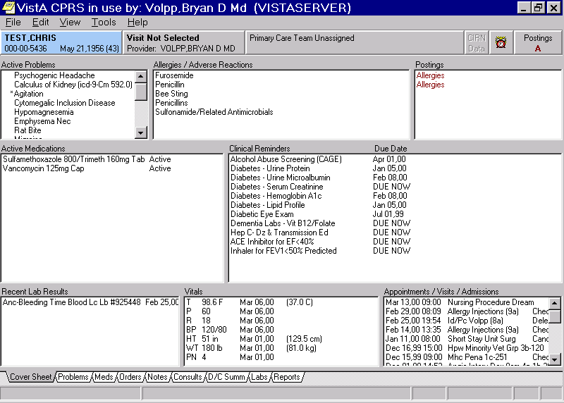

Slide 11
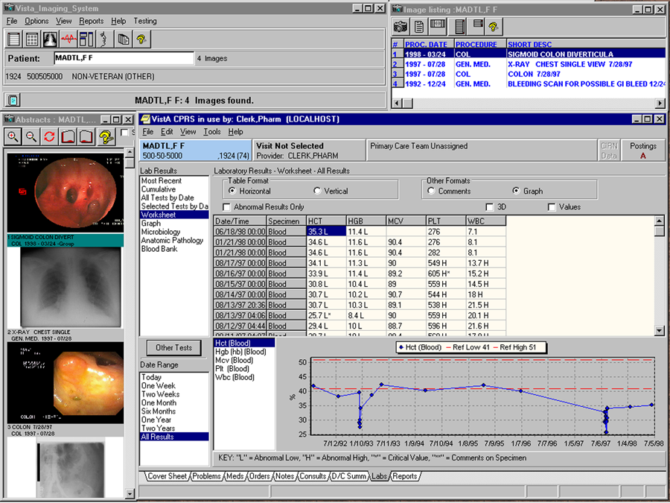

Slide 12
Quality of Veterans Healthcare
Performance measures
Indicator | VA (mean) |  | Best Reported
Beta blocker & AMI | 97% |  | 94%(MMCP)
LDL Cholesterol <130 post AMI | 74% |  | 59%(NCQA)
Cholesterol screening | 91% |  | 73%(BRFSS)
Cholesterol Screening & AMI | 92% |  | 77%(NCQA)
Diabetes:Cholesterol (LDLC) | 94% |  | 87%(MMCP)
Diabetes:Cholesterol (LDLC) controlled<130 | 70% |  | 50 %(NCQA)
Diabetes:HgbA1c done in past year | 94% |  | 86%(MMCP)

Slide 13
Quality of Veterans Healthcare
Performance measures
Indicator | VA(mean) | Best Reported
Breast Ca Screen | 80% | 75%(MMCP)
Cervical Ca Screen | 89% | 80%(NCQA)
Colorectal Cancer Screen | 64% | 44%(BRFSS)
Pneumococcal vaccine :patients>65 yrs | 87% | 60%(BRFSS)
Influenza vaccine :patients >65 yrs | 74% | 65%(BRFSS)

Slide 14
Clinical Reminders for Prevention
Clinical Care made Effortless
  Prompts the Provider
  Computer Enters the Order
  Documents in Progress Note

Slide 15
IMPACTS OF CHANGE
%
Proportion of patients receiving cancer screening, immunizations, counseling for alcohol abuse and tobacco use have increased 130 to 500 percent.
Vaccinations have been estimated to prevent approximately 4000 deaths.

Slide 16
Critical Success Factors
Electronic Medical Record Systems
Clinically Relevant and Efficient
Clinical Decision Support
Improves Prevention and Care
Flexible and Customizable
Integrated and Fully Functional
Reliable

Slide 17
VA Healthcare Information Technology Infrastructure
Electronic Health Record System
Clinical Reminders for Prevention
Telemedicine and TeleHome Care

Slide 18
Community Care Coordination Service
VA Program in Florida
Continued the Shift from Hospital to Ambulatory to Home Care for a Complex, Frail Elderly Population
Disease Management for 9 conditions including diabetes, hypertension, CHF, CAD, and COPD
Care Coordination is the key
Technology is the tool
Use of Multiple Innovative Technologies to Enhance Care
Goals: Improved Quality of Life and Reduced Utilization

Slide 19
Community Care Coordination Service
Program Implementation
Six Florida sites: Urban Tertiary Care Medical Centers and Small Rural Hospitals
Population: clinically complex patients with multiple chronic conditions
Multidisciplinary Care Coordination Teams
Initial In-Home Assessment
Equipment Installation and Patient Education
Care Coordination Team Monitors Daily

Slide 20
Community Care Coordination Service
Technology
Simple, Easy to Use
Connects to Telephone: 800 Number
No Internet Service Necessary
Secure, Web-based
Integrated Enrollment, Scheduling, Monitoring Tools
Care Team and Patients Communicate Quickly
Flexible to Address Individual Needs

Slide 21
Community Care Coordination Service
Patients
Answer Personalized Questions Daily
Multilingual Service: English or Spanish
Monitor their Disease Symptoms, Medication Compliance, Disease Knowledge
Access to Patient Education
Daily Responses are Categorized and Risk-Prioritized for Most Serious Outcomes

Slide 22
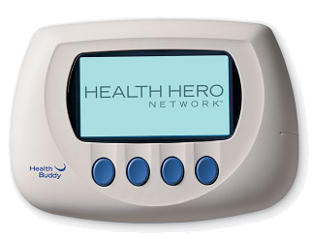
CCCS Appliance

Slide 23
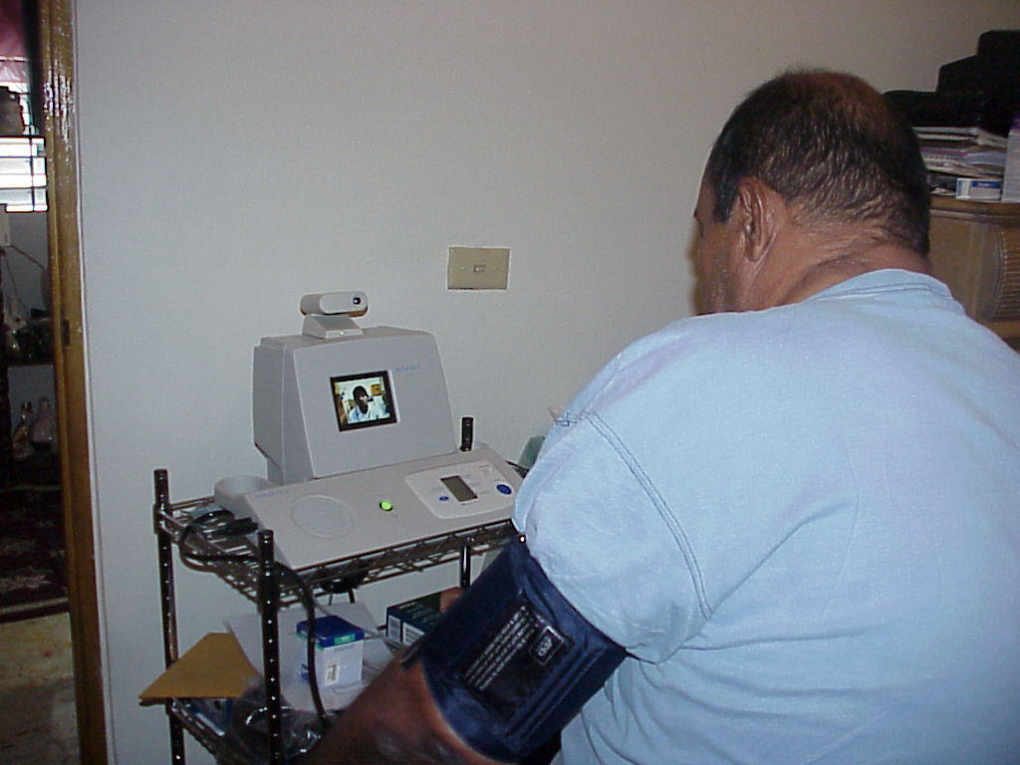
CCCS TeleHome Care

Slide 24
Results of CCCS
Patient Satisfaction: 96-98%
Quality of Life (SF-36V):
  Lake City: 50%physical health perception improved
  Miami : no change
Provider Satisfaction High
Outcomes:
  Reduction in Hospitalization: Lake City 68%;Miami 46%
  Reduction in BDOC: Lake City 71%; Miami 50%
  Prescriptions: Lake City 66%; Miami 5%
  Daily CCCS Use: Lake City 83%; Miami 64%

Slide 25
Community Care Coordination Service
Conclusions
Provides Continuous Care Coordination
Good Patient Satisfaction
Reductions in Health Care Utilization
Stable or Improved Perception of Physical and Mental Health

Slide 26
Technology Tools for Prevention
Summary
1) The U.S. can no longer afford to practice 20th century Preventive Medicine
2) Health Information Technology is an essential tool to improve health promotion, disease prevention, quality of care, and patient satisfaction
3) U.S. health care must become patient-centered, accessible and accountable

