Slide 1
A Strategy for Testing Hardware Write Block Devices
James R Lyle
National Institute of Standards and Technology

Slide 2
DISCLAIMER
Certain trade names and company products are mentioned in the text or identified. In no case does such identification imply recommendation or endorsement by the National Institute of Standards and Technology, nor does it imply that the products are necessarily the best available for the purpose.

Slide 3
Project Sponsors
NIST/OLES (Program management)
National Institute of Justice (Major funding)
FBI (Additional funding)
Department of Defense, DCCI (Equipment and support)
Homeland Security (Technical input)
State & Local agencies (Technical input)
Internal Revenue, IRS (Technical input)

Slide 4
Protection Goals
Prevent any change to data
Allow access to entire user area
Preserve the configuration of the drive
May change a drive configuration – e.G., To access HPA or DCO

Slide 5
Prohibit Change by …
Prohibit changes by a malicious program
Prohibit accidental change (blunder)
Prohibit change by operating system
Prohibit damage to a drive
Prohibit any changes to a hard drive

Slide 6
Write Block Strategies
Block unsafe commands, allow everything else
  + Always can read, even if new command introduced
  Allows newly introduced write commands
Allow safe commands, block everything else
  + Writes always blocked
  - Cannot use newly introduced read commands

Slide 7
Creating a Specification
Specification (informal) vs Standard (Formal ISO process)
Steering committee selects topic
NIST does research: tools, vendors, users
NIST drafts initial specification
Post specification on web for public comment
Resolve comments, post final version

Slide 8
Writing the Specification
Specification for a single forensic function
Describe technical background, define terms.
Identify core requirements all tools must meet.
Identify requirements for optional features related to the function being specified.

Slide 9
Develop Test Assertions
Each test assertion should be a single testable statement (or condition)
Pre-condition: establish conditions for the test
Action: the operation under test
Post-condition: measurement of the results after the operation

Slide 10
Develop Test Cases
A test case is an execution of the tool under test
Each test case should be focused on a specific test objective
Each test case evaluates a set of test assertion

Slide 11
Develop Test Harness
A set of tools or procedures to measure the results of each test assertion
Must be under strict version control
Must measure the right parameter (validated)
Must measure the parameter correctly (verified)

Slide 12
Blocking Device Actions
The device forwards the command to the hard drive.
The blocking device substitutes a different command
The device simulates the command
If a command is blocked, the device may return either success or failure back to the host
Present the drive as a read-only device
May issue commands without a command from the host

Slide 13
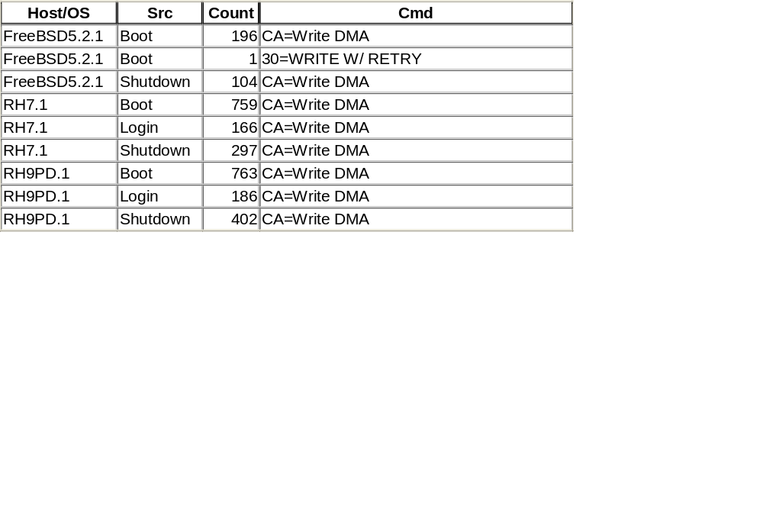
Write Commands Issued by OS (Unix)
Notes:
Write DMA seems popular

Slide 14
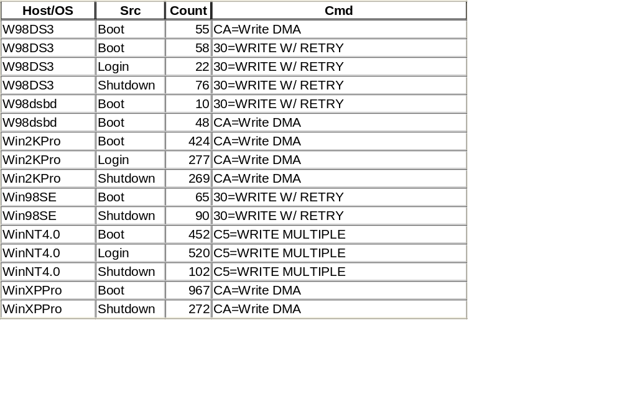
Write Commands Issued by OS (MS)
Notes:
Microsoft keeps evolving

Slide 15
Notable Blocker Behaviors
allow the volatile SET MAX ADDRESS, block if non-volatile
cached the results IDENTIFY DEVICE
substituted READ DMA for READ MULTIPLE
allowed FORMAT TRACK
Depending on OS version, might no be able to preview NTFS partition

Slide 16
Contacts
Jim Lyle Doug White
www.cftt.nist.gov www.nsrl.nist.gov
cftt@nist.gov nsrl@nist.gov
Barbara Guttman
bguttman@nist.gov
Sue Ballou, Office of Law Enforcement Standards
susan.ballou@nist.gov
Notes:
[use if appropriate]

