Slide 1

The Role of the NHQR and the NHDR in Improving the Quality of Health Care
Edward Kelley, Ph.D.
Director, National Healthcare Quality Report
Center for Quality Improvement and Patient
Safety
Agency for Healthcare Research and Quality
U.S. Department of Health and Human
Services
Rockville, MD

Slide 2
Background
Mandated by Congress in the Healthcare
Research and Quality Act (PL. 106-129)
“Beginning in fiscal year 2003, the Secretary, acting through the Director, shall submit to Congress an annual report on national trends in the quality of health care provided to the American people.”

Slide 3
Why Do We Need a National Report?
“Chasm” between actual and ideal performance in the U.S. health care system
Overwhelming amount of health care information available to doctors/patients, yet lack of useable quality information
Consumers care about quality and are increasingly demanding more information
Notes:
Amount of healthcare information available to doctors and patients overwhelming -

Slide 4
NHQR-DR Summary (1)
High quality health care is not a given in the U.S. health care system.
37 of 57 areas with trend data presented in the NHQR show no improvement or have deteriorated
Fewer than one in five people with hypertension have it under control
About one in five elderly Americans prescribed inappropriate/potentially harmful medications
Patient Safety: Inappropriate drug prescription for community-dwelling elderly Americans
16
14
11 drugs that should
always be avoided
12
10
8 drugs that are
rarely appropriate
8
Percent of the elderly
14 drugs that have
6
some indications but
4
are often misused
2
0
1996
1998

Slide 5
NHQR-DR Summary (2)
Gaps in health care quality are particularly acute for certain racial, ethnic, and socioeconomic groups.
Blacks and Hispanics — score lower than whites on about half of quality measures
Hispanics and Asians — score lower than whites on about two-thirds of access measures
Poor people — score lower on about two-thirds of quality and access measures

Slide 6

NHQR-DR Summary (3)
Quality and disparity gaps are worse in preventive services.
Only 40% of people get smoking cessation counseling in the hospital. Only 60% get counseling during office visits
Black, Hispanic, poor adults—less likely to receive colorectal and breast cancer screening, influenza immunization
Black, Hispanic,American Indian women—less likely to receive prenatal care
Black, Hispanic, poor children— less likely to receive dental care
Black, Hispanic, poor elderly—less likely to receive pneumococcal vaccination

Slide 7
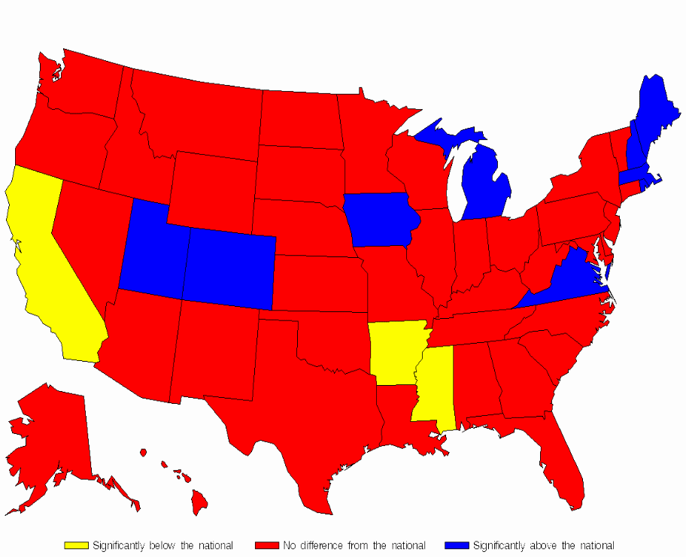
NHQR-DR Summary (4)
Improvement in quality and disparities is possible.
Percent of AMI patients prescribed a beta blocker at discharge by State
Use of beta-blockers for heart attack patients rose from 21% of eligible patients in the early 1990s to 79%. 45 States are at or above 70% on this measure.
70% of women over 40 get mammograms for breast cancer. This exceeds Healthy People 2010 objective.
Black women have higher screening rates for cervical cancer. Death rates among black women are falling at twice the rate as white women.
Quality improvement efforts have resulted in reductions in black-white differences in hemodialysis.
Significantly below national avg.
No different from national avg.
Significantly above national avg.

Slide 8
How the Reports Fit into AHRQ’s Focus on Implementation
Purpose of the Reports:
To promote awareness of the status of health care quality and disparities in America; and
To lead to action and support AHRQ’s overall mission “to improve the quality… of health care for all Americans.”

Slide 9
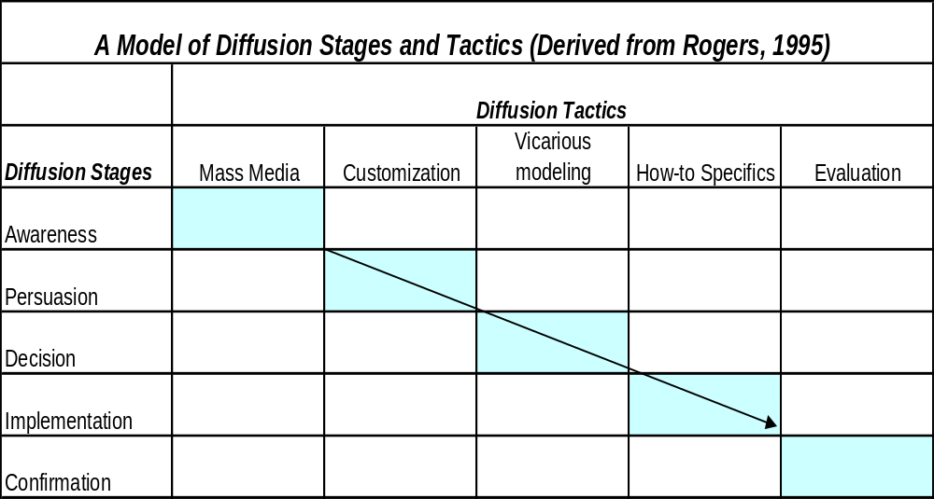
From Knowing to Doing:
Implementing the NHQR-DR

Slide 10
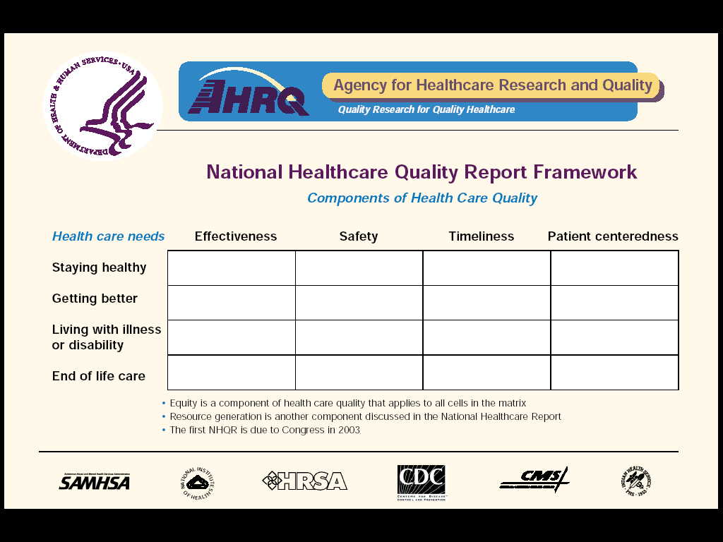
NHQR Conceptual Framework

Slide 11
State Data in the NHQR
Behavioral Risk Factor Surveillance System
Medicare Quality Improvement Organizations (QIO) Program
Minimum Data Set (CMS nursing home data)
National CAHPS® Benchmarking Database
National Immunization Survey
Outcome and Assessment Information Set (OASIS; CMS home health data)
United States Renal Data System
University of Michigan Kidney Epidemiology and Cost Center (ESRD data)
Vital Statistics

Slide 12
A Workbook for Crossing the Quality Chasm in Health Care: A State Leader’s Guide to Diabetes Care,
Quality, Improvement
Purpose
Provide overview of factors affecting quality of care for diabetes
Present core elements of health care quality improvement
Provide best practices/policy approaches on diabetes quality improvement from national organizations, State and Federal governments
Help State policy makers/health care leaders use NHRQ data to plan State-level quality improvement initiatives

Slide 13
A Workbook for Crossing the Quality Chasm in Health Care: A State Leader’s Guide to Diabetes Care,
Quality, Improvement
Audience
State elected leaders—governors, legislators and staff actively involved in health issues
State executive branch officials—State health department, Medicaid and State employee benefits administrators and staff
Non-governmental State and local health care leaders—members of professional societies, provider associations, quality improvement organizations, voluntary health organizations, health plans, business coalitions, etc.

Slide 14
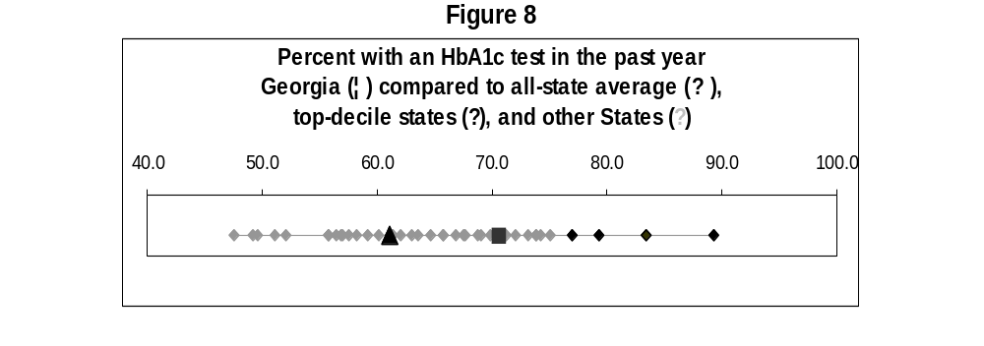
How Do I Use The Report Data? Example From The Chasm Workbook
State 1 is better than the national norm in terms of HbA1c testing, but has room for improvement. (See Figure 8 below.) The percent of adults with diabetes in State 1 who have this test (70.5 percent) is nine points higher than the national average and the difference is statistically significant, indicating that State 1 is more successful in this regard than the typical State in the nation. However, compared to the States with the highest rates (“best in class” States), State 1 has some room for improvement. The average of the top decile of States is 82.3 percent of adults with diabetes receiving an HbA1c test.
State 1

Slide 15
For Further Information
AHRQ’s web site for the NHQR and NHDR:
  www.qualitytools.ahrq.gov
Contact information:
  Dr. Ed Kelley
  Director, National Healthcare Quality Report
  Agency for Healthcare Research and Quality
  540 Gaither Road, Suite 300
  Rockville, MD 20850
  301-427-1321(phone)
  301-427-1341 (fax)
  (ekelley@ahrq.gov)

