Slide 1
Using the ICF as a Framework for Washington Group Measures
Barbara M. Altman
Jennifer Madans
Elizabeth Rasch
National Center for Health Statistics

Slide 2
Meaning of Frame/Framework
Dictionary definition of frame identifies two very relevant components:
  1. Something composed of parts fitted together and united.
  2. The constructional system that gives shape or strength/ such a skeleton not filled in or covered.

Slide 3
Purpose of this Presentation
Examine the ways that the ICF serves as a framework for the work of the Washington Group.
Examine the contribution that the Washington Group work is making to the ICF
Clarify that the Washington Group work is not an implementation of the ICF, but rather one form of utilization of the ICF

Slide 4
The ICF Model

Slide 5
ICF Model as a Frame
ICF Model provides conceptual representation of the disablement process by identifying the basic individual and social components involved in that process. The model also provides a general, non-specific indication of the possible relationships among the components.

Slide 6
The ICF Model as a Frame
Health Condition
Body Functions & Structure
Activity
Participation
Environmental Factors
Personal Factors
Source: ICF, 2001

Slide 7
Elements of the Frame
As a frame or framework, the ICF provides a series of concepts or parts that can be fitted together in a variety of ways - that is the relationship between the parts or conceptual elements are not united into one structure alone, but can be connected to each other in multiple ways that reflect the analytic questions being addressed

Slide 8
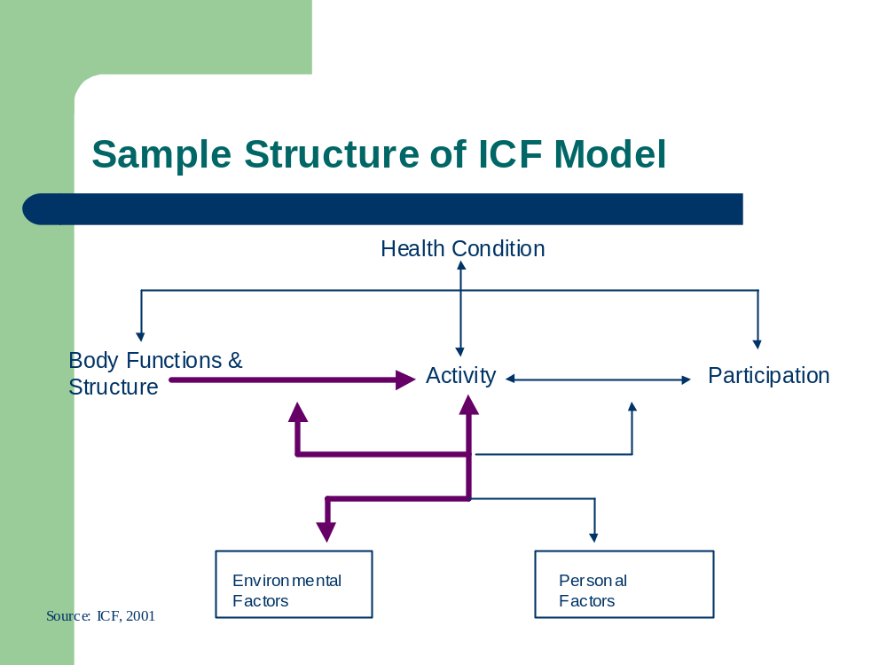

Slide 9
Flexibility of Depicted Model
The sample structure proposes that Body Structure and Body Function can lead to various levels of Activity.
Additionally this version of the model proposes that Environment intervenes between Body Structure/Body Function and Activity as well as impacting directly on Activity.

Slide 10
The Structure of the ICF Model
The flexibility of the ICF Model works well for the work of the Washington Group.
It allows for the inclusion of the various purposes of measurement that can satisfy country’s needs for a variety of data.
  For example the focus on “equalization of opportunity” purpose for the general measure allows the assumption that limitations in “basic action” places persons at risk for participation limitations.

Slide 11
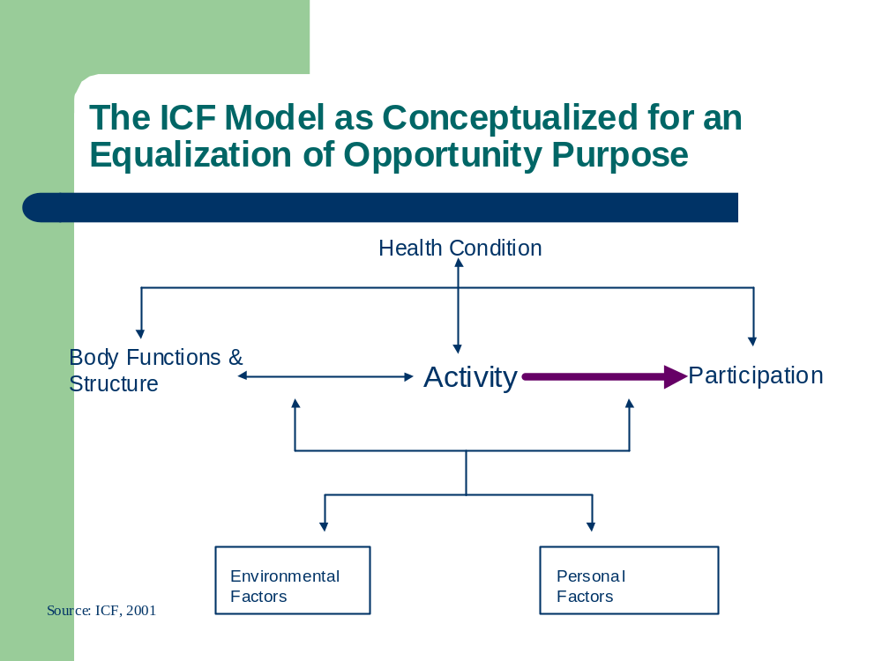

Slide 12
Elements of Conceptual Components/Domains

Slide 13
The ICF Model Depicts Two Parts
Part 1 represents the conceptual components associated with the individual: Body structure/Body function and Activity/Participation
Part 2 represents the conceptual components that are located in the individual’s environmental and experiential contexts: Environmental Factors and Personal Factors.

Slide 14
Strength of the ICF Model
The strength of the ICF Model can be seen as the in depth elaboration of the conceptual components or the specific domains associated with each of the parts that make up the model.
The weakness of the ICF Model can also be found in these elaborations into domains which will need further specification and examination as use of the ICF grows.

Slide 15
The ICF Components Identified for the Work of the Washington Group
The ICF Components chosen for use in development of international comparable measures focus thus far in the following areas:
  Activity - focus for General Census Measure
  Participation - focus for Extended Sets
  Environment - focus for Extended Sets

Slide 16
Criteria for Inclusion of Domains
Cross cultural comparability
Suitability for self-report
Parsimony
Validity across various methodological modes

Slide 17
Focusing on the Area to Measure: Activity Including Basic Actions
Activity - the execution of an action or simple task by an individual
Basic Activities are the deliberate execution of an action (walking); task activity involves coordination of basic activities (functioning at the whole person level) to accomplish a task(dressing)
Activities are building blocks of participation
Basic Activity limitations are a good and general identifier of ‘risk’ of limitations in participation in culturally specified roles

Slide 18
Focusing on the Area to Measure: Participation
Participation - involvement in a life situation
  As related to the purpose of measurement, participation is the outcome variable (not the risk) in which a person may or may not be involved.
Represent problems an individual may have in life situations
Involves the coordination of both physical and cognitive functioning to accomplish multiple tasks within an environment
Is a more complex construction and is often modified or restricted by environment

Slide 19
Focusing on the Area to Measure: Environment
Environment - refers to all aspects of the world external to the individual
  As relates to measurement it involves the natural geography as well as the man made physical and social context
Represents social policies that mold organizations as well as physical barriers in the built world.
Measurement of environment either at the individual level or the community level provides a less well explored challenge

Slide 20
Lesson from WG Work to This Point
Attempts to develop domains to be used for the general census questions that represented basic actions at the whole person level (willful enactment of the actions involved with walking, seeing hearing, etc) demonstrated that these domains fall into two separate components of the model.

Slide 21
Language, Measurement and Measurement Language

Slide 22
ICF Language and Measurement Language
The ICF model concepts are too general to provide indicators for individual questions, i.e. Activity can refer to many actions and simple tasks.
The ICF classification is too detailed to provide a basis for indicators in a census or survey format. Each class would require a separate operationalization.
Washington Group’s task is to operationalize the concepts/domains on a selective basis as they relate to the purpose of measurement.

Slide 23
Transition from Model, Concepts and Domains to Actual Questions
Decision to locate conceptual areas to be used based on purpose for data collection and limitations of mode of data collection.
Census and survey formats preclude in depth detail more suited to clinical settings.
Purpose of census data collection - “equalization of opportunity” - helps focus on domains necessary to provide that kind of information.

Slide 24
Questions - ICF
Coding of Activity/Participation component reflects ICF orientation to unasked/assumed questions about the domain.
Both capacity and performance are represented as qualifiers to the domain code in terms of level of difficulty.
That assumes a question worded as to “how much difficulty is experienced”

Slide 25
Questions and Answers - WG Census Questions
Washington Group work on census questions follows the ICF format very closely.
Example:
  Question:Do you have difficulty seeing even if wearing glasses?
  Answer: a) No - no difficulty b) Yes - some difficulty c) Yes - a lot of difficulty d) Cannot do at all

Slide 26
Draft questions for Censuses
(general disability measure)
Core Questions:
  1. Do you have difficulty seeing even if wearing glasses?
  2. Do you have difficulty hearing even if using a hearing aid?
  3. Do you have difficulty walking or climbing stairs?
  4. Do you have difficulty remembering or concentrating?
Additional Questions:
  5. Do you have difficulty with (self-care such as) washing all over or dressing?
  6. Because of a physical, mental, or emotional health condition, do you have difficulty communicating (for example understanding others or others understanding you)?

Slide 27
Deviations from the ICF Format
Questions 1 and 2 combine use of assistive devices within the question about difficulty functioning.
Questions 3 , 4, 5 and 6 combine two domains into one question - such as walking and climbing stairs - in order to capture more information.

Slide 28
Looking Forward to the Development of Extended Question Sets
Questions on Participation or more complicated aspects of Activity pose a problem.
Participation domains represent a complex set of activities that need to be accomplished.
Developing culturally comparable questions about participation need more extensive specification to capture equivalent data.

Slide 29
An Example: Acquisition of Goods and Services - d620
Once again the implied questions from the ICF coding scheme is how difficult this form of participation is for the individual and how the use of assistance influences the results.
However, making the questions culturally comparable require more than one question to establish the elements that combine to accomplish this form of participation - the questions used may or may not reflect the whole process.

Slide 30
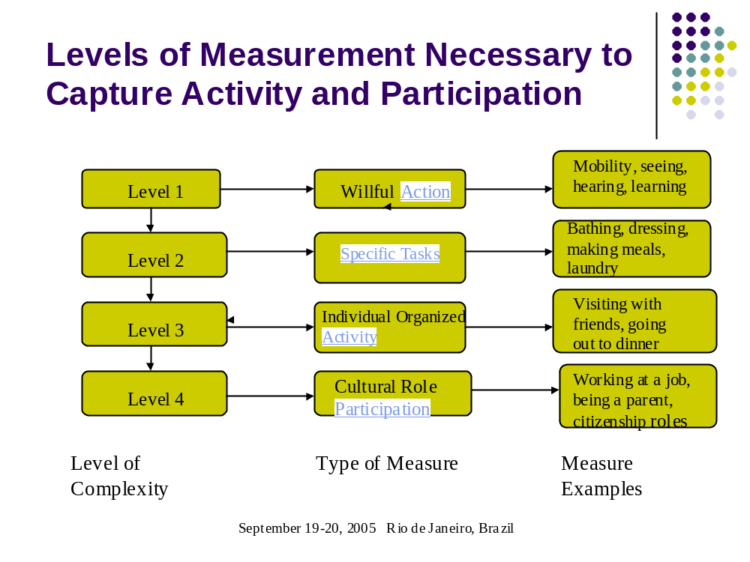

Slide 31
As the Level of Complexity Increases, the Faithfulness to the ICF May Decrease
Lack of a one to one relationship between the question and the domain because of complexity.
Lack of equivalency of code based on different questions.
  re the domain
  re the level of performance or capacity
Lack of underlying standard or knowledge base to represent the domain

Slide 32
Discussion and Conclusion

Slide 33
Washington Group Use of the ICF
Washington Group is using the ICF as a tool to accomplish its stated purposes related to data collection
Washington Group work can be seen as taking the ICF frame (skeleton) of model and classification and beginning to elaborate it for use in survey type conditions.

Slide 34
Additional Limitations Imposed by the Objectives of the WG
Unlike developing surveys or censuses within one national grouping, a basic objective of the WG is to develop measures that are culturally comparable internationally.
Problems generated by the complexity of some ICF domains are compounded when the objective is to develop a measure that represents the same activity cross-culturally.

Slide 35
WG Contribution to Development of Measures for Census and Survey Use
During the process of developing the census measures and in anticipation of developing the extended measures, the WG has demonstrated the usefulness of defining the purpose of data collection.
The WG has also developed a matrix that can be used as a tool to identify appropriate ICF concept areas and domains for the specified purpose.

Slide 36
WG Contribution to Use of the ICF as a Tool for Measurement
In the process of examining the purpose of data collection and identifying relevant domains for measurement, the WG has identified some inconsistencies in the domains.
In order to facilitate the translation of the chosen domains into questions, the WG has also developed a measurement language that relates to the classification hierarchy.

