Slide 1










Appendix: A
Measures Supporting the
National Water Program Guidance
for FY 2007
Office of Water
U.S. Environmental Protection Agency
April 21, 2006

Slide 2
Table of Contents
1) Water Safe to Drink 3
      Fish and Shellfish Safe to Eat 28
      Water Safe for Swimming 32
      Restore and Improve Water Quality on a Watershed Basis 39
      Protect Coastal and Ocean Waters 78
      Protect Wetlands 91
      Protect Mexico Border Water Quality 97
      Protect the Great Lakes 101
      Protect the Chesapeake Bay 109
      Protect the Gulf of Mexico 114

Slide 3
EPA Office of Water Program Offices
and Great Water Body Offices
OGWDW EPA Office of Groundwater and Drinking Water
OST EPA Office of Science and Technology
OWOW EPA Office of Wetlands, Oceans, and Watersheds
OWM EPA Office of Wastewater Management
GLNPO EPA Great Lakes National Program Office
CBPO EPA Chesapeake Bay National Program Office
GMPO EPA Gulf of Mexico National Program Office

Slide 4
Water Safe to Drink
Subobjective and Strategic Targets
Program Activity Measures:
Implement Standards (SDW: 1-5)
Water System Financing (SDW: 6-7)
Water Security (SDW: 8)
Underground Injection Control (SDW: 9-12)
Surface Water Protection (SDW: 13-15)

Slide 5
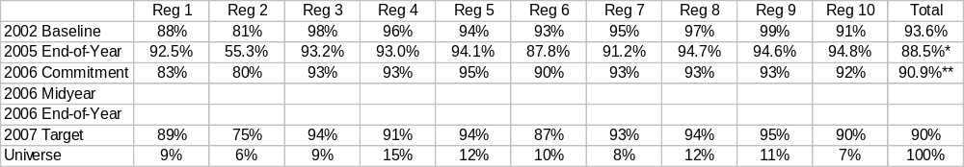
Water Safe to Drink
Measure #: Subobjective 2.1.1 National Office Lead: OGWDW
Measure Description: Percent of the population served by community water systems that receive drinking water that meets all applicable health-based drinking water standards through effective treatment and source water protection.
2008 Target: 95%
National Program Manager Comments:
Target measure
* FY 05 End-of-year data is taken from SDWIS.
** FY 06 national commitment total adjusted from 90.5% to 90.9% to reflect weighted regional commitments.

Slide 6
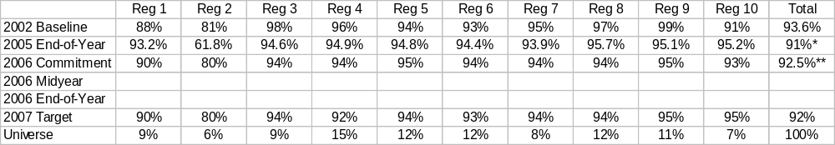
Water Safe to Drink
Measure #: Strategic Target A National Office Lead: OGWDW
Measure Description: Percent of the population served by community water systems that receive drinking water that meets health-based drinking water standards with which systems need to comply as of December 2001.
2008 Target: 95%
National Program Manager Comments:
Target measure
* FY 05 End-of-year data is taken from SDWIS.
** FY 06 national commitment total adjusted from 92.3% to 92.5% to reflect weighted regional commitments.

Slide 7
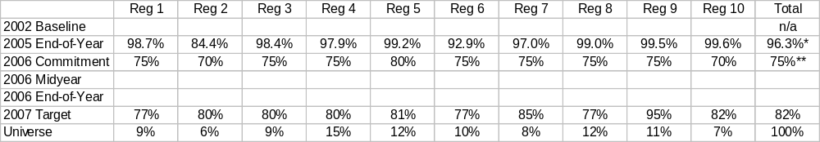
Water Safe to Drink
Measure #: Strategic Target B National Office Lead: OGWDW
Measure Description: Percent of population served by community water systems that receive drinking water that meets health-based standards with a compliance date of January 2002 or later.
2008 Target: 80%
National Program Manager Comments:
Target measure
* FY 05 End-of-year data is taken from SDWIS.
** FY 06 national commitment total adjusted from 74.5% to 75% to reflect weighted regional commitments.

Slide 8
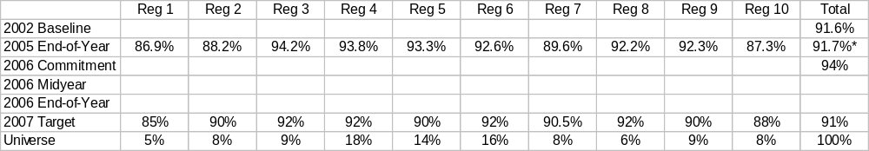
Water Safe to Drink
Measure #: Strategic Target C National Office Lead: OGWDW
Measure Description: Percent of community water systems that provide drinking water that meets health-based standards with which systems need to comply as of December 2001.
2008 Target: 95%
National Program Manager Comments:
Target measure
* FY 05 End-of-year data is taken from SDWIS.

Slide 9
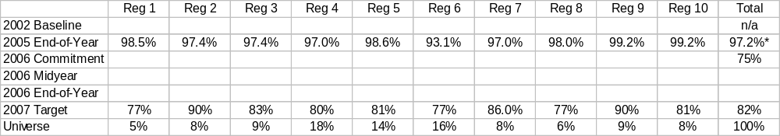
Water Safe to Drink
Measure #: Strategic Target D National Office Lead: OGWDW
Measure Description: Percent of community water systems that provide drinking water that meets health-based standards with a compliance date of January 2002 or later.
2008 Target: 80%
National Program Manager Comments:
Target measure
* FY 05 End-of-year data is taken from SDWIS.

Slide 10
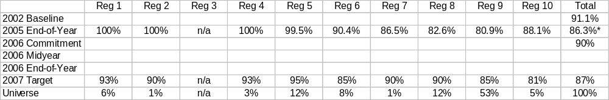
Water Safe to Drink
Measure #: Strategic Target E National Office Lead: OGWDW
Measure Description: Percent of the population served by community water systems in Indian country that receive drinking water that meets all applicable health-based drinking water standards.
2008 Target: 95%
National Program Manager Comments:
Target measure
* FY 05 End-of-year data is taken from SDWIS.

Slide 11
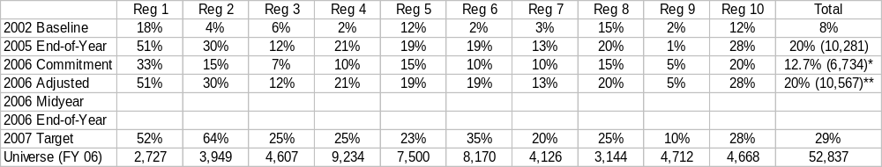
Water Safe to Drink
Measure #: Strategic Target F National Office Lead: OGWDW
Measure Description: Percent of source water areas (both surface and ground water) for community water systems that achieve minimized risk to public health. (cumulative)
2008 Target: 50%
National Program Manager Comments:
Target measure
Note: “Minimized risk” is achieved by the substantial implementation, as determined by the state of source water protection actions in a source water protection strategy.
For purposes of this measure, “source water areas” are treated as community water systems; universe is the number of community water systems.
* FY 06 national commitment total adjusted from 14% to 12.7% to reflect weighted regional commitments.
** 2006 Adjusted is an adjustment of the FY 06 commitment to reflect FY 05 results.

Slide 12
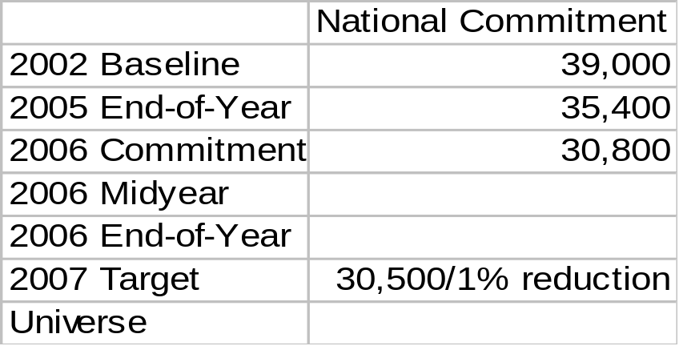
Water Safe to Drink
Measure #: Strategic Target G National Office Lead: OGWDW
Measure Description: Number of households on Tribal lands lacking access to safe drinking water.
2015 Target: 22,000 households
National Program Manager Comments:
Target measure; HQ reported measure.

Slide 13
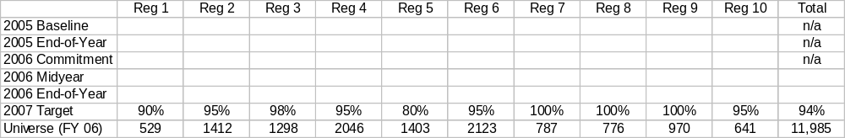
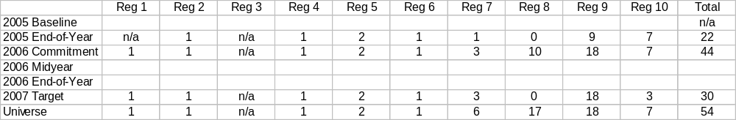
Water Safe to Drink
Measure #: SDW-1 National Office Lead: OGWDW
Measure Description: Percent of community water systems (CWSs) and number of tribal community water systems that have undergone a sanitary survey within three years of their last sanitary survey (five years for outstanding performers) as required under the Interim Enhanced and Long-Term 1 Surface Water Treatment Rules.
(SDW-1a) CWSs in States:
(SDW-1b) CWSs in Tribes:
2008 Target: 95%
2008 Target: n/a
National Program Manager Comments:
Target measure
NOTE: In FY 06, this measure tracked states, rather than CWSs, in compliance with this regulation.

Slide 14
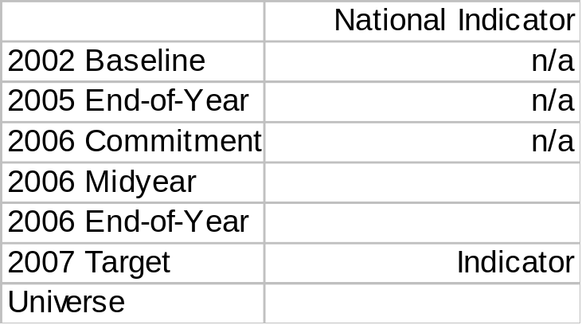

Water Safe to Drink
Measure #: SDW-2 (new) National Office Lead: OGWDW
Measure Description: Percent of the data for violations of health-based standards at public water systems that is accurate and complete in SDWIS-FED for all maximum contaminant level and treatment technique rules (excluding the Lead and Copper Rule). [based on three-year rolling data from data verification audits] (Indicator measure; HQ reported measure.)
Measure #: SDW-3 (new) National Office Lead: OGWDW
Measure Description: Percent of the Lead and Copper Rule action level data for community water systems serving over 3,300 people that is complete in SDWIS-FED. (Indicator measure; HQ reported measure.)
# SDW-2
#SDW-3
2008 Target: n/a
2008 Target: n/a

Slide 15
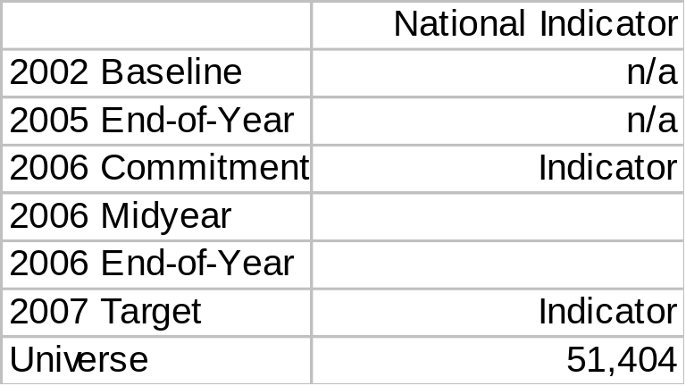
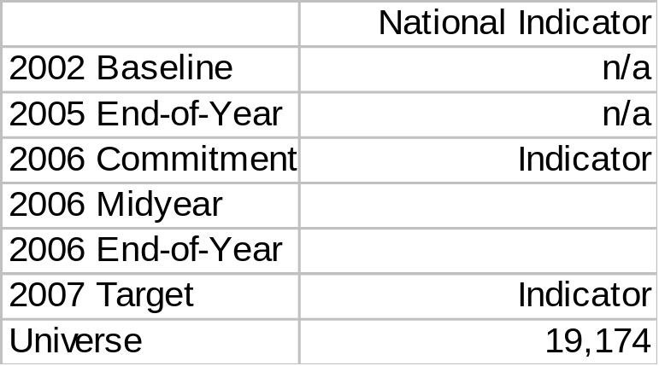
Water Safe to Drink
Measure #: SDW-4 (new) National Office Lead: OGWDW
Measure Description: Percent of community water systems and non-transient, non-community water systems that do not exceed the action level for lead of 15 ppb at the 90th percentile value.
(SDW-4a) Community water systems:
(SDW-4b) Non-transient, non-community water systems:
2008 Target: n/a
2008 Target: n/a
National Program Manager Comments:
Indicator measure; HQ reported measure.

Slide 16
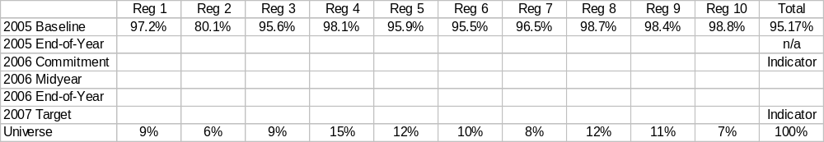
Water Safe to Drink
Measure #: SDW-5 (new) National Office Lead: OGWDW
Measure Description: Percent of “person months” (i.e., the population served by community water systems times 12 months) during which community water systems provide drinking water that meets all applicable health-based drinking water standards.
2008 Target: n/a
National Program Manager Comments:
Indicator measure

Slide 17
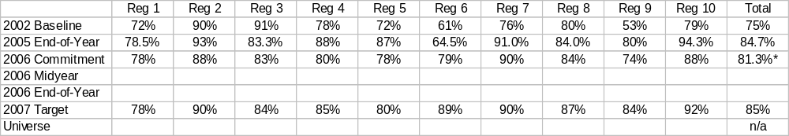
Water Safe to Drink
Measure #: SDW-6 National Office Lead: OGWDW
Measure Description: Fund utilization rate [cumulative dollar amount of loan agreements divided by cumulative funds available for projects] for the Drinking Water State Revolving Fund (DWSRF).
2008 Target: 86%
National Program Manager Comments:
Target measure
* FY 06 national commitment total adjusted from 82% to 81.3% to reflect weighted regional commitments.

Slide 18
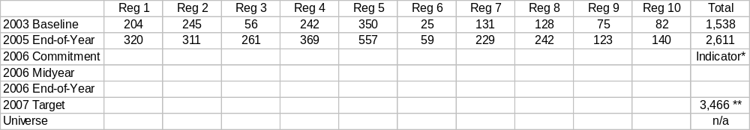
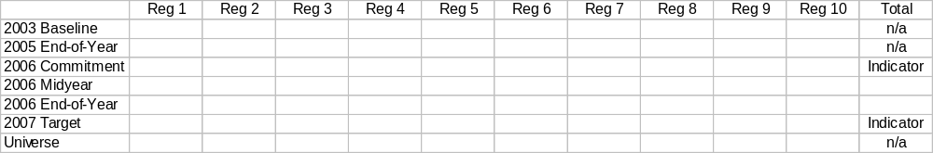
Water Safe to Drink
Measure #: SDW-7 National Office Lead: OGWDW
Measure Description: The number of Drinking Water State Revolving Fund projects that have initiated operations and the number that will assist in returning a community water system to compliance with drinking water standards. (cumulative)
(SDW-7a) Projects Initiated:
(SDW-7b) Projects Returning a CWS to Compliance:
2008 Target: TBD
National Program Manager Comments:
2008 Target: n/a
SDW-7a is a Target measure and SDW-7b is an Indicator measure.
* 2006 PART annual target is 425. ** 2007 Target: Regions should use the national target as a point of reference in working with States to develop Regional commitments during the summer of 2006. Annual target for FY 2007 is 430.

Slide 19
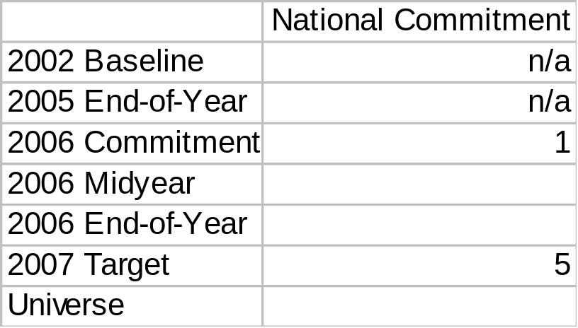
Water Safe to Drink
Measure #: SDW-8 National Office Lead: OGWDW
Measure Description: EPA will install and begin initial operations of monitoring and surveillance pilots to provide early warning of contamination in select drinking water systems.
2008 Target: TBD
National Program Manager Comments:
Target measure; HQ reported measure.

Slide 20
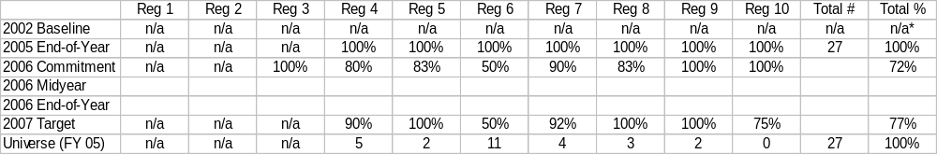
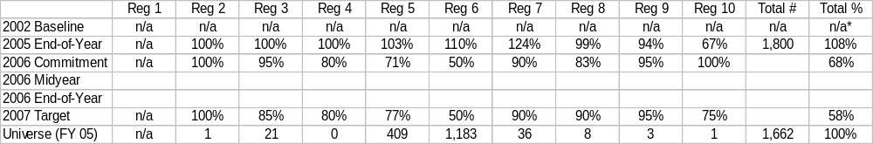
Water Safe to Drink
Measure #: SDW-9 National Office Lead: OGWDW
Measure Description: Separately for each class of well, the percent of Class I, II, III wells identified in significant violation, and Class V wells identified in violation, that are addressed by the Underground Injection Control (UIC) program.
(SDW 9a) Class I:
(SDW-9b) Class II:
2008 Target: 100%
2008 Target: 100%
National Program Manager Comments:
Target measure. * Baseline - Under the FY03 pilot for this measure, too few states provided information to draw a baseline.
The universe reflects FY 05; it is variable and is provided only as a point of reference.

Slide 21
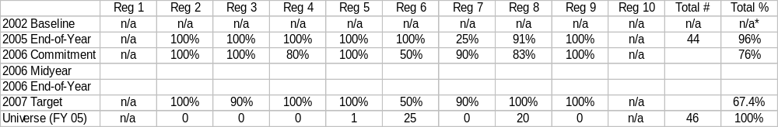
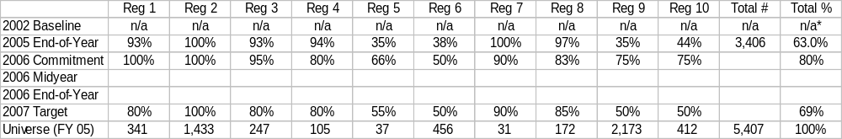
Water Safe to Drink
Measure #: SDW-9, continued National Office Lead: OGWDW
Measure Description: Separately for each class of well, the percent of Class I, II, III wells identified in significant violation, and Class V wells identified in violation, that are addressed by the UIC program.
(SDW-9c) Class III:
2008 Target: 100%
(SDW-9d) Class V:
National Program Manager Comments:
2008 Target: 100%
Target measure . * Baseline - Under the FY03 pilot for this measure, too few states provided information to draw a baseline. Region 1 does not have Class III wells.
The universe reflects FY 05; it is variable and is provided only as a point of reference.

Slide 22
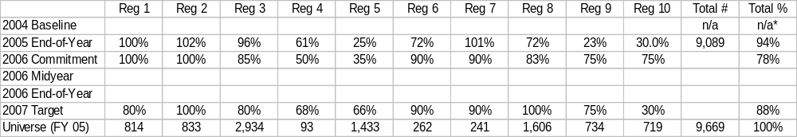
Water Safe to Drink
Measure #: SDW-10 National Office Lead: OGWDW
Measure Description: Percent of identified Class V Motor Vehicle Waste Disposal wells that are closed or permitted.
2008 Target: n/a
National Program Manager Comments:
Target measure
* Baseline - Under the FY03 pilot for this measure, too few states provided information to draw a baseline/universe.
The universe reflects FY 05; it is variable and is provided only as a point of reference.

Slide 23
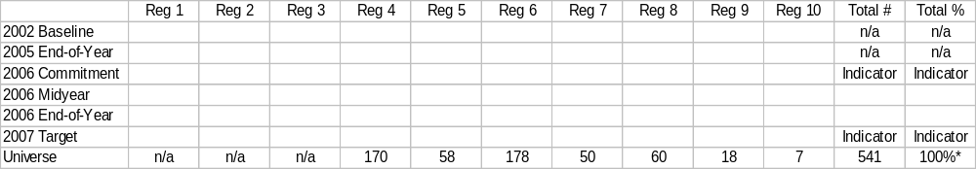
Water Safe to Drink
Measure #: SDW-11 National Office Lead: OGWDW
Measure Description: Separately for each class of wells, the percent of Class I, II and III (salt solution mining wells Class III only) that maintain mechanical integrity.
(SDW-11a) Class I:
2008 Target: n/a
National Program Manager Comments:
Indicator measure
* Universe subject to change.

Slide 24
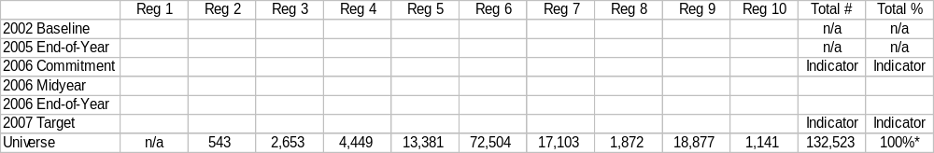
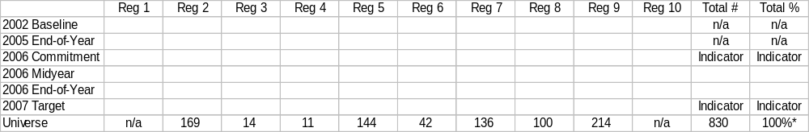
Water Safe to Drink
Measure #: SDW-11, continued National Office Lead: OGWDW
Measure Description: Separately, for each class of wells, the percent of Class I, II and III (salt solution mining wells Class III only) that maintain mechanical integrity.
(SDW-11b) Class II:
(SDW-11c) Class III:
2008 Target: n/a
National Program Manager Comments:
2008 Target: n/a
Indicator measure
* Universe subject to change.
Class III FY 05 Inventory: R1: n/a; R2: 125; R3: 53; R4: 3; R5: 96; R6: 4,692; R7: 3,088; R8: 10,320; R9: 135; R10: n/a.

Slide 25
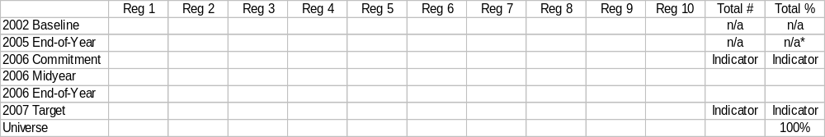
Water Safe to Drink
Measure #: SDW-12 National Office Lead: OGWDW
Measure Description: Number, and national percent, of high priority Class V wells identified in ground water based community water system source water areas that are closed or permitted.
2008 Target: n/a
National Program Manager Comments:
Indicator measure
* Programs still need to improve their capabilities to map source water areas with UIC wells to be able to provide reliable data.

Slide 26
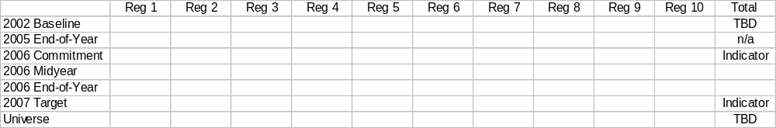
Water Safe to Drink
Measure #: SDW-13 National Office Lead: OGWDW/OST
Measure Description: Percent of community water system intakes using source water that has been designated for a drinking water use.
2008 Target: n/a
National Program Manager Comments:
Indicator measure
The initial baseline of 32 States will be determined in 2006.

Slide 27

Water Safe to Drink
Measure #: SDW-14 National Office Lead: OGWDW/OWOW
Measure Description: Percent of community water system intakes for which the source water was assessed for the drinking water use during the most recent reporting cycle.
2008 Target: n/a
National Program Manager Comments:
Indicator measure
HQ reports results by Region/nationally, based on data collected to support Clean Water Act (CWA) measures when such data becomes available. The number of states reporting drinking water use assessments to the Assessment Database (ADB) under the Integrated Reporting Guidance will increase over time.

Slide 28

Water Safe to Drink
Measure #: SDW-15 National Office Lead: OGWDW/OWOW
Measure Description: Percent of waterbody impairments identified by States in 2002, in which there is a community water system intake and the impairment cause is for either a drinking water use or a pollutant that is regulated as a drinking water contaminant, for which there is: (a) a TMDL, and (b) those waterbody impairments have been restored.
2008 Target: n/a
National Program Manager Comments:
Indicator measure
Baselines and targets to be determined in consultation with OWOW after geo-referencing baseline has been established for Clean Water Act (CWA) reporting and with consideration of targets established for CWA reporting. HQ reports results by Region/nationally based on data collected to support Subobjective 2.2.1.

Slide 29
Fish and Shellfish
Safe to Eat
Subobjective and Strategic Targets:
Program Activity Measures:
States/Tribes Adopting Mercury Criterion (FS-1)
Lake Acres/River Miles Where Fish Tissue Assessed (FS-2)

Slide 30
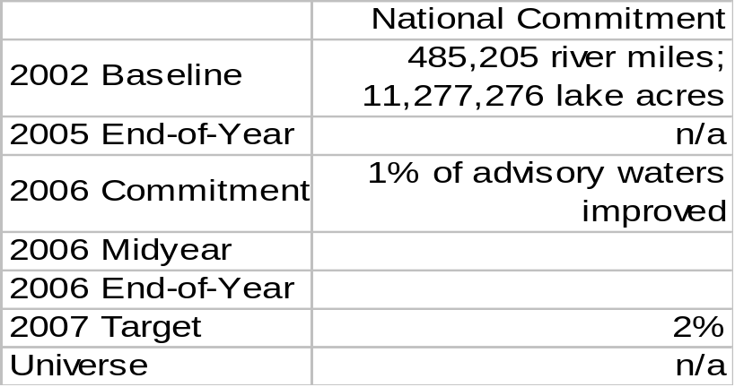
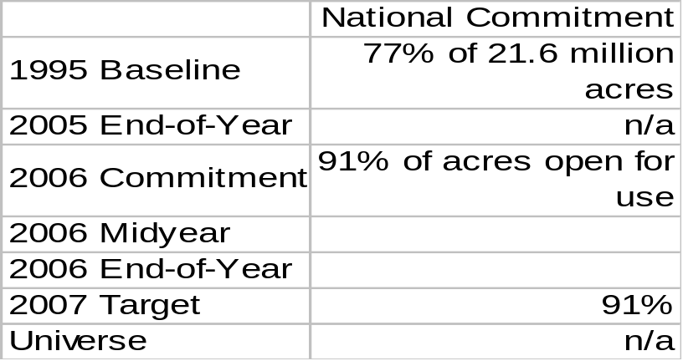
Fish and Shellfish Safe to Eat
Measure #: Strategic Target H National Office Lead: OST
Measure Description: Improve the quality of water and sediments to allow for increased consumption of safe fish in a percentage of the river miles/lake acres identified by States or Tribes as having a fish consumption advisory in 2002.
Measure #: Strategic Target I National Office Lead: OST
Measure Description: Increase the percentage of shellfish-growing acres monitored by States that are approved or conditionally approved for use.
H
I
2008 Target: 3%
2008 Target: 91%
National Program Manager Comments:
Target measures; HQ reported measures. (applies to measures H and I)

Slide 31


Fish and Shellfish Safe to Eat
Measure #: FS-1 National Office Lead: OST
Measure Description: Number of States, Territories and authorized Tribes that have adopted the new fish tissue criterion for mercury.
(FS-1a) States/Territories:
2008 Target: n/a
(FS-1b) Tribes:
2008 Target: n/a
National Program Manager Comments:
Indicator measure; Regions report. * FY 05 End-of-year data is not from ACS.
Universe: States = 50; Territories = 6; Authorized Tribes with any approved water quality standards = 26.

Slide 32
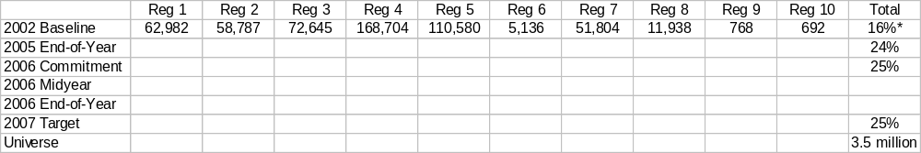
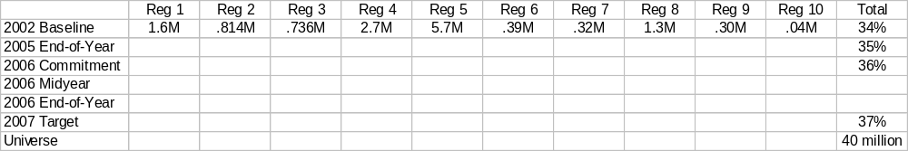
Fish and Shellfish Safe to Eat
Measure #: FS-2 National Office Lead: OST
Measure Description: Percent of river miles and lake acres where fish tissue will be assessed to support waterbody-specific or regional consumption advisories or a determination that no consumption advice is necessary. (Great Lakes measured separately; AK not included.)
(FS-2a) River Miles:
(FS-2b) Lake Acres:
2008 Target: 28%
National Program Manager Comments:
2008 Target: 40%
Target measure; HQ reports results by Region/nationally.
* The 2002 baseline for River Miles is 544,036 and the 2002 baseline for Lake Acres is 13.5 million.

Slide 33
Water Safe for Swimming
Subobjective and Strategic Targets
Program Activity Measures:
- New Pathogen Criteria Adaptation (SS: 1)
Pathogen Reduction (i.e., CSOs/septic tanks) (SS: 2-3)
State BEACH Monitoring (SS: 4)

Slide 34
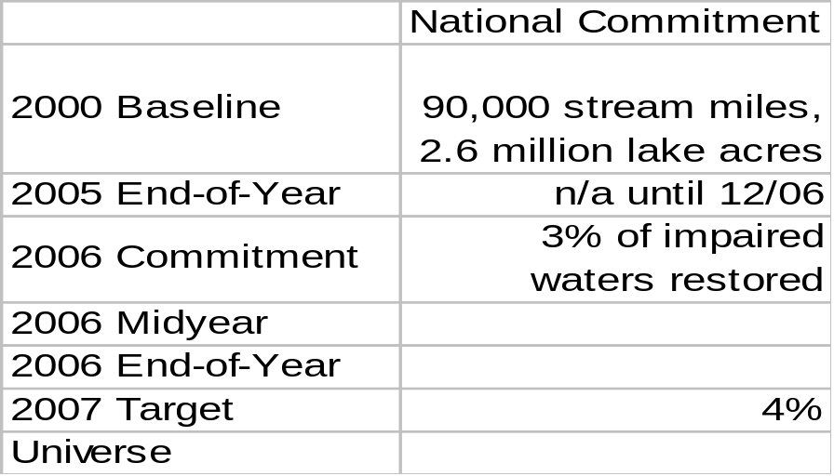
Water Safe for Swimming
Measure #: Subobjective 2.1.3 National Office Lead: OWOW/OST
Measure Description: Restore water quality to allow swimming in waters identified by States in 2000 as unsafe for swimming.
2008 Target: 5% of impaired waters restored
National Program Manager Comments:
Target measure; HQ reported measure.

Slide 35
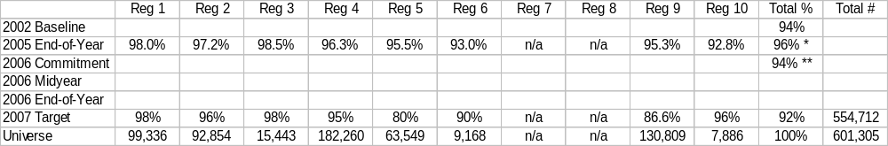
Water Safe for Swimming
Measure #: Strategic Target K National Office Lead: OST
Measure Description: Percent of days of the beach season that coastal and Great Lakes beaches monitored by state beach safety programs will be open and safe for swimming.
2008 Target: 96%
National Program Manager Comments:
Target measure
* FY 05 Regional End-of-Year data is not from ACS.
** This measure was a national commitment only in FY 2006.

Slide 36

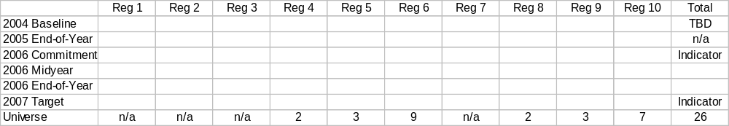
Water Safe for Swimming
Measure #: SS-1 National Office Lead: OST
Measure Description: Number of States, Territories, and Tribes that have adopted current pathogen criteria for non-coastal recreational waters (i.e. waters not covered by the BEACH Act).
(SS-1a) States/Territories:
2008 Target: n/a
(SS-1b) Tribes:
2008 Target: n/a
National Program Manager Comments:
Indicator measure. Note: FY 05 PAM addressed coastal recreational water, rather than non-coastal
recreational waters, and was substantially accomplished.

Slide 37
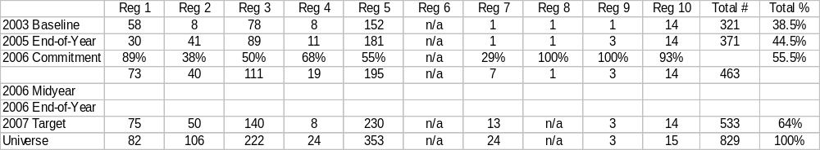
Water Safe for Swimming
Measure #: SS-2 National Office Lead: OWM
Measure Description: Number, and national percent, of CSO permits with schedules in place in permits or other enforceable mechanisms to implement approved Long Term Control Plans (LTCPs). (cumulative)
2008 Target: 75% (622)
National Program Manager Comments:
Target measure
Note: Region 4’s universe has changed from 28 in FY 06 since Atlanta combined several permits into one. In addition, some numbers previously reported for KY have been determined not to meet the requirements of the measure.

Slide 38
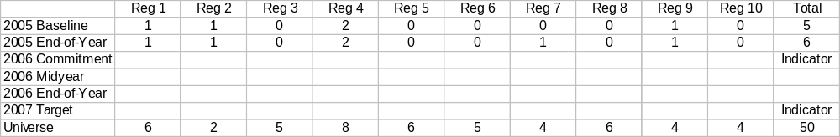
Water Safe for Swimming
Measure #: SS-3 National Office Lead: OWM
Measure Description: Number of States that have adopted the Voluntary Management Guidelines for on-site sewage management. (cumulative)
2008 Target: n/a
National Program Manager Comments:
Indicator measure
2005 State Baseline: Rhode Island, New Jersey, North Carolina, Florida, Arizona, and Iowa.

Slide 39
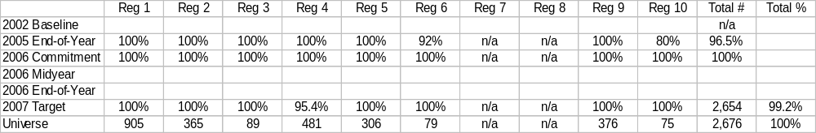
Water Safe for Swimming
Measure #: SS-4 National Office Lead: OST
Measure Description: Percent of all Tier I (significant) public beaches that are monitored and managed under the BEACH Act program.
2008 Target: 100%
National Program Manager Comments:
Target measure
States may change their designation of beaches at any time. Therefore, these numbers may change from year to year.
No BEACH Act implementation in 2002.

Slide 40
Restore and Improve Water Quality on a Watershed Basis
Subobjective and Strategic Targets
Program Activity Measures:
- Water Quality Standards (WQ: 1-6)
Monitoring (WQ: 7-12)
TMDLs (WQ: 13-14)
Nonpoint Source Pollution Control (WQ: 15-16)
Discharge Permit Program (WQ: 17-22)
POTW Financing and Operations (WQ: 23-26)
Restore and Improve Watersheds (WQ: 27-33)

Slide 41
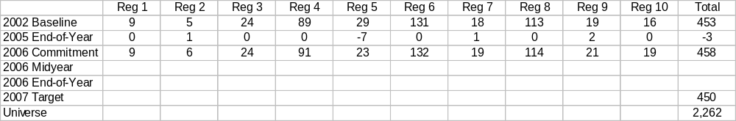
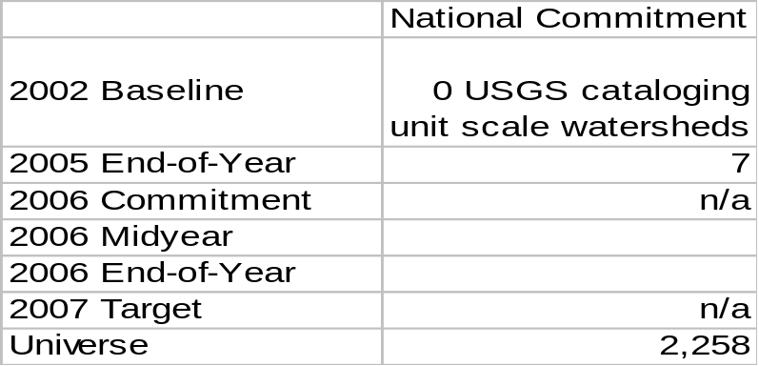
Restore and Improve Water Quality on a Watershed Basis
Measure #: 2.2.1 National Office Lead: OWOW
Measure Description: Use both pollution prevention and restoration approaches to increase:
2.2.1a : Watersheds where water quality standards are met in at least 80% of the assessed waters segments.
2008 Target: 450
2.2.1b: The number of the watersheds where all assessed water segments maintain their quality and at least 20% of assessed water segments show improvement above conditions as of 2002.
2008 Target: TBD
National Program Manager Comments:
Target measure; 2.2.1a is regionally reported and 2.2.1b is HQ reported.

Slide 42
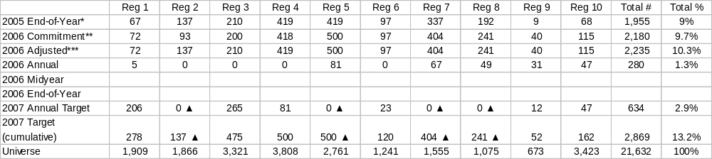
Restore and Improve Water Quality on a Watershed Basis
Measure #: Strategic Target L National Office Lead: OWOW
Measure Description: Number and national percent of those waterbodies identified in 2000 as not attaining standards where water quality standards are restored. (cumulative)
National Program Manager Comments:
2012 Target: 25% (5,408)
Target measure
* FY 05 end-of-year results increased from 8.2 to 9% as a result of corrected data.
** FY 06 commitments adjusted to correctly report cumulative numbers. For Region 1, 72 waterbodies will attain standards except for mercury. For Region 1 in FY 07, 206 (annual) and 278 (cumulative) waterbodies will attain standards except for mercury.
*** Note: FY 06 adjusted line is the higher of the FY 05 adjusted end-of-year or FY 06 commitment.
▲ FY 07 Targets under review.

Slide 43
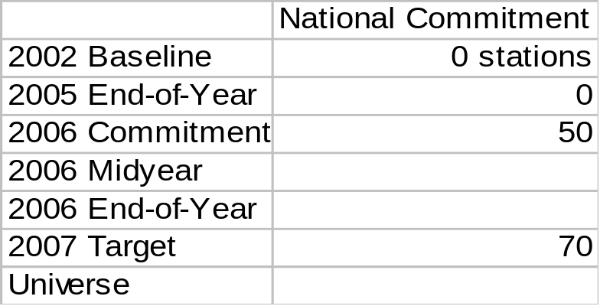
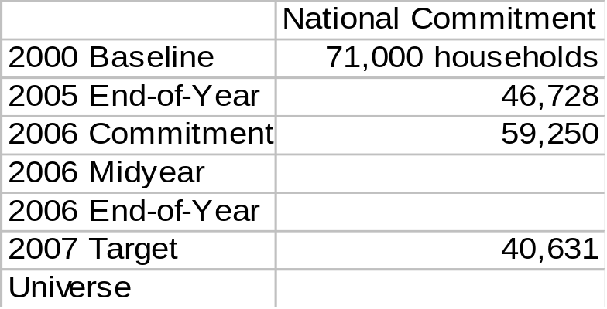
Restore and Improve Water Quality on a Watershed Basis
Measure #: Strategic Target N National Office Lead: OWOW
Measure Description: Show improvement of at least 10% in each of four key parameters at a number of the 900 water monitoring stations in tribal waters.
Measure #: Strategic Target O National Office Lead: OWM
Measure Description: Reduce the number of households on tribal lands lacking access to basic sanitation.
N
O
2008 Target: 90 stations
2015 Target: 35,000
National Program Manager Comments:
Target measures; HQ reported measures. (applies to measures N and O)
For Measure N, (i.e., shows at least a 10% improvement for each of four key parameters: total nitrogen,
total phosphorus, dissolved oxygen, and fecal coliforms.) (900 stations nationwide)

Slide 44
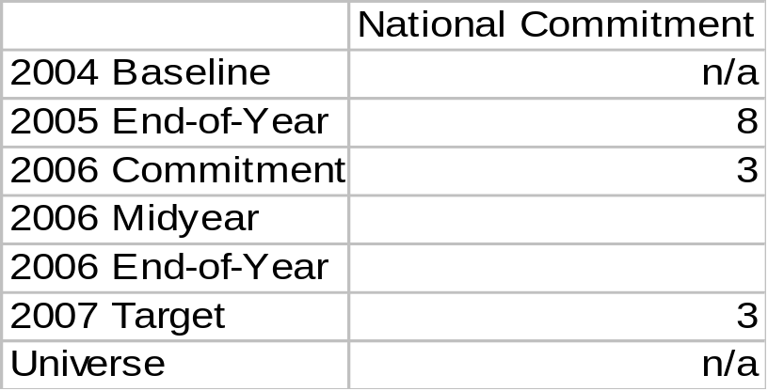
Restore and Improve Water Quality on a Watershed Basis
Measure #: WQ-1 National Office Lead: OST
Measure Description: Number of new or revised pollutant criteria documents published in draft or final by Headquarters annually that assist states and tribes to better control water pollution through improved water quality standards and ecological/human health risk assessment under the Clean Water Act.
2008 Target: Target set annually* *(changed from 3 per year in FY 06 National Program Guidance)
National Program Manager Comments:
Target measure; HQ reported measure.

Slide 45
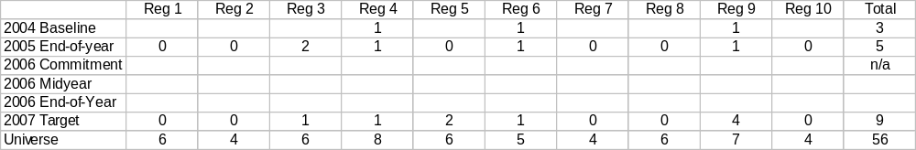
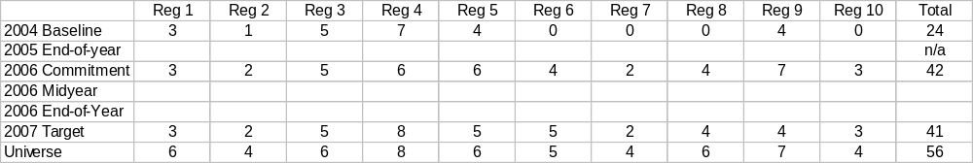
Restore and Improve Water Quality on a Watershed Basis
Measure #: WQ-2 National Office Lead: OST
Measure Description: Number of States and Territories that have adopted EPA approved nutrient criteria into their water quality standards, or are on schedule with a mutually agreed-upon plan to adopt nutrient criteria into their water quality standards.
(WQ-2a): States/Territories that have adopted approved nutrient criteria (cumulative)
(WQ-2b): States/territories on schedule to adopt nutrient criteria (annual)
2008 Target: TBD
National Program Manager Comments:
2008 Target: TBD
Target measure
Until a state or territory has adopted nutrient water quality standards for all its applicable waters, it may be counted in both WQ-2a and WQ-2b

Slide 46
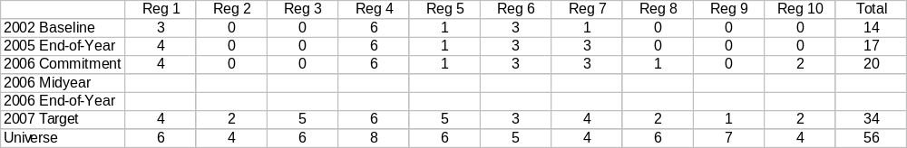
Restore and Improve Water Quality on a Watershed Basis
Measure #: WQ-3 National Office Lead: OST
Measure Description: Number of States and Territories that have incorporated into their water quality programs for streams and small rivers, quantitative biological criteria that are used to help assess attainment of water quality standards. [Note: biological criteria may include quantitative endpoints or narrative criteria with quantitative implementation procedures or translators]. (cumulative)
2008 Target: TBD
National Program Manager Comments:
Target measure

Slide 47
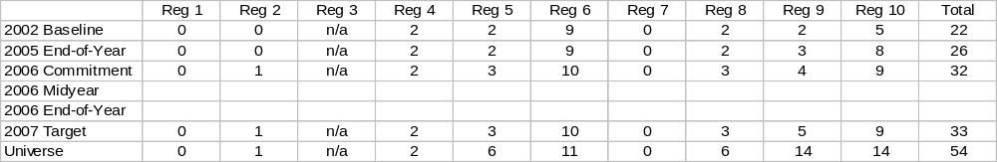
Restore and Improve Water Quality on a Watershed Basis
Measure #: WQ-4 National Office Lead: OST
Measure Description: Number of Tribes that have water quality standards approved by EPA. (cumulative)
2008 Target: 36
National Program Manager Comments:
Target measure
The universe reflects all Federally recognized Tribes who have applied for “treatment in the same manner as a
state” (TAS) to administer the water quality standards program (as of January 2005).

Slide 48

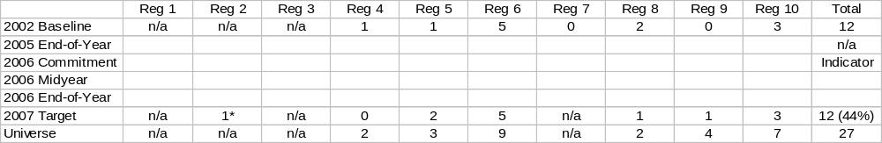
Restore and Improve Water Quality on a Watershed Basis
Measure #: WQ-5 National Office Lead: OST
Measure Description: Number, and national percent, of States and Territories and authorized Tribes that within the preceding three year period, submitted new or revised water quality criteria acceptable to EPA that reflect new scientific information from EPA or other resources not considered in the previous standards.
(WQ-5a) States/Territories:
(WQ-5b) Authorized Tribes:
2008 Target: TBD
National Program Manager Comments:
2008 Target: TBD
Target measure (to conform with 106 PART measure). (Indicator in FY 06.) Universe is number of States/Territories and Tribes that have EPA approved water quality standards as of April 2006 (to be updated in September 2006).
* This is the first submission for this tribe in Region 2. Until approved, it will not be counted as part of the universe.

Slide 49
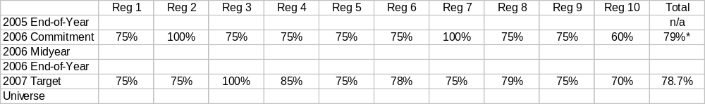

Restore and Improve Water Quality on a Watershed Basis
Measure #: WQ-6 National Office Lead: OST
Measure Description: Percent of State/Territorial and Tribal water quality standards submissions (received in the 12 month period ending April 30th of the fiscal year) that are approved by EPA. Partial approvals receive fractional credit.
(WQ-6a) States/Territories:
2008 Target: TBD
(WQ-6b) Tribes:
National Program Manager Comments:
2008 Target: TBD
Target measure (to conform with SWP PART measure). * FY 06 commitment was for percent of state/territorial and tribal standards approvals. Universe changes annually based on number of WQS submissions. Submissions with partial approvals will receive proportionate credit.

Slide 50

Restore and Improve Water Quality on a Watershed Basis
Measure #: WQ-7 National Office Lead: OWOW
Measure Description: Number of States and Territories that have adopted and are implementing their monitoring strategies in keeping with established schedules.
2008 Target: 56
National Program Manager Comments:
Target measure
“In keeping with established schedules" means that states include in their annual Section 106 Monitoring Initiative workplans specific actions that are intended to implement their monitoring strategies and that states demonstrate that they are making a good faith effort to do these activities.

Slide 51


Restore and Improve Water Quality on a Watershed Basis
Measure #: WQ-8 National Office Lead: OWOW
Measure Description: Number of Tribes that currently receive funding under Section 106 of the Clean Water Act that have developed and begun implementing monitoring strategies that are appropriate to their water quality program consistent with EPA Guidance, and the number that are providing water quality data in a format accessible for storage in EPA’s data system.
(WQ-8a) Tribes implementing monitoring strategies:
(WQ-8b) Tribes providing water quality data:
2008 Target: TBD
National Program Manager Comments:
2008 Target: TBD
Target measure
* FY 06 Commitment deferred pending development of tribal monitoring guidance.

Slide 52

Restore and Improve Water Quality on a Watershed Basis
Measure #: WQ-9 National Office Lead: OWOW
Measure Description: Number of national probabilistic monitoring assessments completed.
2008 Target: TBD
National Program Manager Comments:
Target measure; HQ reported measure.
Note: FY 06 baseline reflects streams having been assessed using statistically valid surveys. Assessments of lakes and rivers are expected in future years. (ACS shows FY 06 commitment as a percentage.)

Slide 53

Restore and Improve Water Quality on a Watershed Basis
Measure #: WQ-10 National Office Lead: OWOW
Measure Description: Number of States and Territories that provide Integrated Reports consistent with EPA’s guidance for Assessment, Listing, and Reporting requirements pursuant to Sections 303(d), 305(b), and 314 of the Clean Water Act. (cumulative)
2008 Target: 50
National Program Manager Comments:
Target measure

Slide 54

Restore and Improve Water Quality on a Watershed Basis
Measure #: WQ-11 National Office Lead: OWOW
Measure Description: Number of States and Territories using the Assessment Database (ADB) (or compatible electronic format) to record their assessment decisions (Integrated Report/303(d)/305(b)) and provide geo-referencing information for assessment unit locations. (cumulative)
2008 Target: at least 50 states/territories
National Program Manager Comments:
Target measure
Regions and States are encouraged to make strong progress towards adoption of ADB or compatible electronic formats in FY 07. Data from the ADB (version 2)(or in a compatible format) are needed to efficiently document outcomes of the surface water protection and section 106 grant programs; these data support measures used in OMB PART and annual budget reviews of these programs.

Slide 55

Restore and Improve Water Quality on a Watershed Basis
Measure #: WQ-12 National Office Lead: OST
Measure Description: Number of methods developed or validated for new or emerging biological or chemical contaminants.
2008 Target: Target set annually
National Program Manager Comments:
Target measure; HQ reported measure.
More than 200 analytical methods have been approved by EPA, and those methods are listed in 40 CFR 136. Additions and revisions to part 136 reflect development of new methods and new approvals for updated methods.

Slide 56


Restore and Improve Water Quality on a Watershed Basis
Measure #: WQ-13 National Office Lead: OWOW
Measure Description: Number of TMDLs, and national percent, that are established by states or EPA on a schedule consistent with national policy.
(WQ-13a) Total TMDLs:
2008 Target: 3,524
(WQ-13b) TMDLs developed by States:
National Program Manager Comments:
2008 Target: 3,412
Target measure; annual pace is number of TMDLs needed to be established consistent with national policy, i.e. generally within 13 years of listing of the water as impaired. * FY 06 numbers reflect revisions received from the Regions as of 1/19/06. They do not reflect data in ACS. 2006 and 2007 WQ-13 a and b pace totals are adjusted from 5,521 and 5,409 respectively for Pennsylvania scaling. 2008 Targets will be refined as we develop 2008 pace numbers.

Slide 57

Restore and Improve Water Quality on a Watershed Basis
Measure #: WQ-14 National Office Lead: OWOW
Measure Description: Number of TMDLs for impaired waterbodies which affect Tribal waters approved by EPA where the Tribe participated in the TMDL or comparable watershed restoration planning process.
2008 Target: n/a
National Program Manager Comments:
Indicator measure

Slide 58



Restore and Improve Water Quality on a Watershed Basis
Measure #: WQ-15 National Office Lead: OWOW
Measure Description: Estimated annual reduction in million pounds of nitrogen, phosphorus, and tons of sediment from nonpoint sources to waterbodies (Section 319 funded projects only).
(WQ-15a) Nitrogen:
(WQ-15b) Phosphorus:
(WQ-15c) Sediment:
2008 Target: 8.5 million lbs
2008 Target: 4.5 million lbs
2008 Target: 700,000 tons
National Program Manager Comments:
Target measure; HQ reported measure; PART measure. (Indicator measure in FY 06.)
FY 05 End-of-year totals are actually for a 6 month period only, starting with FY 06, a full year of data will be reported.

Slide 59

Restore and Improve Water Quality on a Watershed Basis
Measure #: WQ-16 National Office Lead: OWOW
Measure Description: Number of waterbodies identified by States (in 2000 or subsequent years) as being primarily NPS-impaired that are partially or fully restored. (cumulative)
2008 Target: 250
National Program Manager Comments:
Target measure; HQ reports results by Region; PART measure.
The universe is the estimated waterbodies impaired primarily by nonpoint source.
Only counting waters on Success Story website – approximately 10 waters are to be added in the short-term.

Slide 60

Restore and Improve Water Quality on a Watershed Basis
Measure #: WQ-17 National Office Lead: OWM
Measure Description: Number, and national percent, of follow-up actions that are completed by assessed NPDES programs. (cumulative)
2008 Target: n/a
National Program Manager Comments:
Indicator measure; Regional counts are confirmed by HQ action item database.
* FY 05 End-of-year data is not from ACS.
Assessed programs include 45 authorized states (excluding MA, NH, NM, AK, ID), 1 authorized territory (VI), and 10 Regions assessed through the Permits for Environmental Results (PER) program.
Universe is 295 includes all follow-up actions for which a schedule was established.

Slide 61


Restore and Improve Water Quality on a Watershed Basis
Measure #: WQ-18 National Office Lead: OWM
Measure Description: Number, and national percent, of non-tribal NPDES permits that are considered current and number, and national percent, of tribal permits that are considered current.
(WQ-18a) Non-tribal NPDES permits that are current:
(WQ-18b) Tribal permits that are current:
2008 Target: 90%
National Program Manager Comments:
2008 Target: 90%
Target measure
* FY 05 End-of-year data is not from ACS.

Slide 62


Restore and Improve Water Quality on a Watershed Basis
Measure #: WQ-19 National Office Lead: OWM
Measure Description: Number, and national percent of Phase I and Phase II stormwater permits that are issued and current for: (a) industrial stormwater general permits; (b) construction stormwater general permits; and (c) MS-4 general and individual permits.
(WQ-19a) Industrial:
2008 Target: 100%
(WQ-19b) Construction:
2008 Target: 100%
National Program Manager Comments:
Target measure; PART measure.

Slide 63

Restore and Improve Water Quality on a Watershed Basis
Measure #: WQ-19, continued National Office Lead: OWM
Measure Description: Number, and national percent of Phase I and Phase II stormwater permits that are issued and current for: (a) industrial stormwater general permits; (b) construction stormwater general permits; and (c) MS-4 general and individual permits.
(WQ-19c) MS-4:
2008 Target: 100%
National Program Manager Comments:
Target measure; PART measure.

Slide 64

Restore and Improve Water Quality on a Watershed Basis
Measure #: WQ-20 National Office Lead: OWM
Measure Description: Number, and national percent, of facilities covered under either an individual or general permit by type: (a) MS-4s (including co-permitees); (b) industrial storm water; (c) construction storm water; and (d) CAFOs.
(WQ-20a) MS-4s:
2008 Target: n/a
(WQ-20b) Industrial storm water:
2008 Target: n/a
National Program Manager Comments:
Indicator measure

Slide 65
Restore and Improve Water Quality on a Watershed Basis
Measure #: WQ-20, continued National Office Lead: OWM
Measure Description: Number, and national percent, of facilities covered under either an individual or general permit by type: (a) MS-4s (including co-permitees); (b) industrial storm water; (c) construction storm water; and (d) CAFOs.
(WQ-20c) Construction storm water:
2008 Target: n/a
(WQ-20d) CAFOs:
2008 Target: n/a
National Program Manager Comments:
Indicator measure

Slide 66


Restore and Improve Water Quality on a Watershed Basis
Measure #: WQ-21 National Office Lead: OWM
Measure Description: Number, and national percent, of (a) Significant Industrial Users (SIUs) in POTWs with Pretreatment Programs that have control mechanisms in place that implement applicable pretreatment requirements; and, (b) Categorical Industrial Users (CIUs) in non-pretreatment POTWs that have control mechanisms in place that implement applicable pretreatment requirements.
(WQ-21a) SIUs:
(WQ-21b) CIUs:
2008 Target: 95%
National Program Manager Comments:
2008 Target: n/a
WQ-21a is a Target measure and WQ-21b is an Indicator measure. * FY 05 End-of-Year numbers are percents in ACS.
For CIUs: Universe is the number of known CIUs discharging to POTWs without Approved Treatment Programs. The universe for Region 4 now includes AL and MS CIUs which are permitted by the states.
Baseline is the known percentage of those CIUs that are ‘controlled’ in some way, shape, or form.

Slide 67


Restore and Improve Water Quality on a Watershed Basis
Measure #: WQ-22 National Office Lead: OWM
Measure Description: Percent of major dischargers in Significant Noncompliance (SNC) at any time during the fiscal year, and of those, the number, and national percent, discharging the pollutant(s) of concern on impaired waters.
(WQ-22a) Percent of Major Dischargers in SNC:
2008 Target: ≤ 22.5
(WQ-22b) Number of Major Dischargers on Impaired Waters in SNC:
2008 Target: n/a
National Program Manager Comments:
WQ-22a is a Target measure and WQ-22b is an Indicator measure. HQ reports results by Region. (WQ-22a is a 106 PART measure; Target of ≤22.5% is a 3 year average that shows overall trends.) * FY 05 End-of-year data is not from ACS.

Slide 68

Restore and Improve Water Quality on a Watershed Basis
Measure #: WQ-23 National Office Lead: OWM
Measure Description: Number, and national percent, of all major publicly-owned treatment works (POTWs) that comply with their permitted wastewater discharge standards (i.e. POTWs that are not in significant non-compliance).
2008 Target: TBD
National Program Manager Comments:
Target measure (PART measure)

Slide 69

Restore and Improve Water Quality on a Watershed Basis
Measure #: WQ-24 National Office Lead: OWM
Measure Description: Fund utilization rate [cumulative loan agreement dollars to the cumulative funds available for projects] for the Clean Water State Revolving Fund.
2008 Target: 94%
National Program Manager Comments:
Target measure

Slide 70


Restore and Improve Water Quality on a Watershed Basis
Measure #: WQ-25 National Office Lead: OWM
Measure Description: Number of waterbodies restored or improved per million dollars of CWSRF assistance provided, and number of waterbodies protected per million dollars of CWSRF assistance provided.
(WQ-25a) Number of waterbodies restored/improved:
(WQ-25b) Number of waterbodies protected:
2008 Target: TBD
2008 Target: TBD
National Program Manager Comments:
Target measure; HQ reported measure; SRF PART measure.

Slide 71

Restore and Improve Water Quality on a Watershed Basis
Measure #: WQ-26 National Office Lead: OWM
Measure Description: EPA will work with water and wastewater utilities and others to begin implementing a strategy for promoting sustainable management practices.
2008 Target: n/a
National Program Manager Comments:
Indicator measure; HQ reported measure.

Slide 72

Restore and Improve Water Quality on a Watershed Basis
Measure #: WQ-27 National Office Lead: OWOW
Measure Description: Number of watershed-based plans supported under State Nonpoint Source Management Programs since the beginning of FY 2002 that have been substantially implemented. (cumulative)
2008 Target: n/a
National Program Manager Comments:
Indicator measure in FY 2007. (Target measure in FY 05 and FY 06.)
* FY 06 Commitments are not from ACS.

Slide 73

Restore and Improve Water Quality on a Watershed Basis
Measure #: WQ-28 National Office Lead: OWOW
Measure Description: Number of Tribes that have developed and begun to implement a watershed based-plan for tribal waters.
2008 Target: n/a
National Program Manager Comments:
Indicator measure

Slide 74



Restore and Improve Water Quality on a Watershed Basis
Measure #: WQ-29 National Office Lead: OWM
Measure Description: Number, and national percent, of high priority state NPDES permits; high priority EPA non-tribal NPDES permits; and high priority tribal NPDES permits, that are issued as scheduled.
(WQ-29a) High priority state NPDES permits:
(WQ-29b) High priority EPA non-Tribal NPDES permits:
2008 Target: 95%
(WQ-29c) High priority Tribal NPDES permits:
2008 Target: 95%
National Program Manager Comments:
2008 Target: 95%
Target measure (based on national performance). WQ-29a conforms to 106 PART measure; the sum of WQ-29a, b, c conforms to SWP PART measure. *Universe listed is 2006 and is to be updated later. HQ reports results by Region.

Slide 75


Restore and Improve Water Quality on a Watershed Basis
Measure #: WQ-30 National Office Lead: OWM
Measure Description: Number of permits providing for trading between the discharger and other water pollution sources, and in those permits, the number of dischargers that carried out trades. (cumulative)
(WQ-30a) Number of Permits Providing for Trading:
2008 Target: 110
(WQ-30b) Number of Dischargers that Carried Out Trades (cumulative):
National Program Manager Comments:
2008 Target: n/a
WQ-30a is Target measure (FY 05 End-of-year total will be baseline in future years to ensure accuracy). WQ-30b is an Indicator measure (Universe is the number of dischargers covered under a permit under WQ-30a). * FY 05 End-of-year data is not from ACS.

Slide 76

Restore and Improve Water Quality on a Watershed Basis
Measure #: WQ-31 National Office Lead: OWM
Measure Description: Number of current watershed-based permit(s) issued. (cumulative)
2008 Target: n/a
National Program Manager Comments:
Indicator measure
The FY 06 measure has been revised to no longer request information on rotating basins; the revised measure counts permits rather than watersheds. Watershed-based permits are as defined in EPA watershed-based permitting implementation guidance.

Slide 77

Restore and Improve Water Quality on a Watershed Basis
Measure #: WQ-32 National Office Lead: OWM
Measure Description: Number of impaired watersheds (at the 12 digit scale) where water quality conditions improve. (cumulative)
2008 Target: n/a
National Program Manager Comments:
Indicator measure
Note: Improved means that one or more of the impairment causes identified in 2002 are removed for at least 40% of the impaired waterbodies or impaired miles/acres.
* Universe of an estimated 0 watersheds improved of an estimated 40,000 – 50,000 impaired USGS 12 digit watersheds with one or more waterbody impaired.

Slide 78

Restore and Improve Water Quality on a Watershed Basis
Measure #: WQ-33 National Office Lead: OWOW
Measure Description: Number of water segments known to be impaired or threatened for which States and EPA agree that initial restoration planning is complete (e.g. EPA has approved all needed TMDLs for pollutants causing impairments to the waterbody or has approved a 303(d) list that recognizes that the waterbody is covered by a Watershed Plan (Category 4b)). (cumulative)
2008 Target: n/a
National Program Manager Comments:
Indicator measure
Universe consists of waters identified as impaired in state submissions in 1998 and 2000.

Slide 79
Protect Coastal and Ocean Waters
Subobjective and Strategic Targets
Program Activity Measures:
- Coastal Monitoring (CO: 1-2)
- Coastal State Programs (CO: 3)
- National Estuary Program (CO: 4-6)
Ocean Protection (CO: 7-9)

Slide 80


Protect Coastal and Ocean Waters
Measure #: Subobjective 2.2.2 National Office Lead: OWOW
Measure Description: Improve national and regional coastal aquatic system health on the “good/fair/poor” scale of the National Coastal Condition Report. (Rating is a 5-point system where 1 is poor and 5 is good.
Measure #: Strategic Target P National Office Lead: OWOW
Measure Description: Maintain water clarity and dissolved oxygen in coastal waters at the national levels reported in the 2002 National Coastal Condition Report.
2.2.2
P
2008 Target: 2.6*
2008 Target: Maintain clarity at 4.3;
dissolved oxygen at 4.5*
National Program Manager Comments:
Target measures; HQ reported measures. (applies to measures 2.2.2 and P)
* FY 2008 Target for both measures are fixed in 2003-2008 Strategic Plan; to be revised in FY 07.)

Slide 81




Protect Coastal and Ocean Waters
Measure #: Strategic Target Q National Office Lead: OWOW
Measure Description: Improve ratings reported on the national "good/fair/poor" scale of the National Coastal Condition Report for:
(Q1) Coastal Wetlands Loss:
(Q2) Contamination of Sediments:
2008 Target: 1.6*
2008 Target: 1.5*
(Q3) Benthic Quality:
(Q4) Eutrophic Conditions:
2008 Target: 1.6*
2008 Target: 1.9*
National Program Manager Comments:
Target measure; HQ reported measure.
*2008 Target fixed in 2003-2008 Strategic Plan; to be revised in FY 07.

Slide 82

Protect Coastal and Ocean Waters
Measure #: IV-D National Office Lead: OWOW
Measure Description: Working with National Estuary Program partners, protect or restore additional acres of habitat within the study areas for the 28 estuaries that are part of the National Estuary Program (NEP). (cumulative)
2008 Target: 250,000 cumulative
National Program Manager Comments:
Target measure
Note: FY 05 End-of-year regional data is not from ACS and is cumulative.
* FY 07 Targets under review.
FY 08 Target is fixed in 2003-2008 Strategic Plan; to be revised in FY 07.

Slide 83

Protect Coastal and Ocean Waters
Measure #: CO-1 National Office Lead: OWOW
Measure Description: Headquarters to publish a revised National Coastal Condition Report describing the quality of the Nation’s ocean and coastal waters.
2008 Target: TBD
National Program Manager Comments:
Target measure; HQ reported measure.

Slide 84

Protect Coastal and Ocean Waters
Measure #: CO-2 (new) National Office Lead: OWOW
Measure Description: Number of coastal waterbody impairments restored.
2008 Target: n/a
National Program Manager Comments:
Indicator measure
Each impairment counts; universe of number of impairments in coastal waters is under development.

Slide 85

Protect Coastal and Ocean Waters
Measure #: CO-3 (new) National Office Lead: OWOW
Measure Description: Number of coastline miles protected from vessel sewage by “no discharge zone(s).” (cumulative)
2008 Target: n/a
National Program Manager Comments:
Indicator measure
Note that coastline mileages were estimated using Reachfile version 1 at a 1:300,000 scale. Coarse scales such as this will produce an under accounting of actual miles; however, this under accounting is consistent across Regions and the overarching universe of coastline miles. As better data becomes available, we will revise these estimates. Note also that the numbers for Regions 2, 9, and 10 respectively do not include coastline miles for Puerto Rico, U.S. Virgin Islands, Hawaii, or Alaska.

Slide 86

Protect Coastal and Ocean Waters
Measure #: CO-4 (new) National Office Lead: OWOW
Measure Description: Number of coastal waterbody impairments restored within NEP study areas.
2008 Target: n/a
National Program Manager Comments:
Indicator measure
* Universe of coastal waterbody impairments in NEP study areas is under development.

Slide 87


Protect Coastal and Ocean Waters
Measure #: CO-5 National Office Lead: OWOW
Measure Description: Number of National Estuary Program priority actions in Comprehensive Conservation and Management Plans (CCMPs) that have been initiated in the current reporting year and the number that have been completed. (cumulative)
(CO-5a) Priority actions initiated (in current reporting year):
2008 Target: n/a
(CO 5b) Priority actions completed (cumulative):
2008 Target: n/a
National Program Manager Comments:
Indicator measure

Slide 88

Protect Coastal and Ocean Waters
Measure #: CO-6 National Office Lead: OWOW
Measure Description: Rate of return on Federal investment for the National Estuary Programs [dollar value of “primary” leveraged resources (cash or in-kind) divided by Section 320 funds received by the National Estuary Programs (including supplemental, line items, earmarks, and (for LIS) Sections 119)].
2008 Target: n/a
National Program Manager Comments:
Indicator measure (Dollars in millions and rounded to nearest tenth of a percent.)
Note that “primary” leveraged dollars are those the National Estuary Program (NEP) played the central role in obtaining. An example of primary leveraged dollars would be those obtained from a successful grant proposal written by the NEP.

Slide 89

Protect Coastal and Ocean Waters
Measure #: CO-7 National Office Lead: OWOW
Measure Description: Number of dredged material management plans that are in place for major ports and harbors.
2008 Target: n/a
National Program Manager Comments:
Indicator measure
*This number represents major coastal/Great Lakes ports/harbors (commercially significant/ deep draft and regionally significant). Development of a dredged material management plan is not necessary or feasible for all ports and harbors in the universe.

Slide 90


Protect Coastal and Ocean Waters
Measure #: CO-8 National Office Lead: OWOW
Measure Description: Number of active dredged material ocean dumping sites that are monitored in the reporting year, and then the number where action has been initiated in the reporting year to ensure that the site meets environmentally acceptable conditions.
(CO-8a) Sites monitored each year:
2008 Target: n/a
(CO-8b) Sites where action initiated:
2008 Target: n/a
National Program Manager Comments:
Indicator measure

Slide 91

Protect Coastal and Ocean Waters
Measure #: CO-9 (new) National Office Lead: OWOW
Measure Description: Number of active dredged material ocean dumping sites achieving environmentally acceptable conditions (as reflected in each site’s Site Management Plan) in the reporting year.
National Program Manager Comments:
Indicator measure
Note: This measure is proposed for inclusion in the 2006-2011 Strategic Plan. It is being included in FY 07 as an Indicator measure only.

Slide 92
Protect Wetlands
Subobjective and Strategic Targets
Program Activity Measures:
- Number of Wetland Acres Restored/Enhanced (WT-1)
- Number of States/Tribes Building Capacity (WT-2)
Number Watershed-based Projects Supported by EPA (WT-3)
Number States Measuring Trends in Condition (WT-4)

Slide 93


Protect Wetlands
Measure #: Subobjective 4.3.2 National Office Lead: OWOW
Measure Description: Working with partners, achieve a net increase of acres of wetlands per year with additional focus on biological and functional measures. (cumulative)
Measure #: Strategic Target IV-E National Office Lead: OWOW
Measure Description: Annually, beginning in FY 2004, work with the U.S. Army Corps of Engineers (COE) and other partners to achieve no net loss of wetlands under Section 404 of the Clean Water Act regulatory program.
4.3.2
IV-E
2008 Target: 400,000 cumulative (100,000 per year)
2008 Target: No Net Loss
National Program Manager Comments:
Target measures; HQ reported measures. (applies to measures 4.3.2 and IV-E) Data source: U.S. Fish & Wildlife Service Wetland Status and Trends Report. * FY 05 End-of-year data is not from ACS.

Slide 94

Protect Wetlands
Measure #: WT-1 National Office Lead: OWOW
Measure Description: Number of wetland acres restored and enhanced, under the President’s 2004 Earth Day Initiative. (cumulative)
2008 Target: 9,600
2009 Target: 12,000
National Program Manager Comments:
Target measure; HQ reported measure.
These acres may include those supported by Wetland 5 Star Restoration Grants, National Estuary Program, Section 319 grants, Brownfields grants, or EPA’s Great Waterbodies Program.

Slide 95


Protect Wetlands
Measure #: WT-2 National Office Lead: OWOW
Measure Description: Number of states and tribes that have built capacities in wetland monitoring, regulation, restoration, water quality standards, mitigation compliance, and partnership building.
(WT-2a) States:
(WT-2b) Tribes:
2008 Target: n/a
National Program Manager Comments:
2008 Target: n/a
Indicator measure. Substantial progress to be shown in three of the six areas identified during the last 3 years (i.e. monitoring, regulation, restoration, water quality standards, mitigation compliance, and partnership building).

Slide 96


Protect Wetlands
Measure #: WT-3 National Office Lead: OWOW
Measure Description: Number of watershed-based wetlands and stream corridor projects in States and on Indian Reservations (combined 5-Star and non-5-Star projects) for which EPA has provided /contributed significant financial and/or technical assistance. (cumulative projects)
(WT-3a) State Projects:
(WT-3b) Tribal Projects:
2008 Target: n/a
National Program Manager Comments:
2008 Target: n/a
Indicator measure (changed Tribal indicator to be consistent with the way we are tracking states).
Note: WT-3a is reported by Regions and HQ.

Slide 97

Protect Wetlands
Measure #: WT-4 National Office Lead: OWOW
Measure Description: Number of States where the trend in wetland condition has been measured as defined through biological metrics and assessments.
2008 Target: 14
National Program Manager Comments:
Target measure
Target reflects cumulative achievements expected by 2008. Regions evaluate and make determinations that the State is “on track” to show change in condition by FY 08.

Slide 98
Protect Mexico Border Water Quality
Subobjective and Strategic Targets
Program Activity Measures:
Safe Drinking Water to Homes in Mexico Border Area (MB-1)
Adequate Wastewater Sanitation to Homes in Mexico Border Area (MB-2)

Slide 99

Protect Mexico Border Water Quality
Measure #: Strategic Target IV-A National Office Lead: OWM
Measure Description: Achieve currently exceeded water quality standards in impaired reaches or segments of significant shared and transboundary surface waters.
2012 Target: >50%
National Program Manager Comments:
Indicator measure; HQ reported measure.
* 42 impairments are located on 19 segments.

Slide 100

Protect Mexico Border Water Quality
Measure #: MB-1 (new) National Office Lead: OWM
Measure Description: Provide safe drinking water to homes in the Mexico Border area that lacked access to safe drinking water in 2003.
Anticipated 2012 Target: 25% (24,629 homes)*
National Program Manager Comments:
Indicator measure; HQ reported measure.
* 24,629 homes represent 25% of the 98,515 homes which lacked access to safe drinking water.
The 2012 Target is proposed for the new Strategic Plan.

Slide 101

Protect Mexico Border Water Quality
Measure #: MB-2 (new) National Office Lead: OWM
Measure Description: Provide adequate wastewater sanitation to homes in the Mexico Border area that lacked access to wastewater sanitation in 2003.
Anticipated 2012 Target: 25% (172,681 homes)*
National Program Manager Comments:
Indicator measure; HQ reported measure.
* 172,681 homes represent 25% of the 690,723 homes which lacked access to wastewater sanitation.
The 2012 Target is proposed for the 2006-2011 Strategic Plan.

Slide 102
Protect the Great Lakes
Subobjective and Strategic Targets
Program Activity Measures:
- Permit Points Reflecting Great Lakes Guidance (GL:1)
- Percent CSO Permits Consistent with National Policy (GL: 2)
- Number of Sediment Remedial Actions (GL: 3)
- Percent of High Priority Beaches Monitored (GL: 4)

Slide 103


Protect the Great Lakes
Measure #: Subobjective 4.3.3 National Office Lead: GLNPO
Measure Description: Prevent water pollution and improve the overall aquatic ecosystem health of the Great Lakes using the Great Lakes 40-point scale.
Measure #: Strategic Target IV-G National Office Lead: GLNPO
Measure Description: Reduce the average concentrations of PCBs in whole lake trout and walleye samples from 2000 levels.
4.3.3
IV-G
2008 Target: 22
2008 (Cumulative) Target: 25% decline
National Program Manager Comments:
Target measures. (applies to measures 4.3.3 and IV-G)

Slide 104


Protect the Great Lakes
Measure #: Strategic Target IV-H National Office Lead: GLNPO
Measure Description: Reduce the average concentrations of toxic chemicals (PCBs) in the air in the Great Lakes basin from 2000 levels (average annual long-term decline).
Measure #: Strategic Target IV-I National Office Lead: GLNPO
Measure Description: Restore and de-list Areas of Concern (AOCs) within the Great Lakes basin.
IV-H
IV-I
2008 Target: 30% decline
2010 Target: 10 AOCs restored
National Program Manager Comments:
Target measures. (applies to measures IV-H and IV-I)
IV-H: Average concentrations from 2002 were Lake Superior: 60 pg/m2; Lake Michigan: 87 pg/m2;
Lake Huron: 19 pg/m2; Lake Erie: 183 pg/m2; Lake Ontario: 36 pg/m2.

Slide 105

Protect the Great Lakes
Measure #: Strategic Target IV-J National Office Lead: GLNPO
Measure Description: Remediate cubic yards (in millions) of contaminated sediment in the Great Lakes. (cumulative from 1997)
2008 Target: 3.3 million*
National Program Manager Comments:
Target measure
*FY 2008 Target fixed in 2003-2008 Strategic Plan; to be adjusted in 2006-2011 Strategic Plan.

Slide 106

Protect the Great Lakes
Measure #: GL-1 National Office Lead: GLNPO
Measure Description: Number and percent of all NPDES permitted discharges to the Lakes or major tributaries that have permit limits that reflect the Guidance's water quality standards, where applicable.
2008 Target: 100%
National Program Manager Comments:
Target measure
* FY 06 commitments based on FY 06 universe of 3,199.

Slide 107

Protect the Great Lakes
Measure #: GL-2 National Office Lead: GLNPO
Measure Description: Number and percent of all CSO permits in the Great Lakes basin that are consistent with the national CSO Policy.
2008 Target: 100%
National Program Manager Comments:
Target measure

Slide 108

Protect the Great Lakes
Measure #: GL-3 National Office Lead: GLNPO
Measure Description: Number of sediment remedial actions (annual). (U.S. partners have completed about 3 per year since 1997.)
2008 Target: 3 per year
National Program Manager Comments:
Target measure

Slide 109

Protect the Great Lakes
Measure #: GL-4 National Office Lead: GLNPO
Measure Description: Percent of high priority Tier 1 (significant) Great Lakes beaches where States and local agencies have put into place water quality monitoring and public notification programs that comply with the US EPA National Beaches Guidance.
2008 Target: 100%
National Program Manager Comments:
Target measure

Slide 110
Protect and Restore the Chesapeake Bay
Subobjective and Strategic Targets
Program Activity Measures:
- Point Source Nutrient Load Reductions (CB-1)
Forrest Buffers Planted (CB-2)

Slide 111


Protect and Restore the Chesapeake Bay
Measure #: Subobjective 4.3.4 National Office Lead: CBPO
Measure Description: Prevent water pollution and protect aquatic systems so that overall aquatic system health of the Chesapeake Bay is improved and acres of submerged aquatic vegetation (SAV) increase. (cumulative)
Measure #: Strategic Target IV-K National Office Lead: CBPO
Measure Description: Reduction in number of pounds of nitrogen entering the Chesapeake Bay each year from 1985 levels.
4.3.4
IV-K
National Program Manager Comments:
Target measures (applies to measures 4.3.4 and IV-K). FY 07 SAV target is less than FY 06 commitment because it reflects a more realistic yet ambitious timeframe to achieve 185,000 acres, based on consultation with top recognized, independent experts on SAV restoration who considered anticipated nutrient and sediment reductions, knowledge and experience with SAV recovery, and geographic location of SAV beds.

Slide 112


Protect and Restore the Chesapeake Bay
Measure #: Subobjective IV-L National Office Lead: CBPO
Measure Description: Reduction in number of pounds phosphorus entering the Chesapeake Bay each year from 1985 levels.
Measure #: Strategic Target IV-M National Office Lead: CBPO
Measure Description: Reduction in number of tons of sediment entering the Chesapeake Bay each year from 1985 levels.
IV-L
IV-M
National Program Manager Comments:
Target measures (applies to measures IV-L and IV-M). FY 07 sediment reduction target is less than the FY06 commitment because it reflects a more realistic, yet ambitious, timeframe based upon historic progress, and historic and new funding.

Slide 113


Protect and Restore the Chesapeake Bay
Measure #: CB-1 National Office Lead: CBPO
Measure Description: Percent of the point source nitrogen reduction and phosphorus reduction goals achieved.
(CB-1a) Nitrogen reduction:
(CB-1b) Phosphorus reduction:
2008 Target: 74%
2008 Target: 85%
National Program Manager Comments:
Target measure

Slide 114

Protect and Restore the Chesapeake Bay
Measure #: CB-2 National Office Lead: CBPO
Measure Description: Percent of the forest buffer planting goal achieved.
2008 Target: 60%
National Program Manager Comments:
Target measure

Slide 115
Protect the Gulf of Mexico
Subobjective and Strategic Targets
Program Activity Measures:
- Percent Impaired Segments Restored (GM:1)
- Acres Habitat Restored (GM: 2)
- Early Warning System HAB (GM: 3)
- Shellfish Illness Rate Reduced (GM: 4)

Slide 116


Protect the Gulf of Mexico
Measure #: Subobjective IV-N National Office Lead: GMPO
Measure Description: Prevent water pollution and improve the overall aquatic ecosystem health of coastal waters of the Gulf of Mexico by 0.2 on the "good/fair/poor" scale of the National Coastal Condition Report, a 5-point scale in which 1 is poor and 5 is good.
Measure #: Strategic Target IV-O National Office Lead: GMPO
Measure Description: Reduce releases of nutrients throughout the Mississippi River Basin to reduce the size of the hypoxic zone in the Gulf of Mexico.
IV-N
IV-O
2008 Target: 2.5
2015 Target: less than 5,000 km2
National Program Manager Comments:
Target measures. (applies to measures IV-N and IV-O)
* IV-O Baseline:1996-2000 running average size is 14,128 km2

Slide 117

Protect the Gulf of Mexico
Measure #: GM-1 National Office Lead: GMPO
Measure Description: Number of the impaired segments in the 12 priority coastal areas where water and habitat quality is restored to levels that meet state water quality standards.
2008 Target: 71 segments (20%)
National Program Manager Comments
Target measure

Slide 118

Protect the Gulf of Mexico
Measure #: GM-2 National Office Lead: GMPO
Measure Description: Number of additional acres ofimportant coastal and marine habitats that are restored, enhanced, or protected, above improvements accomplished through 2003. (USGS 2000 baseline for all Gulf of Mexico coastal wetland habitats - 3,769,370 acres)
2008 Target: 20,000 acres
National Program Manager Comments:
Target measure

Slide 119

Protect the Gulf of Mexico
Measure #: GM-3 National Office Lead: GMPO
Measure Description: Implement integrated bi-national (U.S. and Mexican Border States) early-warning system to support State and coastal community efforts to manage harmful algal blooms (HABs).
2008 Target: TBD
National Program Manager Comments:
Target measure

Slide 120

Protect the Gulf of Mexico
Measure #: GM-4 National Office Lead: GMPO
Measure Description: Reduce the rate of shellfish-borne Vibrio vulnificus illnesses caused by consumption of commercially-harvested raw or undercooked oysters from the average illness rate for the years 1995-1999.
2008 Target: 0.121 million
National Program Manager Comments:
Target measure

