Slide 1
EXPLICIT METHODS FOR STIFF EQUATIONS
C. W. Gear
NEC Laboratories America (retired)
Univ of Illinois at Urbana-Champaign (retired)
Princeton University (part time)
wgear@princeton.edu
cwg@nec-labs.com
Collaboration with
I. G. Kevrekidis
Dept of Chemical Engineering
Princeton University
yannis@princeton.edu

Slide 2
Objectives of this talk
Describe some new explicit methods for stiff ODEs – they have the potential to provide large speedups for some types of problems
Discuss how they might be applied to problems in transient network analysis
Hopefully interest at least one of the audience in pursuing this further on network problems

Slide 3
A brief (biased) review of the early evolution of transient network analysis
Early-mid `60s: A lot of clever matrix techniques to create a system of ODEs from element specifications and Kirchoff laws
and many proposals for special methods to handle the stiff ODEs that arose
Late `60s-early `70s: Understanding that one had to use implicit methods for stiff equations and the introduction of, e.g. BDF, IRK, as general methods
Development of methods for sparse equations
Early `70s: Direct methods for Differential Algebraic Equations (DAEs) introduced to avoid the need to find the underlying ODEs
Mid `70s: View that it was better not to manipulate equations to eliminate variables since it tended to destroy sparsity, making the major task that of solving the (non-linear) equations at each time step.
Most of the computational work placed on the (non)linear equation solver

Slide 4
The methods to be proposed in this talk are explicit methods for ODEs. They achieve their advantage, if any, by avoiding the solution of large systems of (non-linear) equations. They do not apply (at the moment) to DAEs – and it probably will not make sense to apply them directly to DAEs because then it would be necessary to solve the non-linear equations, removing any advantage they might have.
Possible difficulties:
Are the earlier methods of reduction to ODEs applicable to the current range of problems?
Do we have enough information about the behavior (e.g. time constants) of network subsections to permit use of these methods? (We will need this information)
Will other forms of computational overhead destroy any savings?
If your reaction to these methods is that they will never work for these problems, I will have to respond that you are probably correct, but that we will never make progress if we don’t explore new approaches and revisit some of the approaches that were dropped in the past for reasons that may no longer be valid!

Slide 5
Background
The methods to be described were initially developed for a type of multiscale modeling.
In that application one had a microscopic model of a system (or process) that operated over very small time scales, but one wished to look at the macroscopic behavior over long time scales and (perhaps) ignore the fine detail.
Information was extracted from the detailed model and used to project forward in time (a form of extrapolation), so the method was called a projective method. It is related to some methods used for highly oscillatory problems in network analysis (see talks in this meeting), but that will not be the focus of this talk.
In this talk I will focus on the favorable stability properties of these explicit methods. Some of the reports and references are available on
www.neci.nj.nec.com/homepages/cwg/

Slide 6
Basic idea of projective integration
We have some sort of simulation process that we call the inner integrator (explicit integration, Monte Carlo, etc.) which we run for a (short) period of time – “until the system has settled down” which can mean until unwanted stiff components have damped, or we have reached a reasonable average configuration, or … - and then we estimate the time derivatives of the variables of interest from the more recent computational results. For example, we could use the chord through the last two computed points. This estimate is used in some integration-like formula that we call the outer integrator,
y
Starting value
Inner integration “output” points
Integration processes
Derivative estimate
time

Slide 7
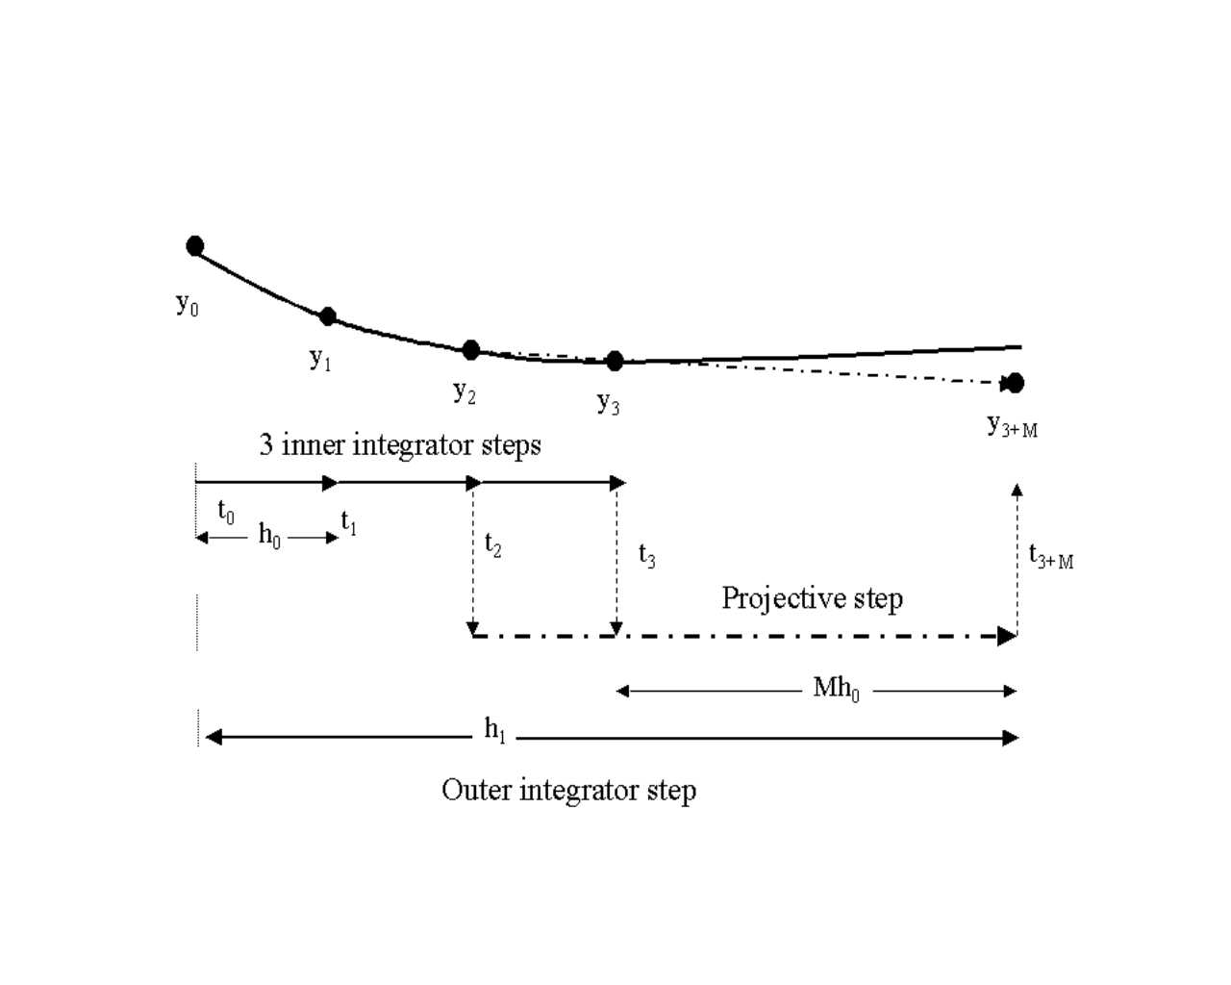
Projective Forward Euler Method - linear fit to last two points

Slide 8
Projective Integration
We suppose we have a one-step integrator Φ(y) that computes y(t+h) from y(t) for a the differential equation y′ = f(y)
Starting from y₀ = y(t₀) we apply this k times to form y₁, y₂, … , y_{k}. Now we apply it one more time and use y_{k} and y_{k+1} to estimate the derivative.
We then use this derivative to integrate (extrapolate) forward a distance Mh. It can be written as:
y_{k+1+M} = (M+1)y_{k+1} – My_{k}
This is the Projective Forward Euler method

Slide 9
Projective Integration - a sequence of outer integration steps:
The accuracy and stability of these methods can be studied with the usual tools.
In this talk we will focus on use of extensions of these methods to get integrators that are stable in specified regions.

Slide 10
Stability analysis – simple case:
Projective Forward Euler (PFE)
Usual linear analysis: for y′ = λy
Assume that one step of the supplied integrator Φ(y) (the inner integrator) has an amplification of ρ(hλ)
for Forward Euler ρ(hλ) = 1+hλ
for an “exact” integrator ρ(hλ) = exp(hλ)
Amplification of PFE from t₀ to t_{k+1+M} is
σ = ρ^{k}[(M+1)ρ – M] = ρ^{k}[1 + (M+1)(ρ-1)]
which is ρ^{k}[1 + (M+1) hλ] if inner is Forward Euler
Region of absolute stability: Set of ρ such that |σ| ≤ 1.
(Note: we express stability in terms of ρ making σ independent of the form of the inner integrator - which we may not know.)
Compute stability region by finding all ρ such that |σ| < 1
The region of absolute stability of takes one of two forms:

Slide 11
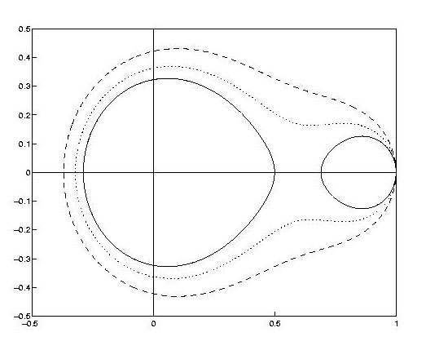
M = 5
M = 7
M = 9
ρ-plane plot k = 2, M = 5, 7, and 9
As M increases, change from one region to two. This happens when M/k ≈ 3.6
Note: ρ = 1+hλ if inner integrator is Forward Euler this is usual stability plot.

Slide 12
If M is large:
ρ-plane [= (1+hλ)-plane]
1
0
Such a small stability region - what’s the point?

Slide 13
Consider large M: Outer Integrator step ≈ Mhλ:
Mhλ - plane is one of interest for stability
Asymptotically a disk of radius
M^{(1 - 1/k)}
Asymptotically the stability region of the
Forward Euler method
≈ -M
-2
0

Slide 14
For any k, and M = 0, the stability region is simply the stability region of the inner method.
For fixed k, as M gets large, the stability region divides into two parts.
Asymptotically in large M they are:
1. A disk around the origin of the ρ-plane of radius (1/M)^{(1/k)}
2. A region that in the M(ρ - 1)-plane (i.e. the Mhλ-plane for FE)* is the stability region of the outer integrator (the Forward Euler method in the example discussed).
In other words, asymptotically we get exactly the stability we might expect for an explicit method with large step size, Mh, plus a region around the origin of the ρ-plane. This additional region is the one we will use to damp the stiff components.
* NOTE: If inner integrator is consistent the (ρ-1)-plane is asymptotically the same as the hλ-plane near the origin because ρ(h λ) = e^{h λ} + O(h λ)²

Slide 15
Note that the stability region around the origin has radius (1/M)^{1/k}
Suppose we have a problem with a gap in its spectrum - two disjoint clusters of eigenvalues:
S₀ -- a disk centered at -λ₀ < 0 with radius λ₀r - the potentially stiff components
S_{A} -- a region near the origin - the active components
If we choose h = 1/ λ₀ for the inner step (and use forward Euler), and if k is chosen large enough such that r^{k} < 1/M, then the method will be stable for the cluster S₀.
We can then choose an outer step commensurate with the active components in S_{A}.
Similar results follow for higher-order methods:

Slide 16
First-order, explicit methods are seldom sufficiently accurate. There are several ways to get increased accuracy:
(i) use the inner integrator Φ a further q times after y_{k} and project forward using a q-th order polynomial extrapolation through y_{k}, y_{k+1}, … , y_{k+q}
(ii) use information from several past groups of inner steps in a multistep-like integrator
(iii) use implicit methods (but in an explicit manner – will not be discussed further today)

Slide 17
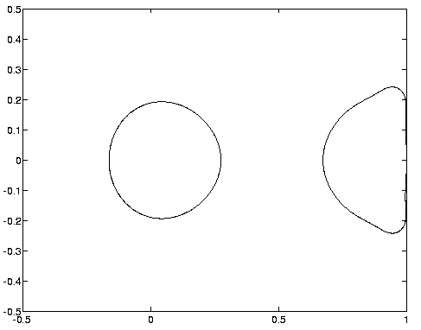
Approximately
1/M Stability
Region of
4th order
R-K method
Radius about
(q!/M^{q})^{1/k}
A 4-th order method:
Stability region: k=4, q=4, M=10

Slide 18
What good is a couple of Stability Regions?
Typical problem has lots of eigenvalues that could be:
Spread in an unknown fashion in the negative half plane
In moderately well known clusters – each due to the time constant(s) of a particular subsystem but there could be many such clusters
Have negative real parts but with significant imaginary parts
How do we handle these situations with this simple method?

Slide 19
Telescoping Projective Methods
(handling multiple clusters of eigenvalues)
We have created an “outer integrator” over a step size of h(k+q+M) using an inner integrator Φ over step size h.
Why not use recursion? (really iteration) Let the inner integrator be Φ₀
First level outer integrator is Φ₁ e.g., for Projective Euler
Φ₁ = Φ₀^{k}((M+1) Φ₀ - M)
Projective integrator based on Φ_{i} is Φ_{i+1}
Φ_{i+1} = Φ_{i}^{k}((M+1) Φ_{i} - M) for PFE (if k and M are fixed)
It uses step size h(k+q+M)^{i+1} - growing exponentially, or, more generally,
h_{i+1} = (k_{i} + q_{i} + M_{i})h_{i}

Slide 20
One outer integrator step - Φ₁
Projective Forward Euler Method - linear fit to last two points

Slide 21
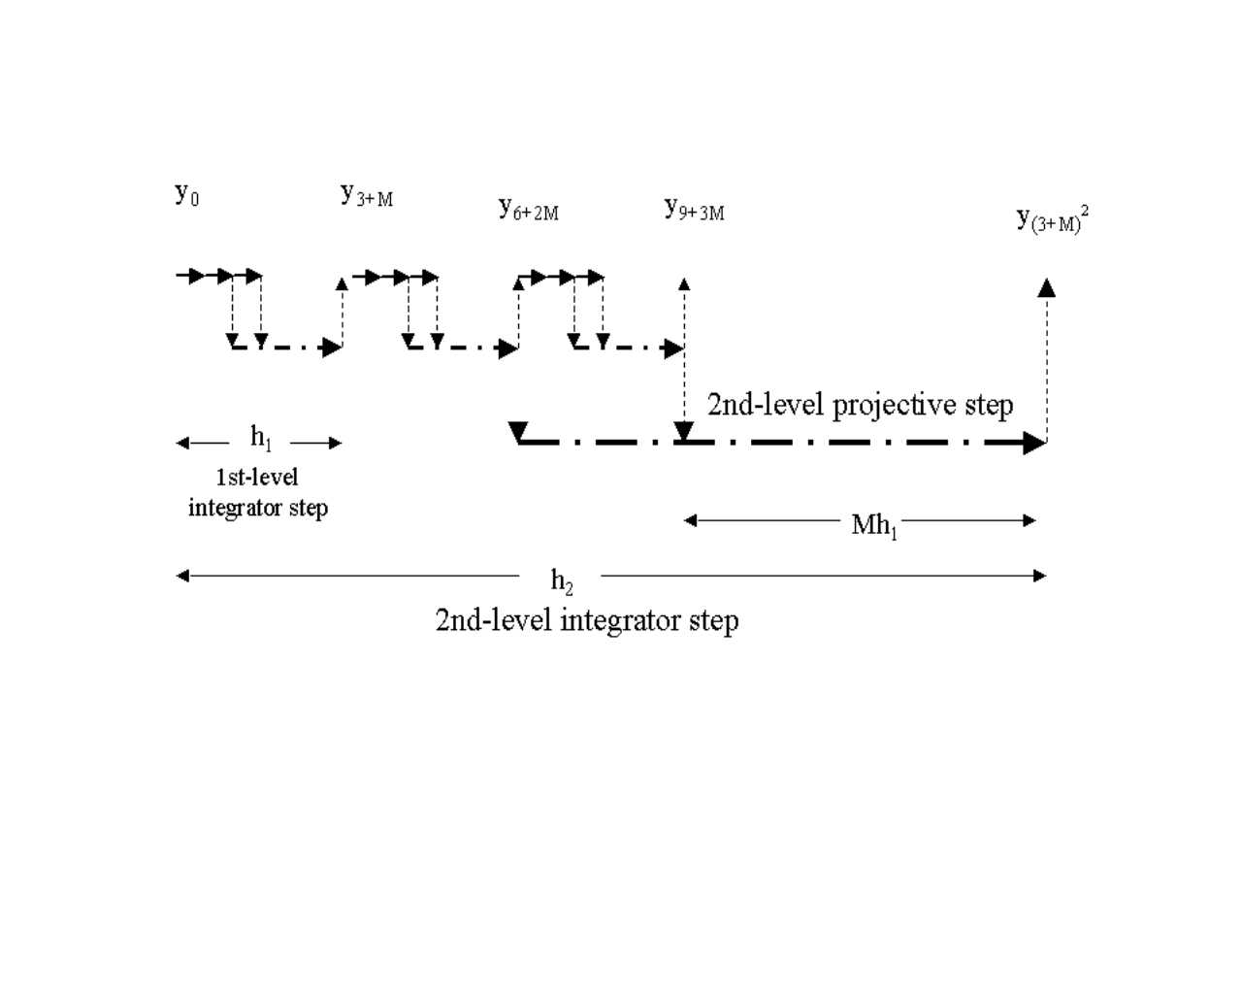
y₀ y_{3+M} y_{6+2M} y_{9+3M}
Φ₂
Two-level Projection method (k = 2 at both levels)

Slide 22
Let us consider the stability of Telescopic methods.
No need to use same method at each level, or same k and M at each level, but to illustrate concepts we will start by considering the use of (projective) forward Euler at all levels.
In practice, we will use first-order methods at all levels except for the outermost level since at the inner levels the step size/method is determined by stability only. At the outer level the step size/method must be chosen for accuracy.

Slide 23
Telescoping Projective Methods:
What is stability? Consider Projective Forward Euler.
Let amplification of level i integrator be σ_{i} We have
σ_{i+1} = σ_{i}^{k}[(M + 1)σ_{i} - M]
Stability region is set of σ that remain in unit disk (or, remain bounded) in iteration
σ ← σ^{k}[(M + 1)σ - M]
This stability region will contain the stability region of the method with any finite number of iterations.

Slide 24
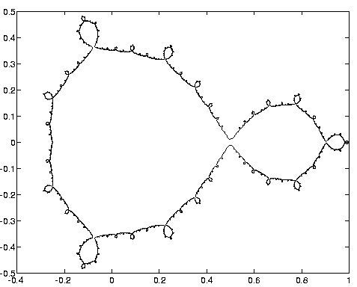
10 iterations of PFE with k=2, M=3. Outer stepsize is 60,466,176h₀
As # iterations → ∞ boundary becomes fractal
Note that M is small so that [0,1] (or [-1,0]) is inside the stability region
In this case, the stability boundary touches the real axis 10 times.
Use of a slightly smaller M would place [-β,1) in the interior of the stability region.

Slide 25
We can show that for any M there is a k₀ such that for all k ≥ k₀ the stability region includes the negative axis from 0 to 1 in the ρ-plane in the case of the Forward Euler method.
In some ways, these are like high-stage number Runge Kutta Methods which have been used to extend the region of stability. (The previous slide’s 10-level projective integrator is a 59049-stage RK method!)
A more interesting application may be to problems with multiple clusters of eigenvalues as shown on the next slide:

Slide 26
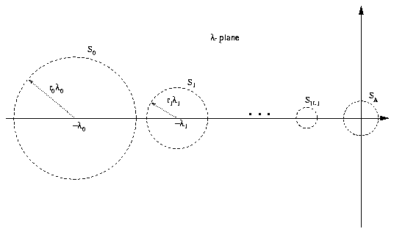
Suppose all eigenvalues lie in a union of (disjoint) disks:

Slide 27
… by choosing an inner step size of 1/λ₀ and then using an effective step size at the outer levels of projective integration of 1/λ_{i} for the i-th level we can choose values for k_{i} (the number of steps at the (i -1)-st level before projecting at the i-th level to achieve stability over these disks.
The step size at the i-th level is defined as
h_{i} = h_{i-1}(k_{i-1} + M_{i-1} + 1)
A particular case with h = 1, 11, and 121 is shown in the next slide:

Slide 28
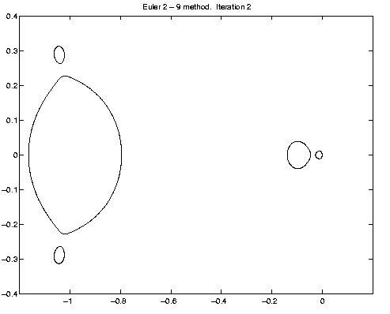
A two-level PFE2-9 method
3 stability regions determined by the 3 stepsizes:
Inner
1st level
2nd level
These regions are due to k (2) and cannot be placed where needed.

Slide 29
In effect, each successive stepsize damps eigenvalues of the order of the inverse of that stepsize.
Thus, if we know where the “stiff” eigenvalues are, we can select a sequence of stepsizes to damp them.
In a sense, this method is a little like using a Chebshev type iteration to remove eigencomponents in decreasing order of size, except that it is spread out over many steps. (If the problem is highly non-linear in a way that cause the eigendirections to change rapidly, more iterations (that is, inner steps) are needed, and the method becomes less efficient.

Slide 30
NOTE
A telescopic method is NOT the same as using a collection of different step sizes. The telescopic method can be designed so that the number of steps at any given level before a projective step is determined solely by the ratio of the step sizes at the two adjacent levels, independent of the number of levels of telescoping.
  If, on the other hand, just a collection of step sizes are used, more smaller steps are needed as the size of the largest step increases.

Slide 31
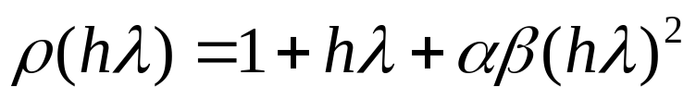
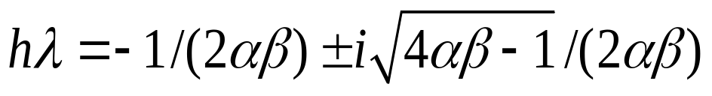
What about complex eigenvalues?
Use some sort of two-stage method (RK-like) which will have ρ(hλ) = 0 when hλ has complex conjugate values (if used as the inner integrator) or σ(ρ) = 0 when ρ has complex conjugate values for intermediate stage integrators..
For example,
This has
which has roots at
and are complex for r = αβ > 1/4. (Second order if r = 1/2.)

Slide 32
Similar technique can be used for intermediate level projective step.
Alternatively (and more simply) one can use k+2 inner steps and then do a projective step using the last three points in:
y_{k+2+M} =rM²y_{k+2}+(M-2rM²)y_{k+1} -(M-1-rM²)y_{k}
to achieve a stability polynomial of the form
σ = ρ^{k}[1 + M(ρ-1) + rM² (ρ-1)²]
This places stability regions around the complex conjugate eigenpair given on the last slide.
With this technique we can place regions of stability around any desired sets of locations in the complex plain, as shown in the next slide.

Slide 33
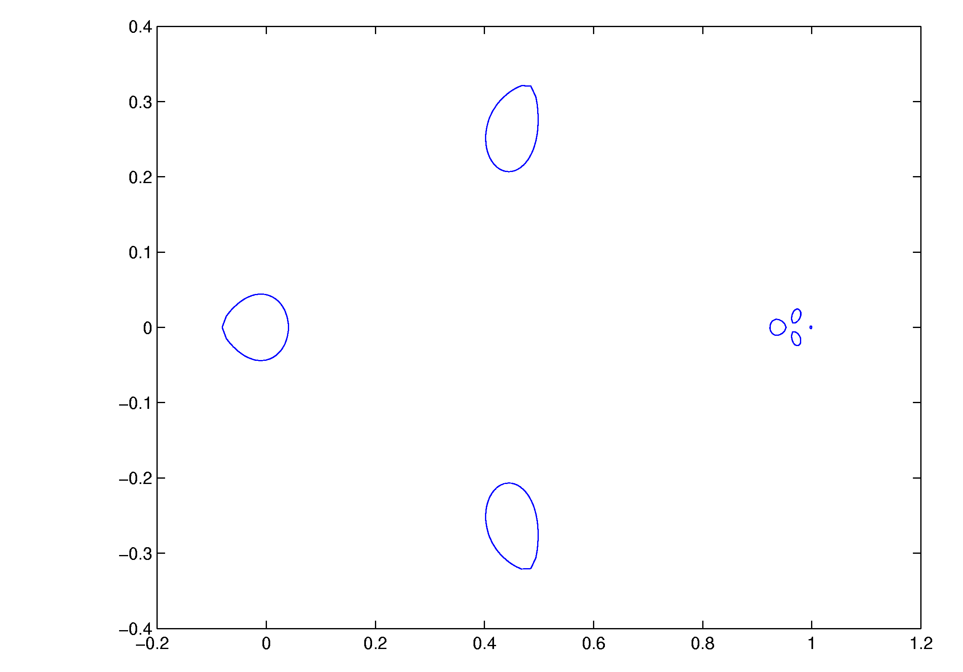
Stability plot of 4-level projective method in the ρ = 1+h₀λ plane. The sizes of steps at each level are h₀, 4h₀, 20h₀, 80h₀, and 880h₀. The outermost is Projective Forward Euler (k=1, M=9), so the right-most region - a dot in the figure at (0,1) is near the stability region for the forward Euler with step size 880h₀. The first and third levels used the method on the last slide with r=0.3 and r=0.35 respectively (with k=1, M=3) to place stability regions around 0.44±0.25i, and 0.976±0.015i respectively. The second level was PFE with k=1, M=3 placing a region near 0.95. Larger values of k would make the regions (except for the rightmost) larger.

Slide 34
Concluding remarks
if eigenvalue locations are known (or can be estimated on the fly), and
if we can reduce the system to ODE’s
these methods may be able to save significant time because no large systems have to be solved.
Because method is explicit, “subcycling” (also known as multirate methods – different time steps for different components) is easier to apply. If certain eigenvalue groups are isolated in subparts of the network, it may be possible to restrict the use of the stepsizes designed to damp those eigenvalues just to those subnetworks.

