Slide 1
Session 31
Issues Related to the Return of Title IV Funds: Beyond the Calculation
Brian Kerrigan – OPE
Dan Klock – FSA
Derek Kalm – Pearson Government Solutions

Slide 2
Final Regulations
November 1, 2002
Late disbursements/post-withdrawal disbursements
Institutions required to take attendance
Approved leave of absence
Timely returns
Transfer or re-entry students
Recalculation required
R2T4 on the Web

Slide 3
Final Regulations
November 1, 2002
Early implementation was permitted
  (see 67 FR 67050)
Clarification of an institution that is required to take attendance--must apply to all students who withdraw on or after the institution’s implementation date
Leave of absence changes--must apply to all students who are granted a leave of absence on or after the institution’s implementation date

Slide 4
Late Disbursements/
Post-withdrawal Disbursements (PWDs)

Slide 5
Late disbursements/PWDs
Deadline for making a late disbursement/PWD
Old Regulation
90 days
New Regulation
120 days
May request past 120 days on exception basis if not student’s fault
To request an exception, send an email to: Jeff.Baker@ed.gov

Slide 6
Late disbursements/PWDs
Clarification of Must make vs. May make
Must make:
Student withdraws during period
Student completes period
May make: Student doesn’t withdraw, but drops below 1/2 time enrollment

Slide 7
Late disbursements/PWDs
The conditions that make a student eligible for a late disbursement must be met before the student withdrew in order for Title IV aid to be considered “aid that could have been disbursed” and included in the Return of Title IV Aid calculation.
However, if limitations apply, that aid may not be used to make a PWD.

Slide 8
Late disbursements/PWDs
Conditions for a late disbursement (668.164(g)(2))
ED processed SAR or ISIR with official EFC (not needed for PLUS)
FFEL/Direct Loan-institution certified or originated the loan
Perkins/FSEOG-institution made the award

Slide 9
Late disbursements/PWDs
Limitations on making a late disbursement (668.164(g)(4))
Second or subsequent disbursements of FFEL/Direct Loan, unless student completed period
FFEL/Direct Loan if student did not complete the 30-day delay period, if applicable
Pell Grant – need a valid SAR/ISIR by the deadline in the Federal Register

Slide 10
Late disbursements/PWDs – for example
First time, first year student starts class on Sept.1st and withdraws on Sept. 28th and his/her Stafford loan for $1,000 has not been disbursed
  Include the amount of the loan on the Return to Title IV worksheet as funds that “Could have been disbursed”
  BUT, these funds cannot be disbursed because the student was not elig. due to the fact that the student had not been in attendance for 30 days

Slide 11
An Institution that is Required to take Attendance

Slide 12
An institution that is required to take attendance
Old Regulation
The Department determines whether an outside entity requires an institution to take attendance
New Regulation
Determination is made by the outside entity

Slide 13
An institution that is required to take attendance – for example
XYZ Motor Corp. Scholarship – requires attendance taking for its recipients (even though, your school meets the definition of an institution not required to take attendance)
  Student A, an XYZ scholarship recipient and Student B (his brother - who did not receive an XYZ scholarship) cease attendance at your school without contacting the “Withdrawal Office”
  Withdrawal date for Student A = LDA
  Withdrawal date for Student B = midpoint or the last date of an academically-related event that the institution can document

Slide 14
An institution that is required to take attendance
If you are required to take attendance for only some students, you are an institution that is required to take attendance for those students only.

Slide 15
An institution that is required to take attendance
If you are required to take attendance for a limited period of time, you are an institution that is required to take attendance for that limited period of time only.
Includes attendance for census date purposes if you are required to take attendance continuously for the period.

Slide 16
An institution that is required to take attendance
Remember, if the outside entity that imposes the requirement does not consider its requirement to require you to take attendance for the limited period of time, you are not an institution that is required to take attendance for the limited period of time.

Slide 17
An institution that is required to take attendance
If you can demonstrate that a student is in attendance after the limited period and the student later withdraws, the withdrawal date is determined according to the requirements for institutions that are not required to take attendance.
If not, the withdrawal date is the last date of academic attendance as determined by the institution from its attendance records.

Slide 18
Approved Leave of Absence (LOA)

Slide 19
Approved leave of absence
Old regulatory criteria for granting LOAs
Generally, one LOA in a 12-month period
One subsequent LOA of no more than 30 days permitted if necessary due to unforeseen circumstances
Additional LOAs permitted for jury duty, military reasons, or circumstances related to FMLA
Total LOAs in 12-month period not to exceed 180 days

Slide 20
Approved leave of absence
New regulatory criteria for granting LOAs
Multiple LOAs permitted, total of all LOAs not to exceed 180 days in a 12-month period.

Slide 21
Approved Leave of Absence
Request from student
Old Regulation
Institution’s policy must require written, signed and dated request
New Regulation
Institution’s policy must require written, signed and dated request that includes the reason for the request
See 67 FR 67058

Slide 22
Approved Leave of Absence
Coursework upon return
Old Regulation
All students returning from LOA must return to same point in coursework they were at when LOA began
New Regulation
Students on LOAs from clock-hour and non-term credit hour programs not required to begin where they left off

Slide 23
Approved leave of absence
Repeat coursework upon return
Student is still considered to be on a LOA
No additional charges permitted
If student never begins attendance at point left off - the withdrawal date is the date the LOA began. The date of determination would be the earlier of either the date of the end of the LOA or the date the student contacted the school and indicated that s/he would not be returning

Slide 24
Timely Returns

Slide 25
Timely returns
Timeframe for return of funds
An institution must return the amount of Title IV funds for which it is responsible as soon as possible, but no later than 30 days after the date of the institution’s determination that the student withdrew. (§668.22(j)(1))

Slide 26
Timely returns
Why is this so important?
Affects students
May affect your institution’s financial responsibility evaluation – see Subpart L of the Student Assistance General Provisions

Slide 27
Timely returns
Why is this so important?
When your auditor examines your institution’s return calculations, if 5% or more of the return calculations in the reviewed sample were late, your institution must post a letter of credit.
Exception: There are only one or two late returns.

Slide 28
Timely returns
What it means to make a timely return
Institution does one of the following no later than 30 days after date determines student withdrew:
Deposits or transfers the funds into the bank account it maintains for Federal funds
Initiates an EFT
Initiates an electronic transaction instructing an FFEL lender to adjust a loan for the amount of the returned funds
Issues a check – (definition in next slide)

Slide 29
Timely returns
What it means to make a timely return
An institution is not considered to have issued a check within 30 days after the date it determines the student withdrew if:
Institutions records show that the check was not issued by that date; OR
The date on the cancelled check shows that ED or FFEL lender bank endorsed the check more than 45 days after the date institution determines the student withdrew.

Slide 30
Timely returns
Exceptional circumstances
Allows for reconsideration of a finding if
The institution believes the finding is a mistake; OR
Noncompliance is due to exceptional circumstances beyond the institution’s control.
Request for reconsideration and documentation must be submitted no later than the date the LOC would be due.

Slide 31
Timely returns
Letter of credit requirements
LOC is due no later than 30 days after the earlier of the date that
The compliance audit is due
The OIG issues a final audit report
The designated ED official issues a final program review determination
ED or a guaranty agency issues a preliminary report showing untimely returns for more than 10% of sampled students
ED sends written notice explaining reasons for and requests LOC from the school

Slide 32
Timely returns
Letter of credit requirements
Less than $5,000 letter of credit due, not required to submit if school demonstrate reserves of at least $5,000 available at all times.

Slide 33
Timely returns
Tolerance threshold change
Old Regulation
An institution is considered to meet the cash reserves requirement of the law if no more than one return is made untimely.
New Regulation
An institution is considered to meet the cash reserves requirement of the law if no more than two returns are made untimely.

Slide 34
Transfer or Re-entry Students

Slide 35
Transfer or re-entry
Applies to:
A credit hour non-term program; or
A program that measures progress in clock hours.

Slide 36
Transfer or re-entry
Re-entry into the same program within 180 days
  The student stays in the same payment period
  An R2T4 calculation will have been done
  The student is immediately eligible to receive all Title IV funds that were returned when the student previously ceased attendance as well as any funds for the period that were not disbursed because the student withdrew.

Slide 37
Transfer or re-entry
Re-entry into the same program after 180 days
  The student starts a new payment period
  The student will have withdrawn from the institution
  An R2T4 calculation will have been done

Slide 38
Transfer or re-entry
Transfer into a new program at the same or at a new school (within any # of days)
  The student starts a new payment period
  Assumes that the student was withdrawn from the institution
  Assumes that an R2T4 calculation was done
  If no withdrawal from school, student stays in the same payment period

Slide 39
Transfer or re-entry
For the new payment period
  The school treats the hours remaining as if those hours comprise the student’s entire program.
  If the remainder of a student’s program is one-half of an academic year or less, the entire remaining period constitutes one payment period.

Slide 40
Transfer or re-entry - example
Student A begins a 900 clock hour program. The student withdraws having completed 100 clock hours
Returns after 180 days
  900 – 100 = 800 hours (more than ½ AY)
  Payment Period #1 of 400 hours
  Payment Period #2 of 400 hours
Student B had completed 500 hours
  900 – 500 = 400 hours (less than ½ AY)
  Payment Period = 400 hours

Slide 41
Transfer or re-entry
A student’s eligibility for Title IV aid may be subject to limitations.
Example: Pell Grant-student may never receive more than scheduled annual award
Example: FFEL-annual loan limits, existence of overlapping loan periods or award years

Slide 42
Recalculation required

Slide 43
Recalculation required
Recalculation of a student’s eligibility for Pell and campus-based funds is required when a student withdraws before beginning attendance in all classes for which the student was registered.
See GEN-00-24 Q & A #4 Principle #1

Slide 44
Recalculation required
First you recalculate the student’s eligibility for Pell Grant and campus-based aid
Then, you perform a Return calculation based on the student’s revised eligibility

Slide 45
R2T4 on the Web

Slide 46
How Do I Access Return of Title IV Funds on the Web?
Web-based application
Internet access
FAA Access to CPS Online – FAA Main Menu – ‘Return of Title IV Funds’ option
No need to install software

Slide 47
Security
PC security options no longer apply
Use Participation Management
Destination Point Administrator (DPA) sets FAA User access rights
Options
  Write (Update, Submit, Delete,etc.)
  Read (View)

Slide 48
Homepage and “Look and Feel”
Homepage contains:
  Help
  FAQs (Frequently Asked Questions)
  Navigation links
  Links to lots of helpful information!
Utilize “Look and Feel” of other ED web applications

Slide 49
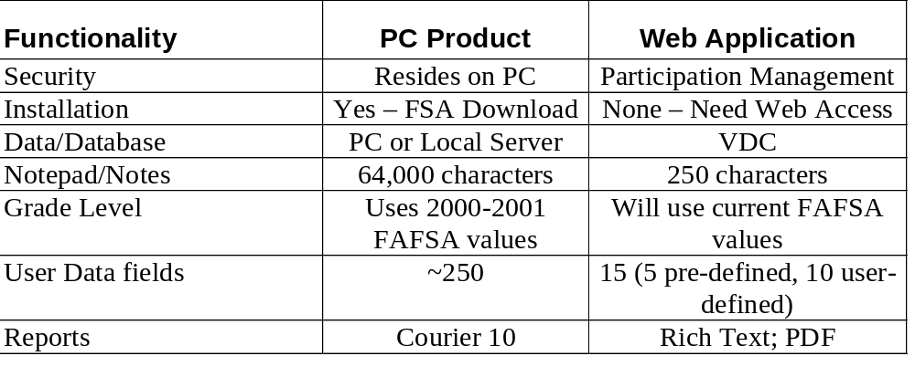
How Does Moving to a Web Application Affect Me?
Changes

Slide 50
Tech Slide
We appreciate your feedback and comments. We can be reached:
Brian Kerrigan 202-219-7058
Email: brian.kerrigan@ed.gov
Dan Klock 202-377-4026
Email: dan.klock@ed.gov
Derek Kalm 319-665-7966
Email: Derek.Kalm@pearson.com

