Slide 1
Withdrawals &
Return to Title IV Funds Policy
Session 32
Brian Kerrigan
Dan Klock

Slide 2
Today’s Agenda
Collection of withdrawal information
R2T4 Calculation
Notification
Compliance self-monitoring
DCL issues
Questions & Answers

Slide 3
Presentation Objectives:
Understand that R2T4 non-compliance is a top finding
Today’s session will equip you to prevent R2T4 findings from occurring on your campus

Slide 4
Collection of Withdrawal Information
Institutions required to take attendance
  Outside entity has a requirement that the institution take attendance - Nov. 1, 2002 change (67 FR 67073)

Slide 5
Collection of Withdrawal Information Date of Determination
Required to Take Attendance
When the student begins the official withdrawal process at the school
When student exceeds the institution’s policy on excused absences, not more than 14 days after the withdrawal date
Not Required to Take Attendance
When the student begins the official withdrawal process at the school
The date the institution becomes aware that the student has ceased attendance

Slide 6
Collection of Withdrawal Information Withdrawal Date
Required to Take Attendance
The last recorded date of attendance from the institution’s attendance records
Not Required to Take Attendance
Begins the formal withdrawal process
Date student provided intent to withdraw
Midpoint – unofficial withdrawal
The date an LOA began for a student who does not return from an LOA
Illness, accident, grievous personal loss, events beyond the student’s control
Academically-related event as documented by the school

Slide 7
R2T4 Calculation
For a standard term based program, use payment period.
For a non-term based or non-standard term program, use payment period or period of enrollment.
For a non-term or non-standard term based program, an institution must consistently use either a PP or POE for all students (in a category) in a particular program.

Slide 8
R2T4 Calculation
Percentage Earned is a two-step process
Calc 1 – Determine Clock Hours Completed
clock hours completed equals > 60%, student has earned
total hours in the period 100% of title IV Funds
Calc 2 – Percentage Earned
clock hours completed equals 70% or more
clock hours scheduled to complete use scheduled hours

Slide 9
R2T4 Calculation
Percentage Earned is equal to –
calendar days completed
  calendar days in the period
  Note: Exclude institutionally scheduled breaks of 5 or more consecutive days
  When a student has completed MORE than 60%, 100% of Title IV funds are earned

Slide 10
R2T4 Calculation
After you calculate the amount the student earned - 3 possibilities:
  A. The amount disbursed = the amount earned
    Eureka! No further action necessary!
  B. The amount disbursed > the amount earned
    The unearned portion must be returned to the programs
  C. The amount disbursed < the amount earned
    Post-withdrawal disbursement

Slide 11
R2T4 Calculation
B. The amount disbursed > the amount earned
  Calculate the unearned portion from the school
  Institution returns the lesser of –
    1.) amount disbursed 2.) institutional charges
    - amount earned (or) x percentage not earned
  Calculate the unearned portion that the student owes: Total unearned amount less amount school paid

Slide 12
R2T4 Calculation
B. The amount disbursed > the amount earned
  Amount of unearned the student owes =
    Title IV Loans – repay in accordance with the loan repayment provisions
    Title IV Grants – the initial amount of the grant overpayment is reduced by 50% (the product is referred to as the original amount of the grant overpayment)

Slide 13
Notification
C. The amount disbursed < the amount earned
  Post-withdrawal disbursement (PWD)
    Credit the student’s account for direct costs
    With permission – credit the student’s account for indirect educational costs
    If Title IV loan funds are credited, must notify borrower of right to cancel or reduce loan
    If PWD exceeds costs credited – institution must offer PWD w/in 30 days of the date of determination

Slide 14
Notification
  Post-withdrawal disbursement (PWD)
    14-day Rule
    Institutional flexibility beyond 14-day Rule
    120 days to complete the PWD

Slide 15
Notification
Grant Overpayment Notification
  45-day period of extended eligibility
    Notify student w/in 30 days of Date of Determination that s/he must take Positive Action to
      Fully repay the overpayment
      Make arrangements with school to repay
      Make arrangements with ED to repay
  Institutional monitoring

Slide 16
Compliance Self-Monitoring
R2T4 is one of the most common audit findings
  Use our free software
  Ease of use
  Use reports to manage the process and assure compliance

Slide 17
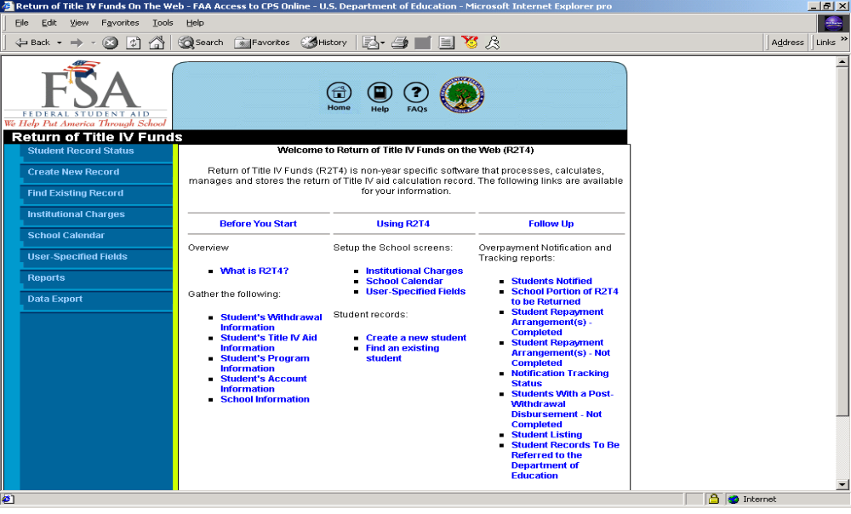

Slide 18
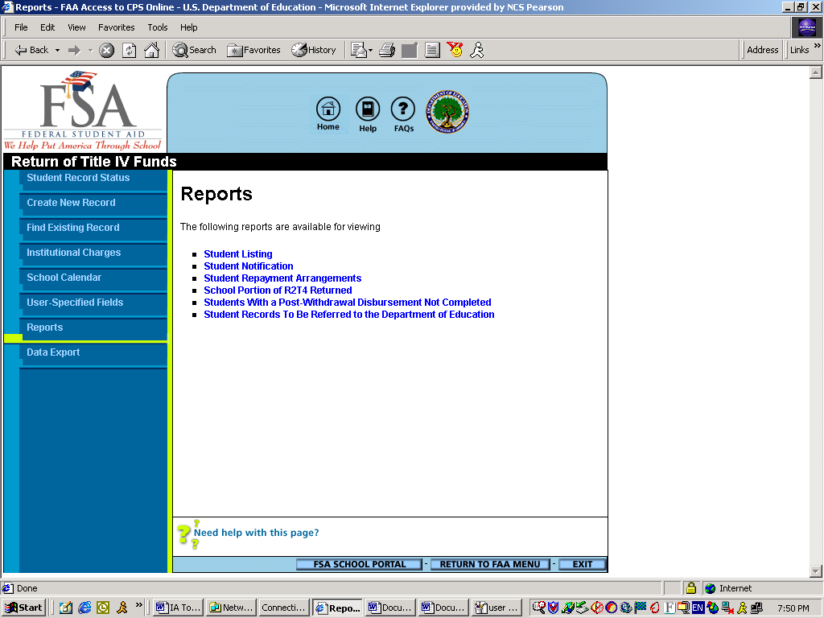

Slide 19
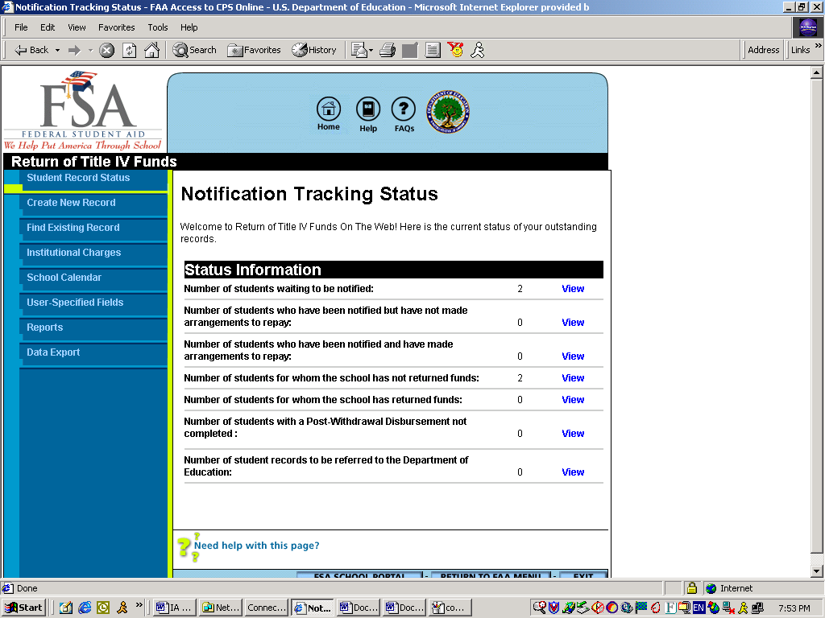

Slide 20
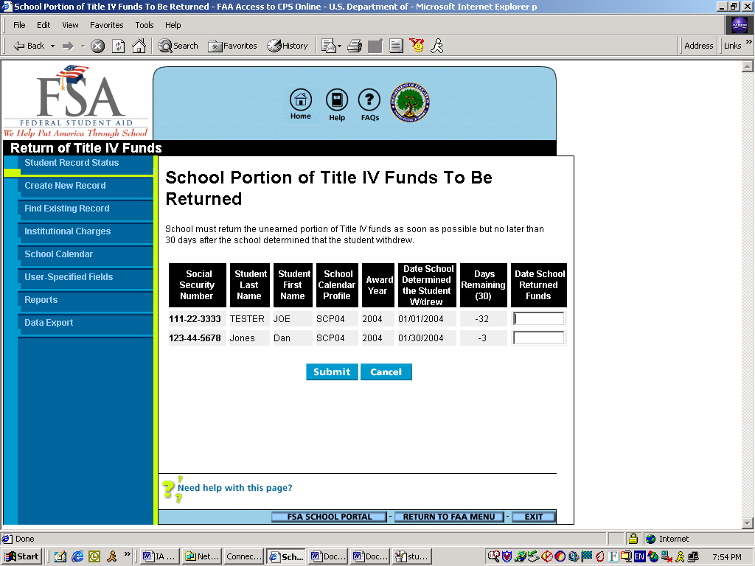

Slide 21
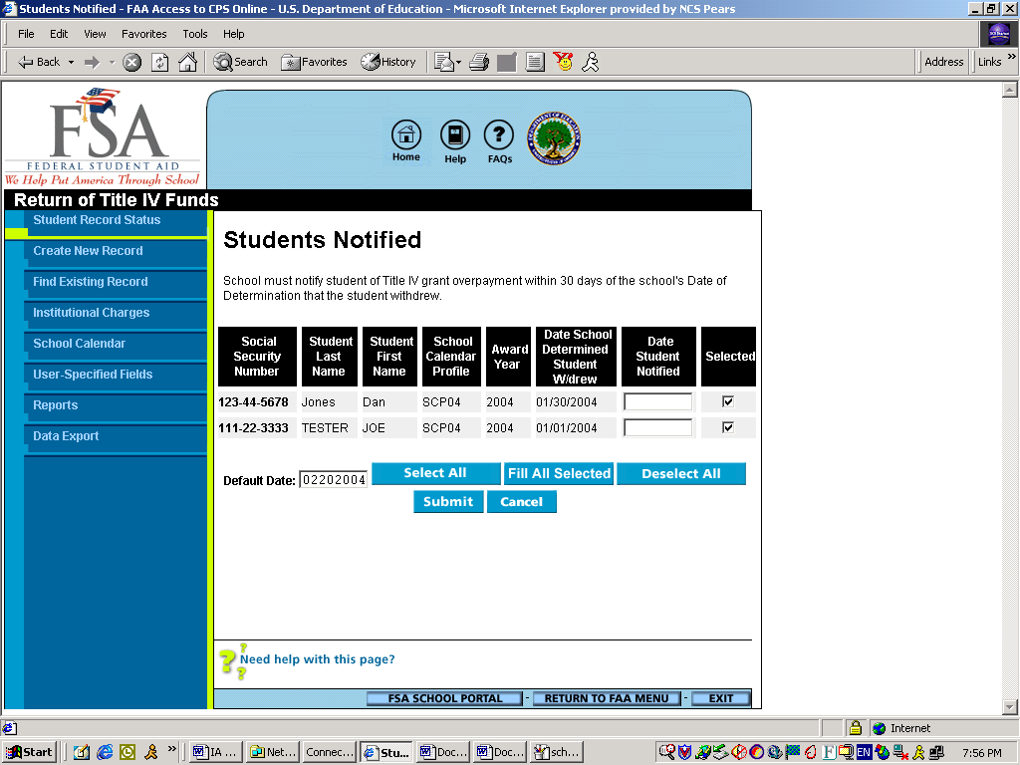

Slide 22
Compliance Self-Monitoring
How do I access R2T4OTW?
It’s Easy!
  SIGN-UP!
    Sign-up via SAIG Enrollment website
      https://www.fsawebenroll.ed.gov/PMEnroll
  Note: The R2T4 Web Application when available will be accessed via FAA Access
    https://fafsa.ed.gov/faa/faa.htm

Slide 23
Compliance Self-Monitoring
CUSTOMER SERVICE
Software Support
  CPS/WAN Technical Support
    CPSSAIG@ed.gov
    (800) 330-5947
Policy
  ED's Customer Support center
    fsa.customer.support@ed.gov
    (800) 433-7327

Slide 24
DCL 05-16
“Aid that could have been disbursed” (ATCHBD)
  Signed Title IV loan promissory note (PN)
    A PN must be signed before the amount can be included as ATCHBD
    Q: Must the PN be signed before the student withdrew? Ans: No

Slide 25
DCL 05-16
Aid That Could Have Been Disbursed
  If PN is signed subsequent to withdrawal or when the student loses eligibility but meets the conditions of 34 CFR 668.164(g) = PWD or late disbursement

Slide 26
DCL 05-16 Other Topics
The use of Web sites to provide required notifications and disclosures directly to students
Additional unsubsidized Stafford loan amounts for an otherwise eligible child of a parent who is not a U.S. citizen or permanent resident
Bankruptcy and eligibility for Parent Loans for Undergraduate Students (PLUS) and additional unsubsidized loan amounts
Free Application for Federal Student Aid (FAFSA) questions and same-sex marriage

Slide 27
DCL 05-16 Other Topics
Asset valuation of a rental unit within a principal place of residence in need analysis
The definition of a veteran
The treatment of combat pay
The use of stored-value cards and other alternative methods of managing Title IV funds
Debit cards and third party servicers
The Reserve Educational Assistance Program (REAP or Chapter 1607)

Slide 28
Dear Colleague Letter (DCL)
(GEN-04-03)
Title IV Credit Balances
Aid That Could Have Been Disbursed
Verification not completed before withdrawal
No Passing Grades
Withdrawal – Credit Hour, Non-Term Program
Date of Determination of Withdrawal for Institutions not required to take attendance
Treatment of LEAP Funds

Slide 29
Title IV Credit Balances
Hold all Title IV Credit Balances until R2T4 calculation is completed.
Credit Balance is “Aid Disbursed.”
Determine if Credit Balance changes because of a Refund Policy or R2T4.
Use Credit Balance to repay Title IV Grant Overpayment on behalf of student.
Release Credit Balance within 14 days.

Slide 30
Aid That Could Have Been Disbursed
Old Policy -- Aid that could have been disbursed before withdrawal did not include
  Second loan disbursement, or
  Loan within first 30 days.
New Policy -- All aid for period, if conditions for late disbursement were met before the student withdrew, is included. (668.164(g)(2))
However, if limitations apply, that aid may not be paid to the student. (668.164(g)(4))

Slide 31
Conditions for a Late Disbursement
For all student aid (including Pell) - ED processed SAR/ISIR with official (not necessarily a valid) EFC. (Not needed for PLUS)
For FFEL/Direct Loan - Institution certified or originated the loan.
For Perkins/FSEOG - Institution made the award

Slide 32
Limitations on Making a Late Disbursement
No second or subsequent disbursements of FFEL/DL, unless student completes the period.
No FFEL/DL unless student completes the 30-day delay period.
No Pell Grant without a valid SAR/ISIR by the deadlines in the Federal Register.
No 2nd pp Pell if 1st pp not completed.
No 2nd pp FFEL/DL if 1st pp not completed

Slide 33
Importance of Aid That Could Have Been Disbursed
If total aid (Aid That Could Have Been Disbursed plus Aid Disbursed) is greater, the amount earned will be greater.
This results in a smaller amount to be returned, or in a post-withdrawal disbursement.
But, remember - Aid must correspond to the period for which you are doing the Return Calculation. (pp or period of enrollment)

Slide 34
Aid That Could Have Been Disbursed
(aid that could have been disbursed from the 2nd pp)
(clock hour school)
Length of Period is 1000 hours
Student withdrew after 400 hours
Period of enrollment basis
Old New
Aid for Period ($2000 Pell; $2000 FFEL) = $4000 $4000
Aid Disbursed ($1000 Pell; $1000 FFEL) = $2000 $2000
Aid That Could Have Been Disbursed = $ 0 $2000
Amount Earned (40% x $2000 or $4000) = $ 800 $1600
Amount to be Returned = $1200 $ 400

Slide 35
Aid That Could Have Been Disbursed
(aid that could have been disbursed from the 2nd pp)
(credit hour school)
Length of Period is 24 semester hours, 224 days (no terms)
Student withdrew after 56 days
Period of enrollment basis
Old New
Aid for Period ($2000 Pell; $2000 FFEL) = $4000 $4000
Aid Disbursed ($1000 Pell; $1000 FFEL) = $2000 $2000
Aid That Could Have Been Disbursed = $ 0 $2000
Amount Earned (1/4 x $2000 or $4000) = $ 500 $1000
Amount to be Returned = $1500 $1000

Slide 36
Aid That Could Have Been Disbursed
(aid that could have been disbursed from the 1st & 2nd pp)
(clock hour school)
Length of Period is 1000 hours
Student withdrew after 400 hours
Period of enrollment basis
Old New
Aid for Period ($2000 Pell; $2000 FFEL) = $4000 $4000
Aid Disbursed ($1000 Pell; $0 FFEL) = $1000 $1000
Aid That Could Have Been Disbursed = $1000 $3000
Amount Earned (40% x $2000 or $4000) = $ 800 $1600
Amount to be Returned / PWD (FFEL) =($ 200) $ 600

Slide 37
Aid That Could Have Been Disbursed
(aid that could have been disbursed from the 1st & 2nd pp)
(credit hour school)
Length of Period is 24 semester hours, 225 days (no terms)
Student withdrew after 75 days
Period of enrollment basis
Old New
Aid for Period ($2000 Pell; $2000 FFEL) = $4000 $4000
Aid Disbursed ($1000 Pell; $0 FFEL) = $1000 $1000
Aid That Could Have Been Disbursed = $1000 $3000
Amount Earned (1/3 x $2000 or $4000) = $ 667 $1333
Amount to be Returned / PWD (FFEL) = ($ 333) $ 333

Slide 38
Aid That Could Have Been Disbursed
(limitation on disbursement – no 2nd FFEL disbursement)
(clock hour school)
Length of Period is 1000 hours
Student withdrew after 601 hours
Period of enrollment basis
Old New
Aid for Period ($2000 Pell; $2000 FFEL) = $4000 $4000
Aid Disbursed ($2000 Pell; $1000 FFEL) = $3000 $3000
Aid That Could Have Been Disbursed = $1000 $1000
Amount Earned (100% of $4000) = $4000 $4000
Amount of FFEL PWD (instead of $1000) = $ 0 $ 0

Slide 39
Aid That Could Have Been Disbursed
(limitation on disbursement – no 2nd FFEL disbursement)
(credit hour school)
Length of Period is 24 semester hours, 224 days (no terms)
Student withdrew after 135 days
Period of enrollment basis
Old New
Aid for Period ($2000 Pell; $2000 FFEL) = $4000 $4000
Aid Disbursed ($2000 Pell; $1000 FFEL) = $3000 $3000
Aid That Could Have Been Disbursed = $1000 $1000
Amount Earned (100% of $4000) = $4000 $4000
Amount of FFEL PWD (instead of $1000) = $ 0 $ 0

Slide 40
Aid That Could Have Been Disbursed
(limitation on disbursement – completion of < 30 days)
(clock hour school)
Length of Period is 1000 hours
1st year, 1st time student withdrew on 28th day of program, after completing 125 hours
Period of enrollment basis
Old New
Aid for Period ($2000 FFEL) = $2000 $2000
Aid Disbursed ($0 FFEL) = $ 0 $ 0
Aid That Could Have Been Disbursed = $ 0 $2000
Amount Earned (12.5% of $0 or $2000) = $ 0 $ 250
Amount of FFEL PWD (instead of $250) = $ 0 $ 0

Slide 41
Aid That Could Have Been Disbursed
(limitation on disbursement – completion of < 30 days)
(credit hour school)
Length of Period is 24 semester hours, 224 days (no terms)
1st year, 1st time student withdrew on 28th day of program
Period of enrollment basis
Old New
Aid for Period ($2000 FFEL) = $2000 $2000
Aid Disbursed ($0 FFEL) = $ 0 $ 0
Aid That Could Have Been Disbursed = $ 0 $2000
Amount Earned (12.5% of $0 or $2000) = $ 0 $ 250
Amount of FFEL PWD (instead of $250) = $ 0 $ 0

Slide 42
Aid That Could Have Been Disbursed
(completion of < 30 days: Pell disbursement; no FFEL)
(clock hour school)
Length of Period is 1000 hours
1st year, 1st time student withdrew on 28th day of program, after completing 125 hours
Period of enrollment basis
Old New
Aid for Period ($1000 FFEL; $1000 Pell) = $2000 $2000
Aid Disbursed ($0 FFEL; $0 Pell) = $ 0 $ 0
Aid That Could Have Been Disbursed = $ 0 $2000
Amount Earned (12.5% of $0 or $2000) = $ 0 $ 250
Amount of PWD - Pell = $ 0 $ 250

Slide 43
Aid That Could Have Been Disbursed
(completion of < 30 days: Pell disbursement; no FELL)
(credit hour school)
Length of Period is 24 semester hours, 224 days (no terms)
1st year, 1st time student withdrew on 28th day of program
Period of enrollment basis
Old New
Aid for Period ($1000 FFEL; $1000 Pell) = $2000 $2000
Aid Disbursed ($0 FFEL; $0 Pell) = $ 0 $ 0
Aid That Could Have Been Disbursed = $ 0 $2000
Amount Earned (12.5% of $0 or $2000) = $ 0 $ 250
Amount of PWD - Pell = $ 0 $ 250

Slide 44
Verification
Must complete R2T4 within 30 days.
If Verification not completed
  Return Interim Disbursements of aid subject to verification.
  Include Unsubsidized and PLUS loans in R2T4.
If Verification completed later, but within Verification timelines
  School must perform new R2T4 calculation using additional eligible aid.

Slide 45
No Passing Grades
School must have a process for determining if student completed.
No passing grade, institution must document completion of period.
Grading Policy that differentiates between Failing, Completed; and Failing, Did Not Complete.

Slide 46
Withdrawal from a Non-Term, Credit Hour Program
Percentage Earned is equal to calendar days completed divided by calendar days in the period.
Project calendar days in period if student is in a Self-Paced Program.

Slide 47
Date of Determination that Student Withdrew for Schools Required to Take Attendance
Usually no later than two weeks after last date of attendance.
Based on Attendance Records.
Date of Official Notification if prior to that.
After end of school’s Absence Policy.

Slide 48
Treatment of LEAP Funds
Law excludes FWS but not LEAP.
The State Grant (LEAP) is included in calculation if the State Grant Agency has told the school, in writing one of the following things…

Slide 49
Treatment of LEAP Funds
The dollar or percent of the student’s State Grant that is LEAP. ($ or % up to $5000)
That the specific student’s State Grant includes an unknown amount of LEAP. (Entire amount of Grant, up to $5000)
The percent of LEAP in the school’s State Grant amount. (% up to $5000)
That all State Grants include LEAP funds. (Entire amount of Grant, up to $5000)

Slide 50
Appendix
Reminders that you can read on your own

Slide 51
The Law, Regulations, DCLs
Section 484B of the HEA
  Enacted October 7, 1998, as part of the Higher Education Amendments of 1998
NPRM published August 6, 1999
Final Reg published November 1, 1999
  Effective Date of Reg - July 1, 2000

Slide 52
The Law, Regulations, DCLs
Dear Colleague Letter GEN-00-24
NPRM published August 8, 2002
Final Reg published November 1, 2002
Dear Colleague Letter GEN-04-03

Slide 53
Old Approach – (Refunds and Repayments)
  Dictated use of specific refund policies.
  Determined amount of institutional charges that a school had earned and not earned.
New Approach – (Return to Title IV Funds)
  Determines amount of title IV aid a student has earned, the unearned portion is returned
  “Paycheck theory” – if you aren’t there for the entire period you owe some of the money back

Slide 54
Schools prohibited from allowing Title IV funds to escheat (be paid to a third party)
  Credit balances and post-withdrawal disbursements
  School must ensure that Title IV funds are used only for educational purposes
  Funds cannot escheat to a third party (state or institutional coffers)
  Must have a process to identify non-negotiated checks and return the funds to the Title IV programs before the checks are stale and escheat to an unintended third party

Slide 55
Leave of Absence
  The previous limit of only one LOA in 12 months was eliminated in the November 1, 2002 final regulations.
  Total leave days cannot exceed 180 in any 12-month period.
  The institution must have a formal policy that the student and institution follow.

Slide 56
Academically-Related Activity
  An institution not required to take attendance MAY ALWAYS use the last date of an academically-related activity as the withdrawal date.
  The school, not the student, must DOCUMENT
    That the activity is academically-related, and
    The student’s attendance at the activity.

Slide 57
Examples of Academically- Related Activities
  Examinations or quizzes,
  Tutorials,
  Computer-assisted instruction,
  Completing an academic assignment, paper, or project,
  Attending a school assigned study group.

Slide 58
Thank You
We appreciate your feedback and comments. We can be reached at:
Phone: Brian Kerrigan (202) 219-7058
Dan Klock (202) 377-4026
Fax: Brian Kerrigan (202) 502-7874
Dan Klock (202) 275-4552
Email: brian.kerrigan@ed.gov dan.klock@ed.gov

