Slide 1
Achievements and Challenges for I/O in Computational Science
Rob Ross
Mathematics and Computer Science Division
Argonne National Laboratory
Notes:
25 minutes.

Slide 2
I/O in Computational Science
I/O is an increasingly important part of computational science
Lots of different I/O needs from applications
  Initialization
    Input datasets vary widely in size and format
  Checkpointing (defensive I/O)
    Lots of data written all at once
  Visualization
    Subset of checkpoint data
    More frequent writes during runtime
    than with checkpoints
    Probably read many times
  Data movement
    Wide-area data access
Application | Reading and Generation | Post-processing, Checkpointing | Analysis
Astrophysics | 20-200 | 20-200 | 20
Supernova | 20 | 2 | 2
Climate Modeling | 2 | 2 | 1
Cosmology | 5 | 1 | 1
Fusion | 1,000 | 1 | 0.5
All values are for a single run; units are TBytes. Data primarily from workshop on Requirements for Ultrascale Computing in Washington, DC, June 2003.
Notes:
I/O I imagine has come up as an issue for every application represented in the room, whether it is for reading large input datasets, checkpointing during the run, outputting visualization data, or moving data to a remote site for further processing. Either you’ve run a problem where I/O just took too long or you can imagine such a problem. Usually when we think of I/O as a problem, we are thinking about performance issues.

Slide 3
Parallel I/O
Parallel I/O is simply using many I/O resources in a coordinated way to solve a single problem more quickly
  Example: storing a checkpoint into a single file
  Same thing we do in parallel processing
Parallel I/O is becoming mandatory for applications
  “It’s not working like it used to?”
  A single BG/L compute node has no more than 60 Mbyte/sec of I/O bandwidth
  But the whole machine might have 30 Gbyte/sec of I/O bandwidth (e.g. LLNL)!
I/O software determines how well we can make use of the available I/O hardware
  Especially at scale
Notes:
BG/L machine makes a good case

Slide 4
What Drives I/O in HPC?
Not just providing performance with parallel I/O
Three metrics on which we measure success:
  Usability – How well I/O interfaces map to application data models and access patterns
    Solutions are unique to HPC
  Performance and scalability – How well our I/O systems are tuned for common application patterns (e.g. concurrent access, noncontiguous access) and metadata access
  Reliability and management – How much maintenance our parallel I/O systems require, how well they handle failures
This talk covers all three areas, pointing out both successes and challenges
Notes:
How well the software works when applications use it; fraction of peak.

Slide 5
Usability

Slide 6
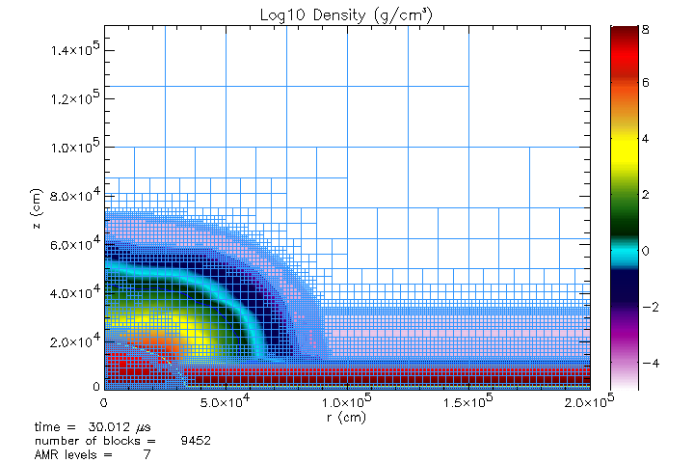
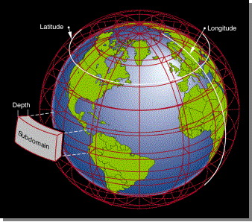
Application View of I/O
It doesn’t matter how fast the I/O system is if apps can’t use it well
Applications internally use complex data structures to organize data
Ideally data would be stored in a similar format
  Canonical representation
  Typed data
  Multidimensional, unstructured datasets
  Attributes of data, of the run
More domain or data model specificity leads to more convenience for applications
  But we can’t afford to rewrite everything for each application…
Graphic from A. Siegel, ANL
Graphic from J. Tannahill, LLNL
Notes:
Usability is always with respect to your *users*. For computational science, our users are very different from “general purpose” users.

Slide 7
Organization of I/O Software
Application
I/O components layered
to provide needed
functionality (I/O stacks)
  Common APIs allow
  combination of components
Parallel file system
organizes hardware into
single, fast storage space
I/O middleware matches to programming model, provides optimizations
  Example: collective I/O operations in MPI-IO
High-level I/O libraries (HLLs) provide usability
High-level I/O Library
I/O Middleware (MPI-IO)
Parallel File System (POSIX)
I/O Hardware

Slide 8
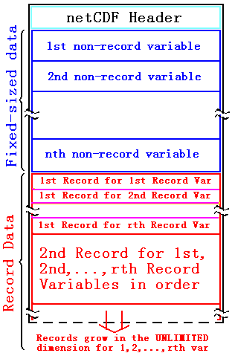
High-level I/O Libraries
Provide structured data storage
  Multidimensional, typed datasets
  Attributes of data, provenance
Metadata is placed in the file itself,
simplifying data movement, archiving
Two good examples
  HDF5 – first to use MPI-IO, widely used
  PnetCDF – parallel API for netCDF data
Compelling alternative to POSIX, MPI-IO
  Both of these are too low-level
Important step, but still somewhat general…

Slide 9
Challenge: Bridging the Usability Gap
Applications still struggle to
use this infrastructure
Build new layers on top of
existing I/O software stack
  Maximize code reuse
  Benefit from optimizations
Match I/O interfaces to data models or domains
  Must be a collaborative effort!
    Application people know the models
    I/O system people know the optimizations
Application
Model-Specific I/O API
High-level I/O Library
I/O Middleware (MPI-IO)
Parallel File System
I/O Hardware

Slide 10
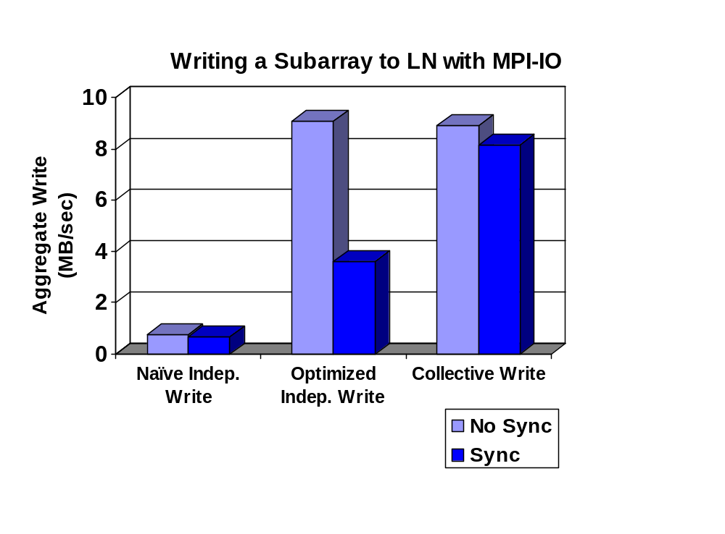
Challenge: Standard APIs to Wide-Area Data Access
Recent trend: Accessing data between sites
Tools for moving data across the wide area
  GridFTP
  Storage Resource Managers
  Logistical Networking
  Storage Resource Brokers
Groups are developing MPI-IO
interfaces to various wide-area
data transfer tools
  SRM, GridFTP, SRB,
  Logistical Networks
  HDF5, PnetCDF between sites
Performance can vary even more
widely than local file systems!

Slide 11
Performance and Scalability

Slide 12
Performance and Scalability
Goal: Minimize the time applications spend performing I/O-related operations
  Maximize time applications spend computing
End-to-end I/O performance includes
  Concurrent access to files
    For real application access patterns
  Metadata operations
    Creating files, traversing directories, etc.
  Overhead of all I/O software layers
    Features aren’t free

Slide 13
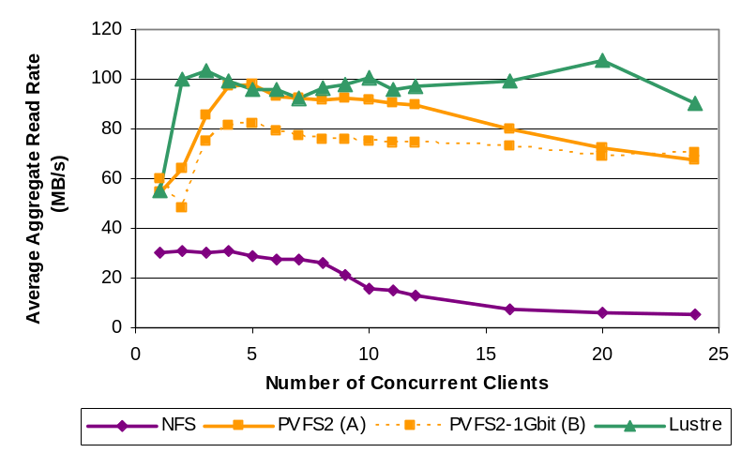
Parallel File Systems
...
Clients
(1000s-10,000s)
Three popular parallel file system solutions
  GPFS
  Lustre
  PVFS/PVFS2
All three being actively developed and deployed
  Competition in this space is good
  No “one size fits all” solution at this time
  All three already in use on BG/L systems!
All capable of 10GByte/sec+ I/O rates, given adequate storage hardware and easy access patterns
Storage or System
Network
...
I/O devices or servers
(10s-1000s)
Updated results from “Shared Parallel Filesystems in Heterogeneous Linux Multi-Cluster Environments” by Cope, Oberg, Tufo, and Woitaszek of Univ. of Colorado at Boulder, using caggreIO benchmark.

Slide 14
Complication: I/O Access Patterns
Application I/O is often complex, not just big blocks
  Ignoring ghost cells, extracting subarrays
  Additional data stored by high-level I/O libraries
  These result in noncontiguous I/O
I/O interfaces determine ability to extract performance
  Define the knowledge that the I/O system has to work with
Standard (POSIX) file system interface does not allow for efficient noncontiguous access

Slide 15
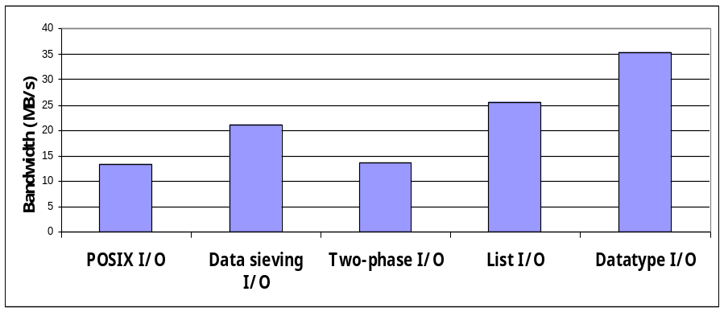
Supporting Noncontiguous I/O
Three approaches for noncontiguous I/O
  Use POSIX and suffer
  Perform optimizations at the MPI-IO layer as work-around
  Augment the parallel file system
Augmenting the parallel file system API is most effective
MPI-IO
Optimizations
PFS Enhancements
POSIX I/O
Results from “Datatype I/O” prototype in PVFS1 with tile example

Slide 16
Creating Files
Even creating files can take significant time on very large machines!
Why?
  It’s complicated ☺
  …but it mostly has to do with the interface we have to work with and implications on synchronization
What happens if we change this interface?

Slide 17
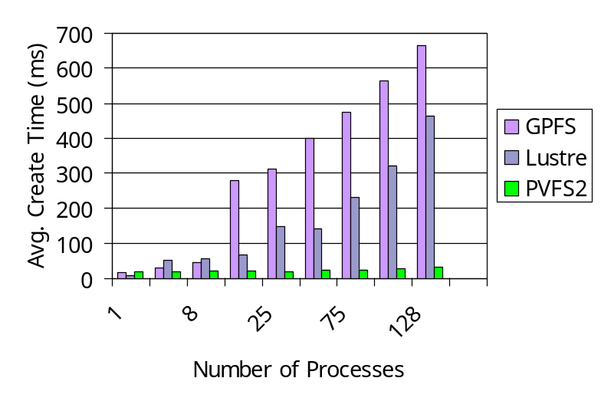
Creating Files Efficiently
Improving the file system interface improves performance for computational science
  Leverage communication in MPI-IO layer
...
...
POSIX file model forces all processes to open a file, causing a storm of system calls.
Time to Create Files Through MPI-IO
...
...
A handle-based model uses a single FS lookup followed by a broadcast of the handle (implemented in PVFS2).
Notes:
Change in the interface allows us to take advantage of capabilities of other layers in I/O stack.

Slide 18
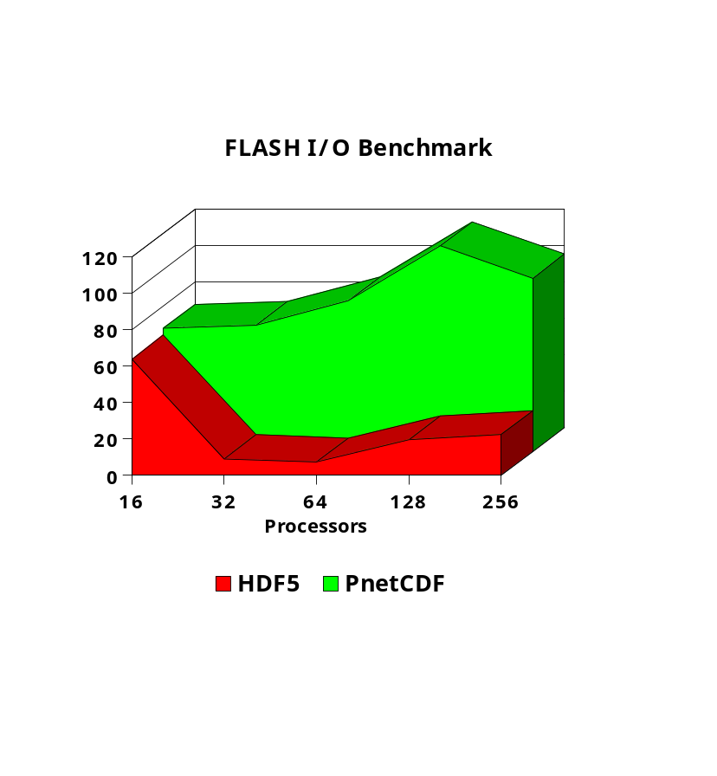
High-Level I/O Library Performance
High-level I/O libraries cost performance
Second-generation high-level I/O libraries are showing promise
  Better leveraging features of MPI-IO
  Using simpler file models that allow for greater concurrency
Still, performance is only a fraction of peak!
Applications must make tough decisions in some cases between functionality/usability and performance
Mbytes/sec
The FLASH I/O benchmark, shows PnetCDF performance to be competitive with and in some cases significantly higher than HDF5 performance. This is due to the light-weight, low-overhead nature of PnetCDF and its tight coupling to MPI-IO (results from ASCI Frost machine at LLNL, rates in MB/sec). This work performed in collaboration with Alok Choudhary and Jianwei Li of NWU.
Notes:
Need to think about the performance of the I/O stack as a whole.

Slide 19
Challenge: Minimizing I/O Costs
Need other parallel file systems to adopt API enhancements
  Currently available in PVFS2 file system
  Standardizing extensions to POSIX I/O for HPC
High-level I/O libraries need more work
  Caching components integrated into HLLs
    Or maybe I/O middleware?
  New file formats, tuned for performance

Slide 20
Reliability and Management

Slide 21

I/O System Complexity
Sheer number of devices is an issue
  Administration (configuration and tuning)
  Reliability
16 dual P4 servers
7.3 TB each (116TB total)
- multi-home
...
IB
GigE
IB Switch
FastE
GigE Switch
IB
GigE
...
...
...
112 dual P4 nodes
250 IA64 nodes
144 dual P4 nodes

Slide 22
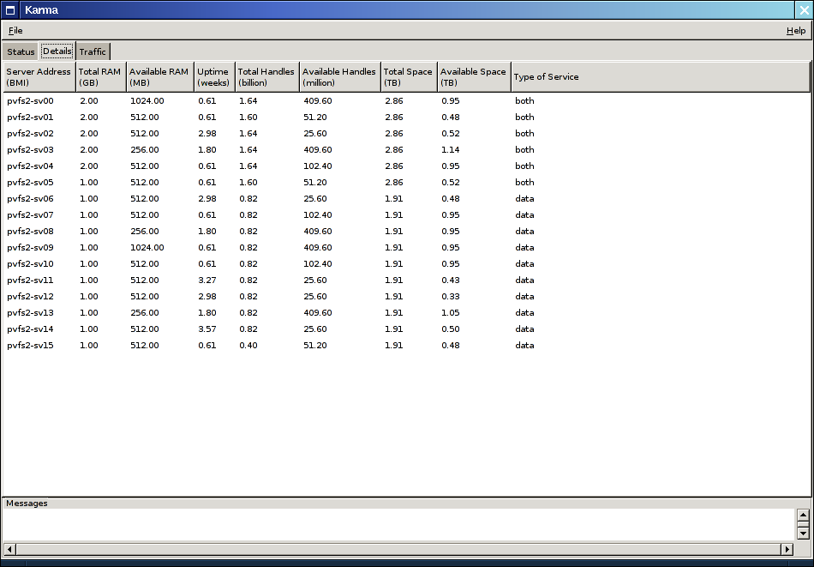
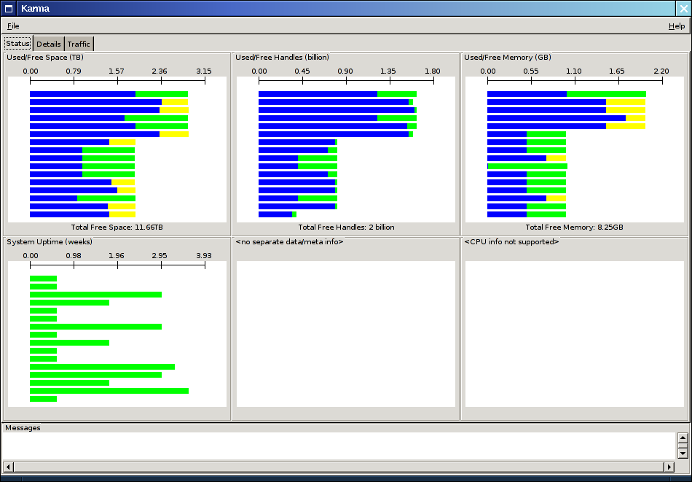
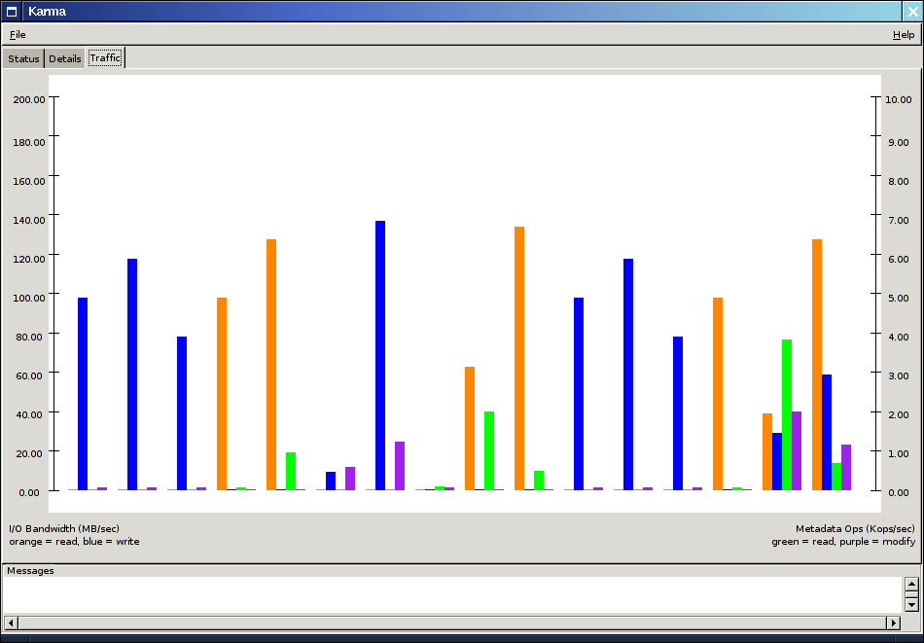
File System Administration
It is the role of the parallel file
system to organize and manage
the I/O resources
PFSes are themselves difficult
to manage!
  Failure tolerance
  Tuning
  Installation and configuration
Similar technologies (e.g. RDBs, networking) now need experts to manage them
New software solutions can alleviate many of these problems for I/O systems
Notes:
What is ironic here…

Slide 23
Autonomic Storage
Self-healing, self-maintaining, self-tuning
  Adapts to device failures transparently
  Automatically integrates new storage devices
  Balances data to preserve performance
Not a reality for parallel I/O, yet.
New PFS designs integrate communication between servers
  Exchange information about health, load, allocated space
  Prototyping in PVFS2 parallel file system
Next step will be to integrate policies, enforce them
  Moving data in response to policy decisions is the easy part!

Slide 24
Impact of Hardware Failures
More components usually means more failures
  Disk failures may be tolerated with RAID-like concepts
  Server failures may be tolerated with high availability approaches
Client failures can be a real problem, especially at scale
  Clients will not all be online
    99.99% up indicates ~6 nodes down at any time on a 64K node system
    99.9% up indicates ~65 down at any time on same
    MTTFs of 6-8 hours on large DOE machines (e.g. ASCI Q)
  Need approaches that minimize impact of client failures
Notes:
Client failures are a real problem as we move into a world of systems with tens of thousands of nodes.

Slide 25
NFS Did Get This Right…
NFS (v3) doesn’t store important data on clients
  Known as “stateless” clients
  Client failures don’t impact servers or other clients
Parallel file systems may be built similarly
  PVFS2 takes this approach
  But we lose traditional performance enhancements
    Such as client-side caching
    No room for cache on BG/L nodes anyway
Notes:
Notorious NFS did get this right.

Slide 26
Challenge: Reliability, Manageability, and Performance
Autonomic storage concepts are not yet reality for parallel file systems
  Maintaining predictable I/O performance in autonomic storage will be tricky!
Getting both reliability and performance is a challenge
  Start with simple, stateless clients
    Analog to smaller OSes being used on clients
  Very difficult if we want to minimize cost!
Notes:
An added complication in bringing autonomic concepts into parallel I/O is the need for predictable I/O performance.
Traditional techniques for reliability require lots of additional hardware…expensive!

Slide 27
Conclusions

Slide 28
Summary
Many recent successes in I/O for computational science
  Multiple file system options
  Multiple high-level interfaces available for applications
  Remote data access capabilities
Usability, performance, management, and reliability of existing parallel I/O systems can all be improved
  Application interfaces aren’t convenient to use
  Observed performance rarely reaches peak performance
  Parallel file systems are difficult to manage, require too much expertise, and are “reliability challenged”
Development and adoption of solutions to these issues are critical to the future success of HPC systems
Notes:
For this group, I think that usability is the #1 problem.

Slide 29
It’s (Almost) All About Interfaces
APIs play a fundamental role in I/O system software development and use
  Organization of components into I/O stacks using common APIs
  Development of new, domain- or model-specific I/O libraries for better usability
  Extensions to traditional parallel file system interfaces to increase performance
  Common interfaces for wide-area data access
  More database-like interfaces for finding data in file systems
Changing interfaces is never easy!
Notes:
Both interfaces that we as I/O system software people use internally and interfaces that you as application groups see and use to interact with these systems.

Slide 30
Looking Forward
Efforts are underway to revitalize I/O system software to tackle problems for current and future HPC systems
Deployment and adoption of these solutions will enable new and more data-oriented applications
It has to be a team effort
  Scientific Data Management SciDAC is actively pursuing these collaborations
  If you can’t get enough I/O, attend our “Parallel I/O in Practice” tutorial at SC2005.

Slide 31
Acknowledgements
The Scientific Data Management Center
Colleagues at ANL
  W. Gropp, R. Thakur, S. Lang, R. Latham, J. Lee
Members of the I/O and data management community and their respective teams
  A. Choudhary, Northwestern University
  W. Ligon, Clemson University
  P. Wyckoff, Ohio Supercomputer Center
  A. Shoshani, Lawrence Berkeley National Laboratory
  N. Samatova, Oak Ridge National Laboratory
  G. Grider, Los Alamos National Laboratory
  L. Ward, Sandia National Laboratories
  T. Critchlow and W. Loewe, Lawrence Livermore National Laboratory
  D.K. Panda, Ohio State University
  G. Gibson, Panasas
  R. Haskin, IBM
This work was supported by the Mathematical, Information, and Computational Sciences Division subprogram of the Office of Advanced Scientific Computing Research, Office of Science, U.S. Department of Energy, under Contract W-31-109-ENG-38.

