Slide 1
Career Development
for
New Engineering Faculty Workshop
May 25, 2007
University of New Mexico
Geoffrey Prentice
gprentic @ nsf.gov
www.nsf.gov
703-292-8371
Tim Anderson
tim @ ufl.edu
University of Florida
352-392-0946

Slide 2
Slide 1 of 2
Workshop Agenda
8:00 Welcome and Introductions [1-4]
8:10 New Faculty Success Strategies [5-12]
8:30 New Faculty Career Planning [13-24]
9:15 Writing Proposals [25-46]
9:55 Break (15 minutes)
10:10 Research Career Planning [47-63]
10:55 Applying to the NSF [64-79]
11:10 The CAREER Award [79-93]
11:25 Working Lunch–Mock Panel [94-101]

Slide 3
Slide 2 of 2
Workshop Agenda
1:30 Managing Research [102-116]
        Student Project Definition, Group/Individual Meetings, Faculty Role, Student Evaluation and Feedback
2:00 Engineering Overview [117-127]
2:10 Identifying Research Problems [128-137]
2:25 More Managing Research [138-153]
        Placement and Professional Development, Other Personnel, Thesis Writing, Defense, T.A., Lab Safety, Group Continuity, Teamwork, $ and Interfacing with Agency
2:55 Developing Research Proposals [154-174]
3:15 Break (15 minutes)
3:30 Time Management [175-197]
4:10 Contacting Funding Agencies [198-217]
4:25 Planning for Tenure and Promotion [218-229]
4:45 Faculty Mentoring [230-237]
4:55 Evaluation & Closing Remarks [241-249]

Slide 4
Comments
◆ Presentation will highlight key
points
  ⧫ Many slides will be hidden –
  mostly informational
  Full presentation online at
  www.nsf.gov/eng/cbet/presentations/
◆ Designed to be an active
workshop – please ask
questions / add experience

Slide 5
New Faculty
Success Strategies

Slide 6
What Do We Know About
New Faculty Development?
◆ Very little study of new
engineering faculty development
◆ Can be stressful
  ⧫ What is the most stressful aspect
  of being a new faculty member?

Slide 7
Exercise
◆ Write on this page what you
find most stressful about being
or making the transition to a
faculty member
◆ Break into groups of 4-6,
introduce yourselves, and share
this information

Slide 8
What Do We Know About
New Faculty Development?
◆ Stress Points (Sorcinelli, 1992)
  ⧫ Not enough time
  ⧫ Inadequate feedback and recognition
  ⧫ Unrealistic self-expectations
  ⧫ Lack of collegiality
  ⧫ Balancing work and outside life

Slide 9
Faculty Characteristics
(Boice 1991, not limited to engineering faculty, extremes)
Quick Starters
◆ Seek social
support / advice
◆ Exemplary teachers
  ⧫ positive attitude
  towards students
  ⧫ less time
  preparing for class
  ⧫ more time
  on scholarly work
  ⧫ complain less
Unsuccessful
◆ Confused about
expectations
◆ Feel socially isolated
◆ Scholarly work only
verbal priority, low
actual time
◆ Defensive teachers
  ⧫ lecture only
  ⧫ content focus
  ⧫ avoid bad
  evaluations

Slide 10
Slide 1 of 2
Success Strategies
◆ Schedule regular time for scholarly
writing (proposals, papers, reports);
keep time log
  ⧫ 30-45 minutes daily or 2-3 longer
  blocks weekly
  ⧫ Keep record of time spent on all activities
◆ Limit preparation time for class
(especially after the first offering)
  ⧫ < 2 hours preparation for 1 hour of lecture
  ⧫ Keep track of time spent in time log

Slide 11
Slide 2 of 2
Success Strategies
◆ Network at least 2 hours / week
  ⧫ Visit offices, go to lunch, have a cup of coffee
  with colleagues in and out of the department
  ⧫ Discuss research, teaching, campus culture
◆ Develop clear goals and
a plan to reach them
  ⧫ Get feedback on plans from department head, mentor,
  other colleagues, and make adjustments
  ⧫ Use planning tool (e.g. Gantt chart to plan course
  development, research, presentations, publications)
  ⧫ Periodically review progress (at least annually)

Slide 12
Faculty Time Scales
◆ Next lecture 2 days
◆ Proposal written 4 weeks
◆ Course 4 months
◆ Publication submitted-published 6 months
◆ Annual evaluation 1 year
◆ Mid-career review 3 years
◆ PhD graduates 4 years
◆ Tenure package due 5 years

Slide 13
Trends & Observations
◆ More dual career families
◆ Tenure rates about same
◆ Faculty demand increasing
  ⧫ Expansion in 60’s-70’s
  ⧫ Enrollment pressure high
◆ Post-doc is more common

Slide 14
New Faculty
Career Planning

Slide 15
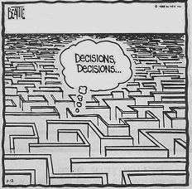
“If you don’t know where you are going, any road will get you there.”
The Cheshire Cat Alice in Wonderland
SNAFU®by Bruce Beattie Valley Daily News Nov. 13, 1988

Slide 16
Components
of Career Planning
◆ Research Career
◆ Teaching Career
◆ Professional Career
◆ Personal Career
Career Elements Are Connected

Slide 17
Developing a Plan:
Mission / Goals /
Objectives / Activities
◆ Mission - What you have a
passion for
◆ Goal - What you would like to accomplish
◆ Objective - What you will accomplish
by specific Activities

Slide 18
Missions
What you have a passion for . . .
◆ What are your
strengths?
◆ What do you like
learning?
◆ What outcome would
you like to see?
◆ Who do you admire?
May change with time
Goals
What you would hope to accomplish . . .
◆ You decide vs.
others decide
◆ Routine vs.
non-routine
◆ Idealistic vs.
realistic
◆ Growth goals

Slide 19
Some Example
Career Development Goals (priority)
Research Goals
◆ Obtain tenure (high)
◆ Establish recognized
research program in
wide-band gap materials
(medium)
Teaching Goals
◆ Introduce molecular concepts
into curriculum (medium)
◆ Explore best use of course
management tools (medium)
Professional Goals
◆ Become a valued member
of the AACG (high)
◆ Improve my writing skills
(medium)
Personal Goals
◆ Learn to play tennis
(medium)
◆ Become fluent in French
(low)

Slide 20
Objectives and Activities:
The Plan to Achieve Your Goals
What you will accomplish
by specific Activities ?
  ◆ List only feasible activities
  ◆ Be specific
  ◆ Include activities currently doing
  ◆ State time frame –
  can separate (week, term, year)
  ◆ Prioritize list – cannot do all

Slide 21
Example
Mission: Contribute to realizing broader use
of solar energy
Goal (6 yr): Obtain tenure
Sub goals: Established funded research
program in photovoltaics
Objectives: Submit a CAREER proposal this semester
Activities:
◆ Write literature review by March 15
◆ Have student complete preliminary experiment by April 15
◆ Draft white paper of proposed REU concept by April 1
◆ Call NSF program manager on Monday to discuss questions

Slide 22
Mission / Goal
Development Exercise
◆ Break into the same groups, write
your mission in one of the 4 areas
(research, teaching, professional,
personal), and then write a goal you
may want to pursue during the next
5 years in support of that mission.
◆ Share this with the other members
of the group
◆ Revisit in a few days, complete and
add mission / goals for other areas

Slide 23
CAREER DEVELOPMENT Worksheet 1
Research Mission Statement:
◆ Gain acceptance for research in electronic materials
processing within the chemical engineering community
◆
Teaching Mission Statement:
◆ Improve learning and faculty efficiency
with sensible use of technology
◆
Professional Mission Statement:
◆
Personal Mission Statement:
◆

Slide 24
Defining Objectives
and Activities Exercise
◆ Using Worksheet 3, list current
and possible objectives for your
highest priority education goal.
◆ Prioritize this list
◆ Then list possible activities that
will contribute to accomplishing
this objective.
◆ Prioritize this list.

Slide 25
Career Development Worksheet 3
For highest priority, 5-Year Teaching Goal
Prioritized Objectives
Activities for Top Objective

Slide 26
Implementation
◆ Establish realistic balance; eliminate
goals if necessary
◆ Implement in context of your situation
(institution, family, health, finances…)
◆ Revisit periodically – goals change
  ⧫ Obtain feedback and tune (chair, colleague,
  mentor)
◆ Keep it visible (e.g., white board,
Gannt chart)

Slide 27
Writing the Proposal

Slide 28
Successful Proposals
◆ Stress the novel aspects of your approach
◆ Differentiate your work from that done by
others
◆ Emphasize the hypothesis that your research
will test
◆ Respond to all aspects of the program
description
◆ Support your ideas with references /
preliminary results
◆ Describe applications that could result
from the research
◆ Show where the research might lead
◆ Include figures and graphs to facilitate
understanding – teach not snow

Slide 29
Common Sections
Slide 1 of 2
I. Project Summary
II. Project Description
  A. Results from prior agency support
  B. Statement of problem and significance
  C. Introduction and background
    ⧫ Relevant literature review
    ⧫ Preliminary data
    ⧫ Conceptual or empirical model
    ⧫ Justification of approach or novel methods

Slide 30
Common Sections
Slide 2 of 2
D. Research plan
    ⧫ Overview of research design
    ⧫ Objectives, hypotheses, and methods
    ⧫ Analysis and expected results
    ⧫ Timetable
  E. References cited
  F. Budgets
  G. Current and pending support
  H. Description of Facilities

Slide 31
Don’t Annoy Reviewers
◆ Typographical errors
◆ Erroneous references
◆ Exceed page length guidelines
◆ Too small font
◆ Overly dramatic

Slide 32
Significance Statement
(Overall Objectives, Overview and Significance, Significance
and Project Objectives, Statement of the Problem)
Slide 1 of 2
◆ Ask what scientists inside vs. outside field
would perceive as greatest contribution
◆ Consider both empirical and theoretical
contributions
◆ Identify and contrast basic and applied uses
of results
◆ Ask how you expect others to use your results
◆ Compare contributions that are likely to be
important 1 year vs. 10 years after completion

Slide 33
Significance Statement
Slide 2 of 2
◆ Be your own best critic:
How would you dispute claims ?
◆ Feature significance statement at beginning
◆ Keep it short
◆ Funnel the reader:
broadest goals to specific aims
◆ Explain the value of the work
◆ Link with other fields
◆ Don’t go overboard

Slide 34
Proposal Title
◆ Present in clear, concise,
meaningful manner
◆ Avoid jargon and overstatement
◆ Be careful with buzzwords (some folks are annoyed)
◆ Avoid cute and too informal titles

Slide 35
Activity
Construct your own title

Slide 36
Executive or
Project Summary
◆ Most important section (initial impressions,
often used for reviewer selection)
◆ Contains goals and scope of study,
significance, brief description of methods,
hypotheses and expected results
◆ Clear, concise, accurate, exciting
◆ Particularly important with panel reviews
◆ Usually 1-2 pages
◆ Conventions vary by field – seek samples

Slide 37
Handout
Sample Executive Summary

Slide 38
Goals, Objectives, Hypotheses
◆ Scientifically far-reaching aspects vs.
specific outcomes
◆ Hypotheses: Specific set of testable conjectures
Goal: “to further our understanding of
the implication of global climate
change on wetlands”
Objective: “to measure the diffusivity of
methanol in water as a function
of temperature and composition”
Hypothesis: “Zinc can effectively compete with
other metals for enzyme-active
sites, transporter proteins, and
other biologically important ligands.”

Slide 39
Introduction and Background
◆ Focus on important points and
establish relevance
◆ Discuss motivation for the project
◆ Not too long
◆ Use schematics, models, headings, and
formatting to channel the reader to show
the direction that proposal is going
◆ Relevant literature review
◆ Preliminary results
◆ Results from prior agency support
⧫ Judging productivity
⧫ Keep concise

Slide 40
Research Plan
Slide 1 of 2
◆ Overview of research plan and
justification
◆ Methods and materials
⧫ Sampling procedures
⧫ Experiment description
⧫ Technical procedures
⧫ Algorithm descriptions
◆ Data analysis

Slide 41
Research Plan
Slide 2 of 2
1. Objective 1
◆ Hypothesis 1A
⧫ methods, materials, and protocol
⧫ data analysis
◆ Hypothesis 1A
⧫ methods, materials, and protocol
⧫ data analysis
2. Objective 2
◆ etc.

Slide 42
References
◆ Be unbiased – cite disputed work
◆ Cite peer reviewed work, minimize unreviewed
◆ Cite your own work but not excessively
◆ Cite recent work
◆ Cite only work you have read – don’t cut & paste
◆ Reviewers will look for their references
◆ Include a sufficient number of references
to establish credibility and feasibility
◆ Ensure accuracy of citations
◆ Place correctly and concisely

Slide 43
Tips
Slide 1 of 2
◆ When your are writing, WRITE!
◆ Ask a colleague to review your proposal
◆ Respected researchers in your field will
read your proposal – make a good
impression
◆ Get help with ‘boiler plate’ and parallel
process
◆ Respect intellectual property, give
appropriate credit
◆ Don’t promise too much

Slide 44
Tips
Slide 2 of 2
◆ Contact program officers
  ⧫ Meet at professional societies
  ⧫ Volunteer to serve as reviewer
◆ Submit early
  ⧫ ~ 1% NSF proposals returned
◆ Federal fiscal year begins October 1

Slide 45
“Press On”: Persistence . . .
“Nothing in the world can take the place
of persistence.
“Talent will not: nothing is more common
than unsuccessful men with talent.
“Genius will not: unrewarded genius is
almost a proverb.
“Education alone will not: the world is full
of educated derelicts.
“Persistence and determination alone are
omnipotent.”

Slide 46
On-Line Proposal Writing Guides
National Science Foundation
www.nsf.gov/pubs/
Environmental Protection Agency
http://www.epa.gov/ogd/recipient/tips.htm
http://www.epa.gov/ogd/grants/how_to_apply.htm
The Foundation Center
http://foundationcenter.org/getstarted/learnabout/proposalwriting.html
NIH
http://grants.nih.gov/grants/grant_tips.htm
http://deainfo.nci.nih.gov/EXTRA/EXTDOCS/gntapp.htm
http://www.niaid.nih.gov/ncn/grants/default.htm
“A Winning Strategy for Grant Applications”

Slide 47
On-Line Proposal Writing Guides
Style Guide
http://www.colorado.edu/Publications/styleguide/symbols.html

Slide 48
Research Career Planning
Note: This workshop will focus on establishing and developing a research career, but encourage you to attend other workshops on teaching (e.g., NETI) and professional development.

Slide 49
Developing a Plan

Slide 50
From
Graduate Student
to Faculty
What was the most difficult aspect about the transition from Graduate Student to Faculty?

Slide 51
The Transition
from Graduate Student
to Faculty Status
Research
From
Conducting →
Directing
(More open-ended)
From
Solving Problem →
Defining Problem /
Seeking Funding
(80% First Proposals Rejected)
Teaching
From
Student → Teacher
(More structured)
From
Reader → Editor
(Student Learning
Improves
in Next Offering)

Slide 52
And I Get Paid to Do This!
◆ Work with young, bright and eager
students
◆ Perform research on topics of my choice
(to a degree)
◆ Sabbatical every 7th year
◆ Travel
◆ Enjoy colleagues in own and other
disciplines, around the world
◆ Retire gracefully
◆ And have great job security (tenure)

Slide 53
Research Career
◆ Develop 5-year and long term plans
and revise (at least annually)
◆ Peer recognized excellence (‘potential’
required for tenure at most institutions)
in research area is long term goal
◆ Important to remain research active
throughout career (traditional graduate
program, REU’s, collaborate with
industry, sabbaticals, education
research . . . )

Slide 54
Cornerstones
of Good Research
◆ Addresses significant research question(s);
breaks new ground / innovative
◆ Uses appropriate and best methods;
can be replicated
◆ Includes appropriate analysis and applies
results
◆ Results are synthesized and
disseminated in a timely and
peer reviewed manner

Slide 55
Research Areas
◆ Most researchers only work in a few
research areas during their career (~1 to 5)
◆ Identify engineering science(s) (base)
and technology (driver)
◆ Criteria for selection: Interesting,
importance of problem, match to your
skills, long-term funding prospects,
available resources, presence of
colleagues, fit with department vision,
student interests, local interests

Slide 56
Research Hierarchies
◆ Chemical
Engineering
Research Discipline
Established
◆ Electronic Materials
Processing
Likely fixed
(sometimes
different than
Ph.D. topic)
Research Field
◆ CVD of
semiconductors
◆ Bulk crystal growth
◆ Solid-state sensors
Research Area
Only a few in
one’s career
◆ p-type doping
of GaN
Research Issues
Distinguishes
Problem Solution
Innovative
◆ Cluster doping

Slide 57
The Numbers ($)
Slide 1 of 3
◆ Graduate students: 5 yr. before first PhD
& continuity, 1 PhD/yr = group size 6-7,
40 yr career = 35 PhDs in career
◆ 35 solutions; ~20 problems; few
research areas in career
◆ Grad. student cost: $22K (stipend)+11K
(overhead)+7K (tuition) = $40K/yr
◆ $280K (7 students) + 50K (3 summer mo)
= $320K + cost of research
(~30K/student) = $530,000/yr funding

Slide 58
The Numbers ($)
Slide 2 of 3
◆ The department investment:
Chair’s view
  ⧫ Salary: $70K/yr for 6 yr = $420K
  ⧫ Start-up (variable): students, summer
  salary, equipment, supplies, reduced
  teaching service assignment,
  . . . = $400K
  ⧫ Total = $820K

Slide 59
The Numbers (time)
Slide 3 of 3
◆ Idea to publication: 3 to 7 years
◆ t = 0 (idea) + 3 mo (preliminary results)
+ 2 mo (write proposal)
+ 3-6 mo (review)
+ 1-13 mo (funding cycle - note 10/1)
+ 0-12 mo (identify graduate student)
+ 12-36 mo (do research)
+ 3 mo (write manuscript)
+ 6-15 mo (submit / review / publish)
= 30-90 months

Slide 60
Identifying Research Area
and Issues in your Field
◆ Extension of thesis
or post-doctoral research
  ⧫ Easiest but competing with former advisor(s)
◆ Tangent to thesis
or post-doctoral research
  ⧫ Easy transition but credibility not fully
  established
◆ New area
  ⧫ Longer time constant & higher risk, but
  return may be high; consider collaboration
  (your contribution must be recognizable)

Slide 61
Exercise
List your research discipline, field & areas
discipline
◆
field
area
◆
◆
area
◆
area
problem
◆
◆
problem
◆
problem

Slide 62
Plan for the Long term
◆ The basis (drivers/gaps) for your research area will not exist in 15 years
The tools you use will become routine
Your peers will for the most part still be active in research
The fundamental engineering sciences will remain valid

Slide 63
Plan for the Long term
Invest in new research directions
  Take sabbaticals
  Collaborative research
  Use ‘investment resources’ wisely
  Pursue growth activities

Slide 64
Misconceptions
About Education Research
‘Education research is not real research’
◆ Few engineers are exposed to ‘real education
research’, but it is a sophisticated combination
of cognitive & behavioral sciences, design and
analysis of experiments w/human element, . . .
‘There is no funding for education research’
◆ Workforce development $ growing rapidly
◆ Success rate often higher than for discipline
research
‘Education research will hurt my career’
◆ Recipients of education scholarship awards are
often discipline leaders of research

Slide 65
Advice on Education Research and Scholarship
◆ Insist on the same standards of
excellence as for discipline research
◆ Include following in proposals (CAREER also)
⧫ Literature review
⧫ Assessment and evaluation plan
⧫ Dissemination plan
⧫ Leverage resources (partners, plug-ins, pyramid)
⧫ Plus usual elements w/ emphasis on hypothesis testing
⧫ Focus
◆ Collaborate with experts in other fields

Slide 66
Advice on Education Research and Scholarship
◆ Decide your level of activity, but do some
  ⧫ Within context of assigned activities to
  integrated with discipline research to pure
  education research project to sole research
Ensure chair is aware of your plans
  ⧫ Often post-tenure activity
◆ Focus on an area you enjoy
  ⧫ Learning with technology, text writing,
  experiential learning, multidisciplinary design,
  K-12 outreach, . . .

Slide 67
Research: Why Write ?
Assign credit:
Who dunnit? “If
it isn’t in print
(or the Internet),
it doesn’t exist”
Personal
pleasure:
of story telling
Inform
colleagues:
about 2000
technical libraries
worldwide
Obtain
closure:
continue or
move on?

Slide 68
Research: Why present ?
Clarification:
Presentation forces
focus: what is the
central story ?
Establish presence:
productivity &
persona
Question others:
establish critical role
Collegial:
meet your
(lifetime) peers
Recruiting:
future students,
faculty
Professional:
societal connectivity
Socialize: (enjoy!)

Slide 69
Balance your life: “Publish and Cherish”
Professional Life: Teaching / Research:
  ⧫ Proposals
  ⧫ Students
  ⧫ Advising
  ⧫ Papers
  ⧫ Conferences, etc.
  . . . Open Ended . . .
Personal Life:
  ⧫ Relationships
  ⧫ Hobbies
  ⧫ Physical activity
  ⧫ Family
  ⧫ Religion
  ⧫ Schools, politics, . . . . . . Open ended . . .
➔ ➔ ➔ Make Balanced Time Investments

Slide 70
Your Academic Career
40 years as a faculty
  ~20 research problems
  35 PhD students
  140 publications
  $15 million in funding
    300 proposals
  70 courses taught
    >2000 students
  6 chairs, 7 deans and 8 presidents
  4 sabbaticals
  2080 Saturdays

Slide 71
Applying for
NSF Grants

Slide 72
Award Criteria
◆ Intellectual merit
⧫ Importance in advancing understanding
in a field
⧫ Creativity and novelty of approach
⧫ Qualifications of investigators
⧫ Completeness of research plan
⧫ Access to resources
◆ Broader impacts
⧫ Promotion of teaching and training
⧫ Inclusion of underrepresented minorities
⧫ Enhancement of infrastructure & partnerships
⧫ Dissemination of results
⧫ Benefits to society

Slide 73
Finding an Appropriate Program
◆ Check list of currently funded programs
  ⧫ Use FastLane
  ⧫ Read titles and abstracts on the website
◆ Find a fit
  ⧫ Contact program director
  ⧫ Prepare a one-page abstract
  ⧫ Specify appropriate program on cover sheet
◆ Consider initiatives and special programs
  ⧫ Sensors initiative
  ⧫ NSE initiative

Slide 74

Award List for Program:
SEPARATIONS and PURIFICATION PROCESSES
[ Click on the Award Number for Additional Information (on Web) ]
◆ Multicomponent Space-Charge Ion Uptake and Ion / Solvent
Transport Models for Ion-Exchange Membranes
Award#: 0331389 Current Year Award Amount: $0 Cumulative Award Amt: $166,310
Estimated Total Award Amount: $166,310
Original Start Date: Sep 01, 2002 Projected Duration: 12 Months
PI: Pintauro Institution: Case Western Reserve State: Ohio District: 00
❖ New Pressure Swing Adsorption Processes
Award#: 0327089 Current Year Award Amt: $90,366 Cumulative Award Amt: $90,366
Estimated Total Award Amount: $277,155
Original Start Date: Aug 01, 2003 Projected Duration: 36 Months
PI: Wankat Institution: Purdue University State: Indiana District: 07
⬥ SGER: Distillation Using Hollow Fibers as Structured Packing
Award#: 0322882 Current Year Award Amt: $49,937 Cumulative Award Amt: $49,937
Estimated Total Award Amount: $49,937
Original Start Date: Jun 01, 2003 Projected Duration: 12 Months
PI: Cussler Institution: Univ of Minnesota-Twin Cities State: Minnesota District: 05

Slide 75
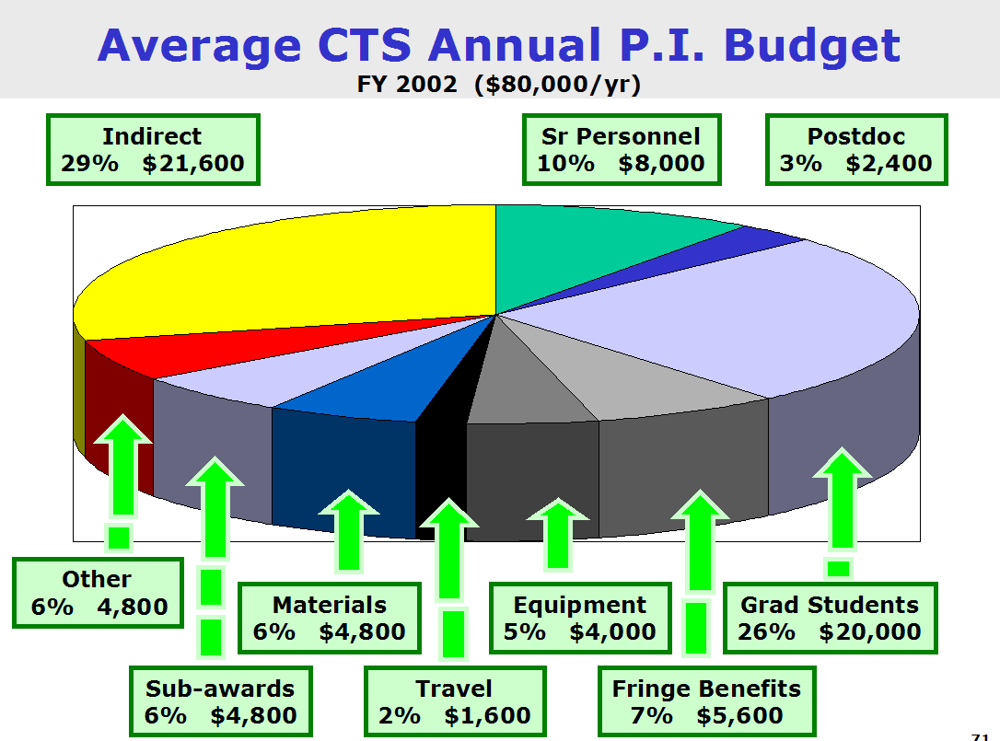

Slide 76
Award Statistics
◆ Distribution by experience
  ⧫ Approximately 30% new investigators
  ⧫ 70% recently funded by NSF
◆ Success rates
  ⧫ Unsolicited proposals about 15%
  ⧫ CAREER about 15%
  ⧫ Initiatives about 10% (varies widely)

Slide 77
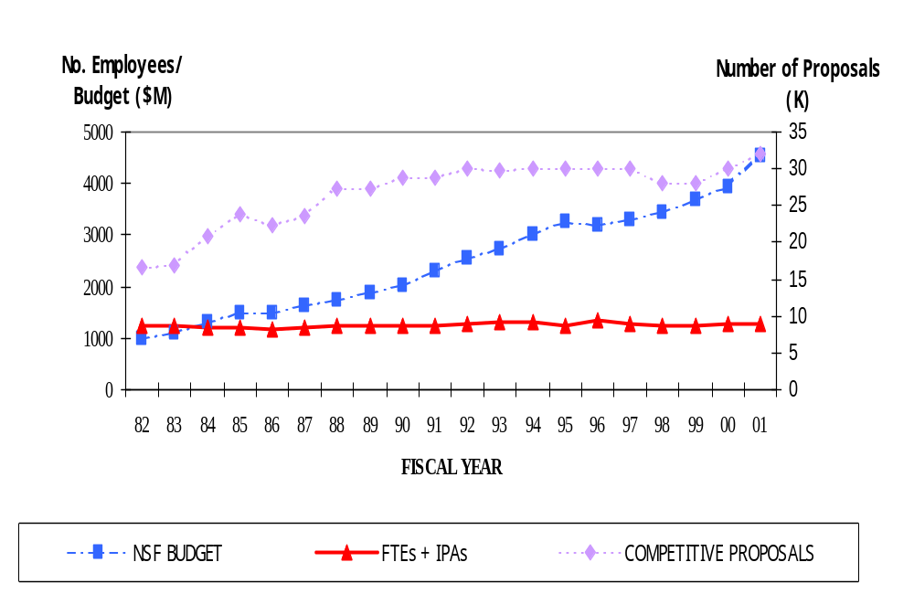
Comparison of NSF Budget, Staff and
Competitive Proposal Submissions over Time

Slide 78
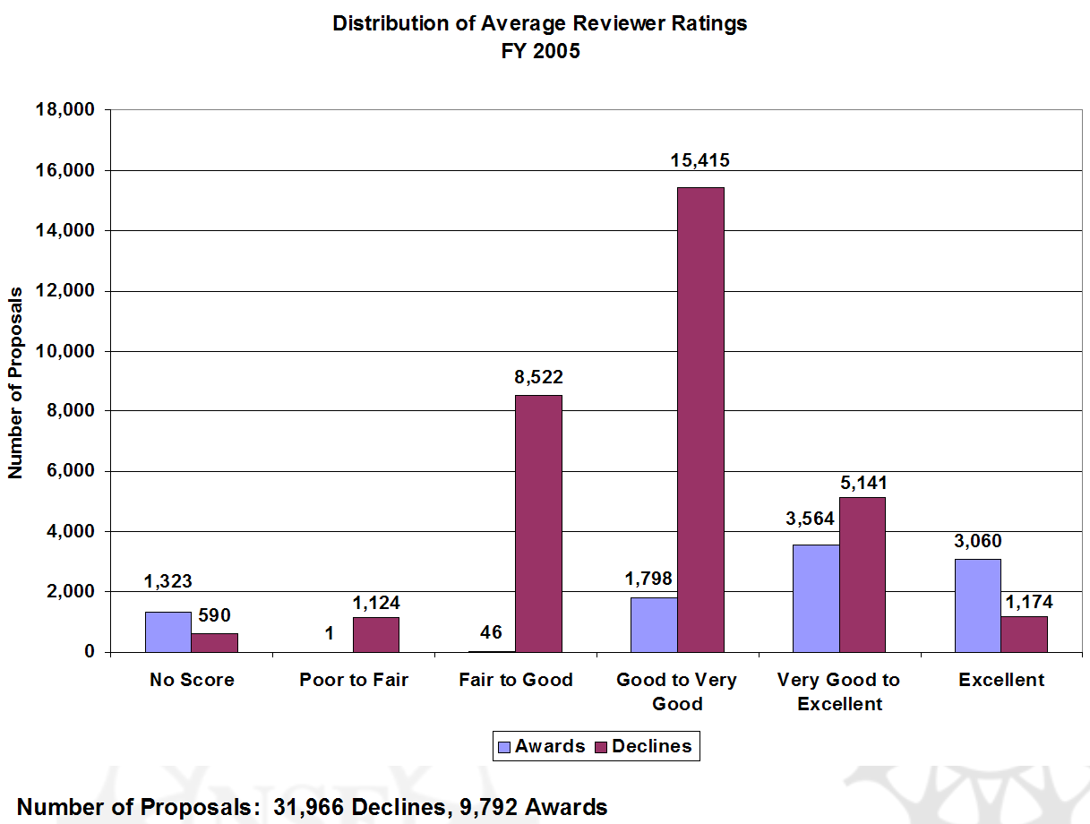
Distribution of Average Reviewer Ratings
FY 2005
Number of Proposals: 41,758 ( 31,966 Declines & 9,792 Awards )

Slide 79
Post Award Considerations
◆ Keep program director informed
⧫ Write nuggets (research achievements) when requested
⧫ Give advance notice of significant publications (e.g., Science, Nature); the NSF public relations department (OLPA) can help publicize
⧫ Submit annual report (90 days before anniversary of grant) and final report (90 days after grant expiration)
◆ Request supplements
⧫ Research Experiences for Undergraduates (REUs) and Research Experiences for Teachers (RETs) are common
⧫ International supplements available

Slide 80
Final Thoughts
◆ Contact program directors
  ⧫ Meet at professional society conferences
  ⧫ Volunteer to review proposals, e.g.,
  http://www.nsf.gov/eng/cbet/reviewer/
◆ Examine successful proposals
  ⧫ Ask colleagues for their proposals
  ⧫ Get proposal reviews from colleagues
◆ Suggest reviewers for your proposal
  ⧫ Use FastLane form provided

Slide 81
Faculty Early Career Development Program
(CAREER)
Faculty Early Career Development Program
CAREER
NSF Announcement #05-579 FY 2006–2008

Slide 82
CAREER: Program Goals
◆ NSF's awards for new faculty members
◆ The size and duration of CAREER awards
are commensurate with PI’s needs
◆ Awardees are selected on the basis of
their plans to develop highly integrative
and effective research and education
careers
◆ Increased participation of those
traditionally under-represented in
science and engineering encouraged

Slide 83
CAREER: Eligibility
Applicants Must:
◆ Hold a doctoral degree as of submission date
◆ Be untenured as of submission date
◆ Be employed in a tenure-track (or
equivalent) position as of October 1 following submission
◆ Be employed as an assistant professor
(or equivalent) as of October 1 following submission
◆ Have not competed more than two times
previously in the CAREER program
◆ Have not previously received an NSF
CAREER or PECASE award

Slide 84
CAREER: Self-Certification
◆ At time of submission, applicants will
self-certify for both CAREER and PECASE
eligibility. Unless applicants properly
complete the checklist, they will not
be able to submit their proposal.
◆ CAREER certification will appear after
the cover page and will be sent to
reviewers as part of the proposal.
◆ PECASE certification will appear on the
Form 1225 (Information about the PI)
and will not be sent to reviewers.

Slide 85
CAREER Proposals
◆ Critical Elements
  ⧫ Research and education
  ⧫ Departure from Ph.D. work
◆ Special Considerations
  ⧫ Panel review - - bring reviewers up to speed
  ⧫ Read current announcement: rules change
  ⧫ PI specifies program for initial assignment
◆ Logistics
  ⧫ Submit early and resubmit if necessary
  ⧫ Follow-up: check for successful submission
  ⧫ Check converted version of proposal
  ⧫ About 1% of proposals returned un-reviewed

Slide 86
CAREER: Departmental Letter
◆ Departmental Letter Must:
⧫ Include standard three-sentence
endorsement
⧫ Describe the departmental/institutional
support
⧫ Verify the self-certified PI eligibility
information
◆ REMINDER: Annual reports should include a
letter from the department chair restating
his/her endorsement and support of the
CAREER PI

Slide 87
CAREER: Proposal Review
◆ Evaluated using NSF’s two merit review
criteria:
⧫ What is the intellectual merit of the
proposed activity?
⧫ What are the broader impacts of the
proposed activity?
◆ Reviewers are also asked to consider the
capability of the applicant to make an
integrative contribution to both education
and research and to integrate diversity in
all program activities.

Slide 88
CAREER:
Award Duration and Size
◆ 5-year duration
◆ Minimum award size of $400,000
◆ BIO minimum award size of
$500,000 for FY03
◆ No maximum award size

Slide 89
CAREER Deadlines
July 17, 2007  BIO, CISE, EHR
July 18, 2007  ENG
July 19, 2007  GEO, MPS, OPP, SBE

Slide 90
PECASE
◆ Presidential Early Career Awards for
Scientists and Engineers
◆ Recognizes outstanding scientists and
engineers who, early in their careers,
show exceptional potential for
leadership at the frontiers of knowledge
◆ Highest honor bestowed by the U.S.
government on scientists and engineers
at the beginning of their careers

Slide 91
CAREER & PECASE
◆ As in previous years, NSF will have twenty
PECASE “slots”
◆ Number of slots per directorate will be
determined by number of proposals received
in each directorate
◆ Each directorate will nominate their
most meritorious CAREER PI(s) for PECASE
◆ PECASE awardees will be announced in
the fall following receipt of the CAREER award
(i.e., approximately 15-18 months
after CAREER proposal submission)

Slide 92
PECASE: Eligibility
◆ NSF nominates the 20 most meritorious
CAREER awardees for PECASE
◆ NSF Applicants Must:
⧫ Meet all of the CAREER eligibility
requirements
⧫ Be U.S. citizens, nationals, or permanent
residents who hold such status on or
before their Directorate's July deadline
for submission of CAREER proposals
⧫ An individual can receive only one
PECASE award

Slide 93
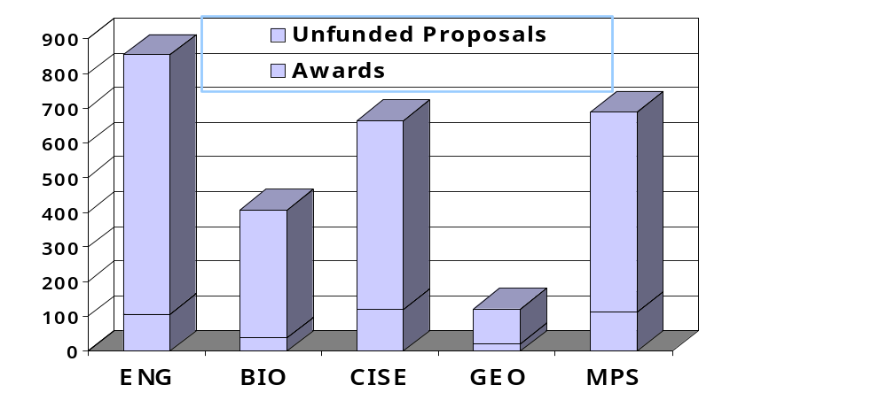
National Science Foundation  Directorate for Engineering
CAREER Program Awards by Directorate
FY 2006
Total Proposals
14%
10%
22%
19%
21%
Awards
Declines
106
747
38
368
119
545
21
101
112
577

Slide 94
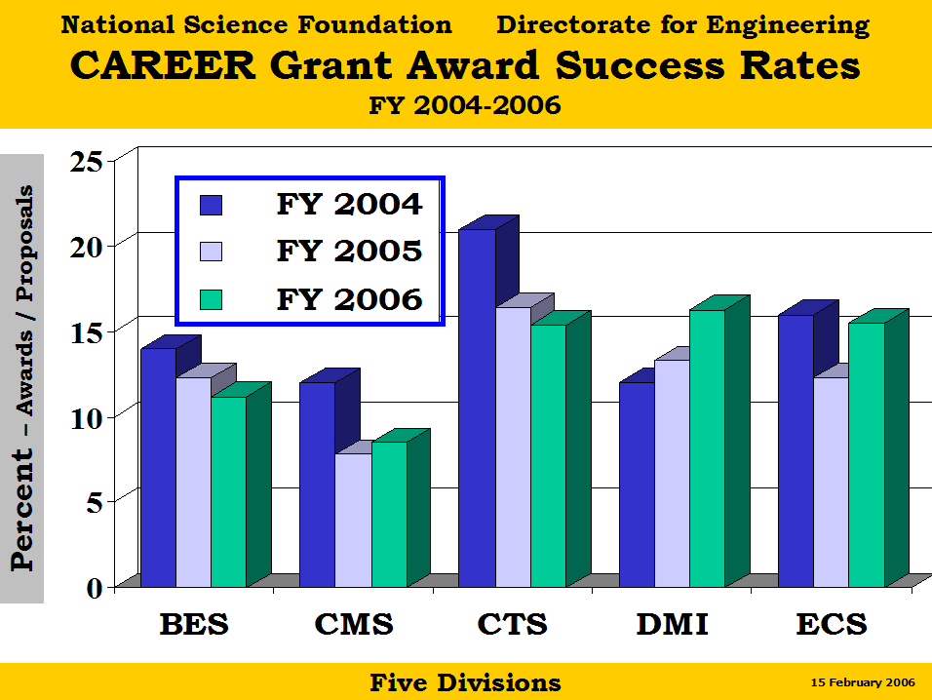

Slide 95
CAREER: Useful Websites
◆ Examples of the “broader impacts criterion”:
http://www.nsf.gov/pubs/2002/nsf022/bicexamples.pdf
◆ CAREER Homepage:
http://www.nsf.gov/career
⧫ Program Solicitation
⧫ Submission Checklist
⧫ Awards lists and abstracts
◆ FAQ (05-027)

Slide 96
Handout
Sample Comments
from
Career Reviews

Slide 97
Other New Faculty
Proposal Opportunities
◆ Beckman Young Investigators Permanent
Resident Alien / Tenure-Track / U.S. Citizen Award
$264K over 3 years / Deadline December 1
http://www.beckman-foundation.com/byiguide2.html
◆ Camille and Henry Dreyfus Foundation
New Faculty Award $50,000 before new
faculty members begins their first tenure-track
appointment, for U.S institutions with PhD granted
in chemistry, biochemistry, or chemical enginerring
http://www.dreyfus.org/nf.shtml
◆ Microsoft Research New Faculty
Fellowship Program ‘advancing computing
research in novel directions’ / $200K / due
typically in October
http://research.microsoft.com/ur/us/nff/

Slide 98
Mock Review
◆ Please break into teams of 6-8
and review proposal.
◆ Generate a summary review.

Slide 99
NSF Award Criteria
◆ Intellectual merit
⧫ Importance in advancing understanding in a field
⧫ Creativity and novelty of approach
⧫ Qualifications of investigators
⧫ Completeness of research plan
⧫ Access to resources
◆ Broader impacts
⧫ Promotion of teaching and training
⧫ Inclusion of under-represented minorities
⧫ Enhancement of infrastructure and partnerships
⧫ Dissemination of results
⧫ Benefits to society
https://www.fastlane.nsf.gov/a5/a5crit_conflict_conf.htm

Slide 100
Review Criteria - - Slide 1 of 2
◆ What is the intellectual merit of the
proposed activity?
⧫ How important is the proposed activity to
advancing knowledge and understanding
within its own field or across different fields?
⧫ How well qualified is the proposer (individual
or team) to conduct the project? (If appropriate, the
reviewer will comment on the quality of the prior work.)
⧫ To what extent does the proposed activity
suggest & explore creative & original concepts?
⧫ How well conceived and organized is the
proposed activity?
⧫ Is there sufficient access to resources?

Slide 101
Review Criteria - - Slide 2 of 2
◆ What are the broader impacts of the
proposed activity?
⧫ How well does the activity advance discovery & under-
standing promoting teaching, training, & learning?
⧫ How well does the proposed activity broaden the
participation of underrepresented groups
(e.g., gender, ethnicity, disability, geographic, etc.)?
⧫ To what extent will it enhance the infrastructure for
research and education, such as facilities,
instrumentation, networks, and partnerships?
⧫ Will the results be disseminated broadly to enhance
scientific and technological understanding?
⧫ What may be the benefits of the proposed activity to
society?
NSF staff will give careful consideration to the following in making funding decisions:
◆ Integration of Research and Education
◆ Integrating Diversity into NSF Programs, Projects, and Activities

Slide 102
Your Potential
Conflicts of Interest
If you have an affiliation or financial connection
with the organization or person submitting this proposal that might be construed as creating a conflict of interest, please describe those affiliations or interests on a separate page and attach it to your review. Regardless of any such affiliations or interests, we would like to have your review unless you believe you cannot be objective.
An NSF program official will examine any state-ment of affiliations or interests for the existence of conflicts. If you do not attach a statement we will assume that you have no conflicting affiliations or interests.

Slide 103
Obligation to Keep Proposals
Confidential
The Foundation receives proposals in confidence and protects the confidentiality of their contents. For this reason, you must not copy, quote from, or otherwise
use or disclose to anyone, including your graduate students or post-doctoral or research associates, any material from any proposal you are asked to review.
Unauthorized disclosure of confidential information
could subject you to administrative sanctions.
If you believe a colleague can make a substantial contribution to the review, please obtain permission
from the NSF Program Officer before disclosing either
the contents of the proposal or the name of any
applicant or principal investigator.
When you have completed your review, please
be certain to destroy the proposal.

Slide 104
GOOD LUCK !!!

Slide 105
Panels
Panel M1
Proposals:
Sample, Doe,
Baker
Coleman
Panel M2
Proposals:
Panel M3
Proposals:

Slide 106
Panels
Panel T1
Proposals: Sample,
Panel T2
Proposals:
Panel T3
Proposals: Koc,

Slide 107
Managing Research
Now that you have funding!

Slide 108
Outline
◆ Student Project Definition
◆ Group / Individual Meetings
◆ Faculty Role
◆ Student Evaluation and Feedback
◆ Placement and Professional
Development

Slide 109
Outline
◆ Other personnel (e.g., post docs,
technicians, undergraduates)
◆ Qualifying Exam, Thesis Writing,
Defense, Teaching Assistant
◆ Group Continuity, Team Work,
Lab Safety
◆ $ and Interfacing with Agency

Slide 110
Guiding Observations
◆ Every student is different
◆ There is not a single correct
management style
◆ When in doubt ask: What is best
for the student?

Slide 111
Reasons Grad Students Fail
◆ Project too difficult or unmanageable
◆ Student lost interest in topic
◆ Student isolation
◆ Poor planning and project management
◆ Writing the dissertation
  ◆ Few problems if turn in parts
  while still doing research
◆ Personal problems: Money is #1
◆ Inadequate or no supervision
(22% of Graduate Students in survey)

Slide 112
Student Project Definition
A Four-Step Process
Step One: Select Student
◆ Keep a sharp eye in the classroom
◆ Participate in the recruiting and
application review process
◆ Impress on the student that this is the
  most important decision they will make
  in graduate school!

Slide 113
Student Project Definition
A Four-Step Process
Step Two: Involve the student in defining the project. It is a periodic process.
◆ Teach student how to define research
problem
◆ Scientific method
◆ Synthesis of literature
◆ Grant/contract requirements must be met
◆ Funded project likely more successful
(peer reviewed, long term support)

Slide 114
Student Project Definition
A Four-Step Process
Step Three: Incorporate early milestones
◆ e.g., specific classes to take, a report,
first paper or presentation, a piece of
equipment designed, literature review,
hypotheses / broad objectives, etc.
◆ Establish a 2-way “probationary”
period
◆ Establish a timeline for project
◆ Require regular progress reports

Slide 115
Student Project Definition
A Four-Step Process
Step Four: Establish the research
committee
◆ Help the student choose the committee,
impressing on them the purpose of a
research committee
◆ Have the student present her/his
hypotheses (depending upon department
rules), objectives, and any initial results
to her/his committee within the first year.

Slide 116
Student Project Definition
◆ Value independent thinking
⧫ Include open-ended component(s)
⧫ Have them involved in document definition
(e.g., thesis outline, submit fellowship application – often requires
  career plan
  ⧫ For every problem they encounter in the lab, I
  encourage them to FIRST think of at least 3 ways
  to solve that problem before they come to me for
  “answers.”
◆ Encourage project “ownership”
  ⧫ Have student be responsible for keeping supplies
  needed for her/his project in stock
◆ Define role in group
  ⧫ Often a friction point
  ⧫ Important to not only show how their work overlaps
  with other students but also to give each student a
  task (e.g., SOPs, lab orders, waste declaration)

Slide 117
Group Meetings
◆ Periodic group meetings are
helpful
  ⧫ Presentations, guests, lectures,
  paper reviews, book chapters,
  special events
  ⧫ Meet with other groups occasionally
  ⧫ Keep it technical
◆ Social events
  ⧫ Holiday party, picnic

Slide 118
Individual Meetings
◆ Establish mechanism
for regular meetings
◆ Every student is different
  ⧫ Identify strengths, weaknesses
  ⧫ Academic children
◆ Clearly convey your expectations

Slide 119
Identify something
your advisor did
that was effective
in managing the group.

Slide 120
Faculty Role
◆ You are the research advisor
not fellow student
⧫ Maintain professional relationship
⧫ Thesis is authored by 1 person
◆ You are role model, academic counselor,
consultant, sounding board, evaluator,
supporter, editor, agent
◆ Establish traditions / build pride
⧫ Hardbound dissertation, dinner, pedigree
chart, . . .
⧫ Maintain contact

Slide 121
Ideal Advisor
◆ Advisor active in research
◆ Has regular meetings with Grad Students
◆ Creates a research climate that
encourages Graduate Students
to have independent ideas
◆ Expects quality
◆ Model for ethical behavior
◆ Want graduates to almost think
they did research & thesis by themselves

Slide 122
Graduate Student Evolution
◆ GS like warm, structured advisors
◆ 1st year Grad Students want to develop
a personal relationship with advisor
◆ 2nd & 3rd year Grad Studetns want
expertise and availability
◆ Grad Students want advisor to adjust
to their growing maturity
◆ In US, laissez-faire often interpreted
as neglect - - particularly by
international Grad Students

Slide 123
Research Advisor Attitude
◆ Advising is a form of teaching.
◆ Advisors need to remember that student’s
growth is more important than research.
Do what is best for the student at all times.
Kant's imperative: Act so that you treat human beings
always as ends and never only as means. Graduate
students deserve dignity and respect.
◆ The best thing for the Grad Student
may not be what the Grad Student wants.
⧫ Thus, there may be periods when the
Grad Student is unhappy.
⧫ Advisors can discuss reasons for their
behavior.

Slide 124
Professors as Advisors
◆ A few are effective with all students,
most are effective with some, and
a few are incapable of advising anyone.
◆ Some professors have problems
over and over.
◆ Some professors are better with
undergraduate and Masters students,
and others are better with PhD students.
◆ Professors improve with experience.
◆ Departments: Track performance
of PhD candidates

Slide 125
Engineering Directorate Activities
Notes:
Last July we concluded that we need to “rethink the ENG Directorate.” The the creation of the “Strategic Thinking Group,” which became the strategic planning group, with Kesh Narayanan as Chair.
A great deal has happened since last July when we began strategic planning
Some of the flavor came out at AdCom last fall.
Several things are now going on:
Joe Bordogna says he would like to see ENG “lifted up”
Arden Bement says that we should be looking for the big thing were we can have an impact
But, though we were on the upswing on the budget, ‘o5 was the first time we have not had ~ 10% increase in 6 years.
We are told that budgets overall may be flat over the next few years.
The success rates of awards (I.e. awards/submissions) have been declining and are quite low.
Seems to be a lot of agreement that curriculum changes need to be made (professional societies & ABET, CE, EE, ME. Methods of teaching need to be improved.
NAE study on Assessing the Capacity of the U.S. Engineering Research Enterprise.
NAE Study on the future of engineering education (2020 report)
National Innovation Initiative from the Council on Competitiveness
We have an outstanding group of DDs and PDs in place to make up the leadership team.
Conclusion: We need to change – and not the “tweaking kind of changes.” We need to be transformational. And that concept is going to be very evident during my presentation.

Slide 126
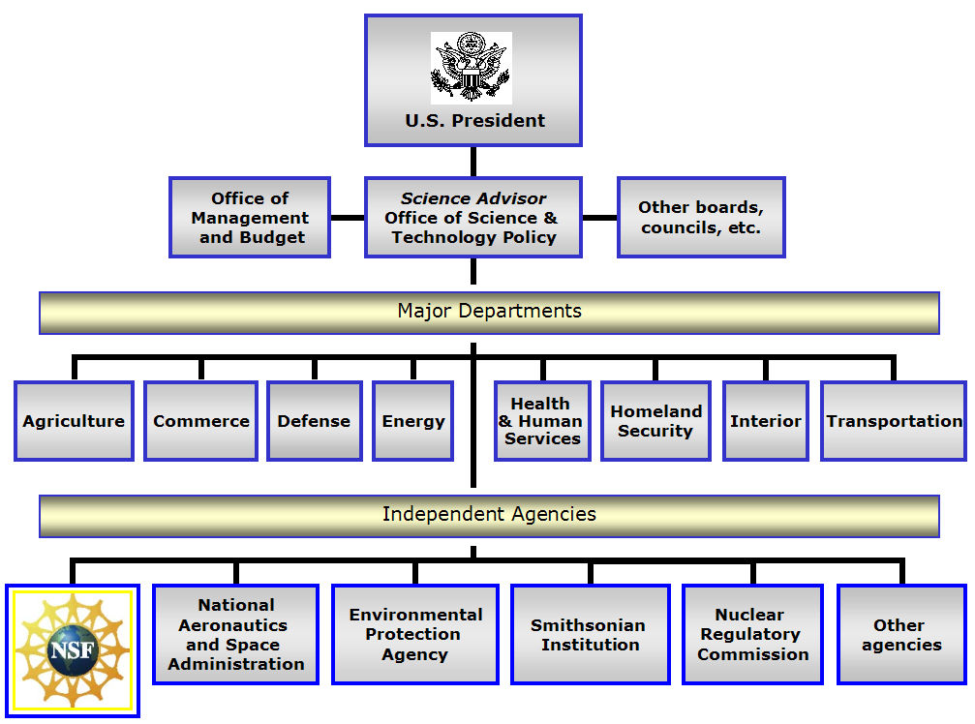

Slide 127
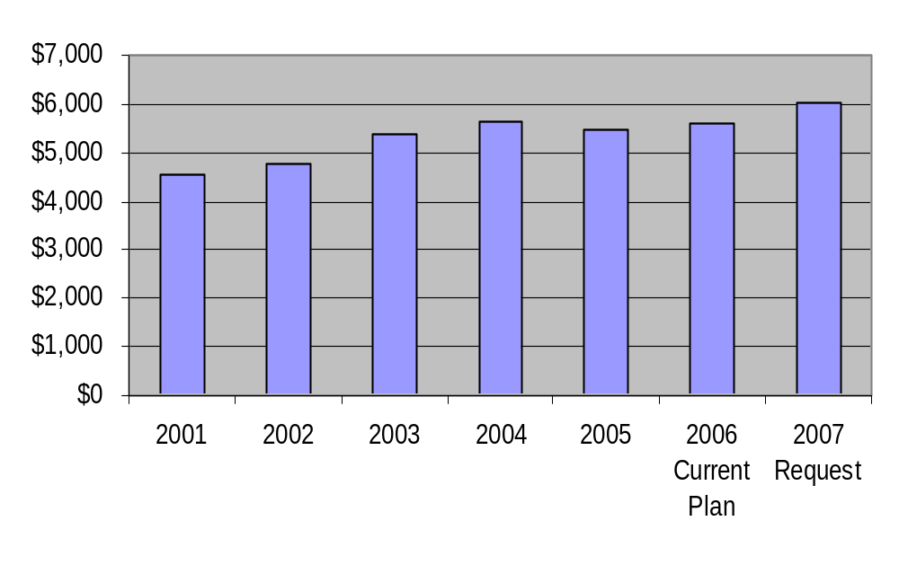
NSF Budget
FY 2001-2007
Dollars in Millions

Slide 128
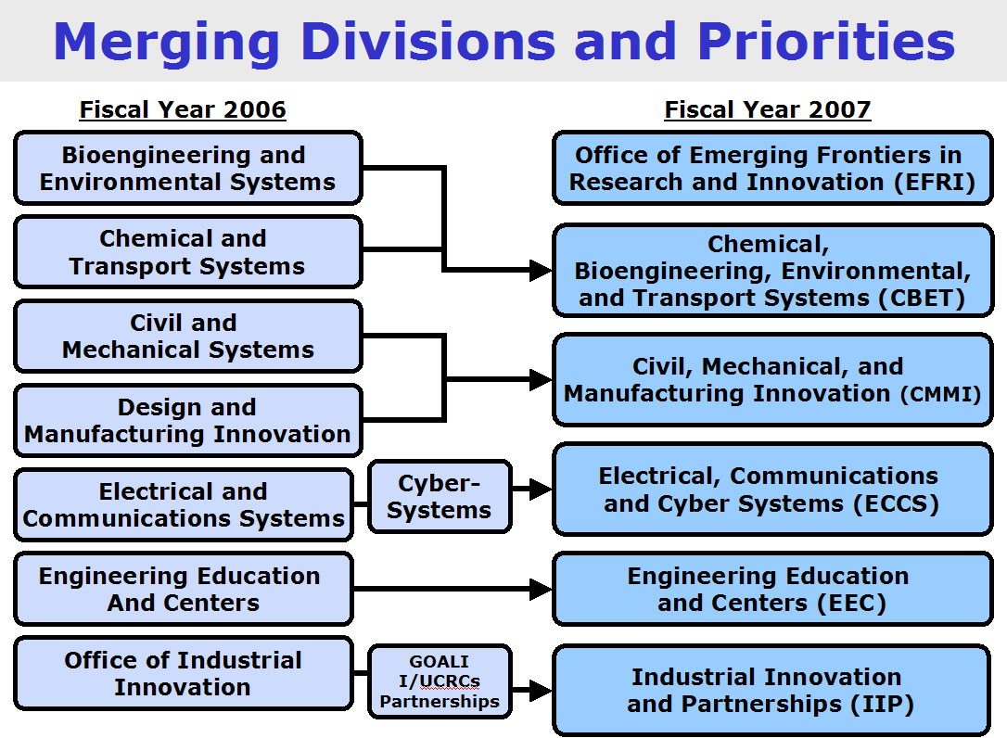

Slide 129
Directorate for Engineering
FY 2007
Office of the Assistant Director
Deputy Assistant Director
(OAD)
Emerging Frontiers in
Research and Innovation
(EFRI)
Senior Advisor
Nanotechnology
Engineering
Education and
Centers
(EEC)
Civil,
Mechanical, and
Manufacturing
Innovation
(CMMI)
Chemical,
Bioengineering,
Environmental,
And Transport
Systems
(CBET)
Electrical,
Communications
and Cyber
Systems
(ECCS)
Industrial
Innovation and
Partnerships
(IIP)

Slide 130

CBET Organization Chart
Division Director
Judy Raper
Senior Advisor
Marshall Lih
Deputy Division Director
Bob Wellek
Chemical,
Biochemical, and
Biotechnology
Systems
Transport and
Thermal Fluids
Biomedical
Engineering and
Engineering
Healthcare
Environmental
Engineering and
Sustainability
Process and
Reaction Engineering
Maria Burka
Thermal
Transport Processes
Pat Phelan
Research to Aid Persons
With Disabilities
Bob Jaeger
Environmental
Engineering
Pat Brezonik
Catalysis and
Biocatalysis
John Regalbuto
Interfacial Processes
And Thermodynamics
Bob Wellek
Biomedical
Engineering
Semahat Demir
Environmental
Technology
Cindy Ekstein
Biochemical
Engineering
Bruce Hamilton
Particulate and
Multiphase Processes
Vacant
Biophotonics
Leon Esterowitz
Energy for
Sustainability
Vacant
Biotechnology
Fred Heineken
Fluid Dynamics
Bill Schultz
Environmental
Sustainability
Cindy Lee
Chemical and
Biological Separations
Geoff Prentice
Combustion, Fire, and
Plasma Systems
Phil Westmoreland

Slide 131
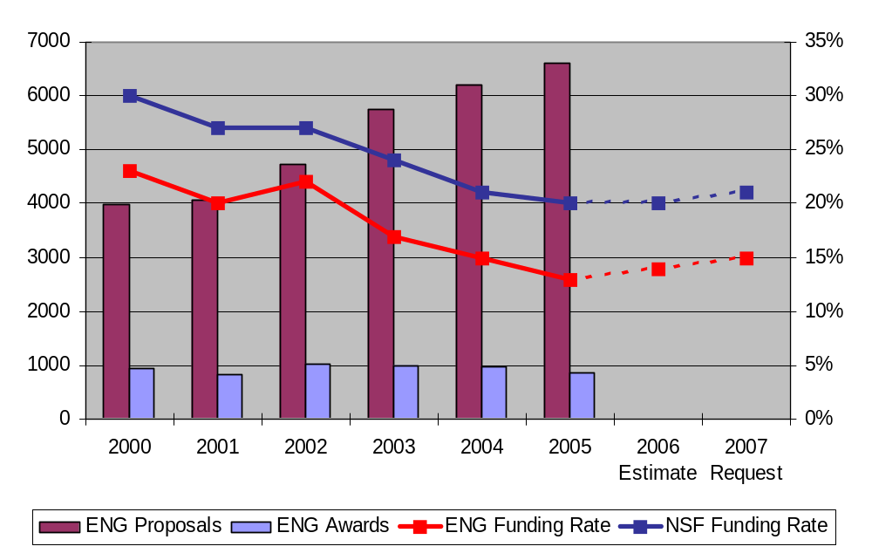
ENG and NSF Funding Rates
Research Grants

Slide 132
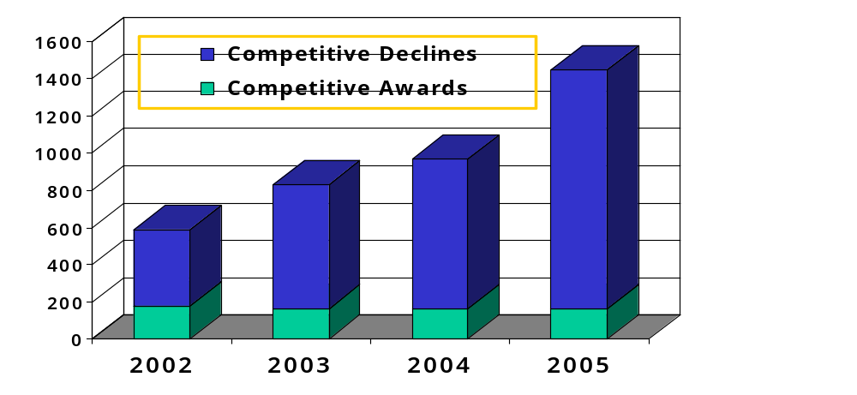
National Science Foundation  Directorate for Engineering
CTS Funding Rate for Competitive Awards
Total Proposal Awards & Declines
31%
20%
17%
11%
Declines
Awards
407
179
664
166
803
163
1286
162

Slide 133
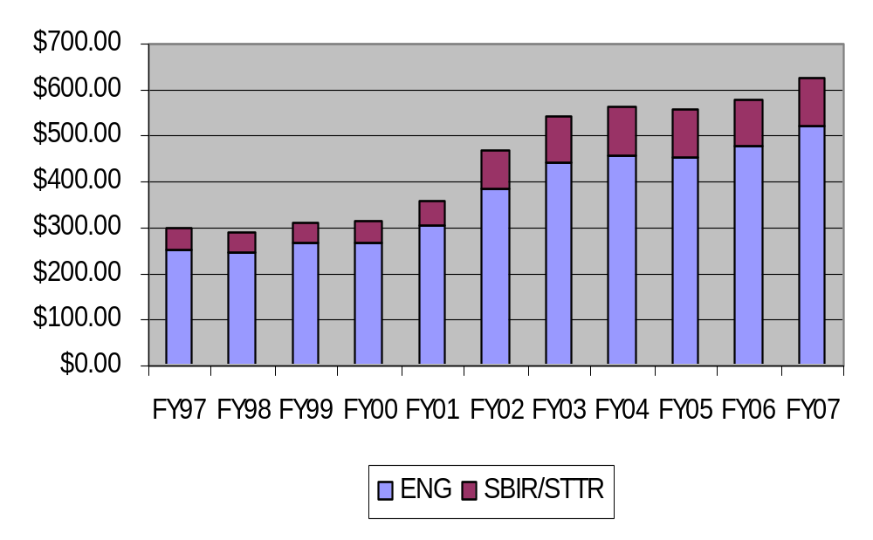
ENG & SBIR/STTR Budget History
Dollars in Millions
Notes:
TO be replaced with split bar for SBIR and other

Slide 134
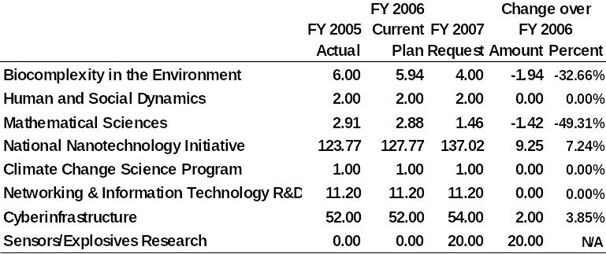
ENG NSF-wide Investments
Dollars in Millions

Slide 135
ENG Research Priorities FY07
◆ Nanotechnology
◆ Energy and Environment
◆ Innovation
◆ Complexity in Engineered
and Natural Systems
◆ Manufacturing Frontiers

Slide 136
Emerging Frontiers in
Research and Innovation (EFRI)
◆ EFRI focuses support on important
emerging areas in a timely manner
◆ Typically, the annual budget for EFRI
will be 3-to-5 percent of the
Directorate budget (~$15-to-$30
million)
◆ It is expected that the investment in
any topic will range from $3 million to
the total annual ERFI budget

Slide 137

Major Initiatives
with Impact on CBET
in FY 2007
◆ NNI
⧫ $43 million
◆ Sensors/Explosives
⧫ $5 million
◆ EFRI (FY08: Cognitive Optimization and Prediction through Reverse Engineering; Resilient and Sustainable Infrastructures) $25 million total ENG

Slide 138
Identifying
Research Problems

Slide 139
Research Problem Solutions
◆ Problem/Solution types:
⧫ Straightforward extension of known
(likely to succeed, but unlikely to
discover much)
⧫ Substantial in novelty and approach
(higher risk, but chance of greater
return)
⧫ Wildly innovative, a hunch
(provocative, but difficult to justify)

Slide 140
What should you look for?
◆ What is my expertise? What is particular
about my expertise that contributes to
the agency’s mission?
◆ What is the right agency for my proposal?
◆ What is the funding agency funding or
planning to fund?
◆ How can I apply my expertise to satisfy the
funding agency’s needs?
◆ What does the solicitation ask for?
◆ Who are the key people to contact?
◆ Who are my competitors?

Slide 141
Identified a
satisfactory problem?
◆ Can problem be pursued
enthusiastically?
◆ Can interest be sustained
by problem?
◆ Is problem solvable? By you?
Revisit
◆ Is problem worth solving?
◆ Will it lead to other research
problems?

Slide 142
Identified a
satisfactory problem?
◆ Potential for original contribution?
◆ Solution demonstrates your
independence (e.g., collaboration)?
◆ Does the area /problem have
promise? Funding potential?

Slide 143
Identify a problem . . . then identify solution method(s)
Slide 1 of 2
◆ Literature(facts):
⧫ Give credit where due, but always
simultaneously point out limitations
(establish how small is current knowledge)
⧫ Use list of limitations (cumulative)
to justify need for proposed research
⧫ Use prior/new methods discussion
to motivate your “methods section

Slide 144
Identify a problem . . . then identify solution method(s)
Slide 2 of 2
◆ Literature(facts) - continued:
⧫ Ideas are not limiting factor;
usually time is the limiting factor
⧫ Collect approaches to solving problems - -
revisit occasionally as tools improve
⧫ Sort out feasibility of each approach

Slide 145
Understanding Industry
◆ Pick one subfield of industry.
  ⧫ e.g., industrial gases
◆ Products, processes, economics,
companies & people.
◆ Read and clip articles.
  ⧫ e.g., Chemical & Engineering News
  and annual reports.
◆ Talk to industrial people
at meetings. Persist.

Slide 146
Advice - Slide 1 of 2
◆ Think Big
  ⧫ Reflect on problem from its broadest
  perspectives
  ⧫ Imaginative solutions to
  fundamentally important problems
  ⧫ If you start small, you will finish even
  smaller
◆ Invest Discretionary Funds to
Differentiate – equipment dollars
are the most difficult

Slide 147
Advice - Slide 2 of 2
◆ Avoid Tunnel Vision
  ⧫ Plan for long-term, beyond
  immediate research area
◆ Take Your Time
  ⧫ It takes considerable time to design
  a research program
◆ Envision Outcomes
  ⧫ Difference that research can make,
  significant papers produced, credited
  with solution to important problem

Slide 148
If Proposal Not Funded
◆ Read reviews – consider resubmission
  ⧫ Minor problems noted: poor proposal organization, references insufficient
  ⧫ Reviewers did not seem to appreciate innovations: re-emphasize key elements
  ⧫ Mixed reviews: stress aspects of proposal relevant to negative comments
  ⧫ Contact program director for advice: is resubmission recommended? is research area a priority? what is the funding situation?

Slide 149
If Proposal Not Funded - 2
◆ Read reviews – consider other options
  ⧫ Consistently low ratings: usually an indication of weak or incremental research
  ⧫ Consistently high ratings: is little funding available? is research area of low priority?
  ⧫ Is the work more appropriate for another agency or industry funding?
  ⧫ Usually helpful to contact program officer if resubmission is being considered

Slide 150
Resubmitting a Proposal
◆ Rewrite the proposal by incorporating changes based on reviewer comments
◆ For NSF, addressing reviewer comments in a separate section is not recommended; other agencies require a separate section
◆ The title need not be changed if the scope does not change
◆ In the Engineering Directorate mostly new panelists will review your resubmission

Slide 151
More
Managing Research

Slide 152
Student Evaluation and Feedback
Slide 1 of 2
◆ Develop an evaluation process
⧫ Examples: Formal process (e.g., your University may
have a process), biweekly meetings, group meetings
◆ Build in methods to detect problems early
⧫ Sample writing, timelines, independence,
professionalism, …
◆ It is never inappropriate to send words of
“thank you,” “job well done,” and “good luck” or
to likewise let them know that you are expecting
better things from them!
◆ Students are usually better than you think!!!
⧫ Don’t be afraid to challenge them!!!

Slide 153
Student Evaluation and Feedback
Slide 2 of 2
◆ Utilize peer group
⧫ Feedback on presentations, research plan,
writing
◆ Return material in a timely manner
◆ Seek advice
⧫ Counselors, other faculty,
international office, …

Slide 154
Placement and
Professional Development
Slide 1 of 4
Help students determine career goals
◆ Academics: Research, Service, and
Teaching
⧫ Expose them to your world
in a positive way!
⧫ Examples: meaningful TA, involve in
writing proposals, direct undergraduates,
have them attend key technical meetings
(have them prepare business cards)

Slide 155
Placement and
Professional Development
Slide 2 of 4
Help students determine career goals
◆ Off-campus experience
⧫ Take them on visits to industrial,
consulting, and governmental facilities,
host visitors from these facilities,
choose someone who works in one of
these locations as an external
committee member, etc.
◆ Discuss pros and cons
of each career choice

Slide 156
Placement and
Professional Development
Slide 3 of 4
Help students prepare for placement
◆ You have an obligation to assist student
in obtaining a suitable position
⧫ Put in the “leg work” for your student
⬥ Network, letter, promote, attend right conference
⧫ Maintain contact lists (industry friends, former students)
⧫ Expose them to the profession - Include students in
conference/session planning, encourage them to volunteer for their
professional societies, participate in short courses, and other
activities that may promote their interaction with professionals
⧫ Host Visitors

Slide 157
Placement and
Professional Development
Slide 4 of 4
Help students prepare for placement
◆ Assist in presentation development,
review resume and supporting documents
⧫ Typical questions, talk with other
students, observe faculty candidates,
sample resumes

Slide 158
Other Personnel
◆ Undergraduates
⧫ Realizing good productivity by UnderGrads
challenging
● Let graduate students advise UnderGrads
● Well defined/scoped project required
◆ Post-doctoral researchers
⧫ More productive, less guidance, assist
in directing graduate students
⧫ Select carefully
⧫ Remember their objective is to find next job
⧫ Cost issue

Slide 159
Other Personnel
◆ Technicians
⧫ They provide continuity / institutional
memory
⧫ Involve in education as well
⧫ Remember this is their career
◆ Staff can be very helpful –
treat with respect

Slide 160
Managing Students
Slide 1 of 3
◆ Qualifying exam (understand
your department’s process)
⧫ Complete early (key indicator of
potential)
⧫ Allow appropriate time for
preparation
⧫ Provide good samples
⧫ Use opportunity to require corrective
measures (e.g., additional
coursework, language course)

Slide 161
Managing Students
Slide 2 of 3
◆ Thesis writing
⧫ Students always underestimate time
⧫ Encourage continuous writing
⧫ Develop “living” outline early
⧫ Do not let student leave before finished!
◆ Defense
⧫ Practice with research group
⧫ Involve student with committee selection
⧫ Demonstrate breadth and depth
● Cannot present entire thesis

Slide 162
Managing Students
Slide 3 of 3
◆ Teaching Assistants
⧫ Teaching Assistants with faculty
other than advisor
● Better learning experience plus
they get to know other faculty
⧫ Emphasize teaching not grading
● Provide feedback on teaching
effectiveness
⧫ Include a creative aspect to
teaching experience

Slide 163
Team Work
◆ Instill confidence and appreciation
of individual scholarship
◆ Also develop teamwork skills
⧫ Develop individual expertise and
promote sharing with group

Slide 164
Continuity Slide 1 of 3
◆ Overlap students
⧫ Have each student be responsible for
training her / his successor
⧫ Use a checklist of basic lab techniques
they must first master
◆ Technicians, research faculty useful

Slide 165
Continuity Slide 2 of 3
◆ Make certain that the laboratory
has teaching resources
⧫ Develop a notebook of SOPs. Have
students write these.
⧫ Keep copy of all equipment manuals
locked up but available
⧫ Have good methods books on hand

Slide 166
Continuity Slide 3 of 3
◆ Document programs, thesis
is good repository
◆ Use lab books (good for IP too)
◆ Maintain contact with students after
graduation

Slide 167
Interacting with
Program Officers
◆ Get to know them professionally
⧫ Meet them (invite then for visit, meet them at a
conference, visit them in their home office)
⧫ Request that you serve on a peer review panel
(i.e., do them a favor!)
◆ Keep them informed of progress
◆ Submit requested information in timely
manner (e.g., reports, slides)
◆ Notify of any changes in plans
◆ Seek their advice

Slide 168
Budget Management
◆ Check expenditures routinely (monthly)
⧫ But don’t spend too much time. Let system
work for you!
⧫ Early on, have the administrative staff in
your department and College explain their
roles in the budget process
◆ ‘Bank’ fund – overhead account/Foundation
◆ If trouble predicted, tell folks
◆ Use educational institution discounts
⧫ ‘training future customers’ rationale

Slide 169
Contract and
Grant Management
◆ Understand requirements
◆ No-cost extension request
◆ Use available help/systems

Slide 170
Lab Safety
◆ Safety first!
⧫ Student training! Hoods in order? Floor drains?
◆ Work with your safety office
⧫ Often yearly lab inspection (and requirement to
have students sign that they have been safety trained)
◆ Plan for power outages
◆ Other questions:
⧫ House gas? Common equipment?
(who pays for maintenance?)
⧫ Have you built-in-time to account for safety
issues?

Slide 171
When/What to Disclose
◆ WHAT: Disclose novel ideas,
discoveries, inventions that are timely
and useful to the marketplace
◆ WHEN: Disclose with sufficient notice
before any publication (prior to
submission) or enabling public
disclosure
◆ Don’t know if you should disclose?
Call local office of licensing/technology

Slide 172
University Owns
Employee Inventions When:
◆ The invention was made while you
were employed at the university
AND
◆ The invention is in the
field/discipline in which you
are/were employed
OR
◆ The invention was made with
university resources

Slide 173
Types of Intellectual Property
◆ Patents
  ⧫ Enable you to exclude others from using
  your ideas for a limited period of time
◆ Copyrights
  ⧫ Grant you the right to exclude others from
  reproducing your work without permission
◆ Know-how
  ⧫ Expertise required to reproduce a patent,
  licensed in conjunction with the patent

Slide 174

Types of Intellectual Property
◆ Trade secrets
  ⧫ Method, formulation, or process not
  disclosed to the public and not covered
  by a patent (ex: recipe for Coca-Cola®)
◆ Trademarks
  ⧫ A distinguishing symbol, design, mark or
  word used by a manufacturer to identify
  its product from a competitor’s
  (ex: Gatorade™)

Slide 175
Tips for Protecting
Your Intellectual Property
◆ Keep accurate lab notebooks
⧫ numbered and bound +
⧫ document date of conception
◆ Always use a Material Transfer Agreement
(MTA) when transferring/receiving materials
from an outside entity*
◆ Always complete a Confidential Disclosure
Agreement (CDA) prior to discussing enabling
aspects of your research with an outsider
◆ Protect your intellectual property
before publicizing your discovery in any way

Slide 176
Criteria for Patentability
◆ Novel
  ⧫ New, never before used
◆ Useful
  ⧫ Must have a purpose or intended use
◆ Non-obvious to
someone “skilled in the art”
  ⧫ Peers and/or patent examiner would not
  readily identify the improvement or new
  application

Slide 177
Events Impacting Patentability
◆ First publication
  ⧫ Includes providing information to others
  without a confidentiality agreement/poster
  sessions/presentations at conferences
◆ First public use
◆ First offer for sale
Foreign Filing: must file before any of the above events or rights to file are lost!

Slide 178
Public Disclosure
◆ Public disclosure can include:
  ⧫ Publication in open literature
  ⧫ Poster sessions & abstracts (postings to web)
  ⧫ Presentations to open forum (thesis defense)
  ⧫ Personal communications without a
  confidentiality agreement
  ⧫ Catalogues and libraries
◆ Primary discriminations:
  ⧫ Good faith attempt to maintain secrecy
  ⧫ Disclosure of enabling (inventive) material

Slide 179
Duty of Disclosure
Special Considerations for Academic Institutions
◆ Abstracts of funded NIH grants are available
on the NIH CRISP internet site within
about 6 weeks of approval date
◆ Full contents of funded NIH grants are available
through FOIA as of the date they are funded,
subject to authorization by the PI and the
university that receives the funding
◆ If a PI or his/her university object to the
release of records on the basis of patentability,
the program director will review the grant to
determine whether the information to be
withheld is in the public domain

Slide 180
Developing a
Research Proposal

Slide 181
Developing a Research Proposal: Overview Slide 1 of 2
◆ Identify and describe the conceptual
framework
◆ Review relevant literature for problem
and related problems
◆ Articulate the general research
question in context of above
◆ Formulate set of hypotheses

Slide 182
Developing a Research Proposal: Overview Slide 2 of 2
◆ Develop approaches to test hypotheses
and to analyze/synthesize results
◆ Evaluate potential alternative outcomes
◆ Combine these items in a coherent,
precise, concise, and exciting proposal
◆ Submit the proposal
◆ Interpret and respond to reviews
of the proposal

Slide 183
Pitfalls
Slide 1 of 2
◆ Failure to establish significance
of your work
◆ Too much text devoted to complex
details or past accomplishments
◆ Failure to construct testable hypotheses
◆ Constructing too many hypotheses

Slide 184
Pitfalls
Slide 2 of 2
◆ Too ambitious for time/money
◆ Inadequate skills or credentials for
proposed task
◆ Poor experimental design
◆ Bad analytical or statistical methods

Slide 185
Idea
A
B
Funding
Agency
Write / Revise
White paper
C
D
E
Obtain
Feedback
Budget/
Boiler plate
F
G
◆ An idea begins the proposal development
and writing process, but sometimes a Request For Proposals (RFP) from a particular agency
can influence or motivate a project.
◆ From the original idea in its written form, scientists, funding agency personnel, and
agency or budgetary guidelines and restrictions can provide inputs that the writer uses to
revise the proposal.
◆ After reconciling all comments and feedback, the author submits the final document.
Pull Together
H
Done

Slide 186
Know Your
Proposal Reviewers
◆ Other academics working same field
(esp. your references, others funded by agency
on similar problems, panel with range of experts)
◆ Agency personnel (less expert perhaps,
but with strong eye on agency relevance)
⧫ Write to YOUR audience
  ⧫ Be critical, but polite

Slide 187
Know the
Proposal Review Process
◆ External
◆ Panel
◆ In-house
◆ Review criteria
◆ Background of reviewers

Slide 188
Know the Review Criteria
Slide 1 of 2
◆ Scientific content and merit
◆ Innovation and scope
◆ Relevance of problem
◆ Rigor of hypotheses

Slide 189
Know the Review Criteria
Slide 2 of 2
◆ Feasibility of research design
◆ Qualifications of Investigator(s)
◆ Suitability of facilities
◆ Impact on broader issues
(e.g., education)

Slide 190
Funding Mechanisms
◆ Grants: financial awards in support of
of research projects with anticipated
but not guaranteed outcomes
⧫ Investigator–initiated grants or
unsolicited (maximum PI freedom)
⧫ Funding source-initiated grants
(restrictions placed by funding source)
⧫ Single vs. multiple investigator grants
⧫ Program project grants
(MD, long-term, project based)

Slide 191
Funding Mechanisms
◆ Cooperative agreements: Federally
employed scientists working with
non-federal organization
  ⧫ Direct involvement of funding agency
  in project design
◆ Contracts: Used to secure a product
or products according to specifications
Notes:
Page 40

Slide 192
R&D Funding Sources
for Academic S&E
FY 2004 ($42.9 Billion Total – in Billions Below)
◆ Federal programs $27.4 64%
◆ Institutions $7.8 18%
◆ State & Local $2.8 7%
◆ Industry $2.1 5%
◆ All Other Sources $2.8 7%
http://www.nsf.gov/statistics/infbrief/nsf06315/nsf06315.pdf
Notes:
Page 41

Slide 193
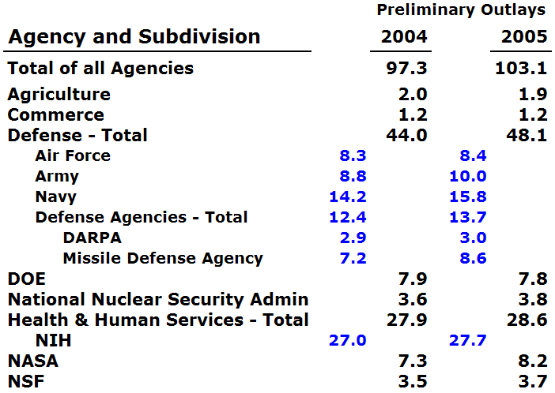
Federal Funds for Total Research & Development
Fiscal Years 2004 & 2005 (Dollars in Billions)
http://www.nsf.gov/statistics/nsf06313/pdf/tables.pdf
Table 4

Slide 194
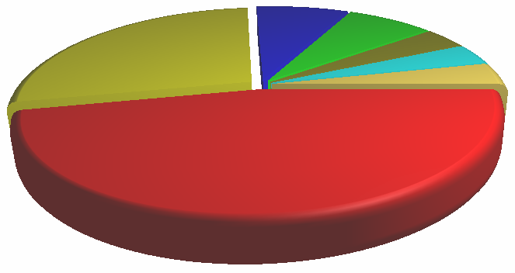
Federal R&D for FY 2005
$103 Billion Total (Dollars in Billions)
NucSec $4 4%
NSF $4 4%
NASA
$8
8%
Other $4
4%
DOE
$8
8%
NIH $28
27%
DOD $48
47%
http://www.nsf.gov/statistics/nsf06313/pdf/tables.pdf
Table 4

Slide 195
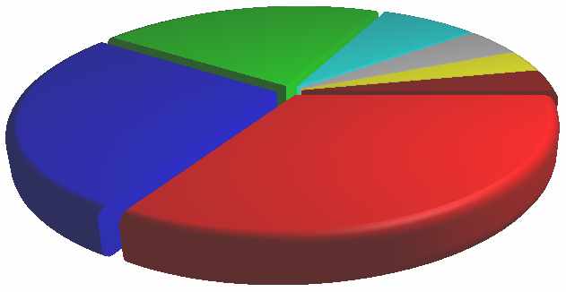
Federal Engineering R&D
FY 2005 $9.1 Billion Total (Dollars in Billions)
DOT $0.4 4.4%
NIH $0.3 3.3%
DOE
$2.0
22.0%
NSF
$0.7
7.7%
Other $0.3
3.3%
NASA
$2.4
26.4%
DOD
$3.0
33.0%
http://www.nsf.gov/statistics/nsf06313/pdf/tables.pdf
Table 22

Slide 196

Federal Academic S&E Support
FY 2005 $22.4 Billion Total (Dollars in Billions)
DOD $1 4%
NASA $1 4%
NSF
$3
14%
DOE $1
4%
NSF
NIH $16
71%
Other
$1
3%
http://www.nsf.gov/statistics/nsf06313/pdf/tables.pdf
Table 59

Slide 197
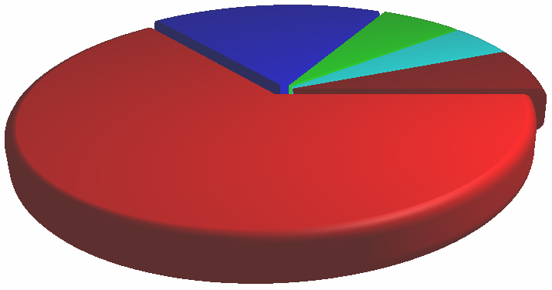
R&D Funding Sources
for Academic S&E
FY 2005 $43 Billion Total (Dollars in Billions)
Institutions
$8
18%
State & Local
$3
7%
Industry
$2
5%
All Other $3 7%
NSF
Federal Programs $27
64%
http://www.nsf.gov/statistics/nsf06323/tables/tab4.xls

Slide 198

National Nanotechnology Initiative (NNI)
FY 2007 Budget Request $1,278 Million (Dollars Below in Millions)
NIST $86 7%
NASA $25 2%
Other $20 2%
NIH
$170
13%
DOE $258
20%
DOD $345
27%
NSF $373
29%
www.whitehouse.gov/omb/budget/fy2007/spec.pdf

Slide 199
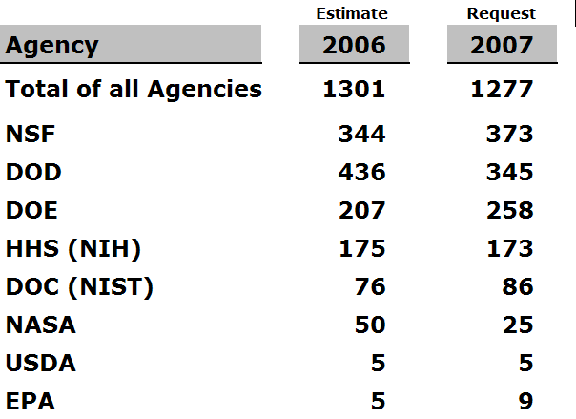
NNI Budget by Agency
Fiscal Years 2006 & 2007 (Dollars in Millions)
http://www.nano.gov/html/about/funding.html

Slide 200
How Do We
Get Information?
◆ Web Sources:
⧫ http://www.nsf.gov
⧫ http:// afosr.sciencewise.com
⧫ http:// www.onr.navy.mil
⧫ http:// www.darpa.mil/baa/
⧫ http:// www.nih.gov/grants/
⧫ http:// www.pr.doe.gov
Notes:
Page 41

Slide 201
How Do We
Get Information?
◆ Community of Science
⧫ http://www.cos.com/
◆ Commerce Business Daily
⧫ http://cbd.cos.com/
◆ Federal Information Exchange
⧫ http://www.sciencewise.com/fedix/
◆ University Research Web Page – Resources
⧫ http://rgp.ufl.edu/research/
Notes:
Page 42

Slide 202
Industry
◆ SBIR’s
  ⧫ Phase I small, Phase II larger, but …
◆ GOALI
◆ Contracts
  ⧫ Shorter term, deliverables,
  frequent reports, milestones,
  changing context, IP issues
◆ Consulting vs. research project
Notes:
Page 42

Slide 203
Internal Sources
◆ Start-up packages
◆ Special programs
◆ Year-end funds
◆ Space
◆ Faculty time
◆ Matching funds
◆ Fellowships
◆ FYI (rgp.ufl.edu/fyi)
Notes:
Page 43

Slide 204
Foundations
◆ Office of Sponsored Research
can help identify
◆ Determine
  ⧫ Appropriateness of idea for
  Foundation funding
  ⧫ Customary level of funding
  ⧫ Application process
  ⧫ Face-to-face meeting desirable?
Notes:
Page 43

Slide 205
Foundations
◆ Private Foundations
  ⧫ Operating: generally conduct research
  with own staff
  ⧫ Company-sponsored:
  Small awards, specific
  ⧫ Independent
◆ National Voluntary Health Organizations
◆ Public Foundations
Notes:
Page 44

Slide 206
Time Management
Notes:
Page 97

Slide 207
Academic Freedom
Lots of it and no personal assistant!
Academic tasks
teaching
research
book writing
Non-academic tasks
calendar
filing
student recruiting
Mandated time
classroom
grading
report writing
committee meeting
Discretionary time
literature reading
proposal writing
email
session chair
Notes:
Page 98

Slide 208
Time Management
Exercises
◆ Write down the most important
time saver that you use
◆ Write down the largest time
waster you face
◆ Share tips
Notes:
Page 98

Slide 209
Know Yourself
◆ Perform time audit
  ⧫ For one week write what you do
  every 30 min
◆ When do you work best?
  ⧫ Internal – time alone
  ⧫ External – time in groups
◆ Cannot do everything – know
priorities
◆ Decide flexibility level you can
tolerate
Notes:
Page 99

Slide 210
Task Classification
Agenda vs. Calendar
Urgency
III
I
IV
II
Importance

Slide 211
Classifications
Urgent and important. (Deadline-driven activities that further your goals.)
Important but not urgent. (Long-term professional, family, and personal activities that further your goals.)
Urgent but not important. (Much e-mail, many phone calls and memos, things that are important to someone else but don’t further your goals.)
Neither urgent nor important. (TV, computer games, junk mail.)
S.P Covey, A.R. Merrill, and R.R. Merrill, First Things First, New York, Simon & Schuster, 1994.

Slide 212
Recommendations
◆ Commit to several hours a week on
Quadrant II items, and cut down on
time spent in Quadrants III and IV.
◆ Work on Quadrant I and II items
when you’re at peak efficiency.
◆ If you’re trying to write a book, put it
on the Quadrant II list, otherwise it
will never get written.

Slide 213
Tips
◆ 55 hours/week doing professor stuff
is about right
⧫ More productive, creative,
accurate
◆ Touch stuff only once, if possible
◆ Ask for help when needed
◆ Delegate with clear instructions of
expectations
Notes:
Page 101

Slide 214
More Tips
◆ Schedule meetings at office of others –
you can leave
◆ Know your business and say no to others
  ⧫ Learn to say no nicely
    ⧫ “I’m sorry, but I’ve just got too many other
    commitments right now.”
    ⧫ “Good talking to you, but I’ve got something
    I need to attend to now.”
◆ Learn to finish
  ⧫ Don’t keep revising (perfectionist) needlessly
  ⧫ One writing/proofing on low importance
  items

Slide 215
Keeping track of it all
◆ Use a calendar
  ❖ Develop own system
  ❖ Schedule all priority activities: research, writing,
  student advising/direction, professional development
  ❖ Schedule teaching preparation time (not too early
  or late – will make a better teacher)
◆ Schedule large blocks of time
  ❖ Understand work ‘start-up’ time, location
◆ Schedule personal time
  ❖ Vacations, growth, extra fun day on travel
◆ Stick to it (as much as possible)
  ❖ Others will adapt
Notes:
Page 99

Slide 216
Keeping track of it all
◆ Use a to do list
  ❖ Card system, PDA, Outlook
  ❖ Identify time for daily update
◆ Filing system vs. Piling system
  ❖ Decide appropriate level of effort
  ❖ Larger chunks, delegate, electronic
◆ Develop system for time sensitive stuff
Notes:
Page 100

Slide 217
(Optimal) Procrastination
◆ Fun vs. urgent vs. important
activities
◆ Fear factor is often cause
  ❖ Break into smaller tasks
  ❖ Schedule it
  ❖ Delegate it
  ❖ Reward or punish self
Notes:
Page 100

Slide 218
E-mail
◆ Assume that your e-mail messages
are not private.
◆ Never write a “hot” e-mail message.
It is too easy to send by accident. Don’t
ever send messages when you are angry.
◆ Make e-mail brief and proof-read it.
◆ Don’t read other people’s e-mail.
◆ Respond to e-mail in batches.
Notes:
Page 101

Slide 219
E-mail
◆ If you will be away, have the e-mail
automatically reply that you will
respond when you return.
◆ Aliases are convenient for sending
e-mail to a number of people, but
the message loses its personal touch.
◆ Requests for people to do work are
much more effective if they are
addressed to only one person instead
of to a group.
Notes:
Page 101

Slide 220
Telephone
◆ If the phone rings at a truly bad
time, such as the moment you’re
leaving for class, do not answer it.
◆ If a call is going to take more time
than you have available, it is polite
to ask if you can call back.
Notes:
Page 102

Slide 221
Telephone
◆ With sales people you do not want
to talk to, be polite but firm –
”I’m really not interested.” If the
caller is rude and ignores this,
repeat the statement and hang up.
◆ If you leave an important message
on an answering machine, make
sure you provide a way (e-mail or
return call) for the recipient to let
you know the message was received
and understood.
Notes:
Page 103

Slide 222
Postal Mail
◆ The goal is to handle each item
only once.
◆ Don’t handle mail (or e-mail) during
your prime work-alone times.
◆ Sort the mail into valid, invalid, and
semi-valid. Discard invalid mail or
save it for a very low energy period.
◆ Open the semivalid mail, scan it,
and reclassify it.
Notes:
Page 103

Slide 223
Postal Mail
◆ Open the valid mail, and as much
as possible complete whatever you
have to do – respond, file it, talk to
someone about it, or discard it at
one sitting.
◆ Do something to move mail forward
every time you pick it up.
◆ Write directly on the letter to
respond to the sender or to make
notes for yourself.
Notes:
Page 103

Slide 224
Postal Mail
◆ Respond immediately to the rare
truly urgent item by fax, e-mail,
or phone.
◆ When you send mail, include your
e-mail address, phone, and fax
numbers, and perhaps the URL to
your homepage on the letterhead.
◆ Envelopes should have return
addresses.
Notes:
Page 103

Slide 225
Postal Mail
◆ Letters should be polite, short,
and to the point.
◆ If you are really angry about
something, write a letter to calm
down, but do not send it. After
you have calmed down, put this
“hot” letter in the trash.
Notes:
Page 103

Slide 226
Time Management
#1. Set goals & prioritize.
#2. Delegate. How can we do this?
  ❖ To secretaries & assistants
  ❖ To graduate students and
  undergraduates as part of learning
  experience. (They don’t work for you!)
  ❖ Give clear assignments & responsibility
  for details.
  ❖ Check on results & give feedback.
  ❖ Give credit.
#3. Use efficient processes.
Notes:
Page 105

Slide 227
To Achieve Flow, You Need:
1. Sense of control.
2. To set realistic goals & subgoals
3. Meaningful rules (e.g., sports & games)
4. Feedback on progress
5. Focused attention
6. Balance between challenge & skills
7. To increase challenge & skills
to prevent boredom
Notes:
Page 106

Slide 228
Truths
◆ There are 24 hours in a day –
everyone is given the same each day
◆ Rate at which humans communicate
is relatively constant
◆ If you are doing something you
really enjoy, it is not called work
◆ A proposal will not be funded
if not submitted
Notes:
Page 106

Slide 229
Contacting
Funding Agencies
Notes:
Page 44

Slide 230
Matching Your Problem with Funding Source
◆ Most important problems/good
solutions are eventually funded
◆ Explore
  ⧫ Funding source’s mission,
  interests, priorities
◆ Be flexible
Notes:
Page 45

Slide 231
Why Contact
Program Officer
◆ Establish credibility
◆ Guidelines on how to shape
your proposal to match
program needs
◆ Increase funding probability
◆ Save time
Notes:
Page 45

Slide 232
Who to Contact
◆ Identify suitable agency
◆ Identify suitable person at agency
  ⧫ Ask colleague/advisor
  ⧫ Search website
  ⧫ Read solicitation
◆ Industry: research expert
  ⧫ Professional meetings
  ⧫ Other networking opportunities
Notes:
Page 46

Slide 233
The Program Officer’s Perspective
Program officer’s job is to assemble the
best research program
  ⧫ Must convince others to fund programs
  ⧫ Wants the best people on board
  ⧫ Often looking for breakthroughs
  ⧫ Open to new ideas, but must fit in program scope
◆ Likely competent but not necessarily
expert in field
Notes:
Page 46

Slide 234
Learn more about Monitor
◆ Ask colleague about monitor’s style
◆ Probe funding patterns
◆ Education
◆ Own research area
◆ Rotator or staff
◆ Program responsibilities
Notes:
Page 47

Slide 235
How to Contact the Program Officer
◆ Email
  ⧫ Solicitation,website
  ⧫ Simple questions, phone
  appointment
◆ Phone call
  ⧫ Prepare questions in advance
  ⧫ Be professional
  ⧫ Listen carefully
Notes:
Page 48

Slide 236
How to Contact the Program Officer
◆ Personal Visit
  ⧫ By appointment
  ⧫ During related activity (panel, workshop)
  ⧫ Show presentation slides on laptop
Notes:
Page 48

Slide 237
How to Contact the Program Officer
◆ White paper / pre-proposal /
letter of intent
  ⧫ Increasingly required /
  recommended
  ⧫ Some program officers will
  volunteer to offer feedback on
  short versions
Notes:
Page 49

Slide 238
What to Ask
◆ Deadlines
◆ Duration restrictions
◆ Funding schedules
◆ Earliest start date
◆ Overhead restrictions
◆ Maximum direct cost
allowed
◆ Review process and
criteria
◆ Research objectives
◆ Project plan
◆ Personnel issues
◆ Application process
◆ Which program?
◆ Advice?
◆ $ for new faculty?
◆ Typical award size
◆ Special equipment
needs
Notes:
Page 49

Slide 239
White Paper
◆ Gives essence of idea
◆ Contains goals and scope of study,
significance, brief description of
methods, hypotheses & expected
results
◆ Clear, concise, accurate, exciting
◆ Addresses broader impact
◆ Usually 1-2 pages
◆ Conventions vary by field/agency –
seek samples
Notes:
Page 50

Slide 240
Proposal Title
◆ Present in clear, concise,
meaningful manner
◆ Avoid jargon and overstatement
◆ Be careful with buzzwords
(some folks are annoyed)
◆ Avoid cute and too informal titles
Notes:
Page 50

Slide 241
DARPA White Paper
WHITE PAPER SUBMISSIONS: Prior to submission of a full proposal, the submission of a brief white paper is highly encouraged (but not required). The white paper should clearly state the uniqueness of the idea presented in the context of existing state-of-the-art in the technical area of interest. It should provide the proposed approach and explain why it is unique. Further, the proposer should demonstrate an understanding of the payoff of the technical idea, especially in terms of how it might make a difference to Defense capabilities. A brief discussion of the technical expertise of the proposed principal investigator and other key team members should be provided. Finally, an estimate of the program costs and duration should be included. White papers should not be longer than 8 pages; however, shorter white papers that can cover the content above are strongly encouraged. The body of the e-mail must include name, mailing address, phone number, and fax of the proposer. (If proposers choose not to use e-mail, U.S. mail may be used. Within two weeks of receipt of the white paper, the proposer will be informed of receipt of the white paper, provided a proposal log number and given both a technical and administrative point of contact. The formal recommendation about whether a formal proposal is recommended will be from the technical point of contact. This recommendation is for the benefit of the proposer and is not a guarantee that the full proposal will be funded.
Notes:
Page 51

Slide 242
Handouts
Sample White Papers
Notes:
Page 51

Slide 243
Activity
◆ Generate outline of a white
paper pre-proposal on a
research problem/solution
of your choice
Notes:
Page 52

Slide 244
Other Ways to Contact Program Officers
◆ Attend open workshops
◆ Attend agency conferences
◆ Meet with at professional/research
society meetings
◆ Get on schedule during campus
visits
◆ Invite for seminar
◆ Volunteer to review, especially panels.
For CBET, volunteer to ‘Become a Reviewer’ at:
www.nsf.gov/eng/cbet/reviewer/
Notes:
Page 52

Slide 245
Intellectual Property
◆ Some faculty uncomfortable
discussing ideas before funded
◆ Although care should be taken,
generally best to be open
◆ Industry: Sometimes disclosure
agreement in place, may want
to disclose ideas before
Notes:
Page 53

Slide 246
Tips
◆ Second time phenomenon
◆ Federal fiscal year begins 10/1
◆ Get involved in proposing
program ideas
◆ Attend program reviews
when appropriate
Notes:
Page 53

Slide 247
If Match Not Found
◆ Don’t take it personally
◆ You saved considerable time and
made a contact
◆ Can idea be changed to match interest?
◆ Discuss what you learned with colleagues
◆ “Press On”: Persistence
  ⧫ “Nothing in the world can take the place of persistence.
  ⧫ “Talent will not: nothing is more common than
  unsuccessful people with talent.
  ⧫ “Genius will not: unrewarded genius is almost a proverb.
  ⧫ “Education alone will not: the world is full of educated
  derelicts.
  ⧫ “Persistence and determination alone are omnipotent.”
Notes:
Page 54

Slide 248
Planning for Tenure and Promotion
‘Preparing for Promotion and Tenure,’ R. M. Diamond, Anker Publ. (1995)
Notes:
Page 107

Slide 249
Understand Context
Some evaluators will be outside
your discipline
  Learn who will evaluate your
  package (tenured package, personnel
  board,dean’s office, university board,
  president’s office)
Time constants can be long
  Idea → proposal → funding → research performed → results published
  Teaching innovation → opportunity → refine
  & repeat → evaluate and assess → results published
Notes:
Page 107

Slide 250
Learn Your Institution’s Process
◆ What is the review process?
  ⧫ Annual, 3-year, teaching?
  ⧫ Who evaluates? Advisory or decision making?
  ⧫ What is timeline?
◆ Understand guidelines and
criteria/expectations
  ⧫ Obtain guidelines and forms
  ⧫ How will teaching quality be evaluated?
  ⧫ How is research evaluated? Paper count?
  Read papers? Reviews? Journal quality?
  Juries? Citations?
◆ Plan to do your best - not the minimum expected
Notes:
Page 108

Slide 251
Learn Your Institution’s Process
◆ Promotion (accomplishments) and
tenure (accomplishments and potential)
have different criteria
◆ What documentation is required?
  ⧫ Standard form, teaching portfolio,
  selected papers, faculty essay, . . .
  ⧫ How are letters solicited? What is
  asked?
  ⧫ Statement of research and teaching
  accomplishments and plans?
Notes:
Page 108

Slide 252
The Real Truth
Notes:
Don’t forget quality as a key factor; Flags: no PhD graduate, flurry of activity, funding but no output, isolation, poor teaching evaluations, no professional activities,

Slide 253
Truths
◆ There are 24 hours in a day –
everyone is given the same each day
◆ Rate at which humans communicate
is relatively constant
◆ If you are doing something you
really enjoy, it is not called work
◆ A proposal will not be funded
if not submitted
Notes:
Page 106

Slide 254
Tips
◆ Talk to folks (chair, department
representative on higher committees,
recent candidates, mentor)
◆ Make effort to know all
colleagues
◆ Keep focused – peer recognized
excellence is overriding
◆ Write (proposals, manuscripts,
document activities)
Notes:
Page 109

Slide 255
Tips
◆ In preparing package, help
evaluators by making quality
and significance self-evident
◆ Become professionally active
◆ Don’t depend on your graduate
students to make tenure for you
◆ Help leaders in your area of
scholarship become aware
of your work
Notes:
Page 109

Slide 256
Interdisciplinary Research
Why Participate?
◆ Available funding (~20%)
◆ Make faculty and industry contacts
◆ Introduced to new research areas
◆ Exposure to other universities
◆ Access to infrastructure
◆ Practice in problem formulation
◆ Good experience for graduate
students

Slide 257
Interdisciplinary Research
But beware of pitfalls
◆ Complacency for proposal
writing ‘work for’ senior faculty
◆ Moved too far out of field
◆ Lower creative content – too
defined

Slide 258
Interdisciplinary Research
◆ Ensure your role is clear
◆ Seek assistance on resource allocation
issues
◆ Use opportunity to assume a small
leadership role
◆ Seek help to ensure relationship with
senior faculty is collegial (e.g., IP)
TIP: Record your contributions to
collaborative work (e.g., CV, T&P template)

Slide 259
Establish Credibility
◆ Amongst peers, research community,
funding agencies
◆ Methods include
  ⧫ Write review articles, attend meetings,
  visits to funding agencies
  ⧫ Presentations, workshop mode conferences
  ⧫ Review panels, volunteer in societies,
  white papers
  ⧫ Seminar chair, request papers,
  preliminary results
◆ New faculty often given special consideration
Notes:
Page 110

Slide 260
Establishing Network/Credibility Exercise
Complete Worksheet 4
Notes:
Page 110

Slide 261
CAREER DEVELOPMENT WORKSHEET 4a
COMMON OBJECTIVES FOR NEW FACULTY
1. Build Network in Community
◆ List Five Research Peers: 1. _________________________
2. _________________________ 3. _________________________
4. _________________________ 5. _________________________
◆ List most important conference/workshop you should attend:
1. Research: _________________________________________
2. Professional: _________________________________________
3. Education: _________________________________________
◆ List Eight Senior Professionals who will be asked to write
recommendation/evaluation letters:
1. _________________________ 2. _________________________
3. _________________________ 4. _________________________
5. _________________________ 6. _________________________
7. _________________________ 8. _________________________
◆ What is the Leading Laboratory/Group in your field?
________________________________________________________
Notes:
Page 111

Slide 262
CAREER DEVELOPMENT WORKSHEET 4b
2. Establish Credibility
◆ List the two best journals in your field:
1. _________________________
2. _________________________
◆ Title of review article to be written in next five years:
___________________________________________________
◆ What is the most original idea you are now working on?
___________________________________________________
◆ What award should you be nominated for in the next five
years?
___________________________________________________
Notes:
Page 111

Slide 263
Attitude
Don’t take yourself or tenure race too seriously.
⧫ Tenure doesn’t help if you’re dead.
Lighten up
⧫ Humor & laughter
⧫ Bad things happen to all professors – don’t dwell
  on them or let them get you down.
  ⧫ Take the university as it is – reform it later.
Take care of yourself
⧫ Eat right, exercise, sleep enough
⧫ Spend time with “family”
◆ If you know something is right thing to do, do it!
Notes:
Page 112

Slide 264
Faculty Mentoring
Notes:
Page 112

Slide 265
Mentor-Mentee Pair Study
(Boice, 1990)
◆ Arbitrarily paired mentors/mentees
worked as well as traditional pairs
◆ Mentors from same and different
departments worked at least as well
◆ Left alone, most pairs displayed
narrow styles
  ⧫ when pairs shared experiences,
  scope expanded
Notes:
Page 113

Slide 266
Mentor-Mentee Pair Study
(Boice, 1990)
◆ Frequent meetings helped ensure
pair bond
◆ Mentors assumed role of
interventionist with reluctance
Notes:
Page 113

Slide 267
Good Practices
◆ Engage best faculty as mentors
⧫ modes of thinking
  ⧫ standards of excellence
  ⧫ instill self-confidence in mentee
  ⧫ some senior faculty feel
  responsibility
◆ Realize mentoring relations are
not forever
‘Mentors should produce protégés, not disciples’
Notes:
Page 114

Slide 268
Good Practices
◆ Chair’s role is facilitator
  ⧫ Establish pair
  ⧫ Nudge activities
  ⧫ Promote collegiality
  ‘the pursuit of truth in the company of friends’
  ⧫ Promote research collaborations
  (fosters collegiality, self confidence)
  ⧫ Clear contribution necessary
  ⧫ Judicious selection of committee work
Notes:
Page 114

Slide 269
Good Practices
◆ Chair’s role is facilitator
  ⧫ Clearly state expectations:
  tenure process, work assignments,
  discuss with committee, etc.
  ⧫ Provide resources
    ⬥ time is extremely valuable
    ⬥ space, $, best students
  ⧫ Reward mentors
Notes:
Page 115

Slide 270
Good Practices
◆ Provide frequent feedback on progress
  ⧫ More for diagnosis than evaluation
  ⧫ Midterm review, self-assessment,
  peer assessment, document progress
◆ Assist in professional development
◆ Support improving teaching effectiveness
  ⧫ Early formative feedback
  ⧫ Support innovation
  ⧫ Participate in FD programs
Notes:
Page 115

Slide 271
Good Practices
◆ Discuss balance in work
and life expectations
◆ Include graduate students
who want to be faculty
◆ Remember they are individuals
with individual needs
Notes:
Page 116

Slide 272
Bibliography
Slide 1 of 3
How to create a WINNING PROPOSAL, Jill Ammon-Wexler and Catherine Carmel, Mercury Communications Corporation, 1978
How to Write a Successful Research Grant Application, Edited by Willo Pequegnat and Ellen Stover, Plenum Press, 1995
The Winning Proposal, Herman Holtz, Terry Schmidt, McGraw-Hill Book Company, 1981
Proposal Preparation, Rodney D. Stewart, Ann L. Stewart, John Wiley & Sons, 1984
Writing Grants Step by Step, Mim Carlson, Jossey-Bass Inc., 1995
Notes:
Page 82

Slide 273
Bibliography
Slide 2 of 3
Handbook for Writing Proposals, Robert J. Hamper, L. Sue Baugh, NTC Business Books, 1995
Engineer's and Manager's Guide to Winning Proposals, Donald V. Helgeson, Artech House, 1994
The Complete Book of Model Fund-Raising Letters, Roland Kuniholm, Prentice Hall, 1995
Writing Successful Science Proposals, Andrew J. Friedland and Carol L. Folt, Yale University Press, New Haven & London, 2000
Notes:
Page 82

Slide 274
Bibliography
Slide 3 of 3
The "How To" Grants Manual, Successful Grantseeking Techniques for Obtaining Public and Private Grants, Third Edition, David G. Bauer, American Council on Education, Oryz Press, 1995
Applying for Research Funding, Joanne B. Ries and Carl G. Leukefeld, SAGE Publications, 1995
How to Write Proposals That Produce, Joel P. Bowman and Bernadine P. Branchaw, Oryz Press, 1992
Teaching Engineering, Phil Wankat,
https://engineering.purdue.edu/che/news_and_events/publications/teaching_engineering/index.html
The Academic Scientists’ Tookit
http://nextwave.sciencemag.org/feature/cdctoolkit.shtml
Notes:
Page 83

Slide 275
Closing Remarks
Notes:
Page 116

Slide 276
Please take a few minutes to complete our survey
Good Luck!

Slide 277

The End
Questions?

Slide 278
Bibliography
How to create a WINNING PROPOSAL, Jill Ammon-Wexler and Catherine Carmel, Mercury Communications Corporation, 1978
How to Write a Successful Research Grant Application, Edited by Willo Pequegnat and Ellen Stover, Plenum Press, 1995
The Winning Proposal, Herman Holtz, Terry Schmidt, McGraw-Hill Book Company, 1981
Proposal Preparation, Rodney D. Stewart, Ann L. Stewart, John Wiley & Sons, 1984
Writing Grants Step by Step, Mim Carlson, Jossey-Bass Inc., 1995
Notes:
Page 82

Slide 279
Bibliography
Handbook for Writing Proposals, Robert J. Hamper, L. Sue Baugh, NTC Business Books, 1995
Engineer's and Manager's Guide to Winning Proposals, Donald V. Helgeson, Artech House, 1994
The Complete Book of Model Fund-Raising Letters, Roland Kuniholm, Prentice Hall, 1995
Writing Successful Science Proposals, Andrew J. Friedland and Carol L. Folt, Yale University Press, New Haven & London, 2000
Notes:
Page 82

Slide 280
Bibliography
The "How To" Grants Manual, Successful Grantseeking Techniques for Obtaining Public and Private Grants, Third Edition, David G. Bauer, American Council on Education, Oryz Press, 1995
Applying for Research Funding, Joanne B. Ries and Carl G. Leukefeld, SAGE Publications, 1995
How to Write Proposals That Produce, Joel P. Bowman and Bernadine P. Branchaw, Oryz Press, 1992
Teaching Engineering. Phil Wankat, https://engineering.purdue.edu/ChE/News_and_Events/Publications/teaching_engineering/index.html
The Academic Scientists’ Tookit http://nextwave.sciencemag.org/feature/cdctoolkit.shtml
Notes:
Page 83

