Slide 1
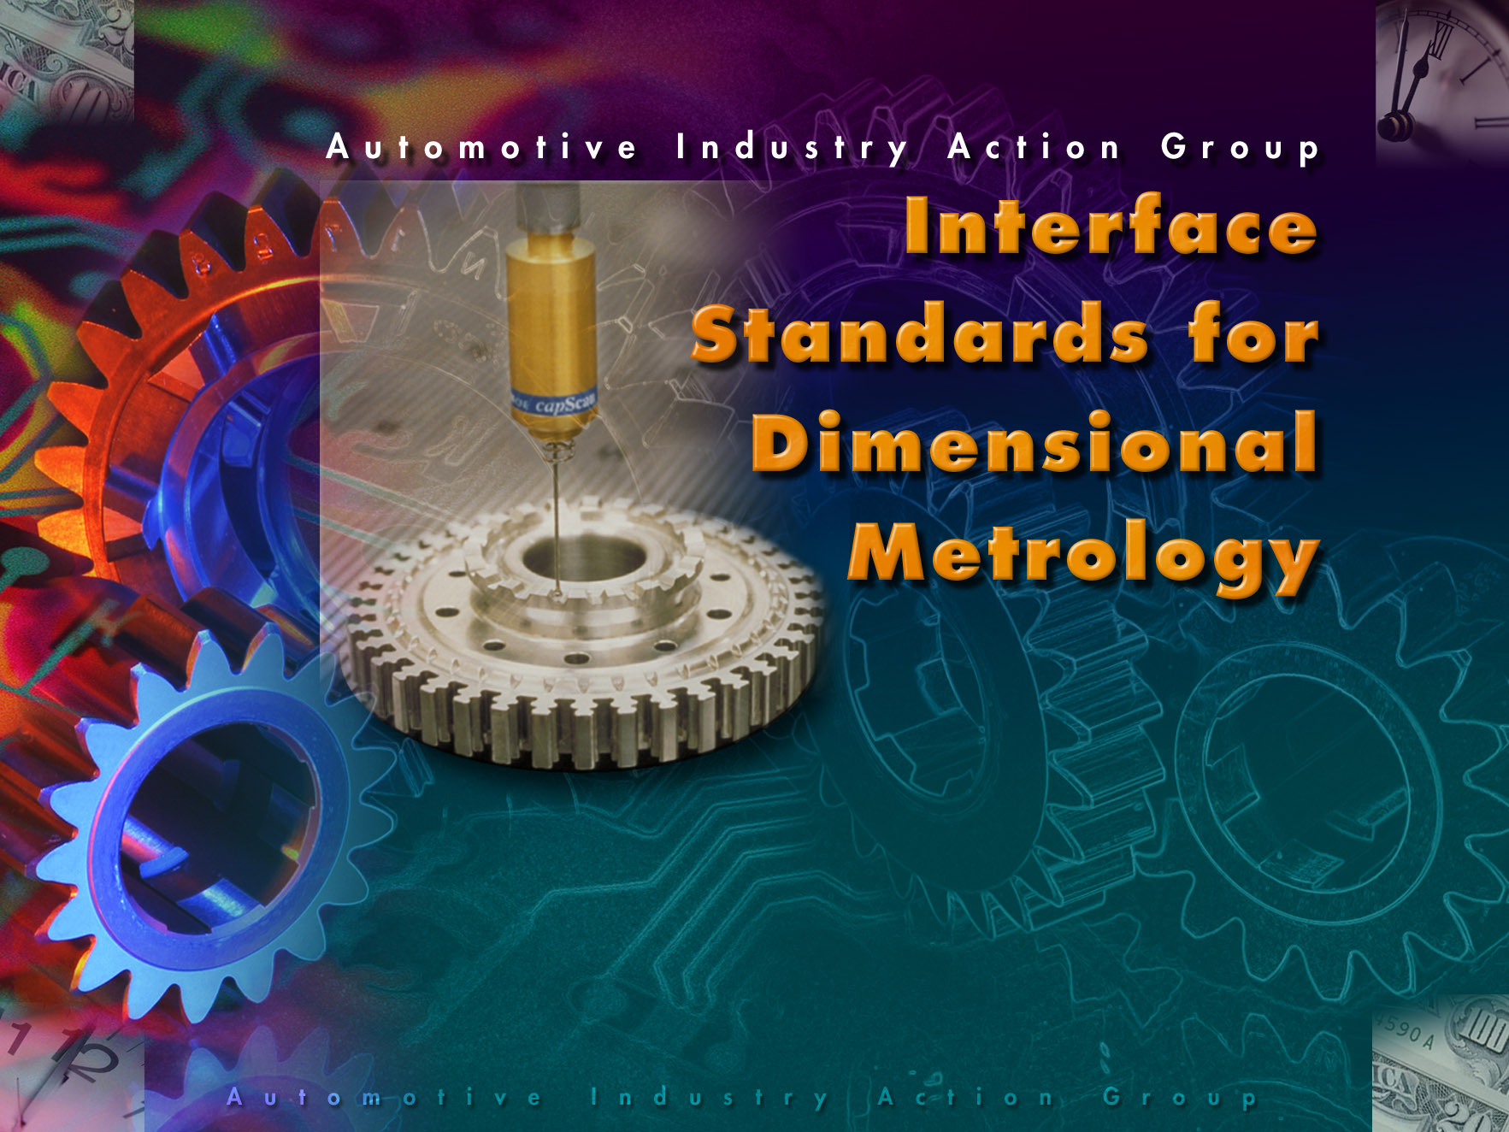

Slide 2
Interface Standards for
Dimensional Metrology
Buying products that support Standards can
Save you Time!
Buying products that support Standards can
Save you Money!
Believe it or not!
Here’s how

Slide 3
Can You Benefit from
Metrology System Standards?
Your training costs are high because your plant maintains different CMM programming/execution systems
You have to regenerate CMM programs to move parts to different machines
You find it difficult to import results data from software packages
You are unable to purchase best-in-class components because of commitments to proprietary products

Slide 4
Benefits from Standards
You can easily interconnect products that support standards
You can reduce training and maintenance costs
You gain flexibility in choice of components, allowing you to choose the best product, or the least expensive product
Increases competition among vendors, reducing your costs

Slide 5
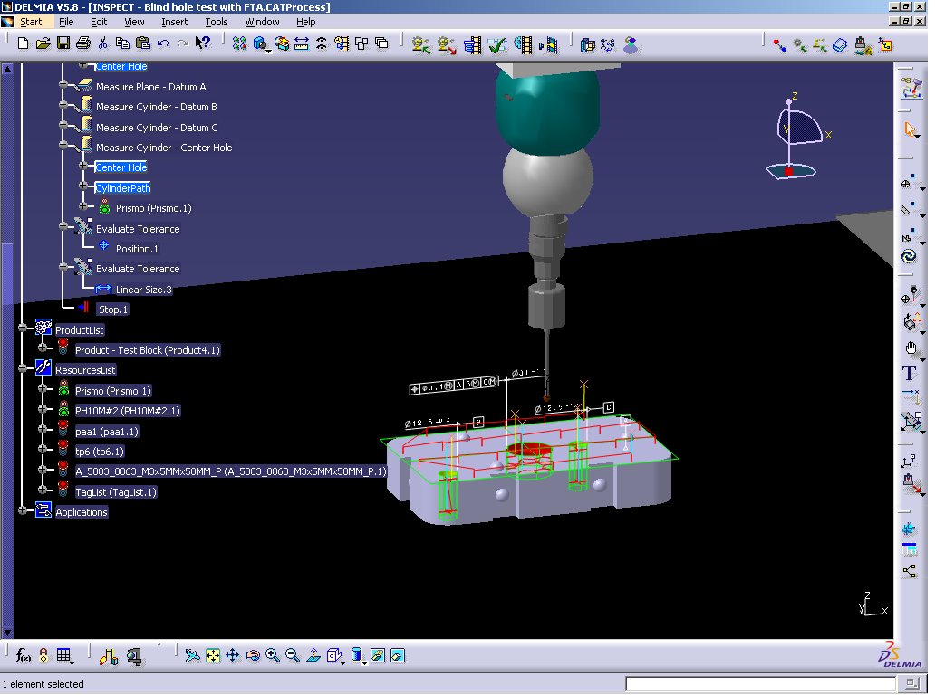
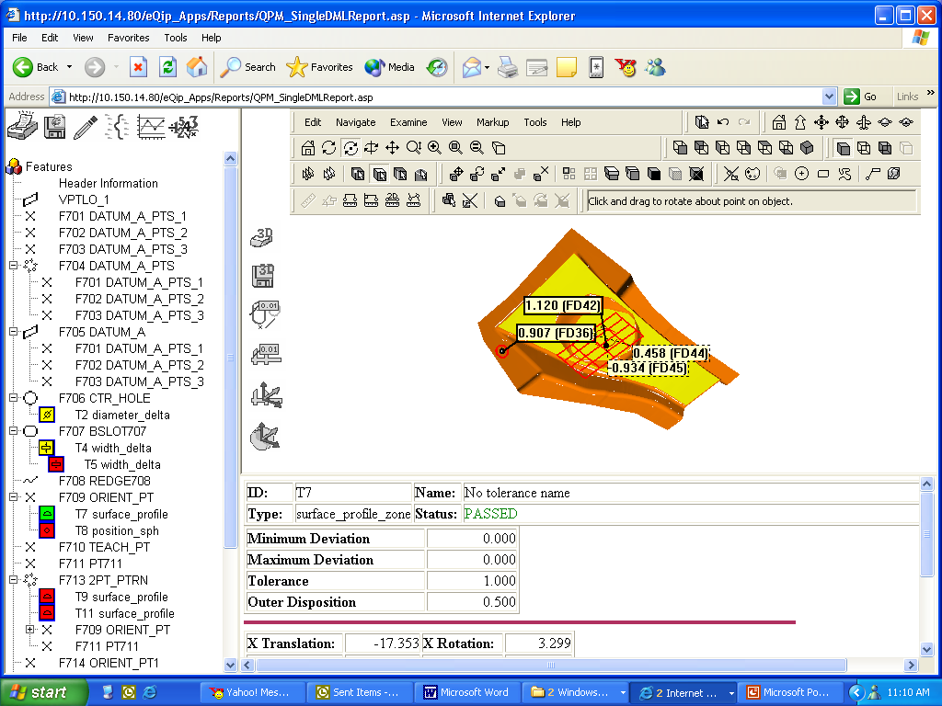
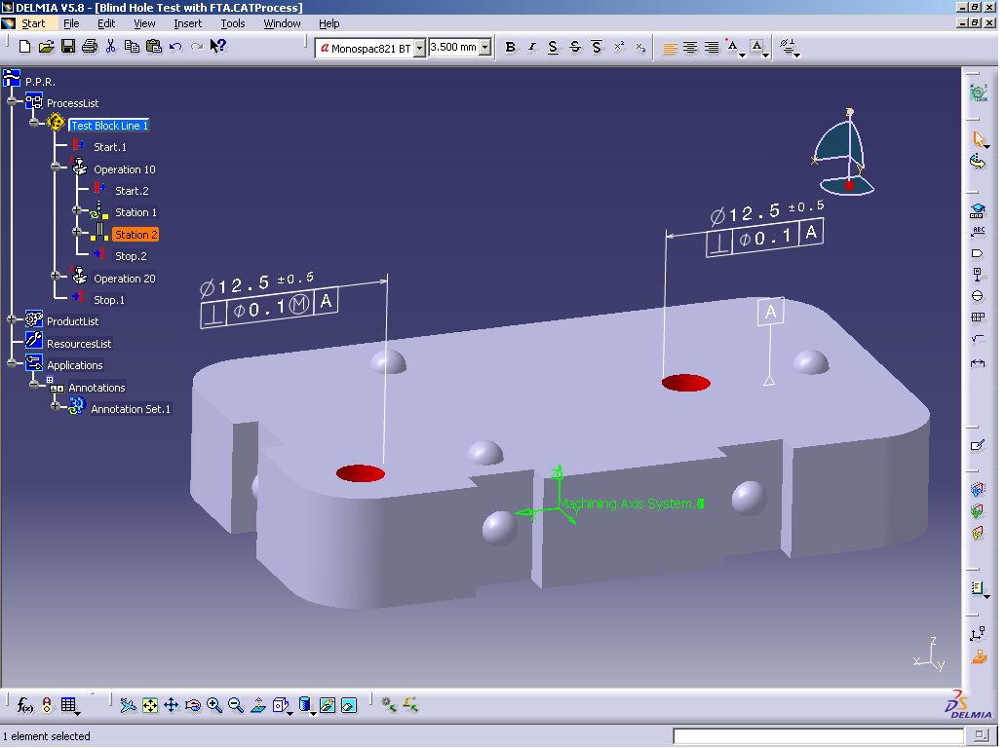
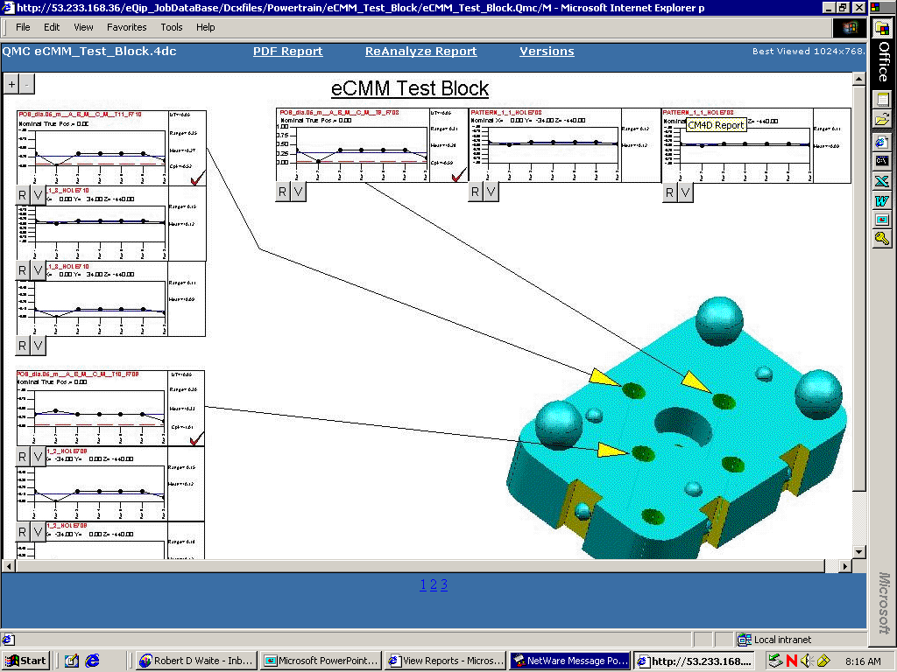
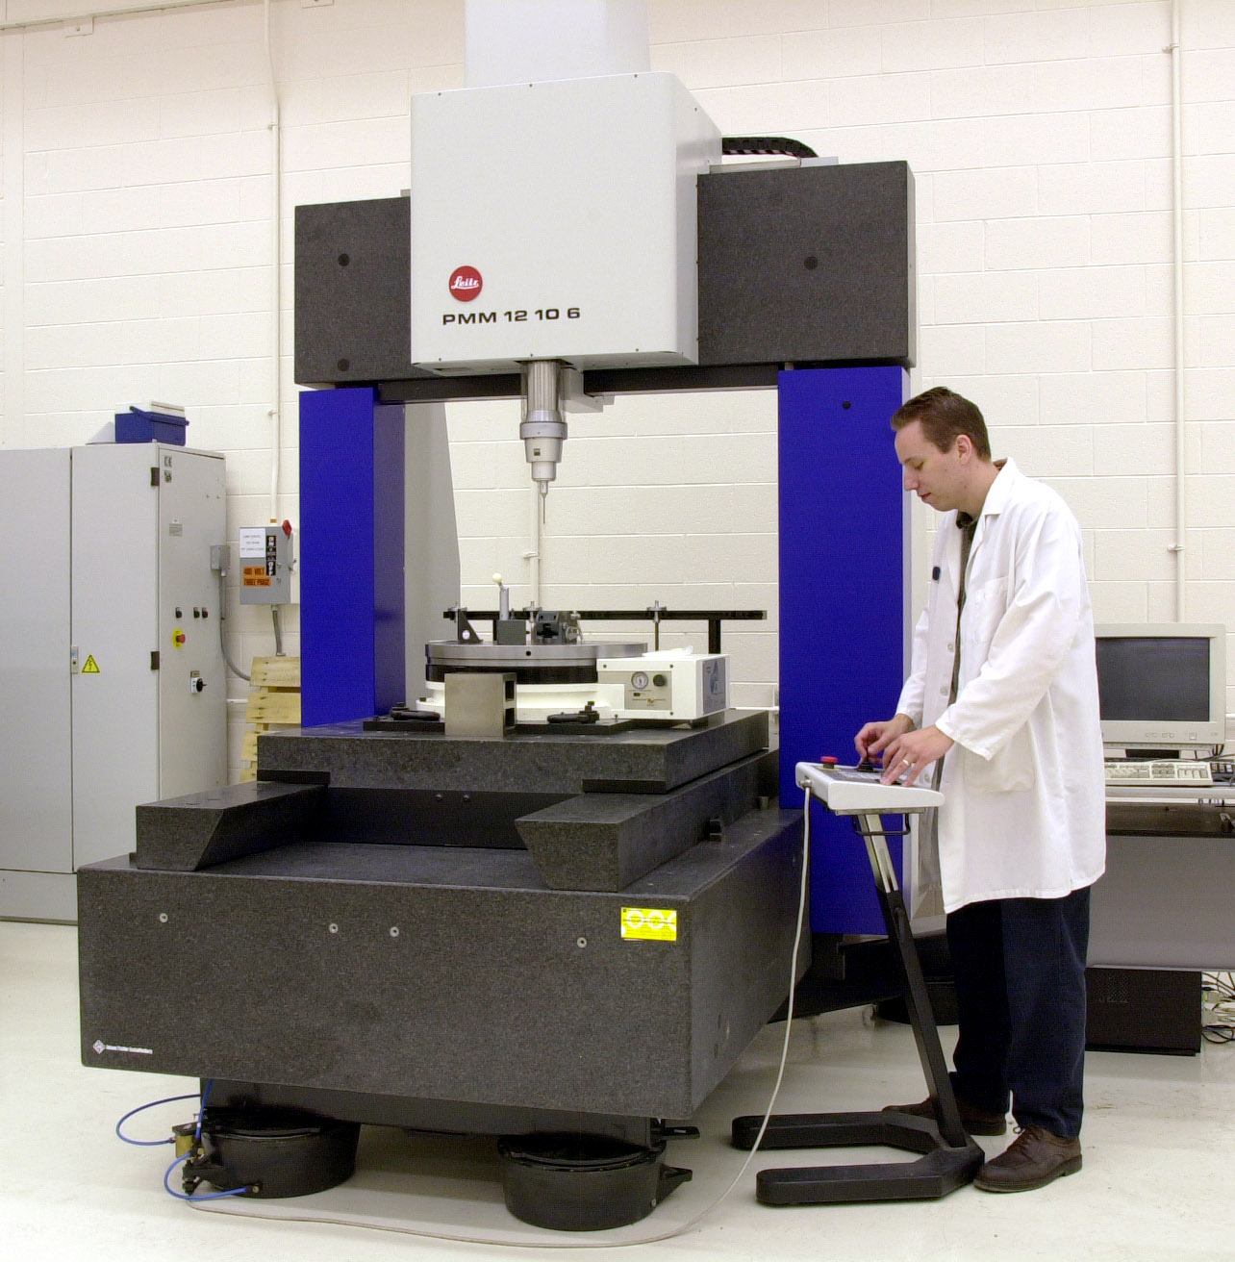
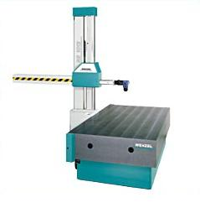
Standards Landscape
Geometry and
Feature
Tolerance
Information:
STEP APs
Off-line Inspection
Process Planning
Software
CAD
Software
Inspection Process
Information: DMIS
Inspection Execution Software
Measurement
Results:
DML
Reporting
& Analysis
Software
CMM control commands
and responses: I++ DME
Coordinate Measuring Machines (CMMs)

Slide 6
STEP CAD Files with GD&T added can go places!
STEP
PROTOCOLS
Inspection
Programming
CAD Models with GD&T info
`
Post Inspection
Analysis

Slide 7
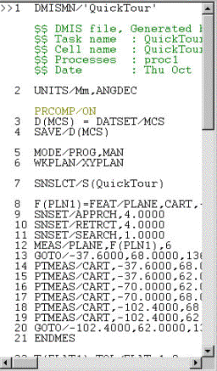
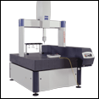
DMIS Programs can be run on all compatible CMM execution systems - no reprogramming needed!
DMIS
DMIS
DMIS

Slide 8
I++DME lets you run your favorite programming/execution system on any compliant CMM!
Change the Programming / Execution Application
Keep the
Application
I++DME
Keep the
CMM
Change the CMM

Slide 9
DML Output Results can go places proprietary or informal data cannot!
DML format
Analysis Software
DML format
DML format

Slide 10
Products That Support
Standards
Can Save YOU
MONEY
TIME!
$$
$$

Slide 11
This Money was brought to you by:
Automotive Industry Action Group
Standards for Manufacturing Metrology
  STEP APs
  DMIS
  I++DME
  DML
Vendors who support standards
$$$

Slide 12
Today’s Interoperability Demo
Programming
And Execution
Applications
A
B
C
D
I++DME Interface Standard
CMMs

Slide 13
Contact Information
NIST John Horst 301-975-3430 john.horst@nist.gov
AIAG/MEPT Bob Waite (Chair) 248-576-6738 rdw5@daimlerchrysler.com
AIAG Akram Yunas 248-358-9758 ayunas@aiag.org
AIAG-MEPT http://www.aiag.org/committees/mept.cfm
NIST http://www.isd.mel.nist.gov/projects/metrology_interoperability/
DMIS http://www.cam-i.org/
DML http://www.dmlspec.org/
I++DME http://www.iacmm.org/
STEP http://pdesinc.aticorp.org/aps_modules.html

Slide 14
End of Show slides
Extra quiz slides come after this
Transitions within the slide are automatic
Click once to go to the next slide.

Slide 15
A real-word example:
Time and money lost!
A new plant start-up was to be supported
by programs already written at another plant
for a brand X CMM
The installation of the new brand X CMM
was delayed by several months. The new
plant did have a brand Y CMM in-house
To ensure not delaying the start-up, the company dispatched two programmers to the new plant,
who worked 12 hour days, 7 days a week to reprogram the part inspections
Results ->

Slide 16
Real-world example:
Results
After two months the programmers completed their reprogramming task, at about the time the original new CMM installation was complete
Cost: estimated $125k in wages and travel for
the programmers (plus, who was doing their
work back home?)
Cost: a delay in bringing the new plant on-line,
due to initial period of plant startup without having reliable inspection. $$ cost = ???
-->

Slide 17
Real-world example:
Alternate Ending
If the original inspection programs were portable between brands of CMMs,
  no reprogramming would have been needed
  the plant launch would not have been delayed for lack of inspections
  cash spent for reprogramming would
  have been saved
  Standards would have saved
  time and money
  -->

Slide 18
Quiz: How can Standards save YOU money?
Question 1: You have programmed the inspection of a family of parts, using your favorite simulation/programming/analysis software with a custom interface to a CMM
Event: the CMM has a hardware failure that takes it offline for a week
Question->

Slide 19
Question 1 - What do you do?
a) You have a second CMM that is programmed using a different software package. You give the part prints to
your best programmer, and they
reprogram the inspection
b) Your original inspection programs were written in DMIS, and you have a second CMM that is compatible with DMIS.
You move the inspection to that machine
-->
hint!

Slide 20
Question 1: Answer
If you answered a), you paid a programmer to generate new programs (and trained him/her in the past). No inspections were done until the new programs were ready
If you answered b) you had no cost
to generate a new program, and no
time was “lost”
The money saving answer is b), you saved money and time using a standard!
-->

Slide 21
Question 1 Summary
Software and CMMs that are DMIS compatible allow you to move inspection programs to different machines
The old way!
The new way!
a)
b)
Pgm A
CMM A
CMM A
DMIS
CMM B
Pgm B
CMM B

Slide 22
Question 2:
Your plant needs another CMM
Do you:
a) buy a great new CMM. The CMM has a different programming/execution application than your other machines though. So, you train your programmers and operators in the new application
Or, -->

Slide 23
Question 2: Your plant needs another CMM.
b) you buy a great new CMM that can be adapted to your existing programming and control systems, because it has an I++DME interface, and so do your existing systems
You don’t need to do any new
software training
-->
hint!

Slide 24
Question 2: Answer
If you answered a), you paid programmers and operators to get training, and you paid their instructors too. You also get a bonus: different, possibly not-portable inspection language to maintain
If you answered b) you saved all the overhead time and expense in a)
The money saving answer is b), you saved money using a standard!
-->

Slide 25
Question 2 Summary
Software and CMMs that are I++DME compatible allow you to interconnect controllers and CMMs
The old way!
The new way!
a)
b)
Ctrl X₁
Ctrl X₂
Ctrl X₃
Ctrl A
Ctrl B
I++DME
Cmm A
Cmm B
Cmm A
Cmm B
Cmm C
Notes:
Animate the switch!

Slide 26
Question 3:
In the past 20 years business has been good so the company has purchased 20 very good machines that do their jobs very well. You are now supporting 10 different off-line programming systems and CMM operator interfaces, and 6 different data output formats. The CEO tells you to streamline things to reduce the training budget and to speed programming and data analysis. He even gives you a budget.
Do you ->

Slide 27
Question 3: Do you:
a) Search for an Application that is compatible with as many of the CMMs as possible, and live with the remaining legacy systems?
b) Search for an Application A that is compatible with as many CMMs as possible, then search for another Application B that takes care of most of the rest, and live with some legacy systems?
c) Hope that either you or the CEO retires
before you have to show faster inspection
results at reduced cost ...
-->

Slide 28
New Question 3
In the next 5 years I++DME is widely supported and you make sure you buy it as a feature on every CMM. Your different departments have been given freedom to purchase their favorite software tools, and they have! Plant-wide, your company is supporting 10 different off-line programming systems and CMM operator interfaces, and
6 different data output formats. 5 years from now the CEO tells you to streamline things to reduce the training budget and to speed programming and data analysis. She even gives you a budget!
--->

Slide 29
Question 3 - Do You:
a) Search for an application, maybe two, that supports the I++DME interface, and solves inspection problems in each department, buy it/them, do some reprogramming and you’re off and running
b) That was easy wasn’t it?
-->

Slide 30
Question 3 Summary
CMMs with controllers that support the I++DME interface will be compatible with any programming/execution application that also supports I++DME
You can keep your favorite software and operator interface, and get the newest, best CMM for your needs!
-->

Slide 31
Did You Save $$ by Buying Products that support Standards?
Compliant products are compatible
Components can be swapped
in/out, effortlessly
You can keep your favorite components even when buying new products
Training costs are reduced or eliminated
No need to reprogram in many cases
--/--

